Slide 1

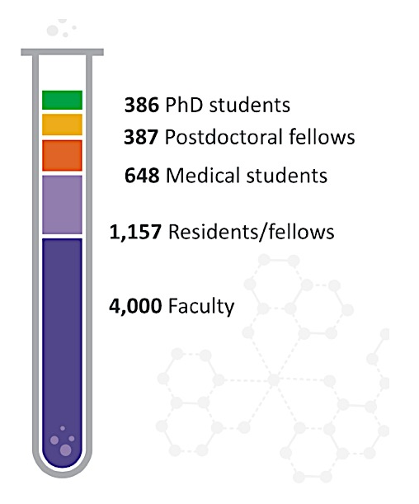
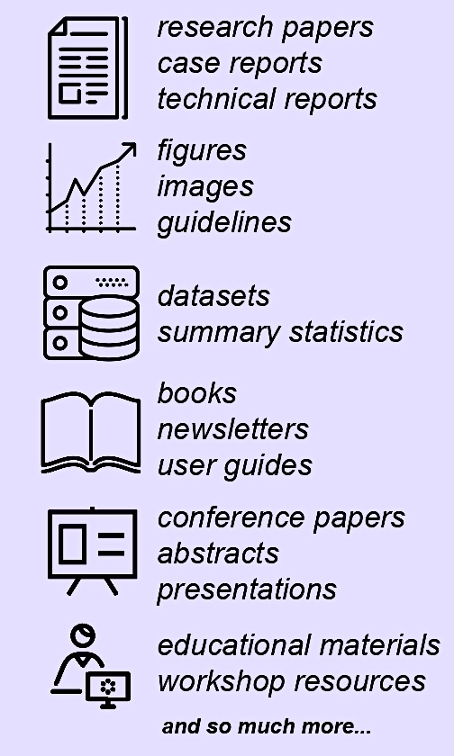
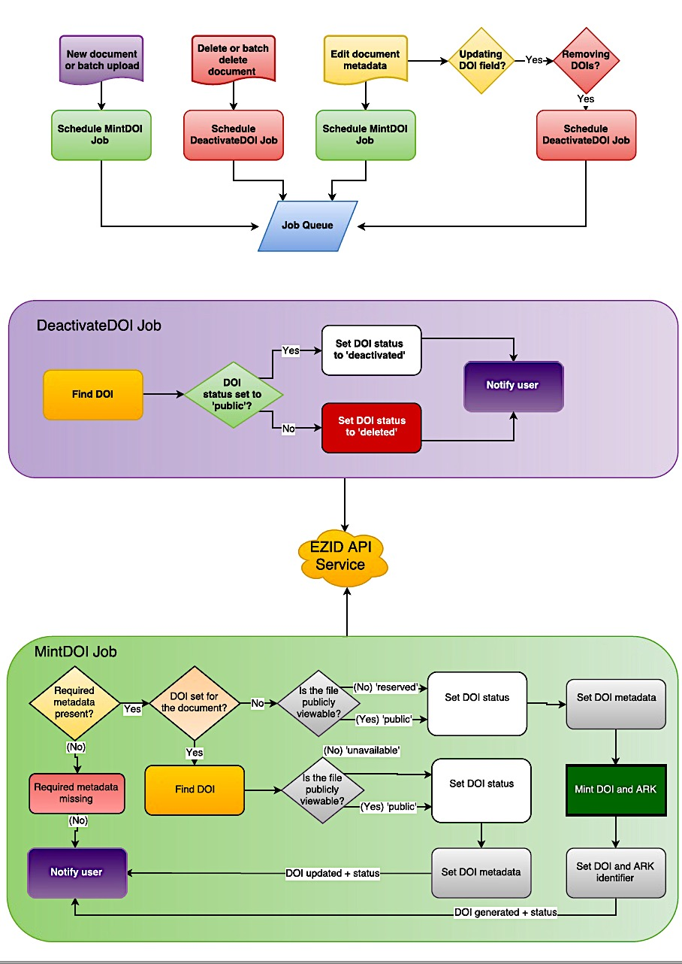
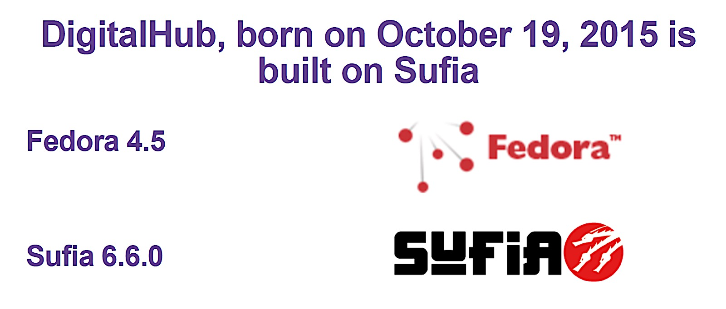

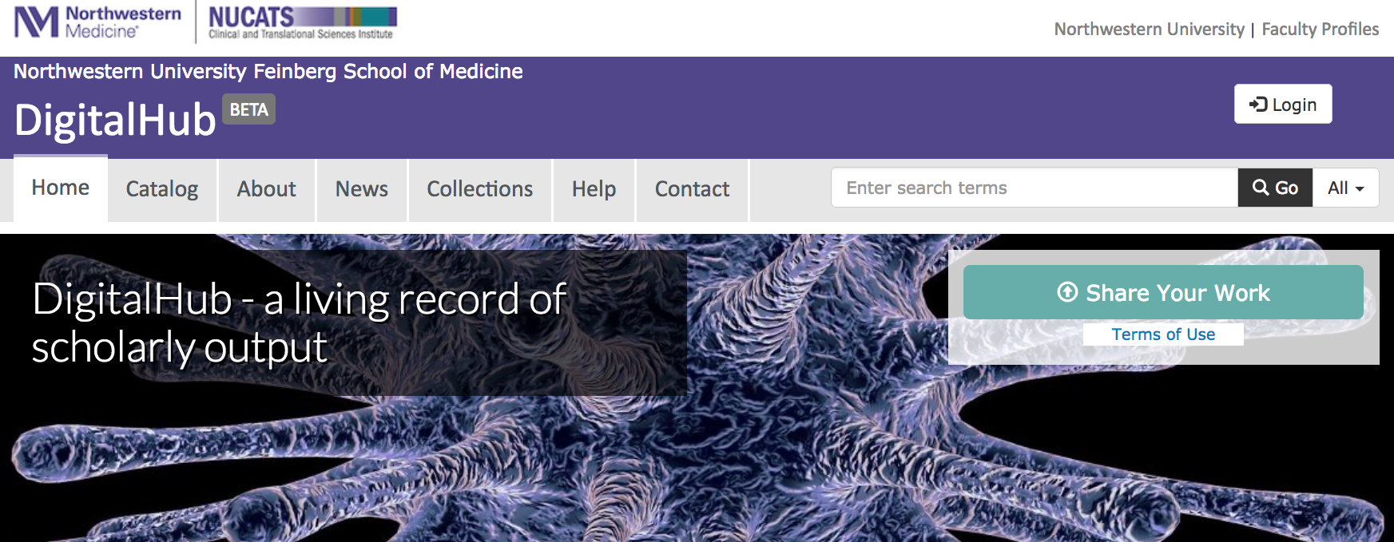
Northwestern University Feinberg School of Medicine
We built it…and they came! Building a Repository Solution for the Future
Violeta Ilik, MAM, MLIS¹; Kristi L. Holmes, PhD^{1,2}; Digital Initiatives Working Group¹
¹Galter Health Sciences Library & Learning Center; ²Department of Preventive Medicine (Health and Biomedical Informatics)
DigitalHub
A Few Noteworthy Collections
Scholarly works to share
This institutional repository aims to preserve a wide range of intellectual works created by the medical scholarly community, enhance the visibility of medical scholarship, and promote its authors by enabling discovery and accessibility of these works by the international scientific community.
Northwestern Scientific Images Contest by Science in Society, 2016
Scientific research often produces stunning images. The winners of the annual Northwestern Scientific Images Contest, showcase the captivating work being done across a range of Northwestern disciplines, from neurobiology to astrophysics. Free, public exhibitions and events share these images across Chicago each year, organized by Northwestern's research center for science education and community engagement, Science in Society.
Pediatric Neurology Briefs (PNB)
PNB is an Open Access (OA) continuing education service designed to expedite and facilitate the review of current scientific research and advances in child neurology and related subjects. The editors provide detailed monthly summaries of published articles, followed by commentaries based on their experience and corroborated by appropriate supplementary citations. Pediatric Neurology Briefs provides pediatric neurologists, neurologists, neurosurgeons, pediatricians, psychiatrists, psychologists, educators and other health professionals with a detailed reference guide to the diagnosis, etiology, pathology, treatment and prognosis of nervous diseases of infants, children and adolescents. Content is intended to be accessible to readers in any medical discipline.
Biostatistics Collaboration Center Lecture Series
* Clinical Trials: Highlights from Design to Conduct
* Enhancing Rigor and Transparency in Research: Adopting Tools that Support Reproducible Research
* Finding Signals in Big Data
* Four Lessons in Biostatistics, and Some Biostatistics Along the Way
* Statistical Considerations for Sex Inclusion in Basic Science Research
* Statistical Power and Sample Size: What You Need and How Much
* The Impact of Other Factors: Confounding, Mediation, and Effect Modification
research papers
case reports
technical reports
supplemental images
data sets
books
conference papers
presentations
educational materials
video
audio
Feinberg School of Medicine
Digital Initiatives Working Group
We applied a team-based approach to the repository project: assemble a cross departmental working group to develop a guiding vision and build a stable solution which facilitates reliable data management, data sharing, and citation tracking for a variety of outputs
DOI and ARK identifiers
Identifiers can help:
Meet funders’ sharing requirements
Promote scientific re-use of your work outputs
Track re-use and discussion of your work and ideas
Better ensure transparency and accountability
The Stack
The repository is built on a Fedora4/Hydra stack and enables machine-readable linked open data for scholarly outputs
StatTag
StatTag is a free plug-in for conducting reproducible research and creating dynamic documents using Microsoft Word with the Stata and SAS statistical software. StatTag allows users to embed statistical output (estimates, tables, and figures) within Word and provides an interface to edit statistical code directly from Word. Statistical output can be individually or collectively updated from Word in one-click with a behind-the-scenes call to the statistical program.
Datasets
DigitalHub repository at Galter Health Sciences Library & Learning Center supports the deposit of datasets associated with publications to help investigators comply with journal data sharing policies. DigitalHub supports a variety of file and compression formats to meet your needs.
The current file size limit is 2 GB
Statistical Considerations in Basic Science Sex Inclusive Research
Statistical Considerations in Basic Science Sex Inclusive Research by Drs. Denise Scholtens and Leah Welty, both associate professors at the Department of Preventive Medicine at Feinberg, is another popular work deposited in DigitalHub. This guide includes an explanation of five scenarios pertaining to the sex of the cells to be used in the experiment along with a description of how an investigator should plan the experiment.
Contact us at:
digitalhub@northwestern.edu
Visit us at:
digitalhub.northwestern.edu

