Slide 1




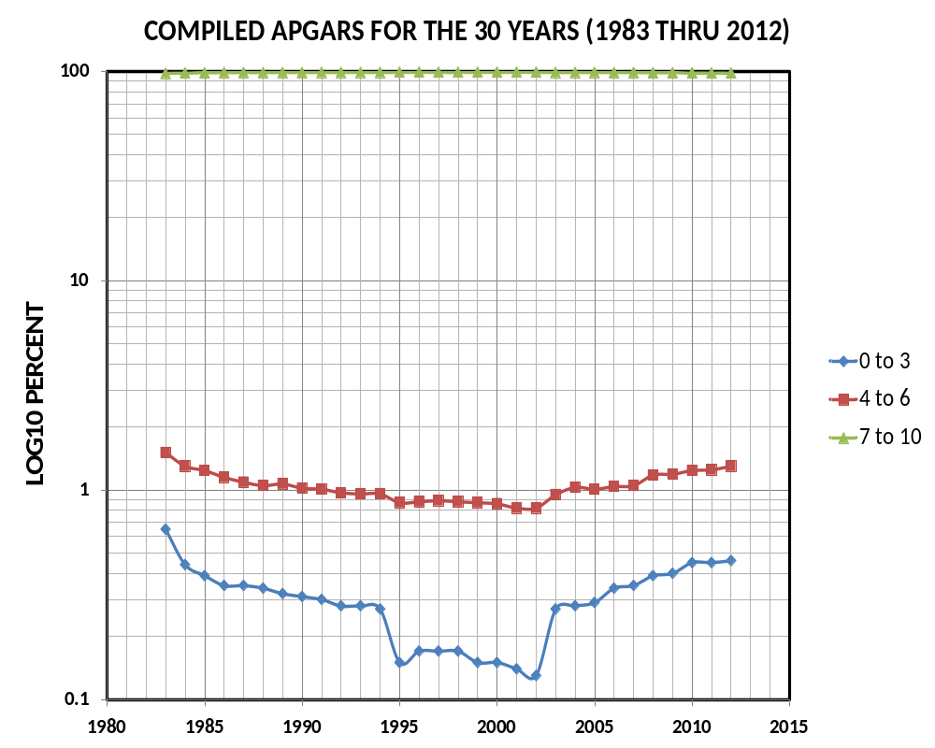
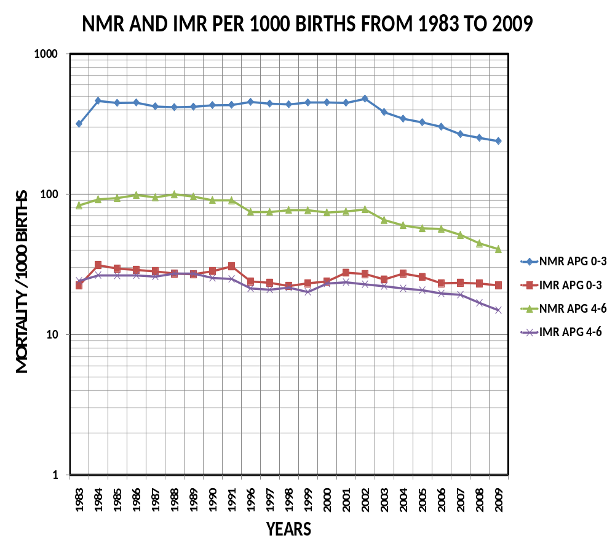
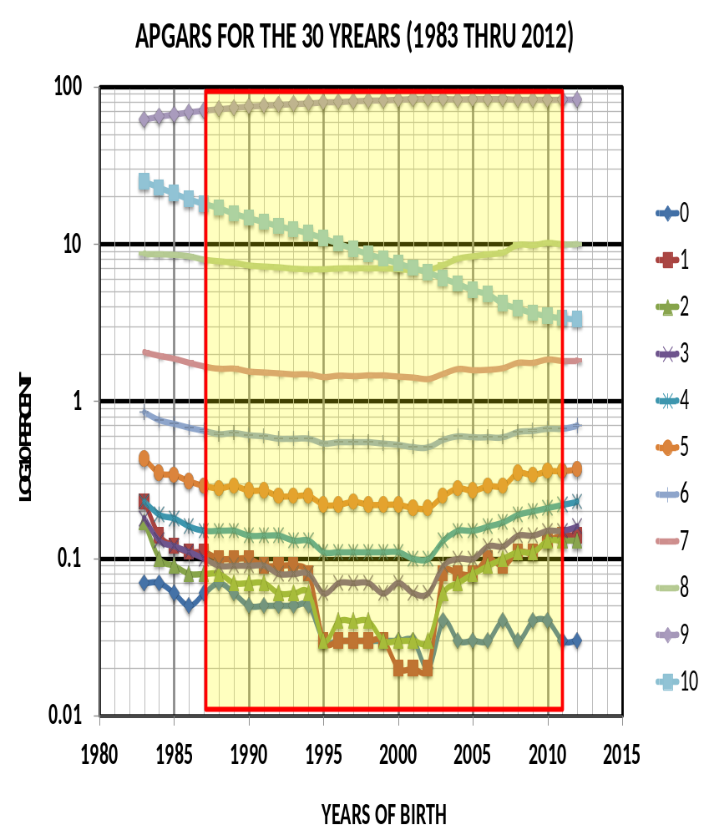
Has Neonatal Resuscitation Program (NRP) made a difference
on the Apgar score at 5 minutes in the last 30 years?
JAGJIT SINGH TEJI
DIVISON OF NEONATOLOGY, DEPARTMENT OF PEDIATRICS Ann and Robert H. Lurie Children’s Hospital, Chicago, Illinois
Introduction
Results
Results Cont’d
1953 Dr. Virginia Apgar published the newborn evaluation in the delivery room. That came to be known as the Apgar Score and survived the test of time.
Apgars Score gives an assessment of the newborn status for the set variables at 1, 5, 10 minutes after birth; sometimes for additional 15, 20, 25 minutes.
Majority of time apgars are assigned at 1 and 5 minutes.
We assume apgars score is assigned to every baby delivered in this world.
It is assumed that introduction of a standardized objective resuscitation program such as NRP would demonstrate an improvement in the apgars scores and the NMM neonatal morbidity and mortality and IMR, infant mortality rate.
NRP was introduced in 1987 and then revised in 2011.
Apg5, is reported to be improved overall around the world following NRP training.
Apgars score at 5 minutes, Apg5, is inversely related to neonatal and infant mortality rate.
Almost 120 million births occurred in the USA over 30 years.
Data was incomplete.
The format changed after a few years.
New birth certificate format and variables collected also changed after a few years.
1983 thru 1988 –no mode of delivery data, no hispanic
classification of ethnicity.
1989-1991—beginning of complete files
1992-1994—only natality files, and no infant death files
created by the NCHS.
1995-2002—complete files.
2003-2009- new birth certificate formatted data reported the
data.
2010-2012-no linked infant death available yet.
Objectives
How has the Apg5 changed in the last 30 years in the USA?
Methods
Over 120 million newborns were considered in the analysis from 1983 thru 2012.
Most significant decline Apg5 of 10 and 0 that declined from 24.96% to 3.32% and 0.07% to 0.03%, from 1983 to 2012, respectively.
While Apg5 of 9 increased from 62.16% to 83.14 %, from 1983 to 2012. Other Apg5 were basically unchanged other than gradual dip in 1995 thru 2002.
Significantly lower Apg5 were noted for male, preterm, non-hispanic black, low birthweight, multiple births, unmarried, non-college educated, and those with maternal risk factors compared to controls.
The data for analysis was obtained from the birth and linked infant death data and natality files from the NCHS vital statistics branch of the CDC in the USA for the years 1983 thru 2012.
Variables used for analysis consisted of the following variables:
    Year of birth,
    Apg5,
    Gestational age,
    Birthweight,
    Plurality,
    Race,
    Ethnicity,
    Maternal age , marital status, and education,
    Maternal risk factors such as hypertension and diabetes and tobacco and alcohol exposure.
    and infant mortality.
STATA 13.0 and Excel 2010 were used in the analysis.
Discussion
This is the largest population assessment of Apg5 for newborns to date.
Proper assignment of apgars and resuscitation efficiency of sick newborns may be the result of NRP.
Improved Apg5 over the study period of 30 years shows gradual decline in mortality for Apg5<7.
Implications for DOHaD?
Nothing to disclose.
Contact Information: JTEJI@LurieChildrens.org

