Slide 1


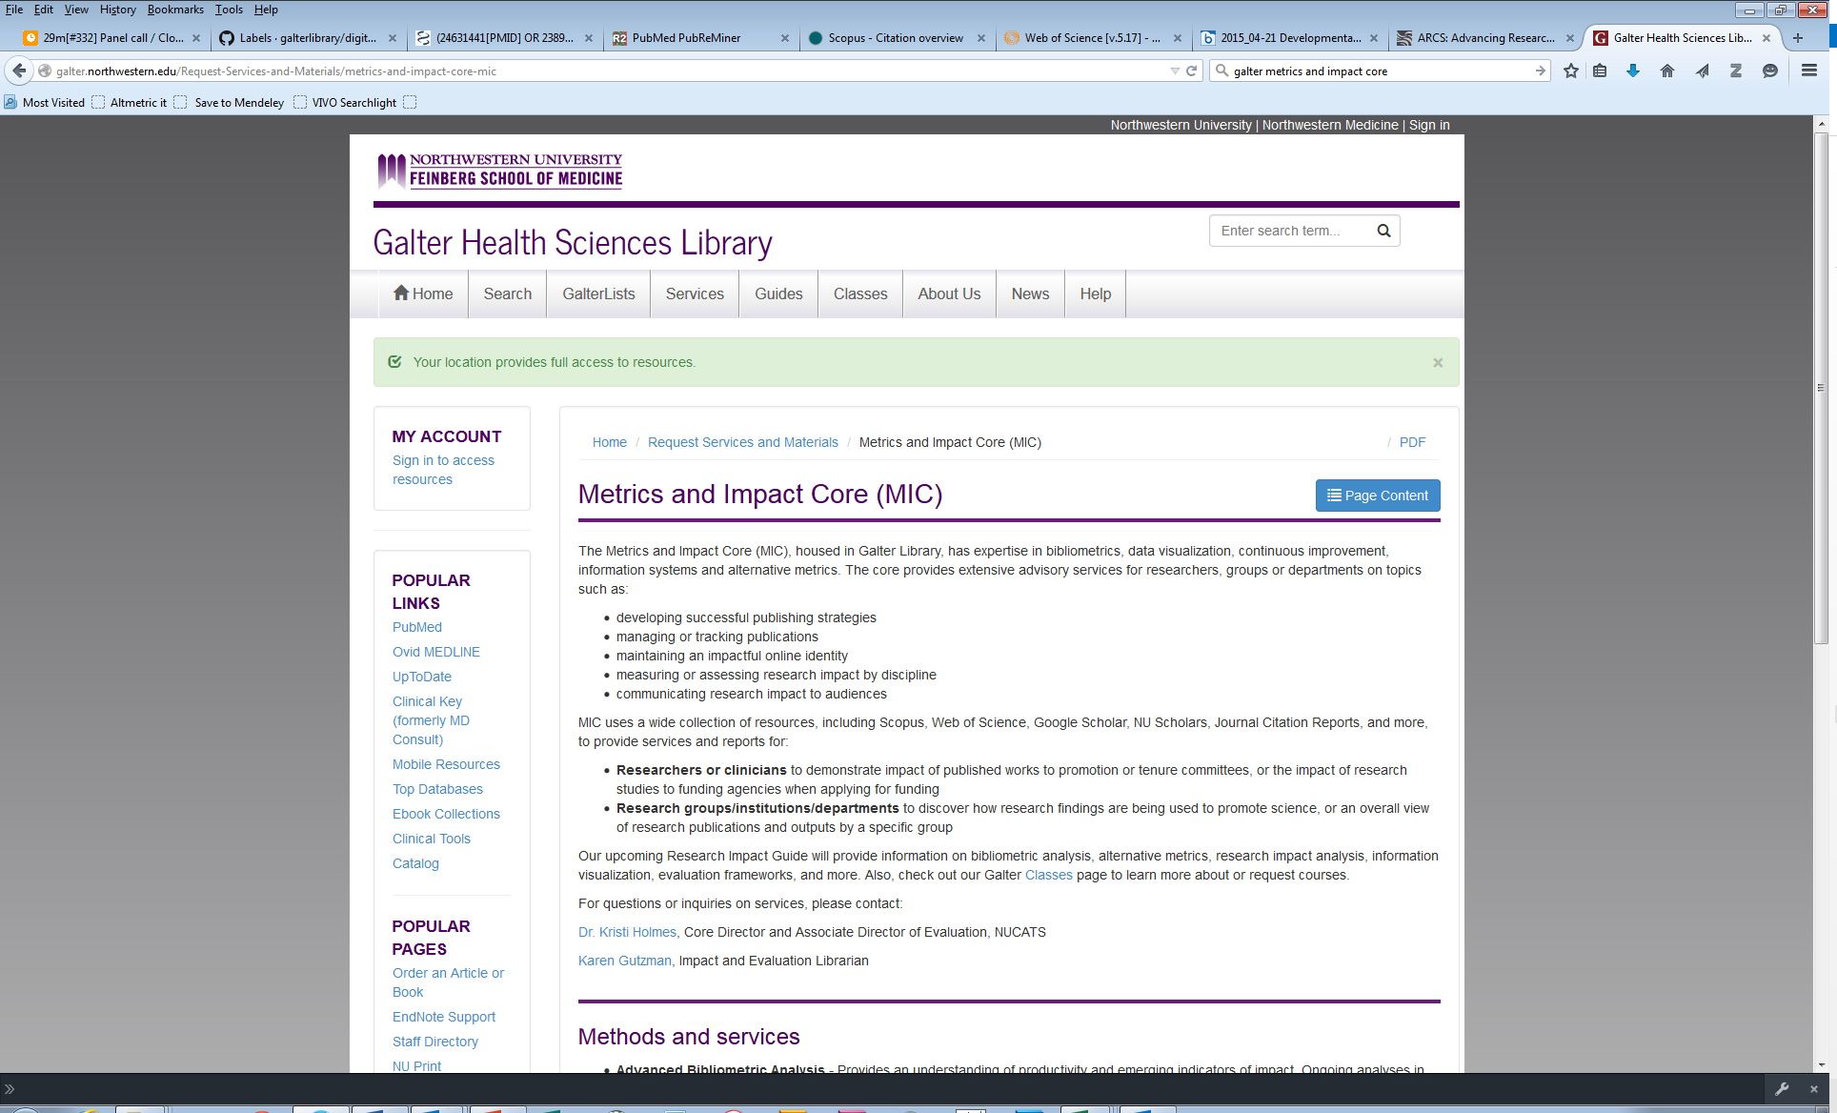
Karen Gutzman
Impact and Evaluation Librarian
Galter Health Sciences Library
Northwestern University
Chicago, IL
Metrics and Impact Core: http://galter.northwestern.edu/Request-Services-and-Materials/metrics-and-impact-core-mic
Managing or tracking publications
Maintaining an impactful online identity
Measuring or assessing research impact by discipline
Communicating research impact to audiences

Slide 2







impact:
demonstrate
assess visualize
Individuals
promotion and tenure
annual review
apply for grant funding
tracking research
Research Groups
Departments
Institutes
advancement of science
planning for infrastructure
return on investment
rankings or comparison
advocate for funding
Icons made by Freepik from www.flaticon.com

Slide 3

example:
New NIH Biographical Sketch format
Section C: Contributions to Science
List up to 5 most significant contribution to science
historical background
central findings
influence of the findings on the progress of science
Specific role in described work
Reference up to 4 peer-reviewed publications or other non-publication research products such as:
audio or video products
patents
data and research materials
Databases
educational curricula
instruments or equipment
models
protocols
software, and more
Galter Guide by Pamela Shaw: https://galter.northwestern.edu/guides-and-tutorials/creating-nih-biosketches-with-sciencv-and-my-bibliography
Why the change?
allow researchers to highlight their accomplishments better by including more objects of scholarly productivity
give researchers involved in team science an opportunity to describe their roles in collaborative projects
NIH announcement 12/5/14: http://grants.nih.gov/grants/guide/notice-files/NOT-OD-15-032.html
Icons made by Freepik from www.flaticon.com
Notes:
The NIH announced on December 5, 2014 that it will require a new format for the NIH biosketch for all NIH and AHRQ grants submitted for due dates on or after May 25, 2015. Up until that time, applicants have the option of using the new or old biosketch format, but some NIH programs are suggesting that applicants use the new format before the required change date.
Why the change?
The NIH believes the new format will
allow researchers to highlight their accomplishments better by including more objects of scholarly productivity than just journal-published manuscripts, such as audio and visual material, databases, curricular material and more (see "What are Contributions to Science?" section below)
give researchers involved in team science an opportunity to describe their roles in collaborative projects
Key differences between the old and the new biosketch format:
The length of the new biosketch has increased from 4 to 5 pages
The new format allows researchers to describe up to 5 "contributions to science" and the historical background of these contributions in the new Section C
Contributions will no longer be limited to "selected publications"
The new format gives researchers the opportunity to provide a link to their full body of work in their MyNCBI My Bibliography. This is encouraged by the NIH though it is not required (NIH biosketch FAQs).

Slide 4

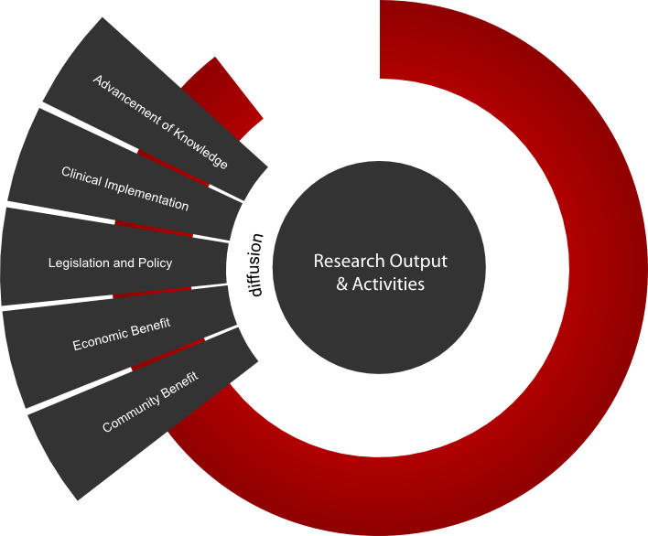
model:
Becker Model for Assessment of Research Impact
350+ outputs and indicators of impact
  Advancement of Knowledge
  Clinical Implementation
  Community Benefit
  Legislation and Policy
  Economic Benefit
Strategies for Enhancing the Impact of Research
Information and Resources
Becker Model:
https://becker.wustl.edu/impact-assessment/model
Becker model image by Robert Altman
Icons made by Freepik from www.flaticon.com
Notes:
Advancement of Knowledge Advancement of knowledge represents research outputs and/or activities that contribute to the scholarly record.
Clinical Implementation Clinical implementation is the application or adoption of research outputs in clinical applications.
Community Benefit Community benefit is the enhancement of well-being to the community as a result of research outputs and/or activities.
Diffusion Diffusion represents translation of research outputs and activities that result in research impact. Diffusion is manifested in a variety of indicators that are categorized in pathways that represent specific areas where research impact can be identified. Pathways are flexible and fluid, and there may be overlap of indicators between pathways.
Pathways of Diffusion as Noted on the Becker Model:
Advancement of Knowledge
Clinical Implementation
Community Benefit
Legislation and Policy
Economic Benefit
Economic Benefit Economic benefit represents economic outcomes as a result of research outputs and/or activities. Indicators Indicators are specific, concrete examples that demonstrate research impact.
Legislation and Policy Enactment Legislation and policy enactment represents codification of research outputs and/or activities into public law, guidelines, standards or policy.
Research Output and Activities Research outputs and activities are products and/or activities resulting from basic or clinical biomedical research. Research Impact Research impact “describes the effects and outcomes, in terms of value and benefit,” as a result of research outputs.
(See the Primary Health Care Research & Information Service’s “Understanding and Measuring Research Impact”).
Examples of impact outcomes include indicators that demonstrate:
Research productivity
Scientific impact
Collaboration patterns
Publication practices
Extent of interdisciplinary research
Citation impact
Contribution to the knowledge base
Change in understanding of a disease, disorder or condition
Implementation of policy or legislation
Change in clinical or research practice
Enhancement of community health
Economic benefits

Slide 5
useful
data
is:
transparent
accessible
high in quality
accurate
relevant
understandable…
Many resources available to us:
Scopus (from Elsevier)
Web of Science (from Thomson Reuters )
Google Scholar
Northwestern Scholars (from Elsevier)
Journal Citation Reports (from Thomson Reuters)
Altmetric
and more…

