Slide 1
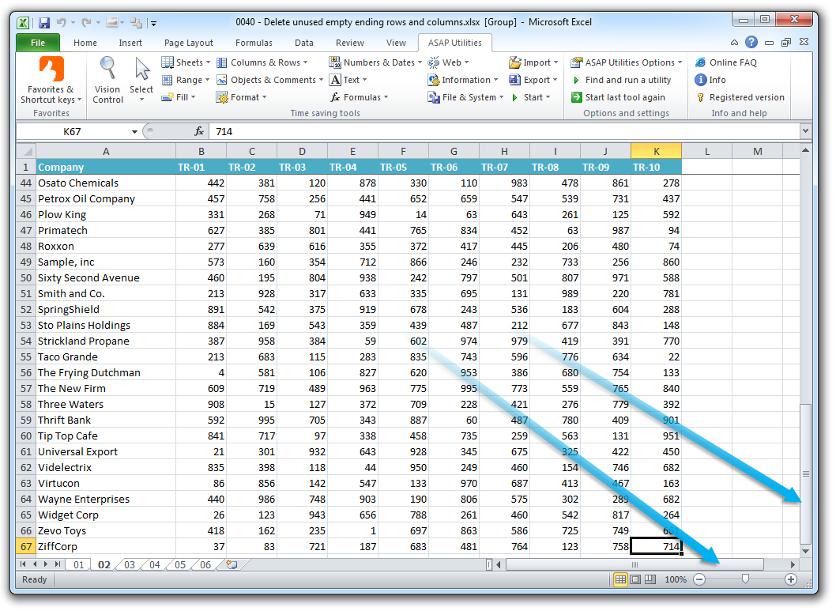
Data Projects: Setup and Key Tips for Excel
Sara Gonzales, MLIS
Data Librarian
Galter Health Sciences Library & Learning Center
Northwestern University Feinberg School of Medicine
Disclaimer: This class is not a general Excel class, but rather a specialized application of Excel. Galter Health Sciences Library & Learning Center does not provide technical support for any Microsoft Products.

Slide 2

Setup Step 1: Make a second copy of your file
To avoid over-writing the original or raw data file, make a copy before beginning data wrangling, cleaning, or analysis.
It may be helpful to lock or password-protect the original data file.
Make the name of the new file something that conveys its status as a data analysis file.

Slide 3
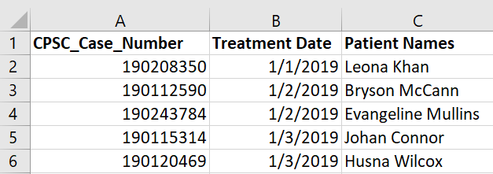
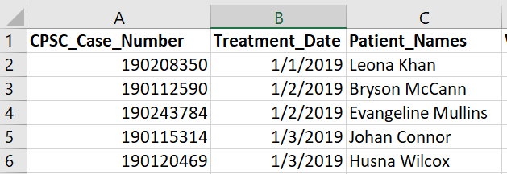
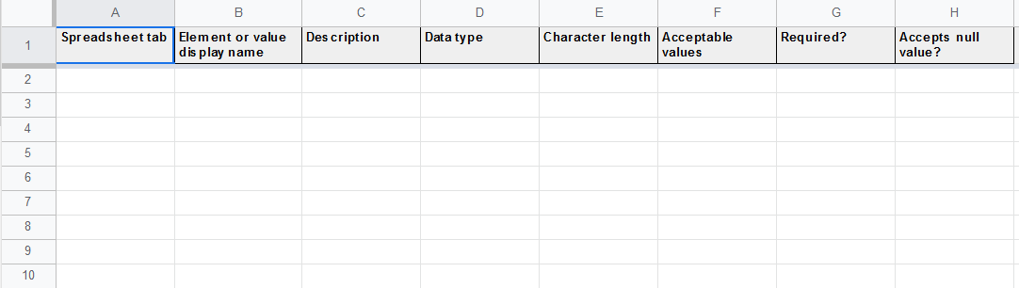
Setup Step 2: Variable naming and documentation
All variable name elements separated with underscores
Name variables/column headers using a consistent naming convention
Create a data dictionary: define all your variables and describe their key characteristics
  Human-readable name
  “Coded” name
  Data type
  Allowable values
  Accepts null value
Notes:
Naming variables consistently is an important first step that allows for easier code-based data manipulations later. Spaces between elements of variable names generally require cleaning before analysis can begin.
Data dictionaries can be as simple or complex as is useful for the research team, and can consist of anything from simple documents to spreadsheets to databases. Free example spreadsheets from the USDA can be found here: https://data.nal.usda.gov/data-dictionary-blank-template.
Be sure to state in the data dictionary what you are using for null, or, missing values, in order to apply this consistently.

Slide 4
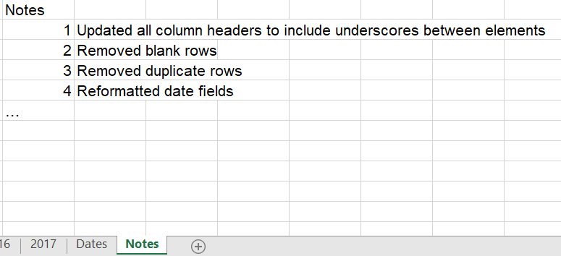
Documentation, continued
Notes Tab
When cleaning data in Excel, there is no automatic capture of the changes one has made to the data.
Keeping track of the changes is highly recommended for reproducibility.
Creating a new worksheet called “Notes” in the same spreadsheet provides a space to record all the changes made.

Slide 5
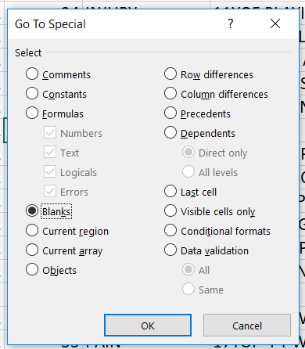
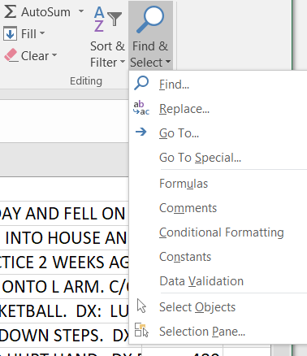
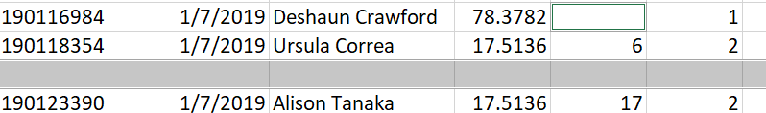
Blank fields – identifying and addressing them
Find blanks fast – but beware!
Home tab -> Find & Select -> Go To Special
Select “Blanks”
Notice that Excel provides a gray highlight for fully blank rows, but also outlines individual blank cells
Double-check the spreadsheet! If you only have blank rows, you can choose Delete -> Delete Sheet Rows from the Home tab. But if there are any single blank cells, their entire rows will be deleted
Single blank cell
Blank row
Notes:
In the double-check step, you may find individual blank cells. Rather than leave them blank, which can confuse some analysis programs you may choose to use after Excel, this is a good opportunity to fill any empty cells with your team’s agreed-upon null value. This can be anything from the word “NULL” to “N/A” to a numeric value that could never occur naturally in the data, like a negative number. Once any individual blank cells are filled in, then the Delete Sheet Rows step will work properly.

Slide 6
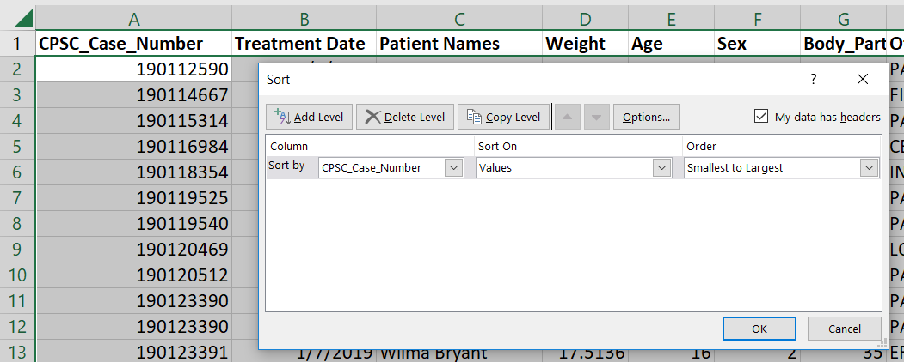
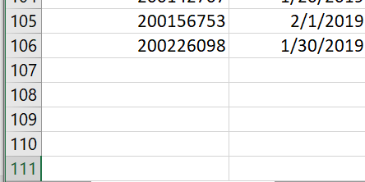
Remove blank rows
A safer way to identify blank rows only for deletion is the following:
Click on the triangle in the upper left corner to select the whole spreadsheet
Select a key column, one which should have unique values for every record
From Sort on the Data Tab, sort by this column from Smallest to Largest
Ctrl-down arrow to reach the bottom of the spreadsheet. Delete the blank rows.
Key column
Deleting the blank rows between your last record and the former last row is a safety step, in case you decide to undo the previous sort.

Slide 7
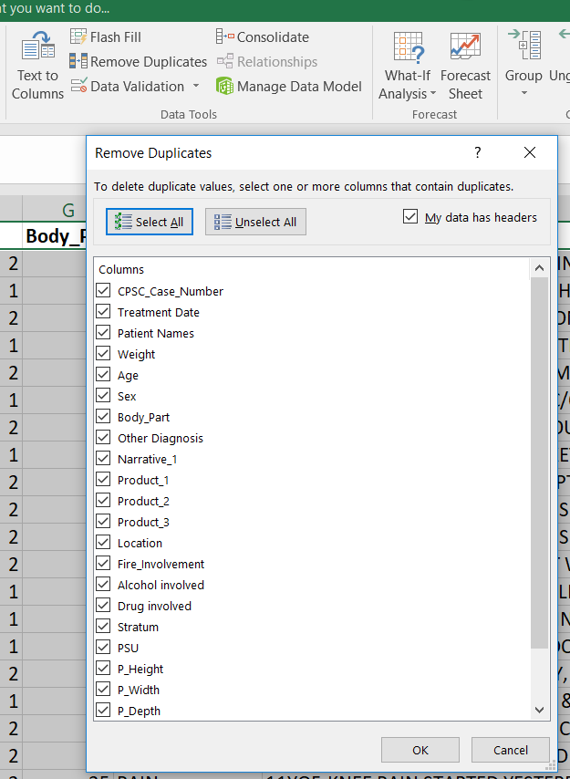
Remove duplicate rows
Method 1
Steps:
From the Data Tab, choose Remove Duplicates
In the dialog box that pops up, you can leave all boxes checked to have Excel check for duplicate information across all columns
  Alternatively, you can choose as many or as few of the column boxes as you like to help identify duplicate records
Click OK; duplicate rows are automatically removed
“Duplicate values” number refers to dupe rows

Slide 8
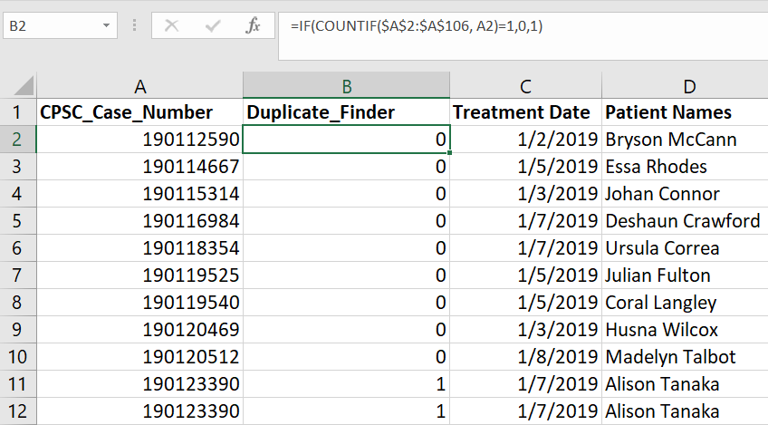
Remove duplicate rows
Method 2
Steps:
Sort the whole spreadsheet by CPSC_Case_Number
Create a new column next to CPSC_Case_Number
Input the formula: =IF(COUNTIF($A$2:$A$106, A2)=1,0,1). Based on the IF statement syntax, this formula searches for whether the value in A2 occurs once. If so, it outputs “0” [the value we assigned to “TRUE”]; if not, it outputs “1” [the value we assigned to “FALSE”]
Wherever two 1’s occur together, the second instance can be deleted
IF Statement Syntax:
IF(logical_test, [value_if_true], [value_if_false])
Notes:
This method of removing duplicates works best when there is one column that can definitively serve as a marker for all unique records, like CPSC_Case_Number in our dataset (each unique record has its own case number).

Slide 9
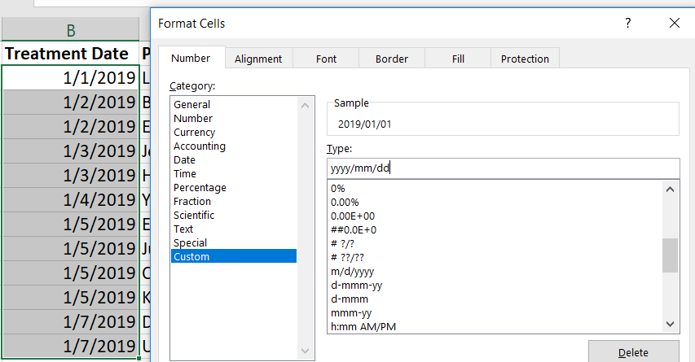
Reformat date fields
ISO Date Formatting:
The date format YYYY/MM/DD is helpful in many data management contexts, and is an international standard. However it is not available in Excel’s pre-loaded list of date types.
To add ISO formatting, highlight your date column, choose “Format Cells”, then “Custom.” In the Type box enter an ISO-based date format.
Dates can be expressed in many ways in Excel, such as with numbers to represent month and day, with month and day spelled out, and even as a number (counting the days from 1/1/1900)

Slide 10
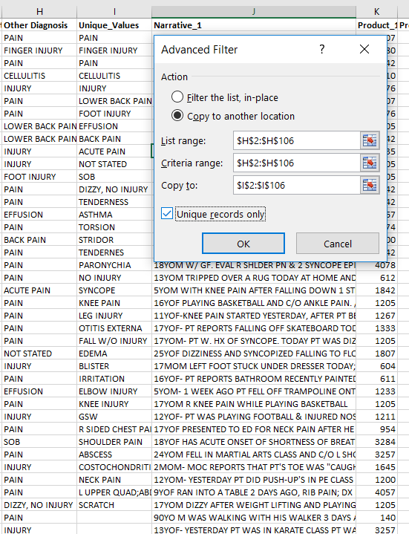
Identify the unique values in a dataset
It can sometimes be helpful to know how many unique data values you have for a given field. This can be found through an Advanced Filter.
Steps:
Create a new column next to Other_Diagnosis
From the Data Tab select “Advanced” near the Filter icon
Choose “Copy to another location”
In List and Criteria Range enter the full range of the column you’re checking for unique values, in this case Column H
In “Copy To” list the range of the new column you’ve created
Check “Unique Records Only”
Click OK
Result: In the new column, only the unique values from the first column are displayed
Notes:
This filtering method can help you find misspellings or other corrections that need to be made to individual data values. When you know which values need to be corrected, you can use simple sorts or filters to find them and clean them more quickly later.

Slide 11
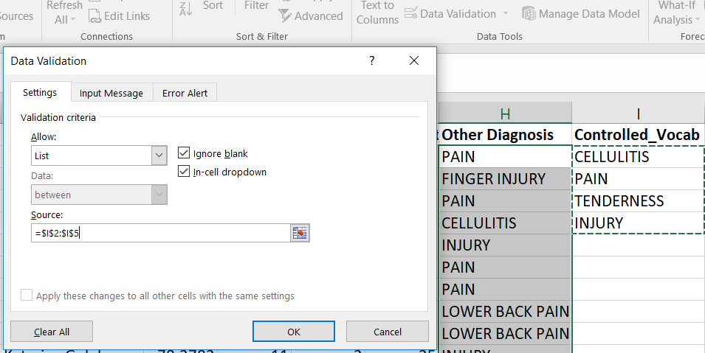
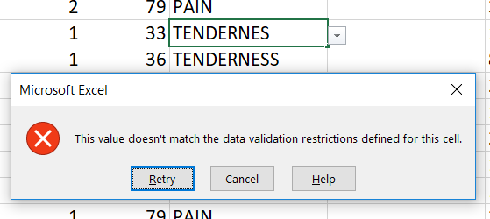
Set up sheet for future data entry – Cell Validation
Steps for text-based validation:
Create a new column for the controlled vocabulary and enter values
From the Data Tab choose Data Validation
Choose to allow a List, then enter the source of the list (here, =$I$2:$I$5)
Entering any term other than those on the list creates the error message seen above

Slide 12
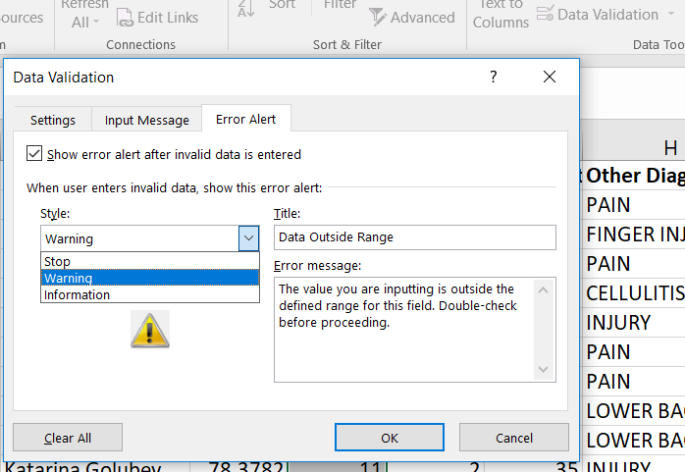
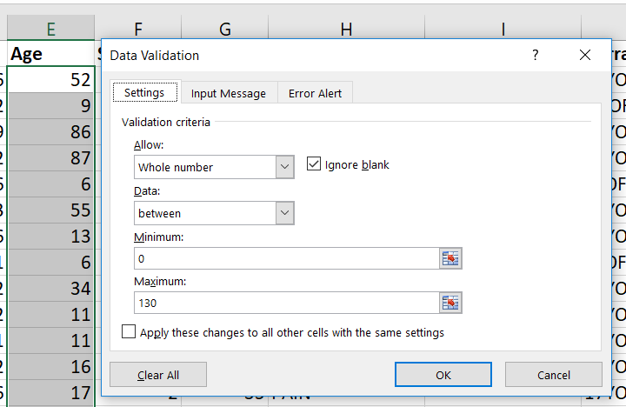
Set up sheet for future data entry – Cell Validation
Steps for number-based validation:
Same as for text, except choose to allow a whole number between a range of #’s
A warning rather than a stop in the error alert will allow the user to enter their value whether it is inside the specified range or not.
Notes:
Validation can also be set up for number-formatted fields, to encourage users to fill in numbers within a certain range. In addition, the strength of the enforcement of the validation can be changed. Users can be warned that their entry is outside the defined parameters for the column, yet still be allowed to enter their desired value anyway.

Slide 13
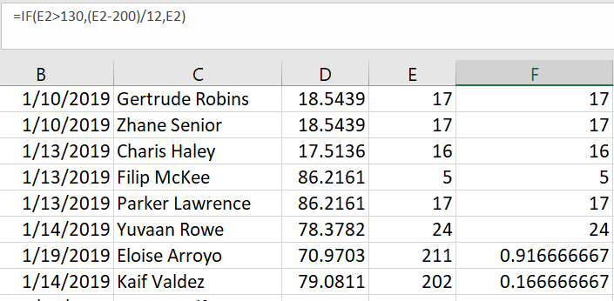
Wrangle both “messy” and “clean” data with conditional calculations
A conditional statement can help us clean the Age column, in which age is entered in years except for patient ages that are described in months, which have “200” added to them.
Steps:
Create a new column next to Age
Type the formula =IF(E2>130,(E2-200)/12,E2)
The logical test is whether the patient’s age is expressed as over 130 years (which should include all the 200+ patients)
If true, Excel then subtracts 200 from the value and divides it by 12
If false, Excel returns the original value
Conditional statement syntax:
=IF(logical test, [value if true], [value if false]
Notes:
Conditional statements allow us to create a consistent formula that we can copy all the way down the column, which does not change the data if one condition is met, but does change it in the requested way if the other condition is met. This same syntax can be used to create a formula that checks for the null value wherever it occurs in a column, since these values might need to be identified and filtered out of calculations.

Slide 14
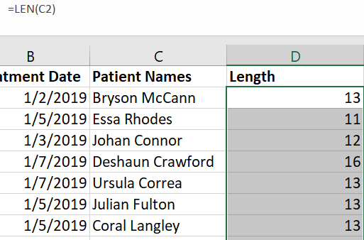
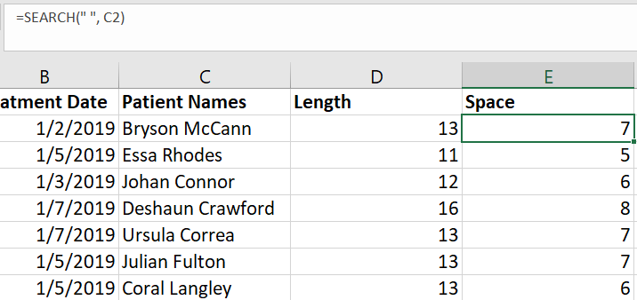
Break down data into smaller elements
We can take the Patient_Names column and break it down into Surname and Given Name using the LEN, SEARCH, and RIGHT/LEFT functions. These functions are defined as:
LEN – counts the number of characters in a cell to express its length
SEARCH – searches for something within a cell, such as a space
RIGHT – returns everything to the right of a specified point in a cell, deletes the rest
LEFT – returns everything to the left of a specified point in a cell, deletes the rest
Searches for where the space occurs in the characters in C2
Enter formula, copy down

Slide 15
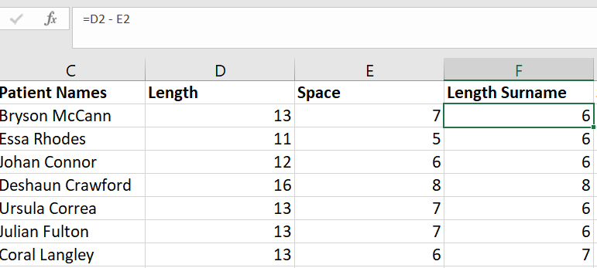
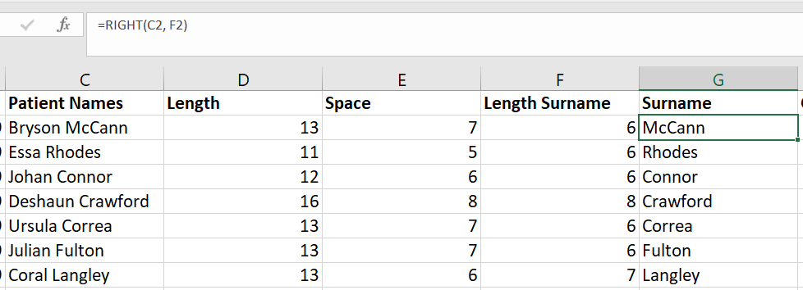
Break down data into smaller elements
Find length of Surname by subtracting the number of characters up to where the space occurs from the total
Using the RIGHT function syntax, from cell C2, take everything in the right of the cell, counting right-to-left up to the surname length specified in cell F2
Notes:
To find the Given (First) Name, we use the opposite of the RIGHT function, the LEFT function. In the formula =LEFT(C2, E2), we ask Excel to take everything in the left of cell C2 up to the character identified in E2, where the space occurs.

Slide 16
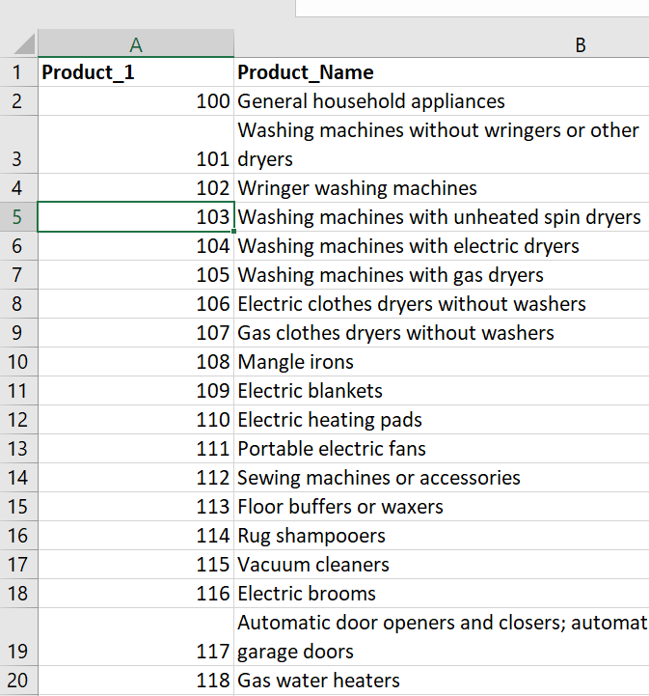
Bring in outside information with VLOOKUP
In our 2019_NEISS_SmallSubset spreadsheet the column Product_1 contains code numbers for the commercial products which were involved in the patients’ injuries. However we don’t see the product names in this sheet. Click over to the second tab called “ProductCodes.” Here is a worksheet that contains both the codes and their corresponding product names.
On the next slide are the steps for using VLOOKUP to look up the product names that were referenced in the top worksheet and bring them over using their product numbers.

Slide 17
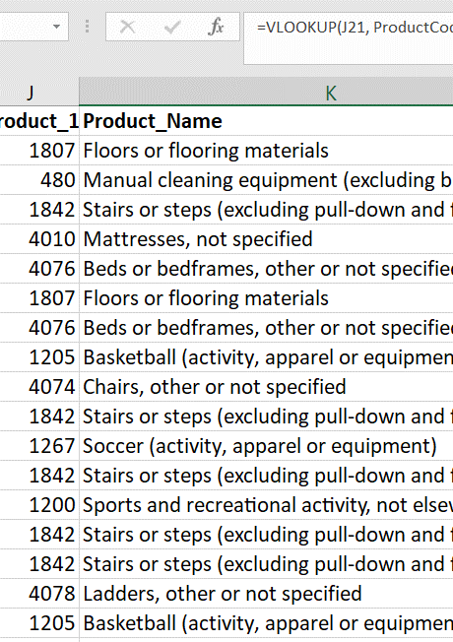
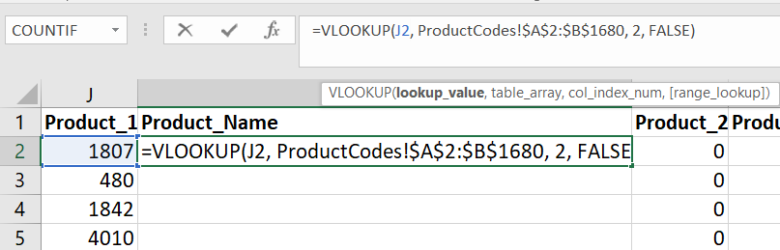
Bring in outside information with VLOOKUP
VLOOKUP is a way to join data between two tables. It works best when the two tables are separate worksheets within the same spreadsheet.
Steps:
In the first worksheet, create a new column next to Product_1
Enter the VLOOKUP formula, which contains the elements 1) the local cell you’d like to look up, 2) the lookup worksheet name and cell range with ! in between, 3) the column number in the range with the value you want to return, and 4) FALSE to indicate that only exact matches are wanted (TRUE here would be a signal to include approximate matches, as well)
1
2
3
4

Slide 18
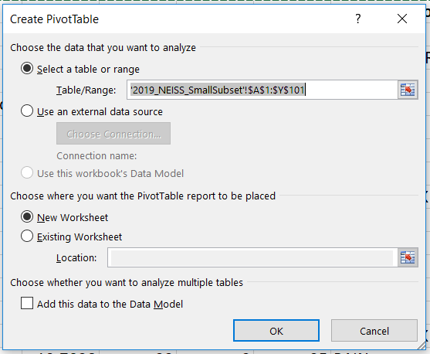
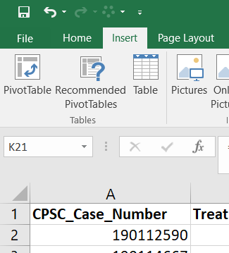
Pivot Tables: Explore data without changing the original worksheet
An initial method of crunching and analyzing data before loading it to a different program is to experiment with it in Pivot Tables. This is a function of Excel that allows you to re-shape the data in a different worksheet, without changing the original data sheet.
The dialog box which pops up alerts you that the range being loaded to Pivot Tables is your top worksheet.
Choose to open Pivot Tables in a New Worksheet rather than the Existing one so you don’t over-write the dataset.

Slide 19
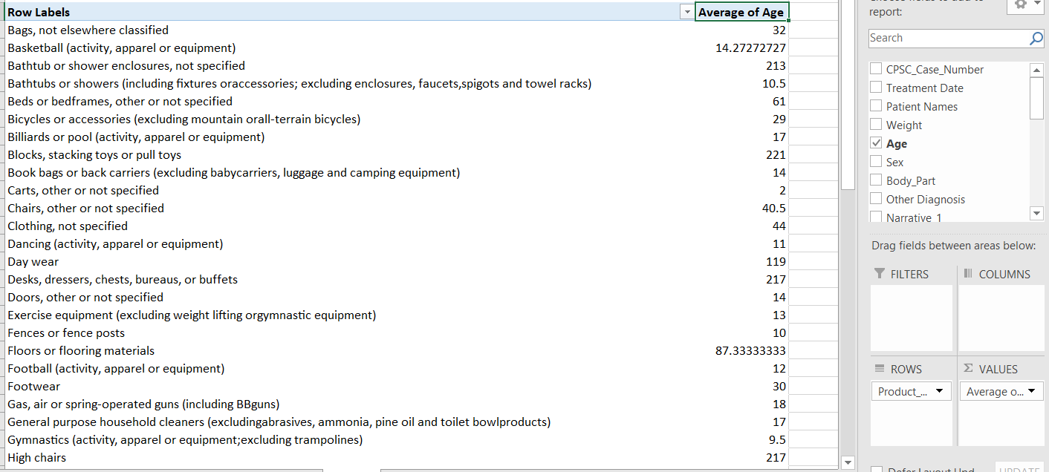
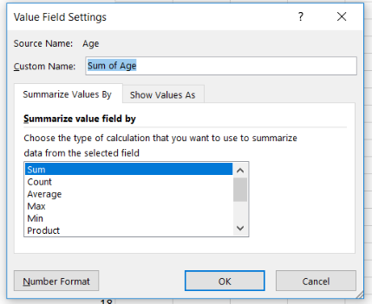
Pivot Tables: Explore data without changing the original worksheet
Experiment with dragging and dropping the column names from your worksheet on the right into the columns, rows, or values boxes. Here we’re comparing product names to average ages of the patients.
“Sum” is the default in the Values box. Click the drop-down arrow next to the name of your field to change the field settings to Average, Count, etc.

Slide 20
Credits
AbleBits.com (article by Svetlana Cheusheva), Excel VLOOKUP tutorial for beginners with formula examples, https://www.ablebits.com/office-addins-blog/2014/07/17/excel-vlookup-tutorial-beginner/
DataCamp, Data Analysis in Spreadsheets, https://learn.datacamp.com/courses/data-analysis-in-spreadsheets
Duke University Libraries (presentations by John Little and Angela Zoss), Excel workshop materials, https://guides.library.duke.edu/excel/cleaning
ExcelHow.net (article by Scott), How to remove duplicate rows by formula in Excel, https://www.excelhow.net/how-to-remove-both-duplicate-rows-by-formula-in-excel.html
Sherry Lake, Tim Dennis, Jez Cope, Francois Michonneau, Christopher Erdmann, erikamias, … yvonnemery. (2020, July). LibraryCarpentry/lc-spreadsheets: LibraryCarpentry/lc-spreadsheets: Library Carpentry: Tidy data for Librarians, July 2020 (Version v2020.07.1). Zenodo. http://doi.org/10.5281/zenodo.3954067
Microsoft Support, VLOOKUP Function, https://support.microsoft.com/en-us/office/vlookup-function-0bbc8083-26fe-4963-8ab8-93a18ad188a1
NNLM Library Carpentry Training, October 29-30, 2020, Library Carpentry: Tidy Data in Spreadsheets, https://docs.google.com/presentation/d/1Cgqa-nFzCi6HoE46TwAKvtXGHDJndsFS8ZCYpMT1PhU/edit?usp=sharing
US Department of Agriculture Ag Data Commons, Data Dictionary – Blank Template, https://data.nal.usda.gov/data-dictionary-blank-template
Developed resources reported in this presentation are supported by the National Library of Medicine (NLM), National Institutes of Health (NIH) under cooperative agreement number 1UG4LM012346. The content is solely the responsibility of the authors and does not necessarily represent the official views of the National Institutes of Health.
Thank you! Contact me at: sara.gonzales2@northwestern.edu

