Slide 1


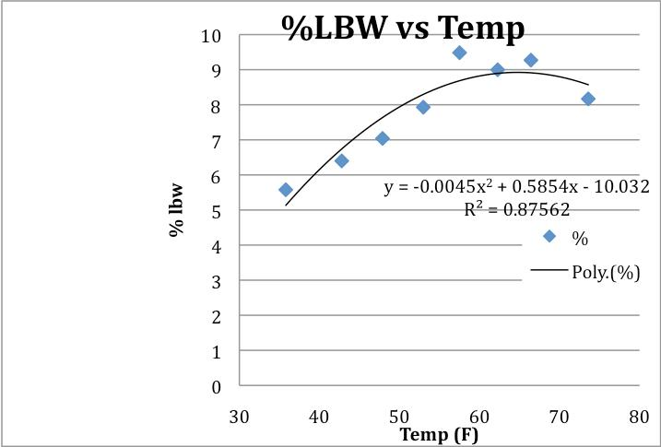
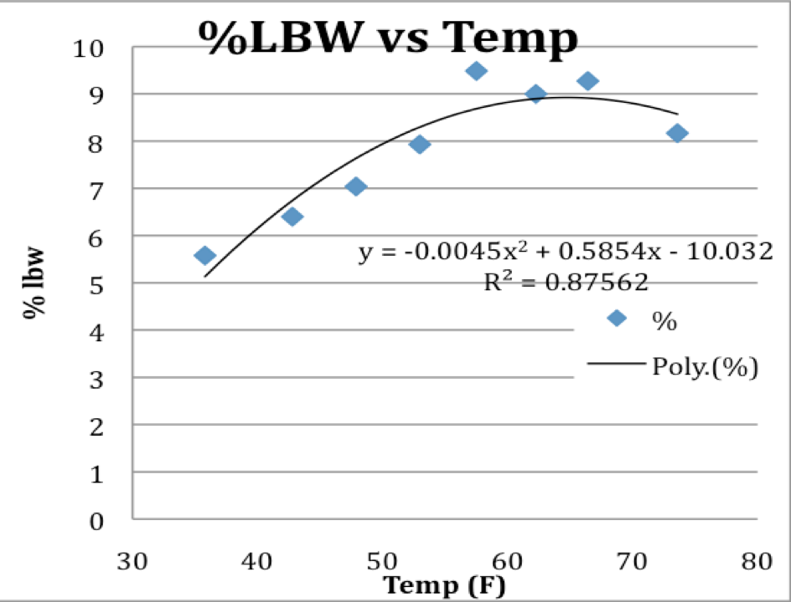
Higher Environmental Temperature During Pregnancy Causes Low Birth Weight (LBW)
Alka Gupta, BSc¹, Jagjit S Teji, MD² and Kamal Eldeirawi, RN; PhD³.
¹University of Illinois, Chicago, ²Pediatrics, University of Chicago, Chicago, ³College of Nursing, University of Illinois, Chicago, Illinois, United States.
Abstract
Methods
Results
Title: Higher Environmental Temperature during Pregnancy causes Low Birthweight (LBW) Alka Gupta, BSc¹, Jagjit S Teji, MD² and Kamal Eldeirawi, RN; PhD³. ¹University of Illinois, Chicago, Illinois, United States; ²Pediatrics, University of Chicago, Chicago, Illinois, United States and ³College of Nursing, University of Illinois, Chicago, Illinois, United States. Background: LBW is a major cause of infant morbidity and mortality in the world. Animal and human studies have shown that intrauterine growth retardation was inversely related to environmental temperature. Objective: The purpose of this study is to assess the associations of higher temperature and lower latitude with lower birth weights in the United States infant born between 1995 and 2002. Design/Methods: The data form CDC Linked Death and Infant Birth Data, from 1995 through 2002. Analyzed only term babies. Other data from MaxMind and National Oceanic and Atmospheric Administration (NOAA) website; The variables from the NCHS file used were maternal age, race, and Hispanic origin of the parents, birth weight, period of gestation, plurality, prenatal care usage, maternal education, live birth order, marital status, and maternal smoking and alcohol usage. Logistical regression was performed with LBW as the dependent variable with all the other dichotomized variables as confounding and where independent varibles latitude and/or temperature with respect to race using STATA 9.0 SE. Results: About 25 million records from over 32 million births were used for analysis. It was noted average annual temperature>55 F and lower latitude had a higher probability of LBW; Odds ratio (OR) 1.228029, P<0.0005; 95% CL-1.22-1.23). Greatest impact of LBW was for NHW and lowest for H, OR 1.22 vs 1.003. Other variables had no impact on the probability of LBW when inversely related to temperature and/or lower latitude of birth. Conclusions: 1. LBW at birth is inversely related to higher environmental temperature during pregnancy. 2. Does this factor alone account for the higher low birth weight rate in the South, or does the temperature truly affect intrauterine growth? 3.Increased incidence of chronic diseases later in life, such as diabetes mellitus, obesity, and heart disease are related to LBW and whether the hotter climate of the South plays a role is also another interesting idea to be further studied.
METHODS/DESIGN
CDC Vital Statistics Linked Death and Infant Birth Data, from 1995 through 2002. We excluded premature births, leaving us with about 24 million birth records.
Assigned each state an avg latitude and avg annual temperature, using data published by MaxMind, a geolocation technology company, and the government’s National Climate Data Center.
Used dichotomous system to assess the effect of different variables on low birth weight (<2500 grams (see Table 1).
Used STATA to run logistical regressions and all other data analysis
TABLE 1
Odds Ratio LBW of a baby gestational age > 36 weeks
Variable | Assigned = 0 | Assigned = 1
Latitude of state | North | South
Temperature of state | <55 F | >55 F
Maternal age | >20 | <20
Tobacco use during pregnancy | No | Yes
Alcohol use during pregnancy | No | Yes
Prenatal care | Adequate | Inadequate
Maternal risk factors (HTN, DM, CRF) | No | Yes
Marital status | Married | Unmarried
Characteristics | ODDS RATIO | 95% CONF. | LIMITS
Maternal age < 20 | 1.13 | 1.12 | 1.14
Mother used tobacco during pregnancy | 2.10 | 2.09 | 2.12
Mother used alcohol during pregnancy | 1.50 | 1.47 | 1.53
Mother had inadequate prenatal care | 1.22 | 1.21 | 1.23
Mother had maternal risk factors | 1.58 | 1.57 | 1.59
Mother was unmarried | 1.58 | 1.57 | 1.59
Mother did not have college education | 1.26 | 1.25 | 1.26
Mother lived in a Southern state | 1.06 | 1.05 | 1.07
Mother lived in a state w/ avg temp >55 | 1.12 | 1.11 | 1.13
Objective
Results
Conclusions
BACKGROUND
Several factors play into intrauterine growth and eventual birth weight, including gestational age, maternal age, tobacco and alcohol use during pregnancy, maternal chronic diseases, socio-economical factors, and birth defects.
Recently there has been more attention given to environmental causes, such as heat and temperature, as being associated with low birth weight.
One world-wide study comparing differences in human birth weight over 140 countries showed with significance an inverse relationship between heat stress and birth.
OBJECTIVE
To study whether higher temperature or lower latitude is associated with lower birth weights in the United States.
Characteristics of North and South
Odds Ratio LBW
in a Southern State1995 – 2002
It is clear that there is a strong association of low birth weight with lower latitudes and higher average temperature in the United States
Our study cannot prove a causal relationship of higher temperature or lower latitude with low birth weight, yet it is interesting to ponder why there is an association.
The only major difference noted between the populations of the Northern and Southern states was a higher incidence of maternal diseases (HTN, DM, CRF) during pregnancy in the South.
Does this factor alone account for the higher low birth weight rate in the South, or does the temperature truly affect intrauterine growth.
 | Northern States | Southern States
Total Birth Records | 11,184,348 | 13,699,827
% unmarried | 31.3% | 33.5%
% tobacco user during pregnancy | 13.9% | 11.5%
% alcohol user during pregnancy | 1.2% | 0.9%
% inadequate prenatal care | 29.7% | 30.5%
% w/ maternal risk factor (HTN, DM, CRF) | 32.3% | 42.0%
% maternal age < 20 years | 10.0% | 14.1%
Year | Odds Ratio
1995 | 1.217
1996 | 1.211
1997 | 1.226
1998 | 1.225
1999 | 1.215
2000 | 1.230
2001 | 1.220
2002 | 1.227
Wells JC. J Theor Biol. 214:413-25, 2002.
Wells JC et al. Am J Phys Anth. 119:276-282, 2002
Wallace JM et al., J Phyisol 565:19-26, 2005.

