Slide 1
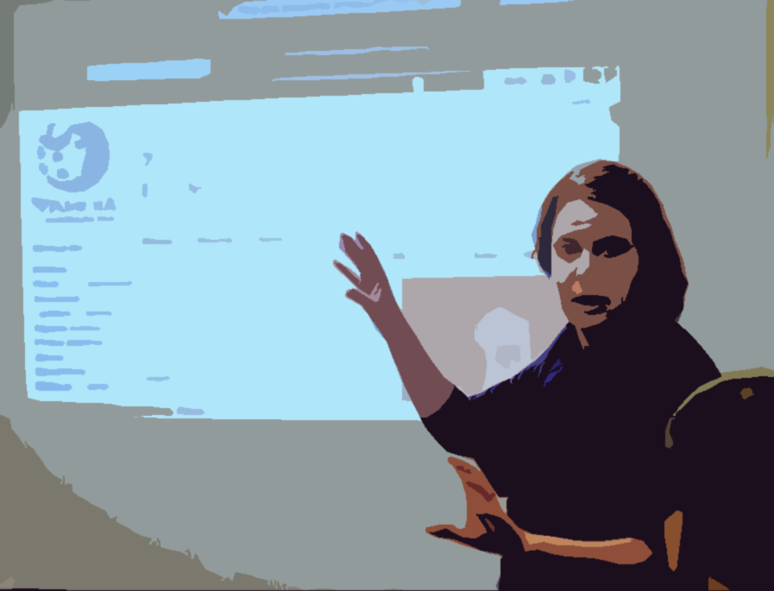


Mastering the Art of Impactful Presentations
A Skills-Focused Webinar
Karen Gutzman
Head, Research Assessment and Communications
Galter Health Sciences Library & Learning Center
Feinberg School of Medicine
Northwestern University
karen.gutzman@northwestern.edu
Notes:
Narrative:
Good morning everyone! I'm Karen Gutzman, and I'm excited to be here with all of you today. I spend a lot of time helping researchers and librarians tell their stories more effectively, and that's exactly what we're going to focus on today - mastering the art of impactful presentations. Whether you're presenting to colleagues, students, or at conferences, the skills we'll cover today will help you connect with your audience and make your message stick.
Course Overview:
https://www.mlanet.org/courses/mastering-the-art-of-impactful-presentations-a-skills-focused-webinar/
Image:
Beatrice Murch, CC BY 2.0 <https://creativecommons.org/licenses/by/2.0>, via Wikimedia Commons

Slide 2
Today’s Agenda
From Information to Strategy – 20 minutes
Building a logical flow that keeps your audience engaged from start to finish.
The Power of Narrative – 10 minutes
Using storytelling frameworks to make your research findings compelling and memorable.
Flow and Engagement – 20 minutes
Techniques to connect with your audience and maintain energy throughout your presentation.
Break – 10 minutes
Design Principles That Work – 20 minutes
Design principles for creating visually engaging slides that support your message.
Designing Information Experiences – 20 minutes
Using charts, graphs, and visuals to tell compelling stories with your research findings.
When Things Go Wrong – 10 minutes
Preparing for and recovering from technical failures during presentations.
Start Small, Build Momentum – 5 minutes
Action items and resources to continue improving your presentation skills.
Notes:
Narrative:
We're going to take a journey from chaos to confidence today. We'll start by learning how to organize your thoughts strategically, then discover how to turn your research into compelling stories that stick with your audience, and how to keep people engaged. After our break we will jump into some practical applications by covering how to create slides that actually support your message instead of competing with it and turn your data into visual experiences that drive understanding. We'll also tackle what to do when technology inevitably betrays you at the worst possible moment. And we'll wrap up with concrete steps you can take immediately to start improving your presentations.

Slide 3
Check-In (1 of 3) : How are you feeling today?
No judgement here. Drop your number in the chat.
1
2
3
4
5
Barely Alive
"I'm here, I'm breathing, the laundry pile has achieved sentience, I had candy for breakfast, and my coffee is cold.”
Brain Full
"My brain is like 47 browser tabs open, 3 frozen, and one playing music I can't find."
Caffeinated Chaos
"Running on coffee and determination. I’m not 100% sure why I’m in this meeting, but I’ll make it work anyways."
Functional Human
"I know what day it is, I’ve managed to feel useful today, and I only have 12 things on my to-do list.”
Ready to Conquer
"I'm caffeinated, organized, AND I actually read the meeting agenda beforehand!"
Notes:
Narrative:
First, let's be honest about how we're all feeling today. No judgment here - we're all human. I'll read through these options, and just drop your number in the chat. Are you barely alive - laundry has achieved sentience and you had candy for breakfast? Brain full with 47 browser tabs open? Running on caffeinated chaos? Functioning like a normal human? Or ready to conquer the world? Drop those numbers in the chat!

Slide 4
Check-In (2 of 3) : How soon do you need to give your next presentation?
If possible, turn your camera on for a quick visual check-in.
🤲 Both hands up This week – no panic here…
✋ One hand up Next few weeks - feeling pressure
👍Thumbs up Next month or two - good timing
✌️Peace sign Someday - here for general improvement
🤷Shrug No specific timeline - just curious
Notes:
Narrative:
Now let's see where you are in your presentation journey. How soon do you need to give your next presentation? This helps me know if we're dealing with immediate panic or if you're here for long-term skill building. Both hands up if it's this week, one hand up for the next few weeks, thumbs up for next month or two, peace sign for someday, or shrug if you're just curious. Let me see those hands!

Slide 5
Check-In (3 of 3): What is your biggest presentation challenge?
Use Zoom’s raise hand feature (it's in the Reactions menu at the bottom). If you can't find that button, just wave at your camera when I read the response that fits you best.
A) Knowing what content to include
B) Making slides that are visually appealing
C) Actually delivering without being too nervous
D) Keeping people engaged
E) None of these above (type in chat your response!)
F) All of the above - help!
Notes:
Narrative:
Last check-in - and this is the big one - what's your biggest presentation challenge? Use Zoom's raise hand feature when I read the option that fits you best.
A – Knowing what content to include
B – Making slides that are visually appealing
C – Actually delivering without being too nervous
D – Keeping people engaged
E – None of these – type yours in the chat
F – All of the above – send help!
Thank you! This gives me a great sense of where we should spend more time today, and spoiler alert: we’ll be tackling every single one of these together.”

Slide 6
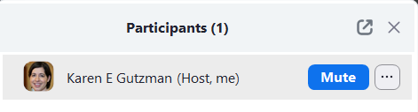
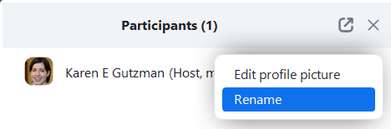
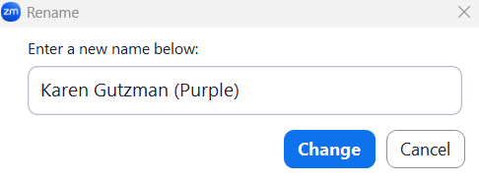
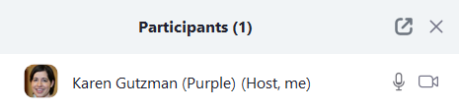
Rename Yourself in Zoom
Your group color is based on your first name:
A, B,C,D,E → 🔵 Blue
F,G,H,I,J → 🟢 Green
K,L,M,N,O → 🟣 Purple
P,Q,R,S,T → 🟡 Yellow
U,V,W,X,Y,Z → 🔴 Red
Click on “Participants” (or “More” → “Participants” on mobile).
2. Hover over your name and click “…” → “Rename” (On mobile: Tap your name, then tap “Rename.”)
3. Add your first name and the color for your group. Click on “Change”
🟢 Example: Sam (Green) or Green - Sam
Notes:
Narrative:
Great! Now let's get organized for some interactive work.
Please take a moment to rename yourself in Zoom by adding a color after your name. You’ll find the instructions right here on the slide, but I’ll walk you through it:
Hover over your video tile or find your name in the Participants list.
Click the ‘More’ button (three dots) next to your name.
Select ‘Rename.’
Add the color based on your first name, after your name. For example: Karen Gutzman – Purple
I’ll give everyone about 30 seconds to do that now. Let me know if you run into any issues!
This will make our group work much smoother later on.

Slide 7

From Information to Strategy
The secret to getting ahead is getting started."
Mark Twain
Writer and Humorist
Audience Needs Drives Everything
Notes:
Narrative:
Now that we know each other, let's dive into the heart of great presentation. Here's the thing - most presentations fail not because of bad content, but because they don't consider what the audience actually needs. Everything we do today is going to be driven by one core principle: audience needs drives everything.

Slide 8
Types of Presentations you may be asked to give…
Instructional
Sessions
Tool Demos
Conference Presentations
Professional Development
10 to 60 minutes
10 to 60 minutes
15-20 minutes
60-80 minutes
Structure
Hook with real research problem
Hands-on practice (60% of time)
3 key takeaways maximum
Check understanding frequently
End with next steps/resources
Structure
Common problems & solutions (i.e. scenarios)
Live demo to build skills
Link to help documentation and contact info
Structure
Hook with a relatable scenario or surprising statistic
Brief methodology
Focus on your main finding
Discussion with implications for practice, limitations
End with call to action
Structure
Strong objectives
Interactive activities throughout
Case studies and scenarios to connect with learners
Notes:
Narrative:
Let's start by thinking about the different types of presentations you might be asked to give. You'll notice these all have different structures because they serve different purposes. Instructional sessions are about building skills - notice how 60% of the time should be hands-on practice. Tool demos focus on solving specific problems through live demonstration. Conference presentations are your chance to share findings and inspire action. Professional development sessions need to be interactive throughout. The key insight here? You can't use the same approach for every type of presentation. Your audience's needs should shape everything from your structure to your timing.
Template(s):
This template was inserted from Power-user, the productivity add-in for PowerPoint, Excel and Word.
Install Power-user to access thousands of templates, icons, maps, diagrams and charts with Power-user.
Visit https://www.powerusersoftwares.com/
©Power-user SAS, terms of license: https://www.powerusersoftwares.com/terms

Slide 9
Start with the Mess
Open access options – confusion about APCs
Discussion: How do you current choose a journal?
Capture everything without judgment or organization. This is your creative phase where all ideas are valid and welcome.
Think. Check. Submit.
What content, concepts, and skills come to mind?
What examples, case studies, or stories could work?
What hands-on activities or exercises might engage learners?
What questions do learners typically ask?
What mistakes or misconceptions do you see repeatedly?
What resources, tools, or databases should they know about?
Impact factor vs other metrics?
Ever been approached by a predatory journal?
What makes a good journal?
Peer review process explained
Notes:
Narrative:
So how do you figure out what your audience needs? Start with the mess. I want you to think about preparing for a presentation like cleaning out your garage - first, you pull everything out onto the driveway. Don't organize yet, don't judge what's important, just get it all out there. Look at these questions - what content comes to mind? What examples could work? What questions do learners ask? What mistakes do you see repeatedly? This is your creative brain dump phase.

Slide 10
Consider your Audience’s Needs
Must Know
Should Know
Nice to Know
Organize your brain dump into meaningful clusters, then prioritize based on learner needs and session constraints.
Importance of Author Guidelines
Think. Check. Submit.
Editorial Board Quality Checks
Open Access Options
What do learners already know coming into this session?
What will they absolutely need to accomplish their goals?
What's foundational vs. what's enhancement?
What can they learn independently after the session?
What requires guided practice or demonstration?
What fits realistically in the time we have?
Journal scope matching exercise
Journal Selection Tools
Peer-review process explained
Cut from this session
Journal Impact Factor
Low quality or predatory publishing
Review a low-quality journal
Notes:
Narrative:
Once you have your mess, now comes the strategic thinking. You'll organize everything into meaningful clusters, then ruthlessly prioritize based on learner needs. Notice those three categories: Must Know, Should Know, Nice to Know - and sometimes, Cut from this session. This is where most presentations go wrong - everything feels equally important to the presenter, but your audience can only absorb so much. Your job is to be the filter.

Slide 11

Matching Content to Audience
A subject librarian was invited to present on scholarly publishing to 'NIH T32 students.' Perfect - she'd given this exact presentation to another T32 group just a few months earlier and it had gone well. She wasn’t well versed in NIH funding mechanisms, but she figured T32 was T32, so she packed up her slides and headed over.
What she didn't realize was that her previous audience had been post-doctoral fellows - seasoned researchers with publications under their belts. This group? First-year PhD students who'd barely started their programs.
As she waited for everyone to arrive, she chatted with a few people already there: 'So, how many of you are currently working on manuscript submissions? Who's dealing with reviewer comments right now?' She looked out expectantly at engaged faces.
Instead, she got blank stares. Uncomfortable silence.
Notes:
Narrative:
Let me tell you a story that perfectly illustrates why audience analysis matters. This might sound familiar to those of you with some presentation experience.
A subject librarian was invited to present on scholarly publishing to 'NIH T32 students.' Perfect - she'd given this exact presentation to another T32 group just a few months earlier and it had gone well. She wasn’t well versed in NIH funding mechanisms, but she figured T32 was T32, so she packed up her slides and headed over.
What she didn't realize was that her previous audience had been post-doctoral fellows - seasoned researchers with publications under their belts. This group? First-year PhD students who'd barely started their programs.
As she waited for everyone to arrive, she chatted with a few people already there: 'So, how many of you are currently working on manuscript submissions? Who's dealing with reviewer comments right now?' She looked out expectantly at engaged faces.
Instead, she got blank stares. Uncomfortable silence.

Slide 12

Matching Content to Audience
Finally, one student spoke up: 'Um... we're first-year doctoral students. We don't even have data to publish yet. Most of us are still taking coursework.’
First-years! Her heart sank as she mentally flipped through her presentation: advanced topics on impact factor selection, strategies for handling difficult peer reviewers, navigating journal revision cycles. She only had 45 minutes and a presentation full of advanced publishing strategies for an audience that needed 'Publishing 101’.
The students were looking at her expectantly. The faculty host was checking his phone. She had to make a choice: forge ahead with inappropriate content or completely improvise.
A classic case of solving the right problem for the wrong audience - her content was excellent, just pitched to people who wouldn't need it for several years.
Notes:
Narrative:
Finally, one student spoke up: 'Um... we're first-year doctoral students. We don't even have data to publish yet. Most of us are still taking coursework.’
First-years! Her heart sank as she mentally flipped through her presentation: advanced topics on impact factor selection, strategies for handling difficult peer reviewers, navigating journal revision cycles. She only had 45 minutes and a presentation full of advanced publishing strategies for an audience that needed 'Publishing 101’.
The students were looking at her expectantly. The faculty host was checking his phone. She had to make a choice: forge ahead with inappropriate content or completely improvise.
A classic case of solving the right problem for the wrong audience - her content was excellent, just pitched to people who wouldn't need it for several years.

Slide 13

Matching Content to Audience
What happened?
She prepared the perfect session …. for the wrong audience
🔵Blue Group, type your responses into chat:
Think about a time when you were either the speaker or audience member and the presentation didn’t match the audience’s needs. As a presenter, what’s something you can do before your session to avoid this mismatch? And what's your backup plan if you discover the mismatch right before or mid-presentation?
🟢 Green Group, you may be called on to:
Summarize one or more of the responses made by members of the Blue Group
Notes:
Narrative:
Blue group, I want you to think about this. Type in the chat about a time when you were either the speaker or audience member and the presentation didn't match the audience's needs. What could the presenter have done differently? Green group, you'll summarize what the Blue group shares.

Slide 14
Matching Content to Audience
She prepared the perfect session …. for the wrong audience
1
Connect with the organizer
Are these medical students, pre-docs, post-docs, staff, or faculty?
What specific needs, assignments, or deadlines brings them here?
What subject areas/disciplines are represented?
How many people are we expecting?
Notes:
Narrative:
Here's how to avoid this mismatch, starting with connecting with the organizer. Don't just ask 'Who's my audience?' Ask specific questions: Are these medical students, pre-docs, post-docs, staff, or faculty? What specific needs or deadlines bring them here? What disciplines are represented? How many people are we expecting? These details change everything about your approach.

Slide 15
Matching Content to Audience
She prepared the perfect session …. for the wrong audience
1
Connect with the organizer
Are these medical students, pre-docs, post-docs, staff, or faculty?
What specific needs, assignments, or deadlines brings them here?
What subject areas/disciplines are represented?
How many people are we expecting?
2
Survey your audience ahead (even 2-3 questions via email):
What's your biggest challenge with [topic]?
How familiar are you with [tool/concept]?
Notes:
Narrative:
Even 2-3 questions sent ahead of time can prevent disasters. Ask about their biggest challenges with your topic, their familiarity with key tools or concepts. Simple questions that save you from major mismatches.

Slide 16
Matching Content to Audience
She prepared the perfect session …. for the wrong audience
1
Connect with the organizer
3
Quick Pulse Checks During
Are these medical students, pre-docs, post-docs, staff, or faculty?
What specific needs, assignments, or deadlines brings them here?
What subject areas/disciplines are represented?
How many people are we expecting?
Show of hands: Who's gotten predatory journal invitations in their email?
Fist to five: How confident do you feel about evaluating journal quality right now? Scale: 5 = I could teach this to someone to 1 = This is all pretty new to me.
Chatterfall: What would make this session a win for you today?
Type in the chat: What's your biggest journal selection challenge right now?
Finding journals in my field
Evaluating journal quality
Understanding metrics and rankings
Avoiding predatory journals
All of the above
Other: [type answer!]
2
Survey your audience ahead (even 2-3 questions via email):
What's your biggest challenge with [topic]?
How familiar are you with [tool/concept]?
Notes:
Narrative:
But even with preparation, you need pulse checks during your presentation. Try a show of hands: 'Who's gotten predatory journal invitations?' Or a fist-to-five confidence check. These quick assessments let you adjust in real-time.

Slide 17
Matching Content to Audience
She prepared the perfect session …. for the wrong audience
1
Connect with the organizer
3
Quick Pulse Checks During
4
Prepare extra content
Are these medical students, pre-docs, post-docs, staff, or faculty?
What specific needs, assignments, or deadlines brings them here?
What subject areas/disciplines are represented?
How many people are we expecting?
Show of hands: Who's gotten predatory journal invitations in their email?
Fist to five: How confident do you feel about evaluating journal quality right now? Scale: 5 = I could teach this to someone to 1 = This is all pretty new to me.
Chatterfall: What would make this session a win for you today?
Type in the chat: What's your biggest journal selection challenge right now?
Finding journals in my field
Evaluating journal quality
Understanding metrics and rankings
Avoiding predatory journals
All of the above
Other: [type answer!]
Prepare backup content for when your audience knows more or less than expected
Basic: What factors should you consider when choosing a journal?
Intermediate: What is your process for researching a journal before submitting?
Advanced: How do you balance journal prestige with publication speed when you have competing career pressures?
2
Survey your audience ahead (even 2-3 questions via email):
What's your biggest challenge with [topic]?
How familiar are you with [tool/concept]?
Notes:
Narrative:
And always, always prepare content at multiple levels. Have basic, intermediate, and advanced versions ready. When you discover your audience knows more or less than expected, you can pivot gracefully.

Slide 18
Matching Content to Audience
She prepared the perfect session …. for the wrong audience
1
Connect with the organizer
3
Quick Pulse Checks During
4
Prepare extra content
Are these medical students, pre-docs, post-docs, staff, or faculty?
What specific needs, assignments, or deadlines brings them here?
What subject areas/disciplines are represented?
How many people are we expecting?
Show of hands: Who's gotten predatory journal invitations in their email?
Fist to five: How confident do you feel about evaluating journal quality right now? Scale: 5 = I could teach this to someone to 1 = This is all pretty new to me.
Chatterfall: What would make this session a win for you today?
Type in the chat: What's your biggest journal selection challenge right now?
Finding journals in my field
Evaluating journal quality
Understanding metrics and rankings
Avoiding predatory journals
All of the above
Other: [type answer!]
Prepare backup content for when your audience knows more or less than expected
Basic: What factors should you consider when choosing a journal?
Intermediate: What is your process for researching a journal before submitting?
Advanced: How do you balance journal prestige with publication speed when you have competing career pressures?
2
Survey your audience ahead (even 2-3 questions via email):
What's your biggest challenge with [topic]?
How familiar are you with [tool/concept]?
5
Create "choose your own adventure"
We can go deep on advanced features OR focus on getting started - what serves you better?
Notes:
Narrative:
Finally, build in flexibility. Ask your audience: 'We can go deep on advanced features OR focus on getting started, what serves you better?' Let them guide the journey

Slide 19
Many ways to support audience needs
Share materials early
agendas, slides, key concepts for advance review
Provide Choice
You can respond in chat, raise hand, or just listen
Low pressure Engagement
optional participation, not mandatory spotlight moments
Tip: If you do need to call on someone, remember to repeat the question and offering a few example responses to avoid putting anyone too much “on the spot.”
Multiple follow-up formats
email summary, recorded session, resource links
.
Notes:
Narrative:
Remember, supporting your audience isn't just about content—it's about creating an inclusive environment. Share materials early, provide choices for participation, offer multiple follow-up formats. Make engagement low-pressure. If you do need to call on someone, repeat the question and offer example responses to avoid putting anyone on the spot.
Template(s):
This template was inserted from Power-user, the productivity add-in for PowerPoint, Excel and Word.
Install Power-user to access thousands of templates, icons, maps, diagrams and charts with Power-user.
Visit https://www.powerusersoftwares.com/
©Power-user SAS, terms of license: https://www.powerusersoftwares.com/terms

Slide 20
Many ways to support audience needs
Share materials early
agendas, slides, key concepts for advance review
Use Peer Teaching concepts:
Invite audience members to share their knowledge and experience with the group, creating a collaborative learning environment.
Examples:
"Sarah, you mentioned you've used this database before—what tips would you give someone just starting out?"
"Before I show you my approach, who has tried solving this problem before? What worked or didn't work for you?"
Provide Choice
You can respond in chat, raise hand, or just listen
Low pressure Engagement
optional participation, not mandatory spotlight moments
Tip: If you do need to call on someone, remember to repeat the question and offering a few example responses to avoid putting anyone too much “on the spot.”
Multiple follow-up formats
email summary, recorded session, resource links
.
Notes:
Narrative:
Peer teaching is when audience members with experience or knowledge share their insights with others in the group, rather than having all instruction come from the presenter. This technique is especially valuable for librarians and educators who often have mixed audiences with varying experience levels. It transforms your presentation from a lecture into a collaborative learning experience while helping you manage diverse knowledge levels in your audience.
Template(s):
This template was inserted from Power-user, the productivity add-in for PowerPoint, Excel and Word.
Install Power-user to access thousands of templates, icons, maps, diagrams and charts with Power-user.
Visit https://www.powerusersoftwares.com/
©Power-user SAS, terms of license: https://www.powerusersoftwares.com/terms

Slide 21
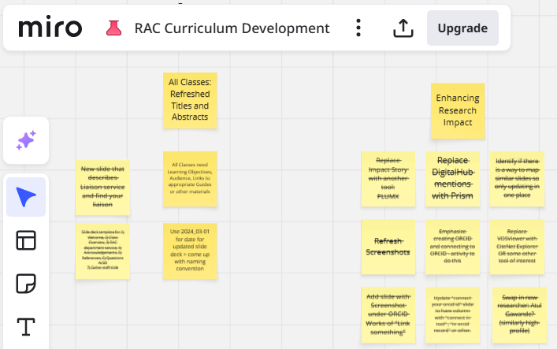
Resources and Tools
MLA’s Guide to Health Sciences Instructional Design https://www.mlanet.org/courses/the-mla-guide-to-instructional-design-basics/
Learner-Centered Pedagogy: Principles and Practice (by Kevin Michael Klipfel and Dani Brecher Cook) https://alastore.ala.org/content/learner-centered-pedagogy-principles-and-practice
Virtual White Boards
Miro - Comprehensive collaboration platform with extensive template library
Microsoft Whiteboard - Simple, integrated option for Office 365 users
Notes:
Narrative:
Before we move on, I want to point you to some fantastic resources. The MLA's Guide to Health Sciences Instructional Design is excellent for deeper learning. For virtual collaboration, try Miro for comprehensive whiteboarding or Microsoft Whiteboard if you're already in the Office 365 ecosystem.

Slide 22
The Power of Narrative
Stories are data with a soul.
Brené Brown
Researcher and Storyteller
Using storytelling frameworks to make your research findings compelling and memorable
Notes:
Narrative:
Now that we've established the foundation of audience-focused content, let's talk about something that can transform even the most technical presentation into something memorable. As Brené Brown says, 'Stories are data with a soul.' We're going to learn how to give your research findings that soul.

Slide 23
Story-telling framework: Simple 3-Act Structure
Human brains are wired to follow narrative patterns
Notes:
Narrative:
Human brains are literally wired to follow narrative patterns. We've been telling stories for thousands of years, and that pattern is embedded in how we process information. The simple three-act structure isn't just for movies—it's a powerful framework for any presentation.
Template(s):
This template was inserted from Power-user, the productivity add-in for PowerPoint, Excel and Word.
Install Power-user to access thousands of templates, icons, maps, diagrams and charts with Power-user.
Visit https://www.powerusersoftwares.com/
©Power-user SAS, terms of license: https://www.powerusersoftwares.com/terms

Slide 24
Story-telling framework: Simple 3-Act Structure
Human brains are wired to follow narrative patterns
Act 1: The Setup (Problem/Challenge)
Outline their quest: Present the current situation or challenge. Systematic Review Session: "Your job as a researcher is to find the most complete, unbiased answer possible"
Establish the stakes: Why should the audience care? EndNote Session: "Meet Tom, who spent 3 hours last week reformatting citations..."
Create tension that needs resolution:
Literature Review Session: "You found 15 studies that support your hypothesis and feel ready to move forward. But here's the problem: you've only scratched the surface. Contradictory evidence and critical gaps are hiding in plain sight."
Notes:
Narrative:
ct 1 is your setup—establish the problem or challenge. Outline their quest: 'Your job as a researcher is to find the most complete, unbiased answer possible.' Establish the stakes: 'Meet Tom, who spent 3 hours last week reformatting citations...' Create tension that needs resolution: 'You found 15 studies that support your hypothesis, but here's the problem—contradictory evidence is hiding in plain sight.
Template(s):
This template was inserted from Power-user, the productivity add-in for PowerPoint, Excel and Word.
Install Power-user to access thousands of templates, icons, maps, diagrams and charts with Power-user.
Visit https://www.powerusersoftwares.com/
©Power-user SAS, terms of license: https://www.powerusersoftwares.com/terms

Slide 25
Story-telling framework: Simple 3-Act Structure
Human brains are wired to follow narrative patterns
Act 2: The Journey (Solution/Process)
Introduce your solution: Show how to address the challenge. Systematic Review Session: "Today we'll learn the systematic review process that ensures you find ALL the evidence, not just the convenient evidence"
Guide through the process: Demonstrate steps and methodology. EndNote Session: "Watch as we transform Tom's chaotic citation process into a streamlined workflow using EndNote"
Address obstacles: Show how to overcome common hurdles. Literature Review Session: “Let’s break down how to build a solid search strategy."
Notes:
Narrative:
Act 2 is the journey—your solution in action. Introduce your solution: 'Today we'll learn the systematic review process that ensures you find ALL the evidnce.' Guide through the process with demonstrations. Address obstacles: 'Let's break down how to build a solid search strategy.' This is where the real learning happens..
Template(s):
This template was inserted from Power-user, the productivity add-in for PowerPoint, Excel and Word.
Install Power-user to access thousands of templates, icons, maps, diagrams and charts with Power-user.
Visit https://www.powerusersoftwares.com/
©Power-user SAS, terms of license: https://www.powerusersoftwares.com/terms

Slide 26
Story-telling framework: Simple 3-Act Structure
Human brains are wired to follow narrative patterns
Act 3: The New Reality (Outcome/Action)
Paint the improved future: Show what success looks like. Systematic Review Session: "Six months from now, you'll confidently say 'I’ve systematically reviewed as much evidence as possible on this topic'"
Provide clear next steps: Give specific, actionable guidance. Literature Review Session: "Your first task: define your research question using PICO by Friday"
Call to action: End with what they should do immediately. EndNote Session: "Start building your EndNote library today with the three articles from your current project"
Notes:
Narrative:
Act 3 paints the improved future. Show what success looks like: 'Six months from now, you'll confidently say I've systematically reviewed all available evidence.' Provide clear next steps: 'Define your research question using PICO by Friday.' End with immediate action: 'Start building your EndNote library today with three articles from your current project.
Template(s):
This template was inserted from Power-user, the productivity add-in for PowerPoint, Excel and Word.
Install Power-user to access thousands of templates, icons, maps, diagrams and charts with Power-user.
Visit https://www.powerusersoftwares.com/
©Power-user SAS, terms of license: https://www.powerusersoftwares.com/terms

Slide 27
Using Metaphors to Explain Complex Concepts
Puzzle Framework
"Finding reliable health information online is like working a jigsaw puzzle. PubMed gives you the corner pieces, but you need other databases to complete the picture”
The GPS Navigation
“Regular literature reviews are like asking for directions. Systematic reviews are like GPS, they show you every possible route and help you choose the best one”
The Mountain Climb
“Learning evidence-based practice is like climbing a mountain, the view from the top is worth it, but you need the right gear and a good guide”
The Fishing Trip
“Googling your research topic is like fishing with a single hook in a crowded pond. Using multiple medical databases is like having professional nets in pristine waters”
The Construction Framework
“We're building a house of evidence. Each study is a brick, and we need all the bricks to build something that won't collapse under scrutiny”
The Journey/Treasure Map
“Your clinical question is the X that marks the spot. PICO formatting is your treasure map,. Without it, you're just wandering around hoping to stumble onto evidence”
Notes:
Narrative:
Metaphors are your secret weapon for explaining complex concepts. Instead of saying 'systematic reviews are comprehensive,' try 'Regular literature reviews are like asking for directions. Systematic reviews are like GPS—they show you every possible route and help you choose the best one.' Or 'Finding reliable health information online is like working a jigsaw puzzle. PubMed gives you the corner pieces, but you need other databases to complete the picture.
Tips for Using Metaphors Effectively
Choose one per session - Don't mix metaphors or confuse your audience
Extend throughout - Return to your chosen metaphor to reinforce concepts
Match your audience - Use familiar experiences (GPS for tech-savvy, maps for traditionalists)
Test understanding - Ask "Does this comparison make sense to you?"
Template(s):
This template was inserted from Power-user, the productivity add-in for PowerPoint, Excel and Word.
Install Power-user to access thousands of templates, icons, maps, diagrams and charts with Power-user.
Visit https://www.powerusersoftwares.com/
©Power-user SAS, terms of license: https://www.powerusersoftwares.com/terms

Slide 28

“Everything is Equally Important”
A librarian was scheduled to give a 50-minute 'Introduction to Research Resources' session for incoming graduate students. They were excited - finally, enough time to be comprehensive! They'd prepared slides covering the library's full range of services.
They started strong: 'Today we'll cover everything you need to know about research support!' Then they launched into their grand tour: 5 minutes on the catalog, 5 minutes on interlibrary loan, 5 minutes on database access, 5 minutes on citation management, 5 minutes on research consultations, 5 minutes on data management, 5 minutes on study spaces, 5 minutes on printing services, 5 minutes on archives access, and 5 minutes on …..
Every topic got the same enthusiastic treatment. They explained the nuances of renewing books with the same detail as finding peer-reviewed articles. They spent as much time on how to reserve a group study room as on how to access databases from off-campus.
Notes:
Narrative:
Here's another scenario that hits close to home.
A librarian was scheduled to give a 50-minute 'Introduction to Research Resources' session for incoming graduate students. They were excited - finally, enough time to be comprehensive! They'd prepared slides covering the library's full range of services.
They started strong: 'Today we'll cover everything you need to know about research support!' Then they launched into their grand tour: 5 minutes on the catalog, 5 minutes on interlibrary loan, 5 minutes on database access, 5 minutes on citation management, 5 minutes on research consultations, 5 minutes on data management, 5 minutes on study spaces, 5 minutes on printing services, 5 minutes on archives access, and 5 minutes on …..
Every topic got the same enthusiastic treatment. They explained the nuances of renewing books with the same detail as finding peer-reviewed articles. They spent as much time on how to reserve a group study room as on how to access databases from off-campus.

Slide 29

“Everything is Equally Important”
Forty-five minutes in, one student asked, 'But what if I just need to find some basic sources for my first research paper?’ They replied, 'Oh, we'll get to search strategies after I finish explaining our digitization services and special collections policies!’
By the end, they'd covered 15 different services with equal enthusiasm. Students left with glazed expressions, furiously scribbling notes about everything from microfilm readers to manuscript archives.
When asked later what they remembered from the session, most said 'Something about... a lot of stuff the library does?’
Notes:
Narrative:
Forty-five minutes in, one student asked, 'But what if I just need to find some basic sources for my first research paper?’ They replied, 'Oh, we'll get to search strategies after I finish explaining our digitization services and special collections policies!’
By the end, they'd covered 15 different services with equal enthusiasm. Students left with glazed expressions, furiously scribbling notes about everything from microfilm readers to manuscript archives.
When asked later what they remembered from the session, most said 'Something about... a lot of stuff the library does?’

Slide 30
“Everything is Equally Important”
They prepared a comprehensive session … but forgot to prioritize what matters
🟣Purple Group, type your responses into chat:
If you were the librarian in this situation, what would you do to improve this session?
🟡 Yellow Group, you may be called on to:
Summarize one or more of the responses made by members of the Purple Group.
Notes:
Narrative:
This next scenario is one we’ve all probably done, trying to give a full, rich picture, we pack in everything. They prepared a comprehensive session … but forgot to prioritize what matters
Let’s dig into this one a bit more.
Purple Group—Imagine you’re the librarian in this scenario, tasked with teaching first-year med students. what would you do to improve this session? Start typing your thoughts in the chat.
Yellow Group, your role is to listen (in this case: read). You may be called on to summarize what someone else shared.

Slide 31
“Everything is Equally Important”
They've prepared a comprehensive session … but forgot to prioritize what matters
Prioritize Pain Points
Address their biggest frustrations first, not your most exciting features.
Ask yourself:
"What’s the biggest barrier preventing students from succeeding with their project?" → Start there.
What causes the most reference desk tickets? → Prioritize that.
What do faculty complain about most? → Focus on fixing it.
Notes:
Narrative:
Here's the solution: prioritize pain points, not your favorite features. Ask yourself: What's the biggest barrier preventing students from succeeding? What causes the most reference desk tickets? What do faculty complain about most? Start there, not with what excites you most.

Slide 32
“Everything is Equally Important”
They've prepared a comprehensive session … but forgot to prioritize what matters
Prioritize Pain Points
Use a Good Hook
Address their biggest frustrations first, not your most exciting features.
Ask yourself:
"What’s the biggest barrier preventing students from succeeding with their project?" → Start there.
What causes the most reference desk tickets? → Prioritize that.
What do faculty complain about most? → Focus on fixing it.
Use what you’ve prioritized as a “hook” for them to focus in on your message.
Problem → Solution → Benefits
"Avoiding Predatory Publishing Traps"
Problem: Researchers falling victim to predatory journals
Solution: Systematic journal evaluation criteria
Benefits: Protected reputation
Notes:
Narrative:
Then use what you've prioritized as your hook. Follow the Problem → Solution → Benefits formula. 'Avoiding Predatory Publishing Traps'—Problem: researchers falling victim to predatory journals. Solution: systematic journal evaluation criteria. Benefits: protected reputation. Your hook should immediately answer 'Why should I care?'"

Slide 33
“Everything is Equally Important”
They've prepared a comprehensive session … but forgot to prioritize what matters
Prioritize Pain Points
Use a Good Hook
Big 3 Takeaways
Address their biggest frustrations first, not your most exciting features.
Ask yourself:
"What’s the biggest barrier preventing students from succeeding with their project?" → Start there.
What causes the most reference desk tickets? → Prioritize that.
What do faculty complain about most? → Focus on fixing it.
Use what you’ve prioritized as a “hook” for them to focus in on your message.
Problem → Solution → Benefits
"Avoiding Predatory Publishing Traps"
Problem: Researchers falling victim to predatory journals
Solution: Systematic journal evaluation criteria
Benefits: Protected reputation
Limit sessions to 3 core takeaways, then layer on enhancements if time allows.
Examples:
Database demo: Search, filter, export. Add advanced features as needed.
Research consultation: How to book, what to bring, what to expect. Cover the comprehensive subject guide tour if time allows.
Notes:
Narrative:
Limit every session to 3 core takeaways, then layer on enhancements if time allows. For a database demo: search, filter, export. Add advanced features only if time permits. For research consultations: how to book, what to bring, what to expect. Save the comprehensive tour for when you have extra time.

Slide 34
Flow and Engagement
The human brain starts working the moment you are born and never stops until you stand up to speak in public.
George Jessel
Actor and Film Producer
Techniques to connect with your audience and maintain energy throughout your presentation
Notes:
Narrative:
I love this quote from George Jessel: 'The human brain starts working the moment you are born and never stops until you stand up to speak in public.' We've all felt that moment of panic. But here's the thing—engagement isn't about being a natural performer. It's about connection, and connection has techniques you can learn.

Slide 35

Warming up the crowd
A librarian was scheduled to give a 30-minute virtual session on 'Finding Grey Literature' to a graduate student writing group. He joined the Zoom meeting right on time and saw 12 people already waiting, but he immediately muted himself and started arranging his notes.
For three minutes, he said nothing while latecomers trickled in. No 'Good morning!' No 'Thanks for having me.' No acknowledgment of the organizer who'd invited him. People sat in awkward silence, staring at a blank screen with his camera off.
Finally, he cleared his throat and began in a barely audible voice: 'Um, okay, so... I guess we should start. Today we're going to talk about finding grey literature sources.’ His voice was so quiet that someone immediately typed in chat: 'Could you speak louder please?'
Notes:
Narrative:
Let me tell you about a presentation that failed before it even started.
A librarian was scheduled to give a 30-minute virtual session on 'Finding Grey Literature' to a graduate student writing group. He joined the Zoom meeting right on time and saw 12 people already waiting, but he immediately muted himself and started arranging his notes.
For three minutes, he said nothing while latecomers trickled in. No 'Good morning!' No 'Thanks for having me.' No acknowledgment of the organizer who'd invited him. People sat in awkward silence, staring at a blank screen with his camera off.
Finally, he cleared his throat and began in a barely audible voice: 'Um, okay, so... I guess we should start. Today we're going to talk about finding grey literature sources.’ His voice was so quiet that someone immediately typed in chat: 'Could you speak louder please?'

Slide 36

Warming up the crowd
He then launched straight into screen sharing without introducing himself, asking who was in the room, or finding out what they were working on. No warm-up questions. No energy. No connection. Just a monotone explanation of database searching while participants' cameras stayed off and chat remained silent.
Twenty-five minutes of dry content delivery later, he ended with: 'Okay, that's everything. Um, any questions? No? Okay, bye.' The meeting ended abruptly. No one had said a word except to ask him to speak up.
Notes:
Narrative:
He then launched straight into screen sharing without introducing himself, asking who was in the room, or finding out what they were working on. No warm-up questions. No energy. No connection. Just a monotone explanation of database searching while participants' cameras stayed off and chat remained silent.
Twenty-five minutes of dry content delivery later, he ended with: 'Okay, that's everything. Um, any questions? No? Okay, bye.' The meeting ended abruptly. No one had said a word except to ask him to speak up.

Slide 37
Warming up the crowd
What happened?
He treated the audience like strangers ….instead of collaborators.
Chatterfall
I’ll give you a prompt/question to respond to
Start typing your response in the chat box
Don’t hit Enter yet!! Keep typing for 1-2 minutes
When I say “Send!” – everyone hits “Enter” at once
Watch the chat “waterfall” of responses appear
Prompt:
What has a presenter has done that made you feel more welcomed, recognized, or engaged?
Notes:
Narrative:
What happened? The audience feels like passive bystanders instead of engaged learners.
Let’s try something together, this is called a “Chatterfall.” I’ll give you a prompt to reflect on: What has a presenter done that made you feel more welcomed, recognized, or engaged?
Go ahead and type your response into the chat—but don’t hit Enter yet!
I’ll give you a minute to type… then we’ll all hit “Send” at the same time and watch the waterfall of responses appear.
(This approach models how we can bring people into the experience rather than keeping them at arm’s length.)
Love seeing all these ideas! Let's take a moment to scan through what everyone shared. These are great real-life strategies we can all learn from. If you saw something you want to try, jot it down—or if something surprised you, let us know in the chat.
[Optional follow-up if time allows: “Anyone want to unmute and expand on your comment?”]

Slide 38
Warming up the crowd
He treated the audience like strangers ….instead of collaborators.
Elements for Engagement
Energy: Exude positive atmosphere & be engaging from the start
Connection: Use their names to create one-on-one connections
Warmth: Use a warm, conversational tone (not monotone lecture voice)
Interest: Vary your pace and inflection to maintain interest
Notes:
Narrative:
So how do we avoid treating our audience like strangers? We engage them right from the beginning.
Let’s break this down into four elements you can actively bring into your sessions:
Energy: Your tone sets the emotional tone for the room. Even in virtual spaces, your enthusiasm can be contagious. Start with positivity and intention, people mirror your energy.
Connection: Names are powerful. Use them when you can, whether you greet participants by name, refer to their questions, or acknowledge their contributions, it creates a sense of personal connection.
Warmth: Ditch the monotone “lecture voice.” Instead, speak like you would to a colleague or friend. A warm, conversational tone is far more inviting and encourages participation.
Interest: Vary your pacing and vocal inflection to keep attention high. Pauses, emphasis, and changes in rhythm all help prevent cognitive drift, especially during longer sessions.
Together, these elements shift the session from a one-way lecture to a shared, engaging experience.

Slide 39
Warming up the crowd
He treated the audience like strangers ….instead of collaborators.
Before You Start:
Try to greet people personally as they are coming in: "Hi Sarah. So glad you're here. Hi Jane. Nice to meet you.”
Opening Words:
Acknowledge the organizer and the group: "Good morning everyone! Thanks, Dr. Martinez, for inviting me. I’m glad to be here with all of you.“
Introduce Yourself:
Share who you are and why you're excited to help them: "I'm Alex, your subject librarian for biology. I've helped hundreds of grad students navigate publishing, and I love solving research puzzles!”
Set the Tone:
Show energy and enthusiasm for what's coming: "I’m excited to share some tools today that should save you time and energy.”
First Engagement:
Get them participating before jumping into content: "Give me one word in the chat that describes your current research status“
Elements for Engagement
Energy: Exude positive atmosphere & be engaging from the start
Connection: Use their names to create one-on-one connections
Warmth: Use a warm, conversational tone (not monotone lecture voice)
Interest: Vary your pace and inflection to maintain interest
Notes:
Narrative:
Here's your template for success. Before you start: greet people personally as they arrive. 'Hi Sarah, so glad you're here. Hi Jane, nice to meet you.' Opening words: acknowledge the organizer and group. 'Good morning everyone! Thanks, Dr. Martinez, for inviting me.' Introduce yourself with energy: 'I'm Alex, your biology librarian. I've helped hundreds of grad students navigate publishing, and I love solving research puzzles!’

Slide 40

The “Pacing Problem”
A librarian was booked for a 45-minute session on 'Research Strategies for Thesis Writing' with doctoral students. She'd prepared what she thought was the perfect amount of content, but things went sideways from the start.
Five minutes in, someone asked a complex question about citation styles that spiraled into a 10-minute tangent. Then another student shared an issue they were having with database access that some how ate up another 8 minutes. By the 20-minute mark, she was still on slide 6 of 30.
Notes:
Narrative:
But engagement without pacing control can backfire spectacularly. Now let's talk about timing.
A librarian was booked for a 45-minute session on 'Research Strategies for Thesis Writing' with doctoral students. She'd prepared what she thought was the perfect amount of content, but things went sideways from the start.
Five minutes in, someone asked a complex question about citation styles that spiraled into a 10-minute tangent. Then another student shared an issue they were having with database access that some how ate up another 8 minutes. By the 20-minute mark, she was still on slide 6 of 30.

Slide 41

The “Pacing Problem”
Panic set in. She started speed-talking through her remaining slides, skipping examples and rushing past the hands-on practice she'd planned. 'So here's advanced Boolean searching—any questions? No? Great, moving on to subject headings...' Students looked bewildered as concepts flew by without explanation.
With 5 minutes left, she realized she hadn't covered half her material, including the most important part: how to actually evaluate sources. She frantically tried to cram 20 minutes of content into her remaining time: 'Okay, quickly—peer review good, Wikipedia – not a primary source, obviously; check the author, look for bias, questions?'
Notes:
Narrative:
Panic set in. She started speed-talking through her remaining slides, skipping examples and rushing past the hands-on practice she'd planned. 'So here's advanced Boolean searching—any questions? No? Great, moving on to subject headings...' Students looked bewildered as concepts flew by without explanation.
With 5 minutes left, she realized she hadn't covered half her material, including the most important part: how to actually evaluate sources. She frantically tried to cram 20 minutes of content into her remaining time: 'Okay, quickly—peer review good, Wikipedia – not a primary source, obviously; check the author, look for bias, questions?'

Slide 42
The “Pacing Problem”
What happened?
She organized the material well … but lost control of the clock
Chatterfall
I’ll give you a prompt/question to respond to
Start typing your response in the chat box
Don’t hit Enter yet!! Keep typing for 1-2 minutes
When I say “Send!” – everyone hits “Enter” at once
Watch the chat “waterfall” of responses appear
Prompt:
What are some strategies you use to keep presentations going on time?
Notes:
Narrative:
Okay, in this scenario, we’re looking at a familiar situation, everything was well-planned and well-structured, but the presenter lost track of time.
Now, let’s do a quick interactive activity called a Chatterfall. I’m going to ask you a question in just a moment, and I want everyone to start typing their response in the chat box, but—don’t hit enter yet!
You’ll have about 1–2 minutes to type. When I say 'Send!' everyone will hit enter at once, and we’ll see the chat fill up like a waterfall. This lets us gather everyone’s input at the same time without influencing each other’s answers.
Love seeing all these ideas! Let's take a moment to scan through what everyone shared. These are great real-life strategies we can all learn from. If you saw something you want to try, jot it down—or if something surprised you, let us know in the chat.
[Optional follow-up if time allows: “Anyone want to unmute and expand on your comment?”]

Slide 43
The “Pacing Problem”
You've organized your material well … but lost control of the clock
Running behind?
Skip examples, not concepts: Cut the stories, keep the core learning
Use a "parking lot”: Save complex questions and discussions to be addressed later
Address it directly: ”We have 10 minutes left, so let's focus on the most important part...”
Option for consultation: “If I rushed anyone too much today, I’m happy to chat individually – here’s my contact.”
Notes:
Narrative:
Great strategies! Here's my emergency protocol when running behind: Skip examples, not concepts. Cut the stories, keep the core learning. Use a 'parking lot' for complex questions. Address it directly: 'We have 10 minutes left, let's focus on the most important part.' Offer individual consultations: 'If I rushed anyone, I'm happy to chat individually.'

Slide 44
The “Pacing Problem”
You've organized your material well … but lost control of the clock
Running behind?
Skip examples, not concepts: Cut the stories, keep the core learning
Use a "parking lot“: Save complex questions and discussions to be addressed later
Address it directly: ”We have 10 minutes left, so let's focus on the most important part...”
Option for consultation: “If I rushed anyone too much today, I’m happy to chat individually – here’s my contact.”
Too Much Time Left?
Open Q&A early: "Let's tackle your real research questions“ or “Who wants to troubleshoot their actual project?”
Build in Flexibility: Create "bonus" material you can add or skip
Be ok with ending early: “I’ll give you back these 15 minutes to try out some of the things we’ve covered.”
Notes:
Narrative:
But what if you have too much time? Open Q&A early: 'Let's tackle your real research questions.' Build in flexibility with bonus material you can add or skip. And be okay with ending early: 'I'll give you back these 15 minutes to try out what we've covered.

Slide 45

The “Glazed-Eye Epidemic"
A librarian was midway through her 'Citation Management Mastery' session for graduate students when she noticed the warning signs. First, someone in the front row started checking their phone. Then another student began responding to emails. By the 20-minute mark, half the room was mentally checked out.
She pressed on with her carefully prepared slides about Zotero features, but the energy was draining from the room like air from a punctured balloon. Determined to get through her material, she kept talking about citation styles and folder organization while the audience disappeared into their devices. 'And here's how you create subgroups,' she said to a room where only three people were still looking at the screen.
Notes:
Narrative:
Now let's talk about every presenter's nightmare—the glazed-eye epidemic.
A librarian was midway through her 'Citation Management Mastery' session for graduate students when she noticed the warning signs. First, someone in the front row started checking their phone. Then another student began responding to emails. By the 20-minute mark, half the room was mentally checked out.
She pressed on with her carefully prepared slides about Zotero features, but the energy was draining from the room like air from a punctured balloon. Determined to get through her material, she kept talking about citation styles and folder organization while the audience disappeared into their devices. 'And here's how you create subgroups,' she said to a room where only three people were still looking at the screen.

Slide 46

The “Glazed-Eye Epidemic"
When she asked, 'Any questions about automatic citation generation?' the silence was deafening. Not because they understood everything, but because they'd mentally left the building.
She finished her presentation to a room full of physical bodies but absent minds. She'd delivered technically accurate content about a useful tool but failed to create any genuine connection or engagement. Her expertise was solid, but her audience was lost.
Notes:
Narrative:
When she asked, 'Any questions about automatic citation generation?' the silence was deafening. Not because they understood everything, but because they'd mentally left the building.
She finished her presentation to a room full of physical bodies but absent minds. She'd delivered technically accurate content about a useful tool but failed to create any genuine connection or engagement. Her expertise was solid, but her audience was lost.

Slide 47
The “Glazed-Eye Epidemic"
What happened?
She is delivering great content … but nobody's actually listening
Chatterfall
I’ll give you a prompt/question to respond to
Start typing your response in the chat box
Don’t hit Enter yet!! Keep typing for 1-2 minutes
When I say “Send!” – everyone hits “Enter” at once
Watch the chat “waterfall” of responses appear
Prompt:
What things has a presenter done that immediately re-engaged you when you were zoning out?
Notes:
Narrative:
Chatterfall time! What has a presenter done that immediately re-engaged you when you were zoning out?"

Slide 48
The “Glazed-Eye Epidemic"
You're delivering great content … but nobody's actually listening
Periodic Check-Ins
Discussion Techniques
Chat responses: "Type 1 if you've published before, 2 if working on first paper, 3 if just starting research.“
Zoom reactions: "Thumbs up if predatory journals concern you, thumbs down if not on your radar.“
Fist-to-five: "Hold up fingers 1-5: How confident with peer review? 1 = never heard of it, 5 = I’ve peer-reviewed papers.“
Chatterfall: "Turn to chat – 2 minutes to type something you've learned about predatory journals!“
Show of hands: "Raise hand if you've submitted a manuscript. Keep it up if you've been through peer review."
Use names strategically: "James just said X. Who can add to that or disagree?"
Fishbowl: 3-4 people have cameras on for discussion while others listen
Hypothetical scenarios: "Your advisor says submit to Nature, but deadline is 2 weeks. What do you do?"
Experience sharing: "What's the worst publishing advice you've ever received?“
Choose your adventure: "We have 4 databases we can choose from today – which would you like me to cover?"
Notes:
Narrative:
hese responses show you understand re-engagement! The solution is periodic engagement. Here are specific techniques: Chat responses: 'Type 1 if you've published, 2 if working on first paper.' Zoom reactions for quick polls. Fist-to-five confidence checks. Chatterfall for deeper sharing. Strategic name use: 'James just said X, who can add to that?' Choose your adventure: 'Which database should we explore first?'"

Slide 49
The “Glazed-Eye Epidemic"
You're delivering great content … but nobody's actually listening
Micro-Summaries
Things to Keep in Mind
"Before we move on..." "So far we've covered three types of peer review: single-blind, double-blind, and open. Now let's talk about what happens after acceptance.“
Key takeaway: "Predatory journals prey on urgency and a lack of information. Next, let's learn how to identify them.”
Build on previous: "Now that you know the submission process, let's tackle the scary part: dealing with reviewer comments."
Try not to talk for more than 7-10 minutes without interaction. Build in polls, questions, or activities every few minute
Use gallery view in Zoom. It’s easier to see who wants to speak
Notes:
Narrative:
Two critical reminders: First, try not to talk for more than 7-10 minutes without interaction. Build in polls, questions, or activities regularly. Second, use gallery view in Zoom—it's much easier to see who wants to speak. And always do micro-summaries: 'So far we've covered three types of peer review. Now let's talk about what happens after acceptance.

Slide 50




Resources and Tools
Professional presentations: Use Mentimeter for sophisticated engagement without sacrificing professionalism
Training sessions: Kahoot creates unforgettable, high-energy learning experiences
Quick check-ins: Native platform tools (Zoom/Teams Polls) maintain seamless flow
Audience size matters: Kahoot and Mentimeter scale better for large audiences
Follow-up strategy: Mentimeter provides best data for post-presentation analysis
Notes:
Narrative:
For engagement tools: Use Mentimeter for sophisticated professional presentations. Kahoot creates unforgettable high-energy learning. Native platform tools like Zoom polls maintain seamless flow. Remember, audience size matters—Kahoot and Mentimeter scale better for large groups.

Slide 51
Post-Presentation Evaluation
Survey questions to ask:
Clarity Check: "Which concept from today's session was clearest to you? Which was most confusing?"
Relevance Test: "What from today's session will you use within the next month?"
Engagement Gauge: "What kept you most engaged during the presentation?"
Missing Pieces: "What question do you still have that wasn't addressed?"
Format Feedback: "What would have made this session more useful for you?"
Notes:
Narrative:
Something that separates good presenters from great ones—systematic feedback collection. You've put all this effort into crafting an impactful presentation, but how do you know if it actually worked.
Clarity Check: "Which concept from today's session was clearest to you? Which was most confusing?"
Relevance Test: "What from today's session will you use within the next month?"
Engagement Gauge: "What kept you most engaged during the presentation?"
Missing Pieces: "What question do you still have that wasn't addressed?"
Format Feedback: "What would have made this session more useful for you?"

Slide 52
Post-Presentation Evaluation
Survey questions to ask:
Clarity Check: "Which concept from today's session was clearest to you? Which was most confusing?"
Relevance Test: "What from today's session will you use within the next month?"
Engagement Gauge: "What kept you most engaged during the presentation?"
Missing Pieces: "What question do you still have that wasn't addressed?"
Format Feedback: "What would have made this session more useful for you?"
Quick Tips:
Consider using tools like Google Forms, SurveyMonkey, or even simple Zoom polls for immediate feedback
Send surveys within 24 hours while the session is fresh
Keep surveys to 5 questions maximum, people won't complete long ones
Use a mix of multiple choice and one open-ended question
Follow up on patterns you notice, if 3+ people mention the same confusion, address it in your next session
Notes:
Narrative:
Send surveys within 24 hours while the session is fresh
Keep surveys to 5 questions maximum, people won't complete long ones
Use a mix of multiple choice and one open-ended question
Consider using tools like Google Forms, SurveyMonkey, or even simple Zoom polls for immediate feedback
Follow up on patterns you notice, if 3+ people mention the same confusion, address it in your next session

Slide 53
Break -10 minutes
Notes:
Perfect timing for a break! We've covered the foundational elements—understanding your audience and structuring your content with narrative power. We also focused on the energy and engagement that brings these frameworks to life. When we come back, we will jump into Design Principles that Work. See you in 10!

Slide 54
Design Principles That Work
Clutter and confusion are failures of design, not attributes of information.
Edward Tufte
Statistician and Professor
Seven design principles for creating visually engaging slides that support your message
Notes:
Narrative:
Now we're moving from content and engagement to the visual elements that support your message. Edward Tufte said, 'Clutter and confusion are failures of design, not attributes of information.' We're going to learn how to make your slides work with you, not against you.

Slide 55
Early 1990’s: The Outline Era
Characteristics
Major headers only on slides
Comprehensive printed handouts
Minimal visual design
Focus on verbal delivery
What drove this?
Limited technology, expensive printing, audience expected takeaways
EndNote Training Workshop
Introduction to EndNote
Creating Your Library
Importing References
Formatting Citations
Managing Your Database
Advanced Features
Troubleshooting Tips
*See handout for details
Notes:
Narrative:
But before we dive into designing your slides, let's explore how we got here by examining the evolution of presentations styles over five decades. By understanding how presentation styles have evolved, and why certain approaches became outdated, you'll develop better instincts for creating slides that look current, professional, and effective.
The 1990s kept it simple: slides were basically speaker notes with major headers only. The real content was in printed handouts, and presentations relied heavily on the speaker's verbal delivery. Limited technology and high printing costs drove this minimalist approach, but it forced presenters to actually present rather than read from slides.

Slide 56
Late 1990’s early 2000’s: The Text-Heavy Era
Getting Started with EndNote Citation Management
Download EndNote from library website
Create new library file (.enl extension)
Set up connection files for databases:
  PubMed connection
  Web of Science connection
  Library catalog connection
Import references from databases
Manually enter book references
Choose citation style (APA, MLA, Chicago)
Insert citations in Word document
Generate bibliography automatically
Back up your library regularly
Characteristics
Slides packed with bullet points
Small fonts, lots of text
Reading directly from slides
Handouts became slide printouts
What drove this?
PowerPoint arrived, novelty, fear of forgetting content, "comprehensive = good”
Notes:
Narrative:
PowerPoint arrived and we went overboard! Suddenly every piece of information went onto slides, bullet points everywhere, tiny fonts, reading word-for-word from the screen. We thought 'comprehensive equals good' and that technology meant we should cram everything onto slides. Spoiler alert: audiences hated it, and 'death by PowerPoint' became a real thing.

Slide 57


Mid-2000’s: The Template & Animation Era
Master Like a Pro!
Create your personal reference library
Import citations from any database
Format perfect bibliographies
Works easily with Microsoft Word
Choose from 6000+ citation styles
Characteristics
Elaborate slide transitions
Clip art everywhere
Decorative templates
Text flying in from all directions
What drove this?
Discovery of PowerPoint's "features“ like clip art, animations, and fancy templates with little visual design awareness
EndNote
This Photo by Unknown Author is licensed under CC BY-SA
Notes:
Narrative:
The mid-2000s were PowerPoint's teenage years, we discovered animations, clip art, and fancy templates and went completely overboard. Text spiraled in from all directions, every slide had swooshing graphics, and clip art was the answer to everything. We confused 'looks cool' with 'communicates well' and learned that just because you CAN make text bounce doesn't mean you SHOULD.

Slide 58

2010s: The Big Image Era
Characteristics
Full-bleed photography
Minimal text overlay
Clean, minimal design
Emphasis on storytelling
What drove this?
Influenced by TED talks and design thinking. One massive image per slide, minimal text, storytelling focus, design minimalism, mobile/social media aesthetics
Notes:
Narrative:
The 2010s brought us the TED talk aesthetic, one stunning image per slide with minimal text overlay. Everything became clean, minimal, and story-focused. Social media and design thinking taught us that emotional connection mattered more than information density. Beautiful to look at, but often impossible to reference later when you couldn't remember what that gorgeous sunset photo was supposed to represent.

Slide 59


Late 2010s early 2020s: The Hybrid Era
Characteristics
Zoom/hybrid optimization
Interactive polls and Q&A
Accessible design focus
Scannable, reference-friendly slides
What drove this?
COVID-19, remote work, accessibility awareness, shorter attention spans
Endnote
Create your personal reference library
Import citations from any database
Format perfect bibliographies instantly
Sync with Microsoft Word seamlessly
Choose from 6000+ citation styles
Notes:
Narrative:
COVID-19 flipped everything upside down. Suddenly presentations had to work on Zoom AND in person, on big screens AND tiny phones, for focused audiences AND people juggling kids at home. We rediscovered the need for clear, scannable slides with interactive elements and accessible design. The 2010s minimalism was beautiful, but it couldn't survive the reality of hybrid work.

Slide 60
2025: The Era of Intelligent Design
Microsoft Designer
Canva
SlidesAI
Gamma
Built into PowerPoint & Office 365
Still developing AI features
Less creative than competitors
Best For: Organizations already using Office 365, professional presentations
Huge template library
Excellent stock photo integration
Great for social media formats
Subscription required for best features
Best For: Creative presentations, social media content, visual-heavy slides
Works as add-on from the Google Workspace Marketplace
Converts written content into slides automatically
Limited customization without manual edits
Best for: Educators, marketers, or researchers needing fast slide creation from text-heavy content
AI-assisted slide creation with a focus on storytelling
Modern templates and clean layouts
Subscription required for best features
Best for: Pitch decks, idea sharing, interactive presentations with a polished look
Notes:
Narrative:
We're now living in what I like to call the Era of Intelligent Design, where generative AI tools are fundamentally changing how we create presentations. These tools don’t just help you design, they help you think, write, and visualize ideas more efficiently than ever before. But the principles remain the same: great design serves the message and the audience.

Slide 61

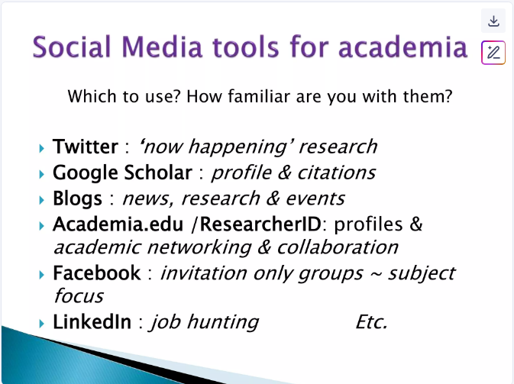
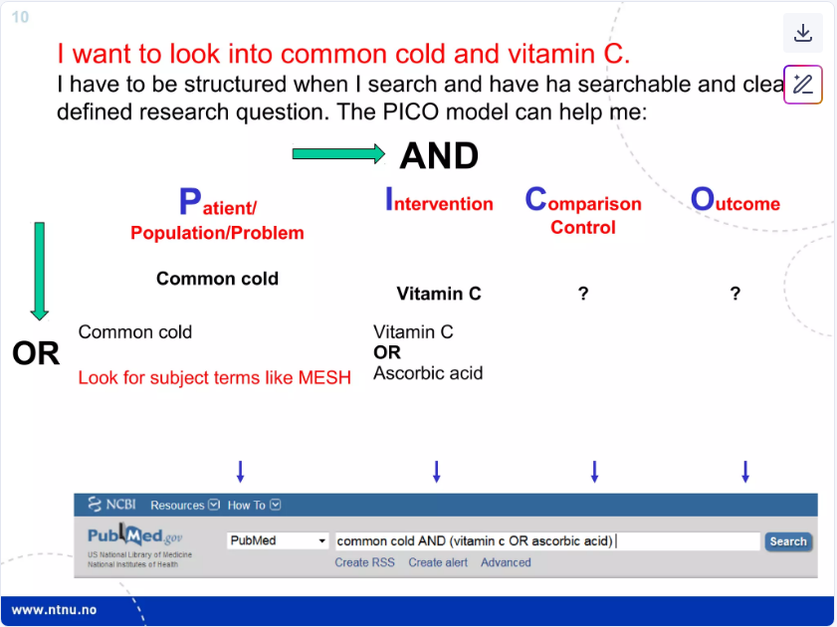
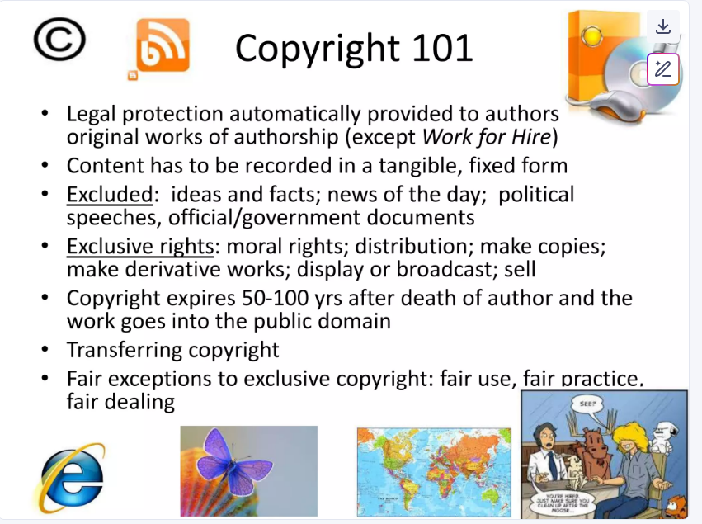
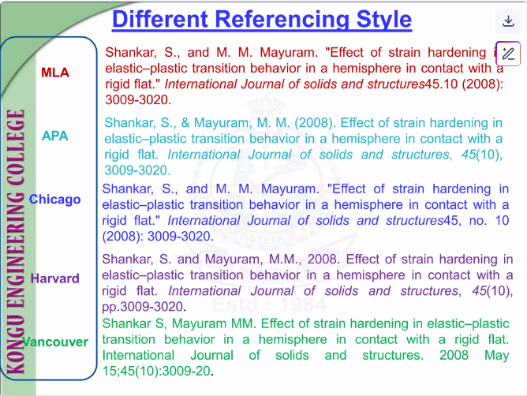
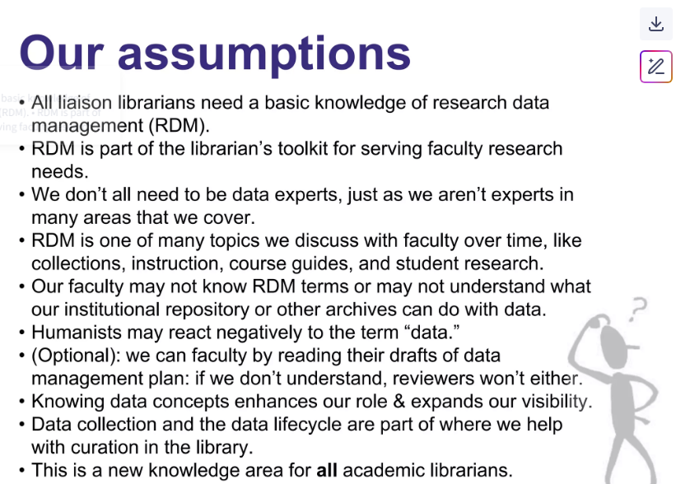
How This Next Section Works
We’re not here to judge... just to improve!
See It: I’ll show you an example slide that has a design issue.
Spot It: We’ll identify what’s not working and why.
Fix It: Then we’ll walk through a better version and talk about the design principle behind the fix.
Notes:
Narrative:
Here's how we'll tackle this: See It—I'll show you an example with design issues. Spot It—we'll identify what's not working and why. Fix It—we'll walk through a better version and the principle behind the fix. We're not here to judge, just to improve!

Slide 62
1
https://www.slideshare.net/slideshow/amaccfv-library-orientation-2015/49000102?from_search=0#6

Slide 63
Design Pitfall: Background Overload
1
Issues:
Background Overload: Background image overwhelms the text
Readability Problems: Hard to read even with bold fonts and shadows
Competing Elements: Audience focuses on decoration, not content
https://www.slideshare.net/slideshow/amaccfv-library-orientation-2015/49000102?from_search=0#6
Notes:
Narrative:
Pitfall number one: background overload. Look at this slide—the background image overwhelms the text, creates readability problems even with bold fonts and shadows, and forces the audience to focus on decoration instead of content.

Slide 64
Design Pitfall: Background Overload
1
Issues:
Background Overload: Background image overwhelms the text
Readability Problems: Hard to read even with bold fonts and shadows
Competing Elements: Audience focuses on decoration, not content
Improvements:
  Choose Simple Backgrounds: Use plain or very subtly textured backgrounds
  Make Images Secondary: If using images, blur them heavily (20-50% transparency)
https://www.slideshare.net/slideshow/amaccfv-library-orientation-2015/49000102?from_search=0#6
Notes:
Narrative:
The fix? Choose simple backgrounds, make images secondary by blurring them heavily, use 20-50% transparency if you must use images.

Slide 65
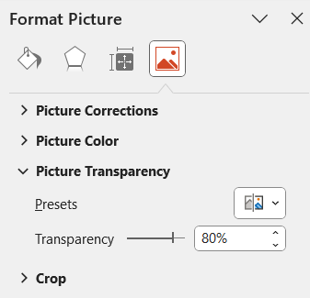


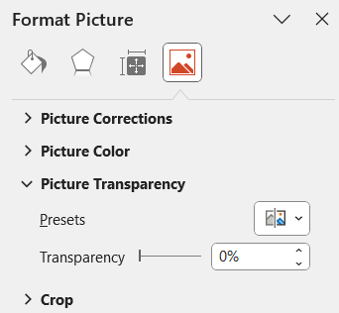
Adding Image Transparency in PowerPoint
1
01
03
Choose Transparency Level
Select Your Image
Click on the image you want to make transparent
02
Open Picture Format
Got to the Picture Format tab.
Tip: 20-50% transparency works best for background images behind text
More information: https://support.microsoft.com/en-us/office/make-a-picture-transparent-ce96ac80-5afc-436c-ae3f-0c78009bf704
Notes:
This template was inserted from Power-user, the productivity add-in for PowerPoint, Excel and Word.
Install Power-user to access thousands of templates, icons, maps, diagrams and charts with Power-user.
Visit https://www.powerusersoftwares.com/
©Power-user SAS, terms of license: https://www.powerusersoftwares.com/terms

Slide 66

Rules and Regulations
Re-design
1
Guidelines for a Productive Learning Environment
Welcome to Galter Health Sciences Library & Leaning Center!
To ensure a respectful and productive environment for all members of our community, please familiarize yourself with our library policies and guidelines.

Slide 67
2
https://www.slideshare.net/slideshow/2c2d-2015/51898331?from_search=0#4

Slide 68
Design Pitfall: Layout Chaos
2
Issues:
Layout Chaos: Eye doesn't know where to look first
Competing Elements: Competing arrows and emphasis styles
No Visual Hierarchy: Inconsistent alignment and spacing
https://www.slideshare.net/slideshow/2c2d-2015/51898331?from_search=0#4
Notes:
Narrative:
Pitfall two: layout chaos. Your eye doesn't know where to look first, competing arrows and emphasis styles fight for attention, inconsistent alignment creates visual confusion.

Slide 69
Design Pitfall: Layout Chaos
2
Issues:
Layout Chaos: Eye doesn't know where to look first
Competing Elements: Competing arrows and emphasis styles
No Visual Hierarchy: Inconsistent alignment and spacing
Improvements:
Establish a clear entry point: guide viewers where they should start looking
Create a visual hierarchy: make the most important elements largest and boldest
Align elements to a grid: use consistent margins, spacing, alignment
https://www.slideshare.net/slideshow/2c2d-2015/51898331?from_search=0#4
Notes:
Narrative:
The solution: establish a clear entry point, create visual hierarchy making important elements largest and boldest, align everything to a consistent grid

Slide 70

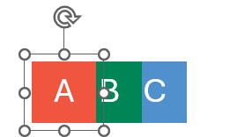
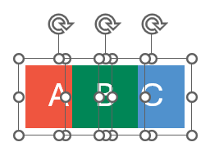
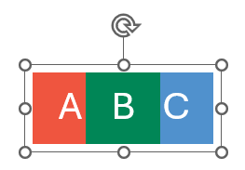
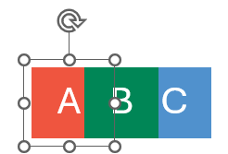
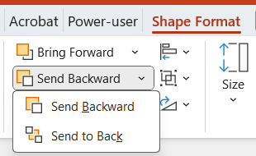
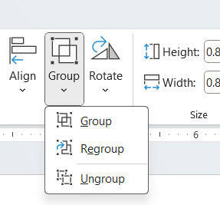
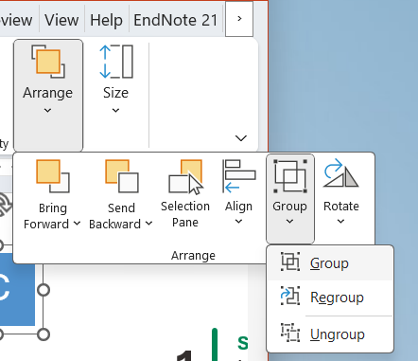
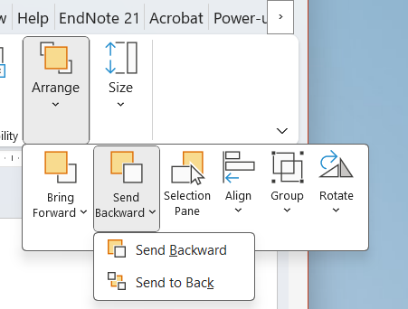
Layering and Grouping in PowerPoint
2
Using Layers
Using Groups
Select a shape, image, or textbox
1
Select multiple shapes, images, or textboxes
Hold the button while clicking on each
1
2
Send “A” Back
In the Shape Format tab, in the Arrange group, click on Send Backward
2
Group the items
In the Shape Format tab, in the Arrange group, click on Group
OR
OR
Notes:
This template was inserted from Power-user, the productivity add-in for PowerPoint, Excel and Word.
Install Power-user to access thousands of templates, icons, maps, diagrams and charts with Power-user.
Visit https://www.powerusersoftwares.com/
©Power-user SAS, terms of license: https://www.powerusersoftwares.com/terms

Slide 71
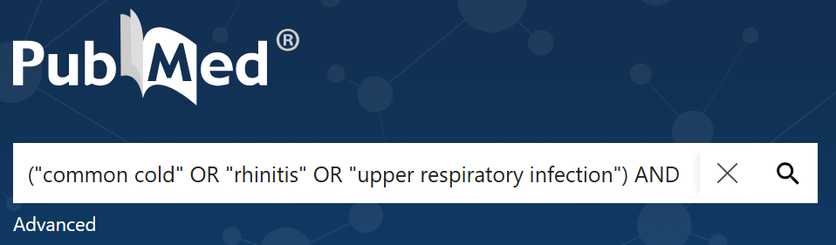

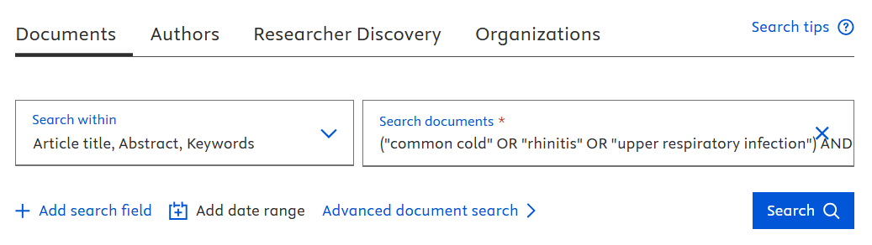
Use PICO for Structured Searches
Re-design
2
Population/Patient/Problem
Who is your study about? What is the condition or problem?
(“common cold” OR “rhinitis” OR “upper respiratory infection”)
P
AND
Intervention
What treatment, therapy, or exposure are you investigating?
(“vitamin C” OR “ascorbic acid” OR “L-ascorbate supplementation”)
I
“I want to look into common cold and vitamin C. I have to be structured when I search and have a clearly defined question.”
AND
Control (as needed)
What is the alternative to compare against?
(“placebo” )
C
“The PICO Model can help me!”
AND
O
Outcome (as needed)
What results or effects are you measuring?
(“symptom duration” OR “recovery time” OR “symptom relief”)
Notes:
Template(s):
This template was inserted from Power-user, the productivity add-in for PowerPoint, Excel and Word.
Install Power-user to access thousands of templates, icons, maps, diagrams and charts with Power-user.
Visit https://www.powerusersoftwares.com/
©Power-user SAS, terms of license: https://www.powerusersoftwares.com/terms

Slide 72
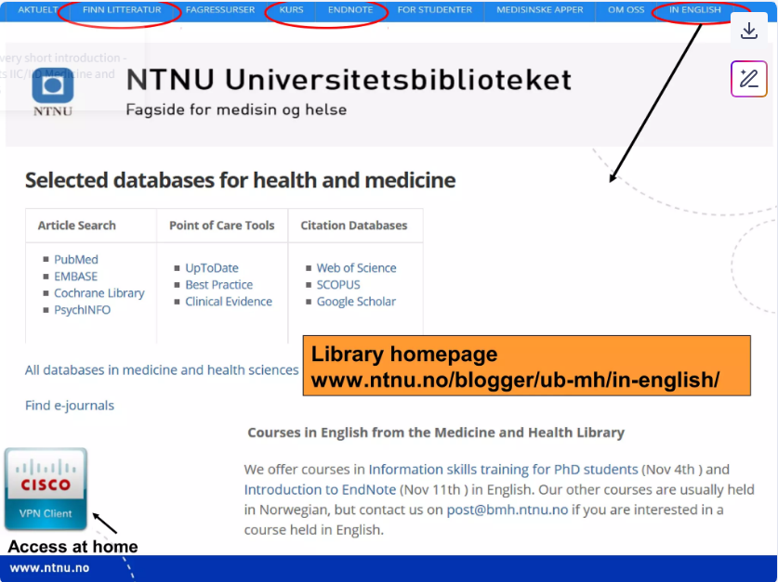
3
https://www.slideshare.net/slideshow/2c2d-2015/51898331?from_search=0#4

Slide 73
Design Pitfall: No Clear Takeaway
3
Issues:
No Clear Takeaway: Multiple competing messages on one slide
Lack of Clear Direction: Attendees leaving instruction sessions confused about next steps or how to implement new resources
https://www.slideshare.net/slideshow/2c2d-2015/51898331?from_search=0#4
Notes:
Narrative:
Pitfall three: no clear takeaway. Multiple competing messages on one slide leave attendees confused about next steps.

Slide 74
Design Pitfall: No Clear Takeaway
3
Issues:
No Clear Takeaway: Multiple competing messages on one slide
Lack of Clear Direction: Attendees leaving instruction sessions confused about next steps or how to implement new resources
Improvements:
Clarify Purpose: Use the "So What?" test for every slide
Create a Visual Hierarchy: Use visual hierarchy to emphasize key points
Provide Support: Include contact information for follow-up
Reinforce Messages: End with 1–3 key takeaways, a call to action, or a recap of your main message
https://www.slideshare.net/slideshow/2c2d-2015/51898331?from_search=0#4
Notes:
Narrative:
Apply the 'So What?' test to every slide, create visual hierarchy to emphasize key points, include contact information for follow-up, end with 1-3 key takeaways or clear calls to action."

Slide 75

Re-design
3
Visit us at:
galter.northwestern.edu
Popular Resources
Look for the Popular Resources section which gives access to frequently used databases like PubMed, UpToDate, and Clinical Key.
Classes and Events
Look for the Classes and Events section to see upcoming classes and registration links.
VPN Reminder
Be sure to connect to the Northwestern VPN when accessing library databases off campus.
Questions? ghls-ref@northwestern.edu

Slide 76
4
https://www.slideshare.net/slideshow/social-media-research-43771744/43771744?from_search=192#5

Slide 77
Design Pitfall: Font Style Overload
4
Issues:
Font Style Overload: Inconsistent or unnecessary font styles mixing serif, sans serif, and italics in one slide
No Visual Hierarchy: Too many styles make everything look equally important… or equally unimportant
Readability Problems: Some font styles, especially script, novelty, or all caps, are hard to read
https://www.slideshare.net/slideshow/social-media-research-43771744/43771744?from_search=192#5
Notes:
Narrative:
Pitfall four: font style overload. Mixing serif, sans serif, and italics creates visual chaos. Too many styles make everything look equally important—or equally unimportant. Script and novelty fonts are hard to read on screens.

Slide 78



Font Style Best Practices
4
Rating my own presentation….
Limit your choices
Use maximum 2-3 fonts per presentation. One for headers, one for body text, and optionally one for special emphasis.
Size Matters
Headings: 32–44 pt
Body text: 20–28 pt
Never go below 18 pt, especially for in-person or hybrid audiences.
Choose Readable Fonts
Sans-serif fonts are generally better for presentation screens. They're cleaner and more readable at a distance.
Aptos
Arial
Calibri
Helvetica
Case Considerations
Sentence case is most readable.
ALL CAPS feels like shouting.
Title Case Works for Headers.
Use Emphasis Wisely
Bold for importance, italics for emphasis or quotes. Avoid overuse - if everything is emphasized, nothing is.
Notes:
Narrative:
Here are your font rules: Limit to 2-3 fonts maximum—one for headers, one for body text, optionally one for emphasis. Choose readable sans-serif fonts like Aptos, Arial, Calibri, or Helvetica. Size matters: 32-44 point for headings, 20-28 for body text, never below 18 point. Use emphasis wisely—bold for importance, italics for quotes. Sentence case is most readable; ALL CAPS feels like shouting.
Reference(s):
Designing Communications for a Poster Fair. 2005. PennState. http://www.personal.psu.edu/drs18/postershow/#fonts

Slide 79






Social Media Tools for Academia
Re-design
4
Which platforms should academics prioritize?
X (formerly Twitter)
LinkedIn
ORCID
Microblogging & News
Professional Networking
Researcher Identity
Academic Uses:
Academic Uses:
Academic Uses:
Share research findings & preprints
Live-tweet conferences & events
Engage in academic discussions
Follow journal updates and news
Build professional network
Share career achievements
Industry collaboration
Academic job searching
Unique researcher identifier
Link all publications
Grant application integration
Institutional reporting
Familiarity:
Very High
Familiarity:
Very High
Familiarity:
High
Bluesky
YouTube
Reddit
Decentralized Social
Video Platform
Discussion Forums
Academic Uses:
Academic Uses:
Academic Uses:
Research discussions
Academic community building
Conference networking
Alternative to X/Twitter
Research explanation videos
Conference presentations
Educational content
Lab techniques tutorials
r/AskScience, r/Academia Q&As
Research AMAs (Ask Me Anything)
Peer support communities
Science communication
Familiarity:
High
Familiarity:
Very High
Familiarity:
Medium

Slide 80
5
https://www.slideshare.net/slideshow/research-data-management-in-the-humanities-and-social-sciences/51725727?from_search=571

Slide 81
Design Pitfall: Bullet Point Overload
5
Issues:
Bullet Point Overload: Audience tries to read while you speak
Key messages get buried: Important insights lost in paragraphs of explanation
Reduced engagement: People stop looking at slides that feel like documents
https://www.slideshare.net/slideshow/research-data-management-in-the-humanities-and-social-sciences/51725727?from_search=571
Notes:
Narrative:
Pitfall five: bullet point overload. When audiences try to read while you speak, key messages get buried in paragraphs, engagement drops because slides feel like documents.
Source(s):
https://www.slideshare.net/slideshow/scientometric-mapping-of-library-and-information-science-in-web-of-science/243668443?from_search=67#4
https://www.slideshare.net/slideshow/practical-research-1-slides-module-4-review-of-related-literature-and-studies-autosaved-pptx/280849668?from_search=9

Slide 82
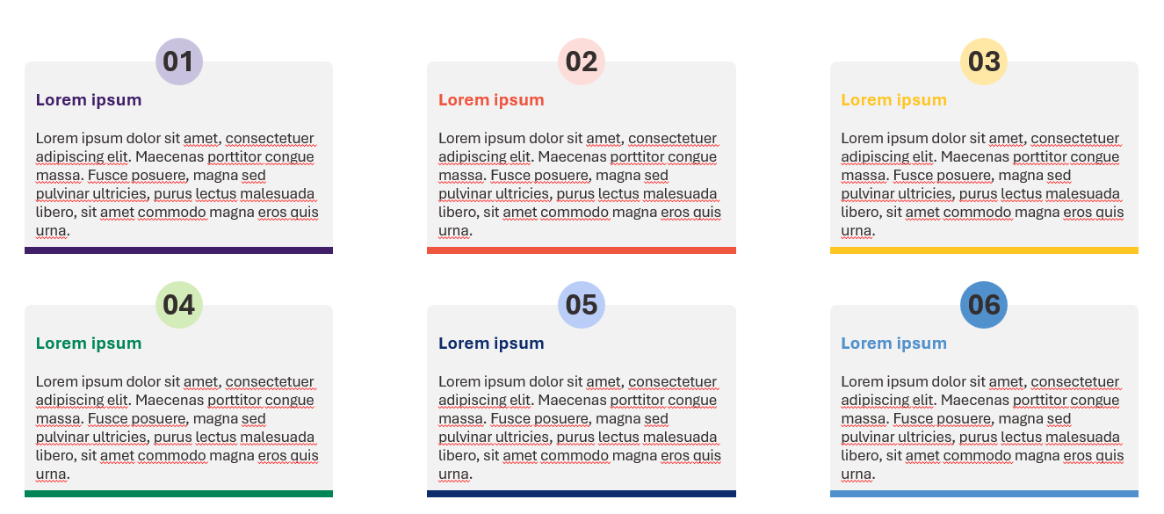
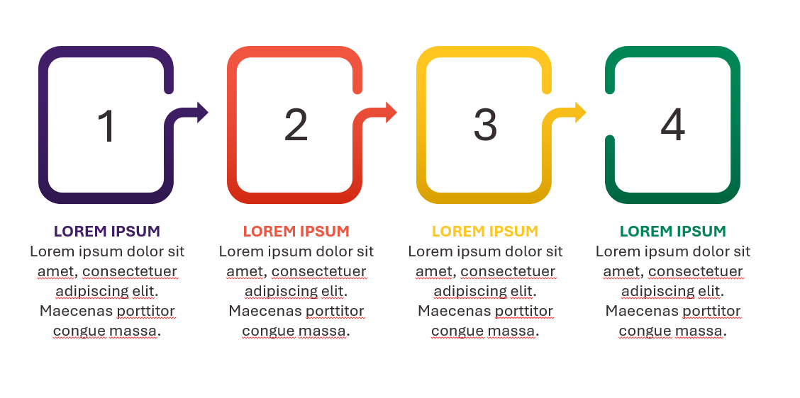
Design Pitfall: Bullet Point Overload
5
Improvements:
Limit bullet points: Keep slides focused use only as many bullet points as necessary
Write concisely: Use phrases rather than full sentences
Use numbered steps: Show sequential techniques clearly
Progressively reveal points: Animate appearance or add incrementally to slides
Resources for Slide Templates
Power-User Add-in: https://www.powerusersoftwares.com/
Duarte Slidedocs: https://www.duarte.com/resources/guides-tools/slidedocs-templates/
Canva: https://www.canva.com/
Notes:
Narrative:
The fixes: limit bullet points, write concisely using phrases not sentences, use numbered steps for sequences, progressively reveal points through animation
Template(s):
This template was inserted from Power-user, the productivity add-in for PowerPoint, Excel and Word.
Install Power-user to access thousands of templates, icons, maps, diagrams and charts with Power-user.
Visit https://www.powerusersoftwares.com/
©Power-user SAS, terms of license: https://www.powerusersoftwares.com/terms

Slide 83
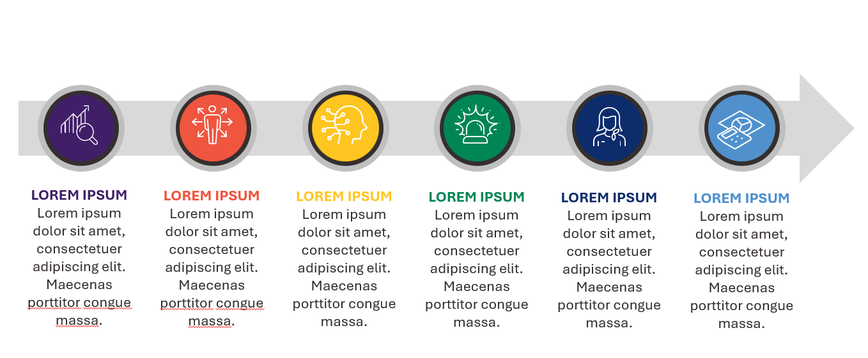
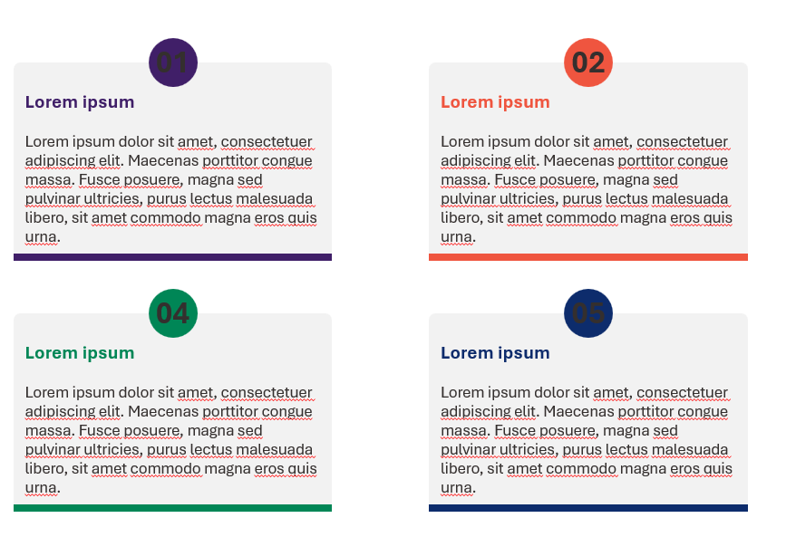
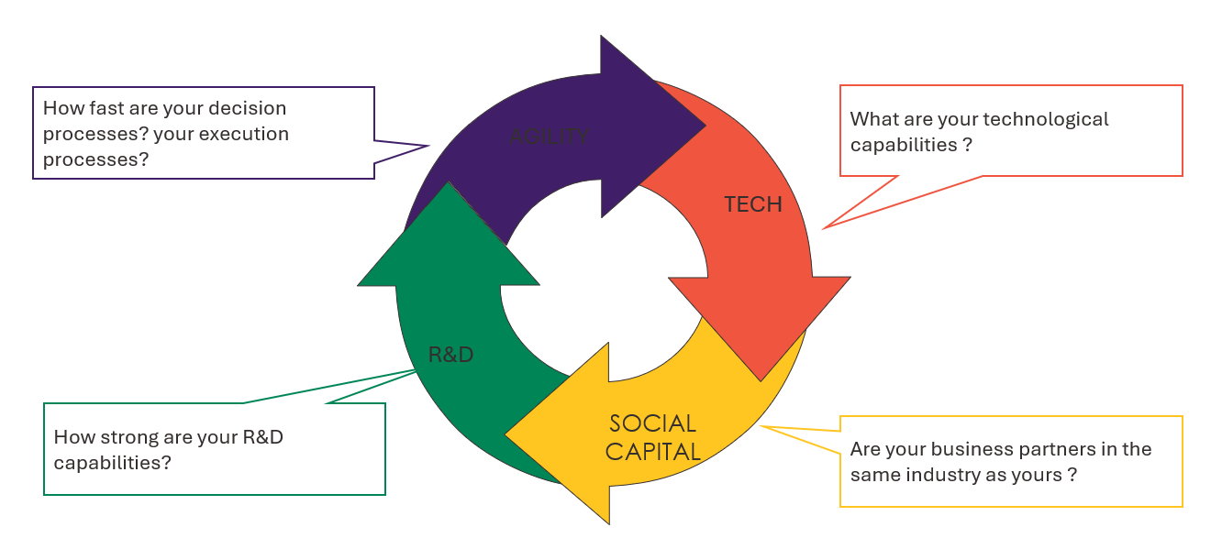
Design Pitfall: Bullet Point Overload
5
Visual Alternatives:
Replace bullets with icons: Use visual elements for each point
Use diagrams & flowcharts: Explain processes and connections visually
Add symbols: Replace text with universal visual language
Create visual hierarchy: Use bold text emphasis on key terms
Resources for Slide Templates
Power-User Add-in: https://www.powerusersoftwares.com/
Duarte Slidedocs: https://www.duarte.com/resources/guides-tools/slidedocs-templates/
Canva: https://www.canva.com/
Notes:
Narrative:
Even better: replace bullets with icons, use diagrams and flowcharts for processes, add symbols for universal visual language, create visual hierarchy with bold key terms
Template(s):
This template was inserted from Power-user, the productivity add-in for PowerPoint, Excel and Word.
Install Power-user to access thousands of templates, icons, maps, diagrams and charts with Power-user.
Visit https://www.powerusersoftwares.com/
©Power-user SAS, terms of license: https://www.powerusersoftwares.com/terms

Slide 84
Re-design
5
Research Data Management (RDM) for Librarians
Four core themes that guide our approach to data management support
Knowledge Foundations
Service Integration
Communication Bridge
Strategic
Growth
All librarians need basic RDM knowledge
We’re generalists, not experts – just like other subject areas
This is a new field for everyone – we’re learning together.
RDM is part of our toolkit for research support
One topic among many in ongoing
faculty relationships
Connections to our curation and preservation mission
Faculty may not know RDM terminology
May not understand what institutional repositories can do
Humanists may react negatively to “data”
RDM knowledge enhances our role
Expands our visibility as research partners
Creates long-term institutional value
Notes:
Template(s):
This template was inserted from Power-user, the productivity add-in for PowerPoint, Excel and Word.
Install Power-user to access thousands of templates, icons, maps, diagrams and charts with Power-user.
Visit https://www.powerusersoftwares.com/
©Power-user SAS, terms of license: https://www.powerusersoftwares.com/terms

Slide 85
6
https://www.slideshare.net/slideshow/reference-style-endnote/121287916?from_search=6#2

Slide 86
Design Pitfall: Color Overload
6
Issues:
Color Overload: Slides with lots of loud or clashing colors can feel disorganized or chaotic
Contrast Problems: Color clutter often leads to low contrast or poor combinations
https://www.slideshare.net/slideshow/reference-style-endnote/121287916?from_search=6#2
Notes:
Narrative:
Pitfall six: color overload. Loud or clashing colors feel disorganized, color clutter creates poor contrast, readability suffers.

Slide 87
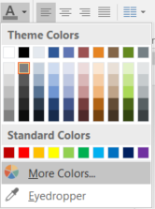
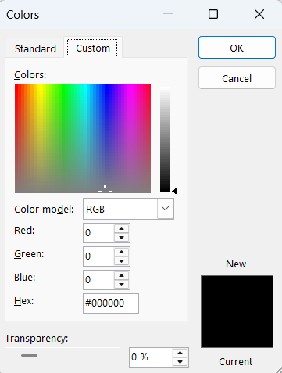
Color and Contrast
6
  Improvements:
  Simplify Palette: Use a limited palette (2–3 colors + neutrals)
  Color with Purpose: Apply color intentionally: to highlight, group, or signal priority
  Prioritize Contrast: Ensure high contrast between text and background
Image: Steps for using custom RGB colors in Microsoft PowerPoint 2016
  Helpful Resources
  Canva’s Color Wheel: https://www.canva.com/colors/color-wheel/
  Canva Palette: https://www.canva.com/colors/color-palette-generator/
  RGB And Hex Color Code Converter: https://www.rapidtables.com/convert/color/index.html
  WebAIM’s Color Contrast Checker: http://webaim.org/resources/contrastchecker/
  ACART’s Contrast Checker: http://www.contrastchecker.com/
Notes:
Narrative:
The solution: simplify your palette to 2-3 colors plus neutrals, use color with purpose—to highlight, group, or signal priority, prioritize high contrast between text and background. Use tools like Canva's Color Wheel, WebAIM's Color Contrast Checker, or ACART's Contrast Checker to ensure accessibility.
Reference(s):
Designing Communications for a Poster Fair. 2005. PennState. http://www.personal.psu.edu/drs18/postershow/#fonts
Resource(s):
Canva’s Color Wheel: https://www.canva.com/colors/color-wheel/
Canva Palette: https://www.canva.com/colors/color-palette-generator/
RGB And Hex Color Code Converter: https://www.rapidtables.com/convert/color/index.html
WebAIM’s Color Contrast Checker: http://webaim.org/resources/contrastchecker/
ACART’s Contrast Checker: http://www.contrastchecker.com/

Slide 88
Different Referencing Styles
6
Re-design
Author Name Format:
APA: Shankar, S., & Mayuram, M. M.
MLA: Shankar, S., and M. M. Mayuram
Chicago: Shankar, S., and M. M. Mayuram
Harvard: Shankar, S. and Mayuram, M.M.
Vancouver: Shankar S, Mayuram MM (no commas, no periods after initials)
APA Style
Shankar, S., & Mayuram, M. M. (2008). Effect of strain hardening in elastic-plastic transition behavior in a hemisphere in contact with a rigid flat. International Journal of Solids and Structures, 45(10), 3009-3020.
Year Placement:
APA: (2008) right after authors
MLA: (2008) near the end
Chicago: (2008) at the end
Harvard: , 2008 after authors with comma
Vancouver: 2008 May 15 at the end with full date
MLA Style
Shankar, S., and M. M. Mayuram. "Effect of strain hardening in elastic-plastic transition behavior in a hemisphere in contact with a rigid flat." International Journal of Solids and Structures 45.10 (2008): 3009-3020.
Chicago Style
Shankar, S., and M. M. Mayuram. "Effect of strain hardening in elastic-plastic transition behavior in a hemisphere in contact with a rigid flat." International Journal of Solids and Structures 45, no. 10 (2008): 3009-3020.
Title Treatment:
APA: Sentence case, no quotes
MLA: "Title case in quotes"
Chicago: "Title case in quotes"
Harvard: Title case, no quotes
Vancouver: Sentence case, no quotes, ends with period
Harvard Style
Shankar, S. and Mayuram, M.M., 2008. Effect of strain hardening in elastic-plastic transition behavior in a hemisphere in contact with a rigid flat. International Journal of Solids and Structures, 45(10), pp.3009-3020.
Journal Information:
APA: Journal, volume(issue), pages
MLA: Journal volume.issue (year): pages
Chicago: Journal volume, no. issue (year): pages
Harvard: Journal, volume(issue), pp.pages
Vancouver: Journal. Year Date;volume:pages
Vancouver Style
Shankar S, Mayuram MM. Effect of strain hardening in elastic-plastic transition behavior in a hemisphere in contact with a rigid flat. International Journal of Solids and Structures. 2008 May 15;45(10):3009-20.

Slide 89
7
https://www.slideshare.net/slideshow/thinking-about-resource-issues-copyright-and-open-access/48426717?from_search=195#4

Slide 90
Design Pitfall: Image Overload
7
Issues:
Image Overload: Viewers are left guessing: “Why is this image here?”
Message Conflict: Creates dissonance or distracts from your message.
Missing Context: Important information is only conveyed in an image without text, labels, or explanation.
https://www.slideshare.net/slideshow/thinking-about-resource-issues-copyright-and-open-access/48426717?from_search=195#4

Slide 91
Design Pitfall: Image Overload
7
Issues:
Image Overload: Viewers are left guessing: “Why is this image here?”
Message Conflict: Creates dissonance or distracts from your message.
Missing Context: Important information is only conveyed in an image without text, labels, or explanation.
Improvements:
Connect to Content: Choose images that directly reinforce your main points
Label Everything: Add captions or annotations to explain what images show
Apply the Relevance Test: Remove images that don't clearly support your message
https://www.slideshare.net/slideshow/thinking-about-resource-issues-copyright-and-open-access/48426717?from_search=195#4
Notes:
Narrative:
Final pitfall: image overload. When viewers can't figure out why an image is there, it creates message conflict and distracts from your content. Important information conveyed only through unlabeled images gets lost. The fixes: connect images directly to content, label everything with captions or annotations, apply the relevance test—remove images that don't clearly support your message.

Slide 92

Resources for images, icons, and illustrations
7
Images:
  NIH's BioArt Source: https://bioart.niaid.nih.gov/
  Open Verse: https://wordpress.org/openverse/
    After searching for images, use the filter for specific Licenses.
  Google Image Search: https://www.google.com/imghp?hl=EN
    When searching, click Tools, then click Usage Rights, then check Creative Commons licenses.
  Flickr: https://www.flickr.com/
    After searching for images, click where it says Any License and change to All Creative Commons.
Icons
  FlatIcon: https://www.flaticon.com/
    Non-Premium icons can be used for commercial purposes with attribution using the link provided
  Bioicons: https://bioicons.com/
    Each icon image lists its re-use license and attribution text.
Illustrations
  Smart Servier Medical Art: https://smart.servier.com/
    All images are provided under a CC 3.0 License which means they can be shared and adapted but you must provide attribution.
  SciDraw: https://scidraw.io/
    All images are provided under a CC4.0 License which means they can be shared and adapted but you must provide attribution.
Notes:
Narrative:
Open Verse, Google Image Search, and Flickr are great for finding images – just make sure you check for that Creative Commons License and provide attribution. For icons, some options include FlatIcon and Bioicons. For Illustrations, you might check out Smart Servier Medical Art and SciDraw.
Other Resource(s):
Simplified Science Publishing Science Images and Templates: https://www.simplifiedsciencepublishing.com/science-images/. Costs provided for each image. Once paid for, images can be re-used even commercially without attribution.
Freepik. https://www.freepik.com/popular-vectors. Free downloads but monthly subscription is $15 and fully year subscription is $119.
Mind the Graph. https://mindthegraph.com/. Good for plant biology and medical-related drawings. Monthly Subscription costs is $7-12+
Adobe Free Collection. https://stock.adobe.com/free.

Slide 93
Copyright 101
7
Re-design
Legal protection automatically provided to authors original works of authorship (except Work for Hire)
Content has to be recorded in a tangible, fixed form
Excluded: ideas and facts; news of the day; political speeches, official/government documents
Exclusive rights: moral rights; distribution; make copies; make derivative works; display or broadcast; sell
Copyright expires 50-100 yrs after death of author and the work goes into the public domain
Transferring copyright
Fair exceptions to exclusive copyright: fair use, fair practice, fair dealing

Slide 94
Time Check!
With only 20 minutes left, what would you like us to focus on?
Option 1
Designing Information Experiences – 20 minutes
Using charts, graphs, and visuals to tell compelling stories with your research findings.
When Things Go Wrong – 10 minutes
Preparing for and recovering from technical failures during presentations.
Start Small, Build Momentum – 5 minutes
Action items and resources to continue improving your presentation skills.
OR
Option 2

Slide 95
Designing Information Experiences
Design is thinking made visual.
Saul Bass
Graphic Designer and Filmmaker
Using charts, graphs, and visuals to tell compelling stories with your research findings
Notes:
Narrative:
We've talked about structuring content, engaging audiences, and creating clean slides. Now we're going to level up and think beyond slides entirely. This section is about transforming your research data into experiences that create understanding, not just information transfer.
You've probably sat through presentations where someone threw a dense table of numbers on screen and said 'As you can see here...' except you couldn't see anything meaningful at all. That's not your audience's fault—that's a design problem.
In the next few minutes, we're going to explore how to turn your data into visual stories. We'll look at how to reduce visual clutter so your insights actually stand out, and how to craft titles and labels that answer the 'so what?' question before your audience even has to ask it.
Remember, your goal isn't to show all your data, it's to help your audience understand what your data means and why it matters.

Slide 96
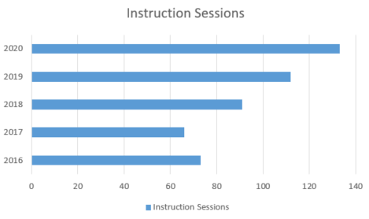
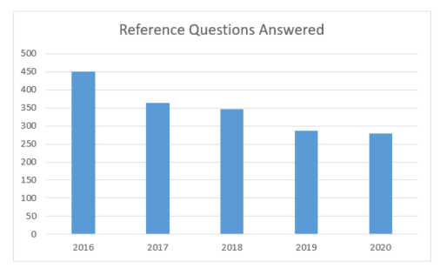
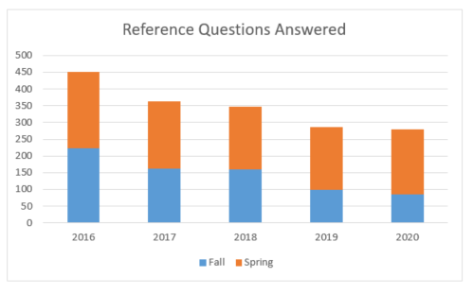
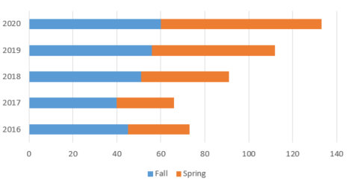
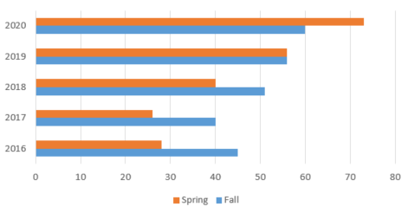
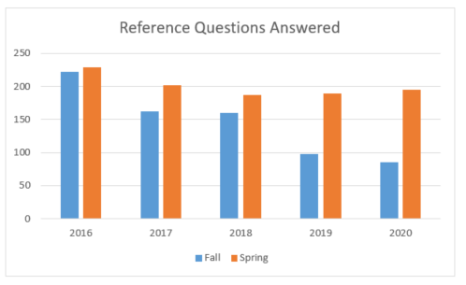
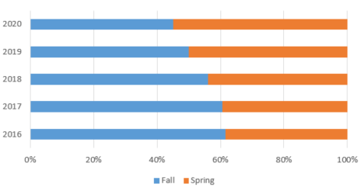
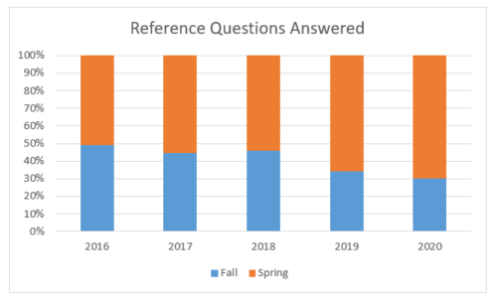
Think Beyond Slides to Create Understanding
1
Charts & Graphs: Show trends, comparisons, and relationships
2
Tables: Organize data for easy comparison and reference
3
Infographics: Combine data with visual storytelling
Notes:
Narrative:
I want you to shift your thinking. Stop asking 'How do I make slides?' and start asking 'How do I create understanding?’
Think about the last time you saw a presentation that made you go 'Wow, I never thought about it that way.' I bet it wasn't because of beautiful bullet points. It was probably because someone showed you information in a way that clicked - maybe a simple chart that revealed a surprising trend, or a diagram that suddenly made a complex process crystal clear.
Charts and graphs can reveal patterns your audience would never spot in a data table.

Slide 97
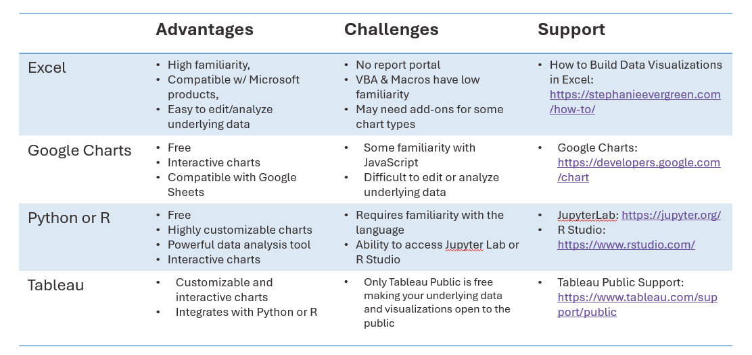
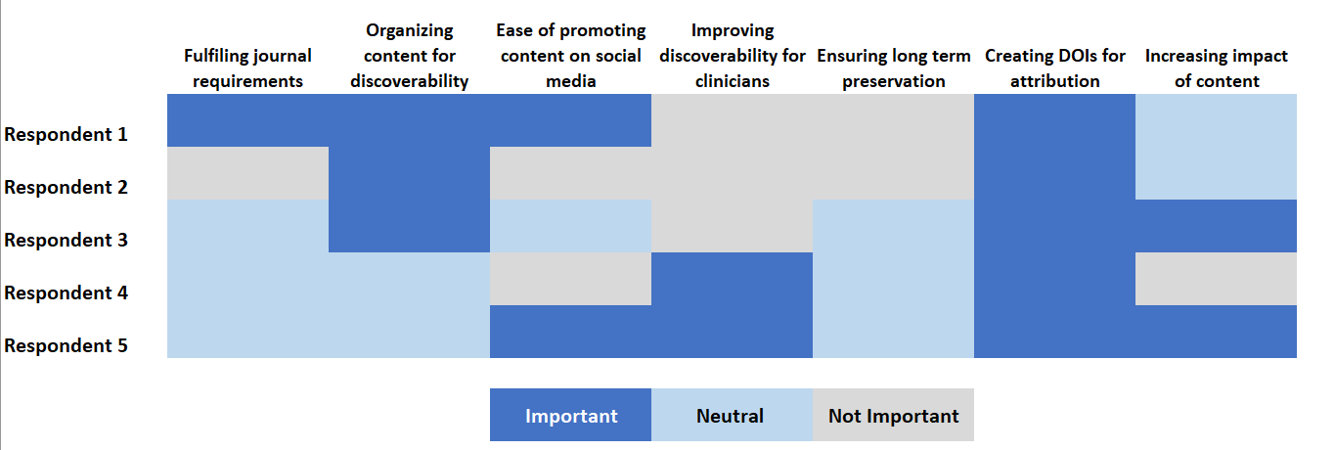
Think Beyond Slides to Create Understanding
1
Charts & Graphs: Show trends, comparisons, and relationships
2
Tables: Organize data for easy comparison and reference
3
Infographics: Combine data with visual storytelling
Notes:
Narrative:
ables organize data for easy comparison and reference.

Slide 98
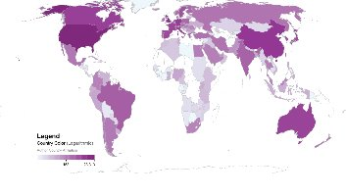
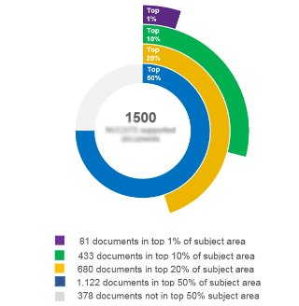
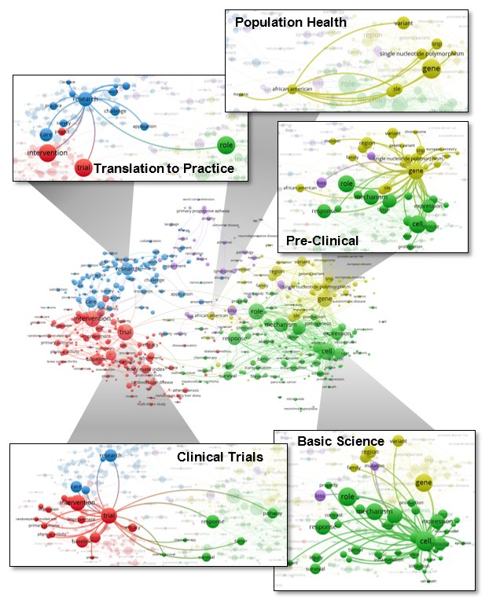
Think Beyond Slides to Create Understanding
Below. Grant supported documents were cited by authors from 159 different countries and in 30 languages (2008-2018)
Below. 75% of grant supported documents rank in the 50th percentile or above for citation impact in their respective subject areas.
1
Charts & Graphs: Show trends, comparisons, and relationships
2
Tables: Organize data for easy comparison and reference
Overview
Over the past 10 years we have supported all areas of the translational spectrum, promoting and accelerating the translation of preclinical research to a clinical application and the communication between basic and clinical scientists.
3
Infographics: Combine data with visual storytelling
Right. This term co-occurrence map displays 493 terms from the titles and abstracts of publications from 2008-2018 from 1,563 documents supported by the grant using VOSViewer. All terms are assigned to a cluster (and colored accordingly ) by a computer clustering algorithm. Term bubbles are sized by the number of times they occur in the title or abstract of the publication: the larger the term the more the occurrences. Each term occurs in at least 10 publications. The distance between two terms indicates how often the terms co-occur in a title or abstract; the smaller the distance, the larger the number of co-occurrences and the stronger the terms are related to each other. Lines between terms indicate when terms were used together in a title or abstract: the thicker the line, the more often the terms are used together.
Notes:
Narrative:
Infographics combine data with visual storytelling. Each serves a different purpose in helping your audience understand complex information.
But here's the thing - most of us default to the same tired formats. We dump data into Excel's default chart templates and call it good. We're going to do better than that. We're going to learn how to make your data tell the story it's dying to tell.
So let's start with the foundation - taking your charts from 'meh' to 'meaningful.’”

Slide 99
Visualization Software
 | Advantages | Challenges | Support
Excel | High familiarity, Compatible w/ Microsoft products, Easy to edit/analyze underlying data | No report portal VBA & Macros have low familiarity May need add-ons for some chart types | How to Build Data Visualizations in Excel: https://stephanieevergreen.com/how-to/
Google Charts | Free Interactive charts Compatible with Google Sheets | Some familiarity with JavaScript Difficult to edit or analyze underlying data | Google Charts: https://developers.google.com/chart
Python or R | Free Highly customizable charts Powerful data analysis tool Interactive charts | Requires familiarity with the language Ability to access Jupyter Lab or R Studio | JupyterLab: https://jupyter.org/ R Studio: https://www.rstudio.com/
Tableau | Customizable and interactive charts Integrates with Python or R | Only Tableau Public is free making your underlying data and visualizations open to the public | Tableau Public Support: https://www.tableau.com/support/public
Notes:
Narrative:
There are many tools available for data visualization. This table shows some advantages and challenges for Excel, Google Charts, Python or R, and Tableau. Note that if you are most familiar with Excel, there are a lot of advanced charts you can make right inside Excel that many people are not aware of. The link on this slide takes you to great resource called How to Build Data Visualizations in Excel. Other tools not listed on here are Qlik and Datawrapper.
Ask: do they have other tools to add?

Slide 100
Resources
Basic and Advanced Excel:
Gutzman, K. E., Mendoza, A. R., Norton, C., Belter, C., & Soulakis, M. (2024). Charting a New Course Excel Workbook (v9.0.0). DigitalHub. Galter Health Sciences Library & Learning Center. https://doi.org/10.18131/1nan8-mzk41
Practice data and examples of charts
Gutzman, K. E., Mendoza, A. R., Norton, C., & Belter, C. (2021). Hands On Creating Basic Charts (v3.0.0).DigitalHub. Galter Health Sciences Library & Learning Center. https://doi.org/10.18131/g3-69ds-eq61

Slide 101
Reduce Visual Clutter: less is often more
1
Every Element Must Earn Its Place
Ask: "Does this help or hurt comprehension?"
Default to removing, not adding
Example: Remove heavy gridlines and borders that compete with data for attention
2
Empty Space Isn't Wasted Space
White space improves readability and focus
Give your data room to breathe
Example: Increase margins around your chart and space between data series
3
Color Should Guide, Not Overwhelm
Use color purposefully to highlight what matters most
High contrast improves accessibility and readability
Example: Use gray for background elements and reserve bright colors for your key data points
Notes:
Narrative:
Rule one: less is often more. Once you've created a chart, it's worth stepping back and asking: What can I remove to make this clearer? Decluttering is about being intentional with every visual element so your message can shine through.
The goal isn't to create boring charts—it's to create charts that communicate instantly rather than eventually. When viewers have to work hard to understand your visualization, they often give up before discovering your insights.
Think of decluttering as applying three key filters to your design:
First, be ruthless about what stays. Every gridline, border, and decorative element should have a clear purpose. If it's not helping viewers understand the data, it's probably hurting.
Second, embrace the power of space. Cramped charts feel overwhelming and unprofessional. Strategic white space doesn't waste real estate—it creates breathing room that helps viewers focus on what matters.
Finally, use color as a guide, not decoration. A restrained palette with purposeful contrast draws attention to your key findings while keeping background elements subtle and unobtrusive.
The ultimate test is simple: if removing an element doesn't hurt comprehension, remove it. Your audience will thank you for respecting their time and cognitive energy.
Reference(s):
Nussbuamer Knaflic, Cole. Chapter 3: Clutter is your enemy. Storytelling with Data; A Data Visualization Guide for Business Professionals. Wiley. 2015. Available at: https://learning.oreilly.com/library/view/storytelling-with-data/9781119002253/c04.xhtml

Slide 102
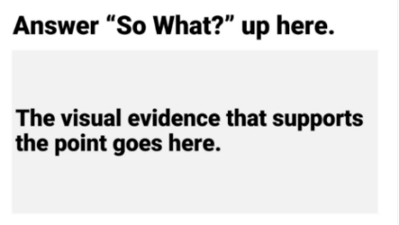
Lead with Meaning: Use Titles & Labels to Answer “So What?”
Revise the Header to Answer “So What?”
Chart titles shouldn’t just describe the data, they should interpret it. A well-crafted title answers the question: Why does this matter?
Use Informative Labels and Legends
Use legends, axis labels, and annotations to guide interpretation. Every element should support understanding.
Help the Viewer See the Story
Titles, subtitles, and callouts can spotlight trends or anomalies that might otherwise go unnoticed.
Evergreen, Stephanie. So What? Available at: https://stephanieevergreen.com/so-what/
Notes:
Narrative:
Rule 2: Rule two: use titles and labels to answer 'So What?' Chart titles shouldn't just describe data—they should interpret it. A well-crafted title answers 'Why does this matter?' Use informative labels and legends to guide interpretation. Help viewers see the story through titles, subtitles, and callouts that spotlight trends or anomalies.
We should also apply that same mindset to legends, axis labels, and annotations. These elements are often overlooked, but they do a lot of heavy lifting in guiding interpretation. If they’re too vague or too technical, they can confuse rather than clarify. Ultimately, our goal is to reduce the amount of work the viewer has to do to understand the point. When we use meaningful titles and labels, we help people see the story we’re trying to tell—and that’s what turns a chart into a compelling insight.

Slide 103
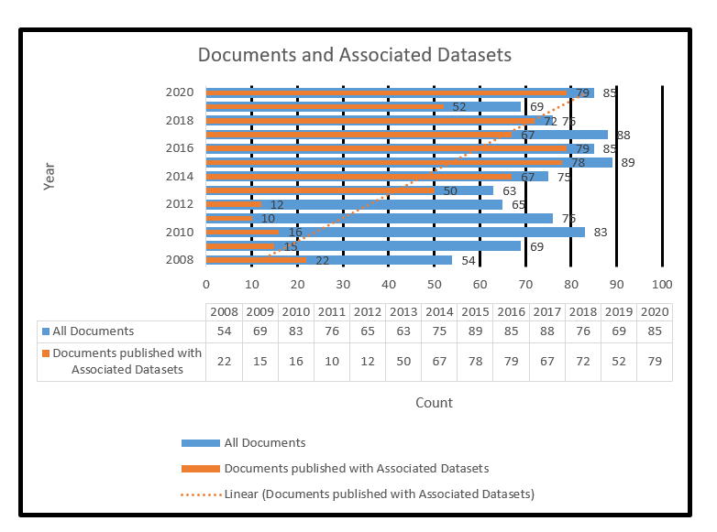
Chart Re-Design
Let’s consider a re-design of this chart by trying to reduce visual clutter and transforming the title to answer the “so what” question
Notes:
Narrative:
Let's practice this. Here's a chart showing the percentage of documents with open datasets by publication year. The original title just describes the data. But look at the redesigned version: '86% of documents have open datasets since the 2013 implementation of the Data Repository.' Now we know not just what happened, but why it matters and when the change occurred.“
Reference(s):
Nussbuamer Knaflic, Cole. Chapter 3: Clutter is your enemy. Storytelling with Data; A Data Visualization Guide for Business Professionals. Wiley. 2015. Available at: https://learning.oreilly.com/library/view/storytelling-with-data/9781119002253/c04.xhtml

Slide 104
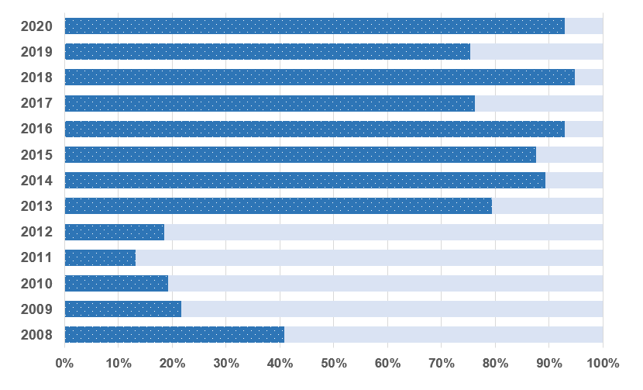
Chart Re-Design
Let’s consider a re-design of this chart by trying to reduce visual clutter and transforming the title to answer the “so what” question
How effective was the data repository policy in promoting open science practices?
86% of documents have open datasets since the 2013 implementation of the Data Repository
% documents with open dataset
% documents without data
Publication Year
Notes:
Narrative:
Now let’s take a look at the same data—but through a redesigned lens that prioritizes clarity and meaning.
In this version, every element on the chart earns its place. I made several intentional changes to reduce visual clutter and better highlight the core message: that there’s been a significant increase in documents published with open datasets since the Data Repository was implemented.
Changed the chart type. You’ll want to use the most impactful chart type for your message. I changed the chart from an overlapping bar chart to a 100% stacked bar chart to better show the significant increase in documents that have been published with open datasets since the Data Repository was implemented.
Removed the chart border. You’ll want to remove any visual elements that are not necessary.
Softened the gridlines. You can leave gridlines in charts if you find it helpful for understanding your data, but make them thin and use a light color so you don’t detract from the main visualization.
Removed Data Markers. Data markers are helpful, but I decided to remove them my chart. I felt that the overall percentages found on the x-axis were sufficient.
Used a different legend. I’m not able to label my data directly, but I was able to re-work the legend and use a patterned background so that I’m not relying on color alone to distinguish percent documents with open datasets and those without.
Removed the axis labels. Because year and percent are good explanations in an of themselves, I did remove the axis labels. Before removing the axis labels, though, make sure your audience has sufficient information elsewhere to know what they are looking at.
This isn’t just about removing things, it’s about keeping what adds meaning. The new design makes it easier for viewers to instantly grasp the trend and the takeaway, even if they don’t have a technical background.
Reference(s):
Nussbuamer Knaflic, Cole. Chapter 3: Clutter is your enemy. Storytelling with Data; A Data Visualization Guide for Business Professionals. Wiley. 2015. Available at: https://learning.oreilly.com/library/view/storytelling-with-data/9781119002253/c04.xhtml

Slide 105
Transform Raw Numbers into Actionable Insights
When Raw Numbers Feel Abstract
Convert to percentages or ratios - "45% market share" vs. "450,000 customers"
Show change over time instead of snapshots - "Sales up 15%" vs. "Sales = $2.3M"
Use familiar units - "$12 per day" vs. "$4,380 per year"
When Comparisons Are Difficult
Create rankings or categories - "Top performer" vs. "scored 847 points"
Show relative to benchmark - "20% above average" vs. "3.2 rating"
Normalize by population - "5 per 1,000 residents" vs. "500 total cases"
When Precision Overwhelms
Round to meaningful digits - "About $50K" vs. "$49,847.23"
Group into categories - "High/Medium/Low risk" vs. "Risk scores 1-100"
Focus on top performers + "other" - "Show top 5 + Other" vs. "Show all 47 items"
Before transforming, ask yourself:
Accuracy
Does this transformation preserve the truth in my data?
Clarity
Does this make patterns more or less obvious?
Relevance
Will this format answer my audience's real questions?
Ethics
Am I being transparent about what I've changed?
Notes:
Narrative:
Rule three: transform raw numbers into actionable insights. Transform when raw numbers feel abstract—convert to percentages or familiar units. When comparisons are difficult—create rankings or show relative to benchmarks. When precision overwhelms—round to meaningful digits or group into categories. The goal is clarity without sacrificing accuracy
But always ask yourself four questions first: Does this transformation preserve truth in my data? Will this format answer my audience's real questions? Does this make patterns more or less obvious? Am I being transparent about what I've changed?"

Slide 106
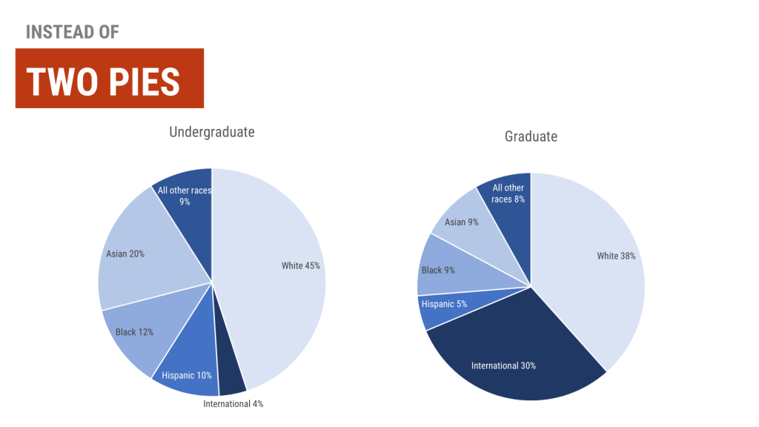
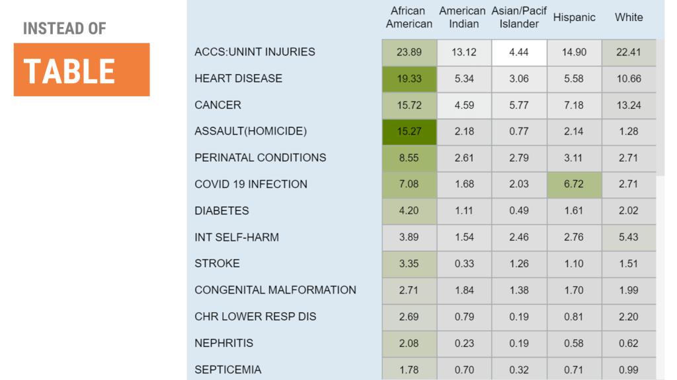
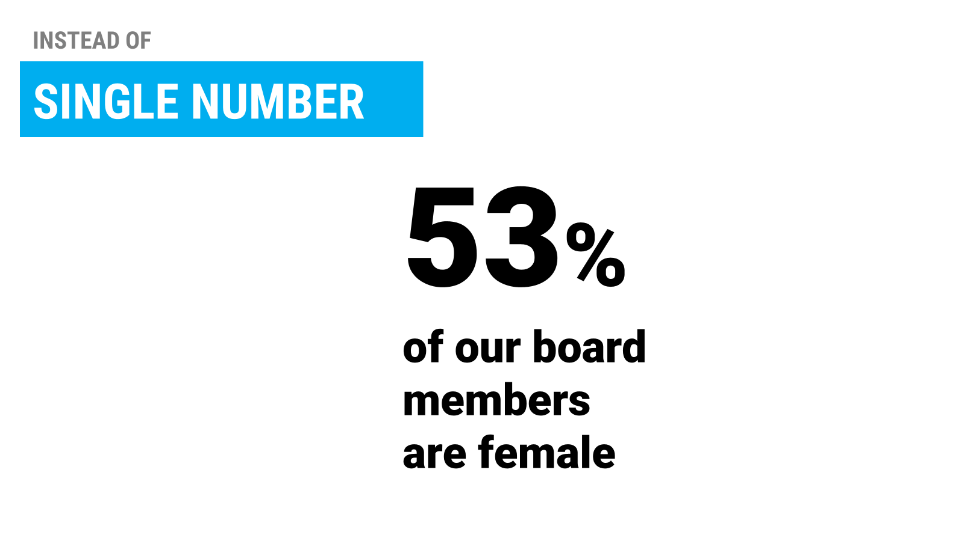



Try different kinds of charts
Source: You Just Need More Chart Choices. Stephanie Evergreen. https://stephanieevergreen.com/you-just-need-more-chart-choices/
Notes:
Narrative:
Many of us default to bar charts or pie charts, even when those choices might be hiding the message we’re trying to communicate. In her blog post, Stephanie Evergreen points out that what we often need is simply more chart options. For example, if you're trying to highlight change between two time points, a slope chart is clearer than stacking two bars. If you're comparing many categories, a dot plot can reduce clutter. This is about moving beyond habit, it's about intentional design. When you choose the right chart for your message, you help your audience understand your data faster and more accurately.
So when a chart isn't working, don't assume the problem is with your data. It might just be that your chart type is holding you back.
Image(s):
Evergreen, Stephanie. You Just Need More Chart Choices. Available at: https://stephanieevergreen.com/you-just-need-more-chart-choices/

Slide 107

Table Re-Design
Let’s consider a re-design of this table by transforming the data and considering different chart types.
Source: Brenner, H. (2002). Long-term survival rates of cancer patients achieved by the end of the 20th century: a period analysis. The Lancet, 360, pp. 1131-1135​.
Notes:
Narrative:
We started with a simple table of cancer survival rates - percentages across different time periods. While accurate, this format buried the most important insights. When you look at raw percentages, your brain has to do a lot of work. Is 78.3% significantly different from 83.2%? How do you quickly identify which cancers are improving or declining over time? With 88 data points, the human eye simply can't process patterns efficiently. The table format was technically correct but practically useless for pattern recognition. People would walk away remembering maybe 2-3 specific numbers, but miss the bigger story entirely.
This perfectly illustrates why visualization choice matters more than data accuracy. The same data, presented differently, can either reveal insights or hide them. Sometimes the most honest way to present data is to transform it in a way that makes the truth more visible, not just more precise. This wasn't about making the data look prettier - it was about making patterns visible that were completely hidden in the table format.
Image(s):
Brenner, H. (2002). Long-term survival rates of cancer patients achieved by the end of the 20th century: a period analysis. The Lancet, 360, pp. 1131-1135​.

Slide 108

Table Re-Design
From Diagnosis to 20 Years Later:
How Cancer Survival Rankings Evolve
5
years
10
years
15
years
20
years
Let’s consider a re-design of this table by transforming the data and considering different chart types.
Insights:
Success stories. Prostate and thyroid cancers stand out with exceptional survival rates - prostate at 98.8% at 5 years and thyroid at 96%.
The Pancreatic Challenge. Pancreas cancer shows devastatingly low survival rates (4% at 5 years, dropping to 2.7% at 20 years), highlighting one of oncology's most urgent challenges.
Brain Cancers. Show consistently low survival rates (32% at 5 years), highlighting the challenges of treating central nervous system malignancies.
Source: Brenner, H. (2002). Long-term survival rates of cancer patients achieved by the end of the 20th century: a period analysis. The Lancet, 360, pp. 1131-1135​.
Source: Brenner, H. (2002). Long-term survival rates of cancer patients achieved by the end of the 20th century: a period analysis. The Lancet, 360, pp. 1131-1135​.
Notes:
Narrative:
By transforming the chart into a bump chart and shifting the relative survival rates from percentages to rankings, we can create insights: 'Success stories—prostate and thyroid cancers show exceptional survival rates. The pancreatic challenge—devastatingly low survival highlights oncology's most urgent need. Brain cancers consistently show the challenges of treating central nervous system malignancies.' Now the data tells a story.
Image(s):
Brenner, H. (2002). Long-term survival rates of cancer patients achieved by the end of the 20th century: a period analysis. The Lancet, 360, pp. 1131-1135​.

Slide 109

Present One Big Idea at a Time
Focus on Insights:
Every visualization should answer one primary question or make one key point.
Your goal isn't to show all your data, it's to communicate insights that drive action.
Strategies include:
Use multiple simple charts instead of one complex chart.
Gray out supporting data. Keep context but don't let it compete for attention.
See: https://www.pewresearch.org/global/2025/07/08/people-in-many-countries-consider-the-u-s-an-important-ally-others-see-it-as-a-top-threat/pg_2025-07-08_allies-threats_0_03/
Notes:
Narrative:
Rule four: present one big idea at a time. Every visualization should answer one primary question or make one key point. Your goal isn't showing all your data—it's communicating insights that drive action. Use multiple simple charts instead of one complex chart. Gray out supporting data to provide context without competition
Image(s):
Pew Research Center. U.S., China and Russia are seen as top threats across multiple countries. Available at: https://www.pewresearch.org/global/2025/07/08/people-in-many-countries-consider-the-u-s-an-important-ally-others-see-it-as-a-top-threat/pg_2025-07-08_allies-threats_0_03/

Slide 110
Infographic Re-Design
Let’s consider a re-design of this chart by trying to present one big idea at a time.
See: https://www.pewresearch.org/global/2025/07/08/people-in-many-countries-consider-the-u-s-an-important-ally-others-see-it-as-a-top-threat/pg_2025-07-08_allies-threats_0_03/
Notes:
Narrative:
Look how we can transform this complex threat perception chart. Instead of trying to show everything at once, we focus on one insight: threat patterns by global powers. The U.S. spans diverse regions, Russia shows regional concentration, China appears as strategic rival in specific areas. One clear story, powerfully told
So, let’s walk through a redesign of this infographic that emphasizes comprehension. Specifically, I wanted to reinforce a single core question: Which countries see the U.S., China, or Russia as their top threat?
To do this, I first I want to group countries by their most perceived threat: U.S., Russia, China, or Other. This creates visual structure, reduces clutter, and lets viewers focus on one category at a time, instead of scanning across many multicolored bars. It helps shape a clear narrative and makes patterns easier to spot.
Second, I would like to add plain-language insights beneath each section. Since not everyone is fluent in interpreting charts, these brief, accessible explanations act as interpretive guides. They highlight what matters most, reducing the effort required to make sense of the data.
Third, I would like to create maps to reinforce regional clustering. Many of these threat perceptions follow geographic lines, and showing them on a map grounds the data in real-world context. This makes the abstract numbers more intuitive and relatable.
All of these design choices are rooted in a single principle: supporting comprehension by guiding the viewer’s attention and simplifying complexity without sacrificing meaning.
Image(s):
Pew Research Center. U.S., China and Russia are seen as top threats across multiple countries. Available at: https://www.pewresearch.org/global/2025/07/08/people-in-many-countries-consider-the-u-s-an-important-ally-others-see-it-as-a-top-threat/pg_2025-07-08_allies-threats_0_03/

Slide 111



Better Graphs Tell Clearer Stories
Stacked Bar Chart
100% Stacked Area Chart
Too much visual noise – The repetition of bars across each country diluted the story rather than focusing attention on the most important insight
Overwhelmed the message – The visual flow distracted from the core idea rather than reinforcing it.
Notes:
Narrative:
When designing this visualization, I explored a few different chart types, including a stream graph and a clustered bar chart. At first glance, these formats seemed visually engaging, but in practice they added more complexity than clarity. The stream graph, while visually striking, was difficult to interpret quickly. It required viewers to track multiple flows at once, which increased cognitive load and made it harder to compare across countries or identify patterns. The clustered bar chart was more conventional, but it grouped too much information together. Viewers had to scan horizontally across multiple bars and colors, making it hard to understand which country saw which nation as the top threat. Ultimately, these designs made the data feel more complicated than it actually was, and distracted from the key insights I wanted to convey. This process reinforced that in data visualization, sometimes less really is more. A good design isn’t just about visual appeal, it’s about reducing friction for the viewer and guiding them toward understanding.
Image(s):
Pew Research Center. U.S., China and Russia are seen as top threats across multiple countries. Available at: https://www.pewresearch.org/global/2025/07/08/people-in-many-countries-consider-the-u-s-an-important-ally-others-see-it-as-a-top-threat/pg_2025-07-08_allies-threats_0_03/
Resource(s):
Evergreen, Stephanie. Better Graphs Tell Clearer Stories: The Breast Cancer Example. Available at: https://stephanieevergreen.com/breast-cancer/

Slide 112




US, China, Russia seen as top threats across multiple countries
Threats
Patterns
Insights
United States is perceived as the greatest threat for 8 countries
The U.S. is seen as a threat that spans diverse regions and are not limited to adversaries but includes allies and neutral countries as well.
Russia is perceived as the greatest threat for 11 countries
% who say _______ is their country’s greatest threat.
Russia is seen as a threat with regional concentration, suggesting influence related to proximity, conflict history, and energy ties.
Not shown: Regional rivalries and internal tensions often eclipse global powers in perceived threat assessments. For example, Turkey (74%) is seen as the top threat by its own citizens, reflecting internal divisions. South Korea names Pakistan. Iran, North Korea, and Israel also appear in regional contexts.
China is perceived as the greatest threat for 3 countries
China is seen as a strategic rival in both the Indo-Pacific and the U.S., aligning with tensions over trade, military buildup, and regional influence.
2025 Pew Research Center
Notes:
Narrative:
This redesign applies principles of visual hierarchy, perceptual grouping, and cognitive load reduction to guide audiences more effectively from data to insight. It emphasizes storytelling through simplified structure and strategic layout, making complex geopolitical sentiment easier to grasp.
Image(s):
Pew Research Center. U.S., China and Russia are seen as top threats across multiple countries. Available at: https://www.pewresearch.org/global/2025/07/08/people-in-many-countries-consider-the-u-s-an-important-ally-others-see-it-as-a-top-threat/pg_2025-07-08_allies-threats_0_03/

Slide 113

Data Visualization Checklist
Source: Evergreen, Stephanie, Data Visualization Checklist. Available at: https://stephanieevergreen.com/wp-content/uploads/2020/12/EvergreenDataVizChecklist.pdf
Notes:
Narrative:
Finally you can use a data visualization checklist to make use of the ideas and concepts share in this presentation. The data visualization checklist by Stephanie Evergreen and Ann K. Emery serves as a guide for the development of high impact data visualizations. Use the checklist to rate each aspect of your visualization including aspects related to the text, arrangement, color, lines and overall appearance.
Image(s):
Evergreen, Stephanie, Data Visualization Checklist. Available at: https://stephanieevergreen.com/wp-content/uploads/2020/12/EvergreenDataVizChecklist.pdf

Slide 114
When Things Go Wrong
Anything that can go wrong will go wrong.
Murphy's Law
Preparing for and recovering from technical failures during presentations
Notes:
Narrative:
Now for everyone's favorite topic—Murphy's Law in action. 'Anything that can go wrong will go wrong.' But here's the secret: the best presenters aren't the ones who never have technical problems. They're the ones who handle problems gracefully

Slide 115

When Tech Betrays You
A librarian was scheduled to give her signature “Advanced Bibliometrics” workshop to a group of 20 faculty members. She had rehearsed three times, tested all her links, and felt completely prepared.
But when she arrived, she discovered that the conference room had outdated technology. The only way to project her screen was by using the podium computer—there was no room for her laptop, and no dual-screen capability to view her speaker notes.
Trying to stay composed, she moved forward without her notes. But when she launched the first database, she hit another roadblock: it required a login, and her credentials (normally auto-filled by her password manager) weren’t saved on the podium computer. None of her bookmarks, saved searches, or carefully prepared examples were accessible.
Notes:
Narrative:
Picture this: A librarian was scheduled to give her signature “Advanced Bibliometrics” workshop to a group of 20 faculty members. She had rehearsed three times, tested all her links, and felt completely prepared.
But when she arrived, she discovered that the conference room had outdated technology. The only way to project her screen was by using the podium computer—there was no room for her laptop, and no dual-screen capability to view her speaker notes.
Trying to stay composed, she moved forward without her notes. But when she launched the first database, she hit another roadblock: it required a login, and her credentials (normally auto-filled by her password manager) weren’t saved on the podium computer. None of her bookmarks, saved searches, or carefully prepared examples were accessible.

Slide 116

When Tech Betrays You
She pivoted to a freely available backup database, only to be met with a bright red error message: “Database temporarily unavailable for maintenance.”
Now clearly flustered, she opened Google Scholar in a last-ditch effort to demonstrate citation metrics. But without her planned search terms or filters, she couldn’t replicate the elegant, precise results she had practiced. Instead, she fumbled through 47,000 irrelevant hits for “climate change,” narrating as participants watched her scroll helplessly through generic results.
She spent the final 10 minutes trying to recreate the session from memory on an unfamiliar computer. The session ended awkwardly. Participants left visibly disappointed, and the host quietly commented, “We’ll try the library again sometime.”
Notes:
Narrative:
She pivoted to a freely available backup database, only to be met with a bright red error message: “Database temporarily unavailable for maintenance.”
Now clearly flustered, she opened Google Scholar in a last-ditch effort to demonstrate citation metrics. But without her planned search terms or filters, she couldn’t replicate the elegant, precise results she had practiced. Instead, she fumbled through 47,000 irrelevant hits for “climate change,” narrating as participants watched her scroll helplessly through generic results.
She spent the final 10 minutes trying to recreate the session from memory on an unfamiliar computer. The session ended awkwardly. Participants left visibly disappointed, and the host quietly commented, “We’ll try the library again sometime.”

Slide 117
When Tech Betrays You
What happened?
She tested everything perfectly … but Murphy's Law strikes during showtime
🔵 Blue Group, type your responses into chat:
What’s in your personal tech emergency kit when teaching?
🟣Purple Group, you may be called on to:
Summarize one of the responses made by a member of the Blue Group
Notes:
Narrative:
Blue Group, type in chat: What's in your personal tech emergency kit when teaching? What are your go-to backup strategies?

Slide 118
When Tech Betrays You
You've tested everything perfectly … but Murphy's Law strikes during showtime
Backup Strategies
Consider becoming familiar with a primary database + 2 alternatives
Prepare slides with screenshots of key databases or search results
Downloaded PDFs of example articles, as needed
Have user-names and passwords available
Notes:
Narrative:
Here's your prevention toolkit: Become familiar with a primary database plus 2 alternatives. Prepare slides with screenshots of key databases or search results. Download PDFs of example articles. Have usernames and passwords readily available, not just saved in browsers.

Slide 119
When Tech Betrays You
You've tested everything perfectly … but Murphy's Law strikes during showtime
Backup Strategies
When Things Break
Consider becoming familiar with a primary database + 2 alternatives
Prepare slides with screenshots of key databases or search results
Downloaded PDFs of example articles, as needed
Have user-names and passwords available
Acknowledge quickly: "Looks like the database is having a moment"
Set a time limit: "I'll try for 2 minutes, then we'll pivot"
Stay calm and narrate: "This actually happens a lot in real life“
Reschedule if reasonable: “Since this is best learned by doing, let’s reschedule“
Notes:
Narrative:
When things break—and they will—here's your response protocol: Acknowledge quickly: 'Looks like the database is having a moment.' Set a time limit: 'I'll try for 2 minutes, then we'll pivot.' Stay calm and narrate: 'This actually happens a lot in real life.' If it's a hands-on session, consider rescheduling: 'Since this is best learned by doing, let's reschedule when the tech cooperates.'

Slide 120
When Tech Betrays You
You've tested everything perfectly … but Murphy's Law strikes during showtime
Backup Strategies
When Things Break
No-Tech Alternatives
Consider becoming familiar with a primary database + 2 alternatives
Prepare slides with screenshots of key databases or search results
Downloaded PDFs of example articles, as needed
Have user-names and passwords available
Acknowledge quickly: "Looks like the database is having a moment."
Set a time limit: "I'll try for 2 minutes, then we'll pivot."
Stay calm and narrate: "This actually happens a lot in real life."
Reschedule if reasonable: "Since this is best learned by doing, let’s reschedule."
Case study discussions: "Let's troubleshoot Maria's actual research question."
Strategy brainstorming: "What would you do if PubMed was down?"
Q&A deep dive: "Let's tackle your real research challenges."
Notes:
Narrative:
Always have no-tech alternatives ready: Case study discussions: 'Let's troubleshoot Maria's actual research question.' Strategy brainstorming: 'What would you do if PubMed was down?' Q&A deep dive: 'Let's tackle your real research challenges.' These often become the most valuable parts of your session.

Slide 121
Start Small, Build Momentum
A journey of a thousand miles begins with a single step.
Lao Tzu
Action items and resources to continue improving your presentation skills
Notes:
Narrative:
We've covered a lot of ground today, and I know it might feel overwhelming. But remember Lao Tzu's wisdom: 'A journey of a thousand miles begins with a single step.' Let's break this down into manageable actions you can take immediately

Slide 122
Action Items
This Week:
Choose ONE design principle to focus on in your next presentation
Create a simple backup plan for your most-used databases/tools
Practice your opening 2 minutes out loud
Next Month:
Try one new engagement technique (polls, chatterfall, or pulse checks)
Redesign 3-5 slides using the "less is more" approach
Test your presentation tech setup in advance
Ongoing:
Apply the "So What?" test to every slide you create
Start each presentation by understanding your audience's needs first
Build your personal library of go-to engagement activities
Notes:
Narrative:
This week, choose just ONE design principle to focus on in your next presentation. Maybe it's simplifying your color palette or writing titles that answer 'So What?' Create a simple backup plan for your most-used databases or tools. And practice your opening 2 minutes out loud—this is where you set the tone for everything that follows.
Next month, try one new engagement technique. Maybe it's a chatterfall, pulse checks, or polls. Redesign 3-5 slides using our 'less is more' approach. Test your presentation tech setup in advance—every single time, no exceptions.
For ongoing improvement: Apply the 'So What?' test to every slide you create. Start each presentation by understanding your audience's needs first, not your content needs. Build your personal library of go-to engagement activities. What worked? What didn't? Keep refining.

Slide 123
Tools and Resources
Books & Guides
"Resonate" by Nancy Duarte - Audience-focused presentation structure
TED Masterclass - Chris Anderson's "The Official TED Guide to Public Speaking”
Practice & Feedback
Toastmasters International - Local clubs for regular practice and feedback
Pecha Kucha - 20x20 format (20 slides, 20 seconds each)
Design & Visual Resources
Stephanie Evergreen's Blog (stephanieevergreen.com) - Data visualization excellence
Presentation Zen Blog - Design philosophy and examples

Slide 124

Share! Upload Presentations to a Repository
Creates a permanent link (DOI) for your posters and presentations to reference in your CV, ORCID record, or other online networking profile.
Content is findable by search engines such as Google.
Note: The content is a permanent deposit into the repository. All authors listed on poster or presentation should provided their approval.

Slide 125
Questions and Comments

Slide 126
Thank you

