Slide 1
Local outreach:
Planning institutional opportunities to enhance and engage a traveling exhibit
Presented to: Midwest Chapter/MLA
Presented on: October 11-13, 2023
Presented by: Gretchen Neidhardt, Galter Health Sciences Library and Learning Center, Feinberg School of Medicine, Northwestern University

Slide 2
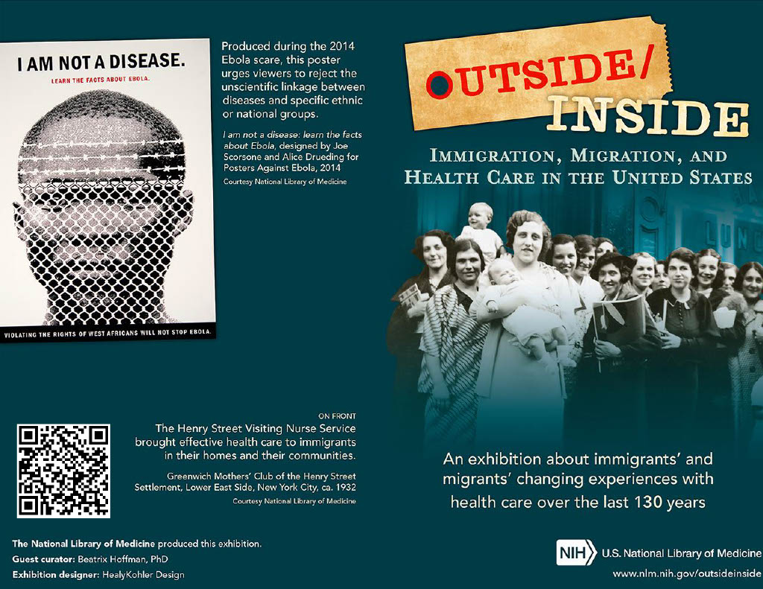
Brochure for NLM traveling exhibit "Outside/Inside: Immigration, Migration and Health Care in the United States," hosted by Galter Health Sciences Library and Learning Center, March 13 – April 22, 2023

Slide 3
Background and timeline
September 15, 2022- Applied to lottery to be host of an NLM traveling exhibit in 2023 (more information about hosting NLM exhibits)
October 18, 2022 - Notified that Galter would be a host site
December 2022-May 2023 – Planning task force creation and work period (task force members: library deputy director, head of Special Collections department, head of Access Services department, metadata and digital projects librarian), choosing MOCHA for project management framework
February 21 – Immigrant health GalterGuide (LibGuide) goes live
March 13-April 22 – NLM poster exhibition is live
March 20-present – Local exhibit in Eckenhoff Reading Room display cases goes live
March 22 – Galter staff discussion session based on NLM education module
April 12 – Invited panel discussion, "A conversation: Immigration status, health, and healthcare access," open to public
May 10 – Lightning talks from departments about a project related to the exhibit theme
Notes:
Note: host institution must show exhibit free of charge; host institution is responsible for shipping costs to next host site. For some NNLM regions, funding awards are available
Panel discussion numbers: Zoom – 47; in person - 46

Slide 4
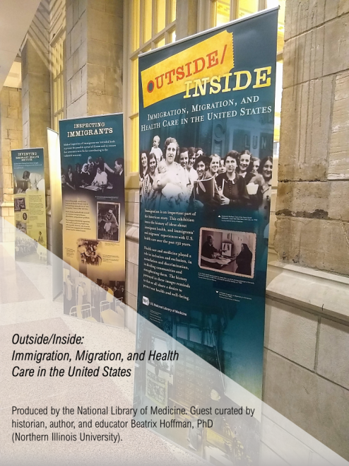
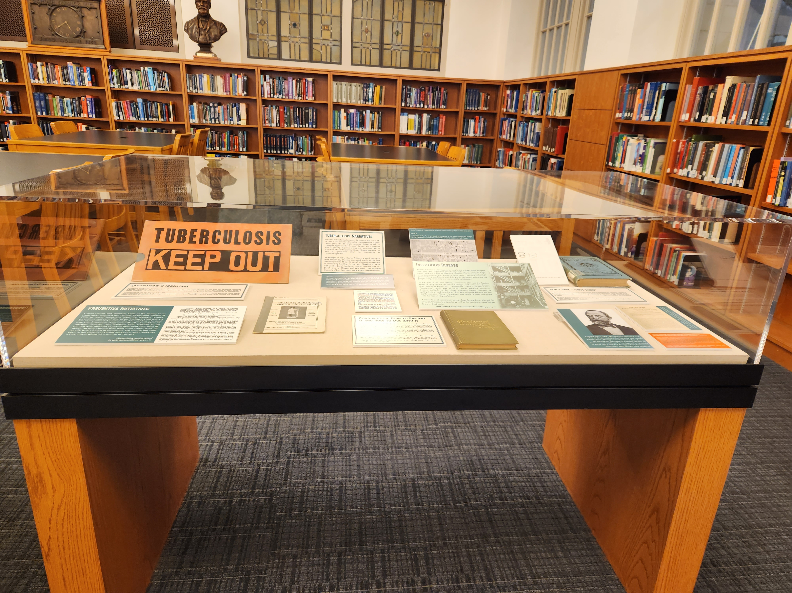
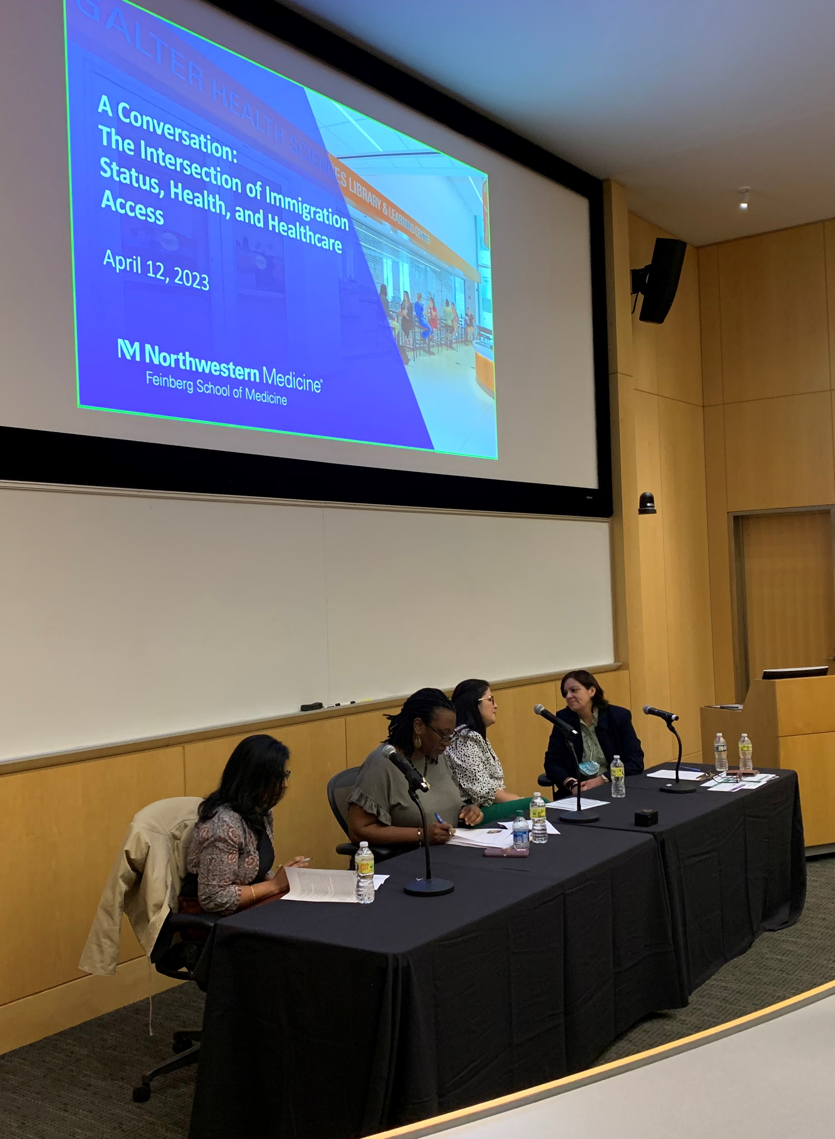
Local outreach
Immigrant status and health panel
NLM exhibit posters outside reading room
Local exhibit in Eckenhoff Reading Room

Slide 5
Institutional opportunities
Using the exhibit as an opportunity to incorporate DEIA principles into routine work
Discussion session
Departmental lightning talks
Existing structure – DEIA Working Group hosts regular sessions
Used pre-existing material: NLM's university module, class 4 (Access and Empowerment)
Asked staff to engage with at least one listed resource deeply (images, annual reports, organization histories)
Used NLM-provided discussion questions, but also tailored additional questions to Galter staff interests (and took questions from participants)
New endeavor, but used an existing all-staff meeting time
Idea formed in DEIA Working Group – brainstorming new ways to encourage incorporation of DEIA principles into daily work
Asked departments to present on a project related to exhibit themes – could be an existing project, new project, future project, or staff interest
Hoped to un-silo and de-mystify our departmental work

Slide 6
Spotlight: Exhibit-related departmental projects
Group 1 - Logistics and Highlights of the NLM Traveling Exhibit
NLM Exhibitions: Behind the Scenes (Administration)
Outside / Inside the Cases: Curating an Exhibit on Healthcare and Immigration (Special Collections/Collection Management and Metadata Services)
Highlighting Immigrant Health Workers Using Library of Congress Name Authority File & Wikidata (Collection Management and Metadata Services)
Group 2 - Immigration, Health, and Libraries
Meeting a need: Development and validation of PubMed search filters for immigrant health (Research and Information Services, Collection Management and Metadata Services)
Books on Immigrant Health: a collection development and management pilot (Collection Management and Metadata Services)
Out of Sight, Out of Mind: Externalizing Death at the Border (book talk on The Land of Open Graves by Jason De León) (Digital Systems)
Notes:
NLM Exhibitions: call goes out over listserv, polled leadership team to see which exhibits we wanted
Local exhibit themes: Avenues of Care, Public Health Department, Pubic Healthcare in Medical Schools, Infectious Disease
LCNAF: Added 9 records, edited 7 records
Wikidata: Added 20 records, edited 12 records
Books on immigrant health: goal to create a set of 100 titles to analyze (added and/or enhanced catalog records for these items so they were discoverable, especially through avenue of theme of immigrant health)

Slide 7
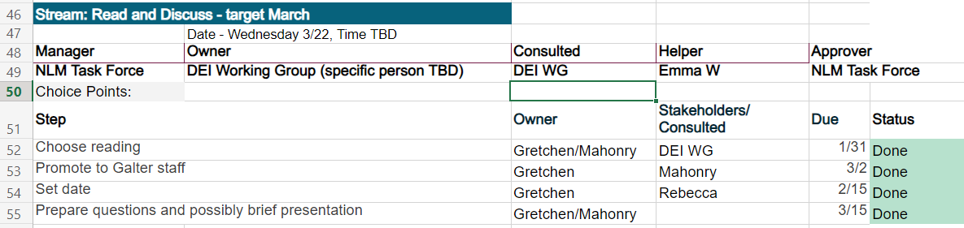
MOCHA process
Manager-Owner-Consultant-Helper-Approver
Each event (stream) had MOCHA roles assigned, along with target dates
Each event then had all steps outlined with owner, consultants/helpers, due date, status, and timeline
Example:

Slide 8
MOCHA process - conclusions
Manager-Owner-Consultant-Helper-Approver
Helped make sure our small organizing team could coordinate with a larger group of people
Ensured we contacted external participants with ample time before event
Kept us on track for our deadlines
Had to remember to constantly check in, had to have buy-in from everyone managing events
As events got closer to the deadline, our MOCHA spreadsheet wasn’t always updated
Website: https://www.managementcenter.org/resources/frequently-asked-questions-about-mocha/

Slide 9
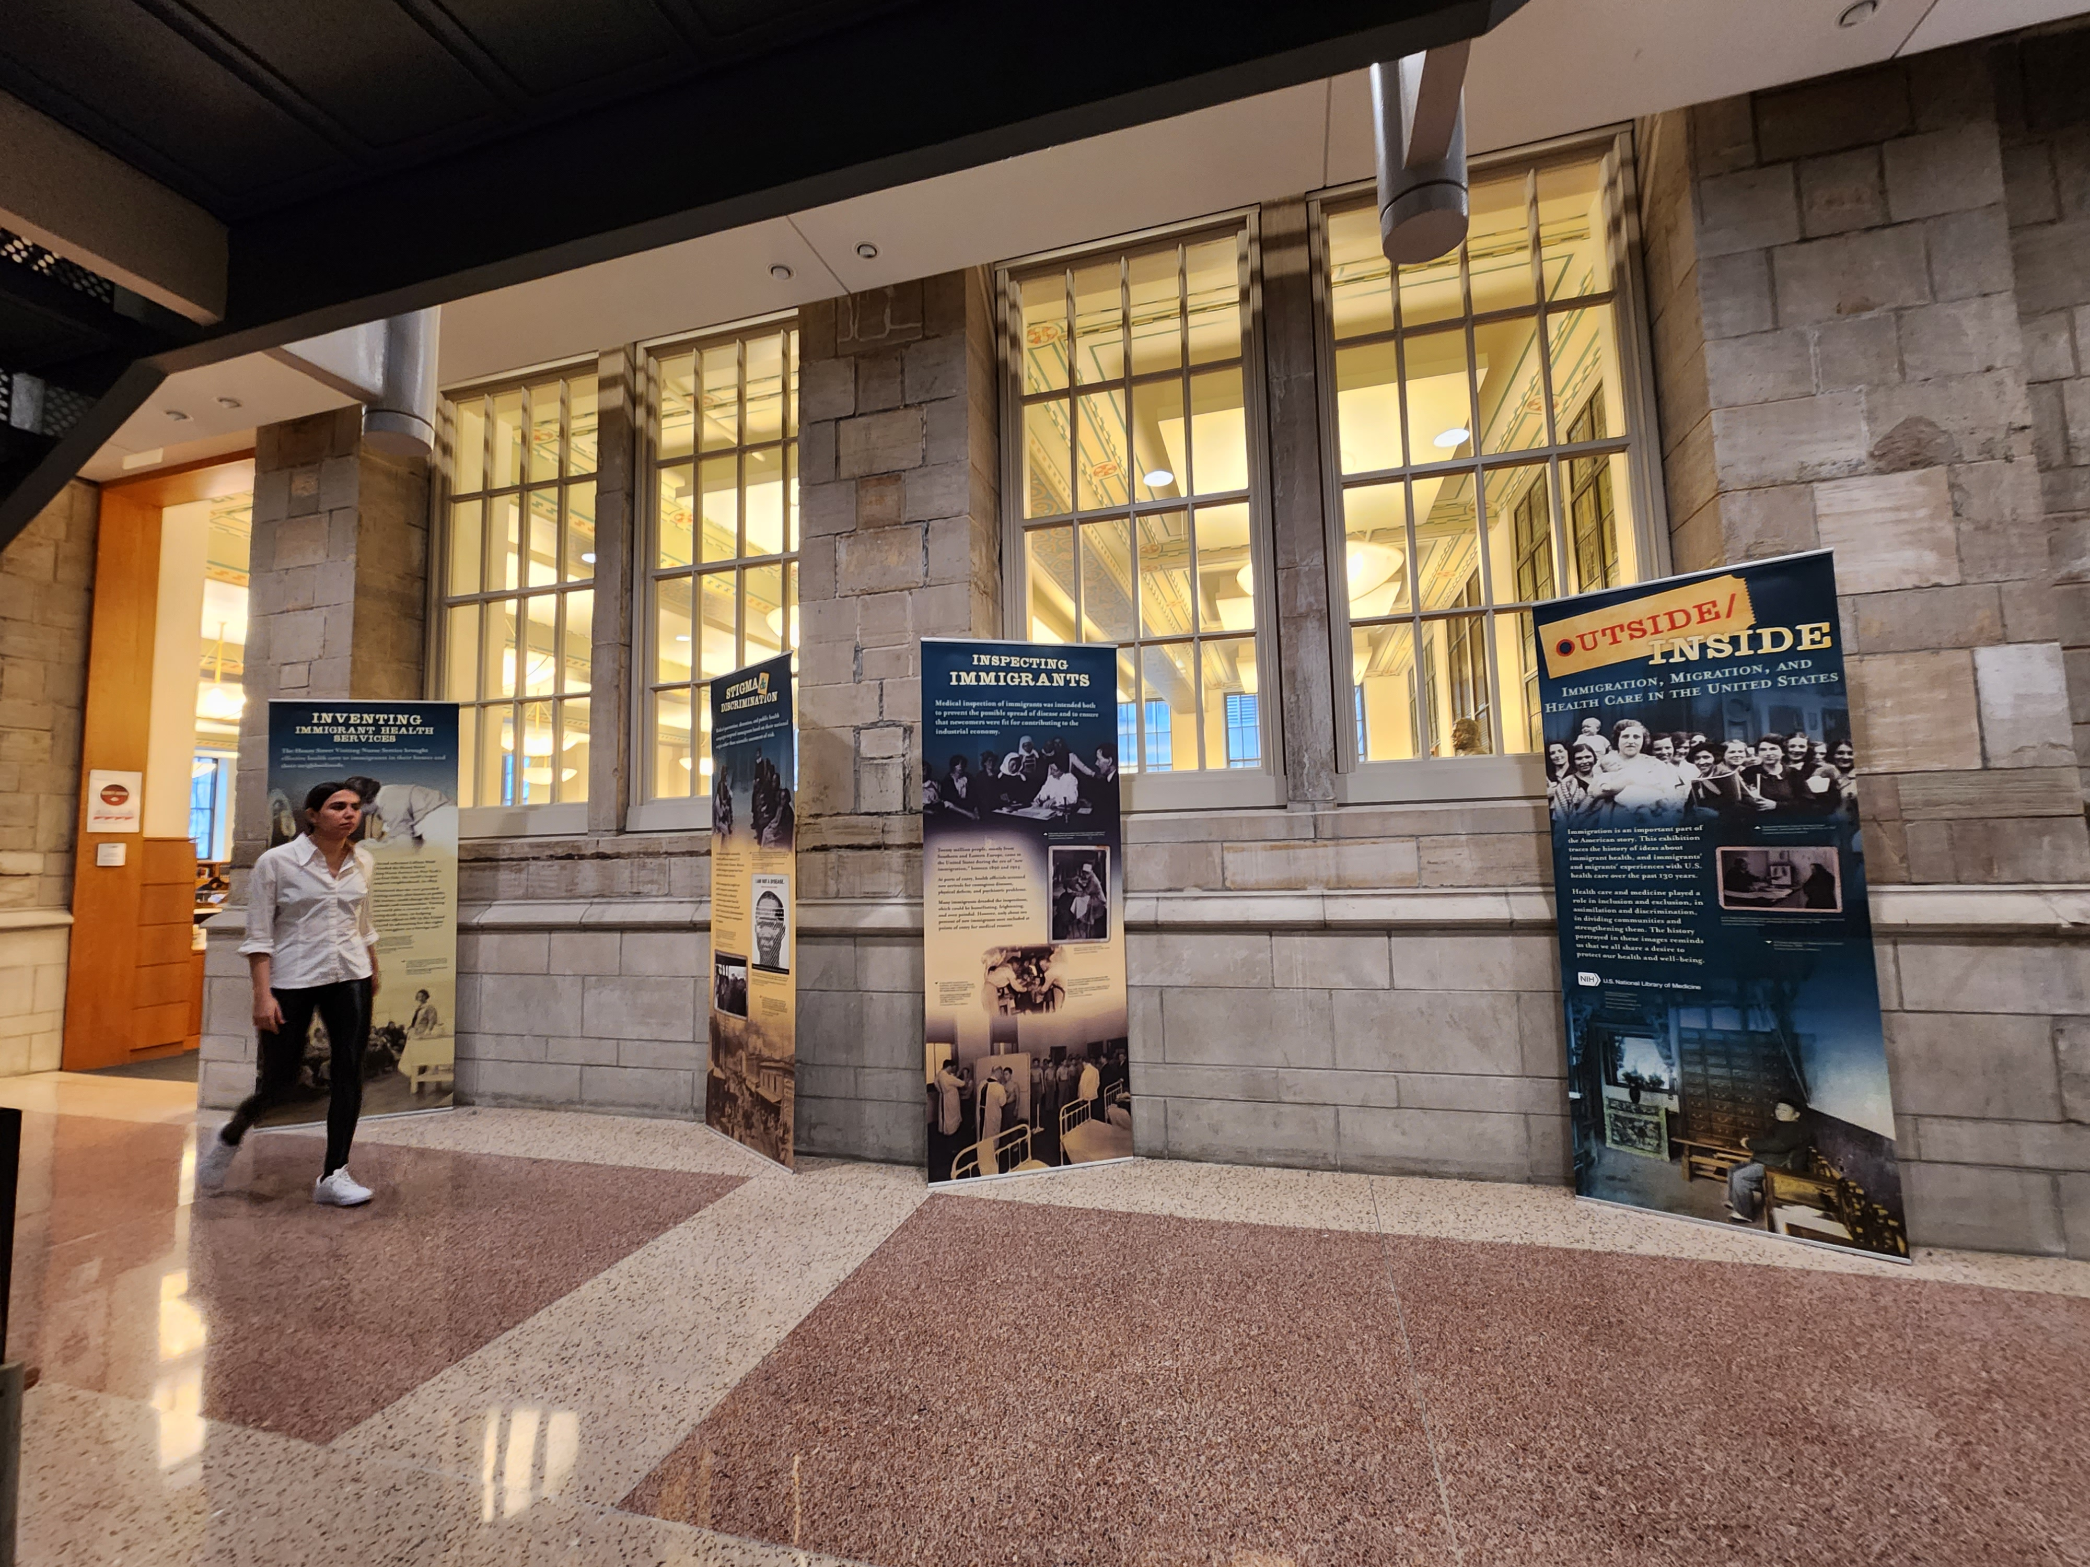
Takeaways
Hosting NLM exhibit was an excellent way to target outreach efforts around a theme
Organize as soon as possible – never can plan too early
MOCHA framework kept events organized if there was buy-in
Staff was interested but busy, and meeting them where they already were led to more engagement

Slide 10
Questions?
gretchen.neidhardt@northwestern.edu

Slide 11
Thank You
Many thanks to my fellow planning task force members: Mark Berendsen, Katie Lattal, and Mary Anne Zmaczynski.
Also, thanks to Ramune Kubilius for presenting a variation on this talk at the Health Science Librarians of Illinois Annual Conference on September 22, 2023.
History of NLM Traveling Exhibit Outreach at Galter: https://www.mlanet.org/blog/what-we're-doing2

