Slide 1
Using REDCap for Data Capture in Clinical Trials:
Database Management on a Budget
2017 Society for Clinical Trials
& International Clinical Trials Methodology Conference
In-Conference Tutorial Workshop #5
10th May, 2017

Slide 2
Welcome & Introductions
Speakers:
Jody D. Ciolino, MS, PhD – Assistant Professor in Preventive Medicine – Biostatistics, Northwestern University (Chicago, IL USA)
Firas H. Wehbe, MD, PhD – Assistant Professor in Preventive Medicine – Health and Biomedical Informatics, Northwestern University (Chicago, IL)
Hannah L. Palac, MS – Statistician, AbbVie Inc., (North Chicago, IL)

Slide 3
Learning Objectives
In the next 90 minutes…
Gain basic understanding of REDCap platform and basic functionalities
Learn tips and tricks for efficient database development and quality control using the REDCap platform
Get started building projects on your own
Learn available resources for continuing education on features and best practices

Slide 4
Outline
REDCap Overview and Functionalities
Data Entry and Quality Control
Advanced Features
  Action Tags
  Randomization
  Surveys
  Application Program Interface (API)
Examples and Use Cases
Hands-on/Question & Answer Session
Pitfalls/Lessons Learned

Slide 5

What is ?
Research Electronic Data Capture
Used for building and managing surveys and study databases efficiently, on a fixed budget, and securely
  This includes protected health information (PHI)
Developed at Vanderbilt University in 2004
Over 2000 institutions in over 100 countries

Slide 6
Background: Data Management and Quality
In the Clinical Trial Setting
Substantial coordination required for accurate, complete, consistent data capture
Requirements:
  Accessibility
  Ease of entry
  Accuracy and consistency
  Security
  Version control/audit trails
  Flexibility
  Fit into the study’s budget

Slide 7
Background: Data Management and Quality
In the Clinical Trial Setting
Stakeholders:
  Participants
  Coordinators
  Monitors (includes safety monitors)
  Data managers
  Statisticians

Slide 8
Getting Started...
NOTE: Institutions may vary

Slide 9
Basic Terminology
Development mode → Production mode
Development
  Build ‘project’ (i.e., database and corresponding structure)
  Design case report forms (CRFs) and surveys in real time
  Designate events and corresponding forms at each event
  Add in customizations (randomization, auto-numbering, scheduling, etc.)
  Test thoroughly – use test data only here
  Assign users and corresponding rights (e.g., ‘read only’ capabilities, randomization ability, etc.)
Production
  Live data capture
  Post-production modifications must be made with caution and may require administrator approval

Slide 10
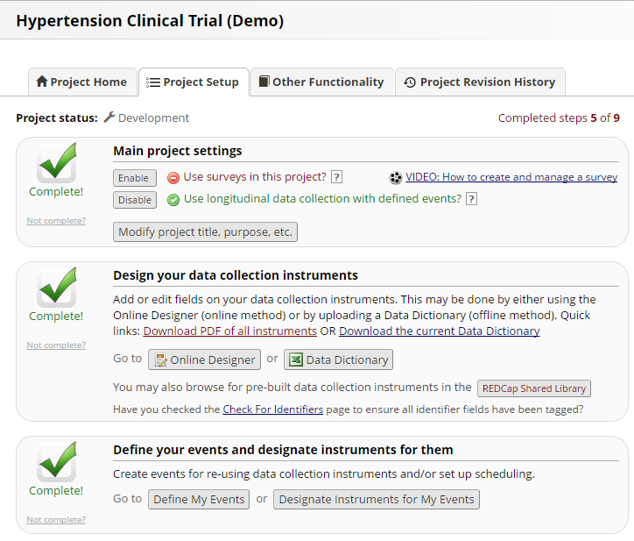
Project Setup Checklist
(Landing Page)

Slide 11
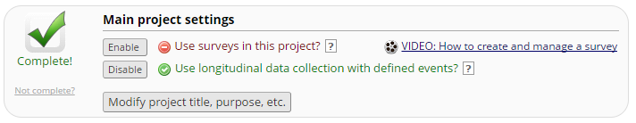
Getting Started
If designing a clinical trial database, almost always will use the longitudinal setting
Two options in developing CRFs
  Online designer
  Data dictionary
Designing data collection tools will inevitably take the most time

Slide 12
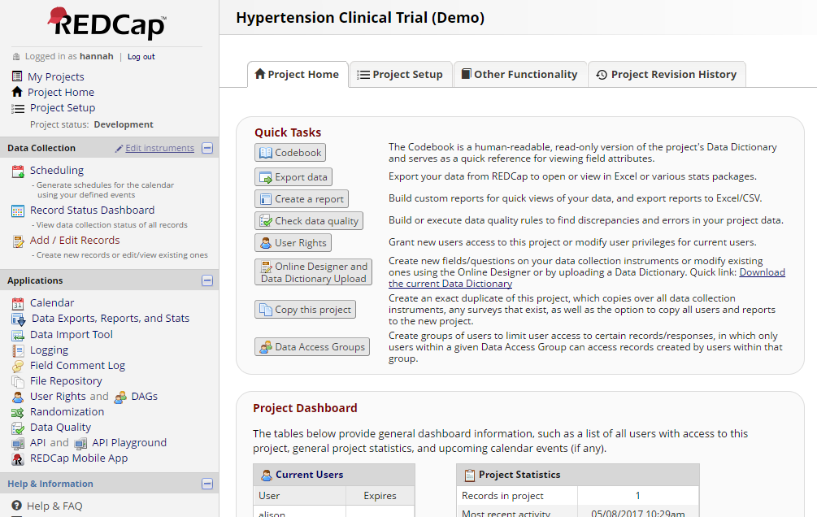
Project Home Tab

Slide 13
Designing Data Collection Tools
NOTE: REDCap platform distinguishes between data entry forms (CRFs) and surveys (may also serve as CRF for clinical trial purposes)
Surveys:
  Can be participant facing (participants do not need to access REDCap database to complete electronically)
  Online completion through public link or QR code
  Online completion through link emailed directly to participant
  Can also be completed by a study team member directly in REDCap
  Have additional settings that allow for greater flexibility (‘save and return later’, ‘survey queue’, etc.)

Slide 14
Designing Data Collection Tools
NOTE: REDCap platform distinguishes between data entry forms (CRFs) and surveys (may also serve as CRF for clinical trial purposes)
‘Regular’ CRFs
  Data entry must occur by authorized REDCap user (study team member with access to the database)
  May not be participant facing

Slide 15
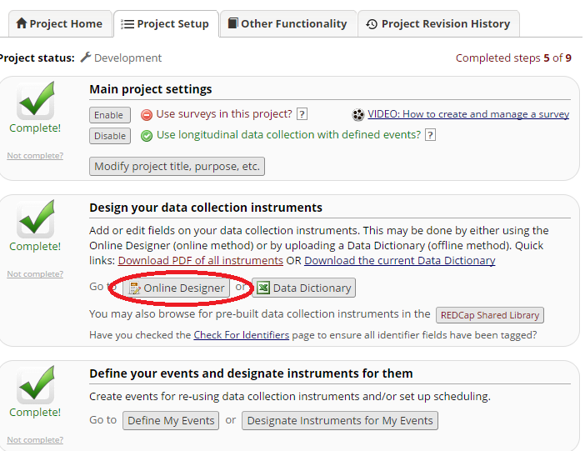
Project Setup: Online Designer

Slide 16
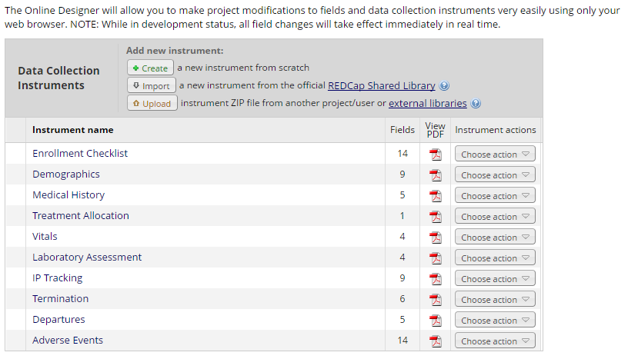

Slide 17
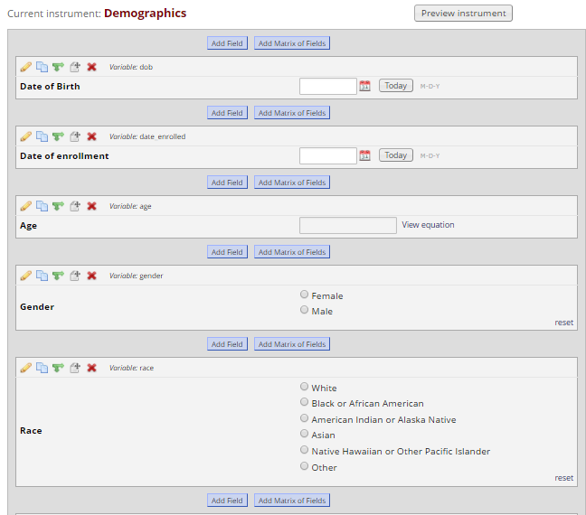
Web-based Form Builder

Slide 18
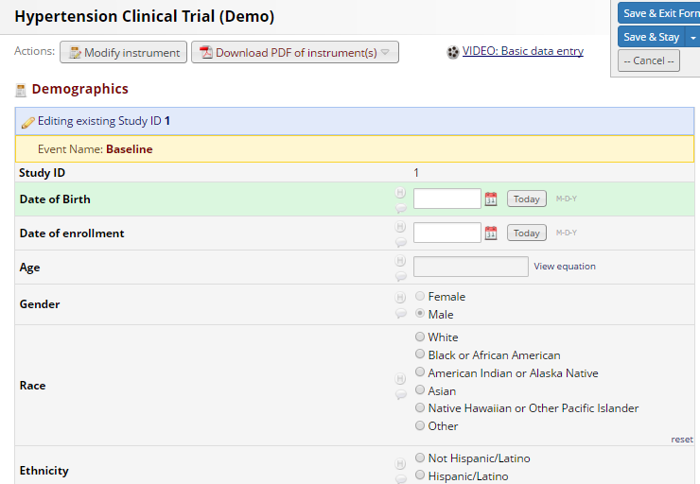
Example Case
Report Form

Slide 19
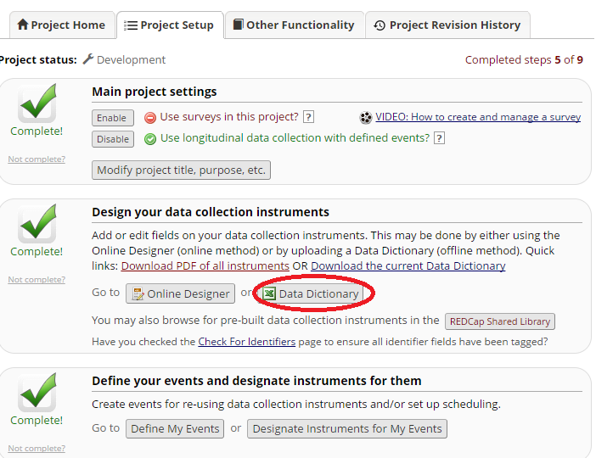
Project Setup: Data Dictionary

Slide 20
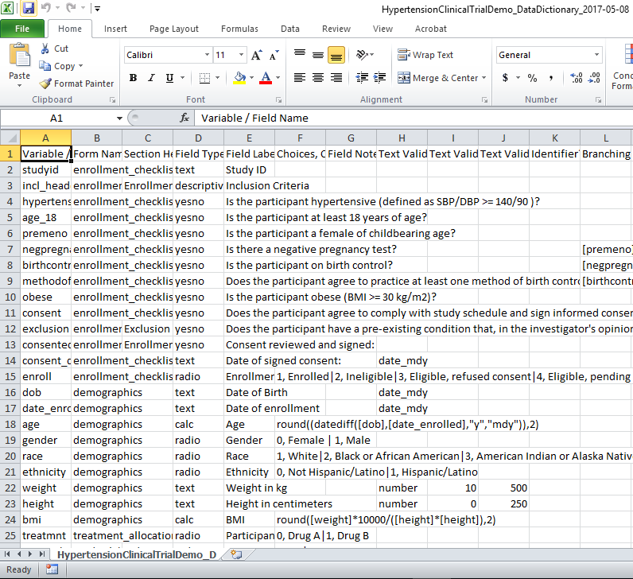
Offline Form Building
via Data Dictionary

Slide 21
Field Types
Text – single-line text box (text and numbers)
Notes – larger text box
Dropdown – dropdown menu with multiple choice options
Radio – radio button with multiple choice options
Checkbox – allow selection of > 1 option
File – upload a document
Calculated – perform real-time calculations (e.g., age)
Descriptive – text displayed with no data entry and optional image/file attachement
Slider – visual analog scale (0 – 100)
Yesno – radio button (1 = yes, 0 = no)
Truefalse – radio button (1 = true, 0 = false)
Signature – allow documentation of electronic signature

Slide 22
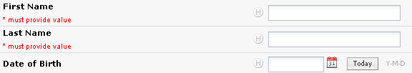
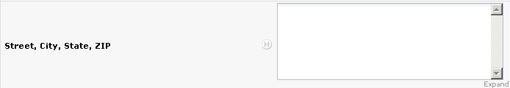

Field Types: Example
Text Box
Notes Box
File Upload

Slide 23
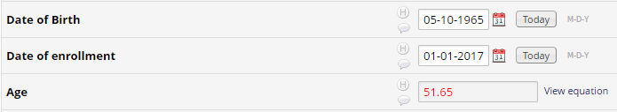
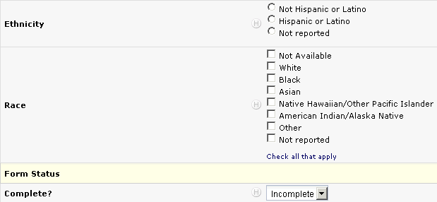
Field Types: Examples
Text Boxes
Calculated Field
Radio Button
Checkbox
(Use Sparingly)
Dropdown

Slide 24
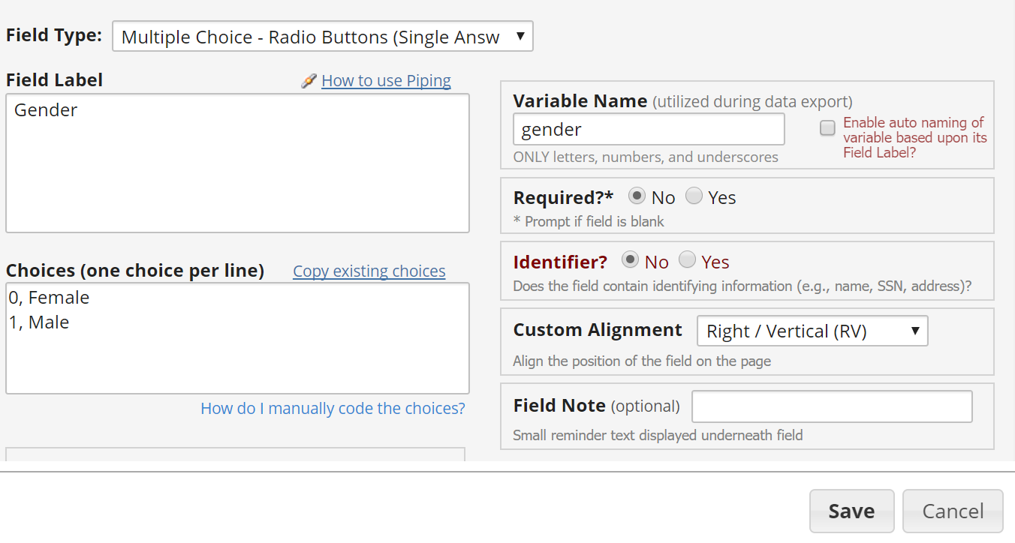
Manual Creation of Radio Button Field

Slide 25
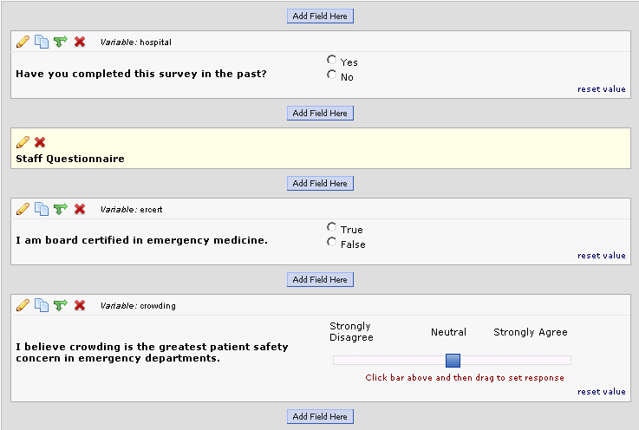
Field Types: Examples
Yes/No
Yes/No
Section Header
Section Header
True/False
True/False
Slider/Analog

Slide 26
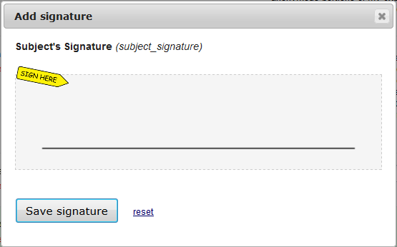
Field Types: Examples
Signature

Slide 27

Field Types: Examples
Descriptive Text: Video Embed

Slide 28

Field Types: Examples
Descriptive Text: Online Image

Slide 29
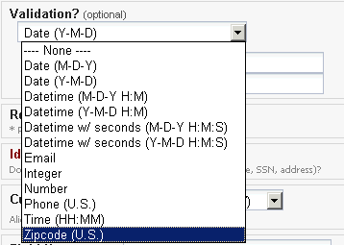
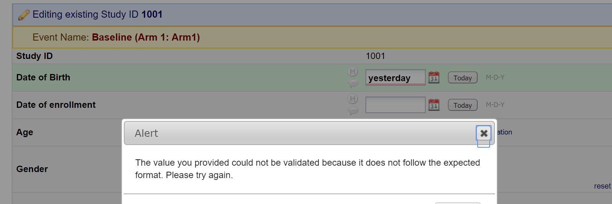
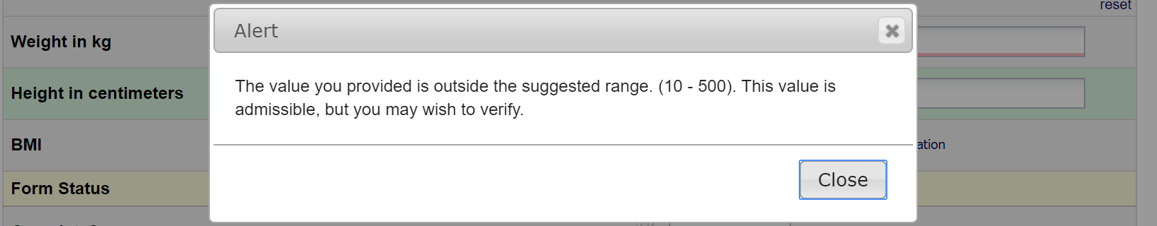
Text Box Validation
Hard Validation - Error
message displayed if entry
does not match expected
format and entry not saved
Soft Validation - Minimum &
Maximum Values
  Can enter (not required) for date, integer, number, and time options
  Will alert data enterer if entry is outside of range, but will still save entry

Slide 30

Required and Identifier Fields
Required – Will alert data enterer if ‘required’ field is left blank, but will allow you to opt to leave blank*
Identifier – Tags variables with PHI for removal option during export
Notes:
*exception is participant-facing surveys
Can also restrict access to those that should not be able export identifiers

Slide 31
Matrix of Fields
Ideal for grouping of questions that share same response options (i.e., Likert scale questions)
‘Answer Format’ can be specified as radio buttons or checkboxes
May use ‘ranking’ to allow only one selection per column across all fields in the matrix (radio buttons only)

Slide 32
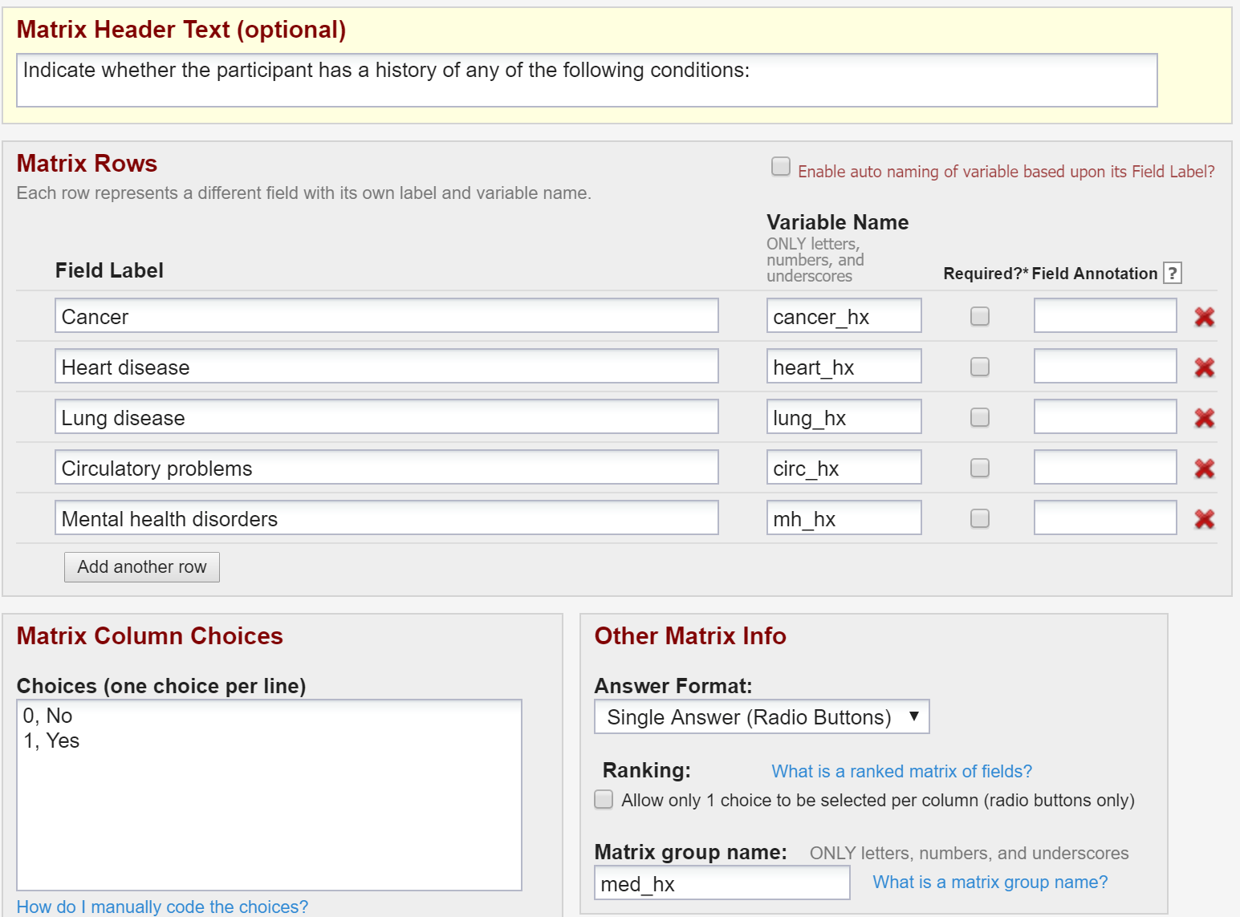
Field Matrix Setup

Slide 33
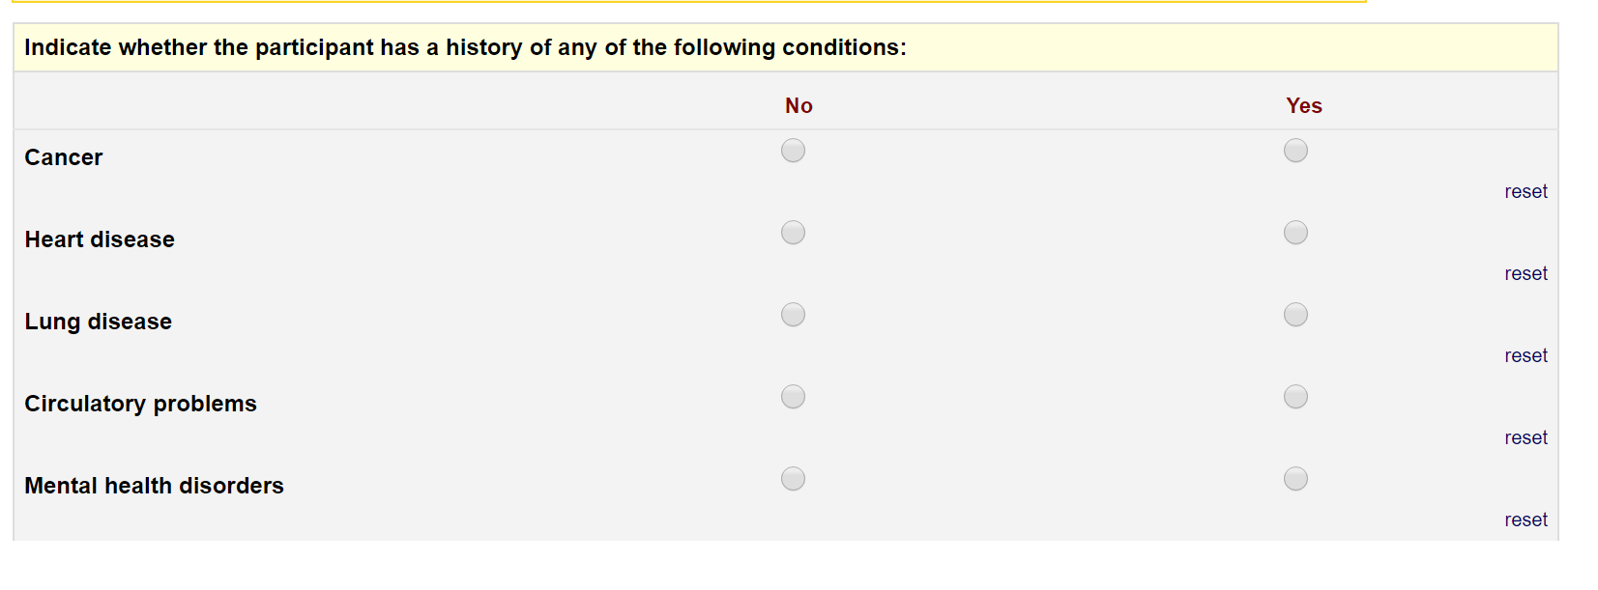
Matrix of Fields: Example

Slide 34
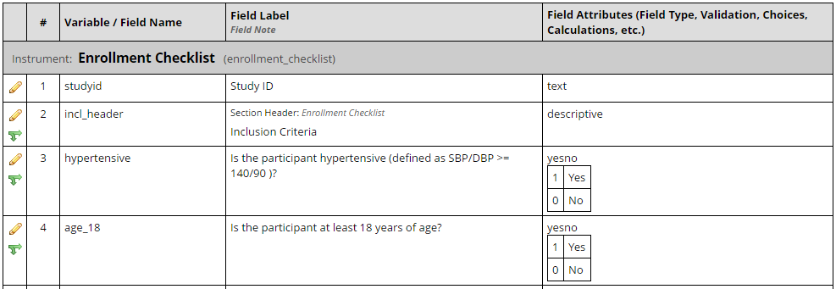
Codebook
Easy-to-read version of project’s Data Dictionary
Quick reference for viewing field attributes
Updated in real-time

Slide 35
Branching (aka ‘skip’) logic

Slide 36
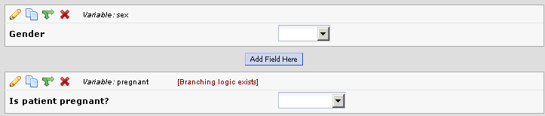
Branching Logic
Can be applied to a field to specify whether it will be displayed depending on information from other fields
‘Section Header’ is the only field type that does not allow branching logic
Notes:
Pop-up to illustrate the specification of branching in web builder

Slide 37
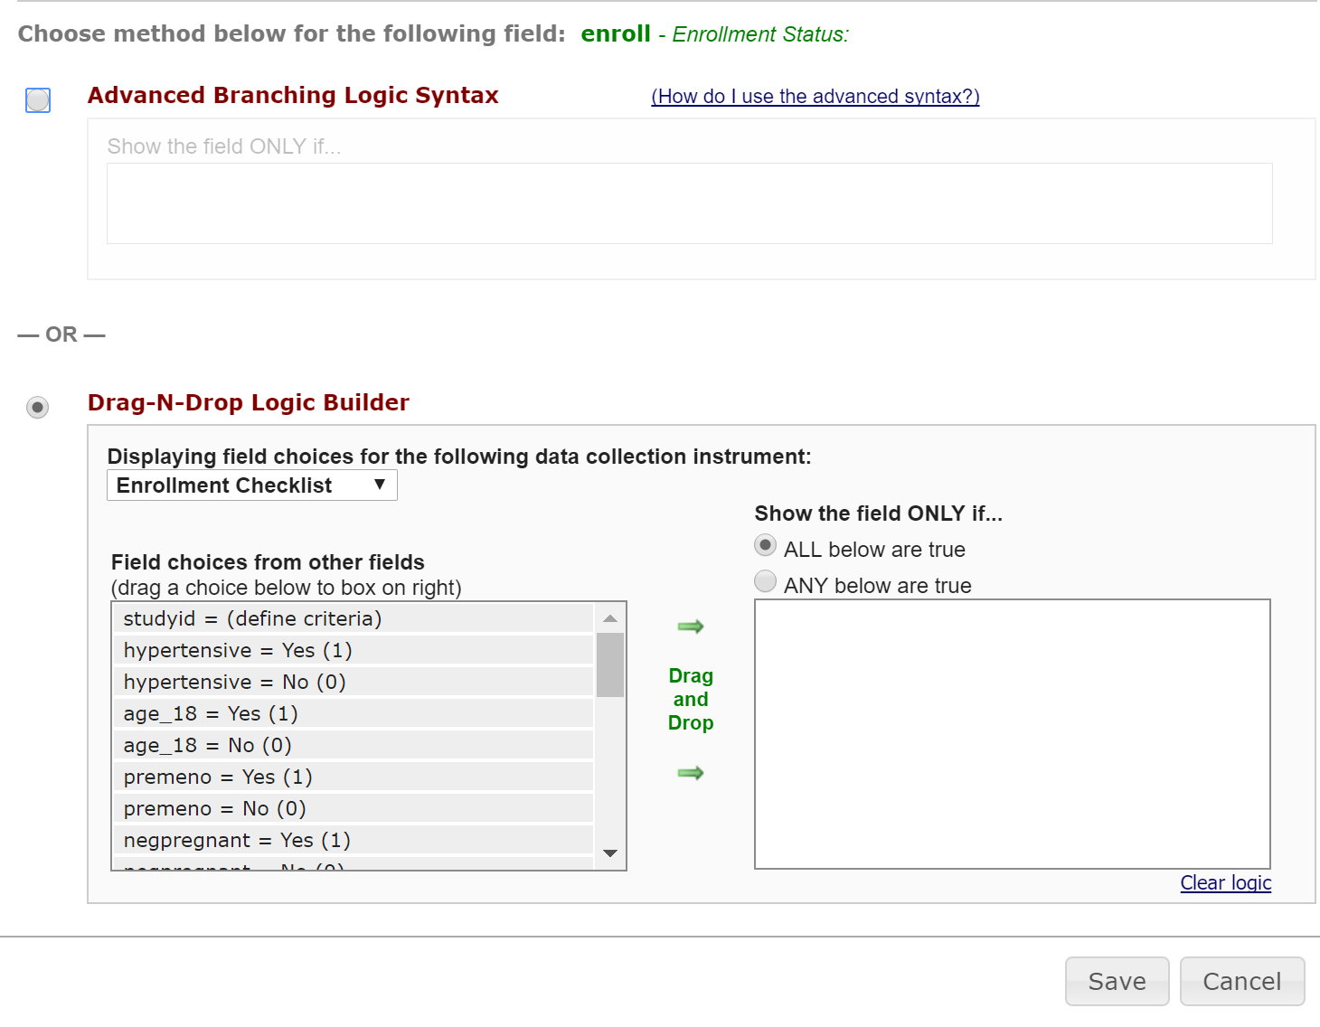

Slide 38
‘Arms’ and Events
Notes:
Word of caution: Data enterers unable to be blinded when utilizing ‘Arms’ functionality

Slide 39
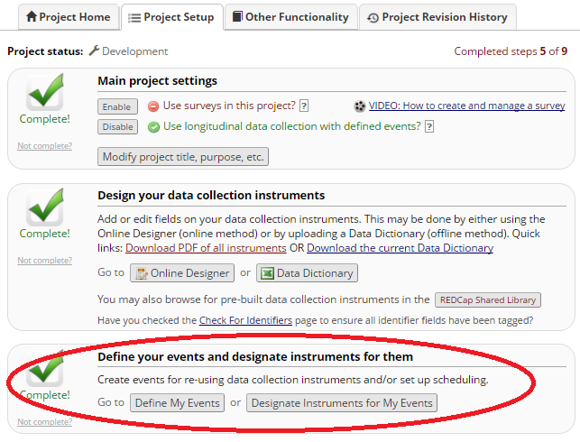
Notes:
Up to this point, you now have all the tools you need to design a cross sectional study. Now, we are going to make the longitudinal portion (the events)

Slide 40
‘Arms’ and Events
Events = groupings of (repeated) forms at specific study time points
Arms = groupings of events (schedule for participants may vary according to study arm or study progress)

Slide 41
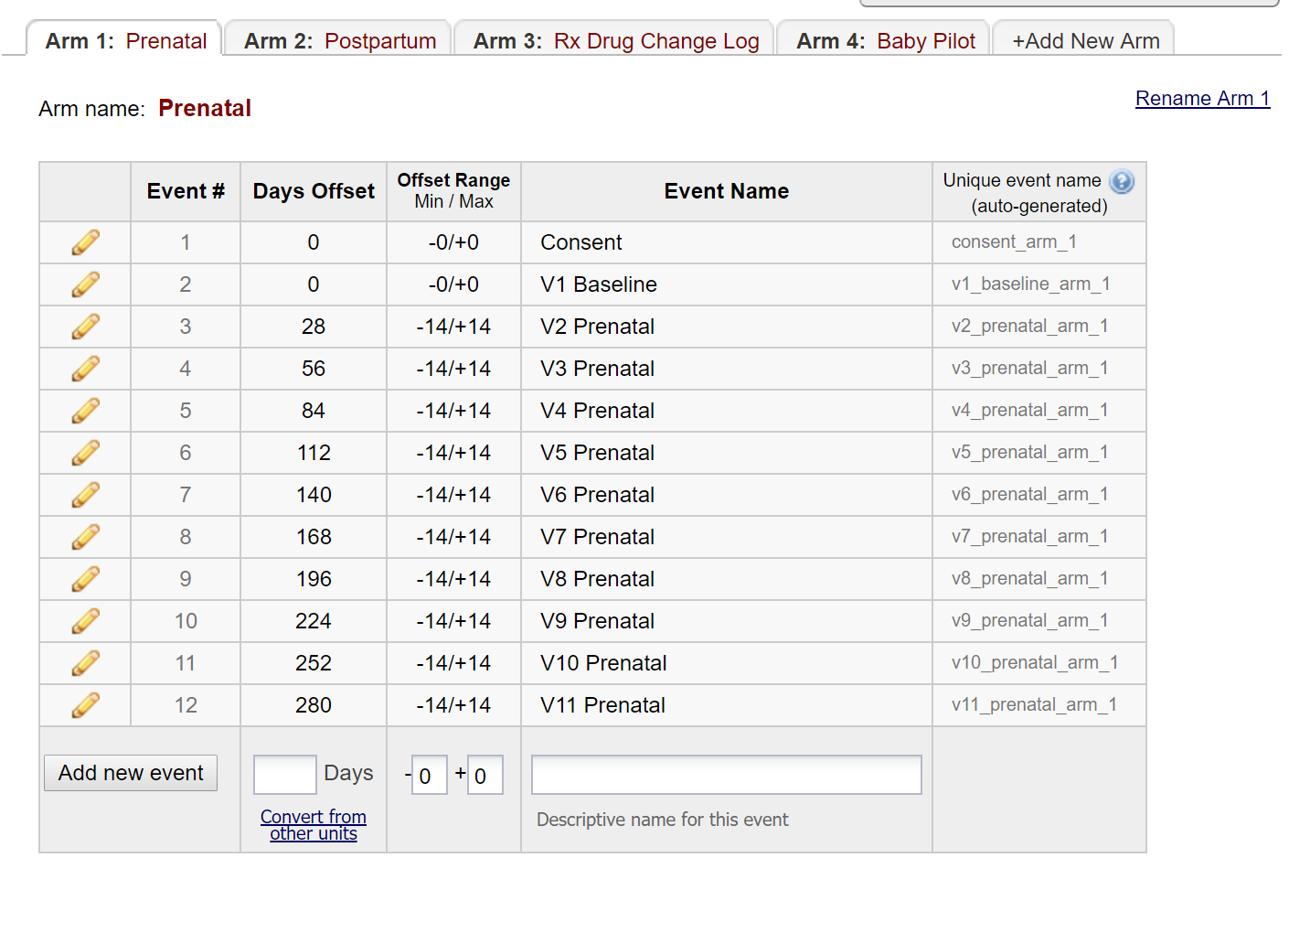

Slide 42
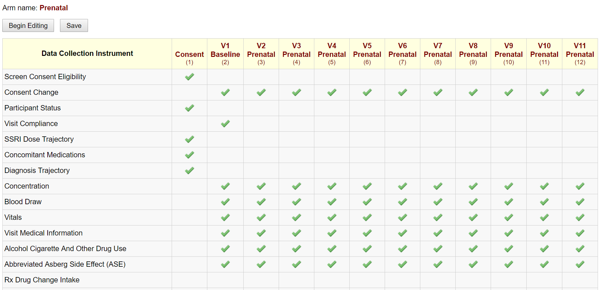
Designate Instruments for Events

Slide 43
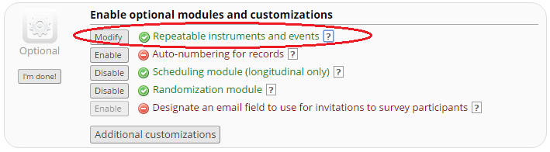
Repeatable Instruments and Events
Ability to repeat a single instrument (e.g., Adverse Events) or an entire event of instruments (e.g., Clinic visits) an unlimited number of times without having to specify the amount needed
Able to implement with surveys

Slide 44
User Rights and Permissions
Grant role-specific access privileges to study team personnel
User rights include:
  Project design and setup
  Data entry
  Data import and export
  Form-specific access
  Other custom/specific rights (e.g., randomization, logging, data import, etc.)

Slide 45
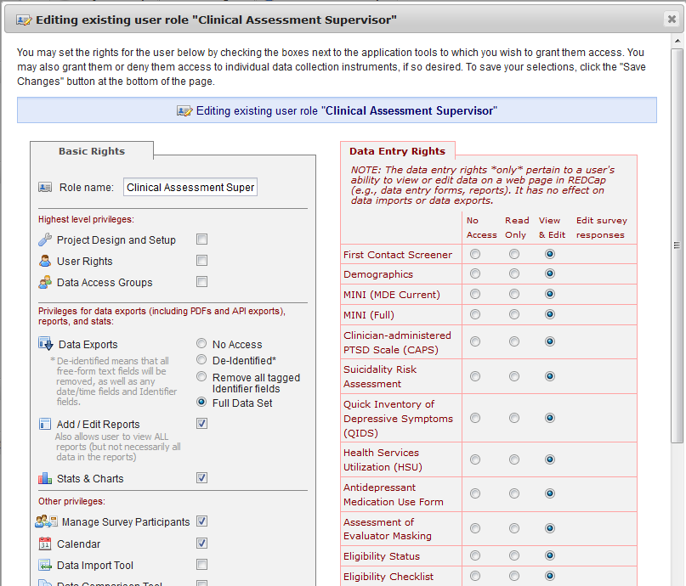

Slide 46
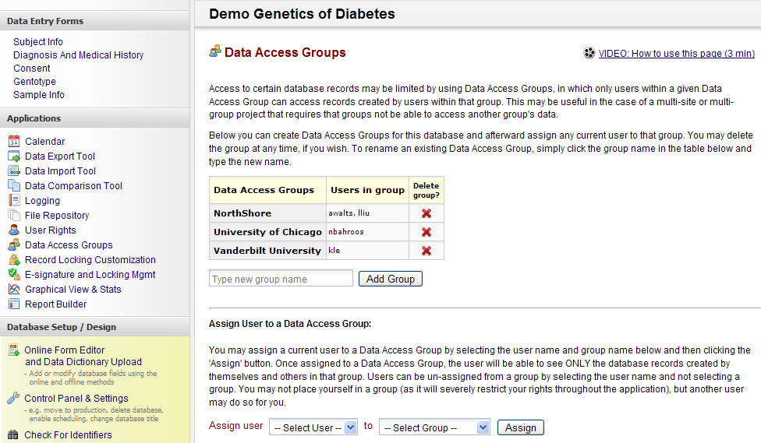
Data Access Groups – Useful for multicenter studies
Allow multiple groups to enter data in one database without groups being able to view each other’s data

Slide 47
Post Database Development…
…Data Entry, Quality Control, and Reporting

Slide 48
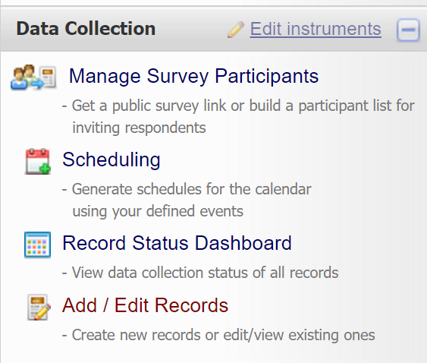
Data Entry

Slide 49
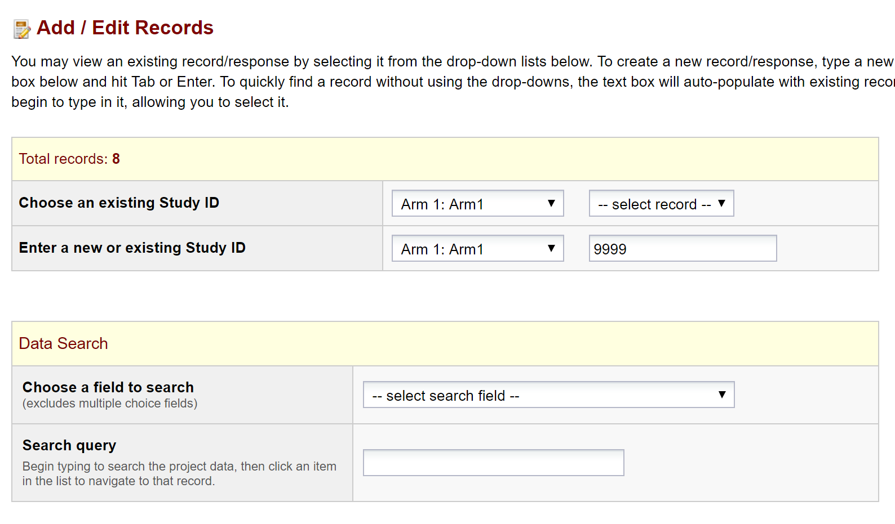

Slide 50
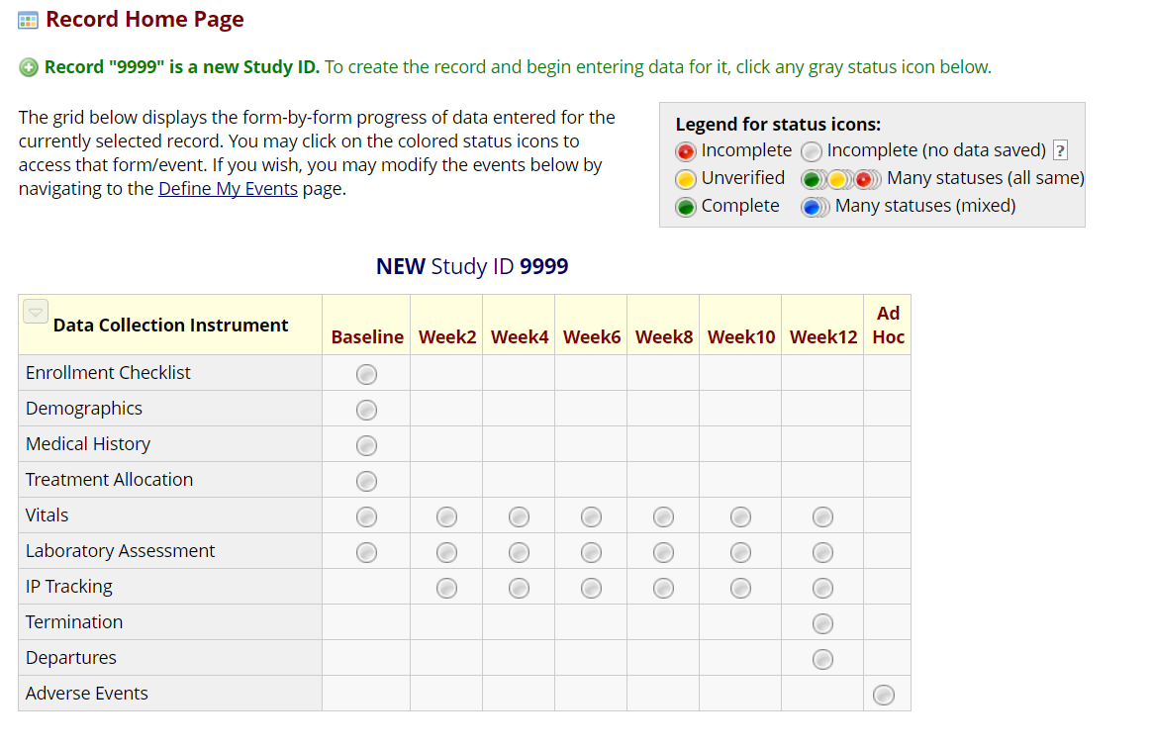

Slide 51
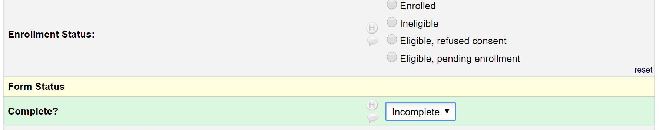
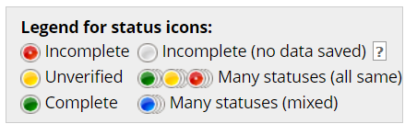
Data Entry/Status Icons

Slide 52
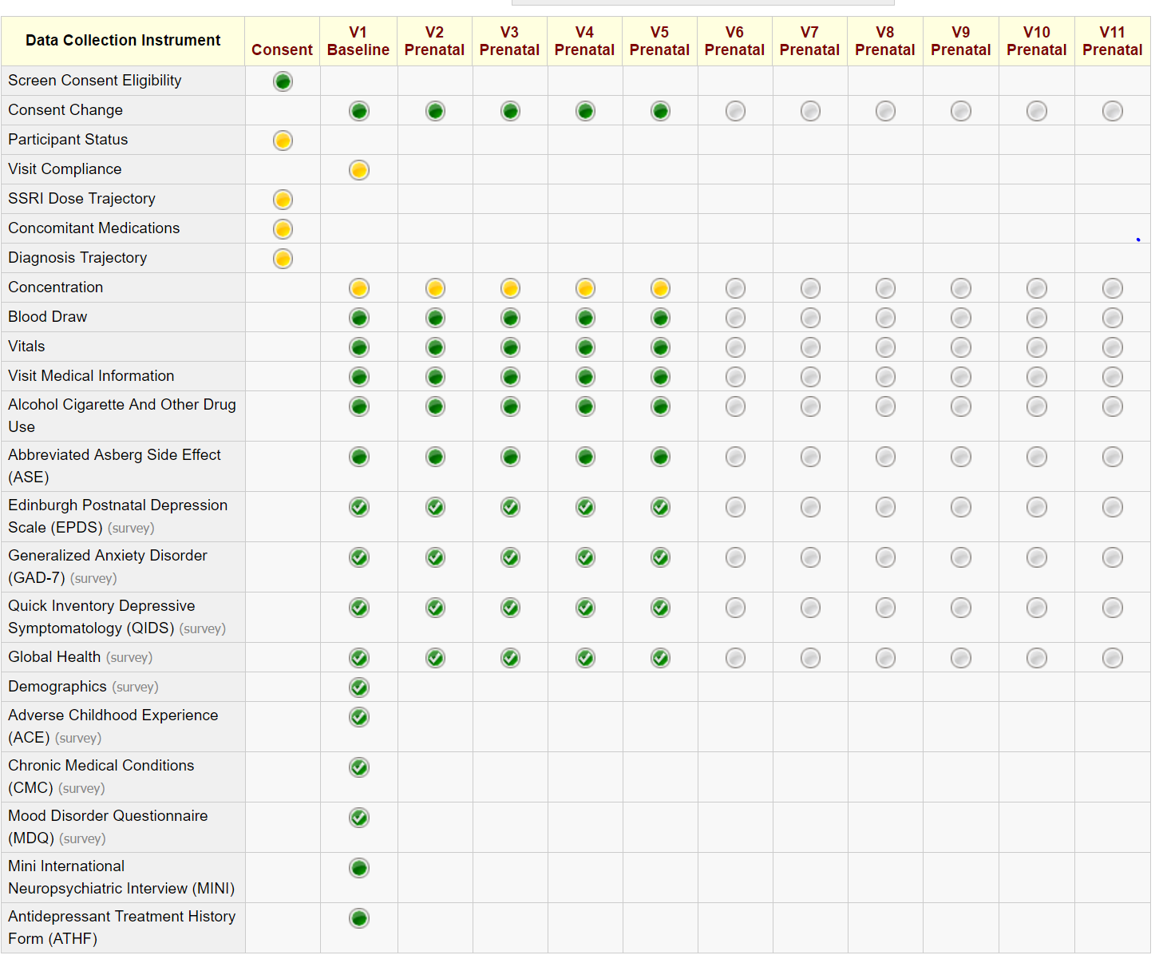
Notes:
One method of quality control – first/second pass system
One person will mark ‘unverified’ (yellow), second pass person will mark complete
If issues, Data Resolution Workflow is one method of resolving queries

Slide 53
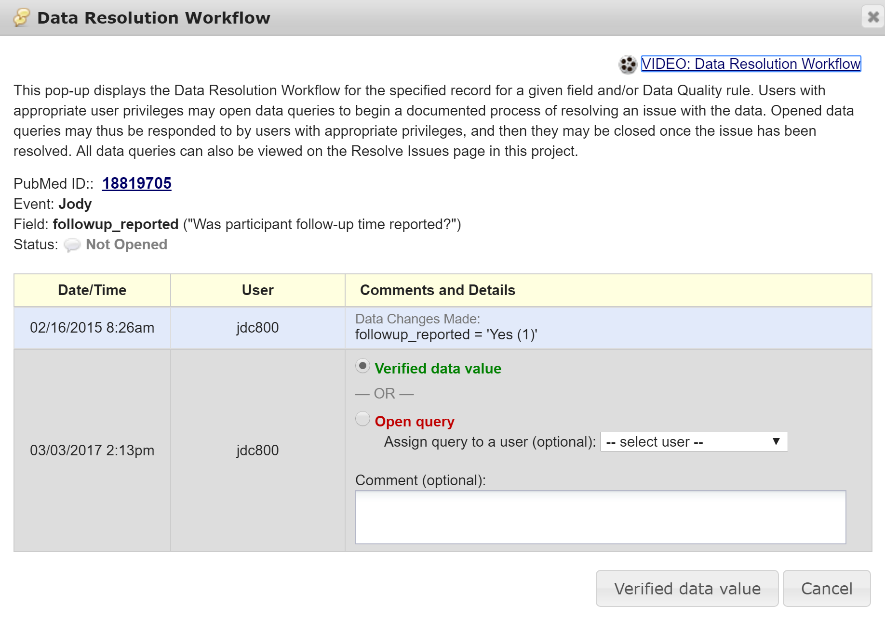
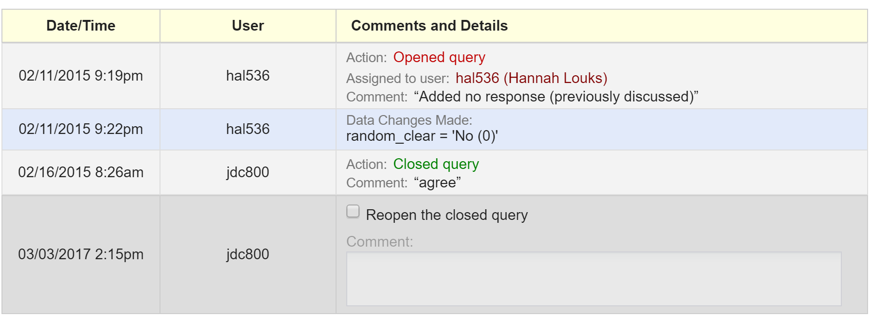
Data Resolution Workflow

Slide 54
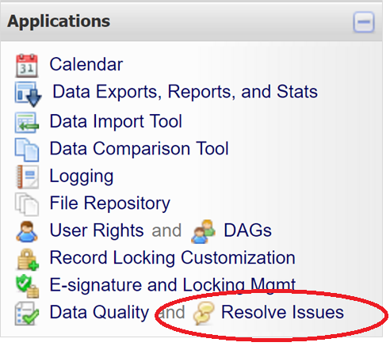
Data Resolution Workflow
Use the resolution dashboard to see all queries
You may organize/filter so that you can only view closed, open, etc. queries
You may also filter by assigned REDCap user

Slide 55
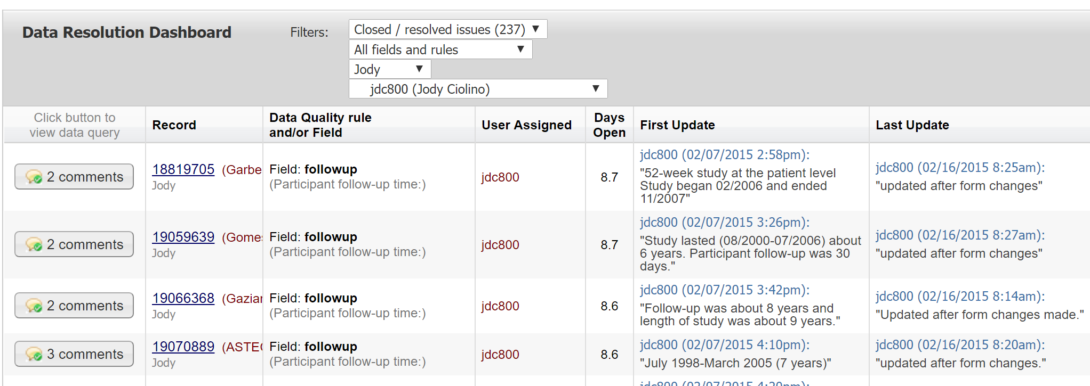
Data Resolution Workflow

Slide 56
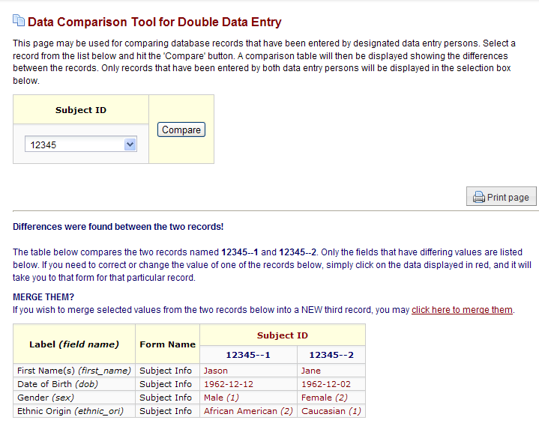
Data Comparison Tool
Another Method for Data Quality

Slide 57
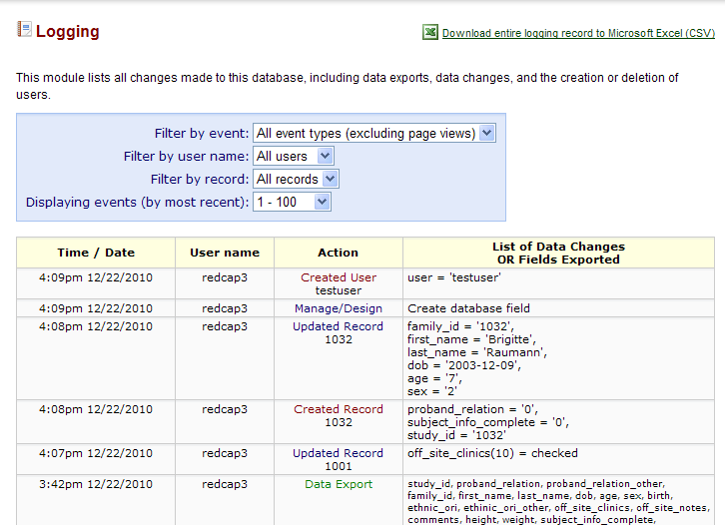
Audit Trail

Slide 58
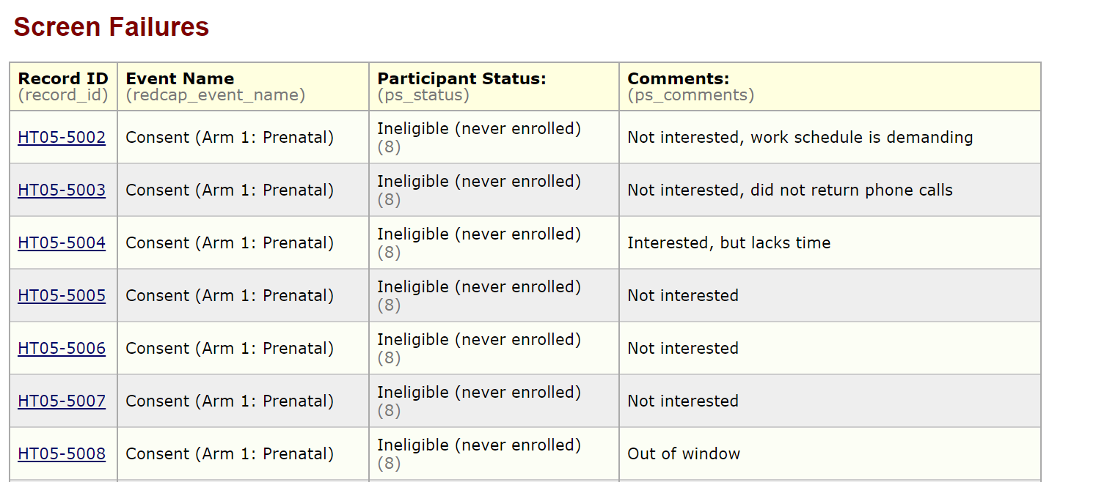
Reports, Graphs, and Descriptive Stats
Reporting feature may be useful for quick summarizations and tracking/coordination

Slide 59
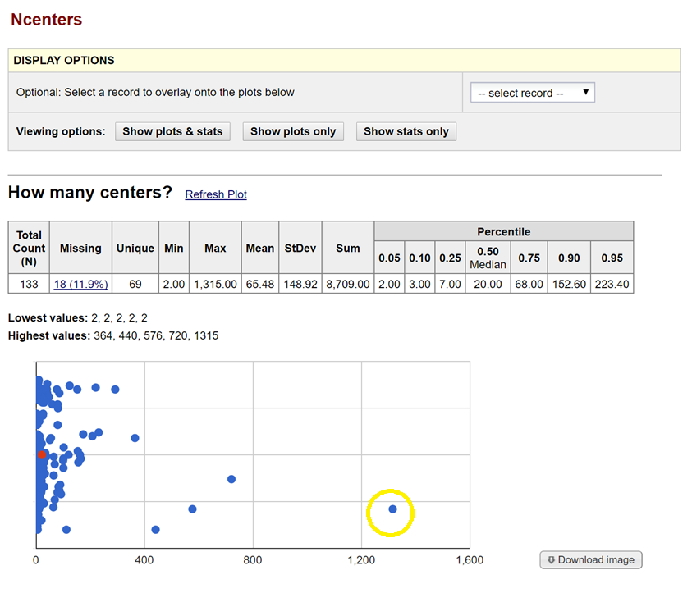
REDCap can also generate simple descriptive statistics and summaries
You can select an individual data point to navigate to that record

Slide 60
Data Export

Slide 61
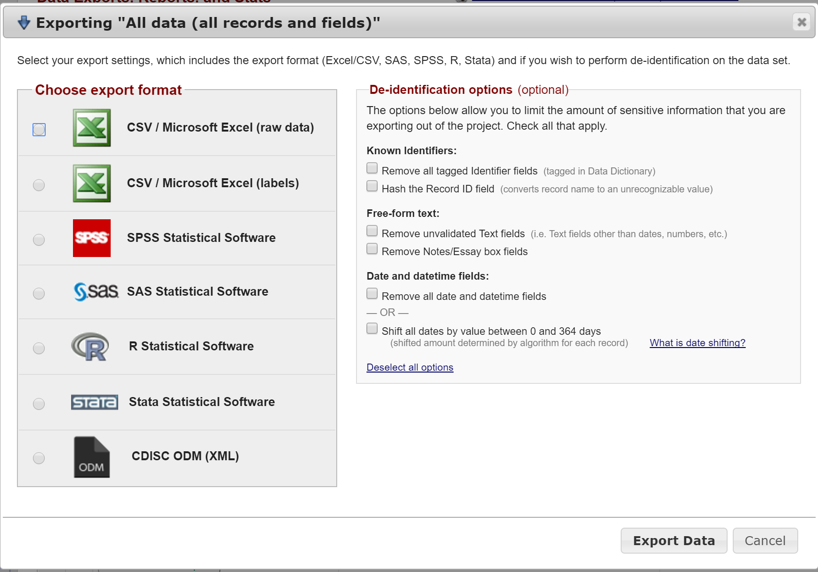
Data Export

Slide 62
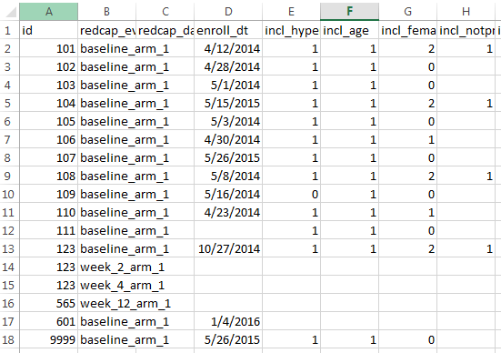
Data Import
Allows users with appropriate user privileges to import data from a CSV file
Data Import Template can be downloaded from Data Import Module within REDCap
For 'dropdown' or 'radio' fields , the numerical value (versus labeled value) must be entered
Longitudinal projects must include [redcap_event_name] variable with events specified

Slide 63
Advanced REDCap Features
Randomization
Survey Administration
Action Tags
API

Slide 64
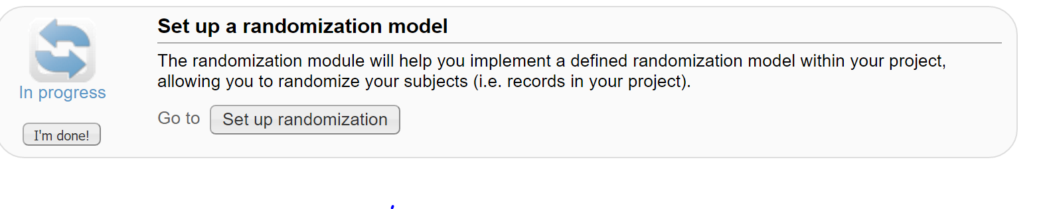
Randomization in REDCap
Allows for custom pre-generated (i.e., not adaptive) randomization list
Must be tied to a single event in a single ‘Arm’
Differing rights:
  Setup (programmer/analyst/statistician)
  Dashboard (unblinded personnel)
  Randomize (unblinded personnel performing randomization)

Slide 65
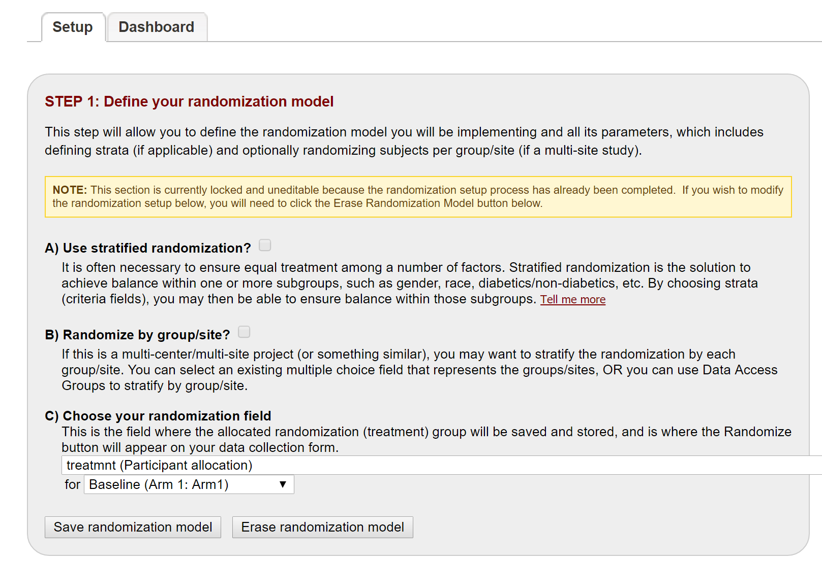

Slide 66
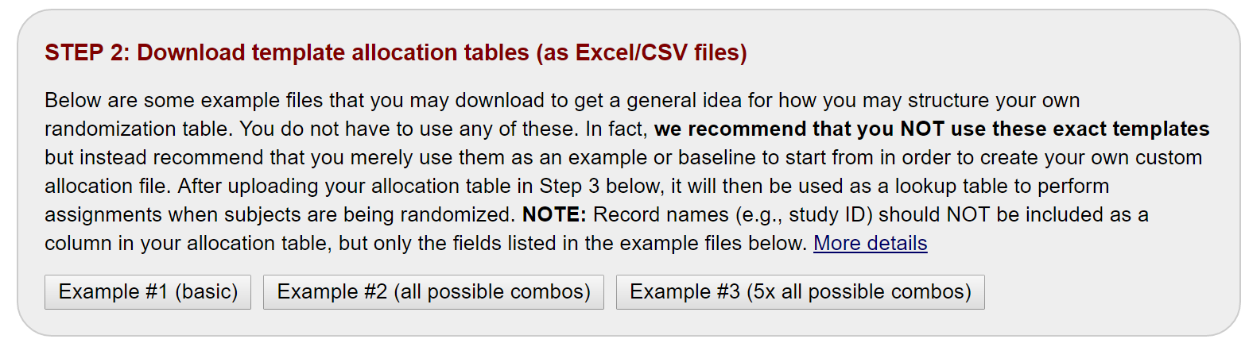
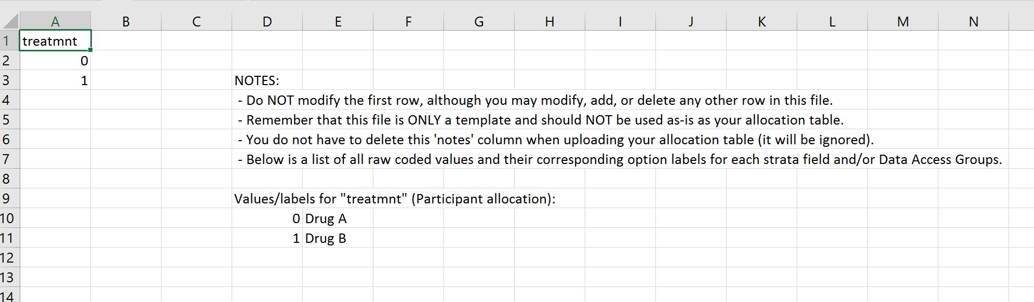

Slide 67

Notes:
Note: you will NOT be able to modify these once in production
You will also not be able to see these once in production (i.e., be able to download the table you create) without assistance from a REDCap administrator

Slide 68
Randomization Caution
Always add a ‘cushion’
Always test thoroughly with study team involved
Tables will be ‘locked’ once in production
Blinded studies are rather difficult to workout logistically (possible, but may need to be creative with this – restrict access and/or use code for randomization field)

Slide 69
Survey Administration

Slide 70
Survey Overview
Public survey link/URL can give access to CRF, regardless if REDCap user
Data entry performed by the respondent
Responses are defaulted to read-only after submission, though can be edited with appropriate user privileges to do so
Multiple modes to administer surveys:
  Public link (anonymous data collection)
  Email invitation
  Automated survey invitation
Notes:
Public link and e-mail invitations allow for survey codes and QR codes

Slide 71


Survey Administration: Getting Started
1. Enable survey functionality under ‘Main project settings’ in the Project Setup Checklist
2. Enable CRF as survey in the Online Designer

Slide 72
Survey Administration: Settings & Customization
Instructions
Logo
Survey aesthetics (font, font size, survey theme)
Question numbering and display, such as single or multiple page display
View aggregate survey results
Text-to-Speech functionality
Survey expiration
Option to ‘Save & Return Later’
Survey completion, such as completion text or confirmation email

Slide 73
Survey Administration: Additional Options
Survey Queue
  Displays a ‘to-do’ list of surveys to a respondent all on a single page
Survey Login
  Forces respondents to authenticate (log in) survey before they are allowed to view and complete the survey
Notifications
  Allows users to be notified via email every time a participant completes a specified survey
Automated Survey Invitations
  Allows invitations to be sent to respondents based upon specific conditions rather than manually sending an invitation

Slide 74
Action Tags
Special terms starting with the '@' symbol that can added to fields upon creation
Each tag has a corresponding action that is performed for the field when displayed on data entry forms and survey pages
  Hiding a field on a page (Ex. @HIDDEN)
  Setting a default value (Ex. @DEFAULT='2017-05-10‘)
  Collecting latitude and longitude of the user (user will be prompted on the webpage to allow or deny this) (Ex. @LATITUDE and @LONGITUDE)
  Setting a field to read only (@READONLY)

Slide 75

Action Tags

Slide 76
REDCap API…

Slide 77
REDCap API
API=Application Programming Interface
Allows external applications (e.g., SAS, R) to connect to REDCap and retrieve and/or modify data
Useful for performing automated data exports and transferring data between REDCap projects

Slide 78
API Token
To use the REDCap API, users must be granted ‘tokens’ by a REDCap administrator that is specific to each username and project
Each user running any code using the API must request their own API token, which should be treated like a password
  Different institutions may have different processes for requesting API tokens
API requests utilizing multiple REDCap projects must request multiple tokens
Token must be included in all API requests
REDCap API Documentation

Slide 79

API: An Example
Crosstalk between two projects in OPTI-MOM Study at Northwestern University
Complex specimen labeling
At each visit, we have multiple specimens labeled this way
Need to ‘track’ specimens somehow (external database)
  Each individual specimen should be a new record in the this database
  LOTS of room for data entry error/failure to enter
API functionality will allow us to pre-populate records in a new database
Core Database:
Specimen Tracking:

Slide 80

API: An Example
Crosstalk between two projects in OPTI-MOM
Coordinator(s) now only need to update records in Specimen Tracking Database (will not need to enter manually)
Example CRF completion in separate database

Slide 81

API: Example R Script
Notes:
Another OPTI-MOM example: use API to export data on daily basis, generate data status/quality reports daily to check on safety and quality of data

Slide 82

API: SAS Script
Notes:
Another OPTI-MOM example: use API to export data on daily basis, generate data status/quality reports daily to check on safety and quality of data

Slide 83

API: SAS Script Cont’d
Notes:
Another OPTI-MOM example: use API to export data on daily basis, generate data status/quality reports daily to check on safety and quality of data

Slide 84
Limitations and Resources

Slide 85
Limitations
REDCap is intuitive, but there is a learning curve
Differing institutions may host different versions and enable/disable different features for end users
FDA has yet to approve that REDCap can be used in compliance with 21 CFR Part 11 and therefore may not be suitable for FDA-governed clinical trials
Notes:
There are some workarounds for the FDA issue, but it will be necessary to check with appropriate resources on what may or may not be allowable under FDA regulations and at each institution

Slide 86
Caution / Pitfalls
Less is more
  Just because technology and features are available, does not mean you need to or should use it: “Don’t use a hammer to swat a fly”
  Consider how each feature and application will fit into your data management procedures
Education, training, communication = key
Like many things, REDCap’s flexibility and ease of use may also open the door for error/disaster without proper education, due diligence, training, and communication
  Test, test, and test again!
It’s ‘free’ for a reason – it is essential that project owners take ownership and assume all responsibility for that project

Slide 87
Optional: Create Free 1-week REDCap Trial Account
1. Go to https://redcapdemo.vanderbilt.edu/trial/
2. Enter information where prompted
3. Check your e-mail for e-mail with the subject ‘REDCap Trial Account’
4. Click the link to set your password
5. You will be logged in and
  You may log into the demo site (https://redcapdemo.vanderbilt.edu/) for one week using your e-mail address and password

Slide 88

The REDCap Consortium + Annual REDCap Conference

Slide 89



Slide 90
Resources/References
http://projectredcap.org
  REDCap Shared Library – a repository for REDCap data collection instruments and forms that can be downloaded and used (for free) by consortium partners
  Video Resources – Webinars and tutorials
  Community Website
Harris PA, Taylor R, Thielke R, Payne J, Gonzalez N, Conde JG. Research electronic data capture (REDCap) – A metadata-driven methodology and workflow process for providing translational research informatics support. J Biomed Inform. April 2009;42(2): 377-381.
University of Iowa REDCap wiki
Clinical Research Data Management MOOC on Coursera (6 week free course with hands-on applications in REDCap).
  https://www.coursera.org/learn/clinical-data-management

Slide 91
‘Hands on’ / Question & Answer
https://critraining.org/redcap/

