Slide 1
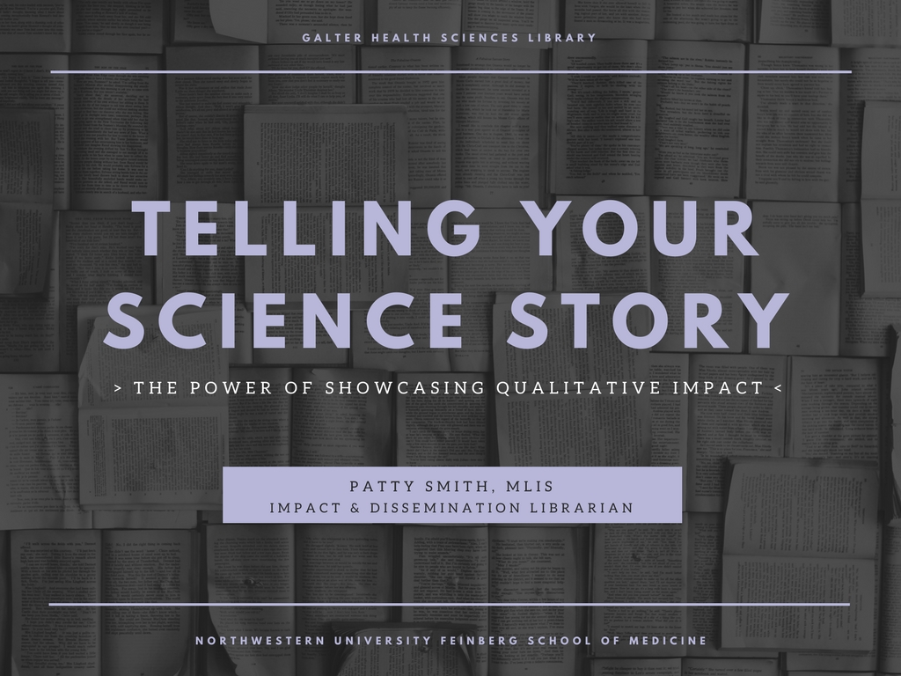
Notes:
As the impact and dissemination librarian at Galter Health Sciences Library, one my roles is to help researchers communicate the impact of their work and identify how their work is being disseminated to various audiences. And through my work helping researchers with communication, I've become very interested in helping them talk about their work in new and creative ways. The traditional way of communicating impact really is a numbers game, focused on number of citations an article has accrued, or the raw number of papers an individual has published, for example. But the idea of telling your science story is becoming more and more popular, and storytelling relies heavily on communicating the qualitative impact of your work.

Slide 2
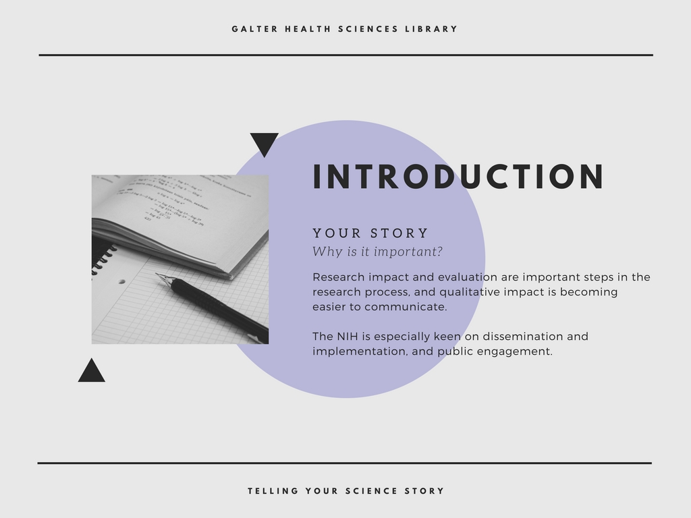
Notes:
Luckily, qualitative impact is becoming easier track and therefore easier to communicate. With the rise of social media, blogs, and academic websites like Faculty of 1000, and tools that aggregate data from these sources, we now have to ability to move past the numbers and dig into the qualitative impact.
Dissemination and Implementation Science and public engagement are topics that are certainly important to the NIH, and thinking about your story and constructing a narrative can help demonstrate the impact your work is having beyond citation counts and journal impact factors.

Slide 3
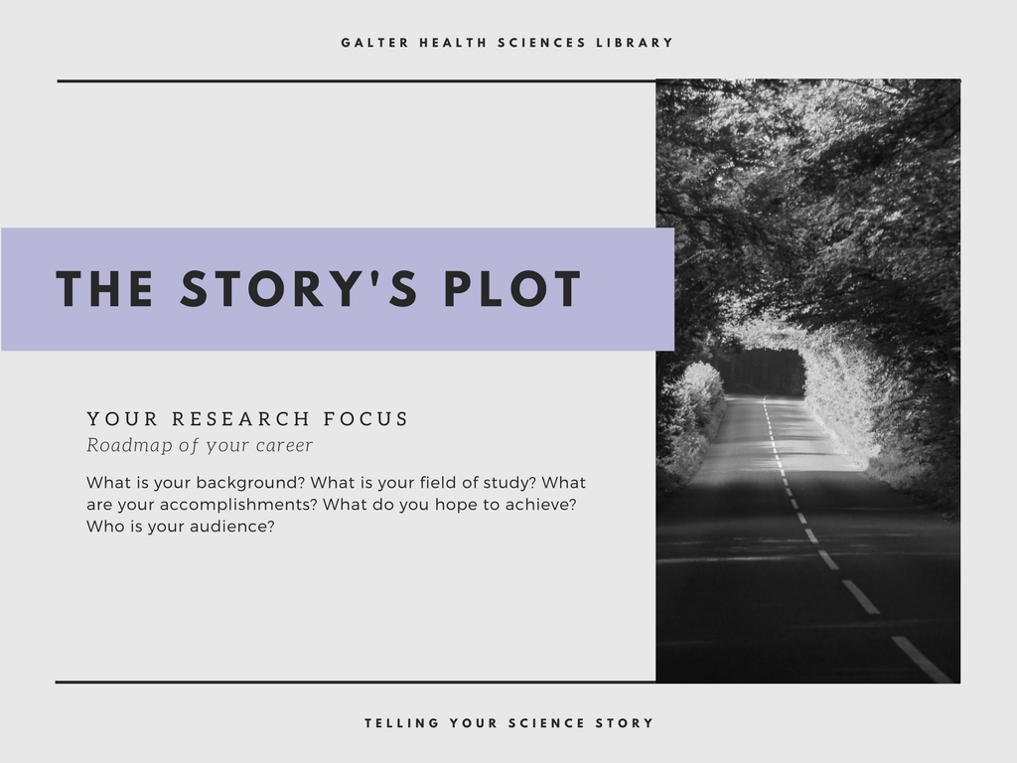
Notes:
Every story has a plot – a sort of roadmap of where you’ve been and where you’re going. And thinking about your research portfolio like a story can get you on your way to constructing an effective narrative. Narrative is the oldest form of communication – interesting, accessible, we’re wired to process and recall information in terms of story.
And the first thing you can do to start thinking about your science story and your story’s plot is to ask yourself the question: what does your science mean to you? How did you end up in your field? Of course the easy answer is “research is cool!” but you have to dig deeper than that. If I’m listening to your story, or reading your story, I want to know where your passion comes from – that sense of conviction really comes across to people if you can communicate it effectively.

Slide 4
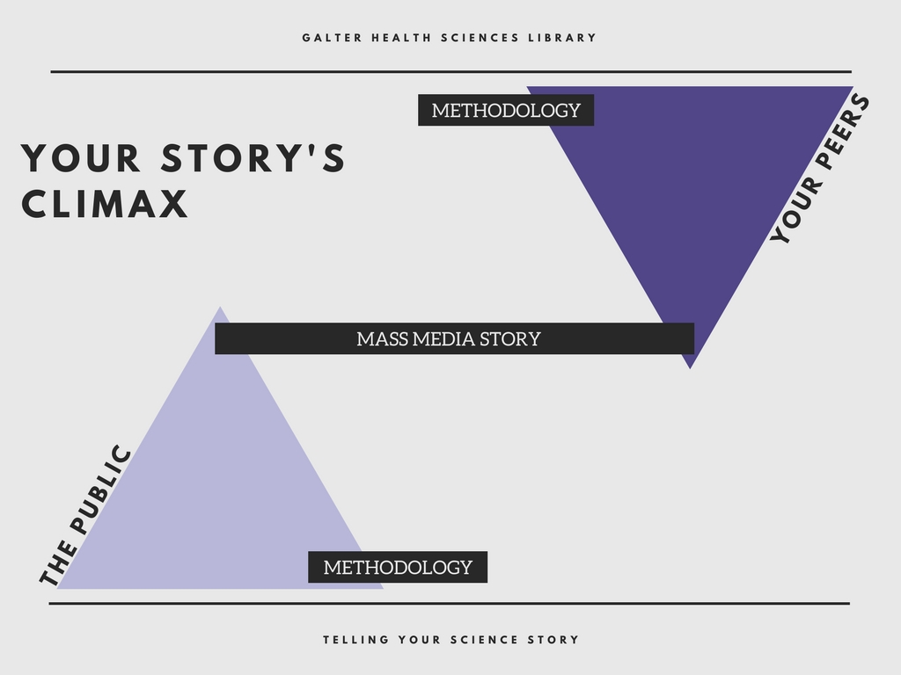
Notes:
When you’re telling your story, you have to know who your audience is and what your goals are for that interaction. Because you don’t just have one science story, you have multiple versions of your story for different audeiences. What are you trying to communicate? For your direct peers, perhaps the most important piece of the story your methodology so they can recreate your experiment. But if you’re telling your story to the public, they’re going to want to know the bottom line – how does your science impact them? Sure, you had to go through these rigorous methods to come to your conclusion, but they don’t care about all that background information, they want to get to the climax of your story. So your narrative will wind in different ways depending on your audience.

Slide 5
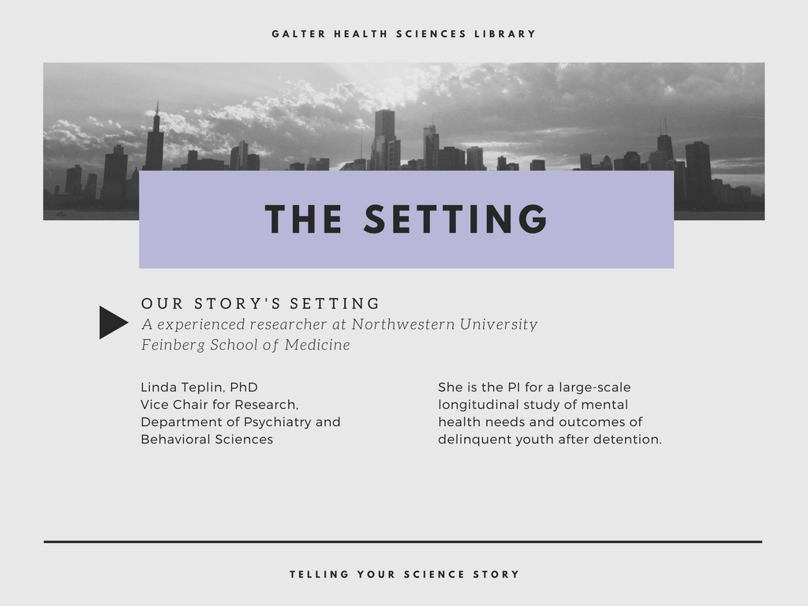
Notes:
So now I’m going to dive into the setting of an example story we’re going to walk through today.
Dr. Linda Teplin is the Primary Investigator for the Northwestern Project, which is the first large-scale longitudinal study of mental health needs and outcomes of delinquent youth after detention. This project has been going on for nearly 20 years, and they have tracked and re-interviewed 2000 participants, assessing a broad range of outcomes including substance abuse, violence, HIV, and death rates.

Slide 6
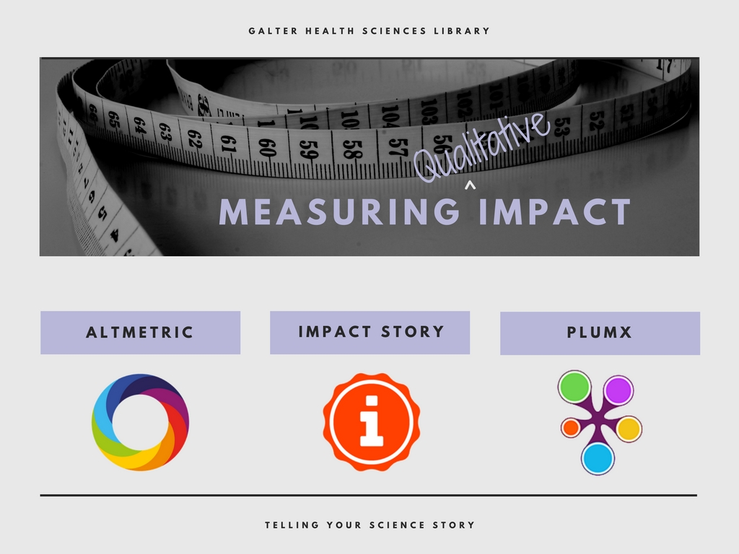

Notes:
Before we can begin constructing our science story narrative, we obviously need to look at the qualitative data. This is where alternative metrics are really wonderful. When I help an individual researcher or a group of researchers communicate their qualitative impact, I usually turn to 3 different tools.
We don’t have an institutional subscription to Altmetric, but their free bookmarklet is still a great tool that helps me dig into a researcher’s work and find out who is interacting with it.
If a researcher has an ORCID id, you can check and see if they have an impact story profile, which presents data in really unique ways, such as look at a person’s body of work and measure how often they publishing open access material.
We have access to Scopus on our campus and the incorporation of PlumX metrics is relatively new, so I’m still getting used to the Plum Print and interpreting the data, but it’s another great alternative metric tool that we have at our disposal.

Slide 7
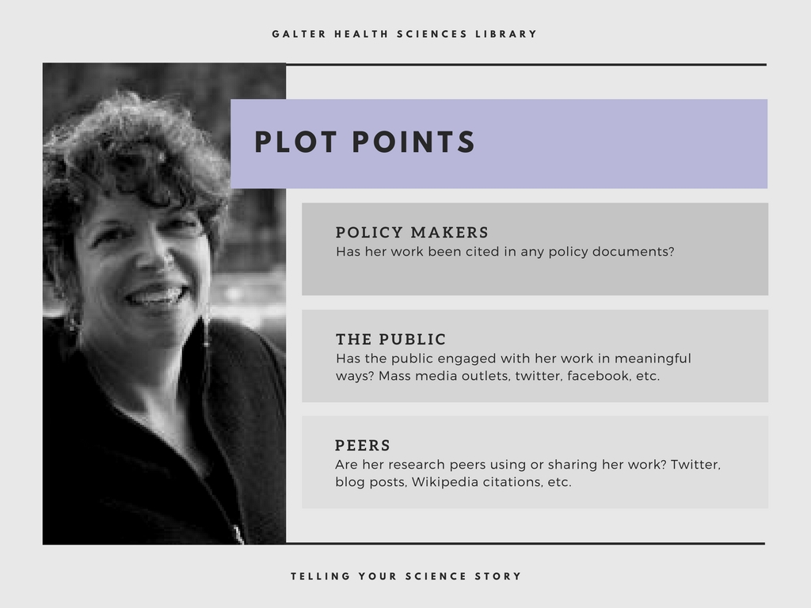
Notes:
Once you harness the data, you can begin to identify the major plot points in your story.
Looking at her alternative metrics, I was able to very quickly see that Dr. Teplin’s work has had qualitiative impact. 3 points : policy makers, public, peers.
She had a single article that was cited in 6 different policy documents, including documents published by the NIH, WHO, and UK government. This could be an indication that her work is not only advancing knowledge in her field, but is also leading to widespread changes.
I can also see that the public is engaging with her work, looking at a group of 10 of her publications, I can see that they’ve been mentioned in over a hundred news stories, including sources like NPR, and the New York Times, but also local outlets like the Chicago Tribune. Her story tells me that her research is making waves on a national level, but is also leading to changes at home. Those same 10 articles were also tweeted over 1300 times, and if you dig into the details of the tweets you get more of that qualitative information. So remember, her work focuses on delinquent youth in a longitudinal study, and I can see that people tweeting about her work include law enforcement, prison systems, and mental illness organizations and advocates. So it is clear that people beyond academia are engaging with her work and using her work to inform their practice. Disseminating her work to larger audiences.
Also, by analyzing the tweets, blog posts, Wikipedia citations, etc. I can see that her peers are sharing and citing her work in these non-traditional ways too.

Slide 8
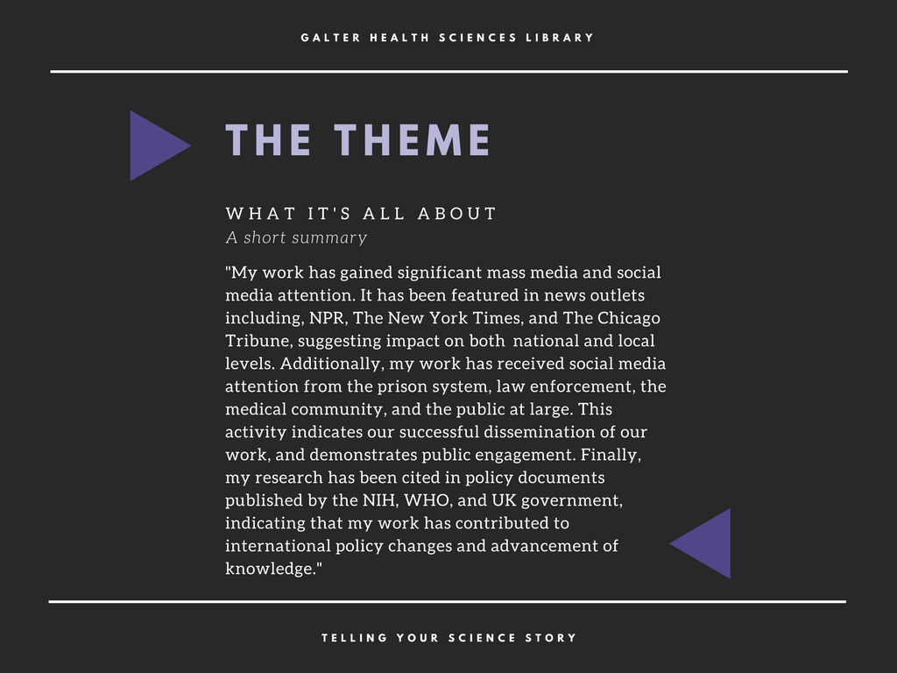
Notes:
So I can take all of these major plot points in her story and start writing out a narrative.
An overall thematic statement about her body of work could be as follows: read slide
This could be used in an NIH biosketch, or in some sort of personal statement for a resume or website, or even used in promotion and tenure packet. And this is a story about her body of work, but I could drill down into those individual policy citations or individual tweets to tell her story at a more granular level. I’ve pulled quotes from news stories, or cited specific

Slide 9
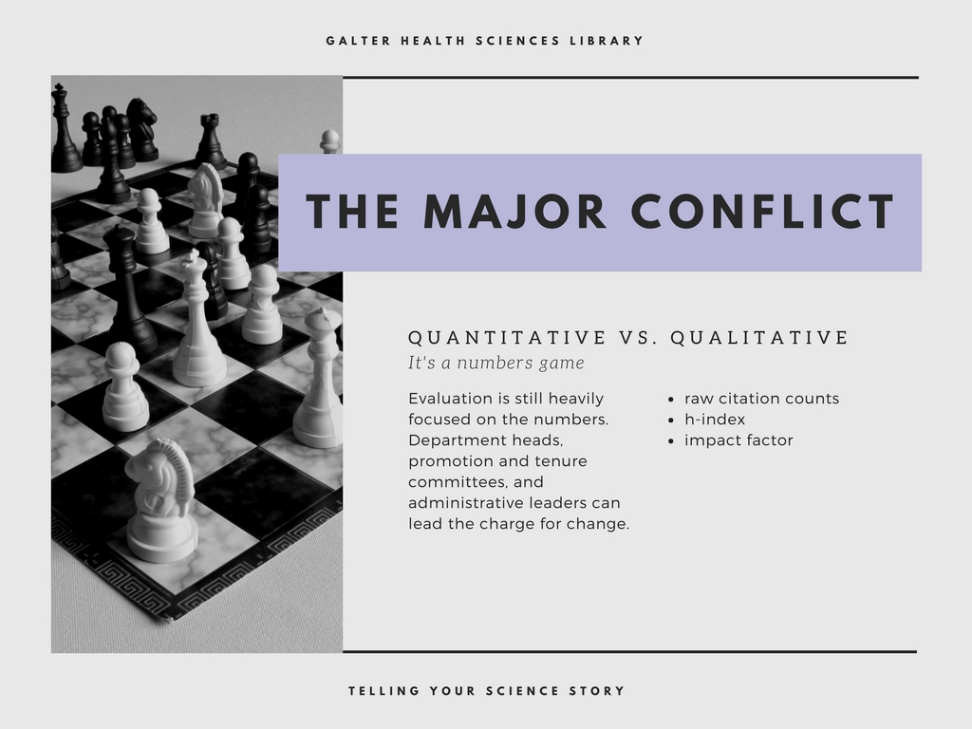
Notes:
Slide 9
Our story does have a major conflict. When we’re talking quantitative vs. qualitative, quantitative almost always wins, because right now, at least in academia, evaluation is still largely a numbers game, and we’re still very focused on raw citation counts, a researcher’s h-index, and journal impact factor.
Usually a story’s conflict comes somewhere in the middle and has a nice resolution at the end. But in our story today, I don’t have a resolution for you. Instead, I challenge you think about your science story, and showcase your qualitative impact, even if you’re not explicitly asked to do so, whether it’s in a grant proposal, on your website, or even in a job interview. I hope in the near future, our department heads, promotion and tenure committees, and other administrative leaders can lead this charge for change and make showcasing qualitative impact an integral part of our work.

Slide 10


