Slide 1
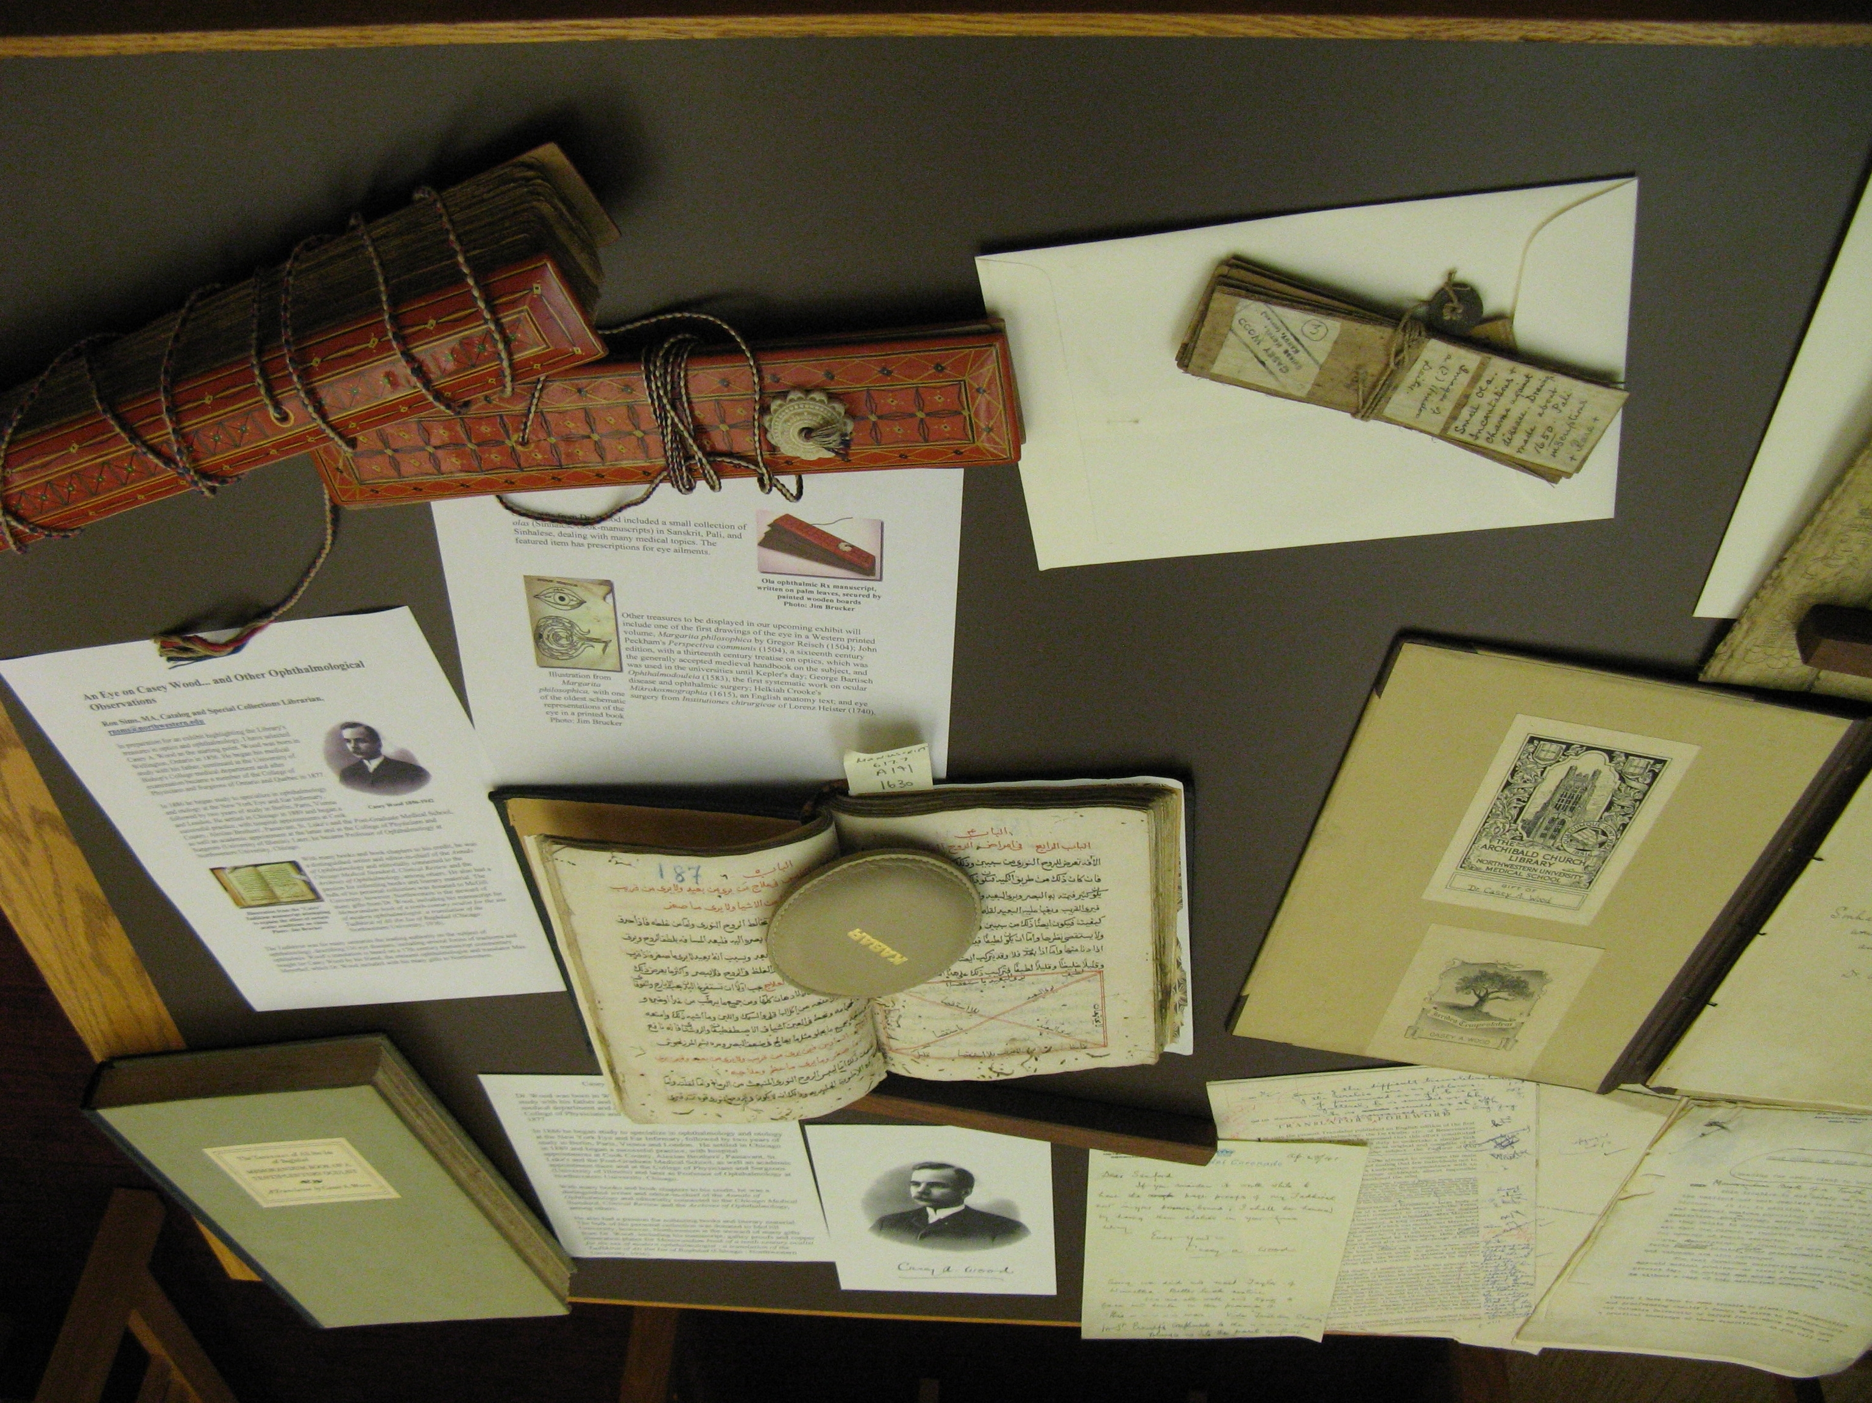




DigitalHub
BETA
Galter Health Sciences Library Develops Digital Repository for Scholarly Outputs
Do you want to:
easily share your research?
track views and downloads of your research?
make your research more discoverable to the global research community?
Check out DigitalHub: digitalhub.northwestern.edu
DigitalHub, developed by Galter Health Sciences Library, is a place to deposit your research outputs and make them publicly available. This institutional repository will provide open access to the scholarly outputs of Northwestern Medicine and stable, long-term storage and ongoing maintenance for content contained within the repository.
Questions? Contact us at: DigitalHub@northwestern.edu

Slide 2

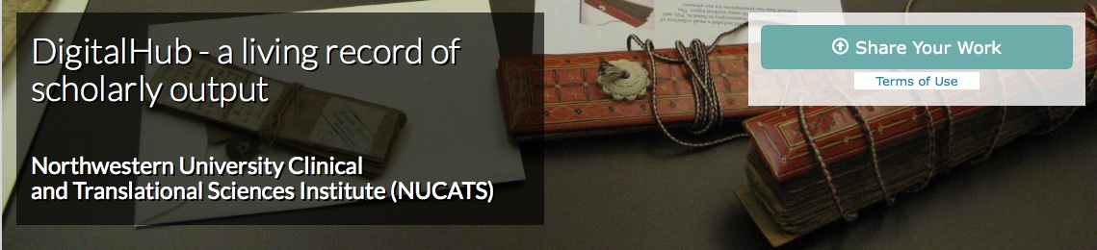

Galter Health Sciences Library DigitalHub
More about DigitalHub
DigitalHub is an institutional repository for the research and scholarly output of Northwestern Medicine. The goals of the repository are to preserve intellectual works created by the Northwestern Medicine scholarly community, to enhance the visibility of Northwestern Medicine scholarship, and to promote its authors by enabling discovery and accessibility of these works by the international scientific community.
For more information, please contact the Galter Health Sciences Library DigitalHub team directly at: DigitalHub@northwestern.edu
What can I deposit in DigitalHub?
The repository provides stable, long-term storage and ongoing maintenance for content contained within the repository. Examples of items that the repository can accommodate at this time include:
Research papers, published or unpublished
Conference papers, presentations, and lectures
Educational materials
Case reports, technical reports, and white papers
Supporting multimedia images
Posters
Open access books
Images
…and more!
Check out DigitalHub: digitalhub.northwestern.edu
Galter Health Sciences Library
Northwestern University Feinberg School of Medicine
303 E. Chicago Avenue, Chicago, IL 60611
312-503-8126 or galter-admin@northwestern.edu

