Slide 1
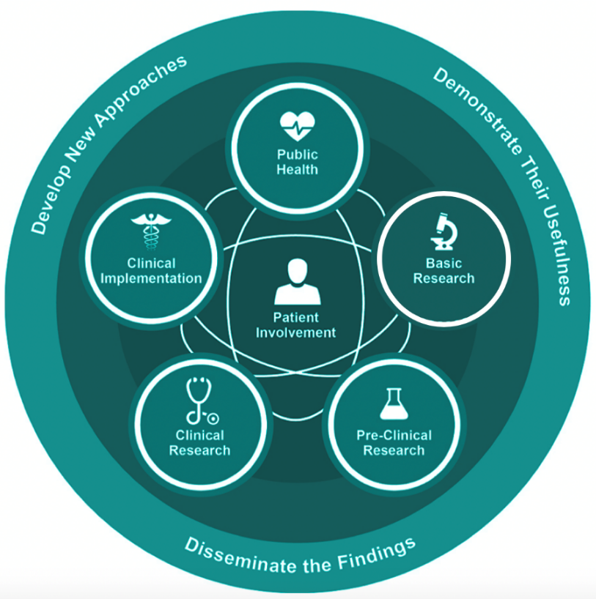


CTS Personas
User Guidebook
CTS Personas is a collection of roles across the ecosystem of translational research.
Basic Research → Pre-Clinical Research → Clinical Research → Clinical Implementation → Public Health
These profiles are intended for use by the CTSA community and beyond, to assist anyone developing software projects, educational and communication materials, understanding stakeholder perspectives, and more.
This project is funded by the CTSA National Center for Data to Health (CD2H) and supported by the NIH National Center for Advancing Translational Sciences, grant number U24TR002306, to help guide the cultural and technological changes necessary for data and informatics to improve research and health care.

Slide 2
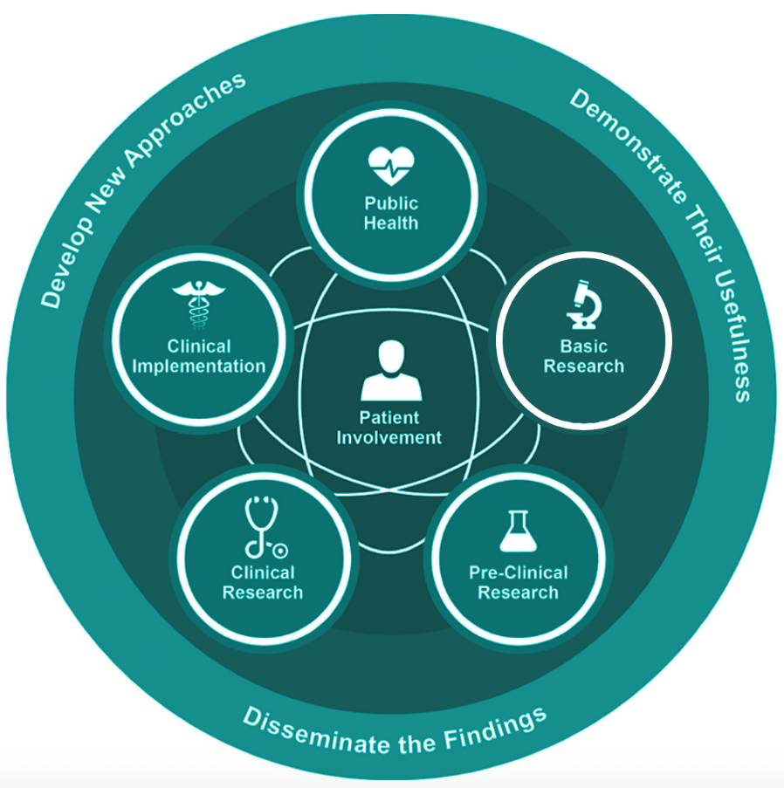
CTS Personas – The User Guidebook
CTS Personas, a project of the National Center for Data to Health (Grant U24TR002306), is an effort to create Persona profiles representing roles across the ecosystem of translational research.
Basic Research → Pre-Clinical Research → Clinical Research → Clinical Implementation → Public Health
In this guidebook you will find:
A key to the Persona profile layout
A key to the Persona profile software icons
A key to the Personas color codes for the translational ecosystem
Sample Personas uses cases
A comparison of common themes across the CTS workforce
Acknowledgements
Persona profile bibliographies
Credits

Slide 3
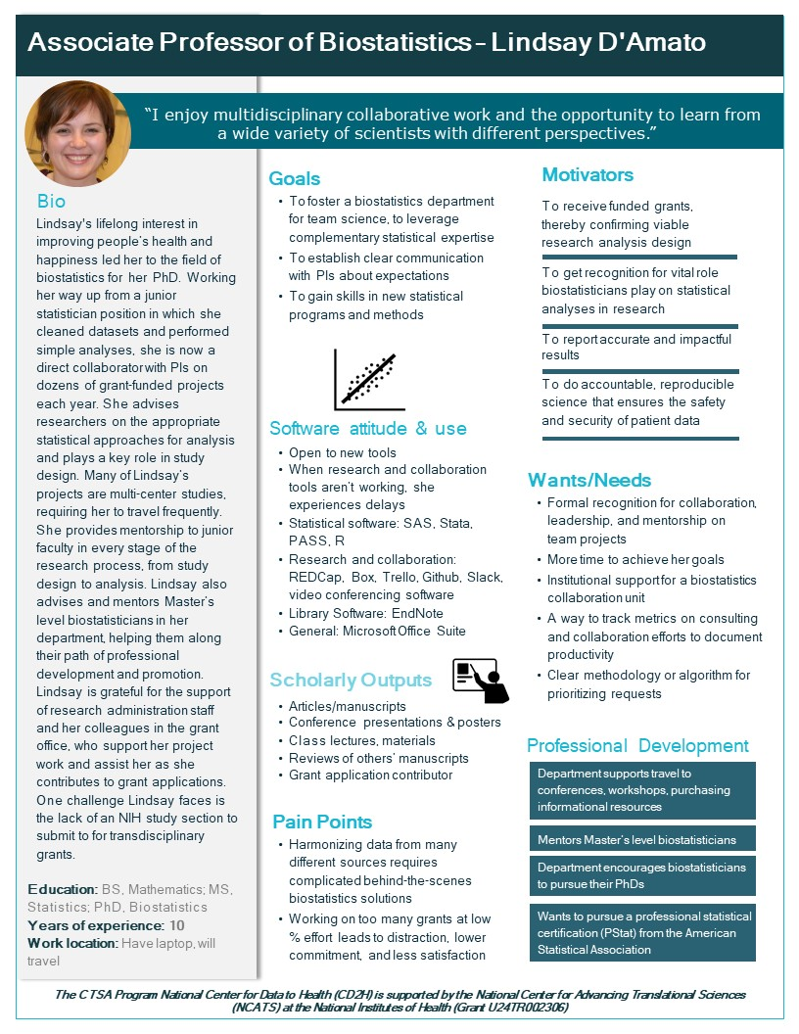
Persona Profile Key:
the translational workforce
4
1
2
3
An effective Persona profile is one that not only outlines the work responsibilities and goals of a CTS employee, or the health conditions and healthcare needs of a patient, but also contains motivators, biographical information, a picture, and a name. Personal details remind the profiles’ users that each profile represents a real person, with real concerns and challenges that they face every day in either their work or their patient experience in the CTSA network. Drawing profile elements from sources such as Usability.gov, the European Bioinformatics Institute, and UX magazine, and adding profile elements for scholarly outputs and continuing education needs (vital concerns for CTS employees), the following profile elements were created:
11
10
5
8, 9
12
Name
Photo
Quote
Descriptive Job Title
Major responsibilities
Expertise: training, years on job, etc.
Workplace environment
Software and data use at work
Technology attitude
Motivators
Goals
Wants/Needs
Pain points/Challenges
Scholarly output activities
Continuing Education Goals/Training Opportunities
14
15
13
6, 7

Slide 4
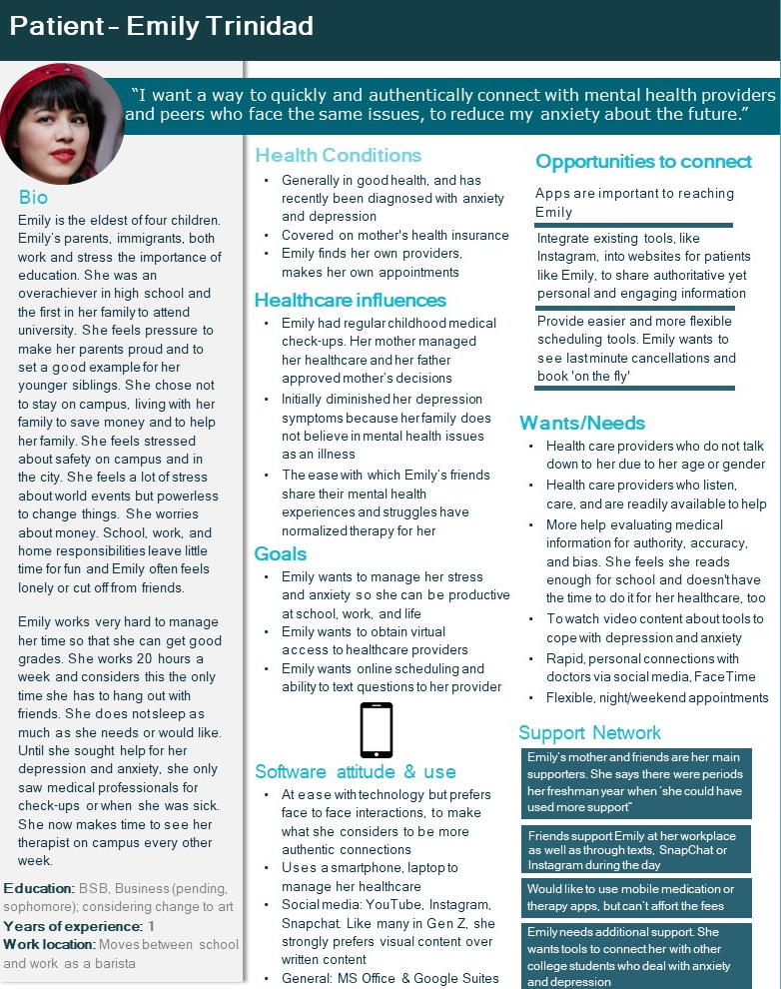
Persona Profile Key:
academic health center patients
1
2
Effective Persona profiles for patients, aside from providing insightful background and biographical information, provide insights into how the patient currently interacts or may wish to interact with the resources and services available to them at CTSA sites and beyond. The following profile elements were chosen for the insights they offer into healthcare beliefs, practices, and the opportunities for engagement that they elucidate between a health center and its patients:
3
8
14
4
9
Name
Photo
Quote
Biographical sketch
Education level
Employment status
Work location(s)
Health conditions
Healthcare influences
Goals
Software attitude and use (with an emphasis on how software is used to manage healthcare)
Wants/Needs
Support network
Opportunities for a CTSA or other health provider to connect with the patient through a website or online tool
12
10
11
13
5
6,7

Slide 5

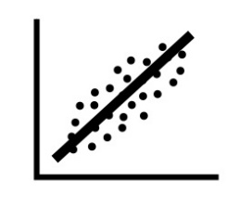
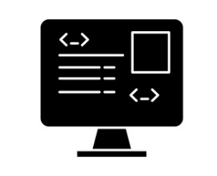



Persona Profile Key: Software Use Icons
Each Persona created through the CTS Personas project is based on research on real professionals in the field, all of whom utilize many different software types through many devices in the course of their work. To help profile users associate a Persona with the type of software programs that they utilize most, each Persona was assigned an icon. A key to the icons can be found below:
Desktop Researcher
The desktop researcher’s primary software-based activities include Internet searching for scholarly publications and data, and writing and reviewing manuscripts in the case of a CTS employee. A patient desktop researcher uses the Internet to research healthcare topics and providers and to schedule appointments. Both the patient and employee use the Internet on a computer for communication and social media. General office suites such as Microsoft and Google are commonly used.
Statistical Modeling
Employees with statistical modeling skills use a variety of software programs to analyze and visualize data. Some use statistical programs in study design and throughout the process of a research project or clinical trial. Commonly used programs include: SAS, Stata, SPSS, and R.
Scripts & Coding
Employees with skills in scripts and coding use various programming languages to write complex database queries and to develop software solutions for both employee and patient end users in the CTSAs. Commonly used programs include: SQL, Ruby, Python, Java, JavaScript, DataGrip, RubyMine, Jenkins, and Postgres
Spreadsheets
A skilled spreadsheet user uses programs like Excel to collect data (both patient-related and financial), manipulate and analyze data, and to perform calculations and basic visualizations.
Visualization
Employees with visualization skills employ a variety of programs to visualize data for the purposes of teaching, presentations, and research impact and promotional reports. Programs commonly used for these purposes include: OpenRefine, Python, R, R Studio, Tableau, VOSViewer, and Jupyter Notebooks.
Mobile
A mobile user may use computers in certain settings, but a mobile phone or tablet is often the first medium through which they will interact with many online resources including hospital and provider portals, appointment scheduling software, online consultations with doctors, websites for research, and texting, email, and social media for both professional and personal communication.
All icon images are copyright Jonah M. Duckles - 2019 Licensed as CC-BY, except the phone image, which is copyright: https://svgsilh.com/svg/1976104.svg

Slide 6






Persona Profile Key: Color Key to the Translational Ecosystem
Each Persona profile contains a band of color in the upper right corner to demonstrate where the role lies within the translational ecosystem. Following the NIH’s outline of the CTS ecosystem, colors have been matched to categories of roles as follows:
Purple: Basic Research
Blue: Pre-Clinical Research
Light Green: Clinical Research
White: Role Spans the Translational Workforce
Yellow: Clinical Implementation
Red: Public Health

Slide 7
Sample Personas Use Cases
In the following pages, you will find sample use cases outlining how the Personas can be used to illustrate and support software, educational, and communications projects at your institution.
New use cases are welcome! Contribute your use case at: https://github.com/data2health/CTS-Personas/issues

Slide 8
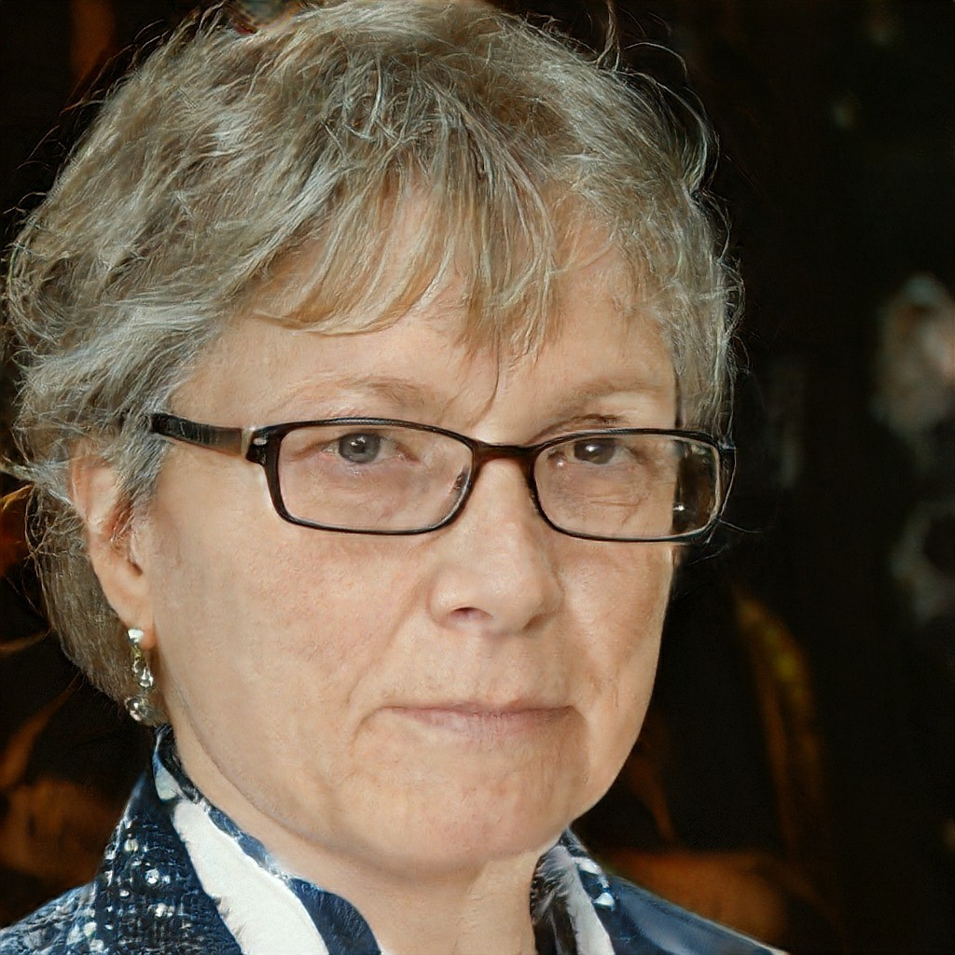
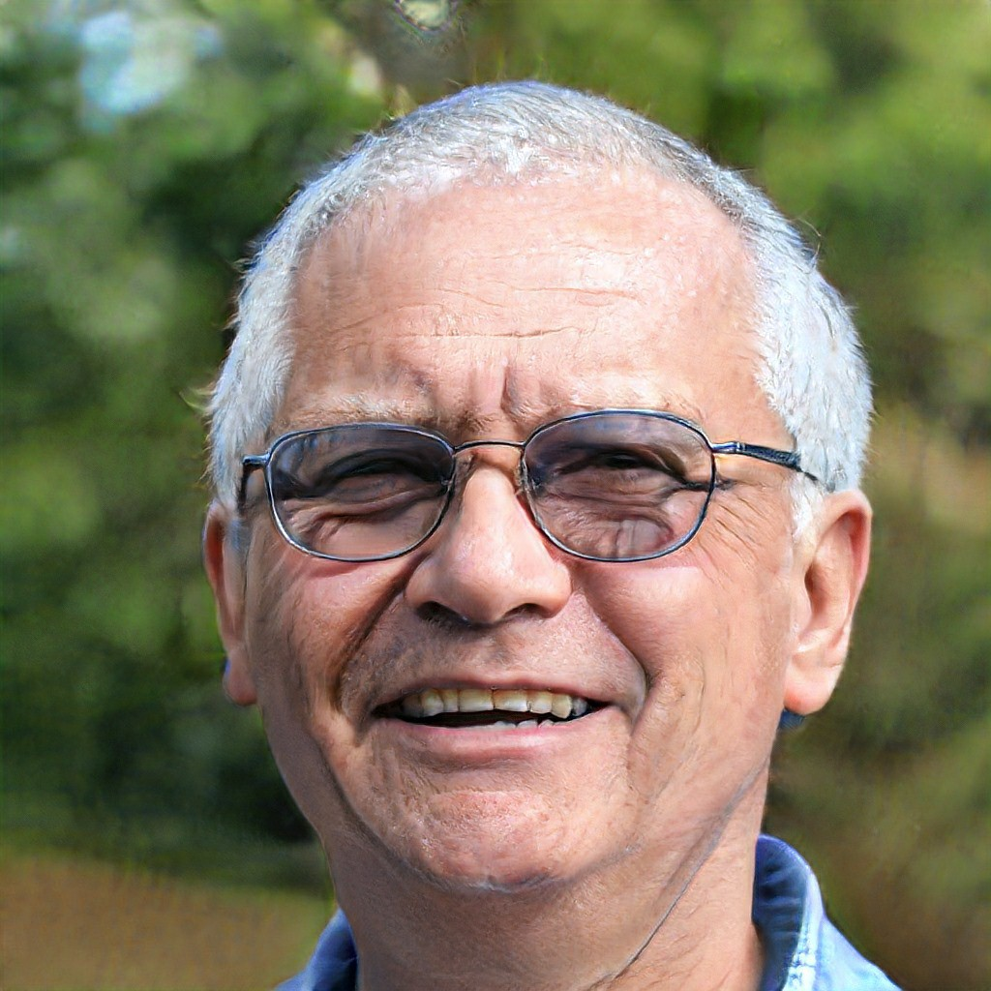
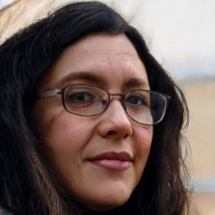
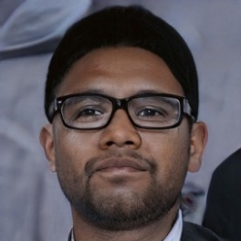
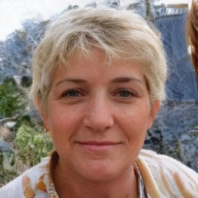
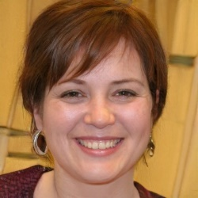
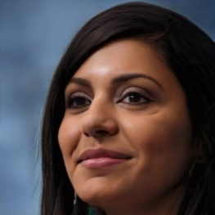
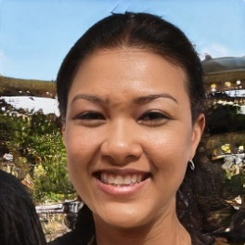
Use Case 1: End to End Patient Platform
Who uses the portal? Who benefits?
End-to-End
Patient Portal
Platform functions:
Schedule appointments
Securely manage patient data
Interact with providers
Allows patients & caregivers to:
Access cancer (or other serious health issue) information
Communicate more easily with physicians
Participate in clinical trial matching programs
Find social support
Find resources more easily with the help of their lay patient navigators, and vice versa
Greta
Community-Engaged Researcher
Tom
Patient
Alice
Patient Navigator
Carmen
Center Administrator
Lindsay Biostatistician
Eli
Developer
Greta received a grant to create an end-to-end patient portal. She is gathering requirements and thinking about design aspects to share with Eli, who will create the portal.
Simran
Physician Scientist
Melody
K Scholar
Greta and Eli found the Personas invaluable for building their user/stakeholder information:
Tom, a patient in his eighties, and Alice, a busy Patient Navigator, are considered primary users. Portal interface design is influenced by their needs, including Tom’s need for larger print, and Alice’s need for fast access to resources given her busy caseload. In addition Alice, Center Administrator Carmen, and Biostatistician Lindsay want to gather de-identified data from the tool to better understand the patient journey through statistical analysis. Eli builds out a data exporter function to serve their needs. Researchers Simran and Melody are able to benefit from both the raw data and others’ analyses by using them as foundational research for their projects, and this evidence-based research will help their work to have a direct impact on patient outcomes.

Slide 9

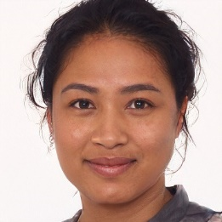
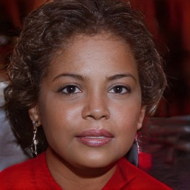
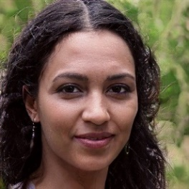
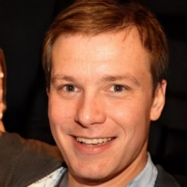
Use Case 2: Clinical Research Center Trainings
Trainings Audiences
Carmen
Center Administrator
Lucy
Clinical Research
Coordinator
Irene
Research Administrator
Clinical Research Center Administrator Carmen is working on the Center’s trainings schedule for 2020. Clinical Research Coordinators and Research Administrators have been her primary audience, but she would like the trainings to serve more stakeholders at her CTSA.
Learning about the time constraints on most of these Personas from their profiles leads Carmen to branch into new class offerings, such as asynchronous and web-based learning.
Lindsay Biostatistician
Melody
Researcher
Consulting the Persona profiles helps Carmen consider the following audiences and their needs:
Irene (Research Administrator): needs classes in latest updates to pre-award rules and regulations, compliance, and mathematical and statistical courses
Lucy (Clinical Research Coordinator): needs classes in Good Clinical Practices, stress management, Python and R for data management
Melody (Researcher): needs classes in Good Clinical Practices and study design
Lindsay (Biostatistician): understands statistical aspects of study design, but wants to take a clinical study design class to see how her work can meld with it more smoothly. A Good Clinical Practices class would also help her in that regard.
Simran and Greta (Clinical Researchers): Given their time commitments and constraints, the researchers would like quick refreshers on study design. They also want trainings for themselves and their teams on all the resources that the Center offers for clinical research, so team members know where to turn for help with specific problems.
Rachael (Librarian) and Jim (Data Analyst): want classes in Good Clinical Practices to help them better serve their clients, the majority of whom are clinical researchers.
Simran
Physician Scientist
Greta
Community-Engaged
Researcher
Rachael
Librarian
Jim
Data Analyst

Slide 10

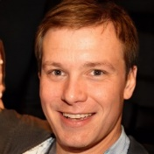
Use Case 3: Building the Software Development Team
Attracting the best candidates:
Other staffing & resource stakeholders:
1
2
3
Clinical Research Center Software Development Team recruitment
Understanding resources and building capacity
Lindsay Biostatistician
Jim
Data Analyst
Eli
Developer
Carmen
Center Administrator
Strategic approach for future team development
The head of digital systems at a Clinical Research Center is trying to build her software development team and is having a hard time hiring. After a couple failed attempts, she decides to work with the CTSA’s talent partner and access the user persona for the developer role (Eli Daniels) to see what they are missing. They are able to learn more about developer motivations, such as the importance of the team being able to create open source tools to share with other hubs. They also learn that the team feels under-supported in terms of project management and UX expertise. The head of digital systems works with her talent partner to re-write the job posting to highlight the commitment to open source technologies and communicate the scope of the work being done. In interviews the talent partner and head of digital systems refer to the motivators and goals of this persona to effectively communicate and ”sell” the role to top candidates.
The head of digital systems and the talent partner are sympathetic to developers’ needs for support staff, but anticipate that their Center Administrator may lack the funds to budget for them. They consult Carmen’s profile to learn about her motivators and goals, and keep these in mind before scheduling a conversation on this topic with their own Center Administrator. After engaging in a balanced dialogue, and learning from Eli’s profile information and the candidates’ requests, their local administrator shifts her fundraising focus to include more funds for development support staff.
The talent partner takes what she has learned from her experience with digital systems and performs a similar scan for support needs, using Personas, in the biostatistics and data analysis departments. She confers with their heads on strategies to hire more support staff in their areas.

Slide 11
CTS Employees: Behind the Profiles
The following pages contain visualizations of some of the common themes and concerns that arose between and among the CTS roles, as elucidated through research and interviews.
For detailed information about software programs used by each of the Personas, see the CTS-Personas GitHub page at: https://data2health.github.io/CTS-Personas/

Slide 12
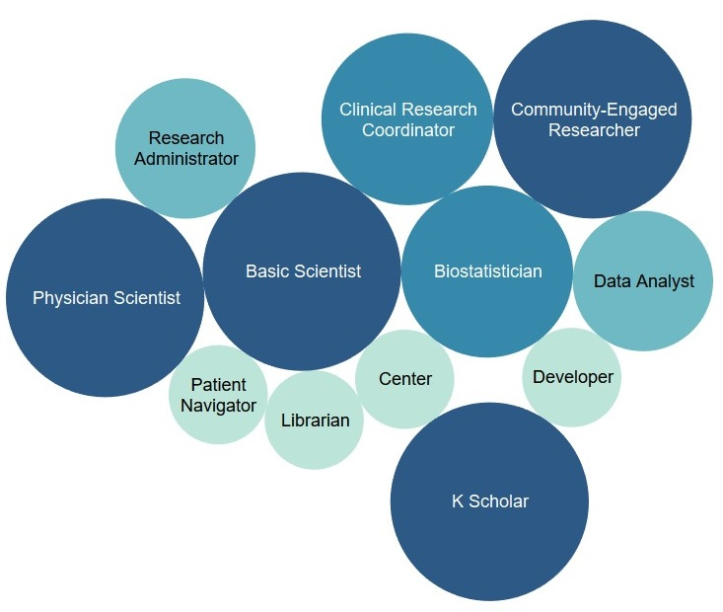
Conducting Reproducible Research
Reproducible research in basic science and clinical trials is the work at the heart of the translational ecosystem. To conduct reproducible research, investigators must be mindful of ethical concerns, patient data safety, study design, statistical analysis, and documentation.
Not only PIs are concerned with conducting ethical, reproducible research. All the Personas profiled have an interest in it, and some have direct involvement in its conduct. The bubbles below are sized from smallest to largest based on a light-to-dark color scale, as defined below.
Clinical Research Coordinator
Community-Engaged Researcher
Key
Supports reproducible research in a secondary way
Directly supports reproducible research
Helps conduct reproducible research
Responsible for reproducible research projects
Research Administrator
Basic Scientist
Biostatistician
Data Analyst
Physician Scientist
Patient Navigator
Center
Administrator
Developer
Responsibilities of conducting reproducible research demonstrate the following Joint Task Force for Clinical Trial Competency Domains¹⁻², categories of knowledge, skills, and attitudes necessary for clinical research.
Scientific concepts and research design
Ethical and participant safety considerations
Clinical trials operations/good clinical practices
Study and site management
Librarian
K Scholar
¹ Sonstein SA, et al. Moving from compliance to competency: a harmonized core competency framework for the clinical research professional. Clinical Researcher 2014; 3: 17–23.
² https://clic-ctsa.org/education/competencies

Slide 13
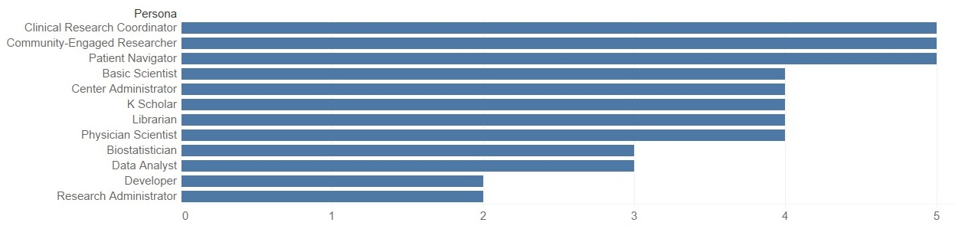
Working both Mobile and Face-to-Face
Powerful laptops and VPN access to files allow many members of the translational workforce to work from home. However, for many, face-to-face interactions are vital. Face-to-face interaction fosters improved communication and greater understanding of workflows and goals, which is essential for ethical, reproducible, team science. The graph below demonstrates each Persona’s frequency of face-to-face work, even when mobile options are available.
Preference for Mobile vs. Face-to-Face Work
Frequency of face-to-face interactions
Commitment to face-to-face engagement in the era of mobile work demonstrates the following Joint Task Force for Clinical Trial Competency Domains¹⁻², categories of knowledge, skills, and attitudes necessary for clinical research.
Leadership and professionalism
Communication and teamwork
¹ Sonstein SA, et al. Moving from compliance to competency: a harmonized core competency framework for the clinical research professional. Clinical Researcher 2014; 3: 17–23.
² https://clic-ctsa.org/education/competencies

Slide 14
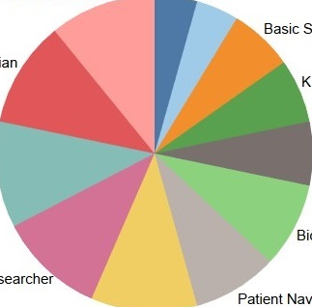
Interoperability Between Data Sources
Whether harmonizing and reconciling biomedical datasets from disparate sources, or gathering information from multiple online platforms to complete grant contracts and budgets, employees across the CTS landscape face the challenges of compiling and analyzing data between systems. Occasionally the systems in question cannot “talk” to each other due to security concerns; in other cases, legacy data repositories are involved. Below is a chart demonstrating the extent to which interoperability between systems, or an easier way to map data from different systems, was expressed as a desire in the Personas research. The size of the pie slice corresponds to the need for interoperability.
CENTER ADMINISTRATOR
RESEARCH ADMINISTRATOR
DEVELOPER
BASIC SCIENTIST
LIBRARIAN
K SCHOLAR
DATA ANALYST
PHYSICIAN SCIENTIST
BIOSTATISTICIAN
COMMUNITY-ENGAGED RESEARCHER
PATIENT NAVIGATOR
CLINICAL RESEARCH COORDINATOR
A commitment to solving interoperability problems demonstrates the following Joint Task Force for Clinical Trial Competency Domains¹⁻², categories of knowledge, skills, and attitudes necessary for clinical research.
Data management and informatics
¹ Sonstein SA, et al. Moving from compliance to competency: a harmonized core competency framework for the clinical research professional. Clinical Researcher 2014; 3: 17–23.
² https://clic-ctsa.org/education/competencies

Slide 15
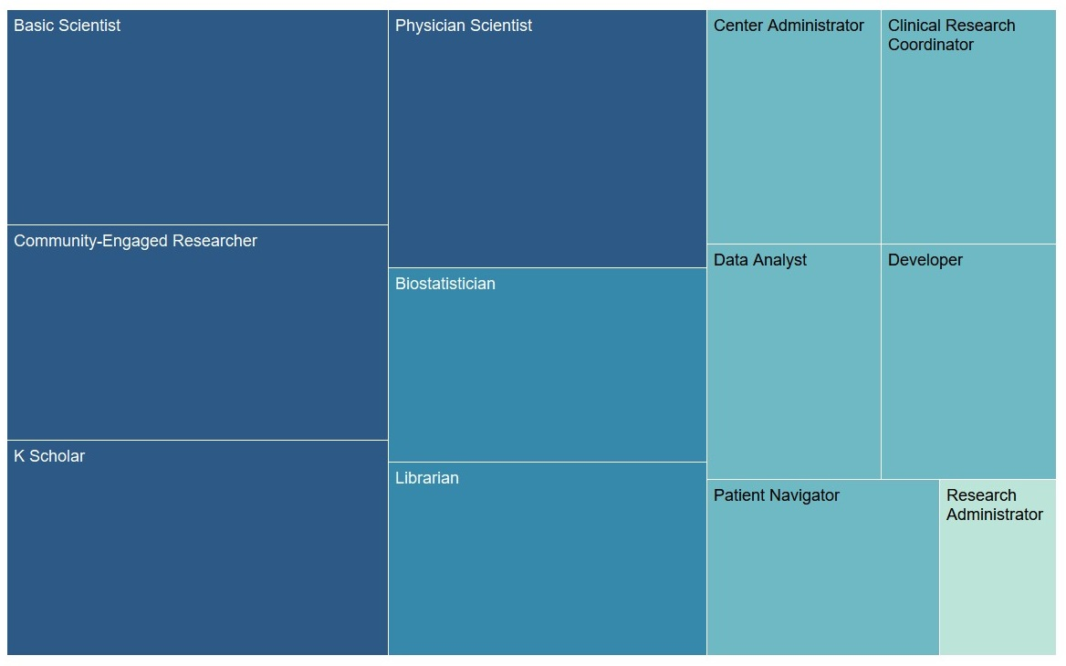
Producing Research Outputs
Traditional research outputs such as peer-reviewed publications and conference presentations are the coin of the realm in biomedical research. Investigators have traditionally been most concerned with increasing their publications, but increasingly many of the employees who support translational science are producing such outputs. In addition, they desire attribution for their contribution to studies, and they wish to track their impact through both traditional research metrics and newer avenues such as social media mentions. The boxes below are sized from smallest to largest in terms of frequency of research output production for each of the Personas on a light-to-dark color scale, with darker shades denoting most frequent production.
Key
Not applicable
Does not frequently produce traditional outputs, but would like attribution when they do
Occasionally produces outputs; would like to produce more
High pressure to produce outputs; attribution and metrics are vital to future promotion and funding

Slide 16

Acknowledgements
The CTS Personas project could not have been completed without the collaboration of the project partners:
Northwestern University:
Sara Gonzales (Project Lead)
Karen Gutzman
Lisa O’Keefe
Guillaume Viger
Annie Wescott
Kristi Holmes
Children’s Hospital of Philadelphia:
Bailey Farrow
Allison Heath
Meen Chul Kim
Deanne Taylor
Oregon Health & Science University:
Robin Champieux
Washington University:
Po-Yin Yen
Special thanks to those employed in the clinical and translational sciences who allowed the project team to interview them to inform the profiles. Your help was a critical component of this project and is very much appreciated!

Slide 17
Persona Profile Bibliographies
Basic Scientist (Professor of Developmental Biology – Arthur “Art” Rosen)
Ballabeni A, Boggio A, Hemenway D. Policies to increase the social value of science and the scientist satisfaction. An exploratory survey among Harvard bioscientists. F1000Res. 2014;3:20. Epub 2014/05/06. doi: 10.12688/f1000research.3-20.v2. PubMed PMID: 24795807; PubMed Central PMCID: PMCPMC3999931.
Sorrentino C, Boggio A, Confalonieri S, Hemenway D, Scita G, Ballabeni A. Increasing both the public health potential of basic research and the scientist satisfaction. An international survey of bio-scientists. F1000Res. 2016;5:56. Epub 2016/01/12. doi: 10.12688/f1000research.7683.2. PubMed PMID: 27347372; PubMed Central PMCID: PMCPMC4909114.
Zerhouni, EA. US Biomedical Research: Basic, Translational, and Clinical Sciences. Journal of the American Medical Association. 2005; 294(11):1352-1358.
Professor of Genetics, Genomics and Cell Biology. Job Posting. Boston University. https://www.bumc.bu.edu/biochemistry/2018/09/15/new-faculty-positions/
Professor of Melanoma Biology. Job Posting. University of Colorado-Denver. https://www.glassdoor.com/job-listing/open-rank-faculty-translational-melanoma-research-university-of-colorado-denver-JV_IC1148156_KO0,49_KE50,79.htm?jl=3288826628
Biostatistician (Associate Professor of Biostatistics – Lindsay D’Amato)
Perkins SM, Bacchetti P, Davey CS, Lindsell CJ, Mazumdar M, Oster RA, et al. Best Practices for Biostatistical Consultation and Collaboration in Academic Health Centers. Am Stat. 2016;70(2):187-94. Epub 2016/10/26. doi: 10.1080/00031305.2015.1077727. PubMed PMID: 27777443; PubMed Central PMCID: PMCPMC5074551.
Biostatistician. Job Posting. Tufts Medical Center. https://jobs.tuftsmedicalcenter.org/jobs/job-detail.aspx?id=3642
Biostatistician 3. Job Posting. Stanford University. https://www.higheredjobs.com/search/details.cfm?JobCode=176949300&Title=Biostatistician%203
Biostatistician 1. Job Posting. University of Utah. https://www.higheredjobs.com/search/details.cfm?JobCode=176951002&Title=Biostatistician%20I

Slide 18
Persona Profile Bibliographies
Clinical Research Center Administrator (Carmen Rosas Lukovich)
Harawa NT, Manson SM, Mangione CM, Penner LA, Norris KC, DeCarli C, et al. Strategies for enhancing research in aging health disparities by mentoring diverse investigators. Journal of clinical and translational science. 2017;1(3):167-75. Epub 2017/09/01. doi: 10.1017/cts.2016.23. PubMed PMID: 28856013; PubMed Central PMCID: PMCPMC5573262.
Quarshie A, Davis A, Strayhorn G, Weaver C, Delano C, Winters K, et al. Establishing the Morehouse School of Medicine (MSM) R-CENTER clinical and translational research web-portal: the role of focus groups. Journal of Health Care for the Poor & Underserved. 2011;22(4 Suppl):165-73. PubMed PMID: 22102312.
Snyder DC, Brouwer RN, Ennis CL, Spangler LL, Ainsworth TL, Budinger S, et al. Retooling institutional support infrastructure for clinical research. Contemp Clin Trials. 2016;48:139-45. Epub 2016/04/30. doi: 10.1016/j.cct.2016.04.010. PubMed PMID: 27125563; PubMed Central PMCID: PMCPMC4889441.
Administrative Director, Clinical Research Operations. Job Posting. Albert Einstein College of Medicine. https://careers-einstein.icims.com/jobs/11772/administrative-director%2C-clinical-research-operations/job?mobile=false&width=950&height=500&bga=true&needsRedirect=false&jan1offset=-360&jun1offset=-300
Director Clinical Research Operations Center. Job Posting. New York University. https://www.indeed.com/rc/clk?jk=0533396519e35398&fccid=848e72c84ce4a7a7&vjs=3
Program Administrator. Job Posting. University of Southern California, Keck School of Medicine. https://www.indeed.com/rc/clk?jk=884dfb9491942e8e&fccid=7455773bace145da&vjs=3
University of Illinois at Chicago, Center for Clinical and Translational Science, Services & Facilities. https://www.ccts.uic.edu/content/clinical-research-services-facilities

Slide 19
Persona Profile Bibliographies
Clinical Research Coordinator (Lucy Silonga)
Baedorf Kassis S, Winkler S, Gianforti MJ ; Needler NA. Research coordinator networks and support models among academic health centers in the CTSA consortium. Journal of clinical and translational science. 2017;1(6):334-339. Doi: 10.1017/cts.2017.309. PubMed PMID: 29707255; PubMed Central PMCID: PMC5915804.
Behar-Horenstein LS, Prikhidko A, Kolb HR. Advancing the Practice of CRCs: Why Professional Development Matters. Therapeutic innovation & regulatory science. 2018;52(6):708-17. Epub 2018/05/02. doi: 10.1177/2168479017750128. PubMed PMID: 29714568; PubMed Central PMCID: PMCPMC6027622.
Bevans M, Hastings C, Wehrlen L, Cusack G, Matlock AM, Miller-Davis C, et al. Defining clinical research nursing practice: results of a role delineation study. Clinical and translational science. 2011;4(6):421-7. Epub 2012/01/04. doi: 10.1111/j.1752-8062.2011.00365.x. PubMed PMID: 22212223; PubMed Central PMCID: PMCPMC3304543.
Speicher LA, Fromell G, Avery S, Brassil D, Carlson L, Stevens E, et al. The critical need for academic health centers to assess the training, support, and career development requirements of clinical research coordinators: recommendations from the Clinical and Translational Science Award Research Coordinator Taskforce. Clinical and translational science. 2012;5(6):470-5. PubMed PMID: 23253669.
Clinical Research Coordinator. Job Posting. Southern California Clinical and Translational Science Institute. https://sc-ctsi.org/about/jobs/join-our-team-as-the-clinical-research-coordinator
Clinical Research Coordinator. Job Posting. Lurie Children’s Hospital of Chicago. https://careers-luriechildrens.icims.com/jobs/9053/clinical-research-coordinator-ii-%28ne%29/job

Slide 20
Persona Profile Bibliographies
Community-Engaged Researcher (MD, PhD in Epidemiology – Greta Oftedal)
Baer, Allison R et al. “Clinical investigator responsibilities.” Journal of oncology practice vol. 7,2 (2011): 124-8. doi:10.1200/JOP.2010.000216
Clinical/Translational Investigator. Job Posting. Virginia Commonwealth University. 2019.
<https://www.vcujobs.com/postings/91185?utm_source=Indeed&utm_medium=organic&utm_campaign=Indeed> Accessed 9 July 2019
Abrams, Sarah. The Circuitous Path of Translational Research. Harvard Catalyst News & Highlights. Harvard Catalyst. June 26, 2019. <https://catalyst.harvard.edu/news/article/the-circuitous-path-of-translational-research/> Accessed 10 July 2019.
Dougherty, Elizabeth.. Understanding LGBTQ Health.. June 27, 2017. Harvard Catalyst News & Highlights. Harvard Catalyst. <https://catalyst.harvard.edu/news/article/understanding-lgbtq-health/> Accessed July 10, 2019.
Hospital Medical Clinical Investigator. Job Posting. Emory University. 2019. <https://faculty-emory.icims.com/jobs/17868/hospital-medicine-clinical-investigator/job?codes=IND&mobile=false&width=864&height=500&bga=true&needsRedirect=false&jan1offset=-360&jun1offset=-300> Accessed 9 July 2019.
Kleppinger, Cynthia F. “Investigator Responsibilities - Regulation and Clinical Trials. FDA’s 2013 Clinical Investigator Training. November 13, 2013. i<https://www.fda.gov/media/87513/download> Accessed 10 July 2019.
Rahman, Rahbel et al. “Delivery of Community-Based Care Through Inter-professional Teams in Brazil's Unified Health System (UHS): Comparing Perceptions Across Community Health Agents (CHAs), Nurses and Physicians.” Journal of community health vol. 42,6 (2017): 1187-1196. doi:10.1007/s10900-017-0369-9
Rockler, Briana E. & Procter, Sandra B. & Contreras, Dawn & Gold, Abby & Keim, Ann & Mobley, Amy R. & Oscarson, Renee & Peters, Paula & Remig, Valentina & Smathers, Carol. "Communities Partnering With Researchers: An Evaluation of Coalition Function in a Community-Engaged Research Approach." Progress in Community Health Partnerships: Research, Education, and Action, vol. 13 no. 1, 2019, pp. 105-114. Project MUSE, doi:10.1353/cpr.2019.0013 <https://muse.jhu.edu/article/720999> Accessed 10 July 2019.
Sherwin, Robert. “Empowering the Community to do research”. Yale University. Consortium Steering Committee Face to Face Meeting. CTSA Abstracts. Pp 156-157. <https://ctsi.ucla.edu/files/view/news/CSCCabstracts.pdf> Accessed 10 July 2019
Tenure Track Clinical Investigator, NIMH. Job posting. NIH Intramural Research.
<https://irp.nih.gov/careers/faculty-level-scientific-careers/tenure-track-clinical-investigator-nimh-0> Accessed 10 July 2019.
Hacker, Karen and J. Glover Taylor. OHRP Research Community Forum. Harvard Catalyst. Harvard Clinical and Translational Science Center. June 21, 2011. <https://catalyst.harvard.edu/pdf/regulatory/CEnR_Webpage_101_Presentation.pdf> Accessed 10 July 2019.

Slide 21
Persona Profile Bibliographies
Data Analyst (Jim Blair)
Nichols TE, Das S, Eickhoff SB, et al. Best practices in data analysis and sharing in neuroimaging using MRI. Nat Neurosci. 2017;20(3):299–303. doi:10.1038/nn.4500
Read KB, LaPolla FW, Tolea MI, Galvin JE, Surkis A. Improving data collection, documentation, and workflow in a dementia screening study. J Med Libr Assoc. 2017;105(2):160-6. Epub 2017/04/06. doi: 10.5195/jmla.2017.221. PubMed PMID: 28377680; PubMed Central PMCID: PMCPMC5370608.
Zammar GR, Shah J, Ferreira AP, Cofiel L, Lyles KW, Pietrobon R. Qualitative analysis of the interdisciplinary interaction between data analysis specialists and novice clinical researchers. PloS one. 2010;5(2):e9400. Epub 2010/03/03. doi: 10.1371/journal.pone.0009400. PubMed PMID: 20195374; PubMed Central PMCID: PMCPMC2827555.
Research Data Analyst Associate. Job Posting. Northwestern University CTSI. https://www.indeed.com/rc/clk?jk=f531a5e6132400e5&fccid=bc51f56762438d6f&vjs=3
Data Manager. Job Posting. UCLA Health. https://www.uclahealthcareers.org/job/8994603/data-manager-los-angeles-ca/
Research Data Analyst. Job Posting. University of Wisconsin-Madison CTSI. https://jobs.hr.wisc.edu/en-us/job/500774/research-data-analyst
Developer (Eli Daniels)
Bioinformatics Engineer. Memorial Sloan Kettering. <https://careers.mskcc.org/jobs/job-details/2019-30996-bioinformatics-engineer-platform-informatics/> Accessed 15 July 2019
Front-end developer Job posting. Center for Research Informatics. University of Chicago. <https://cri.uchicago.edu/careers/> Accessed 15 July 2019.
Informatics Software Engineer. Dana Farber Cancer Institute. July 2, 2019. <https://www.glassdoor.com/job-listing/informatics-software-engineer-full-stack-dana-farber-cancer-institute-JV_IC1154532_KO0,40_KE41,69.htm?jl=3223926872> Accessed 15 July 2019.
Software Developer Job Posting. Northwestern University Software Developer III-Informatics. Allen Institute. <https://www.linkedin.com/jobs/search/?currentJobId=1344707267&keywords=developer%20allen%20institute&location=worldwide&locationId=OTHERS.worldwide> Accessed 15 July 2019.
“Our Mission: Building a Clinical Trials Management System for the BSD.” Center for Research Informatics. University of Chicago.<https://cri.uchicago.edu/clinical-trials-informatics/> Accessed 15 July 2019.

Slide 22
Persona Profile Bibliographies
KL2 Scholar (Assistant Professor of Pulmonology – Melody Zainal)
Guise JM, Winter S, Fiore SM, Regensteiner JG, Nagel J. Organizational and training factors that promote team science: A qualitative analysis and application of theory to the National Institutes of Health's BIRCWH career development program. Journal of clinical and translational science. 2017;1(2):101-7. Epub 2017/06/27. doi: 10.1017/cts.2016.17. PubMed PMID: 28649451; PubMed Central PMCID: PMCPMC5471828.
Roberts SF, Fischhoff MA, Sakowski SA, Feldman EL. Perspective: Transforming science into medicine: how clinician-scientists can build bridges across research's "valley of death". Academic medicine : Journal of the Association of American Medical Colleges. 2012;87(3):266-70. Epub 2012/03/01. doi: 10.1097/ACM.0b013e3182446fa3. PubMed PMID: 22373616.
Schneider M, Guerrero L, Jones LB, Tong G, Ireland C, Dumbauld J, et al. Developing the Translational Research Workforce: A Pilot Study of Common Metrics for Evaluating the Clinical and Translational Award KL2 Program. Clinical and translational science. 2015;8(6):662-7. Epub 2015/11/26. doi: 10.1111/cts.12353. PubMed PMID: 26602332; PubMed Central PMCID: PMCPMC4703562.
Assistant Professor in the Clinical and Translational Science Center. Job Posting. University of New Mexico. https://www.higheredjobs.com/search/details.cfm?JobCode=176834240&Title=Assistant%20Professor%20of%20CTSC%20%28req6603%29
Scientific Teams Advancing Research Translations (START) TL1 Mentored Clinical Research Training Program. Job Posting. Medical College of Wisconsin. https://ctsi.mcw.edu/education/post-doc/start-tl1/
KL2 (K12) Research Scholar Awards. Job Posting. University of Colorado-Denver. http://www.ucdenver.edu/research/CCTSI/education-training/KL2ScholarAwards/Pages/default.aspx
Predoctoral and Postdoctoral Clinical & Translational Research Training (supported by an NIH Clinical and Translational Science Award [CTSA]). Job Posting. Georgia Clinical & Translational Science Alliance. http://georgiactsa.org/training/tl1/index.html

Slide 23
Persona Profile Bibliographies
Librarian (Research Impact and Bioinformatics Librarian, Rachael Pereira)
Akers KG, Higgins M, DeVito JA, Stieglitz S, Tolliver R, Tran CY. Collaboration between health sciences librarians and faculty as reflected by articles published in the Journal of the Medical Library Association. J Med Libr Assoc. 2018;106(4):416-9. Epub 2018/10/03. doi: 10.5195/jmla.2018.559. PubMed PMID: 30271282; PubMed Central PMCID: PMCPMC6148599.
Cooper ID, Crum JA. New activities and changing roles of health sciences librarians: a systematic review, 1990-2012. J Med Libr Assoc. 2013;101(4):268-77. Epub 2013/10/29. doi: 10.3163/1536-5050.101.4.008. PubMed PMID: 24163598; PubMed Central PMCID: PMCPMC3794682.
Crum, JA. Emerging roles for biomédical librarians: a survey of current practice, challenges, and changes. J Med Libr Assoc. 2013;101(4):278-86.
Mi M, Zhang Y. Culturally competent library services and related factors among health sciences librarians: an exploratory study. J Med Libr Assoc. 2017;105(2):132-8. Epub 2017/04/06. doi: 10.5195/jmla.2017.203. PubMed PMID: 28377675; PubMed Central PMCID: PMCPMC5370603.
Read KB, LaPolla FW, Tolea MI, Galvin JE, Surkis A. Improving data collection, documentation, and workflow in a dementia screening study. J Med Libr Assoc. 2017;105(2):160-6. Epub 2017/04/06. doi: 10.5195/jmla.2017.221. PubMed PMID: 28377680; PubMed Central PMCID: PMCPMC5370608.
Research Metrics Librarian. Job Posting. Indiana University School of Medicine. https://www.higheredjobs.com/search/details.cfm?JobCode=176947136&Title=Research%20Metrics%20Librarian
Health Library Informaticist. Job Posting. University of California, Davis. https://www.indeed.com/rc/clk?jk=ca4c6c5273409722&fccid=1d300841a95e6260&vjs=3
Research and Instruction Librarian. Job Posting. University of Utah. https://www.indeed.com/rc/clk?jk=91034af3362c2c75&fccid=6204ad93e6d7930f&vjs=3

Slide 24
Persona Profile Bibliographies
Patient Navigator (Alice Hougen)
Certification Profile for Oncology Patient Navigator, Certified Generalist. Academy of Oncology Nurse and Patient Navigators. 2019. <https://aonnonline.org/certification/oncology-patient-navigator-certified-generalist-opn-cg-certification> Accessed 5 July 2019
Ciccarella, AnneMarie et al. “Transforming research: engaging patient advocates at all stages of cancer research.” Annals of translational medicine. vol. 6,9 (2018): 167. doi:10.21037/atm.2018.04.46
Clark, Jack A et al. “Patterns of task and network actions performed by navigators to facilitate cancer care.” Health care management review vol. 39,2 (2014): 90-101. doi:10.1097/HMR.0b013e31828da41e
Edvokimoff, Merrily. “Patient Activations Using Technology-Supported Navigators”. HIMSS16 Conference. February 29-March 4, 2016. Las Vegas, NV. <https://www.himssconference.org/sites/himssconference/files/pdf/143.pdf> Accessed 9 July 2019.
Fleischer, Linda. “Aligning Metrics and Individual Program Goals”. Video Library. Academy of Oncology Nurses and Patient Navigators. March 29, 2018. <https://aonnonline.org/video-library-categories/standardized-metrics/1012-aligning-metrics-and-individual-program-goals> Accessed 9 July 2019.
Fleischer, Linda. “Data Collection for Navigators”. Video Library. Academy of Oncology Nurses and Patient Navigators. March 29, 2018.
<https://aonnonline.org/video-library-categories/technology/1011-data-collection-for-navigators> Accessed 9 July 2019.
Fleischer, Linda. “Leveraging Technology as a Navigator”. Video Library. Academy of Oncology Nurses and Patient Navigators. March 29, 2018. <https://aonnonline.org/video-library-categories/technology/1013-leveraging-technology-as-a-navigator> Accessed 9 July 2019.
Freeman, Harold P, and Rian L Rodriguez. “History and principles of patient navigation.” Cancer vol. 117,15 Suppl (2011): 3539-42. doi:10.1002/cncr.26262
Guide for Patient Navigators. The GW’s Cancer Institute’s Center of Cancer Survivorship, Navigation, and Policy. George Washington University 2015. <https://smhs.gwu.edu/gwci/sites/gwci/files/Guide%20for%20Patient%20Navigators%20Final%20Jan%202016.pdf> Accessed 5 July 2019.
Jean-Pierre, Pascal et al. “Understanding the processes of patient navigation to reduce disparities in cancer care: perspectives of trained navigators from the field.” Journal of cancer education : the official journal of the American Association for Cancer Education. vol. 26,1 (2011): 111-20. doi:10.1007/s13187-010-0122-x
Keller-Guenther, Yvonne. “How are we doing? How to evaluate Patient Navigator program”. Patient Navigator Training Collaborative. 2014. <http://patientnavigatortraining.org/wp-content/uploads/2014/07/PN-Evaluation-Toolkit.pdf> Accessed 9 July 2019.
Lay Patient Navigator. Job Posting. University of California-San Francisco. 2019
Patient Navigator Barrier and Outcome Tool (PN-BOT). George Washington School of Medicine and Health Sciences. 2016 < https://smhs.gwu.edu/gwci/BarriersTool> Accessed 9 July 2019.

Slide 25
Persona Profile Bibliographies
Patient Navigator (Alice Hougen, continued)
Guise J. “Patient Navigator to Know: Shisha Patel of Robert Wood Johnson University Somerset”. Nurse Navigation: Advancing Coordination, Improving Outcome. Posted February 22, 2019. <http://nursenavigation.com/patient-navigator-know-shisha-patel-robert-wood-johnson-university-hospital-somerset/> Accessed 9 July 2019.
Patient Navigator. Job Posting. Community Health Network, Indianapolis. 2019.
“Patient Navigator to Know: Angela Lee of Robert Wood Johnson University Somerset”. Nurse Navigation: Advancing Coordination, Improving Outcome. Posted March 11, 2019.
<http://nursenavigation.com/patient-navigator-know-angela-lee-robert-wood-johnson-university-hospital-somerset/> Accessed 9 July 2019.
Peart, Annette et al. “Patient navigators facilitating access to primary care: a scoping review.” BMJ open vol. 8,3 e019252. 17 Mar. 2018, doi:10.1136/bmjopen-2017-019252
Phillips, Sara et al. “Patient navigators' reflections on the navigator-patient relationship.” Journal of cancer education : the official journal of the American Association for Cancer Education vol. 29,2 (2014): 337-44. doi:10.1007/s13187-014-0612-3
Phillips, Sara S et al. “Time and Motion Study of a Community Patient Navigator.” AIMS public health vol. 1,2 51-59. 6 Apr. 2014, doi:10.3934/publichealth.2014.2.51
“Please Meet our Newest Patient Navigator: Mary Ellen Rogers. Breast Cancer Resource Center. September 11, 2018. <https://bcrc.org/please-welcome-our-newest-patient-navigator-mary-ellen-rogers/> Accessed 9 July 2019.
Ranaghan, Coleen et al. “Effectiveness of a patient navigator on patient satisfaction in adult patients in an ambulatory care setting: a systematic review.” JBI database of systematic reviews and implementation reports vol. 14,8 (2016): 172-218. doi:10.11124/JBISRIR-2016-003049
Rhiannon Haliburton, Patient Navigator. Caris Life Sciences. 2019. <https://www.carislifesciences.com/about/careers/meet-people/rhiannon-halliburton-patient-navigator/> - Accessed July 9, 2019.

Slide 26
Persona Profile Bibliographies
Physician Scientist (Professor of Medicine in Gastroenterology – Simran Gupta)
Begg MD, Bennett LM, Cicutto L, Gadlin H, Moss M, Tentler J, et al. Graduate Education for the Future: New Models and Methods for the Clinical and Translational Workforce. Clinical and translational science. 2015;8(6):787-92. Epub 2015/12/09. doi: 10.1111/cts.12359. PubMed PMID: 26643714; PubMed Central PMCID: PMCPMC4709034.
Estape ES, Mays MH, Harrigan R, Mayberry R. Incorporating translational research with clinical research to increase effectiveness in healthcare for better health. Clinical and translational medicine. 2014;3:20. Epub 2014/07/16. doi: 10.1186/2001-1326-3-20. PubMed PMID: 25024819; PubMed Central PMCID: PMCPMC4090393.
Feeney MK, Johnson T, Welch EW. Methods for identifying translational researchers. Evaluation & the health professions. 2014;37(1):3-18. Epub 2013/09/26. doi: 10.1177/0163278713504583. PubMed PMID: 24064431; PubMed Central PMCID: PMCPMC4221284.
Lee LS, Pusek SN, McCormack WT, Helitzer DL, Martina CA, Dozier AM, et al. Clinical and translational scientist career success: metrics for evaluation. Clinical and translational science. 2012;5(5):400-7. Epub 2012/10/17. doi: 10.1111/j.1752-8062.2012.00422.x. PubMed PMID: 23067352; PubMed Central PMCID: PMCPMC3476049.
Roberts SF, Fischhoff MA, Sakowski SA, Feldman EL. Perspective: Transforming science into medicine: how clinician-scientists can build bridges across research's "valley of death". Academic medicine : journal of the Association of American Medical Colleges. 2012;87(3):266-70. Epub 2012/03/01. doi: 10.1097/ACM.0b013e3182446fa3. PubMed PMID: 22373616.
Robinson GF, Schwartz LS, DiMeglio LA, Ahluwalia JS, Gabrilove JL. Understanding Career Success and Its Contributing Factors for Clinical and Translational Investigators. Academic Medicine. 2016;91(4):570-82. PubMed PMID: 26509600.
Zammar GR, Shah J, Ferreira AP, Cofiel L, Lyles KW, Pietrobon R. Qualitative analysis of the interdisciplinary interaction between data analysis specialists and novice clinical researchers. PloS one. 2010;5(2):e9400. Epub 2010/03/03. doi: 10.1371/journal.pone.0009400. PubMed PMID: 20195374; PubMed Central PMCID: PMCPMC2827555.

Slide 27
Persona Profile Bibliographies
Research Administrator (Irene Bell)
Baedorf Kassis S, Winkler S, Gianforti MJ, Needler NA. Research coordinator networks and support models among academic health centers in the CTSA consortium. Journal of clinical and translational science. 2017;1(6):334-9. Epub 2018/05/01. doi: 10.1017/cts.2017.309. PubMed PMID: 29707255; PubMed Central PMCID: PMCPMC5915804.
Martinez DA, Tsalatsanis A, Yalcin A, Zayas-Castro JL, Djulbegovic B. Activating clinical trials: a process improvement approach. Trials. 2016;17(1):106. Epub 2016/02/26. doi: 10.1186/s13063-016-1227-2. PubMed PMID: 26907923; PubMed Central PMCID: PMCPMC4765218.
NCURA (National Council of University Research Administrators) 56th Annual Meeting Final Program, August 7, 2014.
Research Administrative Coordinator I. Job Posting. Wake Forest Baptist Health. https://www.linkedin.com/jobs/view/research-operations-administrator-ctsi-at-wake-forest-baptist-health-909447264/
Research Administrator. Job Posting. Northwestern University. https://www.higheredjobs.com/search/details.cfm?JobCode=176946733&Title=Research%20Administrator%20%28Full%2DCycle%20Grant%20Mgt%29

Slide 28
Persona Profile Bibliographies
Patient 1 (Emily Trinidad)
Bethune, Sophia. Gen Z more likely to report mental health concerns. American Psychological Association. January 2019. Vol. 50, No. 1. Print version page 20. <https://www.apa.org/monitor/2019/01/gen-z
Cultural Insights: Communicating with Hispanics/Latinos. Center for Disease Control and Prevention. https://www.cdc.gov/healthcommunication/pdf/audience/audienceinsight_culturalinsights.pdf
Generation Z is stressed, depressed and exam-obsessed. The Economist. February 27, 2019. <https://www.economist.com/graphic-detail/2019/02/27/generation-z-is-stressed-depressed-and-exam-obsessed>
Hibbs, B. Janet and Anthony Rostain, M.D. Why 90 Percent of Gen Z Says They’re Stressed Out. Psychology Today. December 17, 2018 <https://www.psychologytoday.com/us/blog/the-stressed-years-their-lives/201812/why-90-percent-generation-z-says-theyre-stressed-out>
How Millennials and Gen Z are Driving the Digital Healthcare Revolution. https://www2.relatient.net/how-millennials-and-gen-z-are-driving-the-digital-healthcare-revolution/
LatinX. Anxiety and Depression Association of America. https://adaa.org/hispanic-latinos
Porta C, Allen ML, Hurtado GA, et al. Honoring Roots in Multiple Worlds: Professionals' Perspectives on Healthy Development of Latino Youth. Health Promot Pract. 2016;17(2):186–198. doi:10.1177/1524839915606647
Updegraff KA, Kuo SI, McHale SM, Umaña-Taylor AJ, Wheeler LA. Parents' Traditional Cultural Values and Mexican-Origin Young Adults' Routine Health and Dental Care. J Adolesc Health. 2017;60(5):513–519. doi:10.1016/j.jadohealth.2016.10.012
Patient 2 (Thomas “Tom” Movell)
Crotty BH, Walker J, Dierks M, et al. Information Sharing Preferences of Older Patients and Their Families. JAMA Intern Med. 2015;175(9):1492–1497. doi:10.1001/jamainternmed.2015.2903
Medlock, Stephanie et al. “Health information-seeking behavior of seniors who use the Internet: a survey.” Journal of medical Internet research vol. 17,1 e10. 8 Jan. 2015, doi:10.2196/jmir.3749
Turner, Anne M et al. “A Closer Look at Health Information Seeking by Older Adults and Involved Family and Friends: Design Considerations for Health Information Technologies.” AMIA ... Annual Symposium proceedings. AMIA Symposium vol. 2018 1036-1045. 5 Dec. 2018
Voices of Vets: Introducing Personas to Better Understand Our Customers. Findings Report. US Department of Veterans Affairs. VA Center for Innovation. November 2014. <https://www.va.gov/playbook/downloads/Voices_Of_Veterans.pdf>
Walker, Brett. Why You Shouldn’t Dismiss Using Tech to Engage Elderly Patients. Patient BondBlog. April 21, 2017. <https://insights.patientbond.com/blog/why-you-shouldnt-dismiss-using-tech-to-engage-elderly-patients>

Slide 29

CTS Personas - Credits
Applied Data Science for Research graphic is the source of all the Software Use icons. All icon images are copyright Jonah M. Duckles – 2019, licensed as CC-BY. Available at https://github.com/jduckles/dsskills.
Melissa Buote (melissabee.ca) is the designer of the Personas Trading Cards.
This Person Does Not Exist is the source of all Personas images. The creators of this website used AI to generate realistic human faces that are not based on any real person. Available at https://thispersondoesnotexist.com
Translational Science Spectrum image is from the NCATS Strategic Plan, available at https://ncats.nih.gov/strategicplan/introduction
This project is funded by the CTSA National Center for Data to Health (CD2H) and supported by the NIH National Center for Advancing Translational Sciences, grant number U24TR002306, to help guide the cultural and technological changes necessary for data and informatics to improve research and health care.

