Slide 1
Welcome
Dissemination in Action:
Communicating Research in a Digital World
Medical Library Association Annual Conference
Friday, May 18, 2018
1:00 – 5:00 pm
Emory University
Atlanta, Georgia
Notes:
Presenter: Patty
Overview: Increasingly, librarians are involved in tracking research dissemination and impact. The instructors will provide a solid background on dissemination and demonstrate the practical applications of a variety of tools. We will equip participants with the knowledge to help their patrons create better dissemination strategies and inspire compelling impact statements.
http://www.mlanet.org/p/cm/ld/fid=1299

Slide 2
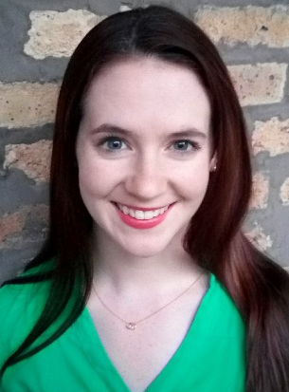
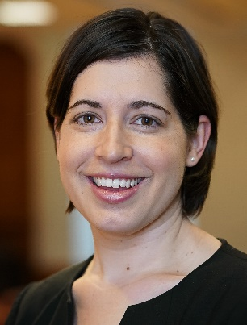
Who we are
Patty is the Impact and Dissemination Librarian at Galter Health Sciences Library where she works with the Metrics and Impact Core. Her responsibilities include supporting individuals and groups in scientific writing, and navigating the publishing and dissemination process. She has a particular interest in helping researchers tell their science story, and enjoys working with individuals to craft narrative statements infused with traditional bibliometrics and alternative metrics to communicate their research impact. She collaborates with a variety of stakeholders, ranging from individuals seeking to improve their promotion and tenure materials, to departments on large-scale dissemination projects.
Patty Smith, MLIS
As the Impact and Evaluation Librarian at Galter Health Sciences Library & Learning Center at Northwestern University where she works with the Metrics and Impact Core. Karen supports individuals and groups in their understanding, assessment, visualization, and reporting of impactful outcomes of biomedical research. She has extensive experience with research impact assessment using bibliometrics, alternative metrics, and qualitative evaluation techniques. Karen is particularly interested in using information visualization to facilitate stronger comprehension of data in the assessment process. She keeps an updated collection of her works in DigitalHub, the institutional repository for Northwestern Medicine.
Karen Gutzman, MA, MSLS
Notes:
Presenter: Patty

Slide 3
Goals for the class
Identify the scope of role in partnerships with faculty, investigators, and researchers;
Expand their understanding of research dissemination to various audiences;
Increase proficiency with dissemination tools and awareness of context;
Develop strategies for writing plain language summaries of research;
Discover tools for tracking attention and impact of research;
Learn to report the attention a researcher’s work receives.
Activities and Resources available at: https://goo.gl/Fn1ya4
Notes:
Presenter: Patty

Slide 4
Schedule for the afternoon
Contextualizing Dissemination
  Introductions
Dissemination Overview
  Activity 1: Choosing a paper
  Activity 2: Dissemination goals
  Activity 3: Choose an audience
  Activity 4: Choose a format
  Break
  Activity 5: Generating Content
  Activity 6: Making Content More Shareable
  Activity 7: Creating Eye-Catching Images
  Break
Using Alternative Metrics
  Activity 8: Writing on Impact Using Alternative Metrics
Wrap up and goodbyes
Notes:
Presenter: Patty

Slide 5
Contextualizing Dissemination
Taking a look at the history of research dissemination
And how we got here today
Notes:
Presenter: Patty

Slide 6
Introduction Activity
Take 5 minutes to explore one these websites
  Social Media Timeline: https://facebookjustice.files.wordpress.com/2011/06/socialmediatl_05.png
  History of Publishing: https://www.pinterest.com/pin/308567011947468925/
  Timeline of Web Technologies: http://www.evolutionoftheweb.com/
  A brief timeline of Open Access: https://symplectic.co.uk/open-access-timeline/
After five minutes, you will introduce yourself to the group:
  Your name
  Your institution
  One interesting thing you found from the websites
Notes:
Presenter: Patty

Slide 7












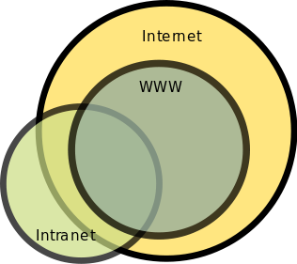


arXiv.org
arXiv, the science pre-print server is founded
Philosophical Transactions of the Royal Society is first published
Elsevier launches its first international journal
Wikipedia is launched
NIH Public Access Policy is mandated
F1000 Research, PeerJ, and eLife are launched
Facebook launches
1665
1869
… 1947 …
1990
1991
1999
2001
2002
2004
2006
2008
2010
2012
Blogger begins
Open Access movement begins
PLOS ONE begins publishing, Twitter Launches
Altmetrics Manifesto is written
Nature publishes its first issue
World Wide Web is invented
Notes:
Presenter: Patty
Notes:
Knowledge was transferred between people through letters and journals.
In academia, the gold-standard way of disseminating work is through peer reviewed journals. A couple hundred years after the invention of the printing press, we have the first journal published in 1665. Several innovative and relatively new journals, including F1000 Research, PeerJ, and eLife, are launched. These journals are experimenting with new forms of peer review, new business models, and new funding sources.
Altmetric Manifesto: http://altmetrics.org/manifesto/
Dissemination online:Resource guides, training material, best practices, data sets, questionnaires/surveys, guidelines, white papers, images, etc.
Resources:
American Journal Experts. Scholarly Publishing: A Brief History. Available at: https://www.aje.com/en/arc/scholarly-publishing-brief-history/

Slide 8
arXiv.org
arXiv, the science pre-print server is founded
Philosophical Transactions of the Royal Society is first published
“It is one of the noblest duties of a university to advance knowledge, and to diffuse it not merely among those who can attend lectures—but far and wide”
Daniel Coit Gilman
Founding President, Johns Hopkins University
Elsevier launches its first international journal
Wikipedia is launched
NIH Public Access Policy is mandated
F1000 Research, PeerJ, and eLife are launched
Facebook launches
1665
1869
… 1947 …
1990
1991
1999
2001
2002
2004
2006
2008
2010
2012
Blogger begins
Open Access movement begins
PLOS ONE begins publishing, Twitter Launches
Altmetrics Manifesto is written
Nature publishes its first issue
World Wide Web is invented
Notes:
Presenter: Patty
Resource:
Johns Hopkins University Press. History. Available at: https://www.press.jhu.edu/about/history

Slide 9
Dissemination Overview
Review of dissemination plans, tools, and resources.
Notes:
Presenter: Karen

Slide 10
Defining terms
Often used interchangeably, but are actually distinct concepts
What is dissemination?
the active process of making research discoverable and accessible to various audiences (e.g. sharing content online through social media)
What is diffusion?
the passive, informal, unplanned spread of information to various audiences (e.g. a tweet going viral overnight)
What is engagement?
the meaningful involvement or exchange between research creators and consumers (e.g. receiving feedback from social media followers)
What is impact?
the demonstrated outcomes of research in academia, society, culture, public policy, and beyond (e.g. evaluating the outcomes of your findings)
Notes:
Presenter: Karen
Source: Mollett A, Brumley C, Gilson C, Williams S. communicating Your Research with Social Media, A practical Guide to Using Blogs, Podcasts, Data Visualizations and Video. Sage Publishing. May 2017. Available at: https://us.sagepub.com/en-us/nam/communicating-your-research-with-social-media/book245914

Slide 11
How does dissemination happen?
Notes:
Presenter: Karen
Resources:
1) Greenhalgh T, Robert G, Macfarlane F, Bate P, Kyriakidou O. Diffusion of innovations in service organizations: systematic review and recommendations. Milbank Q 2004;82(4):581–629. Retrieved from: https://www.ncbi.nlm.nih.gov/pubmed/15595944
2) STELAR Center. ITEST Data Brief. STELAR 2017 JAN; 3(4): 1-2. Retrieved from: http://stelar.edc.org/publications/itest-data-brief-itest-dissemination-strategies

Slide 12

How does dissemination happen?
Online Strategies
Website
Mailing Lists
Virtual Events
Social Media
(Twitter, Facebook, Podcasts, Blogs)
Notes:
Presenter: Karen
Resources:
1) Greenhalgh T, Robert G, Macfarlane F, Bate P, Kyriakidou O. Diffusion of innovations in service organizations: systematic review and recommendations. Milbank Q 2004;82(4):581–629. Retrieved from: https://www.ncbi.nlm.nih.gov/pubmed/15595944
2) STELAR Center. ITEST Data Brief. STELAR 2017 JAN; 3(4): 1-2. Retrieved from: http://stelar.edc.org/publications/itest-data-brief-itest-dissemination-strategies

Slide 13

How does dissemination happen?
Online Strategies
In-person Strategies
Website
Mailing Lists
Virtual Events
Social Media
(Twitter, Facebook, Podcasts, Blogs)
Networking
Workshops or training
Meetings
Conference Presentations
Community Lectures
Notes:
Presenter: Karen
Resources:
1) Greenhalgh T, Robert G, Macfarlane F, Bate P, Kyriakidou O. Diffusion of innovations in service organizations: systematic review and recommendations. Milbank Q 2004;82(4):581–629. Retrieved from: https://www.ncbi.nlm.nih.gov/pubmed/15595944
2) STELAR Center. ITEST Data Brief. STELAR 2017 JAN; 3(4): 1-2. Retrieved from: http://stelar.edc.org/publications/itest-data-brief-itest-dissemination-strategies

Slide 14

How does dissemination happen?
Online Strategies
In-person Strategies
Print Strategies
Website
Mailing Lists
Virtual Events
Social Media
(Twitter, Facebook, Podcasts, Blogs)
Networking
Workshops or training
Meetings
Conference Presentations
Community Lectures
Peer-reviewed journals
Newsletters
White papers
Notes:
Presenter: Karen
Resources:
1) Greenhalgh T, Robert G, Macfarlane F, Bate P, Kyriakidou O. Diffusion of innovations in service organizations: systematic review and recommendations. Milbank Q 2004;82(4):581–629. Retrieved from: https://www.ncbi.nlm.nih.gov/pubmed/15595944
2) STELAR Center. ITEST Data Brief. STELAR 2017 JAN; 3(4): 1-2. Retrieved from: http://stelar.edc.org/publications/itest-data-brief-itest-dissemination-strategies

Slide 15
How does dissemination happen?
Online Strategies
In-person Strategies
Print Strategies
Website
Mailing Lists
Virtual Events
Social Media
(Twitter, Facebook, Podcasts, Blogs)
Networking
Workshops or training
Meetings
Conference Presentations
Community Lectures
Peer-reviewed journals
Newsletters
White papers
Notes:
Presenter: Karen
Resources:
1) Greenhalgh T, Robert G, Macfarlane F, Bate P, Kyriakidou O. Diffusion of innovations in service organizations: systematic review and recommendations. Milbank Q 2004;82(4):581–629. Retrieved from: https://www.ncbi.nlm.nih.gov/pubmed/15595944
2) STELAR Center. ITEST Data Brief. STELAR 2017 JAN; 3(4): 1-2. Retrieved from: http://stelar.edc.org/publications/itest-data-brief-itest-dissemination-strategies

Slide 16
Why dissemination?
With persons and organizations under increasing pressure to demonstrate their relevance and contribution to society, a deliberate digital strategy is vital
Notes:
Presenter: Karen

Slide 17
Why dissemination?
With persons and organizations under increasing pressure to demonstrate their relevance and contribution to society, a deliberate digital strategy is vital
Practical reasons:
Demonstrates contribution. Publically demonstrates contribution to science and exposes findings to colleagues
Increases citations. Increases possibility of receiving citations (which tends to be a feedback loop for promotion)
Garners favorability. Spotlight on research findings looks favorable to funders, managers, and more
Notes:
Presenter: Karen
Sources:
1) Marianne Farkas, Alan M. Jette, Sharon Tennstedt, Stephen M. Haley, Virginia Quinn; Knowledge Dissemination and Utilization in Gerontology: An Organizing Framework, The Gerontologist, Volume 43, Issue suppl_1, 1 March 2003, Pages 47–56, https://doi.org/10.1093/geront/43.suppl_1.47

Slide 18
Why dissemination?
With persons and organizations under increasing pressure to demonstrate their relevance and contribution to society, a deliberate digital strategy is vital
Practical reasons:
Demonstrates contribution. Publically demonstrates contribution to science and exposes findings to colleagues
Increases citations. Increases possibility of receiving citations (which tends to be a feedback loop for promotion)
Garners favorability. Spotlight on research findings looks favorable to funders, managers, and more
Theoretical reasons:
Advance knowledge. Exposure to information increases knowledge of the consumer (e.g. dissemination in journal articles, email, list-servs)
Interact with knowledge. Interactive dissemination allows consumers to explore, learn, decide, or confirm information rather than just reading it (e.g. dissemination through websites, conferences, news media, Reddit)
Increase positive attitudes. Interactive experiences with new information increases positive attitudes towards the new knowledge (e.g. videos, Instagram)
Create gains in competence. Continued interaction with knowledge can increase competence of the consumer (e.g. community lectures, websites, user groups)
Increase usage. Increase the use of a new finding or innovation over time (e.g. user groups, online communities or list servs)
Notes:
Presenter: Karen
Sources:
1) Marianne Farkas, Alan M. Jette, Sharon Tennstedt, Stephen M. Haley, Virginia Quinn; Knowledge Dissemination and Utilization in Gerontology: An Organizing Framework, The Gerontologist, Volume 43, Issue suppl_1, 1 March 2003, Pages 47–56, https://doi.org/10.1093/geront/43.suppl_1.47

Slide 19
Why dissemination?
With persons and organizations under increasing pressure to demonstrate their relevance and contribution to society, a deliberate digital strategy is vital
“Applicants must address plans for collection and dissemination of useful products of the research, including approaches, technologies and tools to the relevant research and user communities. “
NIH Request for Proposal.
Coordination Center for the Models of Infectious Disease Agent Study (MIDAS) Program. https://grants.nih.gov/grants/guide/rfa-files/RFA-GM-18-003.html
“Investigators are expected to promptly prepare and submit for publication, with authorship that accurately reflects the contributions of those involved, all significant findings from work conducted under NSF grants. “
NSF Policies and Procedures.
https://www.nsf.gov/pubs/policydocs/pappg18_1/nsf18_1.pdf
“Dissemination. What channels will be used to disseminate grant products to target audiences?”
Alfred P. Sloan Foundation.
Grant Application Guidelines.
https://sloan.org/storage/app/media/files/application_documents/proposal_guidelines_research_officer_grants.pdf
Notes:
Presenter: Karen
Notes: Search agencies by “outreach” OR “dissemination” or “communication” to find information regarding their requirements on dissemination.
Sources:
1) NIH Request for Proposals. Research Strategy: Applicants must address plans for collection and dissemination of useful products of the research, including approaches, technologies and tools to the relevant research and user communities.
https://grants.nih.gov/grants/guide/rfa-files/RFA-GM-18-003.html
2) General Instructions for NIH and Other PHS Agencies
https://grants.nih.gov/grants/how-to-apply-application-guide/forms-d/general-forms-d.pdf
https://grants.nih.gov/grants/how-to-apply-application-guide/forms-d/supplemental-instructions-forms-d.pdf
3) NSF Policies and Procedures. Investigators are expected to promptly prepare and submit for publication, with authorship that accurately reflects the contributions of those involved, all significant findings from work conducted under NSF grants.
https://www.nsf.gov/pubs/policydocs/pappg18_1/nsf18_1.pdf

Slide 20
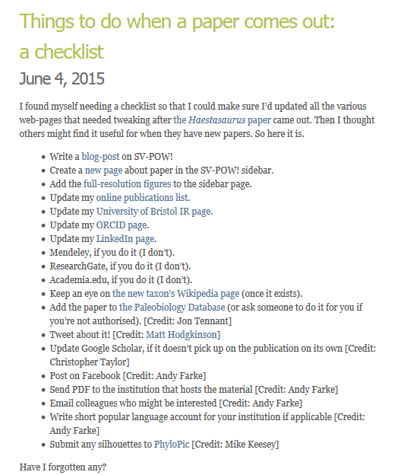
Example of dissemination in action
Let’s say you are a researcher who wants to reach a broad academic and public audience with your research
(above) One researcher’s list of “Things to do...” related to dissemination of paper. https://svpow.com/2015/06/04/things-to-do-when-a-paper-comes-out-a-checklist/
Notes:
Presenter: Karen
Notes: If you are an individual researcher you may simply have a list of things that you and your co-authors can work on to disseminate your paper.

Slide 21
Example of dissemination in action
Let’s say your center works on mental health and wants promote their work to teens, general public, and to policy makers.
Notes:
Presenter: Karen
Notes: For example, if you are trying to reach teenagers in San Francisco to promote your project’s website about new mental health initiatives in the city, consider a targeted campaign using short video clips on platforms with large take-up by this group, such as Instagram and Snapchat. If, for the same project, you also want to raise awareness of your findings for teaching networks, consider a one-minute explainer video that could be shared in teacher Facebook groups and on resource websites. Again, for the same project, if you are looking to show the impact of your project to funders and how it was supported by local MPs and mentioned in a House of Commons debate, a 30-second slideshow of this footage to launch your report plus your other achievements might be part of the path to extra funding. Think about who will be interested in looking at and sharing your videos, photos and research, and map these out or list them – the more specific, the better.

Slide 22
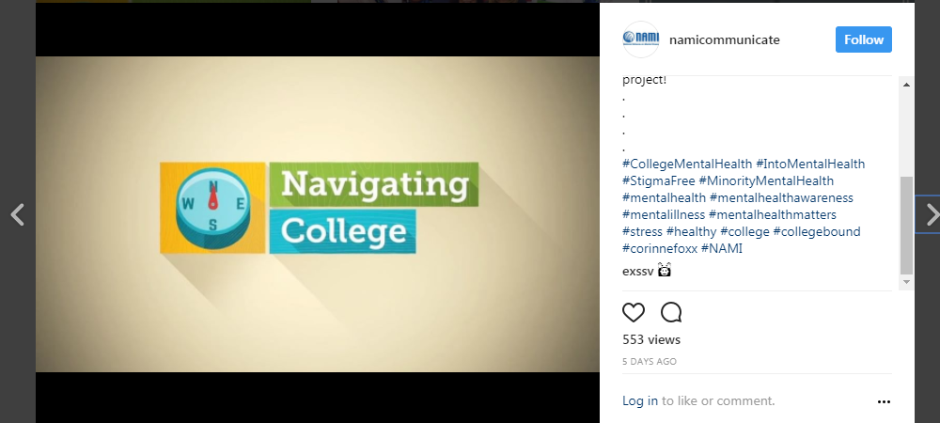
Example of dissemination in action
Let’s say your center works on mental health and wants promote their work to teens, general public, and to policy makers.
Promote mental health initiatives to teens using short video clips on platforms such as Instagram and Snapchat.
(right) Video on Instagram by National Alliance for Mental Health with 553 views #collegementalhealth
Notes:
Presenter: Karen
Notes: For example, if you are trying to reach teenagers in San Francisco to promote your project’s website about new mental health initiatives in the city, consider a targeted campaign using short video clips on platforms with large take-up by this group, such as Instagram and Snapchat. If, for the same project, you also want to raise awareness of your findings for teaching networks, consider a one-minute explainer video that could be shared in teacher Facebook groups and on resource websites. Again, for the same project, if you are looking to show the impact of your project to funders and how it was supported by local MPs and mentioned in a House of Commons debate, a 30-second slideshow of this footage to launch your report plus your other achievements might be part of the path to extra funding. Think about who will be interested in looking at and sharing your videos, photos and research, and map these out or list them – the more specific, the better.

Slide 23
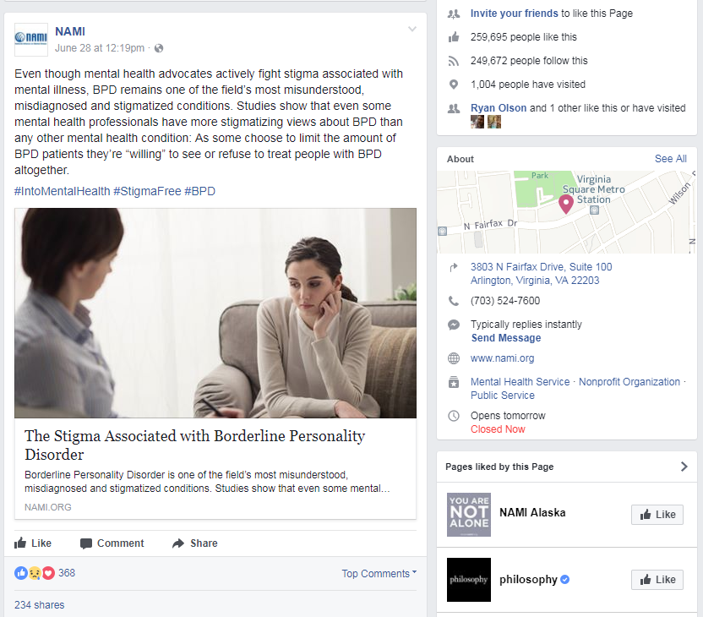
Example of dissemination in action
Let’s say your center works on mental health and wants promote their work to teens, general public, and to policy makers.
Promote mental health initiatives to teens using short video clips on platforms such as Instagram and Snapchat.
(right) Video on Instagram by National Alliance for Mental Health with 553 views #collegementalhealth
Promote plain language summaries of mental health research to the general public that can be shared in Facebook groups and on resource websites.
(right) Short article on Facebook by National Alliance for Mental Health with 368 shares #StigmaFree
Notes:
Presenter: Karen
Notes: For example, if you are trying to reach teenagers in San Francisco to promote your project’s website about new mental health initiatives in the city, consider a targeted campaign using short video clips on platforms with large take-up by this group, such as Instagram and Snapchat. If, for the same project, you also want to raise awareness of your findings for teaching networks, consider a one-minute explainer video that could be shared in teacher Facebook groups and on resource websites. Again, for the same project, if you are looking to show the impact of your project to funders and how it was supported by local MPs and mentioned in a House of Commons debate, a 30-second slideshow of this footage to launch your report plus your other achievements might be part of the path to extra funding. Think about who will be interested in looking at and sharing your videos, photos and research, and map these out or list them – the more specific, the better.

Slide 24
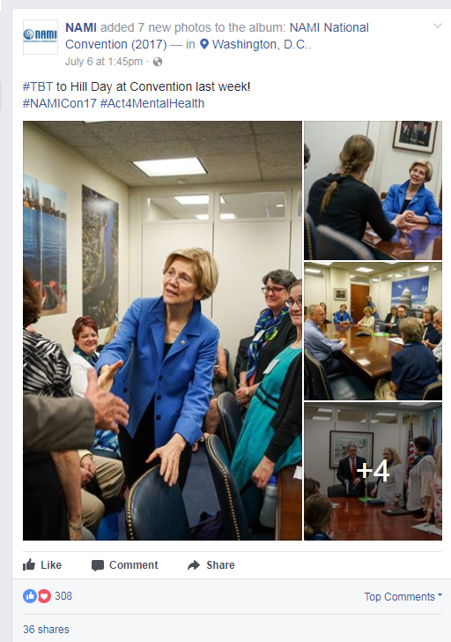
Example of dissemination in action continued…
Let’s say your center works on mental health and wants promote their work to teens, general public, and to policy makers.
Show the impact of work to funders and how it is supported by local policy makers with a short slideshow on Facebook.
(far right, top) White paper on Public Policy Platform of the National Alliance on Mental Illness https://www.nami.org/Learn-More/Public-Policy
(far left, top) Facebook slideshow of National Alliance on Mental Illness meetings with US Senators #Act4MentalHealth
(middle, bottom) Blog post for National Alliance on Mental Illness by guest blogger AJ Mendez https://www.nami.org/Blogs/NAMI-Blog/July-2017/Breaking-Tradition
Notes:
Presenter: Karen
Notes: For example, if you are trying to reach teenagers in San Francisco to promote your project’s website about new mental health initiatives in the city, consider a targeted campaign using short video clips on platforms with large take-up by this group, such as Instagram and Snapchat. If, for the same project, you also want to raise awareness of your findings for teaching networks, consider a one-minute explainer video that could be shared in teacher Facebook groups and on resource websites. Again, for the same project, if you are looking to show the impact of your project to funders and how it was supported by local MPs and mentioned in a House of Commons debate, a 30-second slideshow of this footage to launch your report plus your other achievements might be part of the path to extra funding. Think about who will be interested in looking at and sharing your videos, photos and research, and map these out or list them – the more specific, the better.

Slide 25
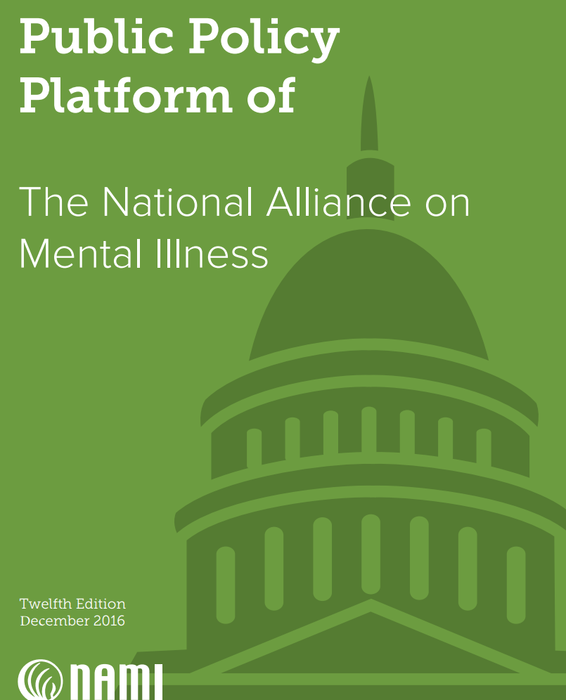
Example of dissemination in action continued…
Let’s say your center works on mental health and wants promote their work to teens, general public, and to policy makers.
Show the impact of work to funders and how it is supported by local policy makers with a short slideshow on Facebook.
Share a white paper on a website with recommendations for policy change.
(far right, top) White paper on Public Policy Platform of the National Alliance on Mental Illness https://www.nami.org/Learn-More/Public-Policy
(far left, top) Facebook slideshow of National Alliance on Mental Illness meetings with US Senators #Act4MentalHealth
(middle, bottom) Blog post for National Alliance on Mental Illness by guest blogger AJ Mendez https://www.nami.org/Blogs/NAMI-Blog/July-2017/Breaking-Tradition
Notes:
Presenter: Karen
Notes: For example, if you are trying to reach teenagers in San Francisco to promote your project’s website about new mental health initiatives in the city, consider a targeted campaign using short video clips on platforms with large take-up by this group, such as Instagram and Snapchat. If, for the same project, you also want to raise awareness of your findings for teaching networks, consider a one-minute explainer video that could be shared in teacher Facebook groups and on resource websites. Again, for the same project, if you are looking to show the impact of your project to funders and how it was supported by local MPs and mentioned in a House of Commons debate, a 30-second slideshow of this footage to launch your report plus your other achievements might be part of the path to extra funding. Think about who will be interested in looking at and sharing your videos, photos and research, and map these out or list them – the more specific, the better.

Slide 26
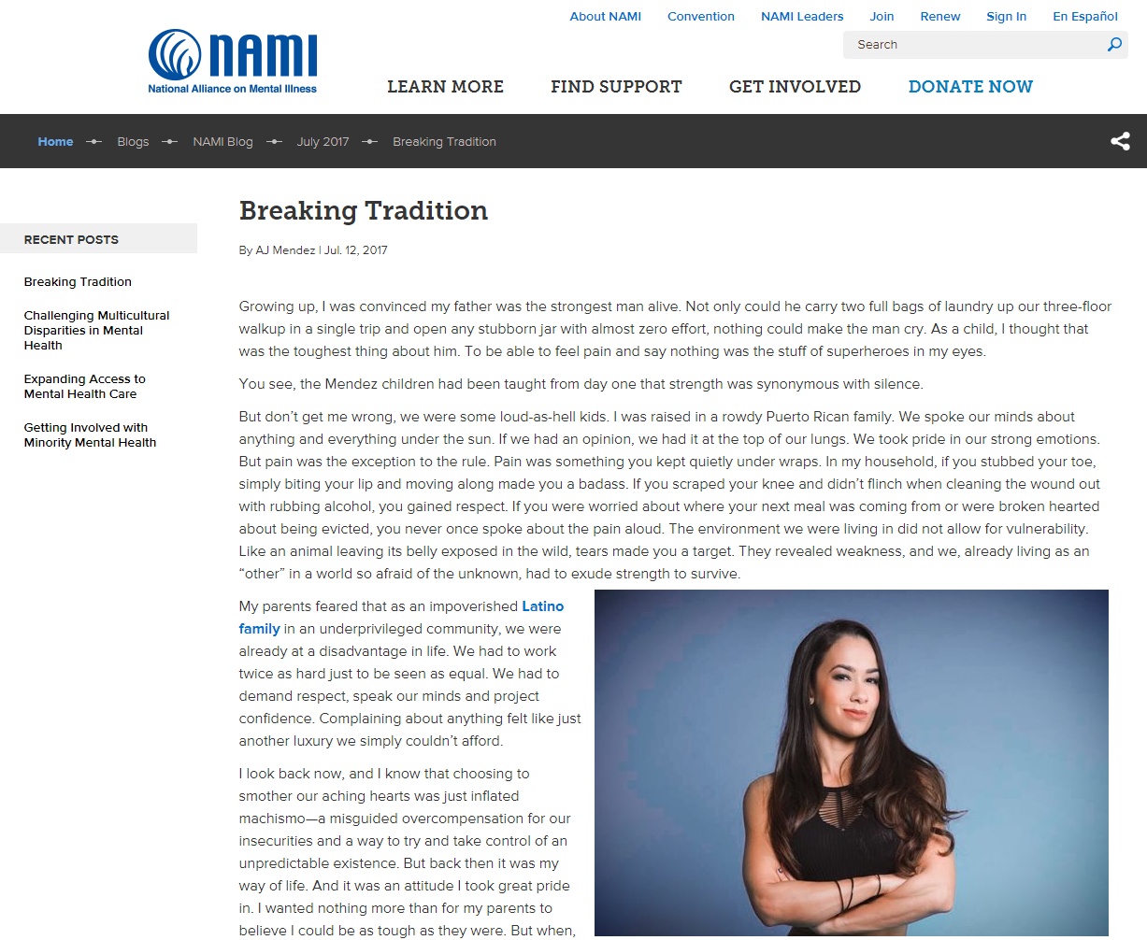
Example of dissemination in action continued…
Let’s say your center works on mental health and wants promote their work to teens, general public, and to policy makers.
Show the impact of work to funders and how it is supported by local policy makers with a short slideshow on Facebook.
Share a white paper on a website with recommendations for policy change.
Generate opportunities for researchers to be featured as guest bloggers on blogs of national organizations.
(far right, top) White paper on Public Policy Platform of the National Alliance on Mental Illness https://www.nami.org/Learn-More/Public-Policy
(far left, top) Facebook slideshow of National Alliance on Mental Illness meetings with US Senators #Act4MentalHealth
(middle, bottom) Blog post for National Alliance on Mental Illness by guest blogger AJ Mendez https://www.nami.org/Blogs/NAMI-Blog/July-2017/Breaking-Tradition
Notes:
Presenter: Karen
Notes: For example, if you are trying to reach teenagers in San Francisco to promote your project’s website about new mental health initiatives in the city, consider a targeted campaign using short video clips on platforms with large take-up by this group, such as Instagram and Snapchat. If, for the same project, you also want to raise awareness of your findings for teaching networks, consider a one-minute explainer video that could be shared in teacher Facebook groups and on resource websites. Again, for the same project, if you are looking to show the impact of your project to funders and how it was supported by local MPs and mentioned in a House of Commons debate, a 30-second slideshow of this footage to launch your report plus your other achievements might be part of the path to extra funding. Think about who will be interested in looking at and sharing your videos, photos and research, and map these out or list them – the more specific, the better.

Slide 27

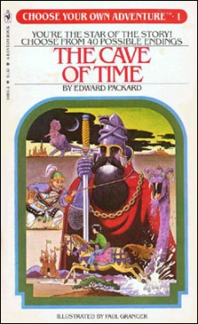

Housekeeping…
Activities and Resources available at: https://goo.gl/Fn1ya4
Reminder
Slides with this checklist remind of our workflow
Instructions
Slides with this book cover indicate instructions for activities.
Solutions
Slides with this computer symbol indicate solutions to activities.
Choose Your Own Adventure:
You are helping a researcher work on a dissemination plan for their newly published paper.
You assisting an entire group of researchers with a dissemination plan for the outputs of their entire research portfolio.
You are a researcher who wants to disseminate your own work.
Notes:
Presenter: Karen
Source:
Image of a book cover by Edward Packard called “The Cave of Time” in the Choose Your Own Adventure book series. Available: https://en.wikipedia.org/wiki/File:Cave_of_time.jpg
Image of checklist was made by Freepik from Flat Icon (https://www.flaticon.com) with a Creative Commons BY 3.0 license (http://creativecommons.org/licenses/by/3.0/)
Image of computer screen was made by Icon Works (https://www.flaticon.com/authors/icon-works) from Flat Icon (https://www.flaticon.com) with a Creative Commons BY 3.0 license (http://creativecommons.org/licenses/by/3.0)

Slide 28
Housekeeping…
Activities and Resources available at: https://goo.gl/Fn1ya4
Reminder
Slides with this checklist remind of our workflow
Instructions
Slides with this book cover indicate instructions for activities.
Solutions
Slides with this computer symbol indicate solutions to activities.
Choose Your Own Adventure:
You are helping a researcher work on a dissemination plan for their newly published paper.
You are assisting a group of researchers with a dissemination plan for the outputs of their entire research portfolio.
You are a researcher who wants to disseminate your own work.
Notes:
Presenter: Karen
Source:
Image of a book cover by Edward Packard called “The Cave of Time” in the Choose Your Own Adventure book series. Available: https://en.wikipedia.org/wiki/File:Cave_of_time.jpg
Image of checklist was made by Freepik from Flat Icon (https://www.flaticon.com) with a Creative Commons BY 3.0 license (http://creativecommons.org/licenses/by/3.0/)
Image of computer screen was made by Icon Works (https://www.flaticon.com/authors/icon-works) from Flat Icon (https://www.flaticon.com) with a Creative Commons BY 3.0 license (http://creativecommons.org/licenses/by/3.0)

Slide 29
Dissemination Plans
A step-by-step review of writing a dissemination plan.
Notes:
Presenter: Patty

Slide 30
Make a plan for dissemination
A basic plan might include:
  Which research findings or products are intended for dissemination?
  What do you want to achieve?
  Who is your target audience(s)?
  What tool, resource, or format do you want to use?
  Do you have content, or does it need to be generated?
More detailed plans and tools:
  Dissemination and Communication tools by Research Partnerships for Healthy Chicagoland Communities: http://arccresources.net/category/dissemination-communication-tools/
  Dissemination Planning Tool by AHRQ: https://www.ahrq.gov/professionals/quality-patient-safety/patient-safety-resources/resources/advances-in-patient-safety/vol4/planningtool.html
  Dissemination and Implementation Framework and Toolkit by PCORI: https://www.mathematica-mpr.com/our-publications-and-findings/projects/pcori-dissemination-and-implementation-framework-and-toolkit
  Recommendations for Research Dissemination by the Center for AIDS Prevention Studies at the University of California, San Francisco: https://caps.ucsf.edu/about/community-advisory-board/recommendations-for-research-dissemination/
Notes:
Presenter: Patty

Slide 31
Make a plan for dissemination
A basic plan might include:
  Which research findings or products are intended for dissemination?
  What do you want to achieve?
  Who is your target audience(s)?
  What tool, resource, or format do you want to use?
  Do you have content, or does it need to be generated?
Notes:
Presenter: Patty

Slide 32

Activity 1: Choose a research paper
Choose a research paper to use in the upcoming activities.
PDFs are located in Google Drive folder: https://goo.gl/Fn1ya4
  Relationship between Clinic and Ambulatory Blood-Pressure Measurements and Mortality
  Gaps in Receipt of Clinically Indicated Genetic Counseling After Diagnosis of Breast Cancer
  Communication About Prognosis With Adolescent and Young Adult Patients With Cancer: Information Needs, Prognostic Awareness, and Outcomes of Disclosure
  Association between use of acid-suppressive medications and antibiotics during infancy and allergic diseases in early childhood
  Association between receptivity to tobacco advertising and progression to tobacco use in youth and young adults in the path study
  Programming of Schwann Cells by Lats1/2-TAZ/YAP Signaling Drives Malignant Peripheral Nerve Sheath Tumorigenesis
Notes:
Presenter: Patty

Slide 33
Activity 1: Choose a research paper
Article title
Does physical activity attenuate, or even eliminate, the detrimental association of sitting time with mortality? A harmonised meta-analysis of data from more than 1 million men and women
Background
High amounts of sedentary behaviour have been associated with increased risks of several chronic conditions and mortality. However, it is unclear whether physical activity attenuates or even eliminates the detrimental effects of prolonged sitting. We examined the associations of sedentary behaviour and physical activity with all-cause mortality.
Interpretation
High levels of moderate intensity physical activity (ie, about 60–75 min per day) seem to eliminate the increased risk of death associated with high sitting time.
Ekelund U, Steene-Johannessen J, Brown WJ, Fagerland MW, Owen N, Powell KE, Bauman A, Lee I-M. Does physical activity attenuate, or even eliminate, the detrimental association of sitting time with mortality? A harmonised meta-analysis of data from more than 1 million men and women. The Lancet. 2016;388(10051):1302–1310.
http://www.thelancet.com/journals/lancet/article/PIIS0140-6736(16)30370-1/fulltext
Notes:
Presenter: Patty
Source:
Ekelund U, Steene-Johannessen J, Brown WJ, Fagerland MW, Owen N, Powell KE, Bauman A, Lee I-M. Does physical activity attenuate, or even eliminate, the detrimental association of sitting time with mortality? A harmonised meta-analysis of data from more than 1 million men and women. The Lancet. 2016;388(10051):1302–1310. http://www.thelancet.com/journals/lancet/article/PIIS0140-6736(16)30370-1/fulltext

Slide 34
Make a plan for dissemination
A basic plan might include:
  Which research findings or products are intended for dissemination?
  What do you want to achieve?
  Who is your target audience(s)?
  What tool, resource, or format do you want to use?
  Do you have content, or does it need to be generated?
Notes:
Presenter: Patty

Slide 35
General goals for dissemination plans
What do you want to achieve?
  Reach your audience in an eye catching way
  Make an impact on policy
  Expand your digital presence
  Reach non-academic audiences
Notes:
Presenter: Patty
Notes: A general public awareness of your project can be achieved through a combined approach of mass and social media platforms to get you broad exposure, but if you are looking to change policy or behaviour in some substantial way, you will need to spend considerably more time understanding the motivations of the ecosystem of stakeholders, actively listening to the feedback and incorporating perspectives from these stakeholders into your research communication activity.

Slide 36
General goals for dissemination plans
What do you want to achieve?
  Reach your audience in an eye catching way
  Make an impact on policy
  Expand your digital presence
  Reach non-academic audiences
Whatever your goal is, make note of it to focus your work toward that goal.
Establishing goals allows you to evaluate whether you’ve accomplished what you had hoped for.
Notes:
Presenter: Patty
Notes: A general public awareness of your project can be achieved through a combined approach of mass and social media platforms to get you broad exposure, but if you are looking to change policy or behaviour in some substantial way, you will need to spend considerably more time understanding the motivations of the ecosystem of stakeholders, actively listening to the feedback and incorporating perspectives from these stakeholders into your research communication activity.

Slide 37
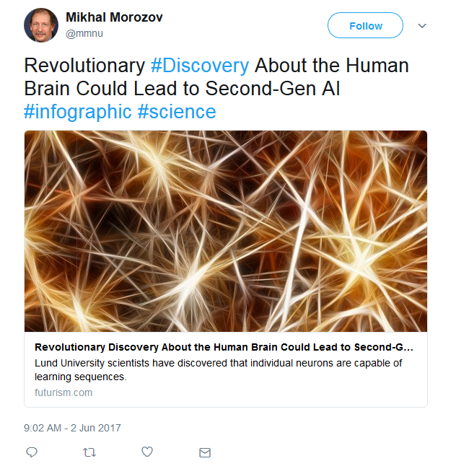
What do you want to achieve? (continued)
(above) Example of an “eye catching” tweet that links to a research article by scientists at Lund University.
Notes:
Presenter: Patty
Notes: A general public awareness of your project can be achieved through a combined approach of mass and social media platforms to get you broad exposure, but if you are looking to change policy or behaviour in some substantial way, you will need to spend considerably more time understanding the motivations of the ecosystem of stakeholders, actively listening to the feedback and incorporating perspectives from these stakeholders into your research communication activity.

Slide 38
Activity 2: What do you want to achieve?
What do you want to achieve?
  Increase awareness of importance of daily physical activity
  Reach a non-academic audience
  Spark discussion on developing healthy workplaces and daily life practices
Notes:
Presenter: Patty

Slide 39
Activity 2: What do you want to achieve?
Take a few moments to review your paper and decide what your goals might be in disseminating the information in paper.
Notes:
Presenter: Patty

Slide 40
Make a plan for dissemination
A basic plan might include:
  Which research findings or products are intended for dissemination?
  What do you want to achieve?
  Who is your target audience(s)?
  What tool, resource, or format do you want to use?
  Do you have content, or does it need to be generated?
Notes:
Presenter: Karen

Slide 41
Choosing an audience
Who is your target audience(s)?
  Consider different types of audiences. Who would benefit from this information?
  Consider what motivates your audiences. Why should they be interested?
  Consider how your audience should adopt or act on your information.
  Actively listen to their feedback and incorporate their perspectives.
Notes:
Presenter: Karen

Slide 42
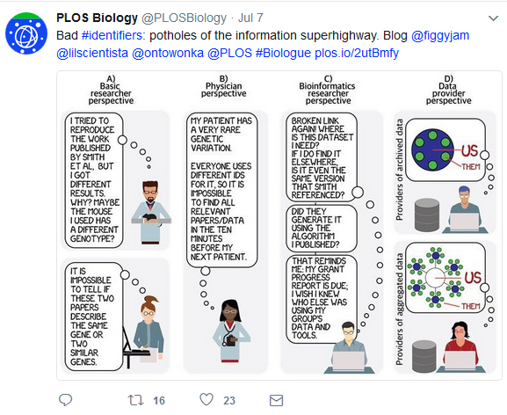
Choosing an audience
(above) Screenshot of tweet aimed at four different audiences on importance of universally used data identifiers by PLoS Biology on July 6, 2017.
https://twitter.com/PLOSBiology/status/883007654154686464
Notes:
Presenter: Karen
Notes: A general public awareness of your project can be achieved through a combined approach of mass and social media platforms to get you broad exposure, but if you are looking to change policy or behaviour in some substantial way, you will need to spend considerably more time understanding the motivations of the ecosystem of stakeholders, actively listening to the feedback and incorporating perspectives from these stakeholders into your research communication activity.

Slide 43
Choosing an audience
“The purpose of personas is to create reliable and realistic representations of your key audience segments for reference.”
Effective personas:
  Represent a major user group for your website
  Express and focus on the major needs and expectations of the most important user groups
  Give a clear picture of the user's expectations and how they're likely to use the site
  Describe real people with backgrounds, goals, and values
  Source: Personas. Available at: https://www.usability.gov/how-to-and-tools/methods/personas.html
“Tailoring health education messages to patients’ characteristics has been shown to enhance the intention to adopt or change particular health behaviors.”
Source: Using personas as an intermediate construct
in the development of tailored messages: a Case Study.
Available at: http://ebooks.iospress.nl/publication/34727
Notes:
Presenter: Karen
Sources:
1) Vosbergen S, Wiggers AM, Lacrioux J, Jaspers M, Peek N. Using personas as an intermediate construct in the development of tailored messages: a Case Study. Studies in Health Technology and Informatics. Volume 194: Context Sensitive Health Informatics: Human and Sociotechnical Approaches. IOS Press. Available at: http://ebooks.iospress.nl/publication/34727
2) P.A. Keller, D.R. Lehmann, Designing Effective Health Communications: A Meta-Analysis, Journal of Public Policy & Marketing 27 (2008), 117-130. Available at: http://www.tuck.dartmouth.edu/uploads/centers/files/designing_effective.pdf

Slide 44
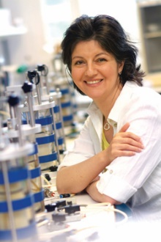
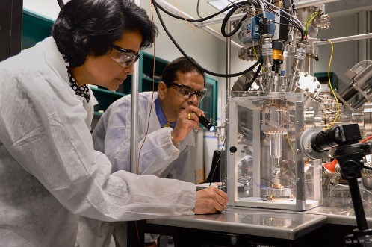
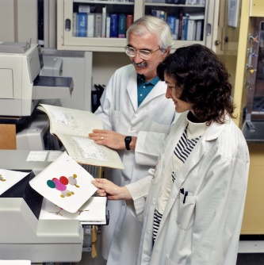
Audience: Basic Science Researcher(s)
Interests or Concerns:
Managing research goals
Obtaining new grant funding
Publishing research findings
Keeping current with new research in field
Considerations:
Uses technology for work and personal life
Knowledge maybe hyper-focused to specific area or field
Images available at:
https://www.flickr.com/photos/cambridgeuniversity-engineering/5390553302
http://mrmc.amedd.army.mil/index.cfm?pageid=media_resources.articles.senior_scientist_retires_from_USAMRICD
https://www.flickr.com/photos/rdecom/15158050618
Notes:
Presenter: Karen
Notes/Source:
The choice of a specific exposure method or channel of communication depends largely on the characteristics of the targeted user. Researchers tend to be located in academic institutions or research institutions that value information appearing in peer-reviewed journals, publications, and scientific conferences (Prohaska et al., 2000; Shepherd, 1982). Providers and administrators typically avoid research literature. Early studies demonstrated that clinical psychologists, for example, read only two to four research articles per month, if that (H. L. Cohen, 1979). Rather than read journals, they tend to seek out new information presented in an interactive format. These can include conferences or presentations; articles mentioned in the popular press, radio, or television (Paisley, 1993); or the exchange of information with other providers or administrators, often about whether the promise of the innovation has been met in practice (Burdine & McLeroy, 1992). Last, dissemination research has suggested that most individuals, including older adults and their families, are more likely to pay attention to information disseminated to them by those in positions of trust and authority whom they find credible (e.g., family physicians, professors) or from “near peers” (e.g., other credible elders; Rogers, 1995) as well as information in a medium that is easy to read (e.g., Internet sites, bulletins). Many consumers and family members, for example, are not comfortable with the electronic media, however, and consequently are best reached through more traditional channels such as newsletters or magazine articles.
1) Marianne Farkas, Alan M. Jette, Sharon Tennstedt, Stephen M. Haley, Virginia Quinn; Knowledge Dissemination and Utilization in Gerontology: An Organizing Framework, The Gerontologist, Volume 43, Issue suppl_1, 1 March 2003, Pages 47–56, https://doi.org/10.1093/geront/43.suppl_1.47

Slide 45
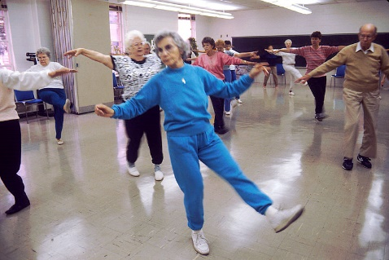

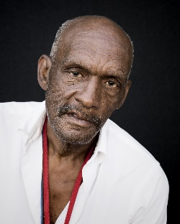
Audience: Senior Citizen(s)
Interests or Concerns:
Keeping up with friends and family
Possibly a caregiver for family member with a health condition
Staying healthy and active
Worried about health of friends
Considerations
Uses cell phone for calling friends and family
Has some social media accounts but uses them sporadically
Searches internet for health information and participates in patient forums
Images available at:
https://pxhere.com/en/photo/702817
https://pxhere.com/en/photo/702817https://commons.wikimedia.org/wiki/File:Aerobics_class.jpg
https://obamawhitehouse.archives.gov/seniors-town-hall
Notes:
Presenter: Karen
The choice of a specific exposure method or channel of communication depends largely on the characteristics of the targeted user. Researchers tend to be located in academic institutions or research institutions that value information appearing in peer-reviewed journals, publications, and scientific conferences (Prohaska et al., 2000; Shepherd, 1982). Providers and administrators typically avoid research literature. Early studies demonstrated that clinical psychologists, for example, read only two to four research articles per month, if that (H. L. Cohen, 1979). Rather than read journals, they tend to seek out new information presented in an interactive format. These can include conferences or presentations; articles mentioned in the popular press, radio, or television (Paisley, 1993); or the exchange of information with other providers or administrators, often about whether the promise of the innovation has been met in practice (Burdine & McLeroy, 1992). Last, dissemination research has suggested that most individuals, including older adults and their families, are more likely to pay attention to information disseminated to them by those in positions of trust and authority whom they find credible (e.g., family physicians, professors) or from “near peers” (e.g., other credible elders; Rogers, 1995) as well as information in a medium that is easy to read (e.g., Internet sites, bulletins). Many consumers and family members, for example, are not comfortable with the electronic media, however, and consequently are best reached through more traditional channels such as newsletters or magazine articles.
1) Marianne Farkas, Alan M. Jette, Sharon Tennstedt, Stephen M. Haley, Virginia Quinn; Knowledge Dissemination and Utilization in Gerontology: An Organizing Framework, The Gerontologist, Volume 43, Issue suppl_1, 1 March 2003, Pages 47–56, https://doi.org/10.1093/geront/43.suppl_1.47

Slide 46

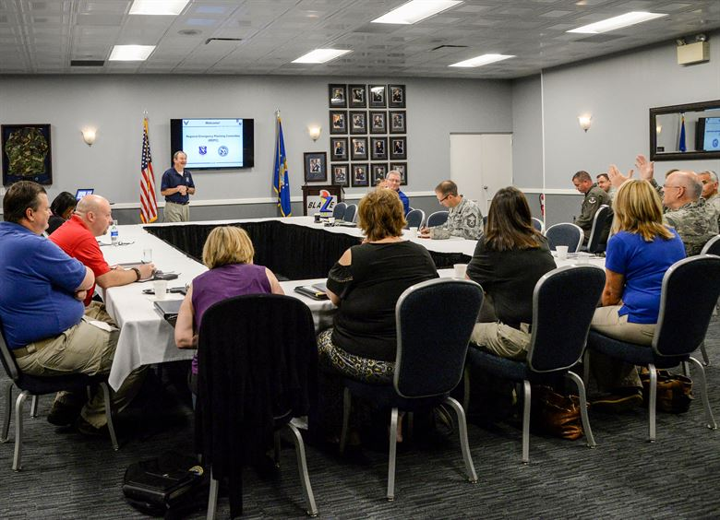
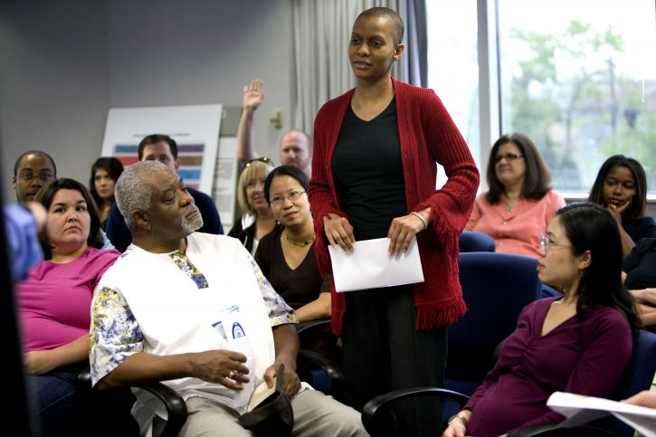
Audience: Community Group/Government/Committee
Interests or Concerns:
Creating a safe, healthy community for all
May have a specific cause or function
Focused on local issues but keeps abreast of national trends
Considerations:
Has an active social network and is comfortable with technology in work and personal life
Uses social media to keep current on topics and communicate with community members
Images available at:
http://www.freestockphotos.biz/stockphoto/16437
http://www.columbus.af.mil/News/Article-Display/Article/1329327/base-community-emergency-management-teams-build-stronger-bonds/
https://pixnio.com/people/crowd/african-american-woman-in-group-of-people
Notes:
Presenter: Karen

Slide 47
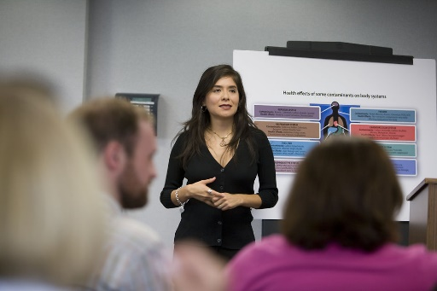
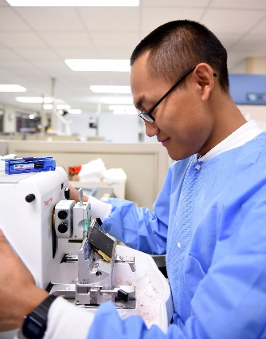
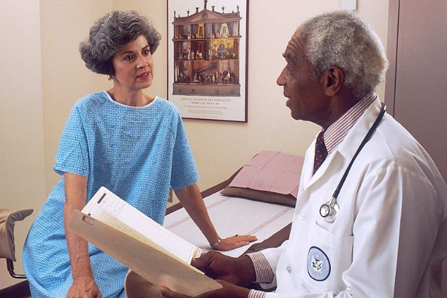
Audience: Clinical Researcher(s)
Interests or Concerns:
Developing research goals and recruiting patients for studies
Spending long hours in the clinic or hospital treating patients
Keeping current with newest research in field
Considerations:
Uses technology for work and personal life
Knowledge maybe hyper-focused to specific area or field
Has well-developed network of mentors and colleagues for support and feedback
Follows a few health-care related blogs and trade publications, frequently overwhelmed with volume of email
Images available at:
http://www.freestockphotos.biz/stockphoto/16433
https://commons.wikimedia.org/wiki/File:Doctor_consults_with_patient_(7).jpg
http://www.59mdw.af.mil/News/Article-Display/Article/1096421/pathology-lab-serves-mtfs-around-the-globe/
Notes:
Presenter: Karen
Notes/Source:
The choice of a specific exposure method or channel of communication depends largely on the characteristics of the targeted user. Researchers tend to be located in academic institutions or research institutions that value information appearing in peer-reviewed journals, publications, and scientific conferences (Prohaska et al., 2000; Shepherd, 1982). Providers and administrators typically avoid research literature. Early studies demonstrated that clinical psychologists, for example, read only two to four research articles per month, if that (H. L. Cohen, 1979). Rather than read journals, they tend to seek out new information presented in an interactive format. These can include conferences or presentations; articles mentioned in the popular press, radio, or television (Paisley, 1993); or the exchange of information with other providers or administrators, often about whether the promise of the innovation has been met in practice (Burdine & McLeroy, 1992). Last, dissemination research has suggested that most individuals, including older adults and their families, are more likely to pay attention to information disseminated to them by those in positions of trust and authority whom they find credible (e.g., family physicians, professors) or from “near peers” (e.g., other credible elders; Rogers, 1995) as well as information in a medium that is easy to read (e.g., Internet sites, bulletins). Many consumers and family members, for example, are not comfortable with the electronic media, however, and consequently are best reached through more traditional channels such as newsletters or magazine articles.
1) Marianne Farkas, Alan M. Jette, Sharon Tennstedt, Stephen M. Haley, Virginia Quinn; Knowledge Dissemination and Utilization in Gerontology: An Organizing Framework, The Gerontologist, Volume 43, Issue suppl_1, 1 March 2003, Pages 47–56, https://doi.org/10.1093/geront/43.suppl_1.47

Slide 48
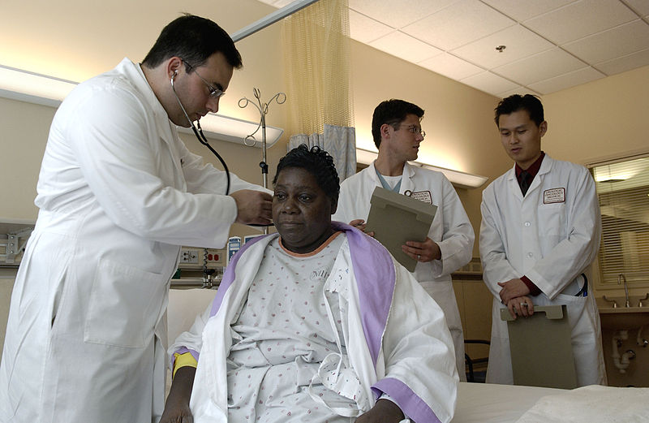
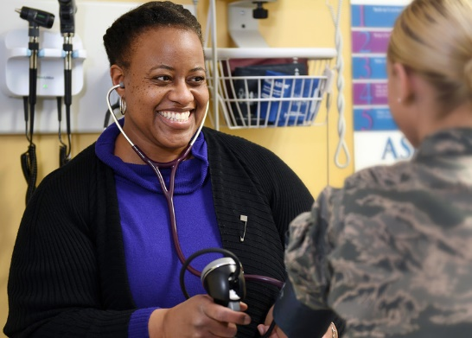
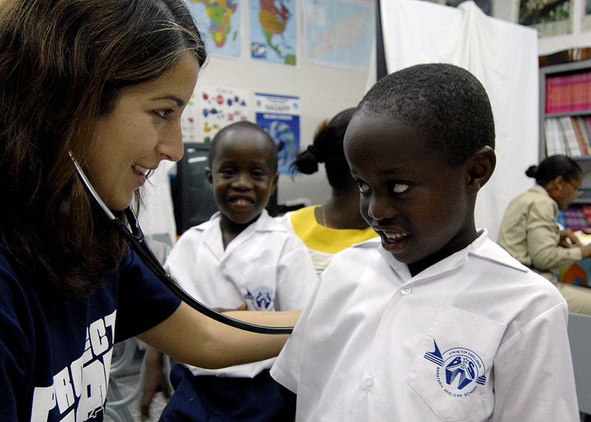
Audience: Health Care Provider(s)
Interests or Concerns:
Providing preventative, curative, or rehabilitative health care services to people, families or communities
Learning new procedures and keeping up to date on newest treatment guidelines
Considerations:
Uses technology for work and personal life
Interested in evidence-based information
Follows a few health-care related blogs and trade publications, frequently overwhelmed with volume of email
Images available at:
http://www.hanscom.af.mil/News/Photos/igphoto/2001893884/
https://commons.wikimedia.org/wiki/File:Doctor_examines_patient.jpg
https://commons.wikimedia.org/wiki/File:US_Navy_070919-N-6278K-082_Karina_Craine,_a_pediatrician_and_Project_Hope_volunteer_attached_to_Military_Sealift_Command_hospital_ship_USNS_Comfort_(T-AH_20).jpg
Notes:
Presenter: Karen
Notes/Source:
The choice of a specific exposure method or channel of communication depends largely on the characteristics of the targeted user. Researchers tend to be located in academic institutions or research institutions that value information appearing in peer-reviewed journals, publications, and scientific conferences (Prohaska et al., 2000; Shepherd, 1982). Providers and administrators typically avoid research literature. Early studies demonstrated that clinical psychologists, for example, read only two to four research articles per month, if that (H. L. Cohen, 1979). Rather than read journals, they tend to seek out new information presented in an interactive format. These can include conferences or presentations; articles mentioned in the popular press, radio, or television (Paisley, 1993); or the exchange of information with other providers or administrators, often about whether the promise of the innovation has been met in practice (Burdine & McLeroy, 1992). Last, dissemination research has suggested that most individuals, including older adults and their families, are more likely to pay attention to information disseminated to them by those in positions of trust and authority whom they find credible (e.g., family physicians, professors) or from “near peers” (e.g., other credible elders; Rogers, 1995) as well as information in a medium that is easy to read (e.g., Internet sites, bulletins). Many consumers and family members, for example, are not comfortable with the electronic media, however, and consequently are best reached through more traditional channels such as newsletters or magazine articles.
1) Marianne Farkas, Alan M. Jette, Sharon Tennstedt, Stephen M. Haley, Virginia Quinn; Knowledge Dissemination and Utilization in Gerontology: An Organizing Framework, The Gerontologist, Volume 43, Issue suppl_1, 1 March 2003, Pages 47–56, https://doi.org/10.1093/geront/43.suppl_1.47

Slide 49
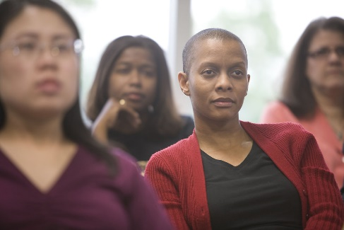
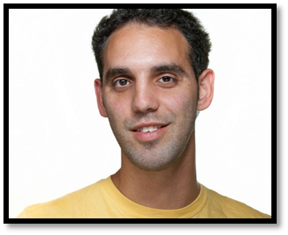

Audience: Professional Worker(s)
Interests or Concerns:
Keeping up with technology trends that affect profession
Working long hours to receive promotion
Possibly a caregiver for family member with health condition
Considerations
Uses technology for work and personal life
Comfortable interacting online in patient or caregiver forums
Frequently uses internet and social media for health-related searching and finding sources of information
Images available at:
https://www.flickr.com/photos/37873897@N06/8049576586
http://www.freestockphotos.biz/stockphoto/16488
http://www.albany.marines.mil/Photos/igphoto/2001700886/
Notes:
Presenter: Karen

Slide 50
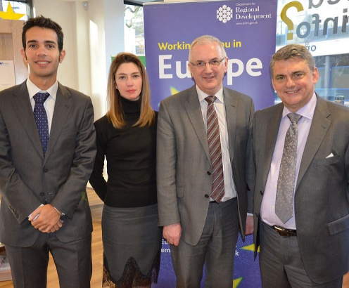
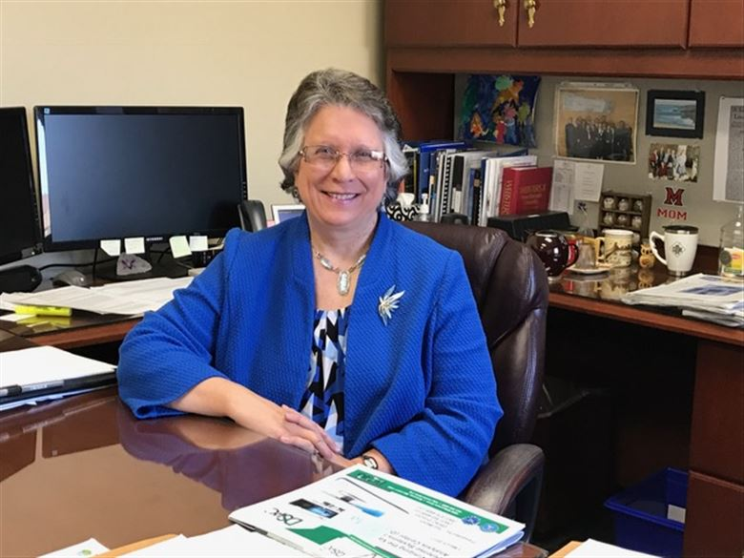
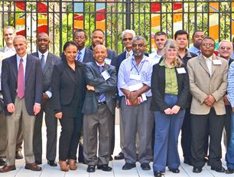
Audience: Funding Agency
Interests or Concerns:
Strongly interested in advancing goals or agenda of agency and has target audience that funding is meant to benefit
Interested in efficiency and effectiveness in the research process and tracking milestones
Tracks actions and sentiments of larger actors, such as governmental bodies, non-profit organizations, regional health departments as related to the agency’s research agenda
Considerations:
Uses social media to interact with target audience, often attracting a large following of supporters
May conduct campaigns online or by other means to increase or sustain funding for research
Concentrates on making outputs of funded research accessible and understandable to target audience or social media followers
Images available at:
https://www.flickr.com/photos/niexecutive/12360696495
http://www.wpafb.af.mil/News/Article-Display/Article/1138562/sponsored-research-funding-is-a-win-win-for-both-afit-students-and-the-sponsors/
http://www.wpafb.af.mil/News/Article-Display/Article/819121/afosr-explores-basic-research-collaboration-with-south-africa/
Notes:
Presenter: Karen

Slide 51
Activity 3: Choose an audience
Who is your target audience(s)?
  Professional workers who sit for 8 hours per day (i.e. office workers, transportation workers, etc.)
Notes:
Presenter: Karen

Slide 52
Activity 3: Choose an audience
Look over the audience types and choose one or two to focus your strategy on.
  Basic Science Researcher(s)
  Senior Citizen(s)
  Community Group/Government/Committee
  Clinical Researcher(s)
  Health Care Provider(s)
  Professional Worker(s)
  Funding Agency
  Not an exhaustive list of all audience types, but enough for today…
Notes:
Presenter: Karen

Slide 53
Make a plan for dissemination
A basic plan might include:
  Which research findings or products are intended for dissemination?
  What do you want to achieve?
  Who is your target audience(s)?
  What tool, resource, or format do you want to use?
  Do you have content, or does it need to be generated?
Notes:
Presenter: Patty

Slide 54

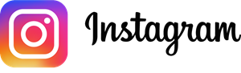













Choosing a format or tool
What tool, resource, or format do you want to use?
A good resource for learning more about Social Media users: Pew Research Center’s “Social Media Fact Sheet” http://www.pewinternet.org/fact-sheet/social-media/
Notes:
Presenter: Patty
Resource: Pew Research Center’s “Social Media Fact Sheet” http://www.pewinternet.org/fact-sheet/social-media/

Slide 55
Audience Poll
Which social media tool do you use most often for work?
Notes:
Presenter: Patty

Slide 56









Number of active users (per month)
Time
1.65 billion globally
Post between 10 am and 3 pm EST Monday through Friday. Thursday is best from 1-2 pm EST.
Key audiences
87% of 18-29 year-olds world wide
77% of adult women online
66% of adult men online
Access/Privacy
Check out applications accessing your Facebook information. From your profile, go to settings, then “Apps”, and see “Active Apps and Websites”.
Used for
Connecting personally with friends, family, and topics that we care about
Advanced Searching
Why it is good for research dissemination
Search using words or phrases. Once you’ve run the search, you will see a filter menu to further narrow the search.
Facebook Search Help: https://www.facebook.com/help/460711197281324/
For advanced Facebook searching, try Search is Back:
https://searchisback.com/
Huge user base. Great for building public and private groups around themed topics. Also great for sharing video.
Engagement
Use photos in posts. Reply to commenters.
Use Facebook “Note” to create a blog post that lives in Facebook.
Notes:
Presenter: Patty
Sources:
1) Mollett A, Brumley C, Gilson C, Williams S. Communicating Your Research with Social Media: A Practical Guide to Using Blogs, Podcasts, Data Visualizations and Video. SAGE; p. 297, 2017.
2) Walters K. 125+ Essential Social Media Statistics Every Marketer Should Know. Hootsuite Blogs. Retrieved from: https://blog.hootsuite.com/social-media-statistics-for-social-media-managers/
3) The Everything Guide to Twitter Success: https://blog.bufferapp.com/wp-content/uploads/2014/09/Twitter-Ebook-vfinal.pdf
4) Best Times to Post on Social Media: 2018 Industry Research: https://sproutsocial.com/insights/best-times-to-post-on-social-media/
5) 24 Hidden Facebook Features Only Power Users Know: https://www.pcmag.com/feature/324797/24-hidden-facebook-features-only-power-users-know/5

Slide 57

Number of active users (per month)
Time
310 million globally
Tweet between 9 am and 3 pm EST, Monday through Thursday. Consider Tweriod to find when your followers are most likely online.
Key audiences
37% of 18-29 year-olds world wide
21% of adult women online
24% of adult men online
Access/Privacy
Check out applications accessing your Twitter account. From your profile settings, go to “Apps.” You then click on “revoke access.”
Used for
Finding news and entertainment, online networking, and feeling connected to large trending debates
Advanced Searching
Why it is good for research dissemination
twitter search: containing both “twitter” and “search”
“happy hour”: containing the exact phrase “happy hour”
love OR hate: containing either “love” or “hate” (or both).
beer –root: containing “beer” but not “root”
hilarious filter:links : containing “hilarious” and linking to URLs
Twitter Advanced Search: https://twitter.com/search-advanced?lang=en
Very popular social media network for connecting with other researchers and also journalists. Follow hashtags around research interests.
Engagement
Use hashtags to double engagement rates. Reply to commenters.
Notes:
Presenter: Patty
Sources:
1) Mollett A, Brumley C, Gilson C, Williams S. Communicating Your Research with Social Media: A Practical Guide to Using Blogs, Podcasts, Data Visualizations and Video. SAGE; p. 297, 2017.
2) Walters K. 125+ Essential Social Media Statistics Every Marketer Should Know. Hootsuite Blogs. Retrieved from: https://blog.hootsuite.com/social-media-statistics-for-social-media-managers/
3) The Everything Guide to Twitter Success: https://blog.bufferapp.com/wp-content/uploads/2014/09/Twitter-Ebook-vfinal.pdf
4) Best Times to Post on Social Media: 2018 Industry Research: https://sproutsocial.com/insights/best-times-to-post-on-social-media/
5) 24 Hidden Facebook Features Only Power Users Know: https://www.pcmag.com/feature/324797/24-hidden-facebook-features-only-power-users-know/5
Huffington Post writer quipped, “You’re only as good as your last tweet” (Lauren, 2013).

Slide 58

Number of active users (per month)
Time
100 million globally
Post Tuesday through Thursday. Best time is Wednesday from 3-5 pm EST.
Key audiences
31% of 30-49 year-olds world wide
28% of adult women online
27% of adult men online
Access/Privacy
Manage your account privacy settings in your profile. In the Privacy tab learn what can be seen about you, what information can be used, etc.
Used for
Professional networking and job hunting; an online CV
Advanced Searching
Why it is good for research dissemination
Simple search is available for people, jobs, and posts.
Advanced search available to premium members
See more information: https://www.linkedin.com/help/linkedin/suggested/302
Good for sharing blog posts, developing a professional network.
Engagement
Users look for posts on industry trends and news, tips or best practices, and jobs or skills
Notes:
Presenter: Patty
Sources:
1) Mollett A, Brumley C, Gilson C, Williams S. Communicating Your Research with Social Media: A Practical Guide to Using Blogs, Podcasts, Data Visualizations and Video. SAGE; p. 297, 2017.
2) Walters K. 125+ Essential Social Media Statistics Every Marketer Should Know. Hootsuite Blogs. Retrieved from: https://blog.hootsuite.com/social-media-statistics-for-social-media-managers/
3) The Everything Guide to Twitter Success: https://blog.bufferapp.com/wp-content/uploads/2014/09/Twitter-Ebook-vfinal.pdf
4) Best Times to Post on Social Media: 2018 Industry Research: https://sproutsocial.com/insights/best-times-to-post-on-social-media/
5) 24 Hidden Facebook Features Only Power Users Know: https://www.pcmag.com/feature/324797/24-hidden-facebook-features-only-power-users-know/5

Slide 59

Number of active users (per month)
Time
100 million globally
Post any day from 2 pm – 4 pm EST , and 8 pm – 1 am EST. Best time is Saturday morning.
Key audiences
34% of 18-29 year-olds world wide
42% of adult women online
13% of adult men online
Access/Privacy
Go to Pinterest Privacy to learn what information is collected and how it is used. See: https://policy.pinterest.com/en/privacy-policy
Used for
Curating images connected to hobbies, ideas, and aspirations. People use Pinterest to seek out information and solutions.
Advanced Searching
Why it is good for research dissemination
Simple search is available for pins, boards or people using keywords or hashtags, or browse pins by category.
Use keywords as part of the file name
See more information: https://help.pinterest.com/en/articles/finding-things-pinterest
For anyone working with infographics and images, this is a useful platform for connecting with students, colleagues, and smaller interest groups.
Engagement
Post images on a blog or website that can be pinned in Pinterest. Lighter images w/out faces are pinned more often (736 X 1102 size).
Create a board of pins and keep it secret, then through out the day, pin them on your live boards.
Notes:
Presenter: Patty
Sources:
1) Mollett A, Brumley C, Gilson C, Williams S. Communicating Your Research with Social Media: A Practical Guide to Using Blogs, Podcasts, Data Visualizations and Video. SAGE; p. 297, 2017.
2) Walters K. 125+ Essential Social Media Statistics Every Marketer Should Know. Hootsuite Blogs. Retrieved from: https://blog.hootsuite.com/social-media-statistics-for-social-media-managers/
3) The Everything Guide to Twitter Success: https://blog.bufferapp.com/wp-content/uploads/2014/09/Twitter-Ebook-vfinal.pdf
4) Best Times to Post on Social Media: 2018 Industry Research: https://sproutsocial.com/insights/best-times-to-post-on-social-media/
5) 24 Hidden Facebook Features Only Power Users Know: https://www.pcmag.com/feature/324797/24-hidden-facebook-features-only-power-users-know/5

Slide 60

Number of active users (per month)
Time
400 million globally
Post Tuesday through Friday from 9 am – 6 pm EST. Best time is Wednesday at 3 pm.
Key audiences
53% of 18-29 year-olds world wide
29% of adult women online
22% of adult men online
Access/Privacy
Instagram was acquired by Facebook in 2012. See Instagram privacy policy here: https://help.instagram.com/155833707900388
Used for
Popular network for instantly sharing photos and videos. Enormous user base among young people around the world
Advanced Searching
Why it is good for research dissemination
Simple search for People, Places or Tags. Can only search one hashtag at a time.
Offers an easy and accessible way of sharing photos and videos with younger audiences. At the forefront of social media photo sharing.
Engagement
Like and comment on other Instagram user’s photos. Use popular hashtags, ask questions in photo captions
Notes:
Presenter: Patty
Sources:
1) Mollett A, Brumley C, Gilson C, Williams S. Communicating Your Research with Social Media: A Practical Guide to Using Blogs, Podcasts, Data Visualizations and Video. SAGE; p. 297, 2017.
2) Walters K. 125+ Essential Social Media Statistics Every Marketer Should Know. Hootsuite Blogs. Retrieved from: https://blog.hootsuite.com/social-media-statistics-for-social-media-managers/
3) The Everything Guide to Twitter Success: https://blog.bufferapp.com/wp-content/uploads/2014/09/Twitter-Ebook-vfinal.pdf
4) Best Times to Post on Social Media: 2018 Industry Research: https://sproutsocial.com/insights/best-times-to-post-on-social-media/
5) 24 Hidden Facebook Features Only Power Users Know: https://www.pcmag.com/feature/324797/24-hidden-facebook-features-only-power-users-know/5

Slide 61

Number of active users (per month)
Time
1 billion globally
Monday – Friday from 12 pm – 4 pm EST.
Key audiences
Almost a third of all people on the internet are YouTube users
Access/Privacy
See YouTube privacy policy here: https://www.youtube.com/static?template=privacy_guidelines
Used for
Dedicated video platform where any individual, brand, or organization can show off their content in a sharable format
Advanced Searching
Why it is good for research dissemination
After typing your search query, click on the Filters drop down menu to narrow your search to type of content, duration, upload date, features.
Playlists show users more of your video content, and strong search and tagging function means your videos will be recommended to others.
Engagement
Most users are looking for educational content, DIY Tips and tutorials.
Notes:
Presenter: Patty
Sources:
1) Mollett A, Brumley C, Gilson C, Williams S. Communicating Your Research with Social Media: A Practical Guide to Using Blogs, Podcasts, Data Visualizations and Video. SAGE; p. 297, 2017.
2) Walters K. 125+ Essential Social Media Statistics Every Marketer Should Know. Hootsuite Blogs. Retrieved from: https://blog.hootsuite.com/social-media-statistics-for-social-media-managers/
3) The Everything Guide to Twitter Success: https://blog.bufferapp.com/wp-content/uploads/2014/09/Twitter-Ebook-vfinal.pdf
4) Best Times to Post on Social Media: 2018 Industry Research: https://sproutsocial.com/insights/best-times-to-post-on-social-media/
5) 24 Hidden Facebook Features Only Power Users Know: https://www.pcmag.com/feature/324797/24-hidden-facebook-features-only-power-users-know/5

Slide 62
But what about…
ResearchGate
“ResearchGate is a social networking site for scientists and researchers to share papers, ask and answer questions, and find collaborators.”
Source: https://en.wikipedia.org/wiki/ResearchGate
Academia.edu
“Academia.edu is a for-profit American social networking website for academics. The platform can be used to share papers, monitor their impact, and follow the research in a particular field.”
Source: https://en.wikipedia.org/wiki/Academia.edu
Kathleen Fitzpatrick (2015) wrote of Academia.edu: “The network, in other words, does not have as its primary goal helping academics communicate with one another, but is rather working to monetize that communication. All of which is to say: everything that’s wrong with Facebook is wrong with Academia.edu, at least just up under the surface, and so perhaps we should think twice before committing our professional lives to it.”
Duffy BE, Pooley JD. “Facebook for Academics”: The Convergence of Self-Branding and Social Media Logic on Academia.edu. Social Media + Society. 2017;3(1):2056305117696523. Available at: http://journals.sagepub.com/doi/full/10.1177/2056305117696523
Notes:
Presenter: Patty
Sources:
1) ResearchGate. Wikipedia. Available at: https://en.wikipedia.org/wiki/ResearchGate
2) Academia.edu. Wikipledia. Available at: https://en.wikipedia.org/wiki/Academia.edu
3) Duffy BE, Pooley JD. “Facebook for Academics”: The Convergence of Self-Branding and Social Media Logic on Academia.edu. Social Media + Society. 2017;3(1):2056305117696523. Available at: http://journals.sagepub.com/doi/full/10.1177/2056305117696523

Slide 63
Considerations for generating an audience
Ask “influencers” to share your content
Be responsive to users: shares, likes, questions, and inquiries
Consider timing:
  Tweet during a conference using their hashtag
  Post to Facebook if there’s recent media attention
Notes:
Presenter: Patty
Resource:
1) Evans B. How to Get 100,000 Facebook Fans in 30 days. Available at: https://www.inc.com/brian-d-evans/how-to-get-100k-facebook-fans-in-30-days.html

Slide 64
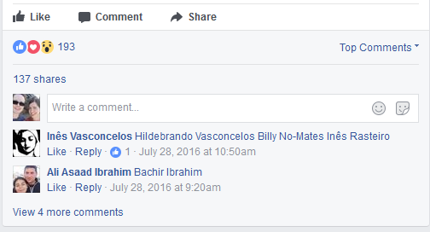
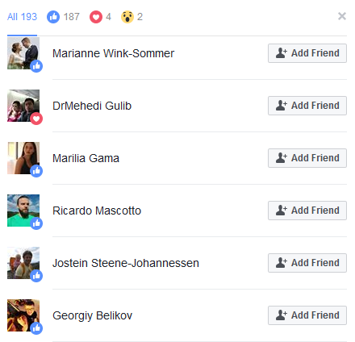
Considerations for generating an audience
Ask “influencers” to share your content
Be responsive to users: shares, likes, questions, and inquiries
Consider timing:
  Tweet during a conference using their hashtag
  Post to Facebook if there’s recent media attention
Many ideas online by searching “how to generate users for [social media platform]”
(above) screen shot of a Facebook post. Clicking on the 193 likes allows you to invite those users to follow your Facebook page.
Notes:
Presenter: Patty
Resource:
1) Evans B. How to Get 100,000 Facebook Fans in 30 days. Available at: https://www.inc.com/brian-d-evans/how-to-get-100k-facebook-fans-in-30-days.html

Slide 65
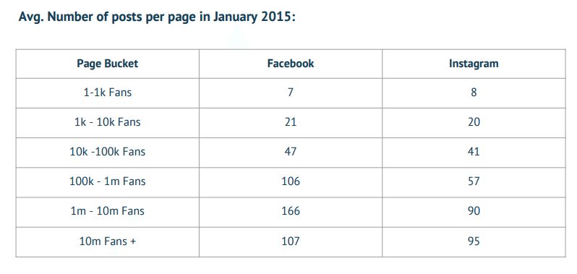
Considerations for generating an audience continued…
Be consistent with posting content. In general, “more successful” accounts tend to post with higher frequency.
(above) Figure showing the frequency of how often Facebook Fan page admins and owners of Instagram profiles post on their accounts. Quintly. Instagram Study. 2015 Retrieve from: http://press.quintly.com/100459-quintly-reveals-instagram-study-q1-2015
Notes:
Presenter: Patty
Source:
1) Quintly. Instagram Study. 2015 Retrieve from: http://press.quintly.com/100459-quintly-reveals-instagram-study-q1-2015

Slide 66

Activity 4: Choose a format
What format do you want to use?
  Facebook
  Twitter
Notes:
Presenter: Patty

Slide 67

Activity 4: Choose a format
Log into Twitter and Facebook
  Use the account we set up for this class
  You can use your personal account
Notes:
Presenter: Patty

Slide 68
Take a break
Notes:
Presenter: Patty

Slide 69
Schedule for the afternoon
Contextualizing Dissemination
  Introductions
Dissemination Overview
  Activity 1: Choosing a paper
  Activity 2: Dissemination goals
  Activity 3: Choose an audience
  Activity 4: Choose a format
  Break
  Activity 5: Generating Content
  Activity 6: Making Content More Shareable
  Activity 7: Creating Eye-Catching Images
  Break
Using Alternative Metrics
  Activity 8: Writing on Impact Using Alternative Metrics
Wrap up and goodbyes
Notes:
Presenter: Karen

Slide 70
Make a plan for dissemination
A basic plan might include:
  Which research findings or products are intended for dissemination?
  What do you want to achieve?
  Who is your target audience(s)?
  What tool, resource, or format do you want to use?
  Do you have content, or does it need to be generated?
Notes:
Presenter: Karen

Slide 71
Considerations for generating content
Do you have content, or does it need to be generated?
  Interesting quotes from published literature
  Presentation slides that can be easily shared
Notes:
Presenter: Karen

Slide 72
Considerations for generating content
Do you have content, or does it need to be generated?
  Interesting quotes from published literature
  Presentation slides that can be easily shared
Plan to have both real-time and evergreen content
  Real-time content is connected to time-based events such as conferences, monthly themes, time-based statistics, current trends, etc.
  Evergreen content stays continually relevant and lasting long past its publication, such as reviews, lists, videos, etc.
Notes:
Presenter: Karen

Slide 73
Considerations for generating content
Do you have content, or does it need to be generated?
  Interesting quotes from published literature
  Presentation slides that can be easily shared
Plan to have both real-time and evergreen content
  Real-time content is connected to time-based events such as conferences, monthly themes, time-based statistics, current trends, etc.
  Evergreen content stays continually relevant and lasting long past its publication, such as reviews, lists, videos, etc.
Consider content on these topics:
  Discussion about research findings
  Raising questions about an area of research
  Comments on publications by other authors
  Recap of conferences attended
  Description of how research can relate to public policy
  Connection of current events (both public and research) to research area
  Plain language summary of research articles
Notes:
Presenter: Karen

Slide 74
Considerations for generating content continued…
Create opportunities for wider sharing
  Ask popular bloggers if researchers can write a guest blog post
  Ask organizations with larger mailing lists to send your content
Notes:
Presenter: Karen

Slide 75
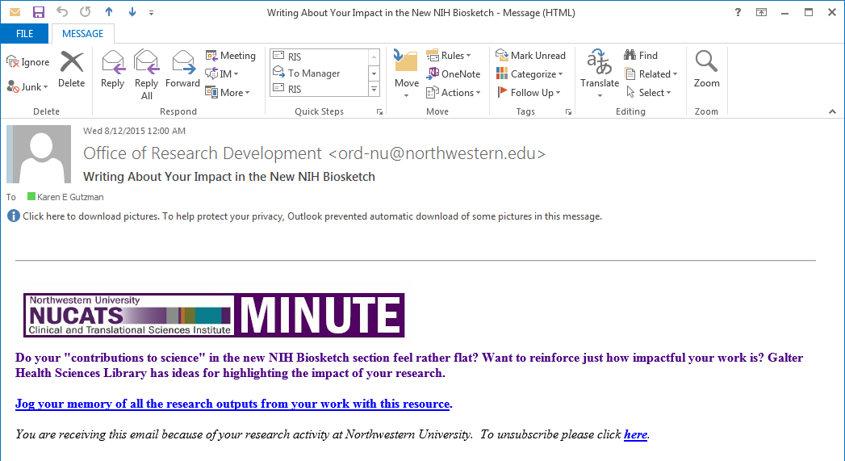
Considerations for generating content continued…
Create opportunities for wider sharing
  Ask popular bloggers if researchers can write a guest blog post
  Ask organizations with larger mailing lists to send your content
(above) Email from NUCATS on content generated by the Galter Library
Notes:
Presenter: Karen

Slide 76
Lay Summaries
A lay summary is a brief summary of a research project that is used to explain complex ideas and technical and scientific terms to people who do not have prior knowledge about the subject.
Source: Multiple Sclerosis Society of Canada
https://mssociety.ca/uploads/files/guide-to-writing-lay-summary-eng-final20130726.pdf
Ideas for Lay Summaries
Stay focused on the questions you’ve been asked - “What is it about?” and “Why is it important?”
Imagine someone asking you “so what?” and consider whether you have answered that implied question.
    Source: Spotlight on: explaining your work in plain language
    https://blog.growkudos.com/2015/12/04/explain-your-work-the-kudos-way/
Notes:
Presenter: Karen
Sources:
1) Multiple Sclerosis Society of Canada. Guide to Writing A Lay Summary. Available at: https://mssociety.ca/uploads/files/guide-to-writing-lay-summary-eng-final20130726.pdf
2) Kudos. Spotlight on: explaining your work in plain language. Available at: https://blog.growkudos.com/2015/12/04/explain-your-work-the-kudos-way/
3) Kaiser Permanente Washington Health Research Institute. Program for Readability in Science & Medicine (PRISM). Available at: https://www.kpwashingtonresearch.org/about-us/capabilities/research-communications/prism
4) Kuehne LM, Olden JD. Lay summaries enhance science communication. Proceedings of the National Academy of Sciences Mar 2015, 112 (12) 3585-3586; DOI: 10.1073/pnas.1500882112
Resources:
1) West Virginia University. Research Integrity and Compliance. Available at: https://oric.research.wvu.edu/files/d/143b076c-3a96-4c73-be6f-fc6fe986bc6a/lay-summary-examples.pdf
2) Multiple Sclerosis Society of Canada. Guide to Writing A Lay Summary. Available at: https://mssociety.ca/uploads/files/guide-to-writing-lay-summary-eng-final20130726.pdf
3) National Cancer Research Institute. How to write a good lay summary. Available at: http://www.ncri.org.uk/wp-content/uploads/2015/07/How-to-write-a-good-lay-summary.pdf
4) Salita, Joselita. Writing for lay audiences: a challenge for scientists. Bremen, Germany. Available at: http://journal.emwa.org/media/2188/2047480615z2e000000000320.pdf
5) Heart and Stroke Research Programs. Lay Reviewers and Structures Lay Summaries. Available at: http://hsf.ca/research/en/4-lay-reviewers-and-structures-lay-summaries
6) UNC Charlotte Honors College. Writing a Layperson Summary. Available at: https://honorscollege.uncc.edu/sites/honorscollege.uncc.edu/files/media/Honors%20application%20Layman%20Summary.pdf

Slide 77
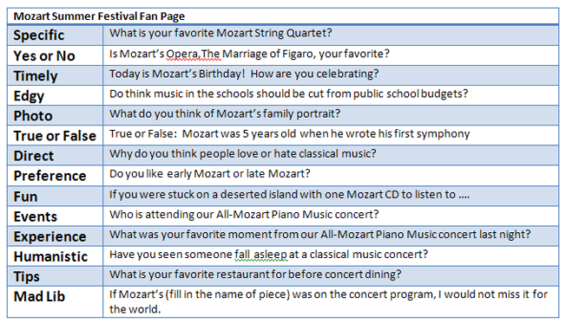
Lay Summaries continued…
Ideas for Lay Summaries continued…
Keep your sentences short – strip out unnecessary words.
  Make most sentences 8-10 words. Limit paragraphs to 3-5 sentences.
Keep your language as simple as possible – avoid terms that are specific to the field.
  Rather than saying “hypertension” why not say “high blood pressure”? Instead of “contraception” why not “birth control”?
  When using abbreviations or acronym, give it first and spell the words out in parenthesis. For example: “Put your baby to sleep on his side or back to lower the risk of SIDS (sudden infant death syndrome).”
  Source: Scientific and Technical Information: Simply Put.
  https://prism.kpwashingtonresearch.org/documents/PRISM_cdc_simply_put.pdf
Keep in mind that you want to engage your audience so that people will consume, comment, like, or share your content.
Source: 8 Surefire ways to Increase Engagement Facebook. https://blog.kissmetrics.com/increase-engagement-on-facebook/
Notes:
Presenter: Karen
Sources:
1) Multiple Sclerosis Society of Canada. Guide to Writing A Lay Summary. Available at: https://mssociety.ca/uploads/files/guide-to-writing-lay-summary-eng-final20130726.pdf
2) The Plain Language Medical Dictionary. Available at: https://www.lib.umich.edu/taubman-health-sciences-library/plain-language-medical-dictionary
3) 8 Surefire ways to Increase Engagement Facebook. https://blog.kissmetrics.com/increase-engagement-on-facebook/

Slide 78
Plain Language
Plain language is a synonym for clear communication…
  your audience “gets it” the first time they read or hear it
  it’s focused on what they need to know
  terms, techniques, and concepts they can relate to
    Source: Program for Readability in Science & Medicine (PRISM): https://prism.kpwashingtonresearch.org/using_plain_language_in_research/PRISM_resources.html
Resources to help with Plain Language
  The Plain Language Medical Dictionary : https://www.lib.umich.edu/taubman-health-sciences-library/plain-language-medical-dictionary
  PRISM Alternative Word List: https://prism.kpwashingtonresearch.org/documents/PRISM_alternative_word_list.pdf
“The language used should be person centered rather than focusing on the circumstance, illness or disability. For example “people with MS” preferable to “MS sufferers” ; a person “has MS” rather than “is a victim of MS”.”
Multiple Sclerosis Society of Canada
https://mssociety.ca/uploads/files/guide-to-writing-lay-summary-eng-final20130726.pdf
Notes:
Presenter: Karen
Sources:
1) Program for Readability in Science & Medicine (PRISM): https://prism.kpwashingtonresearch.org/using_plain_language_in_research/PRISM_resources.html
2) The Plain Language Medical Dictionary. Available at: https://www.lib.umich.edu/taubman-health-sciences-library/plain-language-medical-dictionary
3) PRISM Alternative Word List: https://prism.kpwashingtonresearch.org/documents/PRISM_alternative_word_list.pdf
4) Multiple Sclerosis Society of Canada: https://mssociety.ca/uploads/files/guide-to-writing-lay-summary-eng-final20130726.pdf

Slide 79
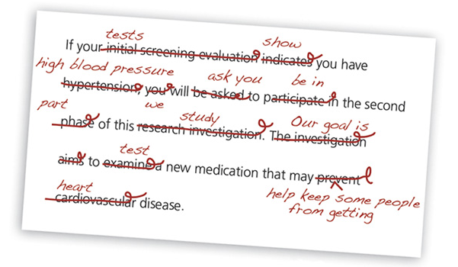
Readability
Readability is the ease in which text can be read.
The primary factors involved are:
  Vocabulary
  Sentence length and structure
  Amount of information
  Page design and formatting
  Logical order and well-organized content
  Degree to which content is meaningful and interesting
How to measure readability?
  The Flesch Reading Ease score
    Based on number of words per sentence and number of syllables per word.
    0-100 point scale, with 100 being most readable
    PRISM goal = 70 or above
  The Flesch-Kincaid Grade Level score
  Roughly the same algorithm as the Flesh Reading Ease,
  but translated to a grade level score
  PRISM goal is 6th – 8th grade
Source: Program for Readability in Science & Medicine (PRISM): https://www.kpwashingtonresearch.org/about-us/capabilities/research-communications/prism
  Other measures:
  The Fry Graph Readability Formula (http://en.wikipedia.org/wiki/Fry_Graph)
  The SMOG Readability Formula (http://en.wikipedia.org/wiki/Smog_readability)
Notes:
Presenter: Karen
Sources:
1) Program for Readability in Science & Medicine (PRISM): https://www.kpwashingtonresearch.org/about-us/capabilities/research-communications/prism

Slide 80
Activity 5 : Generating Content
Do you have content, or does it need to be generated?
  Yes and no. We have a recent study published about the health effects of prolonged sitting. But we need to write some plain language statements…
Plain language statements about the research paper:
  “A brisk walk is just what the doctor ordered! 60 minutes of exercise a day can reverse the negative effects of sitting too much”
  “A brisk walk is just what the doctor ordered! Decrease your risk of sitting mortality through 60 minutes of moderate intensity activity every day.”
  “Do you sit for more than 4 hour per day? You may be at risk for poor long-term health.”
  “Feeling the effects of sitting all day long? Sitting for more than 4 hours a day is associated with increased mortality. Decrease your risk with 60 minutes of moderate exercise every day. “
Notes:
Presenter: Karen

Slide 81

Activity 5: Generating Content
Given what we’ve discussed about lay summaries, plain language, and readability, write 2-3 brief statements about your research paper.
Please keep one the statement to 200 words or less. Other statements can be any length you choose.
Notes:
Presenter: Karen

Slide 82
Make a plan for dissemination
A basic plan might include:
  Which research findings or products are intended for dissemination?
  What do you want to achieve?
  Who is your target audience(s)?
  What tool, resource, or format do you want to use?
  Do you have content, or does it need to be generated?
    Making content more shareable for social media
Notes:
Presenter: Karen

Slide 83

Types of tweets
Oftentimes, we combine types, e.g. a tweet with an image and quote
Links. Be consistent. Put the link in the same spot each time.
Images. Tweets with images receive more attention.
Quotes. Can be a great way to share a key finding and hook the audience.
Retweets. Share others’ content that you find interesting. Reciprocity.
Questions or comments
    Identified relevant keywords and hashtags
  Google Trends (www.google.com/trends): find keywords that people use to query a specific topic
  Hashtagify.me (http://hashtagify.me/): search popularity of hashtags
  Ritetag (https://ritetag.com/): search for trending hashtags
Notes:
Presenter: Patty

Slide 84
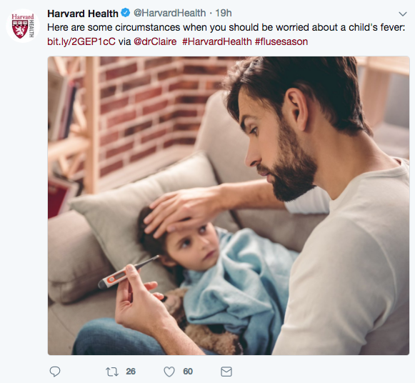
Anatomy of a tweet
Notes:
Presenter: Patty
Notes:
In Kristina Cisnero’s Hootsuite article <http://blog.hootsuite.com/how-to-write-a-tweet-to-increase-click-through-rate/> , she gives an example of a test they carried out on one of their CEO’s Tweets. They posted the same Tweet twice, but the one with the image had a 79% higher engagement rate than the one without the image.”
http://blog.hootsuite.com/how-to-write-a-tweet-to-increase-click-through-rate/

Slide 85
Anatomy of a tweet
Brief, directed text
Notes:
Presenter: Patty
Notes:
In Kristina Cisnero’s Hootsuite article <http://blog.hootsuite.com/how-to-write-a-tweet-to-increase-click-through-rate/> , she gives an example of a test they carried out on one of their CEO’s Tweets. They posted the same Tweet twice, but the one with the image had a 79% higher engagement rate than the one without the image.”
http://blog.hootsuite.com/how-to-write-a-tweet-to-increase-click-through-rate/

Slide 86
Anatomy of a tweet
Brief, directed text
Link to resource
Notes:
Presenter: Patty
Notes:
In Kristina Cisnero’s Hootsuite article <http://blog.hootsuite.com/how-to-write-a-tweet-to-increase-click-through-rate/> , she gives an example of a test they carried out on one of their CEO’s Tweets. They posted the same Tweet twice, but the one with the image had a 79% higher engagement rate than the one without the image.”
http://blog.hootsuite.com/how-to-write-a-tweet-to-increase-click-through-rate/

Slide 87
Anatomy of a tweet
Brief, directed text
Link to resource
Tweet “@” relevant researcher.
Notes:
Presenter: Patty
Notes:
In Kristina Cisnero’s Hootsuite article <http://blog.hootsuite.com/how-to-write-a-tweet-to-increase-click-through-rate/> , she gives an example of a test they carried out on one of their CEO’s Tweets. They posted the same Tweet twice, but the one with the image had a 79% higher engagement rate than the one without the image.”
http://blog.hootsuite.com/how-to-write-a-tweet-to-increase-click-through-rate/

Slide 88
Anatomy of a tweet
Brief, directed text
Link to resource
#Hashtags
Tweet “@” relevant researcher.
Notes:
Presenter: Patty
Notes:
In Kristina Cisnero’s Hootsuite article <http://blog.hootsuite.com/how-to-write-a-tweet-to-increase-click-through-rate/> , she gives an example of a test they carried out on one of their CEO’s Tweets. They posted the same Tweet twice, but the one with the image had a 79% higher engagement rate than the one without the image.”
http://blog.hootsuite.com/how-to-write-a-tweet-to-increase-click-through-rate/

Slide 89
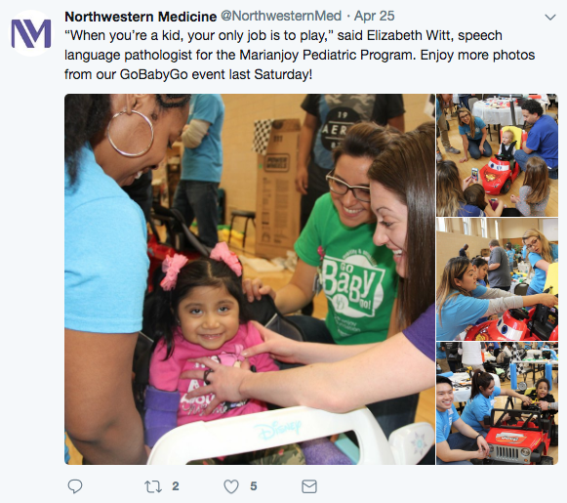
Improving a tweet
Notes:
Presenter: Patty

Slide 90
Improving a tweet
@ElizabethWitt
Notes:
Presenter: Patty

Slide 91
Improving a tweet
@ElizabethWitt
@MarianjoyRehab
Notes:
Presenter: Patty

Slide 92
Improving a tweet
@ElizabethWitt
@MarianjoyRehab
#GoBabyGo
Notes:
Presenter: Patty

Slide 93
Improving a tweet
@ElizabethWitt
Link or other hashtags #pediatricrehab #childdevelopment
@MarianjoyRehab
#GoBabyGo
Notes:
Presenter: Patty

Slide 94

Types of facebook posts
Links. Usually appear at the end of a post; link preview is available.
Images. Posts with images receive more attention.
Videos and Facebook Live. Use high quality videos with subtitles when possible.
Polls. Ability to quickly poll users on simple questions.
Shares. Share other users’ posts that you find interesting.
Notes:
Presenter: Patty

Slide 95
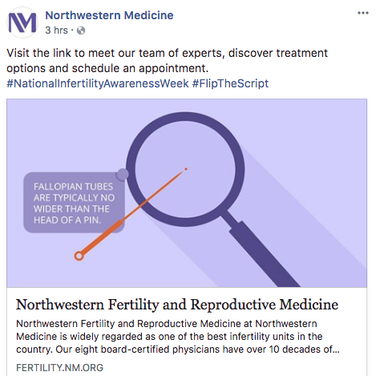
Anatomy of a facebook post
Brief, directed text
Notes:
Presenter: Patty

Slide 96
Anatomy of a facebook post
Brief, directed text
#Hashtags
Notes:
Presenter: Patty

Slide 97
Anatomy of a facebook post
Brief, directed text
#Hashtags
Link to website with preview
Notes:
Presenter: Patty

Slide 98
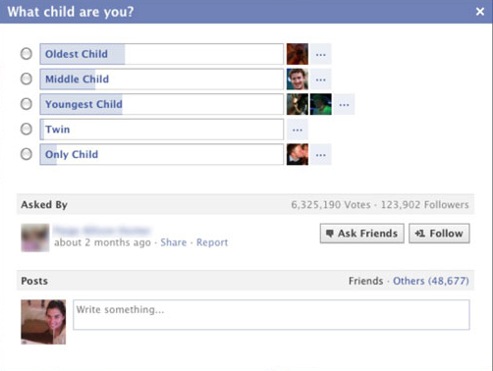
Facebook poll
Notes:
Presenter: Patty

Slide 99
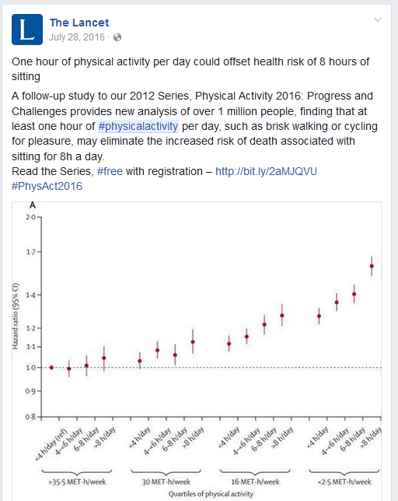
Activity 6: Making content more shareable
Alternate tweet:
A brisk walk is just what the doctor ordered! 60 minutes of exercise a day can reverse the negative effects of sitting too much #wellness #walking #getfit https://bit.ly/2I0NJXR
Notes:
Presenter: Patty

Slide 100
Activity 6: Making content more shareable
Edit your plain language summaries to include hashtags, links, or “@” specific people or organizations.
Notes:
Presenter: Patty

Slide 101
Make a plan for dissemination
A basic plan might include:
  Which research findings or products are intended for dissemination?
  What do you want to achieve?
  Who is your target audience(s)?
  What tool, resource, or format do you want to use?
  Do you have content, or does it need to be generated?
    Making content more shareable for social media
Notes:
Presenter: Karen

Slide 102
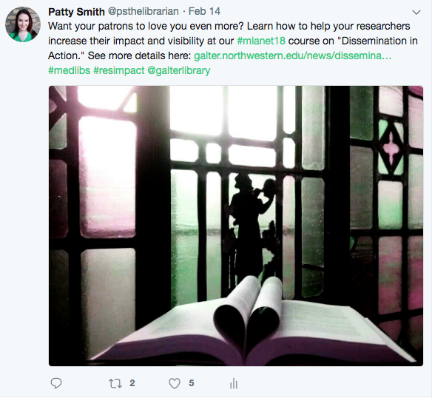
Creating eye-catching images
Picture taken using a cell phone; edited using standard photo editing software on an Android phone.
Notes:
Presenter: Karen

Slide 103

Activity 7: Create eye-catching images
Using Canva
A brisk walk is just what the doctor ordered! 60 minutes of exercise a day can reverse the negative effects of sitting too much #wellness #walking #getfit https://bit.ly/2I0NJXR
Notes:
Presenter: Karen

Slide 104

Activity 7: Create eye-catching images
Using Canva
A brisk walk is just what the doctor ordered! 60 minutes of exercise a day can reverse the negative effects of sitting too much #wellness #walking #getfit https://bit.ly/2I0NJXR
Notes:
Presenter: Karen

Slide 105
Activity 7: Create eye-catching images
Use canva to create an image for Facebook and/or Twitter
Tweet and/or Post your content with image to Facebook or Twitter
Notes:
Presenter: Karen

Slide 106
Take a break
Notes:
Presenter: Karen

Slide 107
Schedule for the afternoon
Contextualizing Dissemination
  Introductions
Dissemination Overview
  Activity 1: Choosing a paper
  Activity 2: Dissemination goals
  Activity 3: Choose an audience
  Activity 4: Choose a format
  Activity 5: Generating Content
  Break
  Activity 6: Making Content More Shareable
  Activity 7: Creating Eye-Catching Images
  Break
Using Alternative Metrics
  Activity 8: Writing on Impact Using Alternative Metrics
Wrap up and goodbyes
Notes:
Presenter: Karen

Slide 108
Navigating Risks of Online Communication
Review of “terms of service”
You retain your rights to any Content you submit, post or display on or through the Services. What’s yours is yours — you own your Content (and your photos and videos are part of the Content).
By submitting, posting or displaying Content on or through the Services, you grant us a worldwide, non-exclusive, royalty-free license (with the right to sublicense) to use, copy, reproduce, process, adapt, modify, publish, transmit, display and distribute such Content in any and all media or distribution methods (now known or later developed). This license authorizes us to make your Content available to the rest of the world and to let others do the same.
    (Twitter, May 25, 2018)
You own all of the content and information you post on Facebook, and you can control how it is shared through your privacy and application settings. In addition: For content that is covered by intellectual property rights, like photos and videos (IP content), you specifically give us the following permission, subject to your privacy and application settings: you grant us a non-exclusive, transferable, sub-licensable, royalty-free, worldwide license to use any IP content that you post on or in connection with Facebook (IP License). This IP License ends when you delete your IP content or your account unless your content has been shared with others, and they have not deleted it.
(Facebook, January 30, 2015)
Notes:
Presenter: Karen

Slide 109
Navigating Risks of Online Communication
  “A troll is someone who deliberately provokes others online, typically through inflammatory, offensive, or provocative comments. Their intent is to upset others and elicit an emotional response (preferably an angry one).”
  “There is a grey area between spirited dissent and out-and-out trolling that houses the passionately misinformed…. For the sake of convenience, this group is often referred to as ‘the internet.”
Have a plan for negative comments or “trolls”:
Talk with your university’s Office of Communication on how to deal with any issues.
Ignore trolls or respond with facts
Diffuse the situation with humor
Block or ban, when appropriate
Source: How to Deal with Trolls on Social Media. Hootsuite. https://blog.hootsuite.com/how-to-deal-with-trolls-on-social-media/
Notes:
Presenter: Karen
Source:
1) Source: How to Deal with Trolls on Social Media. Hootsuite. https://blog.hootsuite.com/how-to-deal-with-trolls-on-social-media/

Slide 110



Managing Social Media Content
Three tools for managing social media content
  Hootsuite (https://hootsuite.com/)
    Free version for individual – only three social media networks (ex. Twitter, Facebook, Linked In)
    Monitor networks
    Publish to networks using a schedule
  Kudos (https://www.growkudos.com/)
    Free version for individual researcher
    Claim publications, write plain language summaries, and publish to Facebook, Twitter, Linked In, or get a traceable link to share across your email, Mendeley, ResearchGate, Academia.edu
    Tracks shares, mentions, readers, etc. across social media networks via Altmetric
  Microsoft Excel
    Share a spreadsheet with people working on content
    Easily keep a schedule for content review and publishing
    Quickly find past content for re-publishing
Notes:
Presenter: Karen

Slide 111
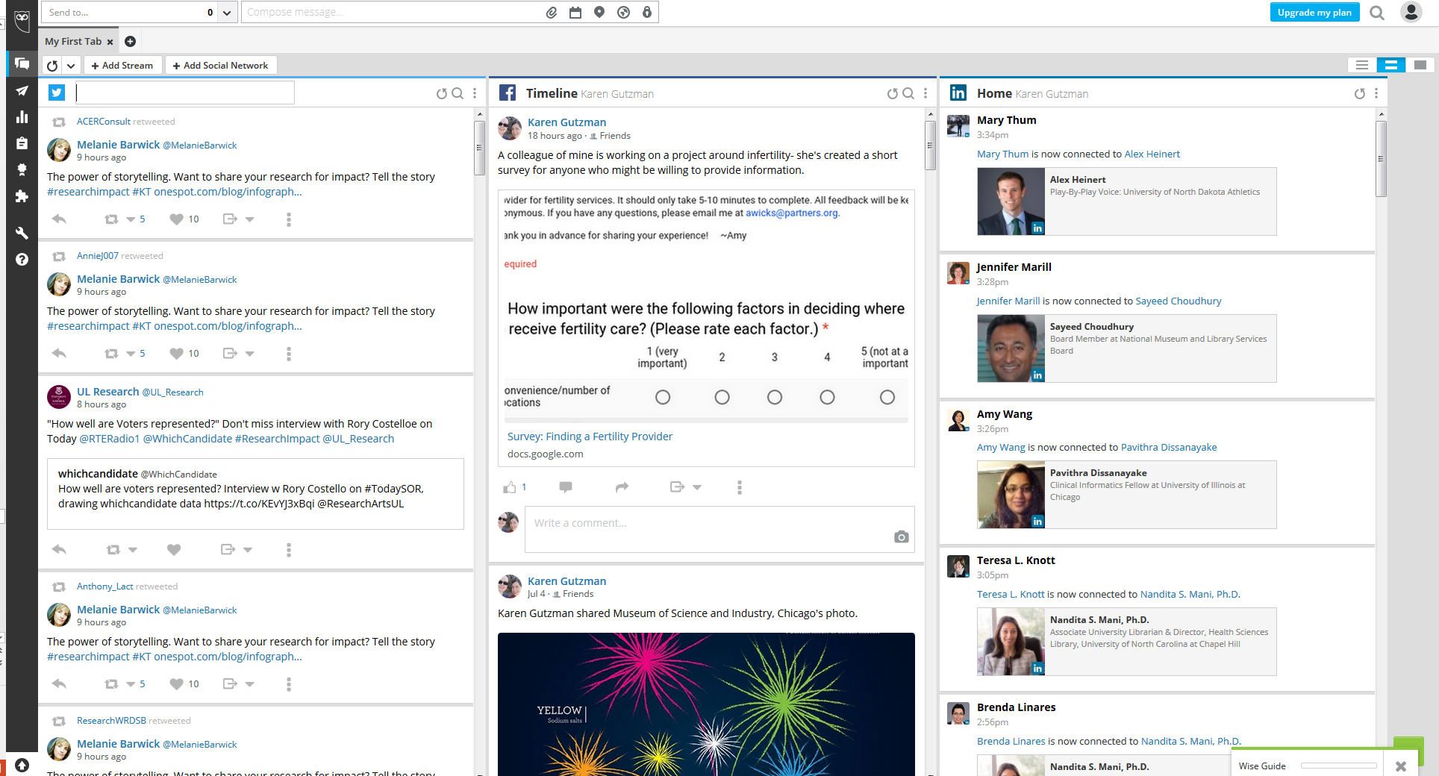
Hootsuite
Notes:
Presenter: Karen
Source: Hootsuite. Available at: https://hootsuite.com/#

Slide 112
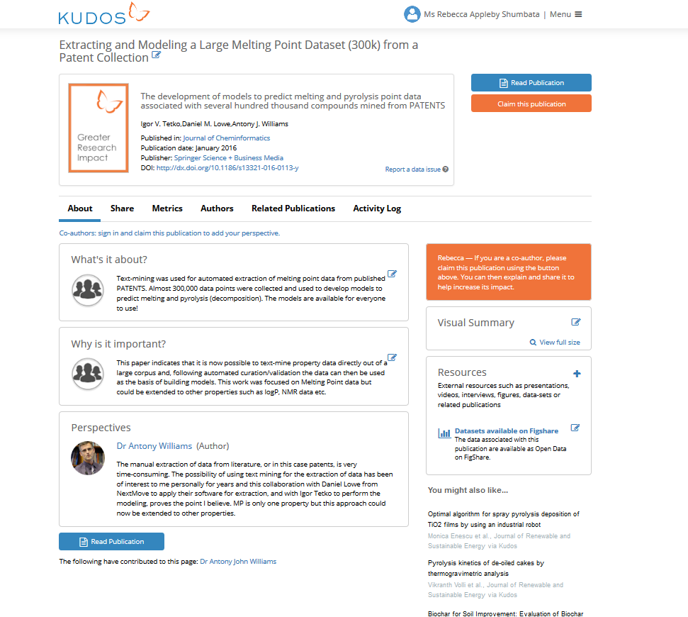
Kudos - Personal Dashboard
Notes:
Presenter: Karen
Source: Kudos. Available at: https://www.growkudos.com/

Slide 113





Managing Social Media Content continued…
Other tools for managing or monitoring social media
  If This Then That (IFTTT): https://ifttt.com/
  Sprinklr: https://www.sprinklr.com/
  Spredfast: https://www.spredfast.com/social-marketing-platform
  Buffer: https://buffer.com/
  Tweetdeck: https://tweetdeck.twitter.com/
  Sysomos http://sysomos.com/
Notes:
Presenter: Karen

Slide 114
Using Alternative Metrics
Notes:
Presenter: Patty

Slide 115









Altmetrics Manifesto is published
Kudos is launched
Elsevier acquires Plum Analytics, integrates metrics in Scopus.
1st HuMetrics workshop held
2010
2012
2013
2014
2017
2018
Almetric, Impact Story, Plum Analytics, DORA are launched
1st Altmetrics conference held; Ebsco integrates PlumX metrics in databases; Springer Nature integrates Altmetric in journals
Metrics Toolkit launched
Notes:
Presenter: Patty
2010 Altmetrics manifesto
A call for more tools and research based on altmetrics
2012 altmetric,impact story launched, plum analytics, DORA launced
2013 Kudos launched
2014 plum incorporated into Ebsco, 1st Altmetric conference held in london, Springer Nature incorporates altmetric
2017 Scopus integrates PlumX metrics

Slide 116


Alternative metrics or Altmetrics
Data that explain both the volume and nature of attention research has received online.
Can measure how many people have shared or engaged with a scholarly output online, e.g.
  Twitter, news outlets, Wikipedia citations, post-publication peer review, citations in policy documents
Provides evidence of engagement with diverse audiences and potential impact
Complementary to bibliometrics (citation-based)
Notes:
Presenter: Patty

Slide 117
Advantages of Using Altmetrics
It can take 2+ years for citations to accrue. Alternative metrics offer real-time information.
Alternative metrics can help show how you’ve reached various audiences, i.e. the public, policy makers, peers in your field.
Alternative metrics can track more than journal articles and books.
Source: What are Altmetrics. Advantages & Limitations. http://www.whatarealtmetrics.com/what/advantages/
Notes:
Presenter: Patty
Source:
1) What are Atlmetrics? Advantages & Limitations. Available at: http://www.whatarealtmetrics.com/what/advantages/

Slide 118
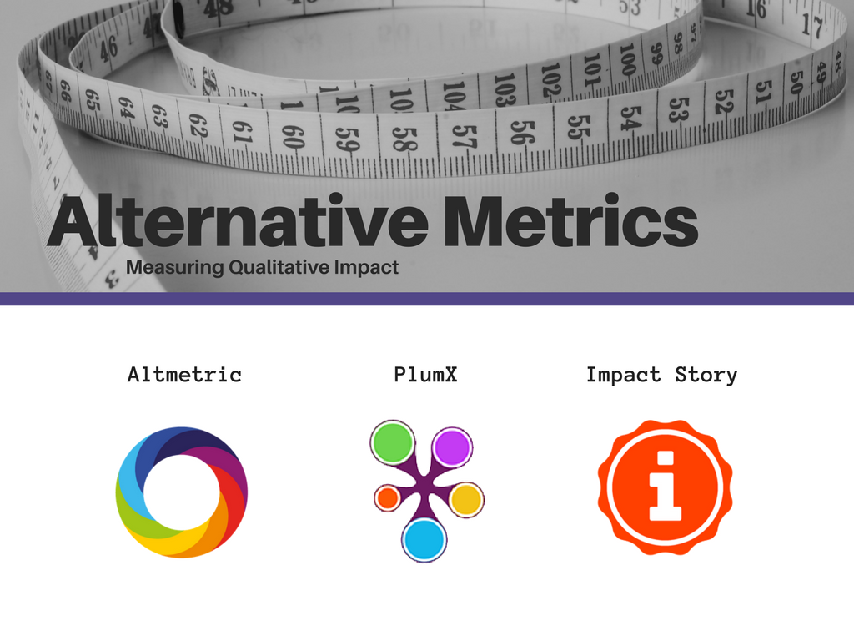
Notes:
Presenter: Patty

Slide 119
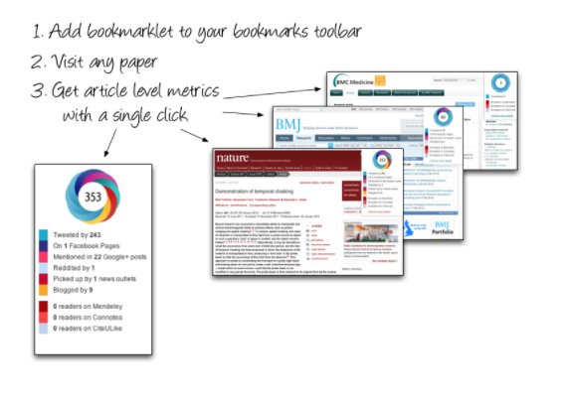
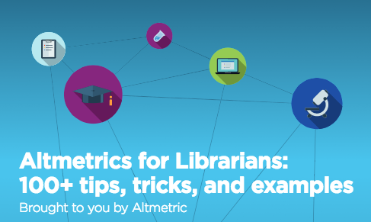

https://www.altmetric.com/products/free-tools/
https://www.altmetric.com/libraries-ebook/
Notes:
Presenter: Patty
Notes: Altmetric = digital science, free tools and subscription. Altmetric donut – each color indicates a different type of attention, red = news outlets, light blue = twitter. Number in the middle = a weighted score.
Source:
1) Altmetric Free Tools. Available at: https://www.altmetric.com/products/free-tools/
2) Altmetrics for Librarians: 100+ tips, tricks, and examples. Available at: https://www.altmetric.com/libraries-ebook/

Slide 120
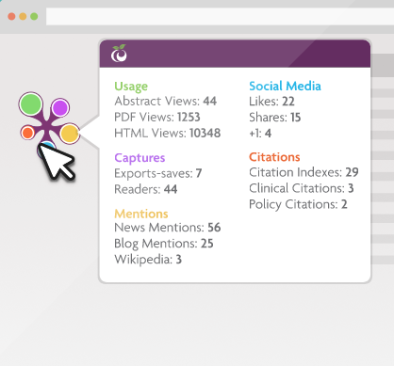

How PlumX Metrics on Scopus help tell the story of your research:
https://www.elsevier.com/solutions/scopus/support/webinars
Plum Goes Orange: Elsevier Acquires Plum Analytics
https://scholarlykitchen.sspnet.org/2017/02/02/plum-goes-orange-elsevier-acquires-plum-analytics/
Spotlight on Captures: Early indicators of citation counts:
https://plumanalytics.com/captures-early-indicators-citation-counts/
Notes:
Presenter: Patty
Notes: PlumX = Elsevier, integrated into Scopus and various Elsevier journals. Plum Print, The colors again indicate a different type of attention, they change size based on how much attention. No single score.
Clinical citations – Dynamed
Source:
1) How PlumX Metrics on Scopus help tell the story of your research. Available at: https://www.elsevier.com/solutions/scopus/support/webinars

Slide 121
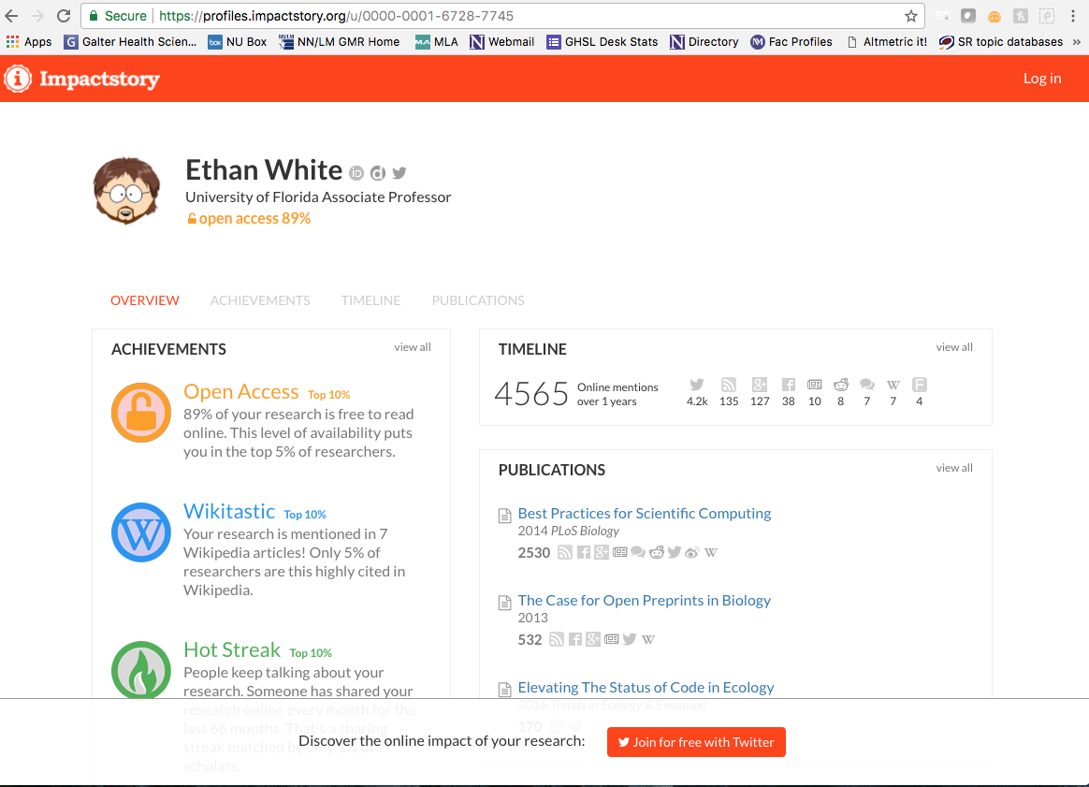
Notes:
Presenter: Patty
Notes: Impact Story = nonprofit funded by the Alfred P. Sloan foundation and the National Science Foundation, free. Marks different ”achievements” a researcher has.

Slide 122

Notes:
Presenter: Patty

Slide 123

Notes:
Presenter: Patty

Slide 124

Notes:
Presenter: Patty

Slide 125

Notes:
Presenter: Patty

Slide 126

Notes:
Presenter: Patty
Notes: 32 cites in scopus

Slide 127

Notes:
Presenter: Patty

Slide 128
Demonstration
Does physical activity attenuate, or even eliminate, the detrimental association of sitting time with mortality? A harmonised meta-analysis of data from more than 1 million men and women
Look up paper
  PMID: 27475271
  https://bit.ly/2HHyt5k
Notes:
Presenter: Patty

Slide 129

Activity 8: Writing on impact using alternative metrics
“This paper has been tweeted by over 1555 twitter users, reaching an audience upwards of 3 million people; it has also receive significant attention in blogs, on Facebook, and by news outlets, demonstrating how diverse audiences, including the public, are engaging with our work.”
Notes:
Presenter: Patty

Slide 130
Activity 8: Writing on impact using alternative metrics
See if your paper has any alternative metrics
Write a brief statement summarizing the attention it has received
Notes:
Presenter: Patty

Slide 131
Why concern ourselves with Altmetrics?
Articles with positive altmetrics scores also have higher citations when compared to similar articles. (Thelwall M, et al. 2013)
Social Media. Tweets, Facebook wall posts, blog mentions, mainstream media mentions, and forum posts are associated with citation counts, though the magnitude of this association is not known. (Thelwall M, et al. 2013)
Online Reference Managers. Articles saved in CiteULike and Mendeley are also likely to have citation counts in Web of Science. (Li X, et al. 2012)
Blogs. Articles receiving blog citations close to their publication time receive more journal citations later than the articles in the same journal published in the same year that did not receive such blog citations. (Shema H, et al. 2014)
Notes:
Presenter: Karen
Sources:
1) Do Altmetrics Work? Twitter and Ten Other Social Web Services. Statistically significant associations were found between higher metric scores and higher citations for articles with positive altmetric scores in all cases with sufficient evidence (Twitter, Facebook wall posts, research highlights, blogs, mainstream media and forums) except perhaps for Google+ posts. Evidence was insufficient for LinkedIn, Pinterest, question and answer sites, and Reddit,…
Thelwall M, Haustein S, Larivière V, Sugimoto CR (2013) Do Altmetrics Work? Twitter and Ten Other Social Web Services. PLOS ONE 8(5): e64841. https://doi.org/10.1371/journal.pone.0064841
2) Validating online reference managers for scholarly impact measurement. Statistically significant correlations were found between the user counts [CiteULike and Mendeley] and the corresponding WoS citation counts, suggesting that this type of influence is related in some way to traditional citation-based scholarly impact but the number of users of these systems seems to be still too small for them to challenge traditional citation indexes.
Li, X., Thelwall, M. & Giustini, D. Scientometrics (2012) 91: 461. https://doi.org/10.1007/s11192-011-0580-x
3). Do blog citations correlate with a higher number of future citations? Research blogs as a potential source for alternative metrics. Articles reviewed in these blogs therefore receive “blog citations.” We hypothesized that articles receiving blog citations close to their publication time receive more journal citations later than the articles in the same journal published in the same year that did not receive such blog citations. Statistically significant evidence for articles published in 2009 and 2010 support this hypothesis for seven of 12 journals (58%) in 2009 and 13 of 19 journals (68%) in 2010. We suggest, based on these results, that blog citations can be used as an alternative metric source.
Shema, H. , Bar‐Ilan, J. and Thelwall, M. (2014), Do Blog Citations Correlate With a Higher Number of Future Citations?. J Assn Inf Sci Tec, 65: 1018-1027. doi:10.1002/asi.23037

Slide 132
Moving forward
Ideas for making use of today’s content…
  General Ideas:
  Make a list of how the library can provide guidance or actual services related to dissemination
  Make a LibGuide on resources for dissemination plans
Working with faculty:
  Work with faculty to write impact statements that includes alternative metrics for their CV, biosketch, online profile, etc.
  Create a presentation on dissemination and social media for researchers
  Use yours or the library’s social media (blogs, news items, twitter, facebook) to highlight researchers who are active on social media
Working with Centers, Programs, Institutes:
  Create a presentation on dissemination and social media for Centers, Programs, and Institutes
  Convene a panel of speakers on research dissemination topics
  Follow the Center (etc.) on social media to help highlight their work
Notes:
Presenter: Karen

Slide 133
Course Evaluation
Please follow the instructions below in order to complete an evaluation and claim an MLA Certificate of Credit for your participation. You have 30 days from the date you completed the course to complete an evaluation and claim credit.
Go to www.medlib-ed.org.
Login
Click My Learning on the blue bar near the top of the page.
Select the course from your list and complete the attestation, evaluation and claim credit.
If you have questions or run into problem, please email MEDLIB-ED@mail.mlahq.org.
Notes:
Presenter: Karen

Slide 134
Acknowledgements
The following people are instrumental in developing research impact and dissemination materials and training, and from whose guidance we have greatly benefited.
Cathy Sarli
Becker Medical Library, Washington University in St. Louis
Amy Suiter
Becker Medical Library, Washington University in St. Louis
Kristi Holmes
Galter Health Sciences Library & Learning Center, Northwestern University

Slide 135
Thank you!

