Slide 1
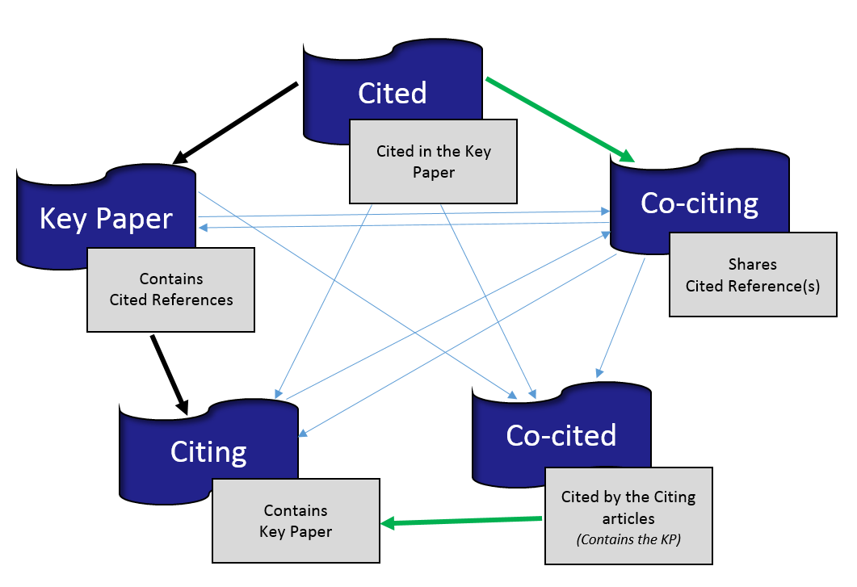
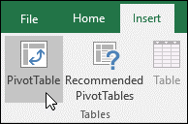

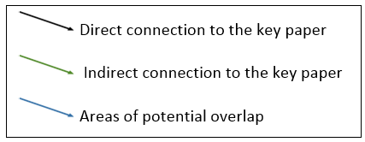
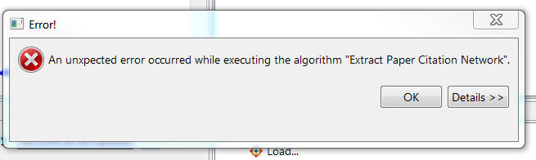

Galter Health Sciences Library, Northwestern University Feinberg School of Medicine
Bridging the Gap: Dare to Incorporate Citation Analysis in Searching for Literature
Q. Eileen Wafford
Objectives
The Process
Librarians participating in comprehensive literature searches are entrusted to capture all relevant literature on specific topics. This leaves many librarians wondering if their results reflect the best balance of precision and recall. Citation analysis adds an objectivity to searches that will reduce uncertainties. We examined the practical applications of Christopher Belter’s citation analysis methodology, which is based on overlapping citations connected by a few key papers, to enhance search strategies and identify relevant literature.
Cited | Web of Science Locate and click on the title of a citation for a key paper Choose Save to Other File Formats Choose Record Content: Full Record and Cited References Choose File Format: Plain Text and click Send Sci2 Tool Load file in the Sci2 Tool File > Load > select file and click Open > Load as ISI flat format > Select Extract paper citation network Data Preparation > Extract Paper Citation Network View the paper citation network in Excel In the Data Manager panel on the right, right click on the Paper information link then select View from the menu options Excel Add a column to indicate citation relationship | Co-citing | Web of Science Locate and click on the key paper citation Click the View Related Records link Choose Save to Other File Formats For the Number of Records, consider records that share at least 2 references with the key paper. Choose Record Content: Full Record Choose File Format: Plain Text and click Send Sci2 Tool Load file in the Sci2 Tool File > Load > select file and click Open > Load as ISI flat format > Select Extract paper citation network Data Preparation > Extract Paper Citation Network View the paper citation network in Excel In the Data Manager panel on the right, right click on the Paper information link then select View from the menu options Excel Add a column to indicate citation relationship | Citing & Co-cited | Web of Science Locate and click on the key paper citation Click the Times Cited link Choose Save to Other File Formats Choose Record Content: Full Record and Cited References Choose for File Format: Plain Text and click Send Sci2 Tool Load file in the Sci2 Tool File > Load > select file and click Open > Load as ISI flat format > Select Extract paper citation network Data Preparation > Extract Paper Citation Network View and label the citation network in Excel Excel Sort the columns by inOriginalDataSet Label columns accordingly. Rows with values in the inOriginalDataSet are citing articles. Rows without values in the inOriginalDataSet are co-cited articles.
Getting Started
Key Paper
The proposed method of citation analysis starts with the identification of one or more key papers. These are usually seminal articles covering the reviewers’ research question and meeting inclusion and exclusion criteria.
Web of Science
We gathered citation data from Web of Science.
Sci2 Tool
The Sci2 Tool is a free modular toolset designed to support temporal, geospatial, topical, and network analysis and visualization of scholarly datasets. We employed the Sci2 Tool to extract the citations we retrieved from Web of Science.
Excel
We used Microsoft Excel to format and summarize the data and citation relationships.
Knowledge Flow
Pivot Tables
A pivot table allowed us to quickly and efficiently summarize, analyze, and format data. Follow the three step below to create a pivot table:
Go to Insert > Tables > PivotTable.
  If you are using Excel for Mac 2011 and earlier, the PivotTable button is on the Data tab in the Analysis group.
Excel will display the Create PivotTable dialog with your range or table name selected.
  In the Choose where you want the PivotTable report to be placed section, select New Worksheet.
Click OK and Excel will create a blank pivot table.
  The Field List panel allows users to add, arrange, and analyze information. Drag and drop the label field to the ROWS area and the Relationship field to VALUES area.
You can now sort and analyze the citation relationships!
Citation Relationships
Direct Relationship
Articles connected to the key paper as:
Cited - a source of information and in the reference list.
Date of Publication: Before the key paper.
Citing - used the key paper as a source of information and include the key paper as a citation in the reference list.
Date of Publication: After the key paper.
Possible Overlap (reference list could also contain the following): Cited articles, co-citing articles, and co-cited articles.
Indirect Relationship
Articles connected to the key paper as:
Co-citing - share a reference with at least one article in the key paper’s reference list.
Date of Publication: Before, concurrent to, or after the key paper.
Possible Overlap (reference list could also contain the following): Citing articles, co-cited articles, and the key paper.
Co-cited - are in the reference lists of articles that have cited the key paper.
  Date of Publication: Before, concurrent to, or after the key paper.
Possible Overlap (reference list could also contain the following): Cited articles, co-citing article, and the key paper.
There are multiple direct and indirect ways in which a citation can be related to an article.
Any previously published paper may appear in the reference list of an article.
Results
Systematic Review
  Identified 670 unique citations for title and abstract screening using traditional searching techniques.
  Selected three key papers and identified 159 citations connected by three or more relationships.
  There were 25 shared citations.
Scoping Review
  Identified 152 citation using traditional searching methods.
  Identified 210 citations using citation analysis.
  There were 5 shared citations.
Key Challenges
Sci2 Tool Error Message
Solution: Remove the row with missing data in Excel.
Large master spreadsheet
Solution: Increase the cut-off number of shared references for “Related Records” in Web of Science.
Possible overrepresentation
Solution: Use key papers published by different authors.
Conclusions
The biggest benefit of incorporating citation analysis is the identification of new and relevant citations. Fortunately, the tools required to incorporate this methodology are widely available, and the uniqueness of each search provides librarians with the flexibility to determine how to apply the results in a way that enhances a particular search.
Acknowledgements: A very special gratitude goes out to Karen Gutzman for her foundational support and Christopher Belter.
Reference: Belter, C. W. (2016). Citation analysis as a literature search method for systematic reviews. Journal of the Association for Information Science and Technology, 67(11), 2766.

