Slide 1
Best Practices in Research Data Management and Data Sharing
An Introduction
Sara Gonzales, MLIS
Data Librarian
Galter Health Sciences Library & Learning Center

Slide 2
Topics we will cover:
What are best practices for research data management?
What are the benefits of data sharing?
Where should I consider data sharing?
What resources are available through Northwestern to help me with data management and data sharing?

Slide 3
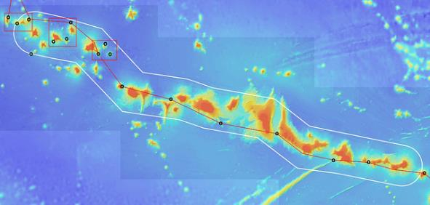
What is Research Data?
Research data is defined as “the recorded factual material commonly accepted in the scientific community as necessary to validate research findings” (Excerpted from OMB Circular A-110 36.d.2.i).
Research data can be analog or digital, and exists in many different styles, structures and formats.
https://www.flickr.com/photos/papahanaumokuakea/35643392263/ (Public Domain)
Notes:
The idea of research data is deceptively simple. Within the brief OMB definition is included many types and formats of data, such as:
Documents (text, Word), spreadsheets
Laboratory notebooks, field notebooks, diaries
Questionnaires, Survey responses, transcripts, codebooks
Health indicators such as blood cell counts, vital signs
Audio and video recordings
Images, films
Protein or genetic sequences
Test responses
Slides, artifacts, specimens, samples
Database contents (video, audio, text, images)
Models, algorithms, scripts
Software code, software for simulation
Methodologies and workflows
(credit: https://researchguides.uoregon.edu/data-management/fileformats).

Slide 4

What is Research Data Management?
Research data management concerns the organization of data, from its entry to the research cycle through to the dissemination and archiving of valuable results.
Research Data Management is part of the research process, and aims to make the research process as efficient as possible, and meet expectations and requirements of the university, research funders, and legislation
Adapted from RDM Principles: Scope, University of Leicester, research archiving blog
Designed by kjpargeter / Freepik, http://www.freepik.com.

Slide 5
The value of data
Data is a valuable asset. Large investments of funds and researcher time are expended to collect data.
Data should be managed to:
  maximize the effective use and value of data and information assets
  ensure its provenance and authenticity by ensuring: data accuracy, integrity, integration, timeliness of data capture and presentation, relevance, and usefulness
  ensure appropriate use of data and information
  facilitate data sharing
  ensure sustainability and accessibility in long term for re-use in science
Adapted from: DataONE Education Module: Why Data Management?
Notes:
The most important reason to practice RDM: data is a valuable asset.
Other reasons:
RDM is part of the responsible conduct of science
RDM facilitates reproducibility for yourself and others
RDM can lead to data sharing and fruitful collaborations for future research
Consistently applied RDM can ease day-to-day workflows in the lab or office.

Slide 6
Data and University requirements
NU Research Data: Ownership, Retention, and Access (policy effective January 2018):
“Research data must be retained for a minimum of three years after the financial report for the project period has been submitted or, for non-sponsored projects, a minimum of three years after the project has ended and, if applicable, the budget reconciled. In addition, any of the following circumstances may justify longer periods of retention
Reasons research data may need to be retained longer:
  If needed to protect any intellectual property resulting from the work
  If a student was involved, the data must be retained until the student’s degree is awarded and any resulting papers are published
  If a funding award or contract with Northwestern specifically requires a longer retention period
  If Federal oversight, regulations, sponsor policies, or journal publication guidelines require a longer retention period”
From Northwestern University, Research Data: Ownership, Retention, and Access Policy
Notes:
Awareness of and planning for research data retention, in the sense of records retention, is not only a best practice, but is required by Northwestern.

Slide 7
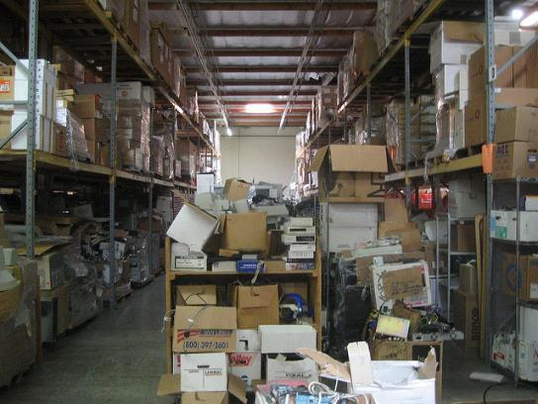
Data Inventories
Data inventories seek to answer the what, who, where, how, and when questions surrounding data collection
What is the data?
  Title
  Description
  Number, format, and size of files
  Rate of file growth
  Versions of files
Who created, accesses, and owns the data?
  PI/Study lead/Contact
  University, Department, Research Core, Research Team, Consortium or Group
  Funder
  Authentication levels/Restrictions
  Outside requesters
https://www.flickr.com/photos/roland/1413399/ (Public Domain)
Notes:
Sometimes a project is underway, but research data management practices need to align better with what was outlined in the grant application’s DMP, or you want to establish a new plan or more comprehensive data documentation, but don’t know where to start. A data inventory is a great place to start, because it allows you to get a big picture view of what you’re currently doing with data so all activities and procedures can be documented. At a minimum, a data inventory should include the what, who, where, how, and when questions surrounding your work with research data.

Slide 8
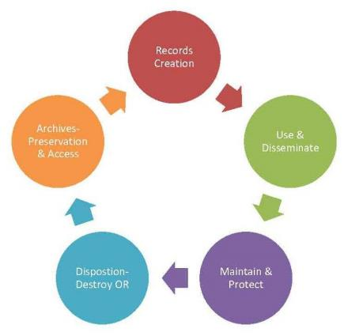
Data Inventories
Data inventories seek to answer the what, who, where, how, and when questions surrounding data collection
Where is the data stored?
  Institutional servers or services (NU Box)
  Filesharing services
  Personal account drives (Google)
  Individuals’ computers
  Backups
When is data being collected, and what are the plans for its future?
  Date created/modified
  Attribution: who did what when?
  Data Retention
  File format migration
  Long-term storage
How is data being created and manipulated?
  Collection techniques and instruments
  File naming
  Workflows
  Metadata
  Analysis tools and software
Image: The Records and Information Lifecycle. Salt Lake County Archives
Notes:
When we defined research data management we mentioned the research cycle of data. While not every project will conform neatly to this exact flow, research projects in general will move from record, or in the case of research, data creation, to use and dissemination (in the form of publication or data sharing), maintenance and protection of data while it’s being worked with, then either destruction or a planned move to an archival preservation platform when day-to-day use of the data is no longer required.
A Project Data Manager is the ideal person to keep track of all your data documentation, and all procedures going forward. This person documents, disseminates, enforces, and updates the project’s data procedures.

Slide 9

Best practices in research data management
Data Backups
Backup Best Practices:
3 copies: original, local/external, and offsite/external
Backup consistently: reminders or auto-backups
Be able to roll back changes for at least 1 month
Optical storage: removable hard drives, CDs, DVDs
Don’t use cloud storage for sensitive data
Image: http://www.freepik.com Designed by rawpixel.com
Notes:
Your data should be kept in three locations – the original, one local backup, and one offsite or cloud-based backup. Original might be your own hard drive, a local backup might be on a removable hard drive or on Northwestern’s servers, and a remote backup could be a hard drive that’s physically removed, or, increasingly, cloud storage services.
Recommendations: Backup consistently per your procedures – set your backup utility to back up automatically at logical intervals. A best practice is to be able to go back at least one month to older versions of your data. Versions older than one month can be deleted unless you need them; only use optical storage in the short-term or as a last resort, because these devices break down over time

Slide 10
Data Storage & Backups
Northwestern Recommendations
FSM File Storage
See FSMIT’s Data Storage Policy
Requirements for secure storage for data containing PHI
  Links to requests for storage and fsmhelp@northwestern.edu for questions
  Northwestern-approved external backup options
File storage, server: FSMResFiles (approved for sensitive data)
File storage, cloud:
  Northwestern SharePoint
File backup, secure cloud: Northwestern Endpoint Device Backup
  Free, secure cloud-based backup available to all FSM departments
  Individually select files or folders to backup, or your whole hard drive
  Restore on your own at any time
Notes:
Northwestern SharePoint features and benefits: 1) customizeable web forms 2) file versioning for collaboration 3) online discussion forums 4) sub-sites for teams and projects 5) Team calendaring with Outlook integration 6) simultaneous user collaboration on Office Documents. NU SharePoint is approved for storing sensitive data when used with the appropriate settings. (Adapted from NUIT OneDrive and SharePoint Overview, https://www.it.northwestern.edu/about/news-events/2022/onedrive-sharepoint-engagement.html)

Slide 11
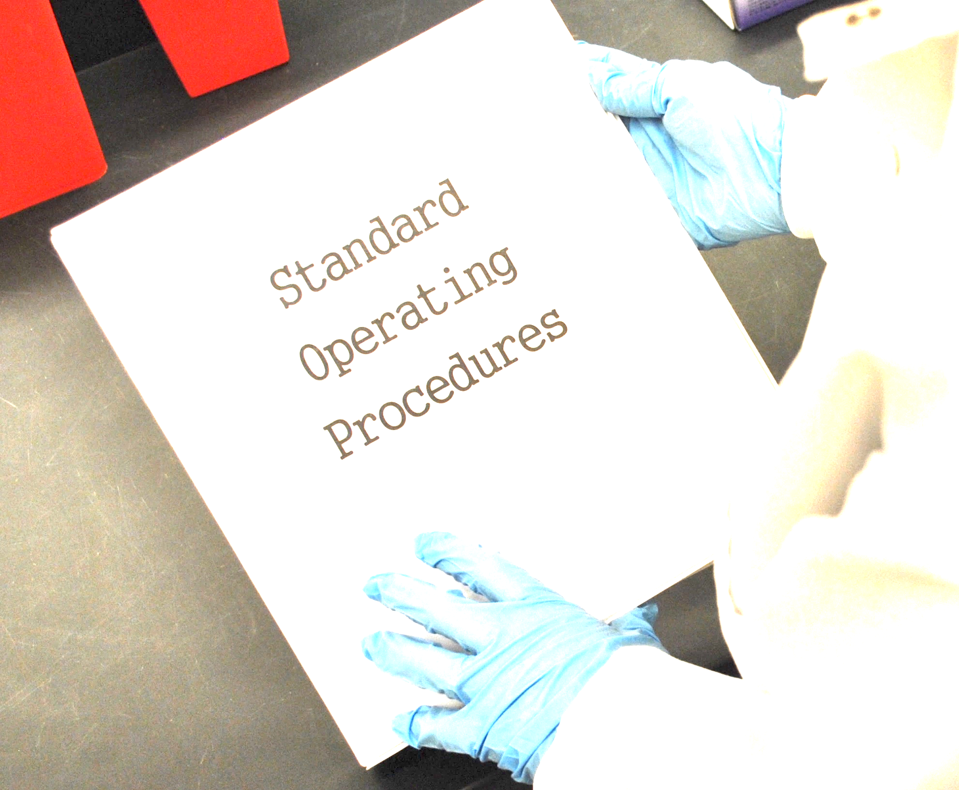
Standard Operating Procedures
Step-by-step Procedures
List all the steps to thoroughly outline a daily operational practice, noting what is to be completed and who is responsible for completing it
Define the Procedure
Give your procedure a name and a definition or purpose to avoid confusion
Who Maintains the Procedure?
List the name or title of the person responsible for upkeep and enforcement of the procedure
Incorporate a Date and Review Regularly
Procedures are more likely to be followed if they’re regularly updated
Definitions
Describe any jargon or acronyms used
Notes:
SOP’s are a good guideline or jumping-off point to document and disseminate your team’s data management best practices. They can outline who is responsible for collecting data and what methods they will use, where data will be stored, and how it will be processed. The templates are only a guide; an SOP can be as detailed as needed in order for the data to be properly described and preserved. Things to describe in SOP’s include file formats in which the data will be stored, software and methodologies that will be used for aggregation and analysis, plans for backups and long-term preservation, and even plans for sharing data.

Slide 12
Standard Operating Procedure to apply a file naming convention
    SOP Title: Naming files per the SR naming convention Date: 2019-02-01
    Purpose: To consistently name all SR files according to the naming convention
    Responsibility: Head, Research and Information Services
    Definitions:
    1) SR Naming Convention: the format for naming files agreed upon by the SR workgroup. This format consists of a multi-part name separated by underscores. The first three parts of any folder or filename are always: Date (YYYYMMDD)_InvestigatorSurname_(Subject)SR
    Procedure:
    Make sure that you are storing your file in the appropriate folder (see folder creation SOP).
    Make a multi-part filename, with the parts separated by underscores, in the following format: Date (YYYYMMDD)_InvestigatorSurname_(Subject)SR_SearchStrategy.docx
    The fourth part in the multi-part filename should always refer to a term from the Systematic Review process. If more detail is needed to describe the file, include this detail in a fifth part.
    If there is more than one word in one of the parts, demarcate a new word with capital letters (see “SearchStrategy” in the example in step 2.
    Do not give two files exactly the same name. Differentiate them with “v02” for version 2 at the end of the filename, or another appropriate designation.
Notes:
Standard Operating Procedure documents can be as long or short as you’d like to make them. Here is a sample one-page SOP I created to document the procedures for naming files in a systematic review. It’s a good inspiration for how to approach SOP’s. Break down the big task of data management by dividing into smaller chunks of tasks, all of which can be governed by a short SOP. Write one for data entry, one for file naming, one for data storage procedures, etc.

Slide 13
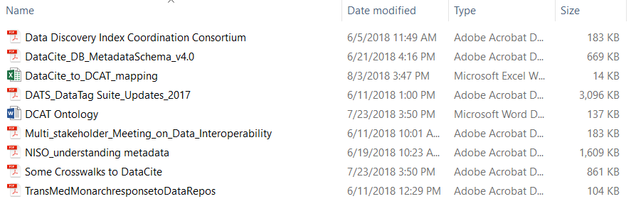
Best practices in research data management
File Naming Conventions and Best Practices

Slide 14
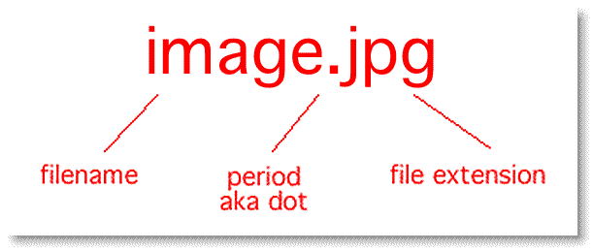
File Naming Conventions and Best Practices
Multi-Part Filenames
-Each section represents something important about the file
-Run the sections together or break with underscores
Quality Control
-Train new staff in the file naming convention
-Apply conventions consistently and run periodic checks for compliance
Sort by Date
-Put the date at the beginning of the filename in YYYYMMDD format
Be Descriptive
Make the parts of the filename something everyone who uses the file will understand
Standard Operating Procedure
-Document and share with all file users the procedure for naming new files
Version Information
-Add “v01” or “v02” to the end of a filename
-Leading zeroes are important!
Notes:
Modern operating systems can handle filenames up to 255 characters, which allows for creation of a descriptive filename (however, don’t make them overly-long!). Avoid using special characters in filenames like slashes, hash signs and question marks. And don’t rely on a nesting folder structure in lieu of a descriptive filename. Folder structures can easily be manipulated, and may not remain in their current state forever. Without a descriptive title, a file in the wrong folder is essentially “lost.”
Things to consider in a multi-part filename for research data:
Project or experiment name or acronym
Location/spatial coordinates
Researcher name/initials
Date or date range of the experiment
Type of data
Conditions
Version number of the file
If you find you need to batch re-name files, try the following tools:
Windows bulk Rename Utility: https://www.bulkrenameutility.co.uk/Main_Intro.php
Mac: https://renamer.com/
Linux, Mac, or Windows, Free: https://www.powersurgepub.com/products/psrenamer/index.html

Slide 15
Sample filenames for data files from a study
  KGH_verbal_StrsHlth_23745_Survey1_20180817.pdf
  23846_StrsHlth_Survey1_KGH_verbal_20180817_v01.pdf
  20180817_StrsHlth_Survey1_43584_KGH_verbal.pdf
Notes:
File characteristics:
PDF files scanned from paper surveys completed by study participants reporting the effect of everyday stress on their health (“StrsHlth” is the shortened study title)
There was more than one survey instrument (we focus on Survey1 here)
Each survey was completed with a member of the research staff present (initials KGH), who administered the questions verbally (“verbal” as a condition of the data collection)
Each interviewee was de-identified (five-digit code numbers)
A note about automatic versioning: Document storage services like OneDrive or Google Drive often save version information, but make sure the information travels with the files, or is embedded or documented somewhere, before transferring files away from storage services and into repositories or other storage

Slide 16

Folder Naming and Organization Best Practices
Incorporate Dates as Needed
As with naming a file, incorporate the date in YYYYMMDD format into your folder names, at any level, when lining up by date is needed.
Start with the Top-Level Hierarchy
The highest level should be a grouping of topics or functional areas that are most important to the project.
Decide on a Naming Convention
Name folders consistently and according to a documented standard. Apply this rule to all levels of folders
File Everything
Once a folder structure is created, don’t let any orphan files exist outside this structure. File individual files in the most appropriate folder, and if one does not already exist, create it.
Include a README file
A README file stored on its own, outside the highest level of the folder hierarchy, can explain to new users the folder organization
Notes:
Best practices for folders
- Have a strategy for folder naming and use, and document it in your standard operating procedures. You can base folder organization around data type, activities, by research products, or whatever makes sense to your team
- Try to avoid having long chains of sub-folders
- Avoid duplication

Slide 17
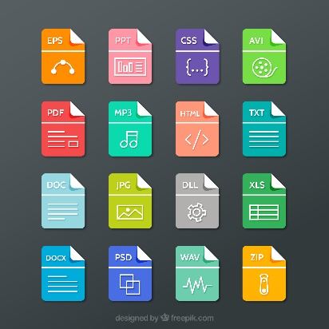
File Format Best Practices
File formats
Choose file formats that ensure long-term access
Open-source formats are preferred to proprietary. They are likely to last longer due to wider buy-in, and their documentation tends to be published and publicly available
Choose loss-less over lossy files (no bit loss due to compression): e.g., choose TIFF over JPG
Image: http://www.freepik.com

Slide 18
Metadata
What is metadata?
Metadata is documentation that describes data.
Properly describing and documenting data allows users (yourself included) to understand and track important details of the work. Having metadata about the data also facilitates search and retrieval of the data when deposited in a data repository.
Research Data Management Services Group, Cornell University, https://data.research.cornell.edu/content/writing-metadata.
Metadata is a more formalized outline and definition of the data descriptors that the research team uses on a day-to-day basis.

Slide 19
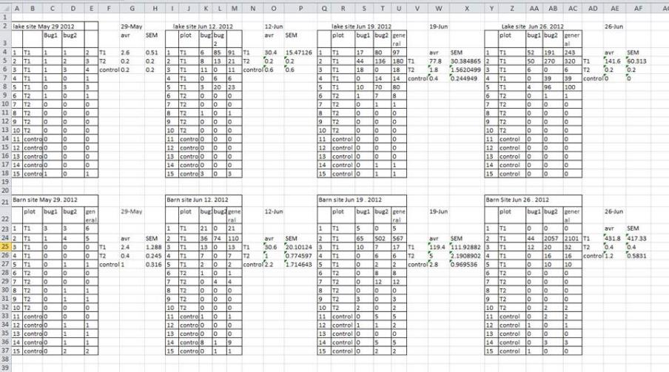
Metadata
Image: Tidy Data for Librarians: Formatting Problems. Library Carpentry
Notes:
Metadata is part of a project from the beginning of data collection, from the moment you name a data receptacle, which can be something as simple as a column in a spreadsheet. Here is an example of research data, taken from one worksheet in an Excel file. What problems do you see with what’s recorded here?
First, and most glaringly, there are 8 data tables in one worksheet. Excel formulas are more likely to go awry or be corrupted when there’s more than one table per sheet. Column headers aren’t used consistently. There is one instance of highlighting used in the spreadsheet, but what was that meant to convey? Is it documented? And all those zeroes – did they really all represent a zero reading, or were they stand-ins for null? Is that documented anywhere?

Slide 20
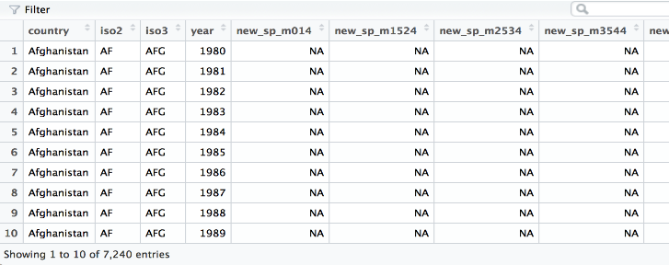
Metadata
Best practices for metadata in the data management stage
Best practice for spreadsheets: columns are the variables, rows are the instances of observation
Name column headers in spreadsheets in a consistent, documented way
Don’t store multiple tables in one worksheet
Don’t store graphs or visualizations directly in a spreadsheet – they are easily corrupted
Don’t use a column or cell earmarked for one purpose for a different purpose
Don’t use formatting (highlights, etc.) as the only method to convey information
Define the null value (numerical, like 0 or 999, works best in spreadsheets)
Create a data dictionary
A much tidier data table. From Data Science with R by Garrett Grolemund: Data Tidying. http://garrettgman.github.io/tidying/.
Notes:
Above is a list of best practices for working with data in spreadsheet programs. Below is an example of tidy data. In this table there is one column per variable, no reliance on formatting, and in this instance the research team decided to use “NA” to represent the null value. The headers beginning with “new_sp” are study variables named according to the team’s naming convention. As with a well-formatted file name, these headers’ elements are broken up by underscores, and the sequence of letters and numbers has some meaning to the team, which is ideally documented in a data dictionary. For advice on creating a data dictionary, see OSF Guide’s “How to Make a Data Dictionary” at: https://help.osf.io/article/217-how-to-make-a-data-dictionary

Slide 21
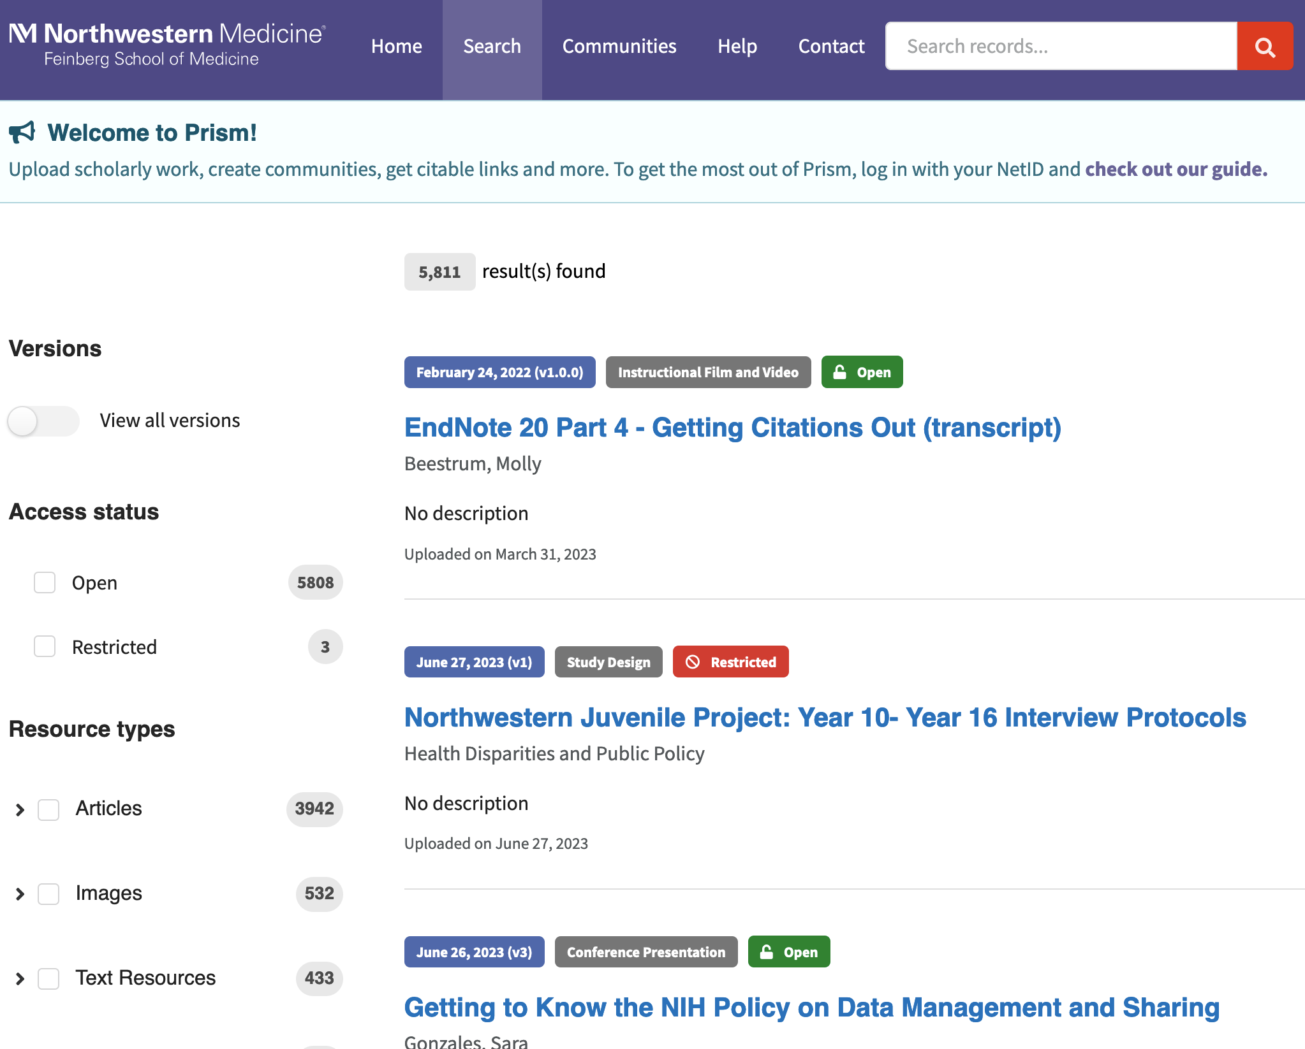
Metadata for preservation and access
Image: https://prism.northwestern.edu/
Notes:
When the study is over and ready to be described for access by others, describe it in a clear, consistent way that adheres to metadata standards.
An institutional repository is a collection of records representing research outputs, each of which is described using fields that adhere to metadata standards.
The metadata that is applied to your deposit of materials into a repository like Prism is the information that allows a user to search by Title, Subject, Creator, etc. Repositories don’t necessarily search on full-text, so the careful choice and application of descriptive metadata is crucial for any resource that you want to preserve and retrieve in the future.

Slide 22
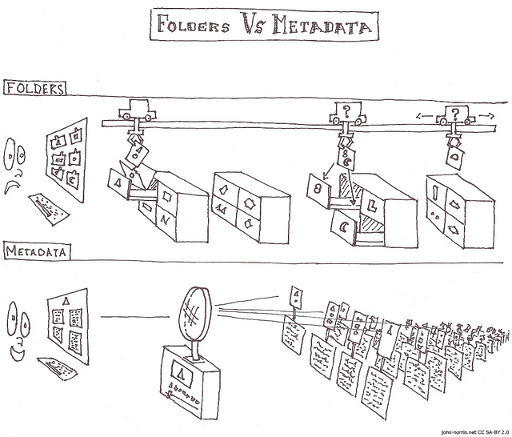
Metadata for preservation and access
https://www.flickr.com/photos/john-norris/5865469840/ (CC BY-SA 2.0)
Notes:
Simply stated, metadata standards help to provide consistency and standardization when you want to describe your digital research outputs in another forum, like a repository. More standardization = greater chance of records being found and accessed by more people. By applying multiple standards to one item, you can ensure that the item will be brought up in a search in many different contexts, all on the basis of its associated metadata. Standards are simple to apply, once you know a few basic rules about the ones you’ll use most often.
Location: Library of Congress subject headings can be used to express locations. ISO standards can also be used.
Dates: The ISO standard 8601 recommends stating dates in the format YYYY-MM-DD, in order to avoid confusion between regions that express dates differently
Keywords and controlled subject listings: Keywords are free-text, which may be the best way to describe a resource. But it’s also advisable to assign some subject terms from controlled lists, like the Medical Subject Headings or Library of Congress. These standards are widely used, so if you use tags from these standards, then your records are findable alongside those of everyone else who tagged records with the same standardized terms.
Personal Names

Slide 23

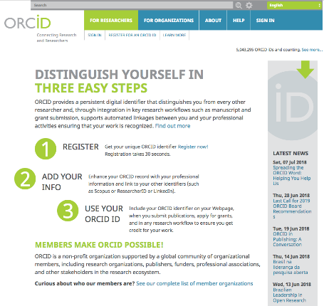
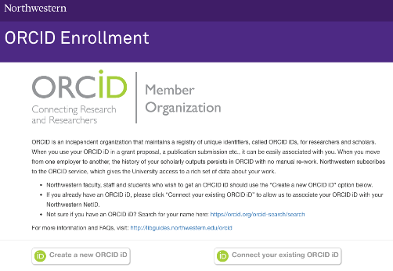
Open Researcher and Contributor iD (ORCiD)
orcid.it.northwestern.edu/
ORCiD LibGuide available from Galter Library
Notes:
ORCID is an independent organization that maintains a registry of unique identifiers, called ORCID iDs, for researchers and scholars.
When you use your ORCID iD in a grant proposal, a publication submission etc., it can be easily associated with you.
When you move from one employer to another, the history of your scholarly outputs persists in ORCID with no manual re-work.
Incentives:
Author disambiguation; follows you your entire career no matter where go
ORCID has the potential to significantly help tracking research outputs at university, department, and college levels.
Funders are embedding ORCID identifies in their grant submission systems. Governmental organizations, such as NIH, OSTI, and CERN are supporting this effort.
Associations are integrating into membership renewal, publishing, and meeting registration. It is supported by major professional organizations, including MLA, APA,AAAS, AGU, ACS, IEEE, AMS, and many others.
Publishers (e.g., PLoS, Springer/Nature) are integrating into manuscript submission and author/reviewer databases. A complete list can be found at: http://orcid.org/organizations/integrators/integration-chart .
Repositories are linking with deposition, search, and updating.
ORCID supporters include all of the major science and technology publishers, including Elsevier, Wiley, Nature, Thomsen Reuters, and more.

Slide 24
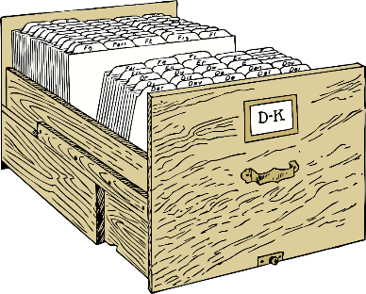
Metadata
Keywords vs. Controlled Vocabularies
MeSH (Medical Subject Headings)
nlm.nih.gov/mesh/
Library of Congress Subject Headings:
id.loc.gov/authorities/subjects.html
Thesaurus of Psychological Index Terms
apa.org/pubs/databases/training/thesaurus.aspx
Statistical Data and Metadata Exchange:
sdmx.org/?page_id=16#package
Image: openclipart.org. Accessed August 16, 2018.
Notes:
The reason that repositories like Prism use both keywords and controlled lists of words like MeSH is to allow for keywords that the researchers assign themselves, words that may be unique and not easily mapped to any existing controlled vocabularies. But it’s good to include terms from controlled vocabs as well. Above are some common controlled vocabularies that Northwestern researchers may or may not be using to describe their digital products.
Controlled vocabularies have a similar function to the old library card catalog. The card catalog used to be the only way to find books in a library, before the catalog went online. And it was cumbersome, having the same information, the cards with some “metadata” about the books, repeated three times. First, it was organized by Author last name (and even back then, consistent spellings and use of names was important!). Then, the books were all listed again by Title. Finally, another whole series of the cards was organized by subjects/Dewey Decimal number. So if books got tagged with the exact same subject, spelled and used the same way consistently, then it was easy to find all the books on the same subject.
The same is true in online repositories. By tagging your digital objects with standardized subject words or “controlled vocabularies,” you help ensure that a search for a subject will bring up the record you tagged with that subject, along with every other resource that was tagged with the identical, standard, and often internationally-used subject term. And that makes your resource more findable, useable and cite-able than if it were only tagged with keywords that might be unique to your research team.
Please reach out to the Galter Library (https://galter.northwestern.edu/) if you need any assistance in assigning controlled subject terms to your research products.

Slide 25
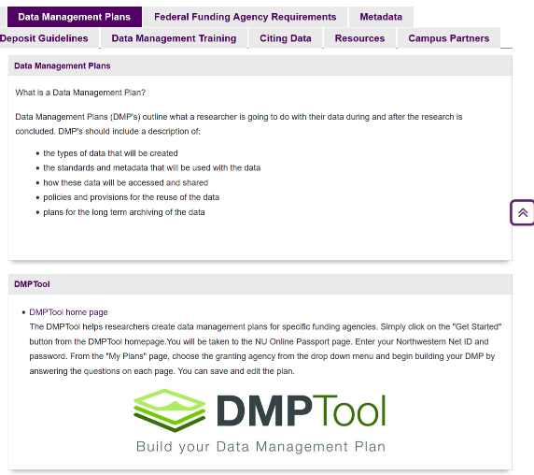
Best practices in research data management
Data Management Plans
(Northwestern LibGuide)
DMPTool.org
Notes:
One form of data documentation that occurs at the beginning of a project, usually when submitting the grant application, is the creation of a Data Management Plan (DMP). In its simplest form, a DMP should document what types of data will be created, in what quantities, who has access to it, and how it will be preserved, accessed, and kept safe/confidential throughout the data lifecycle. For a brief outline of how to create a DMP, see OSF Guides’ Creating a data management plan at: https://help.osf.io/article/144-creating-a-data-management-plan-dmp-document
In addition, NU Libraries offer an online tool to help you construct a DMP, which you can find via the URL above or through dmptool.org. By signing in as a staff member of Northwestern, you can tailor your plan to this institution, and also to individual funders’ requirements.

Slide 26
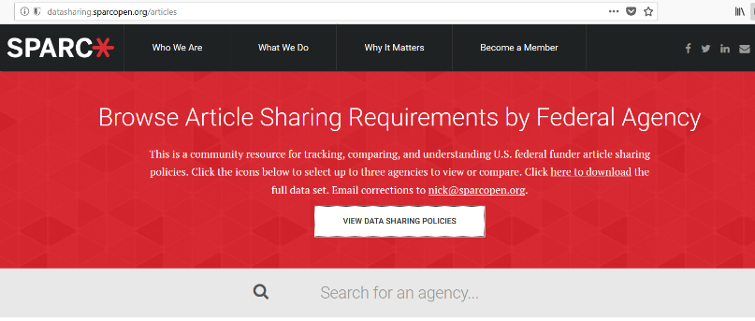
Data Sharing
Federal Scholarly Publication Sharing Requirements
Most Federal funders have specific requirements for making scholarly articles resulting from Federally-funded projects publicly available.
The Scholarly Publishing and Academic Resources Coalition (SPARC) Article Sharing Policies Comparison Tool: datasharing.sparcopen.org/articles can keep you up-to-date on these requirements.
Notes:
A memorandum was released in February 2013 by the White House’s Office of Science and Technology Policy (OSTP) directing federal research funding agencies to make publications resulting from federal funds publicly available within one year of publication. Each agency’s requirement for open access to articles published through federally-funded projects is slightly different. To check NIH’s and other agencies’ publication-sharing requirements, see SPARC’s federal funder public access requirements look-up tool at: datasharing.sparcopen.org

Slide 27
Federal Funder Data Sharing Requirements
OSTP-Mandated Funder Data Sharing Plans
In February 2013 the White House Office of Science and Technology Policy (OSTP) released a memorandum requiring federal agencies supporting research to create plans for increased public access to research data. Several funding agencies in the United States have established data sharing or data management policies, but since the OSTP memo release, many more funding agencies have implemented or are in the process of implementing data sharing and data management plan (DMP) requirements.
NIH Final Policy for Data Management and Sharing
In late 2020 the NIH released its data policy, applicable to all awards after Jan 25, 2023:
2-page data management and sharing plan must be submitted with application
Encourages data/metadata sharing to established repositories (respecting privacy restrictions)
Data must be shared as soon as possible, no later than publication or end of performance period
Keep up to date on funder requirements:
SPARC’s list of Data Sharing Requirements by Federal Agency: datasharing.sparcopen.org/data
Notes:
The 2013 OSTP memo also includes a requirement for making data from federally-funded research publicly accessible.
Late in 2020, the NIH released its final Policy for Data Management and Sharing (https://grants.nih.gov/grants/guide/notice-files/NOT-OD-21-013.html). Going into effect on Jan 25, 2023, it will require submission of a data management plan with grant applications, sharing of data and metadata through established repositories, and timely sharing of data no later than the time of publication or the end of the performance period. Read more about the requirements at NIH’s official site on the policy, https://sharing.nih.gov/. Galter librarians are available for consultations to review data management plans.
How does one meet other funders’ data sharing requirements? Unfortunately, not all federal funders have the same requirements in terms of when to publicly share publications and data, through which repositories to share data, and exactly what is required to constitute sharing (just the raw data? Data and code? Data and code and software?). Check your award agreement and the agency’s website for your funder’s requirements. For online references, see the SPARC website referenced here.

Slide 28
Scholarly Publisher Data Sharing Requirements
Journal Data Sharing Requirements:
The following scholarly publishers require that the author submit underlying research data in addition to their paper:
      PLOS: Editorial and Publishing Policies
      Sage: data submission guidelines
      Science: Data Deposition and Availability of Data
      SpringerNature: research data policies
      Wiley: Data Sharing Service
Resource: MIT Library’s Data Management Guide, Journal Requirements Section
libraries.mit.edu/data-management/share/journal-requirements
Notes:
Some of the publishers listed here are among those that deposit papers automatically to PubMed Central. But beyond the consideration of federally-mandated data sharing, another motivation to prepare one’s data for sharing is increasing scholarly journal requirements to submit supporting data along with papers for publication. The publications that require this supplemental information each have their own policies. See MIT Library’s guide to journal data sharing requirements as a helpful resource.

Slide 29
Scientific Data Sharing Requirements: Choosing a Repository
From: https://grants.nih.gov/grants/guide/notice-files/NOT-OD-21-016.html
  NIH’s Desirable Characteristics for All Data Repositories (full list available here):
Unique Persistent Identifiers: Assigns datasets a citable, unique persistent identifier, such as a digital object identifier (DOI) or accession number, to support data discovery, reporting, and research assessment. The identifier points to a persistent landing page that remains accessible even if the dataset is de-accessioned or no longer available.
Long-Term Sustainability: Has a plan for long-term management of data, including maintaining integrity, authenticity, and availability of datasets; building on a stable technical infrastructure and funding plans; and having contingency plans to ensure data are available and maintained during and after unforeseen events.
Metadata: Ensures datasets are accompanied by metadata to enable discovery, reuse, and citation of datasets, using schema that are appropriate to, and ideally widely used across, the community(ies) the repository serves. Domain-specific repositories would generally have more detailed metadata than generalist repositories.
Curation and Quality Assurance: Provides, or has a mechanism for others to provide, expert curation and quality assurance to improve the accuracy and integrity of datasets and metadata.
Free and Easy Access: Provides broad, equitable, and maximally open access to datasets and their metadata free of charge in a timely manner after submission, consistent with legal and ethical limits required to maintain privacy and confidentiality, Tribal sovereignty, and protection of other sensitive data.
Broad and Measured Reuse: Makes datasets and their metadata available with broadest possible terms of reuse; and provides the ability to measure attribution, citation, and reuse of data (i.e., through assignment of adequate metadata and unique PIDs).
Clear Use Guidance: Provides accompanying documentation describing terms of dataset access and use (e.g., particular licenses, need for approval by a data use committee).
Security and Integrity: Has documented measures in place to meet generally accepted criteria for preventing unauthorized access to, modification of, or release of data, with levels of security that are appropriate to the sensitivity of data.
Notes:
In its supplemental guidance page on Selecting a Repository for Data Resulting from NIH-Supported Research (https://grants.nih.gov/grants/guide/notice-files/NOT-OD-21-016.html), the NIH outlines characteristics that are desirable in a repository for any data deposit, whether the deposit’s goal is to satisfy funder or publisher data sharing requirements. Common characteristics of strong repositories include:
Minting a unique identifier (such as a DOI) to aid in findability and tracking of the resource
Robust metadata to describe the resource
Allows licensing of the data to clearly outline which future uses of it are allowable
Allows free and easy access to data and downloads in common formats
Has a plan for long-term maintenance
Extra protections are available for data originating from humans

Slide 30

Why share data?
To advance scientific discovery
Success stories in data sharing
Big Data analysis identifies new cancer risk genes
(Center for Genomic Regulation study, as reported in ScienceDaily.com www.sciencedaily.com/releases/2018/07/180710104628.htm)
Assessment of the impact of shared brain imaging data on the scientific literature
(Milham, M.P. et al in Nature Communications (2018)9:2818, DOI: 10.1038/s41467-018-04976-1)
Item of Interest: NICHD reports success of data sharing resource (DASH), two years after launch
(NICHD Press Office, National Institute of Child Health and Human Development Newsroom, nichd.nih.gov/news/releases/032018-DASH)
-Two years after inception, 73 data access requests have been made to DASH and 3 new publications have resulted from re-use of data
Antidepressant drug effects and depression severity: a patient-level meta-analysis
(Fournier, J.C. et al in Journal of the American Medical Association 303, 47-53 (2010))
“A mega-analytic approach [of data from multiple studies] is more appropriate and more powerful than a standard meta-analysis when original data are available and a fine-grained multivariate analysis is desired.”
https://www.flickr.com/photos/thadz/14996908380/. Public Domain.
Notes:
Exciting new discoveries can come from pooled and shared data. In many cases, larger datasets are more beneficial to modern analysis techniques.

Slide 31



Why share data?
Sharing win: Harvesting existing datasets
Benefits:
Affordability
Graduate student first research projects
Studying changes occurring over time and/or to large populations
Leveraging Federally-funded clinical trial studies and data
Leighton, Chan, and Patrick McGarey. Using Large Data Sets for Population-Based Health Research. In Principles and Practice of Clinical Research (Third Edition), 2012
Sources for large scale and longitudinal study datasets in the biomedical and social sciences:
ClinicalTrials.gov
DASH (NIH’s Data and Specimen Hub)
Data.gov
ICPSR (Inter-University Consortium for Political & Science Research)
NCBI (National Center for Biotechnology Information)
NHANES (CDC’s National Health and Nutrition Examination Survey)
Notes:
Exciting new discoveries can come from analyzing secondary datasets, or, datasets that you did not collect yourself. A good place to start when considering harvesting data can be government datasets such as those provided at Data.gov, datasets resulting from Federally-funded clinical trials such as those held by ClinicalTrials.gov, and dataset repositories developed by or with University collaborators for the purpose of providing global access to large-scale or longitudinal studies, such as ICPSR.

Slide 32

Why share data?
Sharing win: The benefits of sharing your data
“Publicly available data was significantly (p = 0.006) associated with a 69% increase in citations, independently of journal impact factor, date of publication, and author country of origin using linear regression.” Piwowar, Heather A. et al. Sharing Detailed Research Data Is Associated with Increased Citation Rate. Published March 21, 2007. https://doi.org/10.1371/journal.pone.0000308.
Data repositories with at least one of the following analytics capabilities: view, download, citation, and social media:
Dryad
Figshare
Harvard Dataverse
ICPSR
Open Science Framework
Zenodo
Northwestern Scholars
FSM’s Prism repository
Image: Excelsior Online Writing Lab
Notes:
Data sharing wins include:
Fulfilling funder or publisher requirements
Contributing to the scientific data that is publicly available in the world
Sharing data creates additional routes through which your work can receive citations and Internet exposure through social media

Slide 33
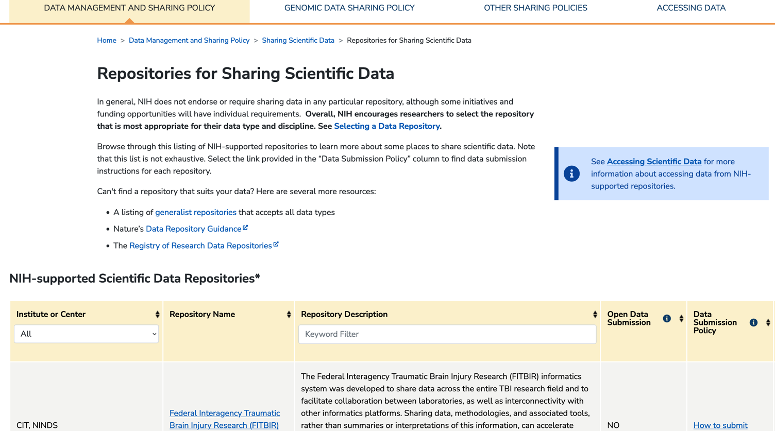
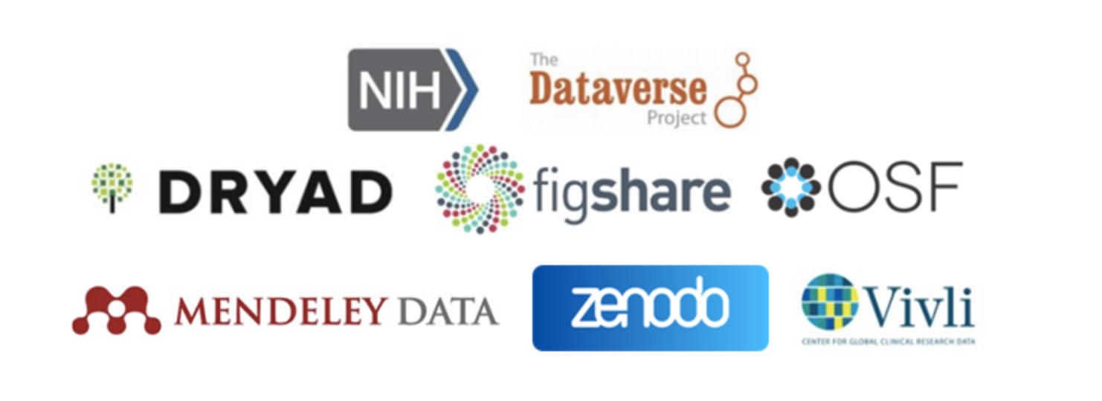
Where to share data?
https://sharing.nih.gov/data-management-and-sharing-policy/sharing-scientific-data/repositories-for-sharing-scientific-data
https://datascience.nih.gov/data-ecosystem/generalist-repository-ecosystem-initiative
Notes:
Data can be harvested from many places. Examples as seen on slide 32 include ClinicalTrials.gov, DASH, Data.gov. ICPSR, NCBI, and NHANES. For data sharing compliance, in most cases the funder or publisher will provide direction about the repository in which to share data. If a specific repository is not mentioned, it can be helpful to follow recommendations developed to support the NIH Data Management and Sharing Policy:
Search the NIH’s list of Repositories for Sharing Scientific Data for an ICO or subject match: https://sharing.nih.gov/data-management-and-sharing-policy/sharing-scientific-data/repositories-for-sharing-scientific-data
Consider sharing the data as supplementary material accompanying an article submitted to PubMed Central ONLY IF the dataset is 2 GB or smaller
Consider sharing the data through a generalist repository (https://datascience.nih.gov/data-ecosystem/generalist-repository-ecosystem-initiative), ONLY IF it is non-sensitive or rigorously de-identified
Consider sharing the data through FSM’s repository, Prism (prism.northwestern.edu) ONLY IF it is non-sensitive. For sensitive data, a metadata-only record (with no associated file deposit) may be made in Prism.

Slide 34
Northwestern resources on data management and data sharing
Local Library, Data, and Repository Resources
NUL Data Management LibGuide: includes a link to the Data Management Plan Tool
  NUL’s Document Sharing and Data Storage Finder Tool
  Galter Health Sciences Library & Learning Center
    Data Organization and Documentation LibGuide
    Creating an NIH Data Management and Sharing Plan LibGuide
  Prism: Feinberg School of Medicine’s Institutional Repository
  Link ORCiD to your Northwestern profile
  Northwestern Scholars

Slide 35
Northwestern resources on data management and data sharing
Northwestern University Offices, Policies and Procedures for Researchers
Northwestern Institutional Review Board (NU IRB)
NU IRB Resources and Guidance (contains protocol templates and forms, SOPs)
Northwestern Office of Sponsored Research (OSR)
OSR: Data Use Agreements (DUA)
OSR Data Retention Policy (Northwestern University, Research Data: Ownership, Retention, and Access Policy)
Northwestern Retention of University Records Policy
Backing up Data at Northwestern
NU IT Endpoint Device Backup

Slide 36
Northwestern resources on data management and data sharing
Northwestern University Resources for Information and Data Security
NU IT Data Center Services
Northwestern University Information Technology (NUIT) Policies for the Protection of Data
Feinberg School of Medicine Information Technology (FSMIT)
FSMIT Policies on Information Security
FSMIT Policies, general
FSMIT Guidelines for file storage
FSMIT Data Security Plan for information used in clinical research

Slide 37
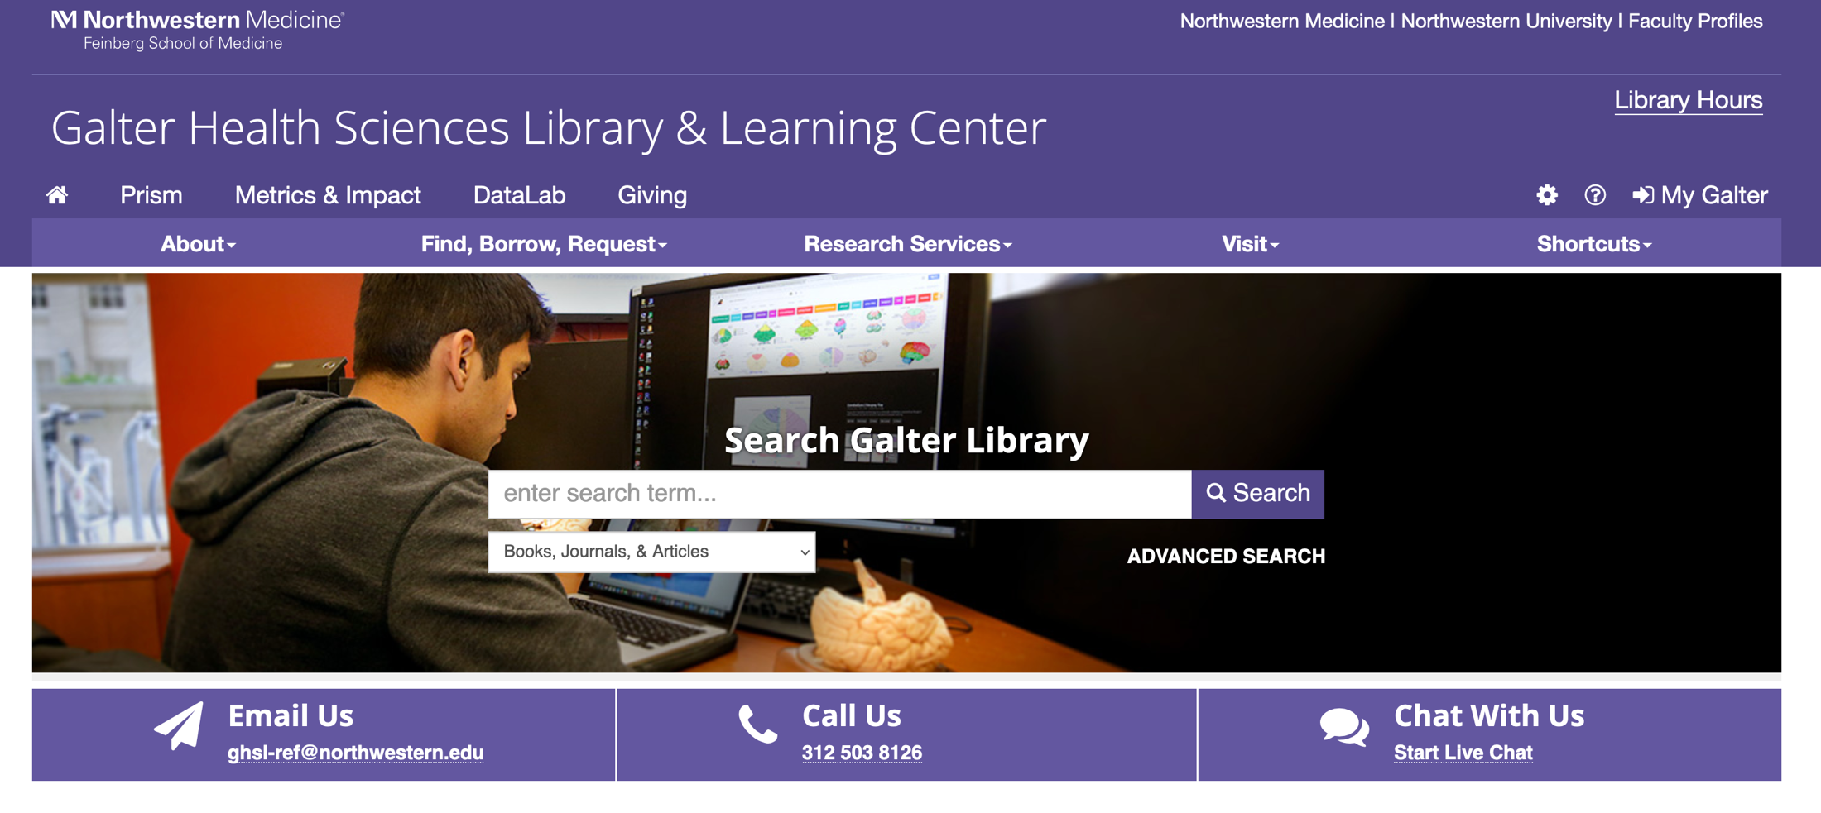
Galter Health Sciences Library & Learning Center
Please contact me with any questions at: sara.gonzales2@northwestern.edu
To request assistance / begin a consultation ticket on a data management and sharing question, please email: ResearchData@northwestern.edu

Slide 38
Thank You!
Developed resources reported in this presentation are supported by the National Library of Medicine (NLM), National Institutes of Health (NIH) under cooperative agreement number 1UG4LM012346. The content is solely the responsibility of the authors and does not necessarily represent the official views of the National Institutes of Health.

