Slide 1
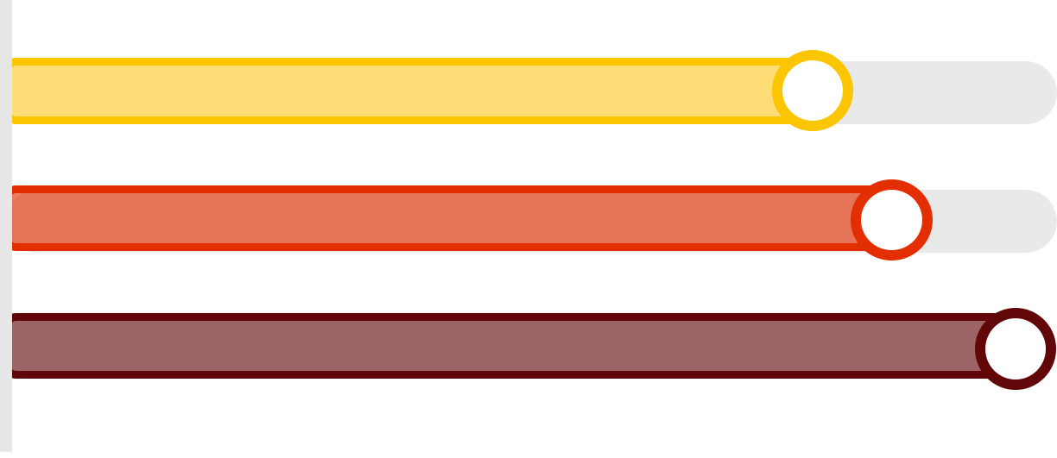
Validating the MEDLINE®/PubMed® Health Disparities and Minority Health Search Strategy
Spotlight: Race and Ethnicity
Q. Eileen Wafford, MSt, MLIS, Corinne H. Miller, MLIS, and Linda C. O'Dwyer, MA, MSLIS
Galter Health Sciences Library & Learning Center
METHODS
RESULTS
We applied a 5-step method that incorporated existing techniques and available resources.
The table below reports the performance measures for the existing and revised PubMed filters.
But first ...
Our initial effort to validate the filter used a different method modeled on a study by Leclercq et al. Using smoking cessation to focus our search, we applied our established inclusion criteria and found all relevant Cochrane reviews and cited clinical trials indexed in PubMed to develop the validation set of citations. This method resulted in too few articles in our validation set. We decided to adapt the method to what’s described below.
Leclercq, E., Leeflang, M. M., van Dalen, E. C., & Kremer, L. C. (2013). Validation of search filters for identifying pediatric studies in PubMed. The Journal of pediatrics, 162(3), 629-634.
Performance Measures
Filter | References Retrieved |  |  |  |  | Sensitivity (%) | Specificity (%) | Accuracy (%) | Precision (%) | NNR
 | Total | Correct Inclusion | Incorrect Inclusion | Correct Exclusion | Incorrect Exclusion
PubMed 3/29/18 | 262 | 127 | 135 | 141 | 29 | 81 | 51 | 62 | 49 | 2.06
PubMed 4/26/18 | 297 | 138 | 159 | 117 | 18 | 89 | 42 | 59 | 47 | 2.15
Revised 4/26/18 | 374 | 156 | 218 | 58 | 0 | 100 | 21 | 50 | 42 | 2.40
INTRODUCTION
The demand for studies on health disparities led librarians at the Galter Health Sciences Library & Learning Center to examine the MEDLINE®/PubMed® Health Disparities and Minority Health Search Strategy (PubMed filter).
The Indexing Effect
Sensitivity Measures
Health Disparities in PubMed
1. DEFINE
Define "health disparities“ by consulting with experts
Ongoing indexing likely explains differences between searches conducted with the PubMed filter in March and April.
PubMed 3/29/18
81 %
While there are known disparities related to health status, based on expert opinions gathered in surveys, we focused on disparities related to access in health care.
PubMed 4/26/18
89 %
Revised 4/26/18
100 %
The inclusion of the recommended terms improved the existing filter’s sensitivity by 13% in April 2018. However, the trade-off was a reduction in specificity by 50%.
2. DEVELOP
Develop a validation or "gold standard" set of articles
We searched the Journal of Racial and Ethnic Health Disparities for articles indexed in PubMed. | We screened records in Rayyan. The inclusion criteria were race/ethnicity and health disparities.
Number Needed to Read (NNR)
Results from a PubMed search of health disparit*[tw] OR health equit*[tw] on April 27, 2018.
PubMed Filter
4/26/18
Revised Filter
NNR is the number of records that need to be read in order to identify a relevant result. The NNR assesses the filter in the context of the resulting workload.
2.15
2.40
OBJECTIVE
3. COMPARE
Compare validation set against the reference set
Revised Filter
Our aim was to assess the PubMed filter’s performance in retrieving citations related to racial and ethnic health disparities.
We evaluated the key performance measures of sensitivity, specificity, accuracy, and precision.
Improved
13%
Sensitivity
We compared results retrieved using the PubMed filter to results generated from the validation set. | The PubMed filter missed 18 articles.
DISCUSSION
Understanding
This process reinforced our understanding of the complexity and many expressions of health disparities.
Adaptability
When one method failed to provide adequate content for analysis, we adapted the methodology and sought ways to improve future analysis.
Performance
The existing PubMed filter is an effective search strategy in relation to race and ethnicity.
Trade-offs
Researchers must determine if capturing more relevant articles is worth managing a larger result set.
Recommendation
We recommend incorporating more keywords and applying broader use of truncation.
Scope
Future study should include more groups of people and a wider definition of health disparities.
Analysis
Further analysis with a larger validation set is needed.
4. EXAMINE
Use frequency analysis and hand-searching to find relevant terms
Starting Point
Health disparities is a complex topic with many domains. We elected to start with the race and ethnicity domain.
Domains
Immigration
Language proficiency
Disability
Race & ethnicity
Sex or gender
Sexual orientation
Geography
Income
Using PubMed PubReMiner, we ran frequency analysis on the missed articles and identified required terms for retrieval. | We manually reviewed PubMed records to identify candidate terms for the validation set and revised the strategy.
5. CALCULATE
Calculate the performance of the PubMed and revised filters
Which domains would you include?
We calculated sensitivity, precision, specificity, and accuracy of candidate terms against the reference set.
REVISED STRATEGY
((barrier*[TIAB] OR bias*[TIAB] OR delivery of health care[MeSH:NoExp] OR dispar*[TIAB] OR disproportionate*[TIAB] OR health behavior [MH] OR health knowledge, attitudes, practice [MH] OR health services accessibility [MH] OR health services, indigenous [MH] OR inequalit*[TIAB] OR inequit*[TIAB] OR mass screening [MH] OR mass screening [TIAB] OR mass screenings [TIAB] OR health services needs and demand [MH] OR patient acceptance of health care [MH] OR patient selection [MH] OR quality of health care [MAJR:NoExp] OR quality of life [MH] OR quality of life [TIAB] OR Culturally Competent Care [TIAB] OR Culturally Competent Care [MH] OR Socioeconomic Factors [MAJR] OR socioeconomic factor [TIAB] OR socioeconomic factors [TIAB] OR Social Determinants of Health [MH] OR underrepresent*[TIAB] OR underserve*[TIAB]) AND (african*[TIAB] OR African Continental Ancestry Group [MH] OR AIAN [TIAB] OR American Native Continental Ancestry Group [MH] OR Asian continental ancestry group [MH] OR asian*[TIAB] OR black*[TIAB] OR cambodian*[TIAB] OR caucasian*[TIAB] OR chinese*[TIAB] OR dakota*[TIAB] OR divers*[TIAB] OR environmental justice [TIAB] OR ethnic*[TIAB] OR filipino*[TIAB] OR foreign*[TIAB] OR ghetto [TIAB] OR ghettos [TIAB] OR hispanic*[TIAB] OR indian*[TIAB] OR japanese*[TIAB] OR korean*[TIAB] OR latin*[TIAB] OR medically underserved area [MH] OR minorit*[TIAB] OR minority groups [MH] OR multiracial*[TIAB] OR native*[TIAB] OR nhb*[TIAB] OR Oceanic Ancestry Group [MH] OR pacific islander [TIAB] OR pacific islanders [TIAB] OR Native Hawaiian [TIAB] OR Native Hawaiians[TIAB] OR Alaska Natives[TIAB] OR people of color [TIAB] OR poverty area [MH] OR poverty area [TIAB] OR poverty areas [TIAB] OR race*[TIAB] OR racial*[TIAB] OR racis*[TIAB] OR rural health [MH] OR rural health [TIAB] OR rural health services [MH] OR rural population [MH] OR rural population [TIAB] OR rural populations [TIAB] OR sioux*[TIAB] OR slave*[TIAB] OR slum [TIAB] OR slums [TIAB] OR spanish*[TIAB] OR urban health [MH] OR urban health services[MH] OR urban population [MH] OR urban*[TIAB] OR vietnamese*[TIAB] OR vulnerable populations [MH] OR vulnerable[TIAB] OR white [TIAB] OR whites [TIAB])) OR ((ethnic*[TIAB] difference*[TIAB]) OR ethnic disparities [TIAB] OR ethnic disparity [TIAB] OR health care disparities [TIAB] OR health care disparity [TIAB] OR health disparities [TIAB] OR health disparity [TIAB ] OR health status disparities [MH] OR "healthcare disparities"[mesh] OR healthcare disparities [TIAB] OR healthcare disparity [TIAB] OR minority health [MH] OR minority health [TIAB] OR (sexual minorities[TIAB]) OR (raci*[TIAB] associat*[TIAB]) OR (raci*[TIAB] difference*[TIAB]) OR racial disparities [TIAB] OR racial disparity [TIAB] OR racial equality [TIAB] OR racial equity [TIAB] OR racial inequities [TIAB] OR racial inequity [TIAB] OR Ageism [MH] OR Racism [MH] OR Apartheid[MH] OR Sexism [MH] OR Social Discrimination [MH] OR Social Segregation[MH] OR Social Marginalization [MH])
Previously included terms in existing filter that have been revised, usually with truncation
New term (no variations of this term are present in corresponding section of existing filter)

