Slide 1

“Publish or Perish”
how metrics can validate or diminish an old paradigm
Karen Gutzman, Impact and Evaluation Librarian
Patty Smith, Dissemination and Evaluation Librarian
Galter Health Sciences Library & Learning Center
InCites Midwest User Group Meeting
Thursday, June 28, 2018

Slide 2
Caveat Emptor
i.e. “buyer beware” or in this case “listener beware”
We are not a statisticians or scientometricians.
We are practitioners of bibliometrics.
We use InCites often.
We follow the literature (e.x. Journal of Informetrics or Scientometrics, among other journal titles) as best we can.
We will admit:
  We do not always fully appreciate the practical implications of the research studies published in these journals.
  We often “check out” and miss whole debates on these topics when we’re too busy with other work to keep up with the conversation.
But, we try.

Slide 3
Our Goal
It [is] the bibliometricians’ responsibility to
choose indicators cautiously
and to inform readers and users of bibliometric results
about their correct interpretation
and where necessary
about their limitations.
Reference: Glänzel W, Thijs B, Debackere K. Productivity, performance, efficiency, impact-what do we measure anyway? some comments on the paper "A farewell to the MNCS and like size-independent indicators" by abramo and D'angelo. J Inf [Internet]. 2016;10(2):658-60. https://doi.org/10.1016/j.joi.2016.04.008

Slide 4
We use metrics to identify or highlight:
research productivity
innovative or impactful research
quality of research communication
collaboration between individuals or groups
engagement with various audiences
advancement of knowledge
health or policy impacts
scientific potential
career prestige
and more. . .
Reference: Martin BR, Irvine J. Assessing basic research. some partial indicators of scientific progress in radio astronomy. Res Policy [Internet]. 1983;12(2):61-90. https://doi.org/10.1016/0048-7333(83)90005-7
Notes:
“In order to establish priorities between research groups competing for scarce funds, one of the most important pieces of information needed by science policy-makers is an assessment of those groups' recent scientific performance.”
Martin BR, Irvine J. Assessing basic research. some partial indicators of scientific progress in radio astronomy. Res Policy [Internet]. 1983;12(2):61-90. https://doi.org/10.1016/0048-7333(83)90005-7

Slide 5
When we were first introduced to InCites, the two metrics that intrigued us the most were:
Category Normalized Citation Impact
Percentile in Subject Area

Slide 6
When we were first introduced to InCites, the two metrics that intrigued us the most were:
Category Normalized Citation Impact
Percentile in Subject Area
We wanted to understand:
How theses metrics were calculated
What to expect with unusual document types
How to use the metrics appropriately and efficiently
What the community had to say about these metrics

Slide 7



Mean Normalized Citation Score
Also known as:
  Category Normalized Citation Impact (InCites)
  New Crown Indicator (CWTS)
  Field Normalized Citation Impact (Scopus)
  Relative Citation Ratio (NIH) *
* calculated with some differences, but overall is similar in nature
Definition:
  One of the most commonly used indicators of research performance
  Is a proxy of the average impact of the publications of a research unit
  Is both field-normalized and size-independent
  Allows comparisons between entities of different sizes and different subject mixes
Calculation:
  The number of citations received by a document divided by the expected number of citations (as received by documents of the same type, publication year, and subject area)
Actual number of citations
Expected number of citations*
*expected number of citations is found by averaging the number of citations received by papers with the same publication year, document type, and in the same subject area
Notes:
“Publications from fields or journals with a high expected number of citations have more weight than publications from fields or journals with a low expected number of citations. Similarly, older publications have more weight than newer ones and ordinary articles generally have more weight than letters.”
https://www.sciencedirect.com/science/article/pii/S1751157710000301

Slide 8
Calculating the
Category Normalized Citation Impact (CNCI)
 | WOS Subject Area | Year | Actual # of citations | Expected # of citations | CNCI
Paper A | Radiology | 2001 | 209 | 180 | 1.16
Paper B | Genetics & Heredity | 2012 | 174 | 50 | 3.48
Paper C | Respiratory System | 2014 | 218 | 18 | 12.1
Paper C | Psychiatry | 2014 | 218 | 50 | 4.36
Paper C | Nutrition & Dietetics | 2014 | 218 | 65 | 3.35
 |  |  |  |  | 6.60
Paper D | Peripheral Vascular Disease | 2010 | 18 | 22 | 0.82
 |  |  |  | Average CNCI | 3.01
WoS Subject Areas
InCites uses the Web of Science Subject area schema for calculating the CNCI. This schema has 250 subject areas, with each journal being assigned to at least one or up to six subject areas.
For multidisciplinary journals (ex. Science, Nature, PNAS) documents, not the journal, are assigned to subject areas.
Papers with multiple subject areas
For a single paper that is assigned to multiple subjects, the CNCI can be represented as the average of the ratios for actual to expected citations for each subject area.
This method is known as “fractional counting of subjects” for papers in more than one subject category.
Average of ratios
The CNCI can be averaged over a group of publications, a process which is called an “ average of ratios ”.

Slide 9
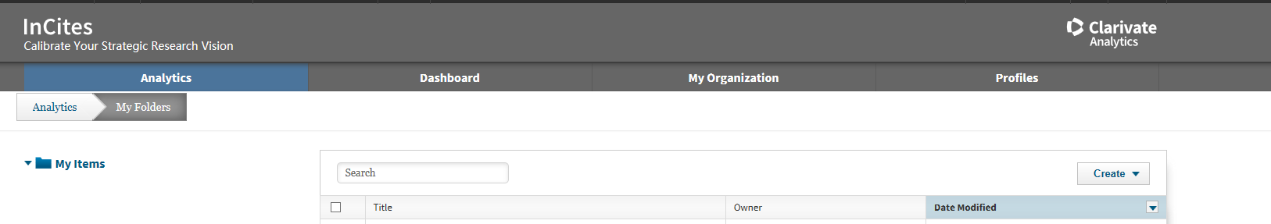
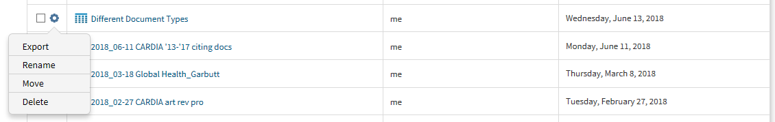
Finding the CNCI in InCites
In “My Folders” → Click on cog next to your dataset → Choose Export

Slide 10
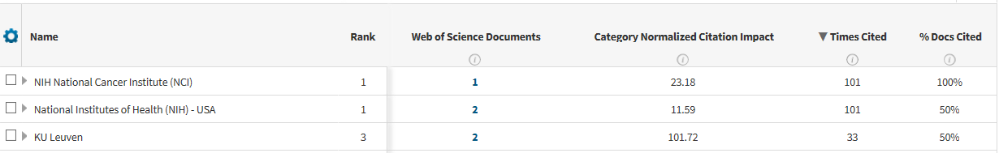
Finding the CNCI in InCites
In Analytics view → CNCI should be a column header

Slide 11
CNCI first look
 | Accession Number | PMID | Document Type | Date | Year | Times Cited in WoS | Times Cited in InCites | Category Normalized Citation Impact
1 | WOS:A1995TM50700017 | n/a | Art Exhibit Review | WIN | 1995 | 2 | 2 | 98.84
2 | WOS:000178102500001 | n/a | Poetry | SUM | 2002 | 4 | 4 | 121.75
3 | WOS:000224556800011 | n/a | Fiction, Creative Prose | 15-Oct | 2004 | 11 | 8 | 35.73
4 | WOS:000338293000008 | n/a | Book | n/a | 2013 | 21 | 15 | 4.85
5 | WOS:000334291400011 | n/a | Article; Book Chapter | n/a | 2013 | 10 | 10 | 0.75
6 | WOS:000317620500005 | 23434901 | Editorial Material | APR | 2013 | 118 | 107 | 24.05
7 | WOS:000326732800017 | 24169299 | Book Review | NOV | 2013 | 1 | 0 | 0
8 | WOS:000329186700018 | 24190113 | Letter | 20-Dec | 2013 | 1 | 1 | 0.28
9 | WOS:000329602600008 | 24332300 | Editorial Material | 31-Dec | 2013 | 10 | 10 | 2.7
10 | WOS:000342983200002 | 25321898 | News Item | 15-Oct | 2014 | 1 | 1 | 1.23
11 | WOS:000371052700001 | n/a | Hardware Review | n/a | 2016 | 4 | n/a | n/a
12 | WOS:000397139900020 | n/a | Art Exhibit Review | n/a | 2016 | 1 | 1 | 13
13 | WOS:000375412600041 | 26797947 | Article; Proceedings Paper | MAY | 2016 | 3 | 3 | 0.71
14 | WOS:000394271200009 | 27660400 | Article | MAR | 2017 | 1 | 0 | 0
15 | WOS:000395068500001 | 28248929 | Article; Data Paper | 1-Mar | 2017 | 4 | 4 | 2.29
16 | WOS:000430797600056 | 29323724 | Article | AUG | 2018 | 0 | n/a | n/a
Notes:
Editorials are a particular type of publications, as they can have various meanings within the journal. The formal definition of the editorial materials in the Web of Science is: An article that gives the opinions of a person, group, or organization. Includes editorials, interviews, commentary, discussions between individual, post-paper discussions, round table symposia, and clinical conferences.
https://link-springer-com.ezproxy.galter.northwestern.edu/article/10.1007/s11192-012-0904-5
WOS Document Type Definitions: https://images.webofknowledge.com/images/help/WOK/hs_document_types.html
Document Type Description
Abstract: An overview or summary of research submitted to or presented at a meeting.
Art and Literature: An original work of fiction, music, poetry, or a script.
Article: A published research paper.
Bibliography: A listing of publications typically devoted to a particular topic, author, or time period
Biography: An article or publication, usually containing a bibliography, on the life and works of an individual.
Book: A monograph or publication written on a specific topic.
Case Report: A description of the presentation, diagnosis and treatment of a patient.
Clinical Trial: A study performed on patients to test the safety and efficacy of medical procedures.
Correction: A second citation of an article or publication for the purpose of correcting an error.
Data Paper: A scholarly publication describing a particular dataset or collection of datasets and usually published in the form of a peer-reviewed article in a scholarly journal. The main purpose of a data paper is to provide facts about the data (metadata, such as data collection, access, features etc) rather than analysis and research in support of the data, as found in a conventional research article.
Data Set: A single or coherent set of data (or a data file) provided by the repository as part of a collection, data study, or experiment. These can be of multiple file formats such as spreadsheet, video, and audio.
Data Study: A description of studies or experiments held in repositories with the associated data used in the data study. These are linked to a repository and may optionally link to Data Set records relating to the more granular data files.
Editorial: An authored viewpoint on a topic. It includes discussions, commentary and opinion pieces.
Government Publication: A publication produced by national, state, or local government.
Legislation: A proposed or enacted law.
Letter: Usually an informal, unsolicited, brief notation submitted to a journal concerning a specific finding or commenting on a previously published item in that journal.
Meeting: A collection of papers or abstracts from a meeting or symposium.
News: An item that reports recent events or developments.
Patent: A uniquely numbered legal, technical description of an invention which secures exclusive rights to its assignees.
Reference Material: Source of collected information to aid in research.
Report: A publication describing the process, progress, or results of research.
Repository: A database or collection of records that stores and provides access to the data from Data Studies and Data Sets.
Retracted Publication: An article that has been withdrawn by an author, institution, editor, or a publisher because of errors or unsubstantiated data.
Retraction: A public notice that an article should be be withdrawn because of errors or unsubstantiated data.
Review: A renewed study or survey of previously published literature providing new analysis or summarization of the research topic.
Standard: A publication of established guidelines for a given biomedical subject area created by an accepted authority such as a committee, society, or government agency.
Thesis/Dissertation: Formal research document written to qualify for an academic degree.
Other: Used when none of the above document types apply.

Slide 12
CNCI first look
 | Accession Number | PMID | Document Type | Date | Year | Times Cited in WoS | Times Cited in InCites | Category Normalized Citation Impact
1 | WOS:A1995TM50700017 | n/a | Art Exhibit Review | WIN | 1995 | 2 | 2 | 98.84
2 | WOS:000178102500001 | n/a | Poetry | SUM | 2002 | 4 | 4 | 121.75
3 | WOS:000224556800011 | n/a | Fiction, Creative Prose | 15-Oct | 2004 | 11 | 8 | 35.73
4 | WOS:000338293000008 | n/a | Book | n/a | 2013 | 21 | 15 | 4.85
5 | WOS:000334291400011 | n/a | Article; Book Chapter | n/a | 2013 | 10 | 10 | 0.75
6 | WOS:000317620500005 | 23434901 | Editorial Material | APR | 2013 | 118 | 107 | 24.05
7 | WOS:000326732800017 | 24169299 | Book Review | NOV | 2013 | 1 | 0 | 0
8 | WOS:000329186700018 | 24190113 | Letter | 20-Dec | 2013 | 1 | 1 | 0.28
9 | WOS:000329602600008 | 24332300 | Editorial Material | 31-Dec | 2013 | 10 | 10 | 2.7
10 | WOS:000342983200002 | 25321898 | News Item | 15-Oct | 2014 | 1 | 1 | 1.23
11 | WOS:000371052700001 | n/a | Hardware Review | n/a | 2016 | 4 | n/a | n/a
12 | WOS:000397139900020 | n/a | Art Exhibit Review | n/a | 2016 | 1 | 1 | 13
13 | WOS:000375412600041 | 26797947 | Article; Proceedings Paper | MAY | 2016 | 3 | 3 | 0.71
14 | WOS:000394271200009 | 27660400 | Article | MAR | 2017 | 1 | 0 | 0
15 | WOS:000395068500001 | 28248929 | Article; Data Paper | 1-Mar | 2017 | 4 | 4 | 2.29
16 | WOS:000430797600056 | 29323724 | Article | AUG | 2018 | 0 | n/a | n/a

Slide 13
CNCI first look
 | Accession Number | PMID | Document Type | Date | Year | Times Cited in WoS | Times Cited in InCites | Category Normalized Citation Impact
1 | WOS:A1995TM50700017 | n/a | Art Exhibit Review | WIN | 1995 | 2 | 2 | 98.84
2 | WOS:000178102500001 | n/a | Poetry | SUM | 2002 | 4 | 4 | 121.75
3 | WOS:000224556800011 | n/a | Fiction, Creative Prose | 15-Oct | 2004 | 11 | 8 | 35.73
4 | WOS:000338293000008 | n/a | Book | n/a | 2013 | 21 | 15 | 4.85
5 | WOS:000334291400011 | n/a | Article; Book Chapter | n/a | 2013 | 10 | 10 | 0.75
6 | WOS:000317620500005 | 23434901 | Editorial Material | APR | 2013 | 118 | 107 | 24.05
7 | WOS:000326732800017 | 24169299 | Book Review | NOV | 2013 | 1 | 0 | 0
8 | WOS:000329186700018 | 24190113 | Letter | 20-Dec | 2013 | 1 | 1 | 0.28
9 | WOS:000329602600008 | 24332300 | Editorial Material | 31-Dec | 2013 | 10 | 10 | 2.7
10 | WOS:000342983200002 | 25321898 | News Item | 15-Oct | 2014 | 1 | 1 | 1.23
11 | WOS:000371052700001 | n/a | Hardware Review | n/a | 2016 | 4 | n/a | n/a
12 | WOS:000397139900020 | n/a | Art Exhibit Review | n/a | 2016 | 1 | 1 | 13
13 | WOS:000375412600041 | 26797947 | Article; Proceedings Paper | MAY | 2016 | 3 | 3 | 0.71
14 | WOS:000394271200009 | 27660400 | Article | MAR | 2017 | 1 | 0 | 0
15 | WOS:000395068500001 | 28248929 | Article; Data Paper | 1-Mar | 2017 | 4 | 4 | 2.29
16 | WOS:000430797600056 | 29323724 | Article | AUG | 2018 | 0 | n/a | n/a

Slide 14
CNCI first look
 | Accession Number | PMID | Document Type | Date | Year | Times Cited in WoS | Times Cited in InCites | Category Normalized Citation Impact
1 | WOS:A1995TM50700017 | n/a | Art Exhibit Review | WIN | 1995 | 2 | 2 | 98.84
2 | WOS:000178102500001 | n/a | Poetry | SUM | 2002 | 4 | 4 | 121.75
3 | WOS:000224556800011 | n/a | Fiction, Creative Prose | 15-Oct | 2004 | 11 | 8 | 35.73
4 | WOS:000338293000008 | n/a | Book | n/a | 2013 | 21 | 15 | 4.85
5 | WOS:000334291400011 | n/a | Article; Book Chapter | n/a | 2013 | 10 | 10 | 0.75
6 | WOS:000317620500005 | 23434901 | Editorial Material | APR | 2013 | 118 | 107 | 24.05
7 | WOS:000326732800017 | 24169299 | Book Review | NOV | 2013 | 1 | 0 | 0
8 | WOS:000329186700018 | 24190113 | Letter | 20-Dec | 2013 | 1 | 1 | 0.28
9 | WOS:000329602600008 | 24332300 | Editorial Material | 31-Dec | 2013 | 10 | 10 | 2.7
10 | WOS:000342983200002 | 25321898 | News Item | 15-Oct | 2014 | 1 | 1 | 1.23
11 | WOS:000371052700001 | n/a | Hardware Review | n/a | 2016 | 4 | n/a | n/a
12 | WOS:000397139900020 | n/a | Art Exhibit Review | n/a | 2016 | 1 | 1 | 13
13 | WOS:000375412600041 | 26797947 | Article; Proceedings Paper | MAY | 2016 | 3 | 3 | 0.71
14 | WOS:000394271200009 | 27660400 | Article | MAR | 2017 | 1 | 0 | 0
15 | WOS:000395068500001 | 28248929 | Article; Data Paper | 1-Mar | 2017 | 4 | 4 | 2.29
16 | WOS:000430797600056 | 29323724 | Article | AUG | 2018 | 0 | n/a | n/a

Slide 15
CNCI first look
 | Accession Number | PMID | Document Type | Date | Year | Times Cited in WoS | Times Cited in InCites | Category Normalized Citation Impact
1 | WOS:A1995TM50700017 | n/a | Art Exhibit Review | WIN | 1995 | 2 | 2 | 98.84
2 | WOS:000178102500001 | n/a | Poetry | SUM | 2002 | 4 | 4 | 121.75
3 | WOS:000224556800011 | n/a | Fiction, Creative Prose | 15-Oct | 2004 | 11 | 8 | 35.73
4 | WOS:000338293000008 | n/a | Book | n/a | 2013 | 21 | 15 | 4.85
5 | WOS:000334291400011 | n/a | Article; Book Chapter | n/a | 2013 | 10 | 10 | 0.75
6 | WOS:000317620500005 | 23434901 | Editorial Material | APR | 2013 | 118 | 107 | 24.05
7 | WOS:000326732800017 | 24169299 | Book Review | NOV | 2013 | 1 | 0 | 0
8 | WOS:000329186700018 | 24190113 | Letter | 20-Dec | 2013 | 1 | 1 | 0.28
9 | WOS:000329602600008 | 24332300 | Editorial Material | 31-Dec | 2013 | 10 | 10 | 2.7
10 | WOS:000342983200002 | 25321898 | News Item | 15-Oct | 2014 | 1 | 1 | 1.23
11 | WOS:000371052700001 | n/a | Hardware Review | n/a | 2016 | 4 | n/a | n/a
12 | WOS:000397139900020 | n/a | Art Exhibit Review | n/a | 2016 | 1 | 1 | 13
13 | WOS:000375412600041 | 26797947 | Article; Proceedings Paper | MAY | 2016 | 3 | 3 | 0.71
14 | WOS:000394271200009 | 27660400 | Article | MAR | 2017 | 1 | 0 | 0
15 | WOS:000395068500001 | 28248929 | Article; Data Paper | 1-Mar | 2017 | 4 | 4 | 2.29
16 | WOS:000430797600056 | 29323724 | Article | AUG | 2018 | 0 | n/a | n/a

Slide 16
CNCI first look
 | Accession Number | PMID | Document Type | Date | Year | Times Cited in WoS | Times Cited in InCites | Category Normalized Citation Impact
1 | WOS:A1995TM50700017 | n/a | Art Exhibit Review | WIN | 1995 | 2 | 2 | 98.84
2 | WOS:000178102500001 | n/a | Poetry | SUM | 2002 | 4 | 4 | 121.75
3 | WOS:000224556800011 | n/a | Fiction, Creative Prose | 15-Oct | 2004 | 11 | 8 | 35.73
4 | WOS:000338293000008 | n/a | Book | n/a | 2013 | 21 | 15 | 4.85
5 | WOS:000334291400011 | n/a | Article; Book Chapter | n/a | 2013 | 10 | 10 | 0.75
6 | WOS:000317620500005 | 23434901 | Editorial Material | APR | 2013 | 118 | 107 | 24.05
7 | WOS:000326732800017 | 24169299 | Book Review | NOV | 2013 | 1 | 0 | 0
8 | WOS:000329186700018 | 24190113 | Letter | 20-Dec | 2013 | 1 | 1 | 0.28
9 | WOS:000329602600008 | 24332300 | Editorial Material | 31-Dec | 2013 | 10 | 10 | 2.7
10 | WOS:000342983200002 | 25321898 | News Item | 15-Oct | 2014 | 1 | 1 | 1.23
11 | WOS:000371052700001 | n/a | Hardware Review | n/a | 2016 | 4 | n/a | n/a
12 | WOS:000397139900020 | n/a | Art Exhibit Review | n/a | 2016 | 1 | 1 | 13
13 | WOS:000375412600041 | 26797947 | Article; Proceedings Paper | MAY | 2016 | 3 | 3 | 0.71
14 | WOS:000394271200009 | 27660400 | Article | MAR | 2017 | 1 | 0 | 0
15 | WOS:000395068500001 | 28248929 | Article; Data Paper | 1-Mar | 2017 | 4 | 4 | 2.29
16 | WOS:000430797600056 | 29323724 | Article | AUG | 2018 | 0 | n/a | n/a

Slide 17
CNCI and Non-citable Items
Non-citable items?
Citable Items are considered the substantive articles that contribute to the body of scholarship in a particular research field and those most likely to be cited by other articles.
Citable items include: articles, reviews, letters, and proceedings papers (CWTS includes letters)
Non-citable items include: editorials, letters to the editor, news items, and meeting abstracts
Consider removing non-citable items in your analysis. . .
Consider stating “the average CNCI of citable items in the dataset is 5.04”
 | Subject Area | Document Type | Year | Actual # of citations | Expected # of citations | CNCI
Paper A | Radiology | Poetry | 2001 | 2 | 0.03 | 121.75
Paper B | Genetics & Heredity | Article | 2012 | 174 | 50 | 3.48
Paper C | Respiratory System | Review | 2014 | 218 | 18 | 12.1
Paper C | Psychiatry | Review | 2014 | 218 | 50 | 4.36
Paper C | Nutrition & Dietetics | Review | 2014 | 218 | 65 | 3.35
 |  |  |  |  |  | 6.60
Paper D | Peripheral Vascular Disease | Editorial Material | 2010 | 1 | 1 | 1.0
 |  |  |  |  | Average CNCI | 33.21
Reference: About Citable Items. InCites Essential Science Indicators Help. Available at: http://ipscience-help.thomsonreuters.com/incitesLiveESI/9607-TRS.html
Notes:
This choice to use only articles, letters and reviews explicitly excluded communication types like ‘meeting abstracts’ and ‘editorial materials’ as a base for bibliometric analysis.
https://link-springer-com.ezproxy.galter.northwestern.edu/article/10.1007/s11192-012-0904-5
WOS Document Type Definitions: https://images.webofknowledge.com/images/help/WOK/hs_document_types.html

Slide 18
CNCI and Document Types
 | Subject Area | Document Type | Year | Actual # of citations | Expected # of citations | CNCI
Paper A | Radiology | Poetry | 2001 | 4 | 0.03 | 121.75
Paper B | Genetics & Heredity | Article | 2012 | 174 | 50 | 3.48
Paper C | Respiratory System | Review | 2014 | 218 | 18 | 12.1
Paper C | Psychiatry | Review | 2014 | 218 | 50 | 4.36
Paper C | Nutrition & Dietetics | Review | 2014 | 218 | 65 | 3.35
 |  |  |  |  |  | 6.60
Paper D | Peripheral Vascular Disease | Editorial Material | 2010 | 1 | 1 | 1.0
 |  |  |  |  | Average CNCI | 33.21
Less common document types?*
Consider removing less common document types such as poetry, creative fiction, hardware reviews from your analysis if they have not been assigned a CNCI. . .
Consider stating “the average CNCI of articles, reviews, and conference proceedings in the dataset is 5.04”
*less common document types in relation to biomedicine which typically includes articles, reviews and conference proceedings

Slide 19
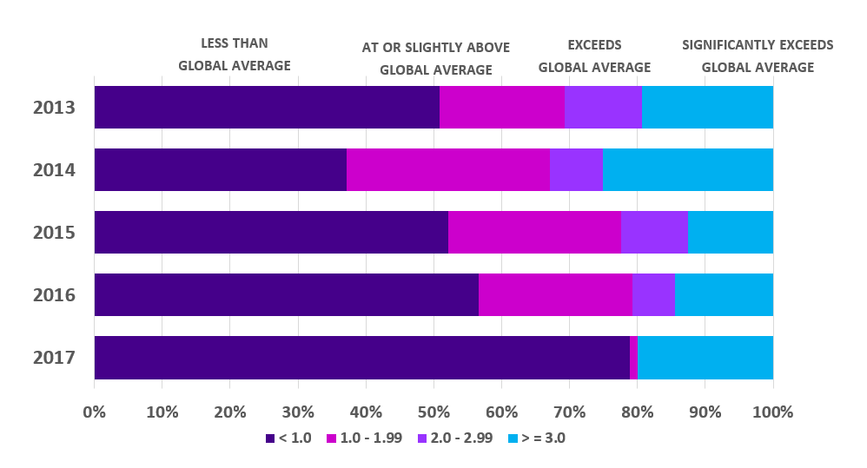
Using CNCI for a group
Text for a group of researchers’ publications
Chart for a group of researchers’ publications
Category Normalized Citation Impact by Year
Group: Department of Name Here
Timespan: 2013 - 2017
Source: InCites
55% of the group’s documents have a citation impact at or above global average
(391 of 710 articles, reviews, conference proceedings indexed in Web of Science from 1987 - 2017 have CNCI >= 1.0, InCites)
15% of the group‘s documents have a citation impact significantly exceeding the global average
(136 of 710 articles, reviews, conference proceedings indexed in Web of Science from 1987 - 2017 have CNCI >= 3.0, InCites)

Slide 20
Using CNCI for an individual
Peer Reviewed Publications
Waltman L, van Eck NJ, Visser M, Wouters P. The elephant in the room: The problem of quantifying productivity in evaluative scientometrics. J Inf. 2016;10(2):671-4. https://doi.org/10.1016/j.joi.2015.12.008
Citations: 10. Cited 20% more than similar papers in field (InCites).
Waltman L, van Eck NJ, van Leeuwen TN, Visser MS, van Raan AFJ. Towards a new crown indicator: Some theoretical considerations. J Inf. 2011;5(1):37-47. https://doi.org/10.1016/j.joi.2010.08.001
Citations: 22. Cited significantly above global average (CNCI: 11.20, InCites).
Waltman L. A review of the literature on citation impact indicators. J Inf. 2016;10(2):365-91. https://doi.org/10.1016/j.joi.2016.02.007
Citations: 22. CNCI: 11.20 (InCites).
The data has been fictionalized and is for demonstration purposes only.

Slide 21
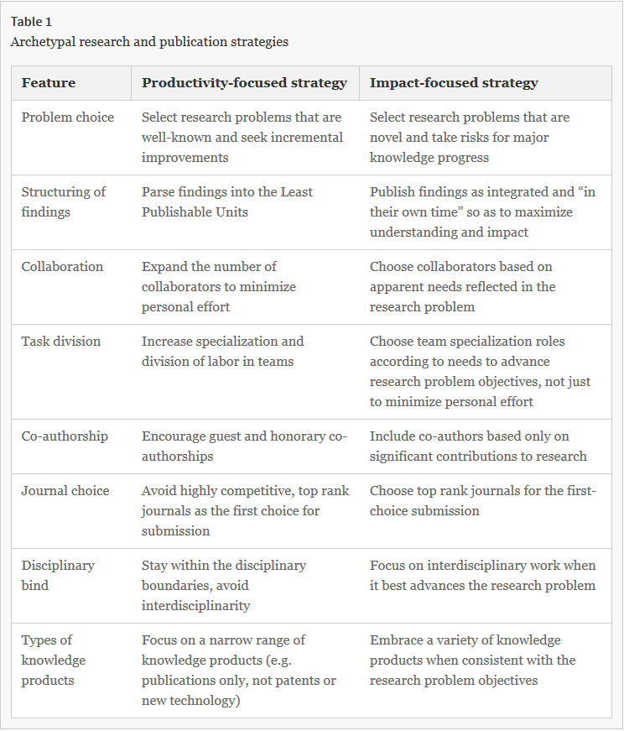

Balancing Productivity and Impact
“Playing-it-safe research and publication strategy maintains high productivity but may not produce high impact or breakthrough research outcomes.”
Kolesnikov, S., Fukumoto, E. & Bozeman, B. Researchers’ risk-smoothing publication strategies: Is productivity the enemy of impact? Scientometrics (2018). https://doi.org/10.1007/s11192-018-2793-8
Notes:
Problem choice
Structuring of finding
Journal choice

Slide 22











CNCI Strengths
Research outputs can be varied in type and extensive in nature.
The CNCI takes into account the most traditional type of scientific output: articles, reviews, conference proceedings papers in journals that are indexed in Web of Science.
The CNCI does not take into account productivity, and therefore does not penalize research groups “for putting effort into producing non-standard scientific outputs”.
Reference: Waltman L, van Eck NJ, Visser M, Wouters P. The elephant in the room: The problem of quantifying productivity in evaluative scientometrics. J Inf. 2016;10(2):671-4. https://doi.org/10.1016/j.joi.2015.12.008

Slide 23
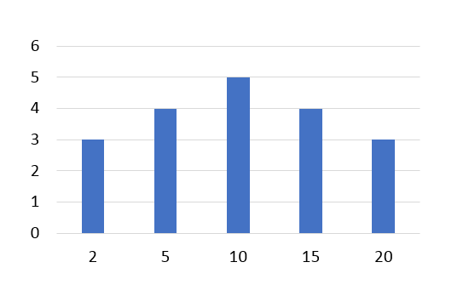
CNCI Limitations
Normal distributions
A normal distribution has values that form a symmetrical “bell curve” and the center value (i.e. measure of central tendency) is generally equal to both the mean and the median.
Many groupings of data naturally fall into a normal distribution:
  Heights of people
  Measurement errors
  Blood pressure
  Points on a test
  IQ scores
  Salaries
Example of a Normal Distribution
of papers and citations for an individual researcher
Mean: 5.0 Median: 5.0
Number of Papers
Number of Citations
Reference: Davis P. How to Manipulate a Citation Histogram. The Scholarly Kitchen. August 8, 2016. https://scholarlykitchen.sspnet.org/2016/08/08/how-to-manipulate-a-citation-histogram/
Mean: the average number of citations
Median: the middle number in the list of citation counts

Slide 24
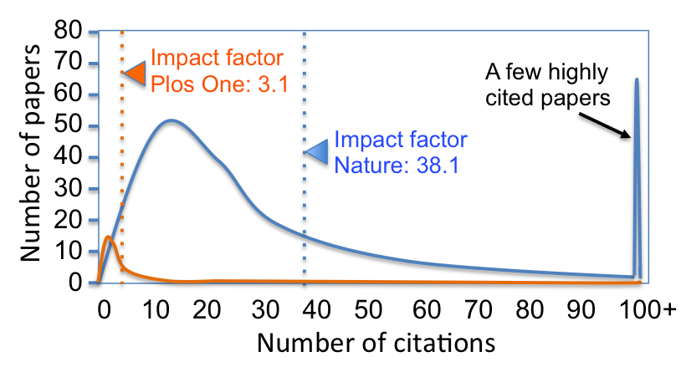
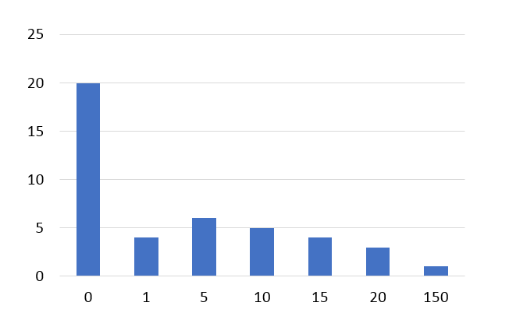
CNCI Limitations
But…citation distributions don’t naturally fall into normal distributions.
Example of a Non-Normal Distribution
for Journal Impact Factor
Example of a Non-Normal Distribution
of papers and citations for an individual researcher
Mean: 8.23 Median: 1.0
Number of Papers
“Journal impact factors (JIFs) are a measure of the average number of citations that articles published by a journal in the previous two years have received in the current year. However, journals with very high impact factors are often based on a small number of very highly cited papers.”
“For instance, most papers in Nature (impact factor 38.1, 2016) were "only" cited 10 or 20 times during the reference year (see figure). Journals with a "low" impact (e.g. PLOS One, impact factor 3.1) publish many papers that are cited 0 to 5 times but few highly cited articles.”
Number of Citations
Reference:
Citation impact. Wikipedia. https://en.wikipedia.org/wiki/Citation_impact

Slide 25
CNCI Limitations
Performance indicators (such as the CNCI) are customarily based on averages which suffer from the usually highly skewed citation distribution, dominated either by highly-cited papers, or non-cited papers.
The “average of ratios” should not be applied at the level of the individual researcher, or for other small sets of publications.
 | Subject Area | Document Type | Year | Actual # of citations | Expected # of citations | CNCI
Paper A | Radiology | Article | 2001 | 20 | 30 | 0.67
Paper B | Genetics & Heredity | Article | 2012 | 1500 | 50 | 30.0
Paper C | Respiratory System | Review | 2014 | 18 | 18 | 1.0
Paper C | Psychiatry | Review | 2014 | 18 | 50 | 0.36
Paper C | Nutrition & Dietetics | Review | 2014 | 18 | 65 | 0.28
 |  |  |  |  |  | 0.55
Paper D | Peripheral Vascular Disease | Conference Proceeding | 2010 | 22 | 20 | 1.10
 |  |  |  |  | Average CNCI | 8.08
Reference: Schreiber M. How much do different ways of calculating percentiles influence the derived performance indicators? A case study. Scientometrics. 2013;97(3):821-9 https://doi.org/10.1007/s11192-013-0984-x
Median: 0.885
Notes:
Bibliometric indicators for the evaluation of performance in terms of citations have been customarily based on average values. Such approaches suffer from the usually highly skewed citation distribution, dominated by highly-cited papers so that the arithmetic mean strongly deviates from the median. As an alternative to mean-based indicators the idea of looking at the position of a publication within a reference distribution has recently lead to an intensive discussion of percentile-based indicators (Bornmann et al. 2012; and references therein).
https://link.springer.com/article/10.1007%2Fs11192-013-0984-x

Slide 26


Percentile in Subject Area
Also known as:
    Percentile Rank
Definition:
  Indicates how a paper has performed relative to others in of the same field, year and document type
    Is both field-normalized and size-independent
    Allows comparisons between entities of different sizes and different subject mixes
Calculation:
“The percentile of a publication is determined by creating a citation frequency distribution for all the publications in the same year, subject category and of the same document type (arranging the papers in descending order of citation count), and determining the percentage of papers at each level of citation, i.e., the percentage of papers cited more often than the paper of interest.”
Reference: InCites Help. Average Percentile. http://ipscience-help.thomsonreuters.com/inCites2Live/indicatorsGroup/aboutHandbook/usingCitationIndicatorsWisely/averagePercentile.html
Notes:
Through the use of the citation limits that define these classes the paper in question can be assigned to one of the six citation impact classes. This procedure is repeated for all papers published by a research group (The use of the percentile for each paper instead of the corresponding percentile impact class might be more preferable (e.g., resulting in a higher power), but this is a very cumbersome and expensive task for a bigger publication set.).
The field normalization is more problematic than the journal normalization because the subject categories of the ISI sometimes heavily overlap and are often misguided (Boyack, Klavans, & Börner, 2005; Leydesdorff & Rafols, 2009; Rafols & Leydesdorff, 2009). These classifications are optimized for the purpose of information retrieval and do not have an analytical base (Pudovkin & Garfield, 2002, p. 1113n). Boyack et al. (2005) estimated that the attribution is correct in approximately 50% of cases across the file (Boyack, personal communication, September 14, 2008). https://www.sciencedirect.com/science/article/pii/S1751157710000106?via%3Dihub
A number of publications has pointed out that in the face of non-normal distributed citation data, the arithmetic mean value is not appropriate as a measure of central tendency.
For citation data (which has non-normal distributions), scientometricians suggest that “where bibliometric data must stand-alone, they should be treated as distributions and not as averages.” https://www.sciencedirect.com/science/article/pii/S1751157710000969?via%3Dihub

Slide 27
Calculating
Percentile in Subject Area
 | Subject Area | Document Type | Year | Actual # of citations | Calculation (# of papers at or below/total papers )*100 | Percentile [Rank] in Subject Area
Paper A | Radiology | Article | 2012 | 0 | (8/8)*100 | 100.0
Paper B | Radiology | Article | 2012 | 5 | (7/8) *100 | 87.5
Paper C | Radiology | Article | 2012 | 24 | (6/8)*100 | 75.0
Paper D | Radiology | Article | 2012 | 24 | (6/8)*100 | 75.0
Paper E | Radiology | Article | 2012 | 35 | (4/8)*100 | 50.0
Paper F | Radiology | Article | 2012 | 40 | (3/8)*100 | 37.5
Paper G | Radiology | Article | 2012 | 40 | (3/8)*100 | 37.5
Paper H | Radiology | Article | 2012 | 75 | (1/8)*100 | 12.5
Calculation in Detail
Percentile Rank = # of papers at or below *100
of Paper X total papers in field
Percentile Rank of Paper F = 3/8 = 0.375 *100 = 37.5%
37.5% of the papers in the field of Radiology are cited the same as or more than (which is actually “below” direction-wise in our table) Paper F.
Papers with multiple subject areas
In the case that a paper is assigned to more than one category, the category in which the percentile value is closest to zero is used (i.e., the best performing value).
Percentile values are rounded to the second decimal place.
Instructions:
  Gather all the papers from Radiology in 2012.
  Sort on “Actual # of citations”.
  Use the calculation provided to find the Percentile [Rank] in Subject Area for each paper.
Reminder: InCites gives you this metric, so you don’t have to do these steps.
Notes:
A percentile is a value below which a certain proportion of observations fall: The higher the percentile for a publication, the more citations it has received compared to publications in the same subject area and publication year and with the same document type. The percentile for the respective publication is determined using the distribution of the percentile ranks over all publications. For example, a value of 90 means that the publication in question is among the 10% most cited publications; the other 90% of the publications have achieved less impact. A value of 50 represents the median and thus an average citation impact compared to the other publications (from the same subject area and publication year and with the same document type).
https://onlinelibrary.wiley.com/doi/full/10.1002/asi.22792

Slide 28
Calculating
Percentile in Subject Area
 | Subject Area | Document Type | Year | Actual # of citations | Percentile [Rank] in Subject Area
Paper A | Radiology | Article | 2012 | 0 | 100.0
Paper B | Genetics & Heredity | Article | 2017 | 1500 | 0.23
Paper C | Respiratory System | Review | 2011 | 18 | 75.0
Paper D | Psychiatry | Review | 2010 | 77 | 75.0
Paper E | Nutrition & Dietetics | Review | 2016 | 4 | 23.2
Paper F | Radiology | Conference Proceeding | 2013 | 22 | 0.12
Paper G | Radiology | Conference Proceeding | 2013 | 22 | 0.12
Paper H | Psychiatry | Article | 2012 | 20 | 12.5
InCites Scale (100 = 0 citations) | Scale we’re used to seeing | Citation Frequency Distribution
90.01 – 100 | 1.00 – 9.99 | 1
80.01 – 90 | 10 – 19.99 | 0
70.01 – 80 | 20 – 20.99 | 2
60.01 – 70 | 30 – 39.99 | 0
50.01 – 60 | 40 – 49.99 | 0
40.01 – 50 | 50 – 59.99 | 0
30.01 – 40 | 60 – 69.99 | 0
20.01 – 30 | 70 – 79.99 | 1
10.01 – 20 | 80 – 89.99 | 1
1.01 – 10 | 90 – 98.99 | 0
<= 1.00 | 99 – 100 | 3
Instructions: Gather the Percentile[Rank] in Subject Area (given to you in InCites) for your custom dataset. Convert the Percentile [Rank] in Subject Area to a scale we’re more used to seeing, and record the number of papers in each frequency.

Slide 29
Calculating
Percentile in Subject Area
Scale we’re used to seeing | Citation Frequency Distribution
1.00 – 9.99 | 1
10 – 19.99 | 0
20 – 20.99 | 2
30 – 39.99 | 0
40 – 49.99 | 0
50 – 59.99 | 0
60 – 69.99 | 0
70 – 79.99 | 1
80 – 89.99 | 1
90 – 98.99 | 0
99 – 100 | 3
Now you can use this information to answer questions, such as:
How many papers are in the 50th percentile or above?
(i.e. the proportion of papers)
(5/8)*100 = 62.5%
62.5% of papers from our dataset are in the 50th percentile or above for citation impact in their respective subject areas.
Notes:
The six percentile rank classes are aggregated as follows:
class >50%: papers with an inverted percentile greater than the 50th inverted percentile,
class 50%: papers within the [50th; 25th[ interval of inverted percentiles,
class 25%: papers within the [25th; 10th[ interval of inverted percentiles,
class 10%: papers within the [10th; 5th[ interval of inverted percentiles,
class 5%: papers within the [5th; 1st[ interval of inverted percentiles,
class 1%: papers with an inverted percentile equal to or smaller than the first inverted percentile.
https://onlinelibrary.wiley.com/doi/full/10.1002/asi.22792

Slide 30
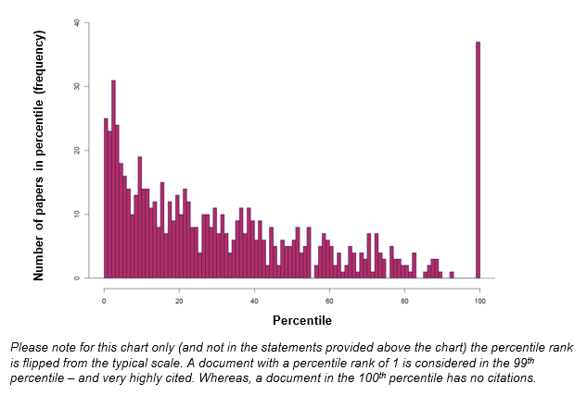
Using Percentile Rank for a group
Text for a group of researchers’ publications
Chart for a group of researchers’ publications
75% of group’s documents rank in the top 50% of their respective subject areas
(538 of 710 articles, reviews, conference proceedings indexed in Web of Science from 1987-2017 are in 50th - 100th percentile in their subject area, InCites)
27% of group’s documents rank in the top 10% of their respective subject areas
(193 of 710 articles, reviews, conference proceedings indexed in Web of Science from 1987-2017 are in the 90th - 100th percentile in their subject area, InCites)

Slide 31
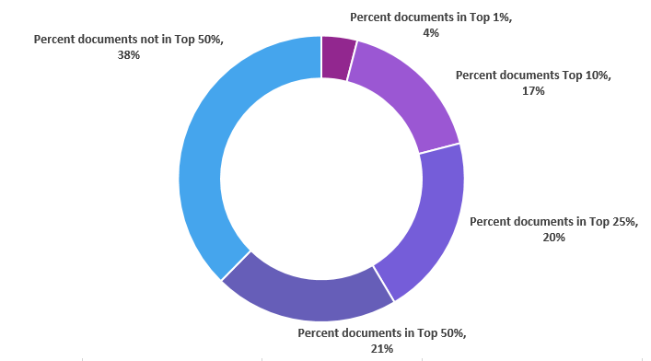
Using Percentile Rank for a group
Chart for a group of researchers’ publications
Percent Documents within Specific Percentiles
Group: Department of Our Name
Timespan: 2013 - 2017
Source: InCites
Reference: Bornmann L. How to analyze percentile citation impact data meaningfully in bibliometrics: The statistical analysis of distributions, percentile rank classes, and top‐cited papers. Journal of the American Society for Information Science and Technology. 2013;64(3):587-95. https://doi.org/10.1002/asi.22792
Notes:
A percentile is a value below which a certain proportion of observations fall: The higher the percentile for a publication, the more citations it has received compared to publications in the same subject area and publication year and with the same document type. The percentile for the respective publication is determined using the distribution of the percentile ranks over all publications. For example, a value of 90 means that the publication in question is among the 10% most cited publications; the other 90% of the publications have achieved less impact. A value of 50 represents the median and thus an average citation impact compared to the other publications (from the same subject area and publication year and with the same document type).
https://onlinelibrary.wiley.com/doi/full/10.1002/asi.22792

Slide 32
Percentile in Subject Area Strengths
Scientometricians suggest that “where bibliometric data must stand-alone, they should be treated as distributions and not as averages.”
The use of percentiles for citation data is very advantageous, because no assumptions have to be made as to the underlying distribution of citations
With percentiles each paper in a paper set of a research group can be field-normalized with a matching reference standard.
Reference: Bornmann L, Mutz R. Further steps towards an ideal method of measuring citation performance: The avoidance of citation (ratio) averages in field-normalization. Journal of Informetrics. 2011;5(1):228-30
Notes:
A ranking from 1 to 99 that indicates what percent of a norm group of papers received citation counts lower than the one a certain paper received. For example, if a paper has a percentile rank of 80, this means that 80 percent of the papers with which their citation count is being compared had lower citation counts than this paper.
http://www.ncme.org/ncme/NCME/Resource_Center/Glossary/NCME/Resource_Center/Glossary1.aspx?hkey=4bb87415-44dc-4088-9ed9-e8515326a061#anchorP

Slide 33

Recent discussion
  Authors: Size-independent indicators must go. Authors say that research performance must use average field-normalized impact per euro spent on research or per researcher
  Critics: Data is not available at scale. Critics agree MNCS could be improved but say authors are being too extreme. Data on scientific inputs (e.g., researchers or research funding) is not available, or it is not of sufficient quality. They argue that MNCS corrects for differences among scientific fields in publication and citation practices and is standardized to an international baseline.
References:
Abramo G, D'Angelo CA. A farewell to the MNCS and like size-independent indicators. J Inf. 2016;10(2):646-51. https://doi.org/10.1016/j.joi.2016.04.006
Waltman L, van Eck NJ, Visser M, Wouters P. The elephant in the room: The problem of quantifying productivity in evaluative scientometrics. J Inf. 2016;10(2):671-4. https://doi.org/10.1016/j.joi.2015.12.008

Slide 34
Recent discussion
Recent discussion
  Authors: MNCS violates productivity axiom. Authors say that metrics should take into account productivity and impact for which they introduce a new metric, call Fractional Scientific Strength (FSS). They contend that MNCS violates “an axiom of production theory: as output increases under equal inputs, performance cannot be considered to diminish.”
  Critics: Expert opinion can determine productivity levels. Critics contend “when the MNCS is used to support an expert committee responsible for the evaluation of a research unit, the committee members may use the MNCS to get insight into the average impact of the publications of the research unit, while they may use their own expert judgment to assess the productivity of the research unit.”
References:
Abramo G, D'Angelo CA. A farewell to the MNCS and like size-independent indicators. J Inf. 2016;10(2):646-51. https://doi.org/10.1016/j.joi.2016.04.006
Waltman L, van Eck NJ, Visser M, Wouters P. The elephant in the room: The problem of quantifying productivity in evaluative scientometrics. J Inf. 2016;10(2):671-4. https://doi.org/10.1016/j.joi.2015.12.008
Notes:
Size Dependent vs. Size Independent
The size-dependent concept of scientific performance is about the overall contribution of a research unit to science, irrespective of the size of the research unit in terms of the number of researchers or the amount of research funding.
Example Metrics: Total Publications, Number of highly cited publications
The size-independent concept of scientific performance is about the contribution of a research unit to science relative to the size of the unit. In this concept of scientific performance, a correction is made for differences between research units in their size.
Example Metrics: CNCI, Hot or Highly Cited Papers, Percentile Rankings
To provide an illustration of the idea of scientific performance as a multidimensional concept, we consider two basic dimensions of scientific performance. These are the size-dependent and the size-independent dimension. The size-dependent concept of scientific performance is about the overall contribution of a research unit to science, irrespective of the size of the research unit in terms of the number of researchers or the amount of research funding. The size-independent concept of scientific performance is about the contribution of a research unit to science relative to the size of the unit. In this concept of scientific performance, a correction is made for differences between research units in their size. The size-independent concept of scientific performance is the concept that AA have in mind and that they seem to consider the only valid idea of scientific performance.

Slide 35
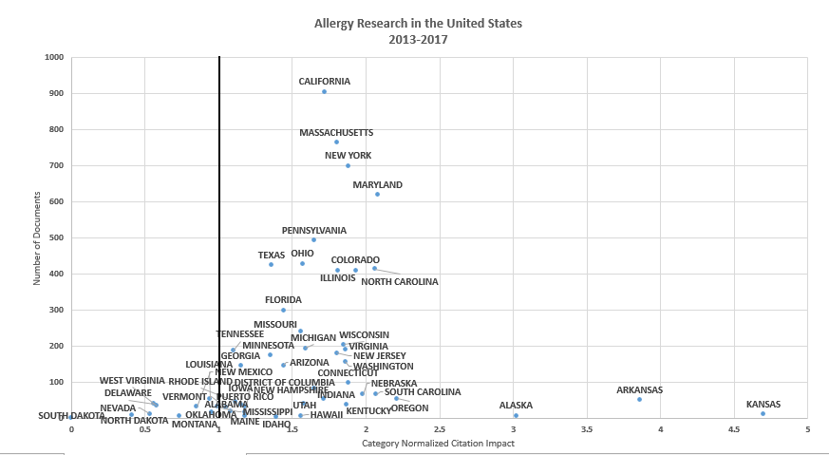
Notes:
Size Dependent vs. Size Independent
The size-dependent concept of scientific performance is about the overall contribution of a research unit to science, irrespective of the size of the research unit in terms of the number of researchers or the amount of research funding.
Example Metrics: Total Publications, Number of highly cited publications, h-index
The size-independent concept of scientific performance is about the contribution of a research unit to science relative to the size of the unit. In this concept of scientific performance, a correction is made for differences between research units in their size.
Example Metrics: CNCI, Hot or Highly Cited Papers, Percentile Rankings
To provide an illustration of the idea of scientific performance as a multidimensional concept, we consider two basic dimensions of scientific performance. These are the size-dependent and the size-independent dimension. The size-dependent concept of scientific performance is about the overall contribution of a research unit to science, irrespective of the size of the research unit in terms of the number of researchers or the amount of research funding. The size-independent concept of scientific performance is about the contribution of a research unit to science relative to the size of the unit. In this concept of scientific performance, a correction is made for differences between research units in their size. The size-independent concept of scientific performance is the concept that AA have in mind and that they seem to consider the only valid idea of scientific performance.

Slide 36
Recent discussion
Recent discussion
  Author: Number of papers in top 10% replaces h-index. “A benefit of the ‘number of class 10% publications’ compared to the h‐index is that a well justified threshold is used to select the significant publications in a set.”
    As percentiles are normalized for subject area and publication year, the number of class 10% publications can be compared between any subject matters or time periods.
    The actual proportion of the class 10% publications can be compared with the expected value of 10%
Reference: Bornmann L. How to analyze percentile citation impact data meaningfully in bibliometrics: The statistical analysis of distributions, percentile rank classes, and top‐cited papers. Journal of the American Society for Information Science and Technology. 2013;64(3):587-95. https://doi.org/10.1002/asi.22792
Notes:
Size Dependent vs. Size Independent
The size-dependent concept of scientific performance is about the overall contribution of a research unit to science, irrespective of the size of the research unit in terms of the number of researchers or the amount of research funding.
Example Metrics: Total Publications, Number of highly cited publications
The size-independent concept of scientific performance is about the contribution of a research unit to science relative to the size of the unit. In this concept of scientific performance, a correction is made for differences between research units in their size.
Example Metrics: CNCI, Hot or Highly Cited Papers, Percentile Rankings
To provide an illustration of the idea of scientific performance as a multidimensional concept, we consider two basic dimensions of scientific performance. These are the size-dependent and the size-independent dimension. The size-dependent concept of scientific performance is about the overall contribution of a research unit to science, irrespective of the size of the research unit in terms of the number of researchers or the amount of research funding. The size-independent concept of scientific performance is about the contribution of a research unit to science relative to the size of the unit. In this concept of scientific performance, a correction is made for differences between research units in their size. The size-independent concept of scientific performance is the concept that AA have in mind and that they seem to consider the only valid idea of scientific performance.

Slide 37

Thank you
Questions?
Karen Gutzman (karen.gutzman@northwestern.edu)
Patty Smith (patty.smith@northwestern.edu)

