Slide 1
All About Metrics:
A review of research impact metrics and how to use them
Annette Mendoza, MLIS
Karen Gutzman, MSLS, MA
Galter Health Sciences Library & Learning Center
Research Assessment and Communications
Notes:
Annette - Welcome to All About Metrics – a review of research impact metrics and how to use them.

Slide 2
All About Metrics:
A review of research impact metrics and how to use them
Course Description: This 45 minute course will provide information on the most common research evaluation metrics. There will also be discussion around metrics in action, the responsible use of metrics, and examples on how to include metrics in your impact statements.
Course Outcomes: At the end of the course, the attendee will:
Become familiar with the most metrics used in research impact.
Understand the concept of responsible metrics.
Be able to create descriptive statements that include metrics.
Become aware of the metrics services available to them through Galter Library.
Notes:
Annette - By the end of the course, you will be familiar with the most common evaluation metrics, understand the concept of responsible metrics, be able to create descriptive statements that include metrics, and be aware of the metrics services available through the Galter Library. We have shared a link to the slide deck that you can use as a reference. We don’t expect that you will have the time now to go into all of the databases we are referencing today, or the tools themselves, this is overview you can utilize to go back at a later time for further investigation.

Slide 3

































User Services
Digital Systems
Research and Information Services
Collection Management and Metadata Services
Administration
Research Assessment and Communications
We are just a click away.
galter.northwestern.edu
Special Collections
Notes:
Annette - The staff at Galter Library strive to advance patient care, research, and education through dedicated services and resources. These services and resources are just a click away at galter.northwestern.edu.
A quick note about the physical library space: the library is open only to Feinberg School of Medicine affiliated faculty, staff, and students. To promote physical distancing, maintain a healthy facility, and create a respectful study environment, the library is currently designated as a quiet zone and the majority of library staff are working remotely at this time.

Slide 4

Metrics can be used to identify:
research productivity
innovative or impactful research
quality of research communication
collaboration between individuals or groups
engagement with various audiences
advancement of knowledge
health or policy impacts
scientific potential
career prestige
and more. . .
Notes:
Annette – In an effort to understand the value of the outputs we produce, we look for ways to measure. Metrics help us do that.
Scholars from all disciplines often use metrics in the following ways:
To quickly learn what others think of their research;
To demonstrate the success of their past outreach efforts when applying for grants; and
To document the influence of their research when going up for tenure and promotion
Reference: Martin, Irvine. “Assessing Basic Research: Some Partial Indicators of Scientific Progress in Radio Astronomy.” Research Policy, vol. 12, no. 2, Elsevier B.V, 1983, pp. 61–90, doi:10.1016/0048-7333(83)90005-7.
Text from: http://www.whatarealtmetrics.com/who/researchers/

Slide 5

How can Galter Library help?
Where possible, we want to help our faculty choose metrics cautiously and to inform users of bibliometric metrics about their correct interpretation and where necessary about their limitations.
Reference: Glänzel, Thijs. “Productivity, Performance, Efficiency, impact—What Do We Measure Anyway?: Some Comments on the Paper ‘A Farewell to the MNCS and Like Size-Independent Indicators’ by Abramo and D’Angelo.” Journal of Informetrics, vol. 10, no. 2, Elsevier Ltd, May 2016, pp. 658–60, doi:10.1016/j.joi.2016.04.008.
Notes:
Annette – Here is where my colleagues and I come in – in our work, we can help inform faculty, staff, and students about responsible research impact metrics, how to interpret metrics and about their limitations. We do our best to keep up with the current conversation about metrics and are committed to using metrics in a responsible fashion.

Slide 6

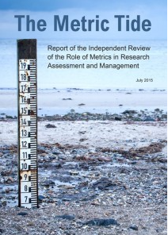
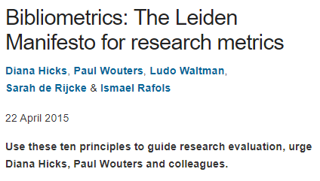
Responsible Metrics Movement
The Declaration on Research Assessment (DORA) is a initiative to improve the ways in which researchers and the outputs of scholarly research are evaluated (2012).
The Metric Tide is an independent review of the role of metrics in research assessment (2015).
The Leiden Manifesto is a list of ten principles to guide research evaluation (2015).
In addition, academic institutions and other organizations have written their own responsible metrics statements.
See: https://thebibliomagician.wordpress.com/statements-of-responsible-metrics-2/
Notes:
Karen – There is seemingly no end of quantitative measures for assessing the impacts of research: from citation counts and journal impact factors, to h-indices, even tweets and Facebook likes. But how robust and reliable are these metrics, and what weight – if any – should we give them in the evaluation of research? If you ponder this, like me, you may be interested in these bold statements on the responsible use of metrics: The Declaration on Research Assessment or (DORA), The Metric Tide, and The Leiden Manifesto. Each provides recommendations for the best use of metrics in evaluation.

Slide 7



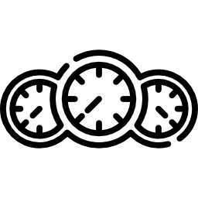
Best Practices for Metrics or Indicators
a metric or an indicator is a proxy; it has the authority to represent something else
Metrics should be easy to understand, open and transparent.
Metrics should not substitute for informed, qualitative assessment.
Different contexts may require different sets of metrics.
Notes:
Karen – The Leiden Manifesto, in particular, emphasizes some best practices that we try to implement in our work at Galter Library.
Where possible we try to use metrics that are easy to understand, open and transparent.
We also advocate that metrics should not substitute for informed, qualitative assessment
And we emphasize that different contexts may require different sets of metrics.
Reference:
Hicks, Wouters. “Bibliometrics: The Leiden Manifesto for Research Metrics.” Nature (London), vol. 520, no. 7548, Apr. 2015, pp. 429–31, doi:10.1038/520429a.
The Leiden Manifesto by Hicks et al. Video: https://vimeo.com/133683418

Slide 8


Best Practices for Metrics or Indicators
Allow those evaluated to verify data and analysis.
Account for variation in fields related to publication and citation practices.
Keep in mind that basic citation metrics can have bias caused by differences in:
publication patterns between research fields,
publication growth and speed,
different document types,
time frames
and/or database coverage.
Notes:
Karen –
We also advocate that those being evaluated with the use of metrics should be allowed to verify the data and the analysis of that data.
And where possible, we try to use metrics that account for variations in publishing and citation practices by different fields.

Slide 9
Where we are going
(Technology time)
Notes:
Karen - Let’s take a look at where we are going and how to get there.

Slide 10





A Quick Note: Databases
Database | Item Count and Content Coverage | Availability | Basic Metrics | Advanced Metrics
 | 160M records [articles, books, theses, abstracts, court opinions, etc.] | Full free version | Google Scholar | Publish or Perish (free tool)
 | 32M records [5,618 Medline journals as well as life sciences journals from PubMed Central and books from NCBI Bookshelf] | Limited free version; Galter Library full version | iCite | iCite (free tool)
 | 75M records [210K books, 120K conferences, 44M patents, 25,100 journals] | Limited free version; Galter Library full version | Scopus | SciVal (no access at Northwestern)
 | 79M records [119K books, 220K conferences, 10M datasets, 46M patents, 34,586 journals] | Limited free version; Galter Library full version | Web of Science | InCites (limited Galter Library access)
by Google
by US National Library of Medicine
by Elsevier
by Clarivate Analytics
Last updated 03/2021
Notes:
Karen –
Today we are going to review metrics from four commonly known literature databases: Google Scholar, Pubmed, Scopus and Web of Science
You will notice that Google Scholar is the largest of the four databases, in terms of individual items that it indexes. And while that may seem like an advantage when it comes to citation metrics, please keep in mind that databases like Scopus, PubMed and Web of Science have documented procedures that help to ensure the quality of the journals and other sources they index. Google Scholar is more of a black box – there’s very little information on their indexing practices, so it’s difficult to assess aspects like quality and completeness in their indexing. Please note that much of the indexing by these databases are focused on English language content.
Also keep in mind that PubMed is focused on biomedicine and health content, which means its scope is more limited than Scopus, Web of Science, and Google Scholar. These databases also index content from the arts and humanities, social sciences, science, and technology. Note that the content indexed in PubMed can be found in Scopus and Web of Science.
Web of Science, Scopus, and Google Scholar all have basic citation metrics in their interfaces.
To find more advanced metrics in Google Scholar you will need to use the free tool, Publish or Perish.
Advanced metrics in Scopus are available in a paid tool called SciVal.
Advanced metrics in Web of Science are available in a paid tool called InCites, which Galter Library has a subscription to with limited access.
Both basic and advanced metrics for PubMed can be found in the free tool, iCite.
NOTE:
Scopus cited references are from the 1970s to present.
Web of Science counts are from platform, not core collection. WOS Cited references are from the 1900s to present.
The full text articles that are available in PubMed Central are a subset of the larger PubMed database.
Each of these databases allow you to create an account free of charge. These types of accounts will allow you additional functionality, like saving lists or saving searches which is helpful when you frequently work in the database.
Future work: Identify citations or references for indexing of English language and non-English language content for each of these databases. Look at Emerging Sources Index in WOS as well.

Slide 11


A Quick Note: Databases
A linked research information dataset that connects grants, publications, datasets and clinical trials to patents and policy documents. Dimensions indexes data from a myriad of sources so that you can track and understand the complete research cycle. The platform includes a free version as well as subscriptions for analytics and cloud services.
Microsoft Academic (MA) uses machine readers powered by artificial intelligence (AI) to scan and extract knowledge from all scholarly publications discovered and indexed by Bing. Bing indexes data from a variety of sources ranging from publisher sites to individual authors' personal homepages. MA's AI agent then cleans and organizes these data into a graph database we call the Microsoft Academic Graph (MAG).
Notes:
Karen – Two other databases to note are Dimensions and Microsoft Academic. Though we don’t have time to cover them in detail today, you’ll hear us mention them a few times. Each has a limited free interface with basic metrics, however you will need a subscription for the full use of their analytics tools.
References:
https://www.dimensions.ai/
https://academic.microsoft.com/home

Slide 12

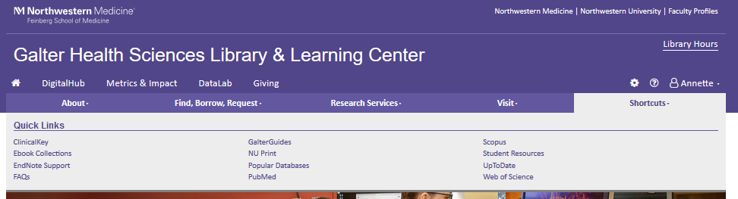
Getting to Scopus, Web of Science and PubMed
Galter Health Sciences
Library & Learning Center:
www.galter.northwestern.edu
To learn more about accessing resources at Galter Library visit the Online Resource Access page on the Library Services FAQs libguide.
Notes:
Karen –
Let’s quickly review how you can access the full licensed versions of Scopus, Web of Science, and PubMed, to ensure you get access to the library’s full text subscriptions.
The easiest option is to sign into the Northwestern VPN and google your way to the database.
But if you’re not on the Northwestern VPN, you can go galter.northwestern.edu and click on the “My Galter” to sign into the library’s website using your NetID and password. Then click on the Shortcuts tab and select Scopus, Web of Science, or PubMed from there.
Remember – even though you can find all of these databases without using the Northwestern VPN or signing into the library’s website – you’ll not have access to all features of Scopus and Web of Science, nor will you have access to our subscriptions in all three of the databases.

Slide 13
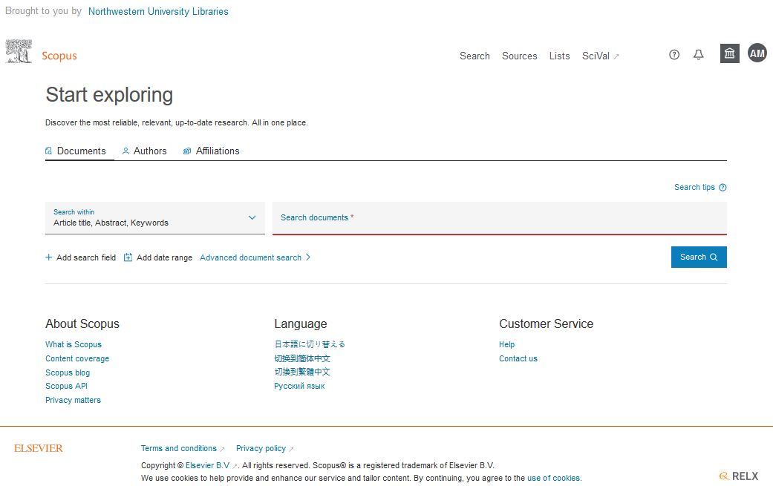
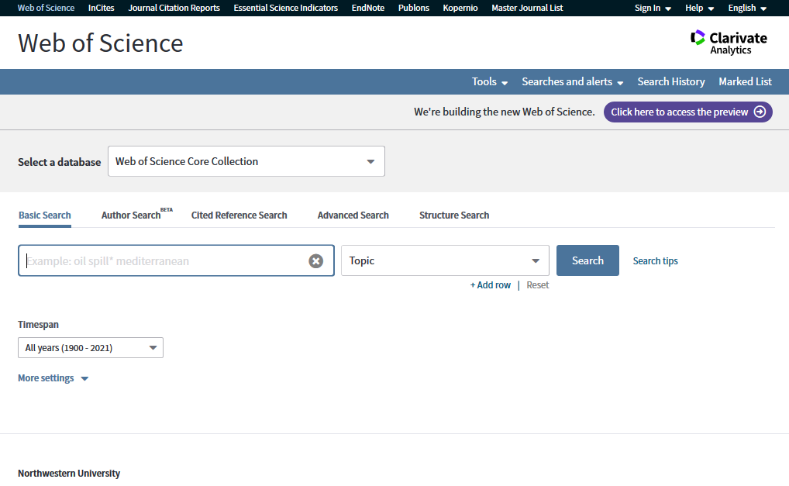
Scopus and Web of Science Home Pages
Notes:
Karen – Here are some screen shots of the home page of Scopus and Web of Science. Each database has options to do a basic literature search, an author search, or an advanced search.

Slide 14
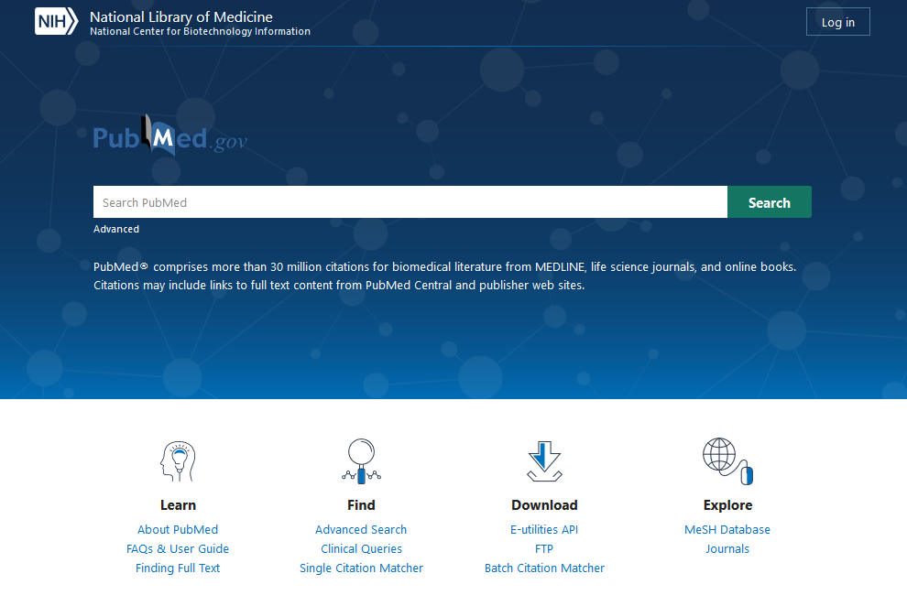
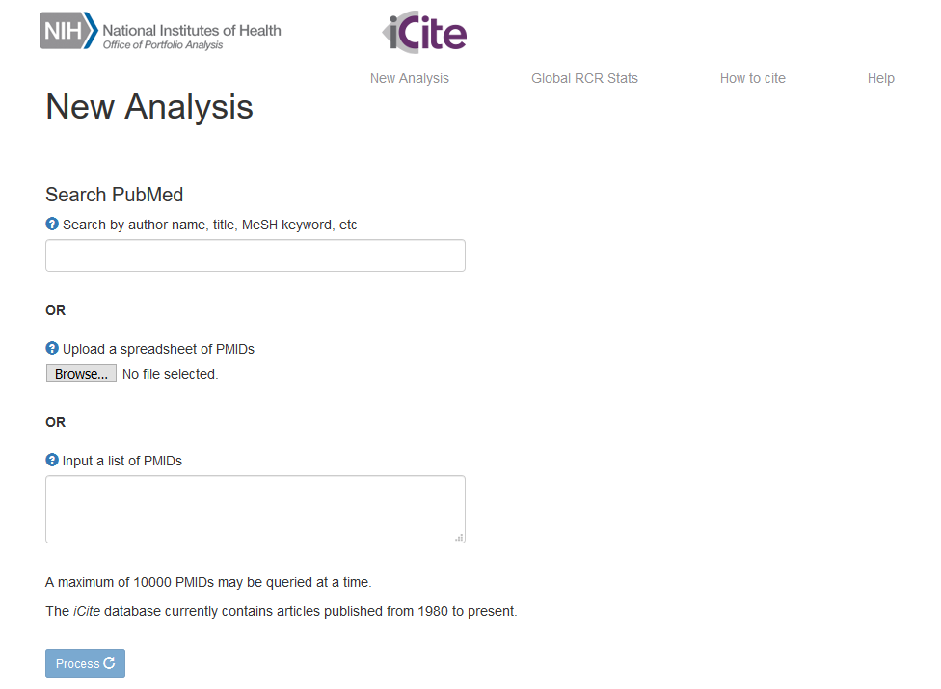
PubMed and iCite
https://pubmed.ncbi.nlm.nih.gov/
https://icite.od.nih.gov/analysis
Notes:
Karen –
PubMed has newly re-worked their interface. Similar to Scopus and Web of Science, you can do basic or advanced literature search. You can also search for authors using field tags in the basic search.
iCite is the free tool you can use to find citation-based metrics for items indexed in PubMed.

Slide 15
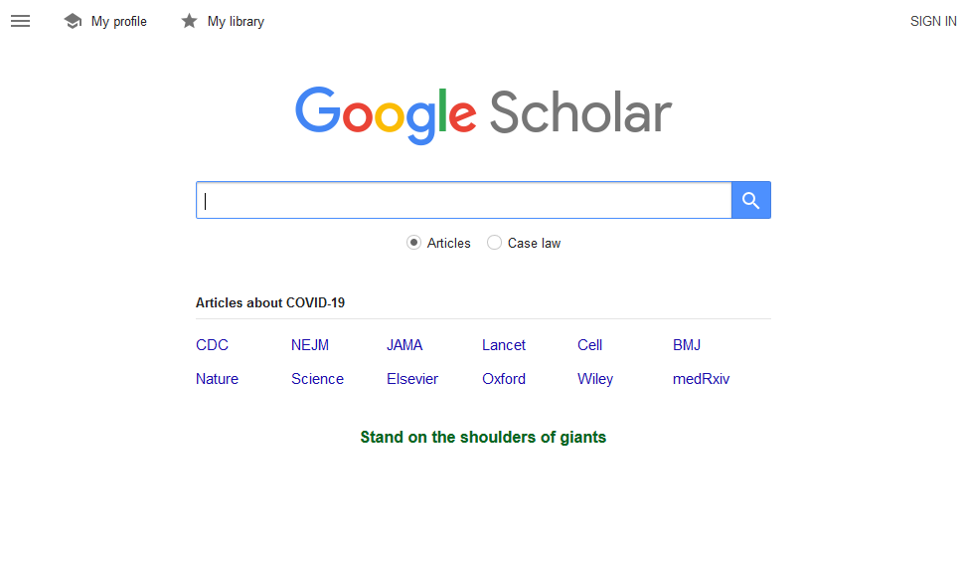
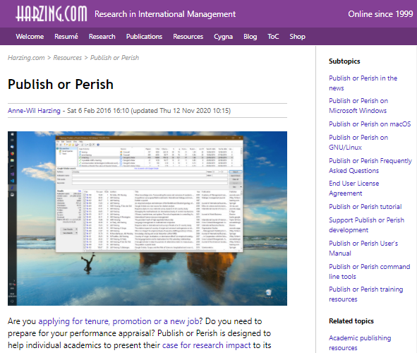
GoogleScholar and Publish or Perish
https://scholar.google.com/
https://harzing.com/resources/publish-or-perish
Notes:
Karen - Many of you are likely familiar with Google Scholar and recognize its home page. As previously noted, citation counts and basic metrics are available in Google Scholar, however if you are looking for advanced metrics, you can use the free tool Publish or Perish, which is a software program that retrieves and analyzes academic citations. Note that Publish or Perish can work with data from Google Scholar or Microsoft Academic.
Reference:
(https://harzing.com/resources/publish-or-perish)

Slide 16

Altmetric Bookmarklet
How to get there:
Go to Altmetric.com
Click on “For Researchers”
Scroll down to section entitled “Tools for researchers”
Select “Altmetric Bookmarklet”
Follow the download instructions
Notes:
Karen - We will also discuss the Altmetric Bookmarklet. This free browser plug-in is made available by the Altmetric company and displays attention metrics for publications with unique identifiers such as DOIs.
To download the bookmarklet, go to Almetric.com, click on “for researchers”, scroll down to the section entitled “tools for researchers”, select “altmetric bookmarklet”, and follow the download instructions.

Slide 17
Exploring Metrics
Notes:
Annette - So, let’s get to it.

Slide 18
Author Level Metrics
Author level metrics help track an individual researcher's impact in an academic discipline.
Author Level Metrics | Article or Book Level Metrics | Journal Level Metrics
g-index | Altmetrics Attention Score | CiteScore
h-index | Category Normalized Citation Impact | Eigenfactor
i10-index | Citation Count | Immediacy Index
m-quotient | Field Citation Ratio (FCR) | Journal Impact Factor (JIF)
 | Field Weighted Citation Impact (FWCI) | SCImago Journal Rank (SJR)
 | Relative Citation Ratio (RCR) | Source Normalized Impact per Paper (SNIP)
Notes:
Annette - We will discuss 16 metrics today – 8 of them in detail. We’ve divided them into three categories:
Author-level metrics help track an individual researcher's impact in an academic discipline.
Article-Level Metrics quantify the reach and impact of published research – for each individual output (or averaged across a group of outputs)
Journal-level metrics measure the impact, reach, or prestige of a journal or a group of journals.
If you have questions, please put them in the chat and we will try to answer them between categories. We will begin by looking at a few author level metrics.

Slide 19

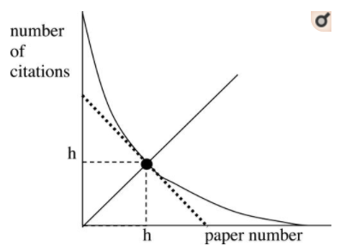



h-index
The h-index is used as evidence of the scholarly influence of an author’s, or group of authors’, body of work.
Use Case
The h-index is equivalent to the number of h publications by an author that have been cited h number of times.
Definition
The h-index can be calculated by hand, however it is offered in databases such as Scopus, Web of Science, and Google Scholar.
Location
Not field normalized.
Point of time in a career will affect this metric.
Inconsistent when you compare it from database to database.
Caveats
Notes:
Annette - The first indicator we will discuss is the h-index. An extremely popular indicator, the h-index is named after J.E. Hirsch the author who introduced the metric back in an article in 2005. The h-index has been used as evidence of the scholarly influence of an author’s, or group of authors’, body of work. It is best used in conjunction with other metrics. The h-index combines publication and citation counts into a single metric and is equivalent to the number of h publications by an author that have been cited h number of times.
Caveats with regard to the h-index:
It is not field normalized so that you cannot compare the h-index for researchers in different fields.
Researchers who have recently begun publishing may not find it very useful because citations take time to accrue.
The h-index is calculated by Scopus, Web of Science, and Google Scholar but differs between databases due to the database coverage.
Reference: Hirsch, J. “An Index to Quantify an Individual’s Scientific Research Output.” Proceedings of the National Academy of Sciences - PNAS, vol. 102, no. 46, National Academy of Sciences, Nov. 2005, pp. 16569–72, doi:10.1073/pnas.0507655102.

Slide 20
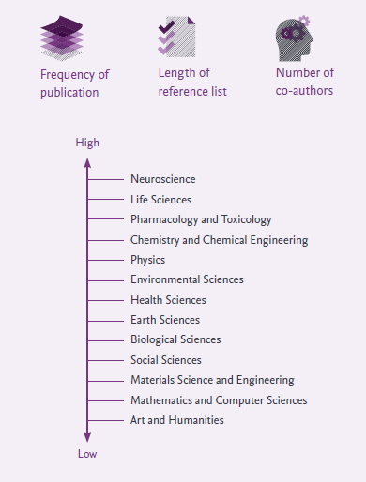

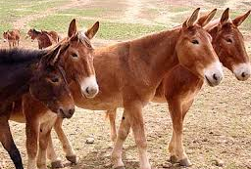
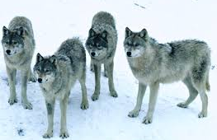
A Quick Note: Field Normalized
“a scientometric indicator that in some way corrects for differences between scientific fields…is referred to as a field-normalized indicator”
? ≠ ?
? ≠ ?
Reference: Waltman, v. (2018). Field normalization of scientometric indicators. https://arxiv.org/ftp/arxiv/papers/1801/1801.09985.pdf
Notes:
Annette - As we discuss metrics, we will note whether the metric IS field normalized or IS NOT field normalized. It would be difficult to compare these three “packs” of animals, just as it would be difficult to compare researchers who work in three different “fields”. Field normalized metrics attempt to correct for bias caused by differences in publication patterns between research fields, publication growth and speed, different document types, time frames, and/or database coverage. Metrics that are field normalized allow us to compare different fields of research and they are extremely challenging to develop. The backbone of a field normalized metric is based on some type of field classification system and often these systems differ between databases.
Reference:
Waltman, v. (2018). Field normalization of scientometric indicators. https://arxiv.org/ftp/arxiv/papers/1801/1801.09985.pdf

Slide 21
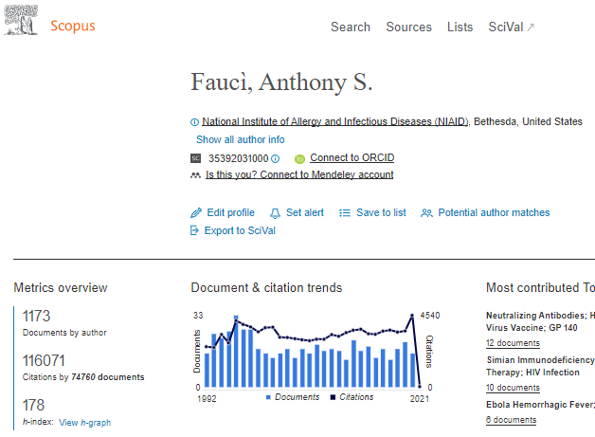
Where to find it: h-index
Notes:
Annette – Scopus generates author profile pages that showcase the researcher’s output and demonstrates their collaboration and research impact. Scopus uses powerful data processing to group papers into an individual’s author profile with a high degree of accuracy based on matching of name, email, affiliation, subject area, citations, and co-authors. To find an author profile page, you can use the author search or click on the hyperlinked name of any author in a document record. Authors can report corrections needed for their profile and can connect their ORCID or Mendeley account. The h-index is available on each author profile page based on the publications that have been attributed to that author. You can also explore the author profile page for documents by the author, total citations, co-authors, and subject areas.
A quick note – We will be using Dr. Fauci and his work for the metric examples in this presentation. My daughter is concerned that I am obsessed with Dr. Fauci, and I have requested that she just mind her own business.
Reference: https://elsevier.libguides.com/c.php?g=1073103&p=7813912

Slide 22
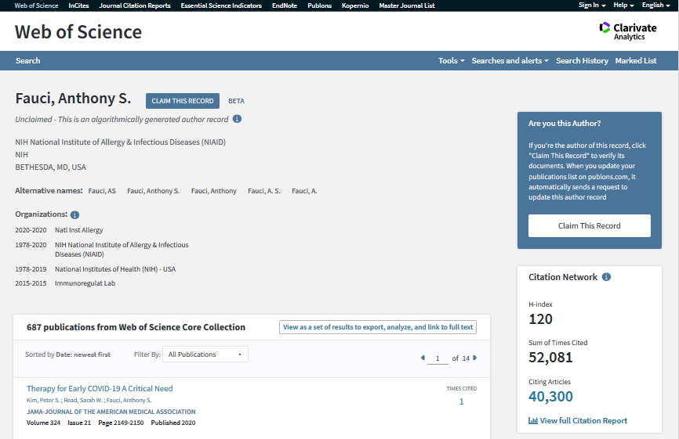
Where to find it: h-index
Notes:
Annette - Web of Science also offers an author search and hyperlinks author names to author profiles. These author profiles are automatically generated by Web of Science using an algorithm that matches over 40 data features, including author name, affiliation, citation behavior and co-authorship patterns. However unlike Scopus, the author profiles in Web of Science are in beta format and you may find several profiles for one author. Authors are encouraged to provide their feedback in Web of Science and connect their unique ORCID identifier to the Web of Science author profile. The h-index is available in the author profile along with other metrics, such as the sum of times cited, citing articles, percentage of first/last corresponding author positions, and top co-authors.
References: https://clarivate.libguides.com/authors/portfolio

Slide 23
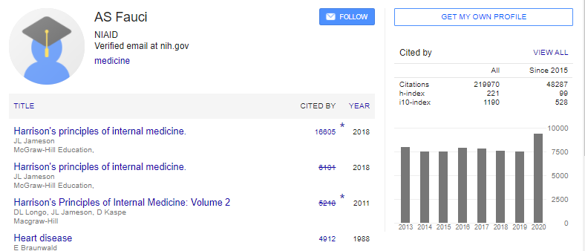
Where to find it: h-index
Notes:
Annette – Author’s can create their own author profiles in Good Scholar via their Google account. Authors can choose to have their list of articles updated automatically, review the updates themselves, or to manually update the articles at any time. The h-index is included in the profile along with citation count and a graph of citations over time. To find Dr. Fauci’s h-index in Google Scholar, I had to search his name to retrieve a list of publications and then click on his author name beneath one of the articles. This takes you to the author profile shown above where the h-index is listed in a metric box on the right.
Reference: https://scholar.google.com/intl/en/scholar/citations.html

Slide 24



Final Thoughts: h-index
Metric statement: Dr. Fauci has created an output of 1174 documents between 1965 and 2020,
and his h-index is 178 (Scopus).
What that means: Dr. Fauci has at least 178 papers that have been cited at least 178 times.
?
=
?
Something To Think About
h-index = 10
[10 papers w/
10 citations each
AND
90 papers w/
9 citations each]
h-index = 10
[10 papers w/
10 citations each]
Notes:
Annette – Using the h-index in practice, I can say:
Dr. Fauci has created an output of 1174 documents between 1965 and 2020, and his h-index is 178 (Scopus).
This means that Dr. Fauci has at least 178 papers that have been cited at least 178 times.
Here is something to think about - If we there are two scientists, each with an h-index of 10, and the first scientist has exactly 10 papers with 10 citations each and the second scientist has 10 papers with 10 citations each AND 90 papers with 9 citations each - would anyone think them equivalent?
Additional information: https://www.metrics-toolkit.org/h-index/

Slide 25
i10-index
The 1-10 index is used as evidence of the scholarly influence of an author’s, or group of authors’, body of work.
Use Case
The i10-index is equivalent to the number of publications by an author with at least 10 citations.
Definition
The i10-index can be found in Google Scholar.
Location
Not field normalized.
Only available in Google Scholar.
Caveats
Notes:
Karen –
Next up is the i10 index, which is an author-level metric introduced by Google in 2011. This metric has been used as evidence of the scholarly influence of an author’s, or group of authors’, body of work.
The i10-index is equivalent to the number of publications by an author with at least ten citations. This indicator is NOT field normalized and cannot be used to compare researchers in different fields.
Source: https://en.wikipedia.org/wiki/Author-level_metrics#i10-index

Slide 26
Where to find it: i10-index
Notes:
Karen – The i-10 index is listed on the Google Scholar author profile directly below the h-index.

Slide 27
Final Thoughts: i10-index
Metric statement: Dr. Fauci currently has an i10-index of 1190 (Google Scholar).
What that means: Dr. Fauci has at least 1190 papers that are cited at least 10 times.
Something To Think About
Problems with reproducibility in Google Scholar – why?
Low quality of metadata, including lack of DOI
Lack of advanced search options
Data manipulations due to fake documents on the web
Notes:
Karen – Using the i-10 index in practice, I can say:
Dr. Fauci currently has an i10-index of 1,190 (Google Scholar) which means that at least 1,190 of his documents have been cited at least 10 times according to Google Scholar.
Remember that Google Scholar citation information is a bit of a black box – we don’t have much information about the scope or quality of Google Scholar’s indexing practices. This may not seem problematic on a every day practical level, but since transparency and data quality are important in the research assessment process, we suggest caution in using Google Scholar as a source of metrics for an evaluation exercise.
Note: GSM has what could be described as a lax indexing policy and does not enforce any type of quality control over the journals it includes.
https://onlinelibrary.wiley.com/doi/abs/10.1087/20130206
References:
-Halevi, Moed. “Suitability of Google Scholar as a Source of Scientific Information and as a Source of Data for Scientific evaluation—Review of the Literature.” Journal of Informetrics, vol. 11, no. 3, Elsevier Ltd, Aug. 2017, pp. 823–34, doi:10.1016/j.joi.2017.06.005.
-Martín-Martín, Thelwall. “Google Scholar, Microsoft Academic, Scopus, Dimensions, Web of Science, and OpenCitations’ COCI: a Multidisciplinary Comparison of Coverage via Citations.” Scientometrics, Sept. 2020, pp. 1–36, doi:10.1007/s11192-020-03690-4.

Slide 28
Author Level Metrics – the others
g-index
m-quotient
The g-index is the (unique) largest number such that the top g articles received (together) at least g² citations.
A g-index of 20 means that an academic has published at least 20 articles that combined have received at least 400 citations.
The m-quotient is calculated by dividing the h-index by the number of years the academic has been active (measured as the number of years since the first published paper).
Not available readily calculated in any citation databases.
Not available readily calculated in any citation databases.
Notes:
Karen –
Other author-level metrics that we won’t cover in depth today, but you may be interested in are the g-index and m-quotient.
The G-index was introduced in 2006 by Leo Egghe as an “improvement to the h-index”. The g-index is the (unique) largest number such that the top g articles received (together) at least g² citations. A g-index of 20 means that an academic has published at least 20 articles that combined have received at least 400 citations.
The m-quotient, similar to the h-index, was also created by Jorge Hirsh. The m-quotient controls for the age of an authors career. It is calculated by dividing the h-index by the number of years since the researcher’s first published paper.
References:
-https://en.wikipedia.org/wiki/Scholar_Indices_and_Impact#m-quotient
-https://harzing.com/popbook/ch1_4_3.htm#:~:text=One%20way%20to%20facilitate%20comparisons,measure%20and%20called%20it%20m
-https://harzing.com/resources/publish-or-perish/tutorial/metrics/h-and-g-index
-Egghe, Leo. “Theory and Practise of the g-Index.” Scientometrics, vol. 69, no. 1, Springer Netherlands, Oct. 2006, pp. 131–52, doi:10.1007/s11192-006-0144-7.
-Hirsch, J. “An Index to Quantify an Individual’s Scientific Research Output.” Proceedings of the National Academy of Sciences - PNAS, vol. 102, no. 46, National Academy of Sciences, Nov. 2005, pp. 16569–72, doi:10.1073/pnas.0507655102.
Notes: [The g-index takes into account the citation evolution of the most cited papers over time. However, unlike the h-index these citations could be generated by only a small number of articles. For instance an academic could have 20 papers, 15 of which have no citations and the remaining five having respectively 350, 35, 10, 3 and 2 citations which would have a g-index of 20, but a h-index of 3 (three papers with at least 3 citations each). Calculating the g-index will frequently provide you with higher number than the h-index, however this metric is not widely used and is not readily available in any citation databases that I am aware of.]

Slide 29


Which of the following situations is a good use of the h-index?
Pop Quiz!
A. Comparing the citation impact of researchers from different fields.
B. Finding highly cited researchers in a field of interest.
C. Deciding which researcher should receive an award.
D. Estimating the broad impact of a researcher’s contributions.
Notes:
Karen – Now we have some quiz questions for you. If you think you have the answer, please use the chat function in zoom to share with the group.
Which of the following situations is a good use of the h-index?
A. Comparing the citation impact of researchers from different fields. (Incorrect: h-index is not field normalized so you cannot compare across fields)
B. Finding highly cited researchers in a field of interest.
C. Deciding which researcher should receive an award. (Incorrect: one metric should most likely never be used as a deciding factor for understanding a career)
D. Estimating the broad impact of a researcher’s contributions.
Answer: B and D
This slide created by SlideLizard.

Slide 30
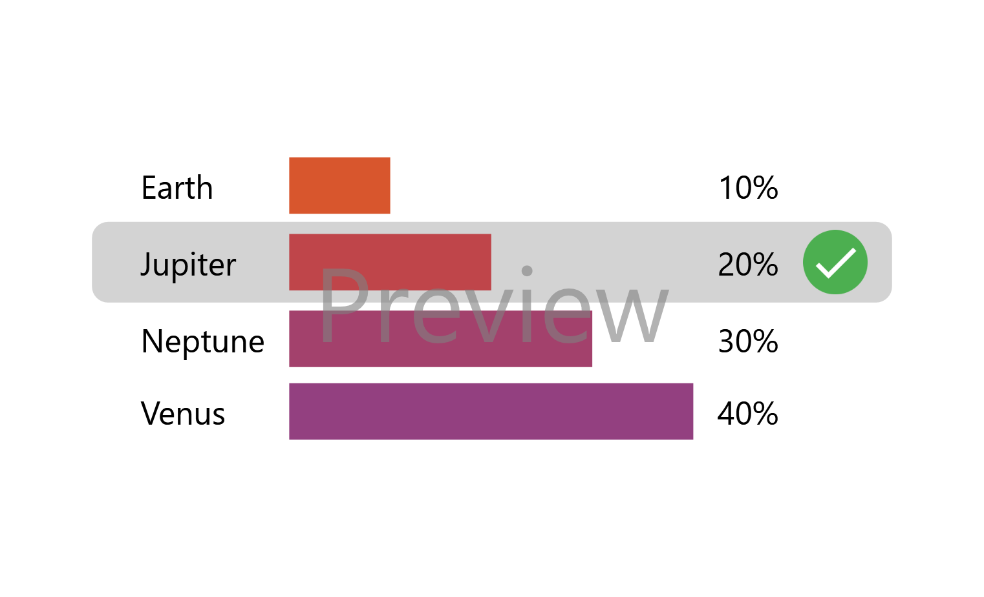
Using the information in the table below, answer the four questions:
Pop Quiz!
Paper | Citations
1 | 11
2 | 10
3 | 7
4 | 3
5 | 2
1. What is my h-index?
2. Which paper does NOT contribute to my h-index?
3. Which paper could receive one more citation and my h-index would increase by one?
4. What is my i10-index?
Notes:
Annette – A researcher has five papers with the citation counts noted in the table. Let’s answer the four questions.
Table:
Paper 1 – 11 citations
Paper 2 – 10 citations
Paper 3 – 7 citations
Paper 4 – 3 citations
Paper 5 - 2 citations
1. What is the h-index? H-index = 3 [How to calculate: An h-index cannot exceed the number of publications an author has. So when we look at this list, we ask – do the five papers each have five or more citations? No. Are there four papers that have four or more citations? No. Are there three papers that have three or more citations? Yes! The h-index for this researcher is 3.
2. Which of these papers do NOT contribute to the h-index? Paper number 4 and 5 do NOT contribute to the h-index.
3. Which paper could receive one more citation and my h-index would increase by one? Paper number 4. There would then be four papers with at least four citations.
4. What is my i10-index? i10 index = 2. There are 2 papers with at least 10 citations each.
______________________________________________________________________________________________________________________________________
Other questions:
True or false: Your h-index be higher than the number of papers that you have published. False, your h-index CANNOT be higher than the number of papers you have published.
___
Researcher Number 1:
Total publications: 111
Average time since first publication: 20 years
Total citations: 9497
Cites per year: 474.85
Cites per paper: 85.56
Authors per paper: 1.86
H-index: 45
G-index: 97
Researcher Number 2:
Total publications: 41
Average time since first publication: 17 years
Total citations: 8304
Cites per year: 488.47
Cites per paper: 202.54
Authors per paper: 3.17
H-index: 26
G-index: 41
Which author has more publications that are not contributing to their h-index? We look at the total number of publications and their h-index, the difference for researcher1 is 66 (59%), the difference for researcher 2 is 15 (37%). Researcher 1.
Which researcher could possibly find it easier to increase their h-index? In theory, in order for one of Researcher 2’s papers to contribute to her h-index, she only has to have a paper reach 27 , where researcher 1 will have to reach 46 citations to increase her h-index.
_____
Can you compare the h-index for researchers from two different fields? No.

Slide 31
Article Level Metrics
Article level metrics quantify the reach and impact of published research
Author Level Metrics | Article or Book Level Metrics | Journal Level Metrics
g-index | Altmetrics Attention Score | CiteScore
h-index | Category Normalized Citation Impact | Eigenfactor
i10-index | Citation Count | Immediacy Index
m-quotient | Field Citation Ratio (FCR) | Journal Impact Factor (JIF)
 | Field Weighted Citation Impact (FWCI) | SCImago Journal Rank (SJR)
 | Relative Citation Ratio (RCR) | Source Normalized Impact per Paper (SNIP)
Notes:
Annette - We will now move to discuss a few of the article level metrics. Article-Level Metrics quantify the reach and impact of published research – for each individual output (or averaged across a group of outputs)

Slide 32
Citation Count
Citation count allows you to go beyond a number and describe why and where important ideas are spread from a researcher’s original work to subsequent citing works.
Use Case
Citation count is the number of times an article is cited in other bodies of literature.
Definition
Citation databases including Google Scholar, Scopus, Web of Science, and Dimensions, and the citation tool iCite.
Location
Not field normalized.
Inconsistent when you compare it from database to database.
Citations are impacted by the age of the paper.
Difficult to track citations to unpublished articles such as preprints or white papers.
Caveats
Notes:
Annette - We will, once again, review the most popular metric in this category first – citation count. A simple metric, the citation count is the number of times an article is cited in other bodies of literature.
Citation count is a metric that allows you to easily go beyond the number and tell a story about the context of the citations. Citation context describes why and where important ideas are spread from a researcher’s original work to subsequent citing works. Researchers can tell the story of why their work is cited; for example, their work was confirmed, corrected, improved, duplicated, or criticized by a citing paper. Researchers can tell the story of where their work is cited; for example, citations in clinical guidelines, policy documents, or legislation indicate societal impact of their work.
You can find the citation count in several databases, however the count will change from database to database because the database only knows about the reference lists of the articles it indexes. In addition, the citation count is not field normalized, therefore citation count for a paper, a group of papers, or an author’s body of work cannot be compared against papers in different fields. Citations are impacted by the age of the paper, more recently published papers have had less time to accrue citations. Most papers “receive a growing number of citations to arrive at a peak somewhere between two and six years after publication before the citation count decreases, while some receive most of the citations within a year or two, others are cited constantly for a long period, and still others remain unmarked before a sudden wave of citations arrives seven or ten years afterwards. Finally, it is difficult to track citations to unpublished articles such as preprints or white papers, and other items without unique identifiers like DOIs. Northwestern researchers can obtain DOIs and track citation counts for their unpublished scholarly works by uploading them to Digital Hub, our institutional repository.
Reference for citation count information:
https://www.sciencedirect.com/science/article/pii/S1751157716300086?via%3Dihub

Slide 33
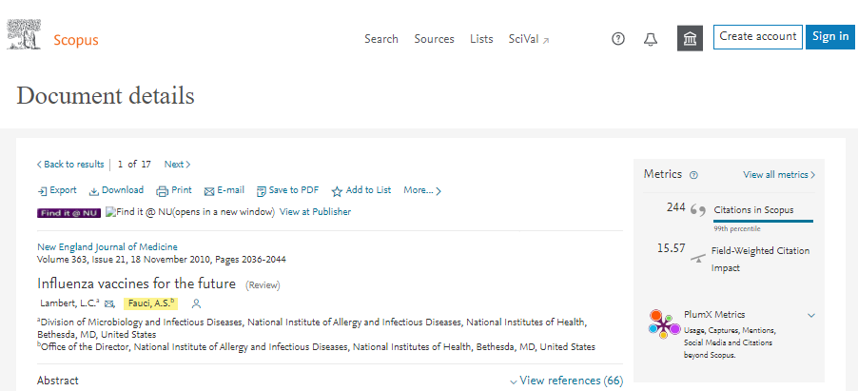
Where to find it: Citation Count
Notes:
Annette – When you view a document record in Scopus, the citation count can be found in the metrics box. The review article “Influenza vaccines for the future” that was co-authored by Dr. Fauci has 244 citations in Scopus.

Slide 34
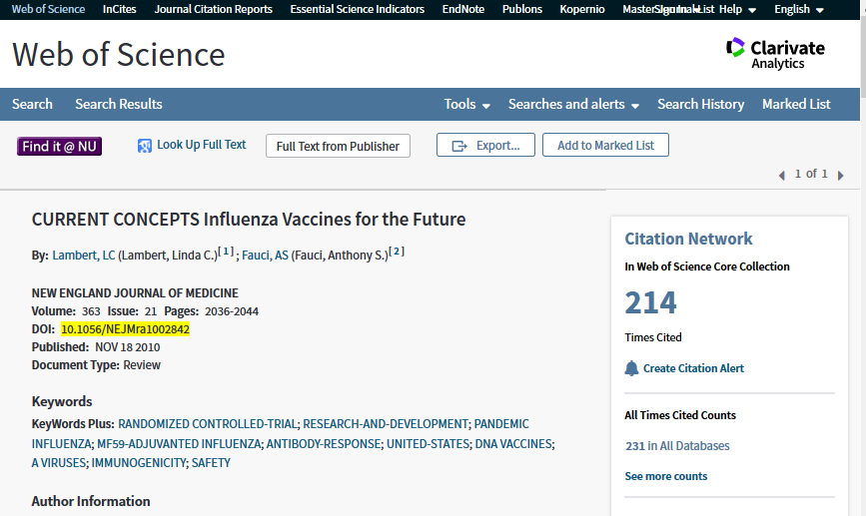
Where to find it: Citation Count
Notes:
Annette – When you review a document record in Web of Science, the citation count is noted as times cited. That same review article has 214 citations in Web of Science.

Slide 35
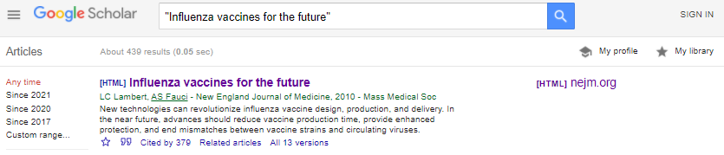
Where to find it: Citation Count
Notes:
Annette – Citation counts in Google Scholar can be found beneath the search result abstract. Dr. Fauci’s review has 379 citations in Google Scholar.

Slide 36
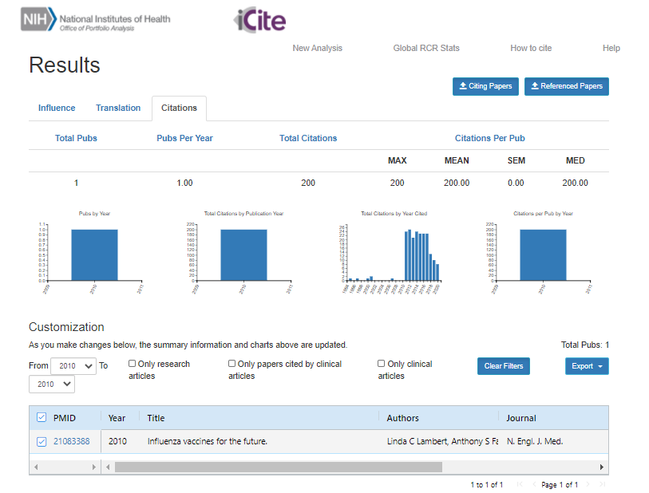
Where to find it: Citation Count
Notes:
Annette – Using the free iCite tool and searching by the PMID allows you to see the citation count for an article. iCite currently has citation data for papers from 1995 to present, but note that papers published in the most recent year (some of which are only a few months old) have not had enough time to accrue a meaningful citation count. The citation counts from iCite come from the NIH Open Citation Collection (NIH-OCC), a public access database for biomedical research that is made freely available to the community. This dataset, which has been carefully generated from unrestricted data sources such as MedLine, PubMed Central (PMC), and CrossRef. CrossRef is a database that indexes data far beyond PubMed and includes 88,958 journals, 1.6M books, and 78K conference proceedings (as of 3/22/2021). iCite shows that Dr. Fauci’s review article has 200 citations.
Should I take that bold statement out?
References:
https://icite.od.nih.gov/user_guide?page_id=ug_find_import_export
https://pubmed.ncbi.nlm.nih.gov/31600197/

Slide 37
Final Thoughts: Citation Count
Metric statement: The review article “Influenza vaccines for the future” which was co-authored by Dr. Fauci has 244 citations (Scopus).
What that means: There are 244 publications that have used this paper in their reference list since the paper was published in 2010.
Self citations: To include or not to include?
Something To Think About
For: You are an expert in a new field or are making strides in a field that continues to build on itself.
Against: Including self-citations makes you concerned that there will be an impression that you are gaming the system.
Notes:
Annette –
I can make the statement: "The review article “Influenza vaccines for the future” which was co-authored by Dr. Fauci has 244 citations (Scopus).”
This means there are 244 publications that have used this paper in their reference list since the paper was published in 2010.
Here is something to think about – Self-citations – to include or not to include? You might be concerned about the optics surrounding self citations. A 2020 study in Scientometrics showed the authors to recognize that - A self-citation is used to show progress of one’s own previous work in a new publication. By doing this, not only do the authors show that they are building upon their own previous work, but it is also used to avoid unnecessary increase in length of manuscript by re-introducing the already published work, hence simply referring to the previous work as a self-citation. Both Scopus and Web of Science offer a citation count that can include or exclude self citations of all authors.
References:
Amjad, Rehmat. “Scientific Impact of an Author and Role of Self-Citations.” Scientometrics, vol. 122, no. 2, Springer, Feb. 2020, pp. 915–32, doi:10.1007/s11192-019-03334-2.
https://journals.sagepub.com/doi/full/10.1177/1094428120969905
https://www.metrics-toolkit.org/citations-articles/
http://www.garfield.library.upenn.edu/essays/V1p188y1962-73.pdf

Slide 38

Field Weighted Citation Impact (FWCI)
The FWCI facilitates the benchmarking of citation performance across groups of different size, disciplinary scope and age, such as research large groups, institutions, or geographic regions.
Use Case
The FWCI is the ratio of the document's citations to the average number of citations received by all similar documents (same document type, publication and field) over a three-year window (in the publication year and the following three years).
Definition
The FWCI can be found in Scopus (SciVal).
Location
Is field normalized.
For papers published in more than one field, the FWCI is determined based on a harmonic mean of the scores from those fields so that each field makes an equal contribution to the metric.
Only available for publications indexed in Scopus.
Caveats
Notes:
Karen – The next article-level metric is the Field Weighted Citation Impact or FWCI, which can be found in Scopus. The FWCI is field normalized and was created to facilitate benchmarking of citation performance across groups of different size, disciplinary scope, and age, such as large research groups, institutions, or geographic regions. The FWCI is the ratio of the actual citations received by a document to the average number of citations received by similar documents over a three year window. It is typically presented as an average for a group of papers, but note that this average can be strongly influenced by outliers. The FWCI is dependent upon the field classification system used in Scopus.
____________
Note: Both the numerator and denominator of the FWCI are limited to three years – the publication year and the following three years.
A similar metric called the Category Normalized Citation Impact, or CNCI, can be found in InCites for Web of Science documents, and it is similarly dependent on the field classification system used in InCites for its calculation (for example, the field Psychology in Scopus will not have the same FWCI as the field Psychology in Web of Science).
References:
-Purkayastha, Palmaro, et.al. “Comparison of Two Article-Level, Field-Independent Citation Metrics: Field-Weighted Citation Impact (FWCI) and Relative Citation Ratio (RCR).” Journal of Informetrics, vol. 13, no. 2, Elsevier Ltd, May 2019, pp. 635–42, doi:10.1016/j.joi.2019.03.012.
https://www.sciencedirect.com/science/article/pii/S1751157718303559
-https://arxiv.org/ftp/arxiv/papers/1507/1507.02099.pdf
-https://elsevier.libguides.com/Scopus/metrics
Harmonic Mean information:
-The harmonic mean is appropriate if the data values are ratios of two variables with different measures, called rates
https://en.wikipedia.org/wiki/Harmonic_mean
-As an example, let us calculate the harmonic average of 3, 4, and 6:
There are three numbers, so n = 3
Let's take the reciprocals: ⅓, ¼, and ⅙
Hence, we have s = ⅓ + ¼ + ⅙ = ¾ .
Finally, calculate the harmonic average: n / s = 3 / ¾ = 4
https://www.omnicalculator.com/math/harmonic-mean

Slide 39
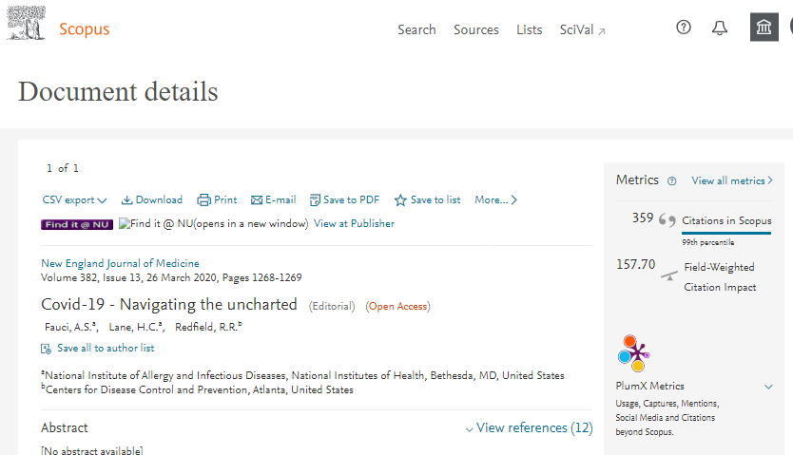
Where to find it: Field Weighted Citation Impact (FWCI)
Notes:
Karen - We can see the FWCI in a document record on the document details page in Scopus. A FWCI of 1 indicates that the document has performed just as expected for the global average. A FWCI of greater than 1 indicates that the document is more cited than expected according to the global average.

Slide 40
Final Thoughts: Field Weighted Citation Impact (FWCI)
Metric statement: This 2020 editorial by Dr. Fauci has a field weighted citation impact of 157.70, indicating it is 157 times more cited than expected (Scopus).
What that means: The actual number of citations that Dr. Fauci’s editorial received is significantly higher than the average expected for an editorial published in the same field at the same time.
Something To Think About
“The FWCI is a sophisticated indicator and normalizes citations across publication year, field, and document type. It is used by various research bodies to benchmark research impact regardless of differences in entity size, disciplinary profile, age, and publication-type composition.”
Reference: Purkayastha, Palmaro. “Comparison of Two Article-Level, Field-Independent Citation Metrics: Field-Weighted Citation Impact (FWCI) and Relative Citation Ratio (RCR).” Journal of Informetrics, vol. 13, no. 2, Elsevier Ltd, May 2019, pp. 635–42, doi:10.1016/j.joi.2019.03.012.
Notes:
Karen – Using the FWCI in practice, I can say:
The 2020 editorial, “Covid-19; Navigating the Uncharted”, by Dr. Fauci has a field weighted citation impact of 157.70, indicating it is 157 times more cited than expected (Scopus)”
This means that the actual number of citations that Dr. Fauci’s editorial received is significantly higher than the average expected for an editorial published in the same field at the same time.
Because the FWCI is typically presented as an average for a university, or a journal, or another large entity, any outliers have a relatively small affect. However, outliers can strongly affect the average FWCI for a relatively small group of documents like we would see for an individual researcher. Therefore we would use this metric cautiously when evaluating individuals.
Reference:
-Purkayastha, Palmaro. “Comparison of Two Article-Level, Field-Independent Citation Metrics: Field-Weighted Citation Impact (FWCI) and Relative Citation Ratio (RCR).” Journal of Informetrics, vol. 13, no. 2, Elsevier Ltd, May 2019, pp. 635–42, doi:10.1016/j.joi.2019.03.012.
Metric toolkit statement of use case cites this article: https://arxiv.org/ftp/arxiv/papers/1507/1507.02099.pdf

Slide 41

Relative Citation Ratio (RCR)
The RCR helps to understand the relative scholarly influence that a scientific article has had, as compared to other NIH-funded research.
Use Case
The RCR represents a citation-based measure that is calculated as the cites/year of each paper, normalized to the citations per year received by NIH-funded papers in the same field and year.
Definition
The RCR can be found in iCite.
Location
Is field normalized.
Benchmarked on NIH funding, therefore likely not useful outside of US.
Only available for MEDLINE citations from 1995 on.
Not available for papers published in the last fiscal year.
Caveats
Notes:
Annette - Our next article level indicator is the relative citation ratio or RCR. It helps to understand the relative scholarly influence that a scientific article has had, as compared to other NIH-funded research.
The RCR represents a citation-based measure that is calculated as the cites/year of each paper, normalized to the citations per year received by NIH-funded papers in the same field and year. As that definition would indicate, this metric is directed to speak to the impact of health related research and is found on iCite, the bibliometric tool that is tied to PubMed.
Some caveats of the RCR – it is field normalized. The field of the article is based on the co-citation network of that article, that is, all articles that have been cited by articles citing the target article. Since it is benchmarked on NIH funding, it may not be useful outside of the United States. It is only available on MEDLINE citations from 1995 on, so anything earlier will not have an RCR. Due to the method of calculation, it is not available for papers published in the last fiscal year, since, in general, not enough time has passed for citation statistics to meaningfully accrue in that time frame. An exception is made for papers with 5 or more citations since publication, as these are deemed to be accruing citations quickly enough for reliable calculations.
Note: The RCR is benchmarked to NIH R01-funded articles such that an RCR value equivalent to 1.0 is at the median for NIH R01-funded articles for that year.
References:
-Purkayastha, Palmaro. “Comparison of Two Article-Level, Field-Independent Citation Metrics: Field-Weighted Citation Impact (FWCI) and Relative Citation Ratio (RCR).” Journal of Informetrics, vol. 13, no. 2, Elsevier Ltd, May 2019, pp. 635–42, doi:10.1016/j.joi.2019.03.012.
-https://www.ncbi.nlm.nih.gov/pmc/articles/PMC6148595/ - Article by Alisa Surkis on RCR
-https://doi.org/10.18131/G3QM76 - this is the detailed explanation of how the RCR is calculated

Slide 42
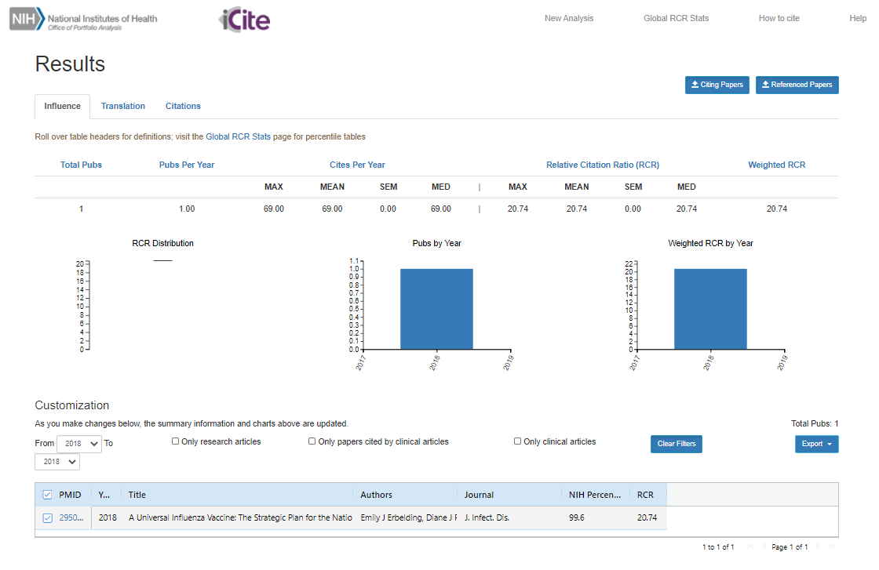
Where to find it: Relative Citation Ratio (RCR)
Notes:
Annette - When we look up an article in iCite, we can search by author name, title, or MeSH keyword. We can also search a group of documents by inputting a list of their PMIDs.
Here we can see the results from a search of Dr. Fauci’s 2018 article about a universal flu vaccine. The RCR is noted to be 20.74 – as stated previously NIH-funded papers are the benchmark for RCR: Any paper with RCR 1.0 has an RCR higher than 50% of NIH-funded papers.
Metric comparisons for this article:
iCite citation count 165 – current RCR 19.31 - FWCI is 20.46 (Scopus times cited 172). CNCI is 18.85 (WOS times cited 151) on 3/23/2021
Notes: Information about Dr. Fauci article:
Citation: Erbelding EJ, Post DJ, Stemmy EJ, Roberts PC, Augustine AD, Ferguson S, Paules CI, Graham BS, Fauci AS. A universal influenza vaccine: The strategic plan for the national institute of allergy and infectious diseases. J Infect Dis [Internet]. 2018;218(3):347-54.
DOI: 10.1093/infdis/jiy103 - https://doi.org/10.1093/infdis/jiy103
Title: A universal influenza vaccine: The strategic plan for the national institute of allergy and infectious diseases
PMID 29506129
Reference: https://icite.od.nih.gov/stats

Slide 43
Final Thoughts: Relative Citation Ratio (RCR)
Metric statement: This 2020 article by Dr. Fauci has a relative citation ratio of 20.74, indicating it has been cited 20x more than expected when compared to other NIH funded work (iCite).
What that means: The actual number of citations that Dr. Fauci’s article received is significantly higher than the average expected for a similar document published by funded NIH researchers at the same time.
Something To Think About
Applying for NIH funding? “Because the RCR makes it straightforward to communicate how a particular article compares to NIH R01-funded works, it has the potential to be a particularly compelling metric among users focused on NIH funding as a primary measure of impact.”
Surkis, Spore. “The Relative Citation Ratio: What Is It and Why Should Medical Librarians Care?” Journal of the Medical Library Association, vol. 106, no. 4, Medical Library Association, Oct. 2018, pp. 508–13, doi:10.5195/jmla.2018.499.
Notes:
Annette - This indicator
I can make the statement: This 2020 article by Dr. Fauci has a relative citation ratio of 20.74, indicating it has been cited 20x more than expected when compared to other NIH funded work (iCite).
This means the actual number of citations that Dr. Fauci’s article received is significantly higher than the average expected for a similar document published by funded NIH researchers at the same time.
Here is something to think about: When applying for funding from the NIH, consider inclusion of the RCR when discussing your work in the application as it has the potential to be a particularly compelling metric among users focused on NIH funding as a primary measure of impact.
_________
Note: The NIH reportedly uses the RCR for strategic planning and the evaluation of funded research, as a supplement to expert judgement. (per the Metrics Toolkit.)
iCite citation count 165 – current RCR 19.31 - FWCI is 20.46 (Scopus times cited 172). CNCI is 18.85 (WOS times cited 151) on 3/23/2021
Notes: Information about Dr. Fauci article:
Citation: Erbelding EJ, Post DJ, Stemmy EJ, Roberts PC, Augustine AD, Ferguson S, Paules CI, Graham BS, Fauci AS. A universal influenza vaccine: The strategic plan for the national institute of allergy and infectious diseases. J Infect Dis [Internet]. 2018;218(3):347-54.
DOI: 10.1093/infdis/jiy103 - https://doi.org/10.1093/infdis/jiy103
Title: A universal influenza vaccine: The strategic plan for the national institute of allergy and infectious diseases
PMID 29506129
Reference:
-Surkis, Spore. “The Relative Citation Ratio: What Is It and Why Should Medical Librarians Care?” Journal of the Medical Library Association, vol. 106, no. 4, Medical Library Association, Oct. 2018, pp. 508–13, doi:10.5195/jmla.2018.499.

Slide 44
Altmetric Attention Score
The Altmetric Attention Score is best used by individual researchers to understand the overall volume of attention that research has received online.
Use Case
The Altmetric Attention Score represents a weighted approximation of all the attention that the company Altmetric can find for a research output. The score is based on three main factors, which are volume, sources, and authors. The colors of the Altmetric donut each represent a different source of attention.
Definition
The Altmetric Attention Score is included in some databases and repositories. It can also be accessed via the Altmetric Bookmarklet.
Location
Score can increase or decrease over time.
Attention can be positive or negative.
Score does not include Mendeley readers, Dimensions citation counts and CiteULike bookmarks.
Caveats
Notes:
Karen –
Altmetrics are data that can explain both the volume and nature of attention that research receives online. Complementary to citation-based metrics, altmetrics can measure how people have shared or engaged with an article, a book, a dataset, or other scholarly output. Examples of attention include mentions on Twitter or in the mainstream media, Facebook posts or citations in policy documents. The Altmetric Attention Score is a metric provided by a company called Altmetric. It is best used by individual researchers to understand the overall volume of attention that research has received online. The score is a weighted approximation of all the attention picked up by Altmetric for a research output, so it is not a raw total of the number of mentions. The Altmetric Attention Score is made available via free browser plug-in called the Altmetric Bookmarklet.
A few caveats about the Altmetric Attention Score is that it can increase or decrease over time as attention-related items, such as news stories or tweets, are added or removed from the World Wide Web.
Resource:
https://help.altmetric.com/support/solutions/articles/6000233311-how-is-the-altmetric-attention-score-calculated-
https://www.altmetric.com/about-our-data/the-donut-and-score/
Reference for all of the below: https://www.altmetric.com/about-our-data/the-donut-and-score/
Volume – The score for an article rises as more people mention it. We only count 1 mention from each person per source, so if you tweet about the same paper more than once, Altmetric will ignore everything but the first.
Sources – Each category of mention contributes a different base amount to the final score. For example, a newspaper article contributes more than a blog post which contributes more than a tweet.
Authors – We look at how often the author of each mention talks about scholarly articles, at whether or not there’s any bias towards a particular journal or publisher and at who the audience is. For example, a doctor sharing a link with other doctors counts for far more than a journal account pushing the same link out automatically.
From time to time you might notice that the Altmetric Attention Score for your paper fluctuates, or goes down. This can happen when the original author of the mentions deletes their post when we remove posts which have been flagged as spam, or occasionally when we add new sources so need to re-weight our scoring algorithm.
It’s also important to note that Mendeley readers, Dimensions citation counts and CiteULike bookmarks do not count towards the score – this is because we can’t show you the full details of who is actually making the mention or reference. It’s our policy that any mentions that count towards the score must be completely transparent and fully visible on the Altmetric details page.

Slide 45

A Quick Note: Alternative Metrics
New way to measure engagement with research outputs
Data that explains both the volume and nature of attention research has received on line
Provides evidence of engagement with diverse audiences and potential impact
Can measure how many people have shared or engaged with a scholarly output online (Twitter, news outlets, Wikipedia citations, Mendeley readers, post-publication peer review, citations in policy documents)
Complementary to bibliometrics (citation-based)
Notes:
Karen - A quick note about alt metrics, also known as alternative metrics, because scholarly outputs can receive attention fairly quickly after publication, alternative metrics can tell a more immediate story of impact when compared to bibliometrics. Aggregator companies, like Altmetric and PlumX, collect mentions and citations in blogs, Wikipedia, Twitter, Facebook, or reader counts on social reference managers like Mendeley and bookmarking platforms like CiteULike.

Slide 46
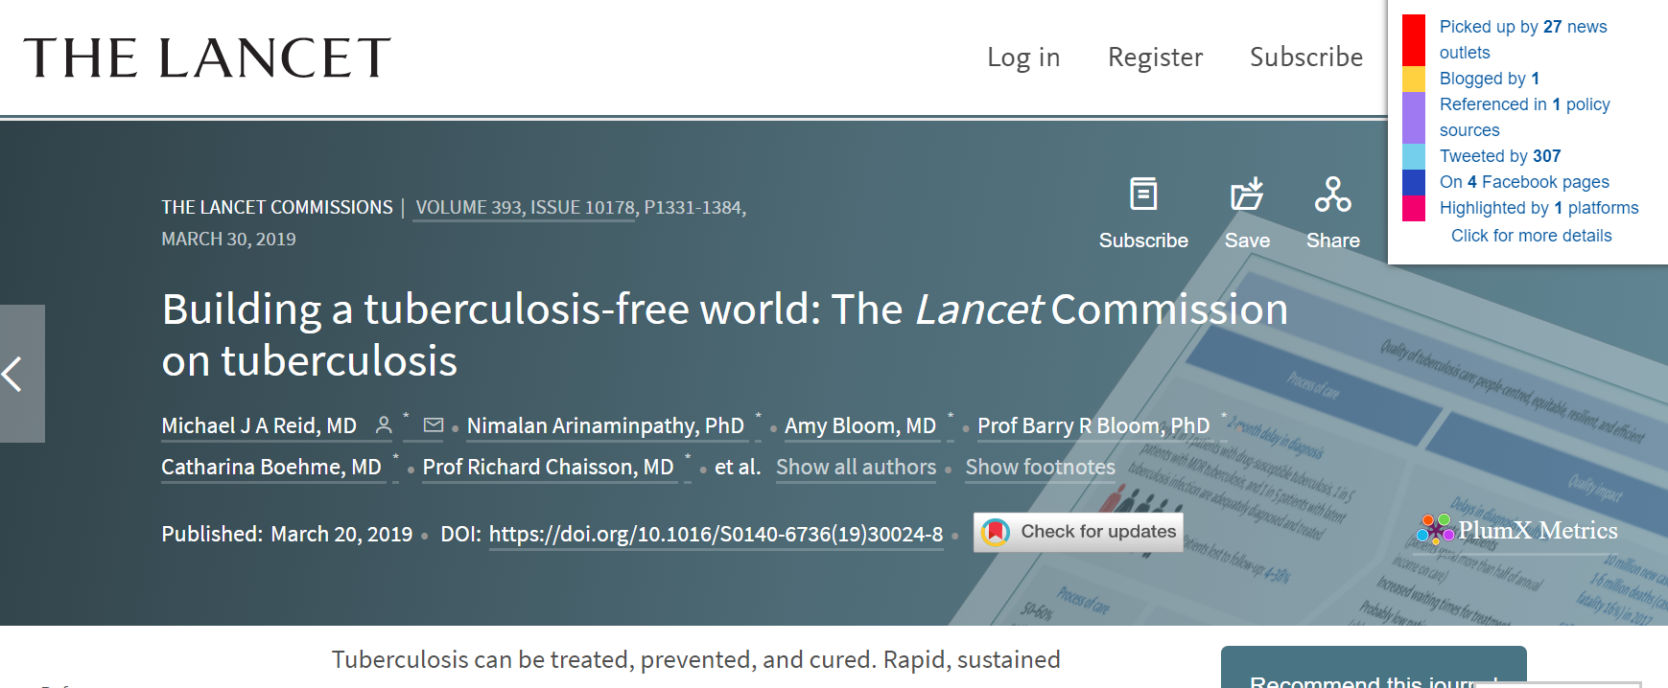
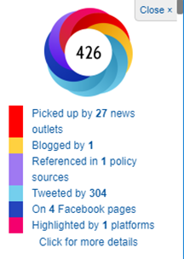
Where to find it: Altmetric Attention Score
Notes:
Karen - When I view this Dr. Fauci article on the publisher website and click on the bookmarklet that is installed in my browser toolbar, the Altmetric Attention score and donut appears on the screen.
________________________________________________________________________________________
FYI – Where the bookmarklet works per https://www.altmetric.com/products/free-tools/bookmarklet/
The Bookmarklet only works on PubMed, arXiv or pages containing a DOI with Google Scholar friendly citation metadata
Additional information here: https://help.altmetric.com/support/solutions/articles/6000241815-bookmarklet-faqs#What-does-it-mean-if-the-bookmarklet-doesn't-support-a-journal?
-Right now the Bookmarklet will only work on Chrome, Firefox or Safari. We'll be supporting other browsers very soon.
-Q:The bookmarklet says that it can't find a DOI on the page but I can see it right there under the title!
-A: The bookmarklet looks for DOIs in the machine readable metadata of the web page you're on, but when that fails you can override it manually. Simply reload the page, highlight the DOI on the page (as if you were going to copy & paste it) then hit the Altmetric It bookmarklet again. The bookmarklet will then pull up details of the highlighted DOI Instead of giving you an error.
This Fauci article: https://www.thelancet.com/pdfs/journals/lancet/PIIS0140-6736(19)30024-8.pdf

Slide 47
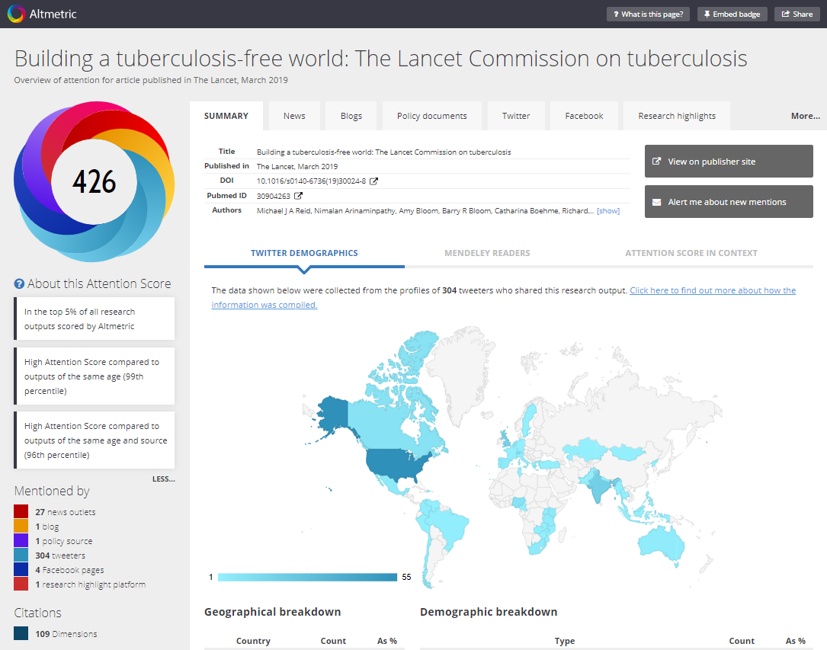
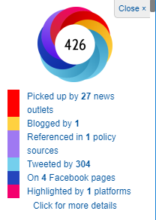
Notes:
Karen – Clicking on “click for more details” in the bookmarklet provides a comprehensive listing of the different types of attention the publication has received. Also included is a ranking of the attention score in context when compared to other research outputs in Altmetric or in the same journal or of a similar age.

Slide 48
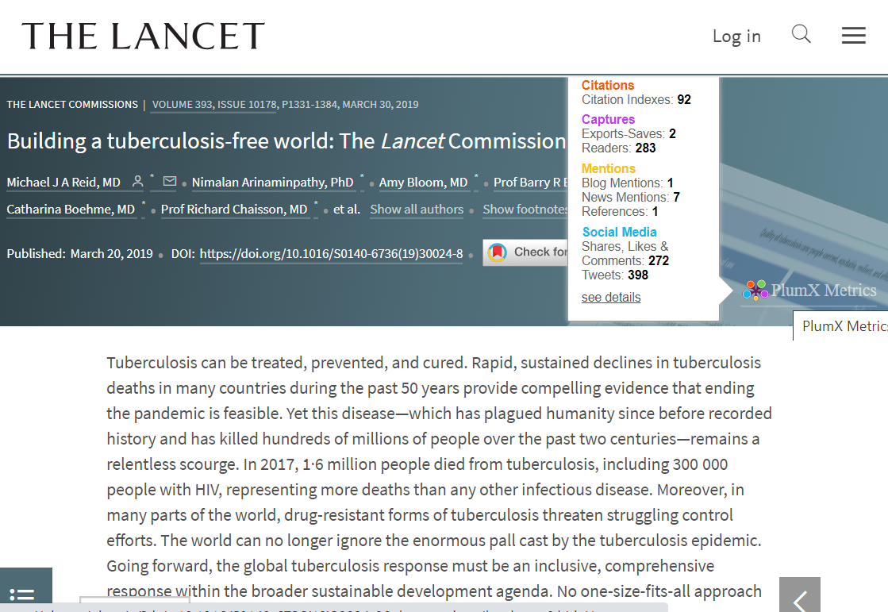
Notes:
Karen - The Lancet website where I was viewing Dr. Fauci’s article has built-in metrics from the PlumX Metrics company. Much like Altmetric, PlumX collects citations, captures, mentions, and social media shares, likes, comments, and Tweets.

Slide 49
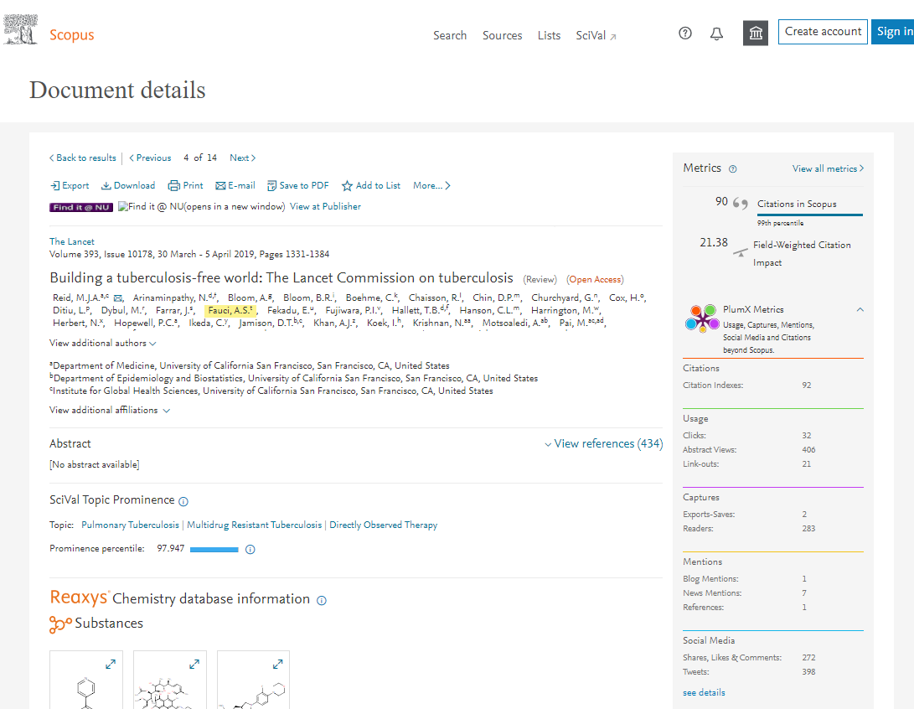
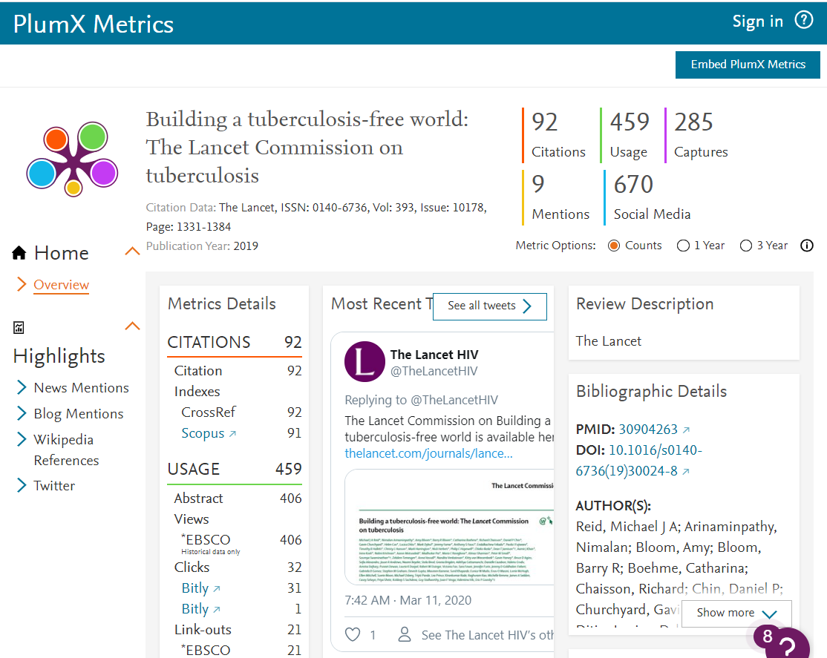
Notes:
Karen - Elsevier, the parent company that owns Scopus also owns PlumX metrics. So Scopus has built in PlumX alternative metrics in their platform.

Slide 50
Final Thoughts: Altmetric Attention Score
Metric statement: The Attention Score for this 2019 review by Dr. Fauci indicates that it is in the 99th percentile when compared to outputs of the same age (Altmetric).
What that means: This review received significantly more on-line attention when compared to all other reviews published in 2019.
More impact statement options include:
Something To Think About
There are 4 policy documents that reference this research output.
There have been 395 tweets from 303 users, with an upper bound of 4,919,556 followers.
There have been 38 news stories from 27 outlets about this output.
Notes:
Karen – Using this metric in practice, I can make the statement: The Attention Score for this 2019 review by Dr. Fauci indicates that it is in the 99th percentile when compared to outputs of the same age (Altmetric).
This means that this review has received significantly more on-line attention when compared to all other reviews published in 2019.
Here is something to think about: Many papers, on average, are not cited until two years after publication, arriving at peak citation somewhere between two and six years after publication. Alternative metrics can begin to provide evidence of impact in a shorter time frame. The information available as part of the Altmetric Attention Score allows you to discuss in greater detail where your work is receiving attention. For example:
Almeltric indicates there are 4 policy documents that reference this research output. Citation in a policy document indicates a research publication's accessibility to the policy authors and its relevance to the policy topic, but digging deeper to review the policy document will reveal how the research has impacted the policy overall.
Altmetric indicates there have been 395 tweets from 303 users, with an upper bound of 4,919,556 followers. Twitter can be used to share published work to a broader audience and draw wide attention to research. Further exploration of the Tweets and Twitter accounts allows you to discuss in greater detail who is drawing attention to your research.
Altmetric indicates there have been 38 news stories from 27 outlets about this output. News stories can be an indication of engagement with diverse audiences, including the general public.

Slide 51
Article Level Metrics – the others
Category Normalized Citation Impact (CNCI)
Field Citation Ratio (FCR)
Calculated by dividing the actual count of citing items by the expected citation rate for documents with the same document type, year of publication and subject area.
Calculated by dividing the number of citations a paper has received by the average number received by documents published in the same year and in the same Fields of Research (FoR) category.
Found in the InCites.
Is field normalized.
Found in the Dimensions database.
Is field normalized.
Notes:
Karen – Here are two article level metrics that we won’t have time to cover in detail today. The Category Normalized Citation Impact and the Field Citation Ratio are very similar to the Field Weighted Citation Impact which is found in Scopus.
The CNCI and the FCR are both calculated by dividing the number of citations a document has received by the average number received by documents published in the same year, of the same type, and in the same field. These metrics are influenced by the field classification system used by the database they are calculated in. The CNCI is available in InCites for Web of Science documents. The Field Citation Ratio is available in Dimensions.
___________________
CNCI Definition: It is calculated by dividing the actual count of citing items by the expected citation rate for documents with the same document type, year of publication and field. CNCI allows comparisons between entities of different sizes and different subject mixes.
Reference: http://help.prod-incites.com/inCites2Live/indicatorsGroup/aboutHandbook/usingCitationIndicatorsWisely/normalizedCitationImpact/version/6
The Field Citation Ratio is an article level metric that is calculated in the Dimensions database. It is calculated by dividing the number of citations a paper has received by the average number received by documents published in the same year and in the same Fields of Research (FoR) category. This indicator is not field normalized.
Reference: https://plus.dimensions.ai/support/solutions/articles/23000018848-what-is-the-fcr-how-is-it-calculated-#:~:text=The%20Field%20Citation%20Ratio%20(FCR,of%20Research%20(FoR)%20category.

Slide 52
Trick question:
Pop Quiz!
Paper A received 2000 citations, paper B received 100 citations, which paper has the highest citation impact?
Notes:
Karen - Trick question: Paper A received 2000 citations, paper B received 100 citations, which paper has the highest citation impact?
Not enough information! Citation counts are NOT comparable across different fields and years, and citations can accrue for reasons other than “impact”.

Slide 53
Which of the following are good uses for the Field Weighted Citation Impact metric?
Pop Quiz!
A. To identify highly impactful papers in a field.
B. To identify highly impactful publications regardless of the year they were published.
C. To review papers in a small field.
D. All of the above.
Notes:
Annette - Which of the following are good uses for the Field Weighted Citation Impact?
To identify highly impactful papers in a field. (correct - normalizes disciplinary or field citation practices)
B. To identify highly impactful publications regardless of the year they were published. (correct - normalizes the time and normalizes the field)
C. To review papers in a small field. (incorrect – the metric relies on the average value and small data sets are more to be skewed due to outliers)
All of the above. (Nope!)
_____
Other questions:
True or false – An RCR value of 0.75 means that a paper is more highly cited than similar NIH papers.
Answer – False – 1.0 is the NIH global average, therefore 0.75 indicates the paper is less cited than similar NIH papers. (similar = published in the same year)
_________
Which metric would I use to find papers with significant attention outside of the academic literature?
RCR
FWCI
Altmetric Attention Score
All of the above.
This slide created by SlideLizard.

Slide 54
Journal Level Metrics
Journal level metrics measure the impact, reach, or prestige of a journal or a group of journals.
Author Level Metrics | Article or Book Level Metrics | Journal Level Metrics
g-index | Altmetrics Attention Score | CiteScore
h-index | Category Normalized Citation Impact | Eigenfactor
i10-index | Citation Count | Immediacy Index
m-quotient | Field Citation Ratio (FCR) | Journal Impact Factor (JIF)
 | Field Weighted Citation Impact (FWCI) | SCImago Journal Rank (SJR)
 | Relative Citation Ratio (RCR) | Source Normalized Impact per Paper (SNIP)
Notes:
Annette - Finally we will discuss journal level metrics. These metrics measure the impact, reach, or prestige of a journal or a group of journals. Please note, these should not be used as an indicator for the quality of particular articles or authors, so we have to be especially cautious how we use these metrics.

Slide 55
Journal Impact Factor (JIF)
The JIF is useful in comparing the relative influence of journals within a discipline, as measured by citations.
Use Case
The JIF is calculated by taking all citations to the journal in the current JCR year to items published in the previous two years, divided by the total number of scholarly items (these comprise articles, reviews, and proceedings papers) published in the journal in the previous two years.
Citations in 2019 to items published in 2017 + 2018
2019
JIF
=
Definition
Number of citable items
in 2017 + 2018
The JIF is located in the Journal Citation Reports (WOS).
Location
Not field normalized.
Only available for journals indexed in the Science Citation Index and Social Sciences Citation Index in the Web of Science Core Collection.
Numerator can be inflated by items not counted in the denominator.
Can be affected by self-citations or highly cited articles within the journal.
Caveats
Notes:
Annette - The most well known journal level metric is the Journal Impact Factor, or JIF. The JIF is useful in comparing the relative influence of journals within a discipline, as measured by citations. The JIF is calculated by taking all citations to the journal in the current JCR year to items published in the previous two years, divided by the total number of scholarly items (these comprise articles, reviews, and proceedings papers) published in the journal in the previous two years.
This indicator is proprietary and is owned by Clarivate Analytics – it can be found in the Journal Citations Report, which is part of InCites. The current JIF was calculated in 2020 for the data collected in 2019. The expected release of the 2020 report is June 29, 2021.
Some caveats of the JIF is that it is NOT field normalized, which means it is influenced by field differences in how researchers cite and write, and therefore comparisons of the journal impact factor cannot be made between journals in different fields. The JIF is only available for journals indexed in the Science Citation Index and Social Sciences Citation Index in the Web of Science Core Collection. Note that journals in the Arts and Humanities Citation Index are not given impact factors. A known discrepancy between the numerator and the denominator of the impact factor allows for citation counts of all items in the numerator to be inflated by highly cited editorials or letters, which are then not counted as citable items in the denominator. The JIF can be affected by self-citations within a journal, which is corrected by the Journal Impact Factor Without Self Cites. This version of the metric excludes any citations to a publication that comes from the publication itself in the numerator. Because the JIF is based on an average, a few highly cited articles within a journal can skew the overall average.
_____________
Notes/References:
https://clarivate.libguides.com/webofscienceplatform/coverage
-Over 11,500 titles from the Science Citation Index-Expanded and Social Sciences Citation Index are covered in JCR
http://jcr.help.clarivate.com.ezproxy.galter.northwestern.edu/Content/home.htm
http://help.prod-incites.com/inCites2Live/indicatorsGroup/aboutHandbook/usingCitationIndicatorsWisely/jifWithout.html
Example: ACTA Crystallographica Section A – there was a large study that was highly cited published in this journal which skewed the 2009 and 2010 impact factor significantly
The 2008 article was called “A Short History of SHELX” and it received 19,400 citations.
https://journalprofile-clarivate-com.ezproxy.galter.northwestern.edu/jif/home/?journal=ACTA%20CRYSTALLOGR%20A&year=2013&editions=SCIE&pssid=H2-adhTLs0kutTr9UecJO6oXucbA1v5AQem-18x2dkJdRoaEw0WEILyGpmx2Fh9wgx3Dx3D8EcVlfBLQw5c5XC6K9x2BGYQx3Dx3D-03Ff2gF3hTJGBPDScD1wSwx3Dx3D-cLUx2FoETAVeN3rTSMreq46gx3Dx3D

Slide 56
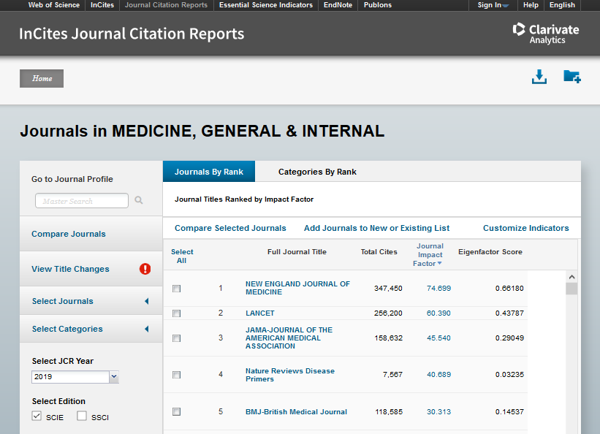
Where to find it: Journal Impact Factor (JIF)
Notes:
Annette - The Journal Citation Reports can be searched by journal or category. This is a screen shot of the Medicine, General & Internal category – we can see that the JIF is one of the indicators listed for each journal title.

Slide 57
Final Thoughts: Journal Impact Factor (JIF)
Metric statement: The Lancet has a JIF of 60.39, which is the second highest journal impact factor of the 165 journals in the category of Medicine, General & Internal (InCites JCR). Of the 688 documents authored by Dr. Fauci that are indexed in Web of Science, 10 of them were published in The Lancet.
What that means: This means that documents published in The Lancet in the most recent two years should receive on average 60.4 citations in the most recent year.
Something To Think About
“The JIF was devised to measure the influence of journals but has been widely used to judge individual articles. This use is based on the specious assumption that all articles in a journal are equally influential, as reflected by their number of citations. This misuse can lead to weak articles being overvalued and important work being undervalued.”
Reference: Surkis, Spore. “The Relative Citation Ratio: What Is It and Why Should Medical Librarians Care?” Journal of the Medical Library Association, vol. 106, no. 4, Medical Library Association, Oct. 2018, pp. 508–13, doi:10.5195/jmla.2018.499.
Notes:
Annette –
I can make the statement: The Lancet has a JIF of 60.39, which is the second highest journal impact factor of the 165 journals in the category of Medicine, General & Internal (InCites JCR). Of the 688 documents authored by Dr. Fauci that are indexed in Web of Science, 10 of them were published in The Lancet.
This means that documents published in The Lancet in the most recent two years should receive on average 60.39 citations in the most recent year.
Here is something to think about: “The JIF was devised to measure the influence of journals but has been widely used to judge individual articles. This use is based on the specious assumption that all articles in a journal are equally influential, as reflected by their number of citations [3, 4]. This misuse can lead to weak articles being overvalued and important work being undervalued.” We caution against the JIF being used to evaluate individual articles because JIF is a journal level metric.
_________
Note: When a measure becomes a target, it ceases to become a good measure. Goodhart’s Law
Reference: Surkis, Spore. “The Relative Citation Ratio: What Is It and Why Should Medical Librarians Care?” Journal of the Medical Library Association, vol. 106, no. 4, Medical Library Association, Oct. 2018, pp. 508–13, doi:10.5195/jmla.2018.499.
https://www.metrics-toolkit.org/journal-impact-factor/
Appropriate use cases: The JIF can be useful in comparing the relative influence of journals within a discipline, as measured by citations. As Haustein (2012) notes: “Mean citation rates, such as the impact factor, normalize citation counts by the number of documents which received them in order to enable comparison of periodicals of different output size…the impact factor was developed as a size-independent measure to compare journal impact for identifying and monitoring the most influential scientific periodicals.” Used appropriately and in conjunction with other metrics, the JIF can be useful in collection development decisions made by librarians. As with all metrics, the JIF should be presented with appropriate context.

Slide 58
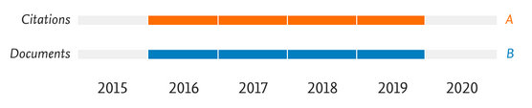

CiteScore
The CiteScore is useful in comparing the relative influence of journals within a discipline, as measured by citations.
Use Case
The CiteScore is equivalent to the number of citations to documents (articles, reviews, conference papers, book chapters, and data papers) by a journal over four years, divided by the number of the same document types indexed in Scopus and published in those same four years.
Definition
The CiteScore is located in Scopus.
Location
Not field-normalized.
Only available for journals indexed in Scopus.
Can be affected by self-citations or highly cited articles within the journal.
Caveats
Notes:
Karen - Moving on from Journal Impact Factor to CiteScore. CiteScore is similar to the JIF, except it has a four year citation window, is calculated for journals indexed in Scopus, and includes a few additional document types in its calculation. The CiteScore is useful in comparing the relative influence of journals within a discipline, as measured by citations. It is equivalent to the number of citations to documents, which includes articles, reviews, conference papers, book chapters, and data papers, by a journal over fours years, divided by the number of the same document types indexed in Scopus and published in those same four years.
CiteScore is a proprietary indicator owned by Elsevier, the parent company of Scopus. Similar to the JIF, the CiteScore is calculated in June for the previous year, so the 2020 CiteScores will be available in June of 2021.
The caveats to keep in mind with regard to CiteScore is that it is NOT field normalized, it is only available for journals indexed in Scopus and it can be affected by self-citations or highly cited articles within the journal.
_____________
Note: The metric values are fixed around springtime, then the Tracker is calculated for the subsequent year. For example, CiteScore Tracker 2020 will be complete and fixed around May 2021, when CiteScore Tracker 2021 will start to be displayed in Scopus.com.
Reference:
https://service-elsevier-com.ezproxy.galter.northwestern.edu/app/answers/detail/a_id/14880/supporthub/scopus/
Terms and conditions of CiteScore in Scopus - https://www.elsevier.com/__data/assets/pdf_file/0011/239078/CiteScore_TermsAndConditions.pdf

Slide 59
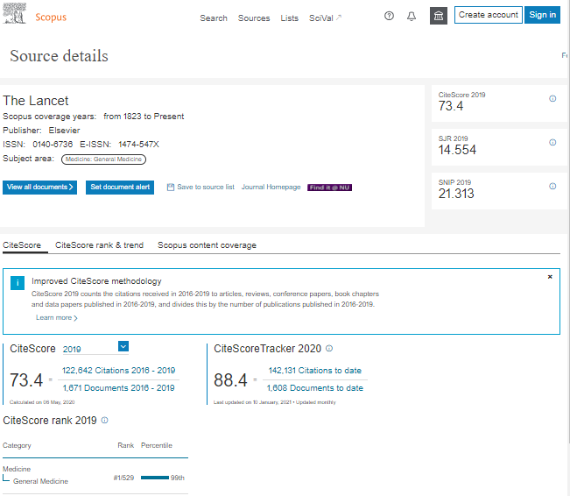
Where to find it: CiteScore
Notes:
Karen – In Scopus you can search for a journal directly, or click on the journal title hyperlinked in a document record, which will bring you to the Source Details page for the journal. The CiteScore is listed on the Source Details page in the right hand column.
Reference:
Teixeira da Silva, Jaime. “CiteScore: Advances, Evolution, Applications, and Limitations.” Publishing Research Quarterly, vol. 36, no. 3, Sept. 2020, pp. 459–68, doi:10.1007/s12109-020-09736-y.
Removed text:
Given that CiteScore covers a longer period (4 years) than the JIF (2 years), and that CiteScore includes a wider range of documents types (as opposed to JIF, which includes articles, reviews, and proceedings papers, and the fact that it could also be assigned to books and conference proceedings, an argument has been made that CiteScore represents a wider perspective of a journal’s published content, and is a more congruent (or “realistic”) journal based metric. However, there are many more pros and cons to consider – so we’ll leave the debate up to the experts.

Slide 60
Final Thoughts: CiteScore
Metric statement: The Lancet has a CiteScore of 73.4, which is the highest CiteScore of the 529 journals in the category of General Medicine (Scopus). Of the 1,174 documents authored by Dr. Fauci that are indexed in Scopus, 14 of them were published in The Lancet.
What that means: The documents published in The Lancet in the most recent four years should receive on average 73.4 citations in the most recent year.
Something To Think About
Consider using the journal quartile
Both CiteScore and JIF offer quartile ranks for journals in their fields, which are derived by assigning each journal a percentile rank. Journals with a percentile rank of 0.25 or below occupy the top quartile of their field.
Notes:
Karen – Using this metric in practice I can make the statement: The Lancet has a CiteScore of 73.4, which is the highest CiteScore of the 529 journals in the category of General Medicine (Scopus). Of the 1,174 documents authored by Dr. Fauci that are indexed in Scopus, 14 of them were published in The Lancet.
This means that the documents published in The Lancet in the most recent four years should roughly receive on average 73.4 citations in the most recent year.
Here is something to think about –
Neither CiteScore or JIF are field normalized but Scopus and Web of Science also provide a metric called the “journal quartile” which allows for comparison of journals from different fields. The “journal quartile” is created by calculating a percentile rank for each journal in its field. Journals with a percentile rank of 0.25 or below occupy Quartile 1, the top quartile of their field. In the event that a journal is assigned to more than one field, typically their highest quartile rank is used. These quartiles help normalize the CiteScore and JIF and allow you to better compare journals in different fields.
_______________
Note: CiteScore is a free metric, while Journal Impact Factor requires a subscription.
http://help.prod-incites.com/inCites2Live/indicatorsGroup/aboutHandbook/usingCitationIndicatorsWisely/jifQuartile.html
Notes:
Q1 denotes the top 25% of the IF distribution, Q2 for middle-high position (between top 50% and top 25%), Q3 middle-low position (top 75% to top 50%), and Q4 the lowest position (bottom 25% of the IF distribution).
https://researchassessment.fbk.eu/quartile_score
Q1 is occupied by the top 25% of journals in the list; Q2 is occupied by journals in the 25 to 50% group; Q3 is occupied by journals in the 50 to 75% group and Q4 is occupied by journals in the 75 to 100% group.
https://www.mondragon.edu/en/web/biblioteka/publications-impact-indexes#7
Reference:
Teixeira da Silva, Jaime. “CiteScore: Advances, Evolution, Applications, and Limitations.” Publishing Research Quarterly, vol. 36, no. 3, Sept. 2020, pp. 459–68, doi:10.1007/s12109-020-09736-y.

Slide 61
Immediacy Index
The Immediacy Index can provide a useful perspective when comparing journals specializing in cutting-edge research.
Use Case
The Immediacy Index indicates the average number of times an article is cited in the year it is published. It is calculated by dividing the number of citations to articles published in a given year by the number of articles published in that year.
Citations from JCR year to items in JCR year
Immediacy Index
=
Citable Items in JCR year
Definition
The Immediacy Index is located in the Journal Citation Reports (WOS).
Location
Not field normalized.
May not predict ultimate citation performance.
Not reliable for items published very late in the year.
Caveats
Notes:
Annette - The final journal level metric we will review today is the immediacy index. This metric can provide a useful perspective when comparing journals specializing in cutting-edge research. The Immediacy Index indicates the average number of times an article is cited in the year it is published. It is calculated by dividing the number of citations to articles published in a given year by the number of articles published in that year.
The Immediacy Index is also proprietary and can be found on the Journal Citation Reports that is part of the Clarivate Analytics family.
Some caveats to consider when thinking about the use of the immediacy index is that is NOT field normalized, it may not predict ultimate citation performance of a publication, and it is not reliable for items published very late in the year.
_________
Reference: http://help.prod-incites.com/inCites2Live/indicatorsGroup/aboutHandbook/usingCitationIndicatorsWisely/immediacyIndex/version/5
Future research – Are only articles used to calculate the immediacy index, or are other document types used?

Slide 62
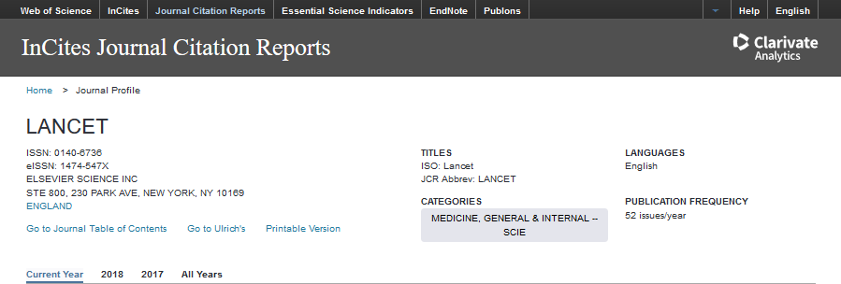
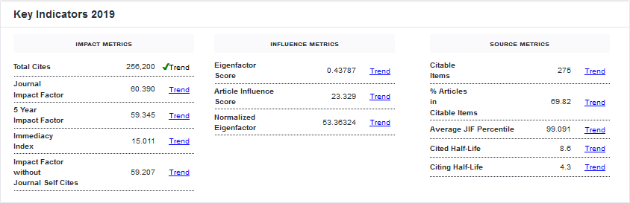
Where to find it: Immediacy Index
Notes:
Annette - If we look again at the InCites Journal Citation Reports, select the journal Lancet, we can see the immediacy index in the left hand column under Impact Metrics.

Slide 63
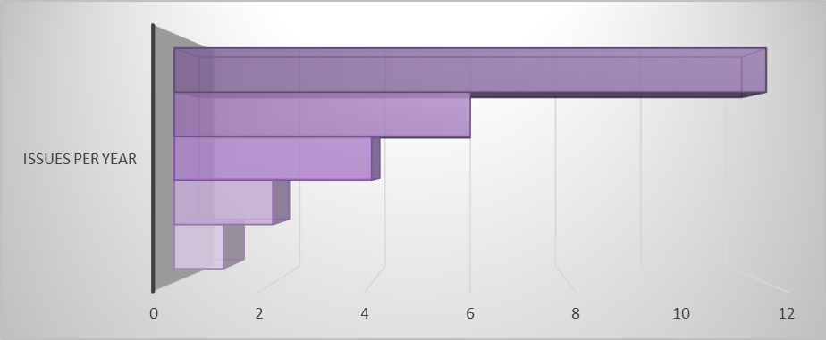
Final Thoughts: Immediacy Index
Metric Statement: The Lancet has an Immediacy Index of 15 (InCites JCR). A 2015 article co-authored by Dr. Fauci published in Lancet was cited 21 times (Web of Science) that same year.
What that means: On average documents published in this journal will receive 15 citations in their first year of publication.
Something To Think About
Advantage
Notes:
Annette – Using this metric in practice, I can make the statement: The Lancet has an Immediacy Index of 15 (InCites JCR). A 2015 article co-authored by Dr. Fauci published in Lancet was cited 21 times (Web of Science) that same year.
This means that on average, documents published in this journal will receive 15 citations in their first year of publication.
Here is something to think about: Frequently issued journals may have an advantage when calculating their Immediacy Index because an article published early in the year has a better chance of being cited than one published later in the year. Many publications that publish infrequently or late in the year have low Immediacy Indexes.
________
Reference: http://help.prod-incites.com/inCites2Live/indicatorsGroup/aboutHandbook/usingCitationIndicatorsWisely/immediacyIndex/version/
Fauci Article: Virological response after 6 week triple-drug regimens for hepatitis C: a proof-of-concept phase 2A cohort study
Citation:
Kohli, Anita et al. “Virological Response after 6 Week Triple-Drug Regimens for Hepatitis C: a Proof-of-Concept Phase 2A Cohort Study.” The Lancet (British edition) 385.9973 (2015): 1107–1113. Web.

Slide 64
Journal Level Metrics – the others
SCImago Journal Rank (SJR)
Source Normalized Impact per Paper (SNIP)
Eigenfactor
Attempts to calculate a percentage estimate of the total time that all journal users spend with that journal compared to all other journals. The numbers are normalized so that the total of all Eigenfactors is 100.
Can be found on the Eigenfactor.org website and on the Journal Citation Report.
Based on the transfer of prestige from a journal to another one; such prestige is transferred through the references that a journal does to the rest of the journals and to itself.
Available in on the SCImago Journal & Country Rank website as well as in Scopus.
Calculated as the number of citations given in the present year to publications in the past three years divided by the total number of publications in the past three years.
Is field normalized.
Can be found on the CWTS Journal Indicators website and in Scopus.
Notes:
Karen – Three other journal level metrics that we won’t cover in detail today include the Eigenfactor, the SCImago Journal Rank or SJR, and the Source Normalized Impact per Paper or SNIP.
Both Eigenfactor and SJR are considered a measure of a journal's total importance to the scientific community. They are based on the number of citations a journal receives from other journals, weighted by their importance, such that citations from important journals like Nature are given more weight than less important titles. Note that importance is determined by the citedness of the journal.
The Eigenfactor Score is calculated for all journals in the Journal Citation Report (JCR) database each year using citation data from the past five year period. An Eigenfactor Score of 1.0 indicates that the journal has 1% of the total influence of all the journals in the JCR database. The scores are scaled so that the Eigenfactor scores of all journals in Journal Citation Reports (JCR) sum to 100. The Eigenfactor Score is not field normalized – when comparing articles from different fields it is best to use its companion metric, the Article Influence Score.
The SJR is based on journals indexed in the Scopus database each year using citation data from the past three year period. Unlike the Eigenfactor, the SJR allows some journal self citations to be counted in the metric and takes into account the number of articles, reviews and conference papers each journal has published. In this way, the SJR is more similar to the Eigenfactor’s companion metric, the Article Influence Score.
The Source Normalized Impact per Paper or SNIP is calculated for each journal in the Scopus database. For a journal, the SNIP is the number of citations given in the present year to documents published in past three years, divided by the total number of documents published in the journal in the past three years. The SNIP is field normalized and it is available in Scopus and on the CWTS Journal Indicators website.
References:
-SJR article - https://www.sciencedirect.com/science/article/pii/S1751157710000246?via%3Dihub
-https://www.sciencedirect.com/science/article/pii/S0306457310000075
-https://lib.guides.umd.edu/bibliometrics/SJR
-https://arxiv.org/ftp/arxiv/papers/0912/0912.4141.pdf
-https://www.researchgate.net/post/Can_someone_explain_the_SJR_SCImago_Journal_Rank
-https://faseb.onlinelibrary.wiley.com/doi/10.1096/fj.08-107938
-https://journals.plos.org/plosone/article?id=10.1371/journal.pone.0149852
-https://www.scimagojr.com/SCImagoJournalRank.pdf
-https://www.journalindicators.com/methodology
-https://www.elsevier.com/authors/tools-and-resources/measuring-a-journals-impact#:~:text=Source%20Normalized%20Impact%20per%20Paper%20(SNIP)%20is%20a%20sophisticated%20metric,of%20publications%20citing%20that%20journal
-https://scholarlykitchen.sspnet.org/2015/07/28/network-based-citation-metrics-eigenfactor-vs-sjr/
-http://help.prod-incites.com/inCites2Live/indicatorsGroup/aboutHandbook/usingCitationIndicatorsWisely/eigenfactor.html

Slide 65
True or False:
Pop Quiz!
- You can use the Journal Impact Factor to compare journals in different fields.
- The average JIF for an author is a good indication of the quality of their work.
Notes:
Karen - True/False – You can use the Journal Impact Factor to compare journals in different fields.
False – this indicator is NOT field normalized.
True/False – The average JIF for an author is a good indication of the quality of their work.
False – the JIF should never be used at the level of author, nor is it an indication of research quality.
_____
Other Possible Questions:
True/False – One incredibly highly cited article can skew the JIF upwards for an entire journal.
True – this is one of the known caveats of the JIF.
This slide was created by SlideLizard.

Slide 66
Metrics – Where to find them
 | g-index | h-index | i10-index | m-quotient | Altmetric Attention Score | Category Normalized Citation Impact (CNCI) | Citation Count | Field Citation Ratio (FCR) | Field Weighted Citation Impact (FWCI) | Relative Citation Ratio (RCR) | CiteScore | Eigenfactor | Immediacy Index | Journal Impact Factor (JIF) | SCImago Journal Rank (SJR) | Source Normalized Impact per Paper (SNIP)
Altmetric Bookmarklet |  |  |  |  | X
CWTS Journal Indicators |  |  |  |  |  |  |  |  |  |  |  |  |  |  |  | X
Dimensions |  |  |  |  | X |  | X | X
Google Scholar |  | X | X |  |  |  | X
iCite |  |  |  |  |  |  | X |  |  | X
InCites |  |  |  |  |  | X
Journal Citation Reports |  |  |  |  |  |  |  |  |  |  |  | X | X | X
Microsoft Academic |  |  |  |  |  |  | X
SCImago Journal & Country Rank |  |  |  |  |  |  |  |  |  |  |  |  |  |  | X
SciVal |  | X |  |  |  |  | X |  | X |  | X |  |  |  | X | X
Scopus |  | X |  |  |  |  | X |  | X |  | X |  |  |  | X | X
Web of Science |  | X |  |  |  |  | X |  |  |  |  |  |  | X
Author
Level
Indicator
Article
Level
Indicator
Journal
Level
Indicator
Notes:
Karen - Here is a last look at where which databases can supply you with which metrics.

Slide 67
How to talk about metrics
Notes:
Karen - Now that we have reviewed these metrics, how do we talk about them.

Slide 68
Sample metric statements
Metric statements can include both traditional bibliometrics and alternative metrics. For example:
My work has been cited over 1,000 times by authors in over 30 countries, demonstrating the global impact of my work. Ten of my papers are in the top 1% when compared to articles of the same age, field and document type. (Scopus)
This group of papers has been collectively cited over 5,500 times by authors publishing in a diverse range of subject areas including Medicine, Engineering, and Social Services. These 200 papers have a weighted RCR of 305, indicating that this is a highly influential set of papers relative to the average NIH-funded paper. (Scopus, iCite)
Our work has been collectively tweeted over 600 times by the medical community, legal community, and patient advocacy organizations. This activity indicates the successful dissemination our work beyond academia and demonstrates public engagement. Our work was cited in policy documents from the CDC, demonstrating that our work is influencing policy at a national level. (Altmetric)
Notes:
Karen - As we reviewed metrics in this presentation, we also included a sample statement using the metric. On this slide, we have included statements that use multiple metrics. Note that we try to include the database or source of the metric at the end of each statement, so that readers can investigate the accuracy of the claim.

Slide 69
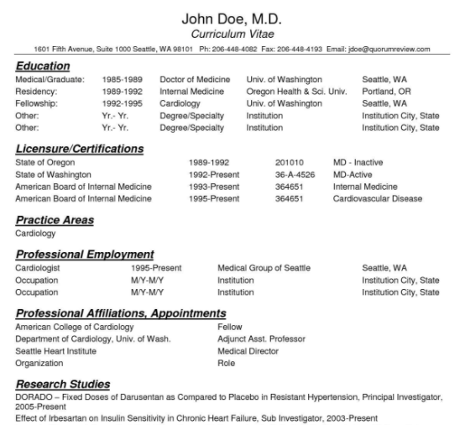
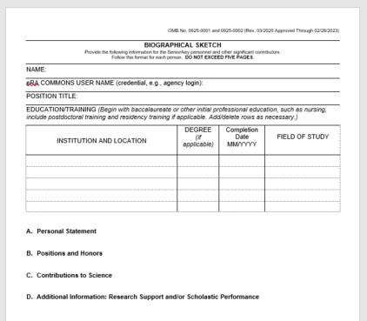
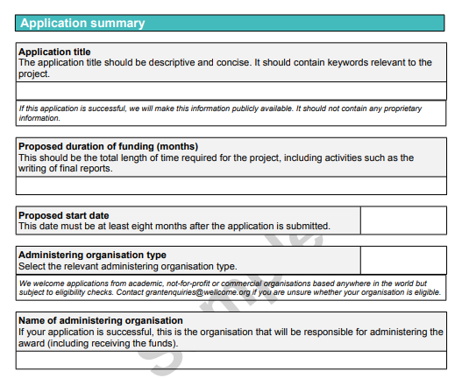
Where to add metric statements
Metric statements can be a valuable tool for showcasing the story of your research in your professional profile and a variety of other academic contexts.
CV
NIH
Biosketch
Grant
Application
Notes:
Karen – Always check with your mentor and others in your field to see where the use of metrics may be appropriate. Metric statements can be valuable in showcasing research impact in your professional profile and a variety of other academic contexts like your CV, in grant applications, and in your NIH biosketch.

Slide 70
Metrics Support
Notes:
Annette -Here at Northwestern you have access to support when it comes to learning about and using metrics.

Slide 71
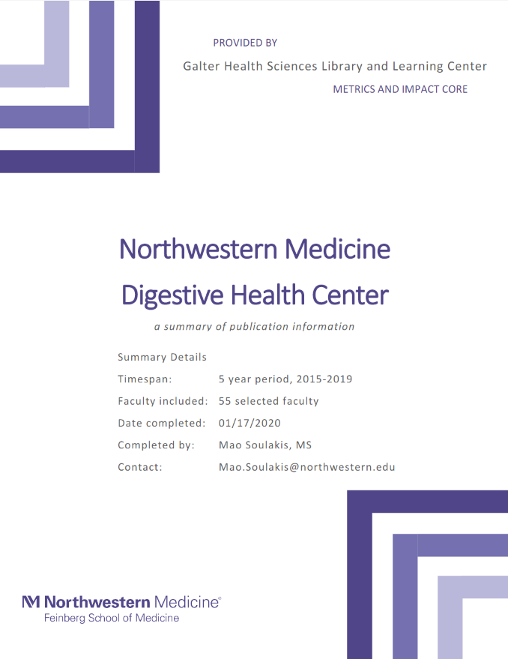
Reports
The Metrics and Impact Core has created a suite of reports that can be generated for you, your team, or your department. These formalized reports capture and visualize productivity, contribution and dissemination of a body of work.
Reports include:
Group Publication Metrics Report
Funding Support Impact Statements
Funding Support Bibliometric Networks
Student or Trainee Publication Report
Member Collaboration Report
Notes:
Annette - The Metrics and Impact Core that is part of the Galter Health Sciences Library and Learning Center has created a suite of reports that can be generated for you, your team or your department. These formalized reports capture and visualize productivity, contribution, and dissemination of a body of work.

Slide 72
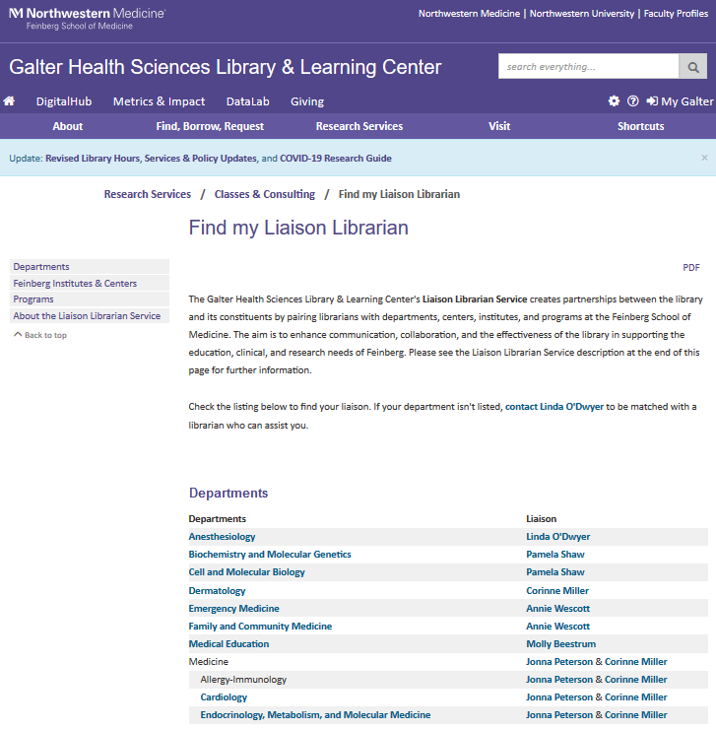
Review
An annual NIH Biosketch Review is offered by your liaison librarian as well as members of the Metrics and Impact Core team.
To find your liaison librarian visit the Research Services guide on the library website. This site provides contact information of the liaisons of departments, institutes, centers and programs of the Feinberg School of Medicine.
Notes:
Annette - Your liaison librarian or a member of the Metrics and Impact Core team can review your NIH biosketch annually and assist you in the creation of metrics statements for your work. You can find your liaison librarian by visiting the Research Services guide on the library website.

Slide 73

Instruction
The staff at the Galter Health Sciences Library & Learning Center provide instruction on a wide array of library topics.
The Metrics and Impact Core is building out their course offerings and you can register for them on the Galter website.
Our team is also available to present on topics in your department meetings, either in person or virtually.
Notes:
Annette - Finally, the staff at the Galter Health Sciences Library & Learning Center provide instruction on a wide array of library topics. You can check the website for classes and register online. Our team is also available to present on topics in your department meetings.

Slide 74
Additional Information
Notes:
Karen - The following slides provide additional information regarding indicators and this presentation.

Slide 75
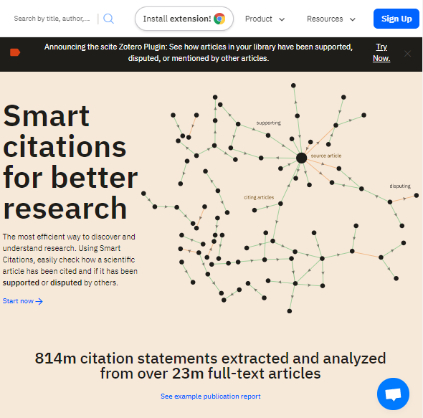
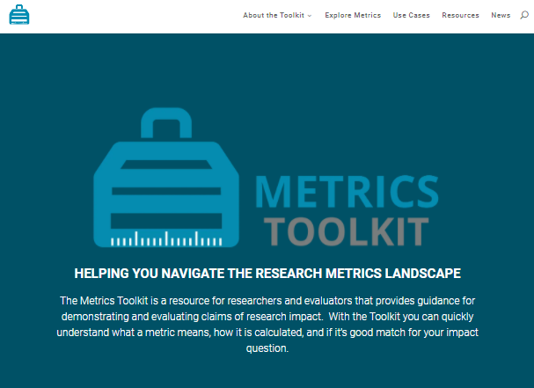
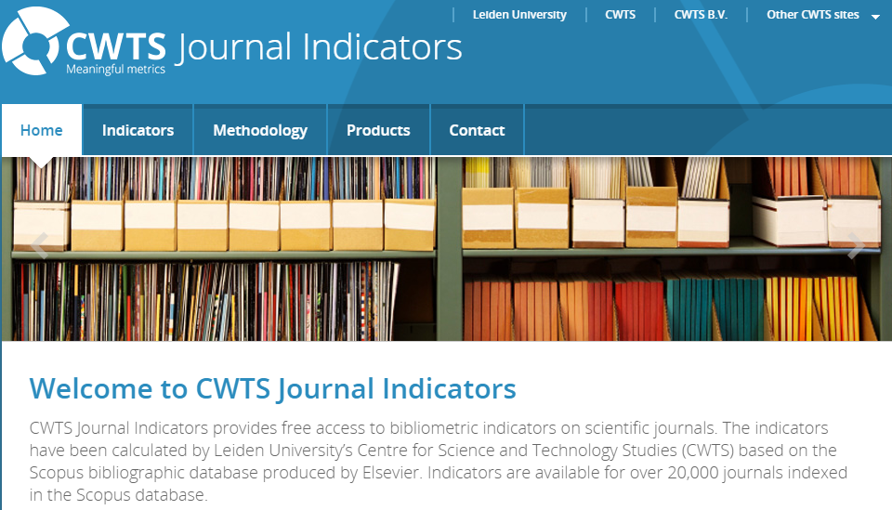
Other resources
https://www.metrics-toolkit.org/
https://scite.ai/
https://www.journalindicators.com/
Notes:
Karen - Bibliometrics and alternative metrics is an ever changing field of study. There are several tools and reference materials available for assistance in understanding and using metrics. Here are three of several resources that may be of interest to you:
Metrics ToolKit - a resource for researchers and evaluators that provides guidance for demonstrating and evaluating claims of research impact. This toolkit can help you understand what a metric means, how it is calculated, and if it is a good match for your impact question. (https://www.metrics-toolkit.org/)
CWTS Journal Indicators provides free access to bibliometric indicators on scientific journals. You can find indicators such as SNIP, impact per paper (IPP) or percent of journal self citations on this website. (https://www.journalindicators.com/)
Scite_ - scite is an award-winning platform for discovering and evaluating scientific articles via Smart Citations. Smart Citations allow users to see how a scientific paper has been cited by providing the context of the citation and a classification describing whether it provides supporting or disputing evidence for the cited claim. (https://scite.ai/)

Slide 76
Acknowledgements:
The following people are instrumental in developing research impact and dissemination materials and training, and from whose guidance we have greatly benefited.
Kristi Holmes
Galter Health Sciences Library & Learning Center, Northwestern University
Cathy Sarli
Becker Medical Library, Washington University in St. Louis
Patty Smith
Previously at Galter Library, Northwestern University, now at Altmetric.com
Amy Suiter
Becker Medical Library, Washington University in St. Louis
Notes:
Karen - The people acknowledged here are instrumental in the development of research impact and dissemination materials and are greatly appreciated for their contributions.

Slide 77
Attributions:
The following attributions are for the icons and photos used in this presentation:
Categories by Andi Nur Abdillah from the Noun Project
Better by Flatart from the Noun Project
Location by Najaya Design from the Noun Project
Warning by priyanka from the Noun Project
note by shashank singh from the Noun Project
Five young people study at table with books and laptop for researching information for their project by Jacob Lund from Noun Project
Highlighter by Creaticca Creative Agency from the Noun Project
Thinking by Ahmed Sagarwala from the Noun Project
Scientist by iconixar from the Noun Project
Science Journal by Llisole from the Noun Project
Notes:
Karen - This is a list of attributions for the icons and photos used in this presentation.

Slide 78
References:
Amjad, Rehmat. “Scientific Impact of an Author and Role of Self-Citations.” Scientometrics, vol. 122, no. 2, Springer, Feb. 2020, pp. 915–32, doi:10.1007/s11192-019-03334-2.
Egghe, Leo. “Theory and Practise of the g-Index.” Scientometrics, vol. 69, no. 1, Springer Netherlands, Oct. 2006, pp. 131–52, doi:10.1007/s11192-006-0144-7.
Glänzel, Thijs. “Productivity, Performance, Efficiency, impact—What Do We Measure Anyway?: Some Comments on the Paper ‘A Farewell to the MNCS and Like Size-Independent Indicators’ by Abramo and D’Angelo.” Journal of Informetrics, vol. 10, no. 2, Elsevier Ltd, May 2016, pp. 658–60, doi:10.1016/j.joi.2016.04.008.
Halevi, Moed. “Suitability of Google Scholar as a Source of Scientific Information and as a Source of Data for Scientific evaluation—Review of the Literature.” Journal of Informetrics, vol. 11, no. 3, Elsevier Ltd, Aug. 2017, pp. 823–34, doi:10.1016/j.joi.2017.06.005.
Hicks, Wouters. “Bibliometrics: The Leiden Manifesto for Research Metrics.” Nature (London), vol. 520, no. 7548, Apr. 2015, pp. 429–31, doi:10.1038/520429a.
Hirsch, J. “An Index to Quantify an Individual’s Scientific Research Output.” Proceedings of the National Academy of Sciences - PNAS, vol. 102, no. 46, National Academy of Sciences, Nov. 2005, pp. 16569–72, doi:10.1073/pnas.0507655102.
Martin, Irvine. “Assessing Basic Research: Some Partial Indicators of Scientific Progress in Radio Astronomy.” Research Policy, vol. 12, no. 2, Elsevier B.V, 1983, pp. 61–90, doi:10.1016/0048-7333(83)90005-7.
Martín-Martín, Thelwall. “Google Scholar, Microsoft Academic, Scopus, Dimensions, Web of Science, and OpenCitations’ COCI: a Multidisciplinary Comparison of Coverage via Citations.” Scientometrics, Sept. 2020, pp. 1–36, doi:10.1007/s11192-020-03690-4.
Purkayastha, Palmaro. “Comparison of Two Article-Level, Field-Independent Citation Metrics: Field-Weighted Citation Impact (FWCI) and Relative Citation Ratio (RCR).” Journal of Informetrics, vol. 13, no. 2, Elsevier Ltd, May 2019, pp. 635–42, doi:10.1016/j.joi.2019.03.012.
Surkis, Spore. “The Relative Citation Ratio: What Is It and Why Should Medical Librarians Care?” Journal of the Medical Library Association, vol. 106, no. 4, Medical Library Association, Oct. 2018, pp. 508–13, doi:10.5195/jmla.2018.499.
Teixeira da Silva, Jaime. “CiteScore: Advances, Evolution, Applications, and Limitations.” Publishing Research Quarterly, vol. 36, no. 3, Sept. 2020, pp. 459–68, doi:10.1007/s12109-020-09736-y.
Waltman, v. (2018). Field normalization of scientometric indicators. https://arxiv.org/ftp/arxiv/papers/1801/1801.09985.pdf
Notes:
Karen - And a list of references of the articles cited in this presentation.

Slide 79
Questions?
Annette Mendoza
Research Impact Librarian
Annette.Mendoza@northwestern.edu
Karen Gutzman
Head, Research Assessment and Communications
Karen.Gutzman@northwestern.edu
Notes:
Karen - Thank you for your attention – are there any questions?

