Slide 1
Karen Gutzman
Impact and Evaluation Librarian
Northwestern University, Feinberg School of Medicine
American Library Association
2017 Annual Conference
Saturday, June 24, 2017
1:00 pm – 2:30 pm
Hyatt Regency McCormick, Clark/CC 22AB
Supporting open research, discovery, and impact in academic research
Panel discussion on Understanding Academic Research: Free and Low-Cost Tools and Workflows

Slide 2





Motivations for Open Science
So that we can all engage with science
The research process and product are made open to a wider audience.
Collaboration makes research more efficient and inclusive.
Openly available tools and resources make research more effective and efficient.
Access to knowledge should be equally distributed and available for everyone.
Digitally available research allows for alternative measures of impact.
Fecher B, Friesike S. (2014). Open Science: One Term, Five Schools of Thought. Open Science. DOI: 10.1007/978-3-319-00026-8_2

Slide 3
Scenario 1
Question:
Where can I find research on climate change and health?
What is the most relevant or recent research?
Resources:
PubMed
Altmetric Bookmarklet
Zotero
Notes:
Climate change refers to a broad range of global phenomena created predominantly by burning fossil fuels, which add heat-trapping gases to Earth’s atmosphere.
Global warming refers to the upward temperature trend across the entire Earth since the early 20th century, and most notably since the late 1970s, due to the increase in fossil fuel emissions since the industrial revolution. Worldwide since 1880, the average surface temperature has gone up by about 0.8 °C (1.4 °F), relative to the mid-20th-century baseline (of 1951-1980).
https://climate.nasa.gov/resources/global-warming/

Slide 4
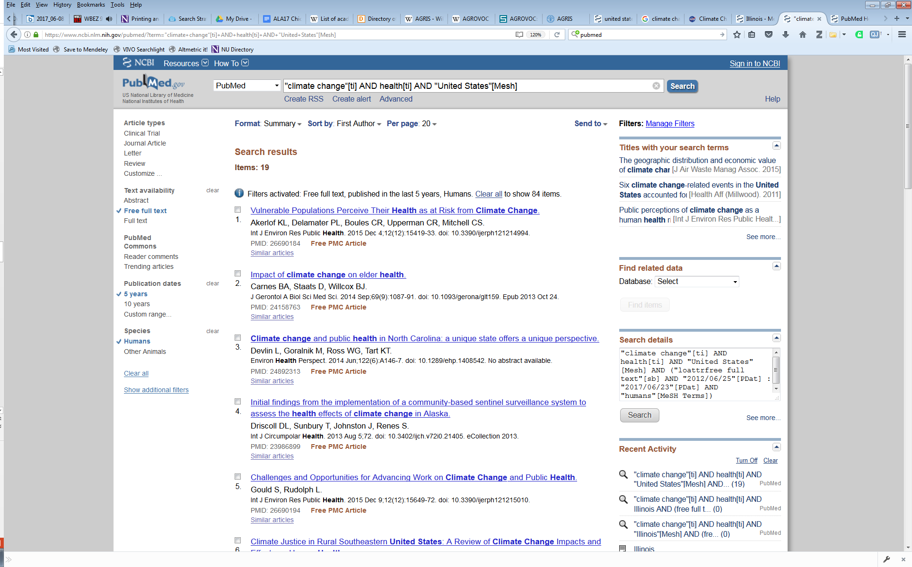
Use Case: discovering relevant information
Resource: PubMed
https://www.ncbi.nlm.nih.gov/pubmed/
Where can I find research on climate change and health? What is the most relevant or recent research?
Notes:
PubMed Search Strategy: "climate change“[ti] AND health[ti] AND "United States"[Mesh]
Consider “title” as a field tag for quick, top-level searches. (https://www.ncbi.nlm.nih.gov/books/NBK3827/#pubmedhelp.Search_Field_Descriptions_and)
PubMed comprises over 26 million citations for biomedical literature from MEDLINE, life science journals, and online books. PubMed is a free resource that is developed and maintained by the National Center for Biotechnology Information (NCBI), at the U.S. National Library of Medicine (NLM), located at the National Institutes of Health (NIH).

Slide 5
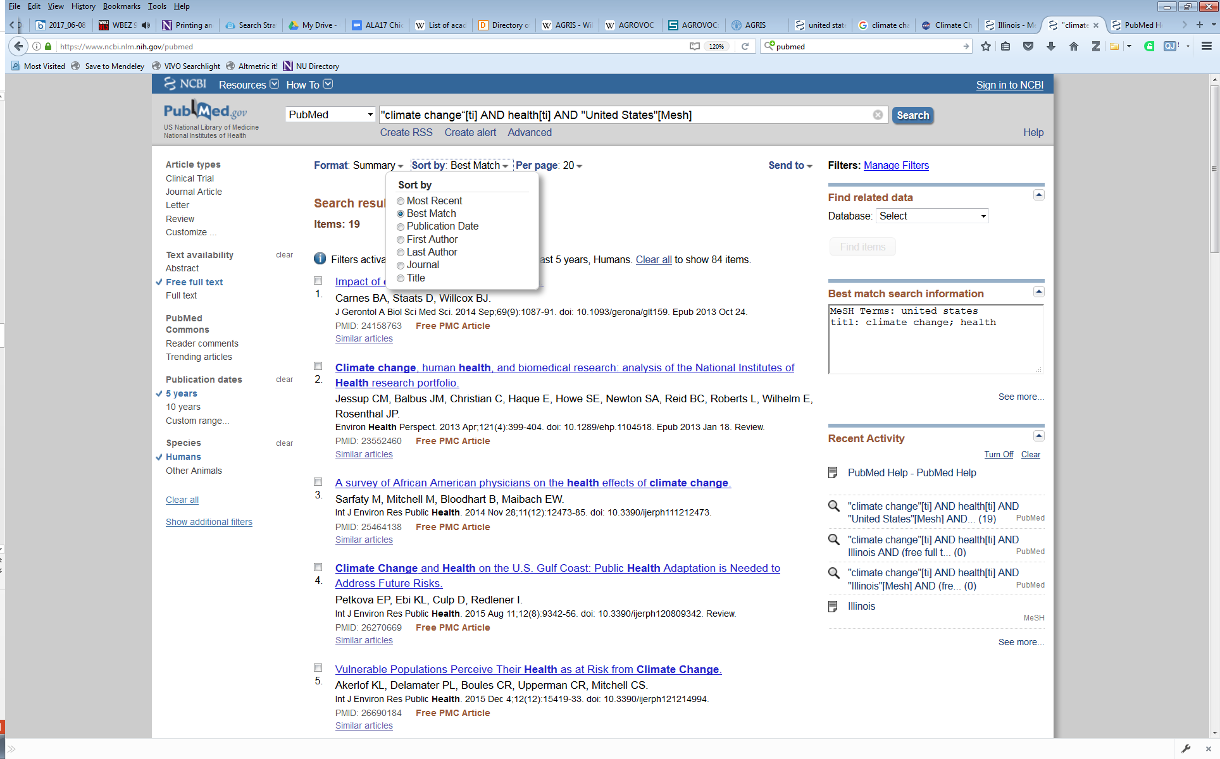
Use Case: discovering relevant information
Resource: PubMed
https://www.ncbi.nlm.nih.gov/pubmed/
Where can I find research on climate change and health? What is the most relevant or recent research?
Notes:
The standard PubMed Best Match sort is based on a weighted term frequency algorithm. This approach calculates the frequency with which terms appear in PubMed records. Those frequencies are then applied in a weighted fashion to return a ranked list of PubMed citations that match your query terms.
The new relevance algorithm includes machine learning to re-rank the top articles returned. This algorithm combines over 150 signals that are helpful for finding best matching results. Most of these signals are computed from the number of matches between the search terms and the PubMed record, while others are either specific to a record (e.g., publication type; publication year) or specific to a search (e.g., search length).
https://www.nlm.nih.gov/pubs/techbull/jf17/jf17_pm_best_match_sort.html

Slide 6
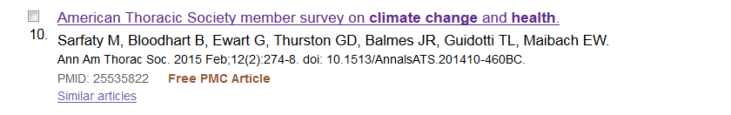
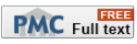
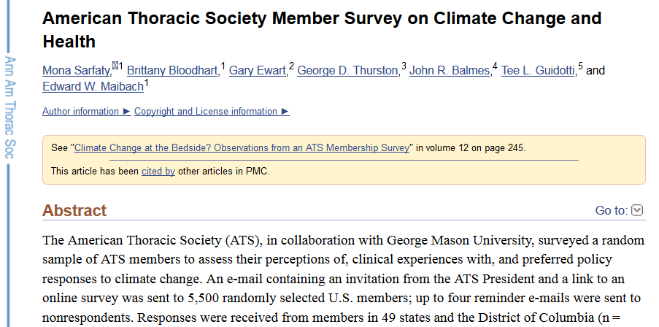
Use Case: discovering relevant information
Resource: PubMed
Where can I find research on climate change and health? What is the most relevant or recent research?
Notes:
PubMed Search Strategy: "climate change“[ti] AND health[ti] AND "United States"[Mesh]
Computation of Similar Articles
https://www.ncbi.nlm.nih.gov/books/NBK3827/
The similarity between documents is measured by the words they have in common, with some adjustment for document lengths.

Slide 7
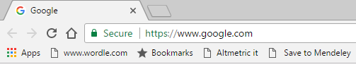
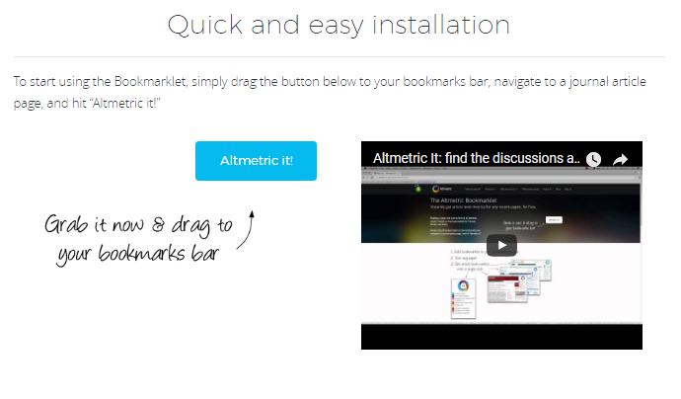
Use Case: discovering relevant information
Resource: Altmetric Bookmarklet
https://www.altmetric.com/products/free-tools/bookmarklet/
Notes:
Altmetric bookmarklet
https://www.altmetric.com/products/free-tools/bookmarklet/
The Bookmarklet only works on PubMed, arXiv or pages containing a DOI
It only supports publishers who embed Google Scholar friendly citation metadata on their pages by default, though we’re adding support for others. You can hurry along support for a particular journal by asking @altmetric for it on Twitter
Twitter mentions are only available for articles published since July 2011
If Altmetric started supporting a publisher after July 2011 then Twitter mentions are only available from that date onwards
Are you a publisher? Don’t use this bookmarklet! We have much better tools for you, just get in touch.

Slide 8
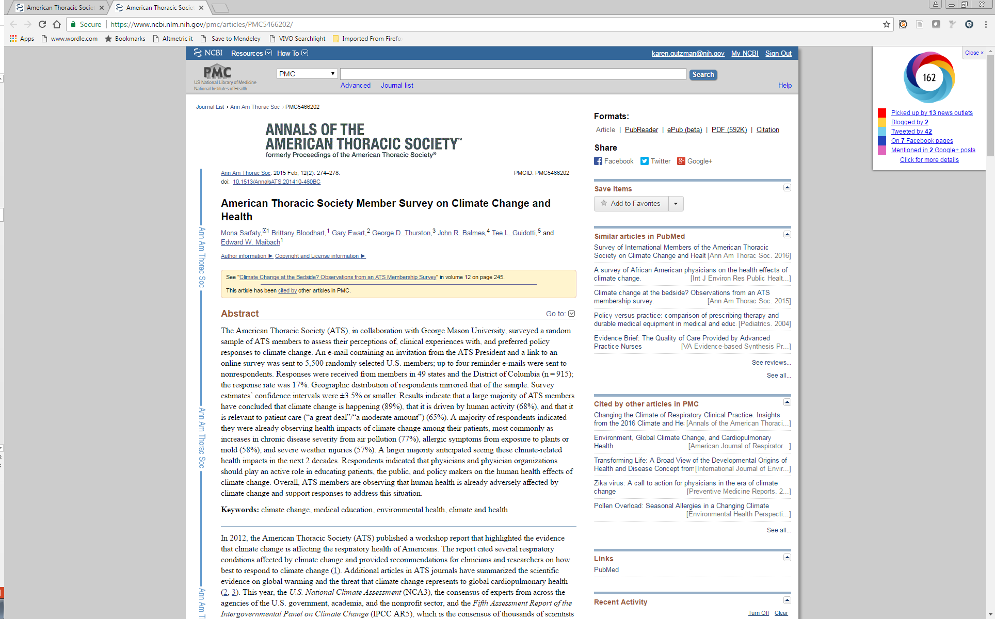
Use Case: discovering relevant information
Resource: Altmetric Bookmarklet
Where can I find research on climate change and health? What is the most relevant or recent research?

Slide 9
Use Case: discovering relevant information
Resource: Altmetric Bookmarklet
Where can I find research on climate change and health? What is the most relevant or recent research?

Slide 10
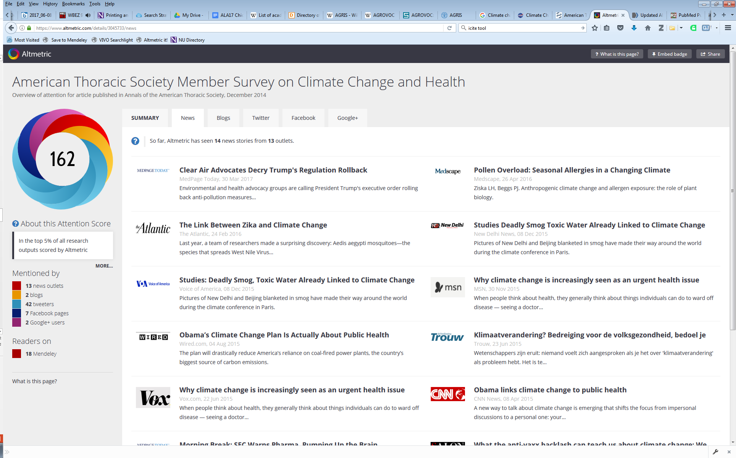
Use Case: discovering relevant information
Resource: Altmetric Bookmarklet
Where can I find research on climate change and health? What is the most relevant or recent research?

Slide 11
Use Case: discovering relevant information
Resource: Altmetric Bookmarklet
Where can I find research on climate change and health? What is the most relevant or recent research?

Slide 12
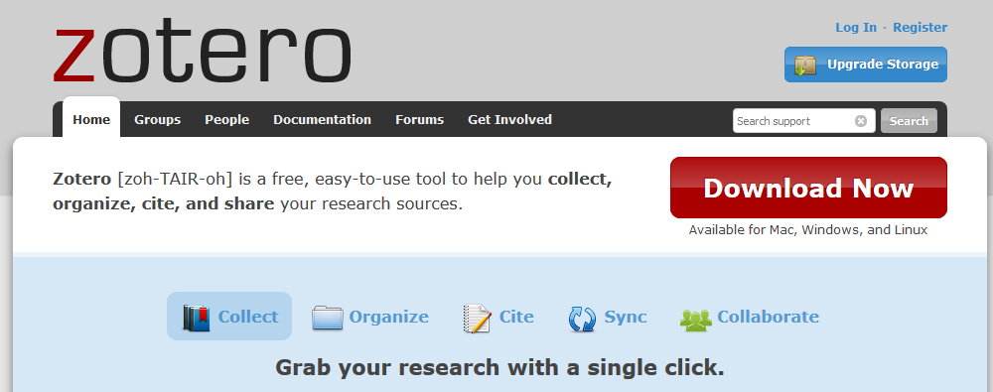
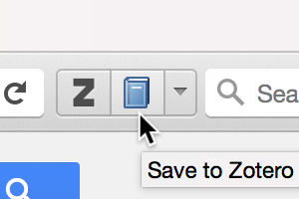
Use Case: discovering relevant information
Resource: Zotero
https://www.zotero.org/

Slide 13
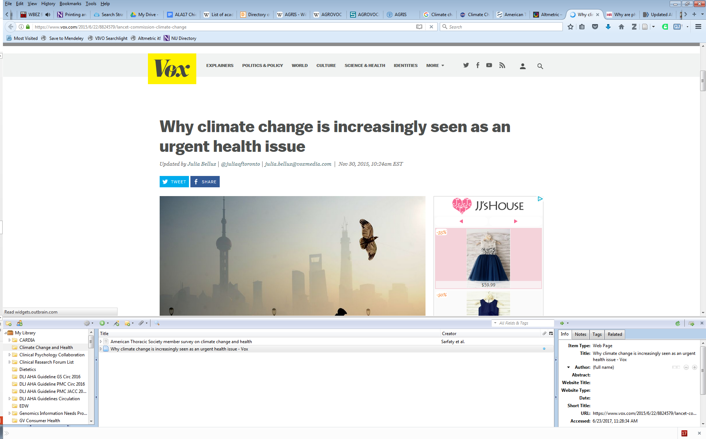
Use Case: discovering relevant information
Resource: Zotero
Where can I find research on climate change and health? What is the most relevant or recent research?

Slide 14
Use Case: discovering relevant information
Resource: Zotero
Where can I find research on climate change and health? What is the most relevant or recent research?

Slide 15
Question:
Where can I find research on climate change and health?
What is the most relevant or recent research?
Resources:
PubMed
Altmetric Bookmarklet
Zotero

Slide 16
Scenario 2
Question:
I am interviewing for medical school with several faculty.
How do I find their most important research papers?
Resources:
PubMed
PubReminer
iCite

Slide 17
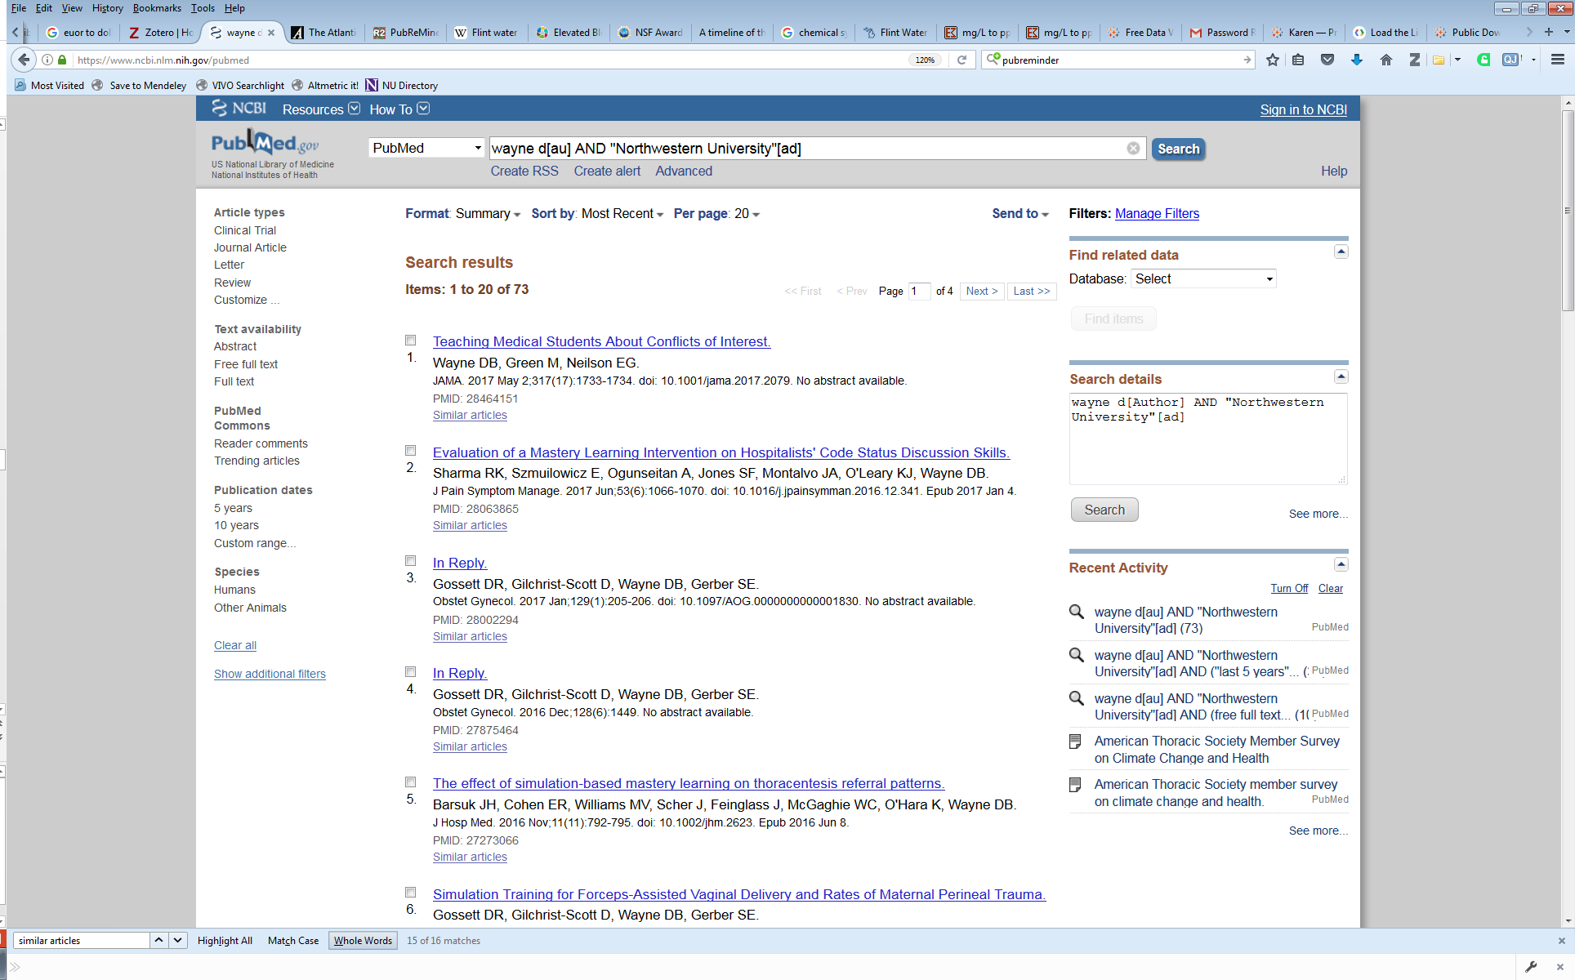
Use case: discovering impactful research
Resource: PubMed
https://www.ncbi.nlm.nih.gov/pubmed/
I am interviewing for medical school with several faculty.
How do I find their most important research papers?
Notes:
PubMed:
Author [AU]
The format to search for this field is: last name followed by a space and up to the first two initials followed by a space and a suffix abbreviation, if applicable, all without periods or a comma after the last name (e.g., fauci as or o'brien jc jr). Initials and suffixes may be omitted when searching.
PubMed automatically truncates a search for an author's name to account for varying initials, e.g., o'brien j [au] will retrieve o'brien ja, o'brien jb, o'brien jc jr, as well as o'brien j. To turn off automatic truncation, enclose the author's name in double quotes and tag with [au] in brackets, e.g., "o'brien j" [au] to retrieve just o'brien j.
Affiliation [AD]
Affiliation may be included for authors, corporate authors and investigators, e.g., cleveland [ad] AND clinic [ad], if submitted by the publisher. Multiple affiliations were added to citations starting from 2014, previously only the first author’s affiliation was included. The Abstract format displays affiliation for citations with fewer than 100 authors.

Slide 18
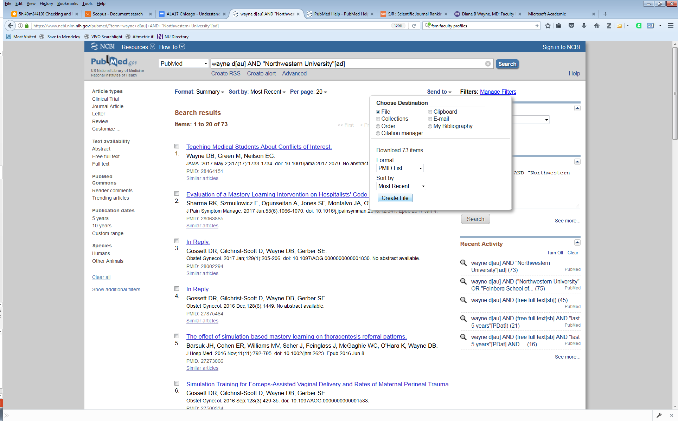
Use case: discovering impactful research
Resource: PubMed
https://www.ncbi.nlm.nih.gov/pubmed/
I am interviewing for medical school with several faculty.
How do I find their most important research papers?
Notes:
PubMed:
Author [AU]
The format to search for this field is: last name followed by a space and up to the first two initials followed by a space and a suffix abbreviation, if applicable, all without periods or a comma after the last name (e.g., fauci as or o'brien jc jr). Initials and suffixes may be omitted when searching.
PubMed automatically truncates a search for an author's name to account for varying initials, e.g., o'brien j [au] will retrieve o'brien ja, o'brien jb, o'brien jc jr, as well as o'brien j. To turn off automatic truncation, enclose the author's name in double quotes and tag with [au] in brackets, e.g., "o'brien j" [au] to retrieve just o'brien j.
Affiliation [AD]
Affiliation may be included for authors, corporate authors and investigators, e.g., cleveland [ad] AND clinic [ad], if submitted by the publisher. Multiple affiliations were added to citations starting from 2014, previously only the first author’s affiliation was included. The Abstract format displays affiliation for citations with fewer than 100 authors.

Slide 19
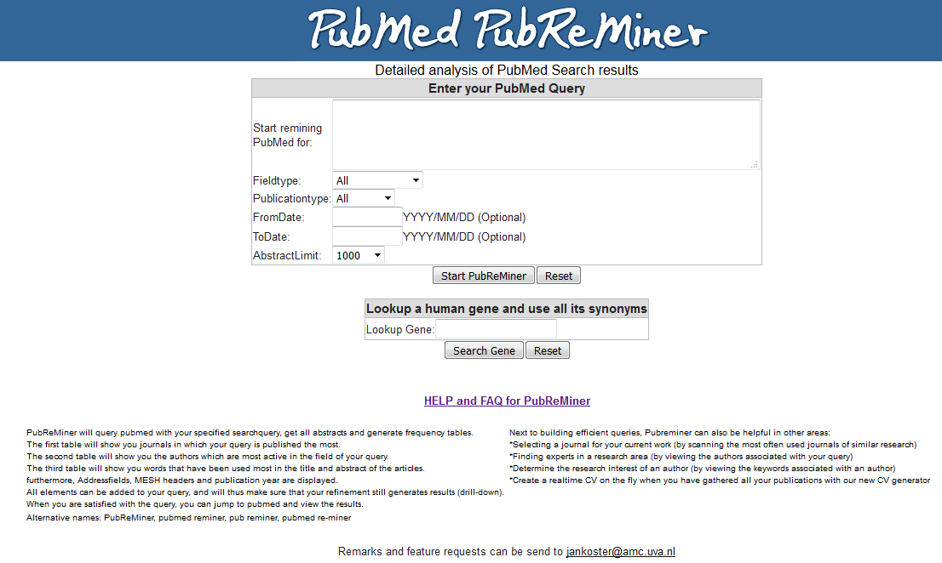
Use Case: discovering impactful research
Resource: PubReMiner
http://hgserver2.amc.nl/cgi-bin/miner/miner2.cgi
I am interviewing for medical school with several faculty.
How do I find their most important research papers?
Notes:
PubReMiner
PubReMiner is a front-end for the popular PubMed literature database at the NCBI. When you submit your query (which can be any query that can be processed by PubMed), PubReMiner will process the result of that query and display its results (in the form of selectable "keywords") in frequency tables, which can be added/excluded from the query to optimize the results.
http://hgserver2.amc.nl/cgi-bin/miner/miner2.cgi

Slide 20
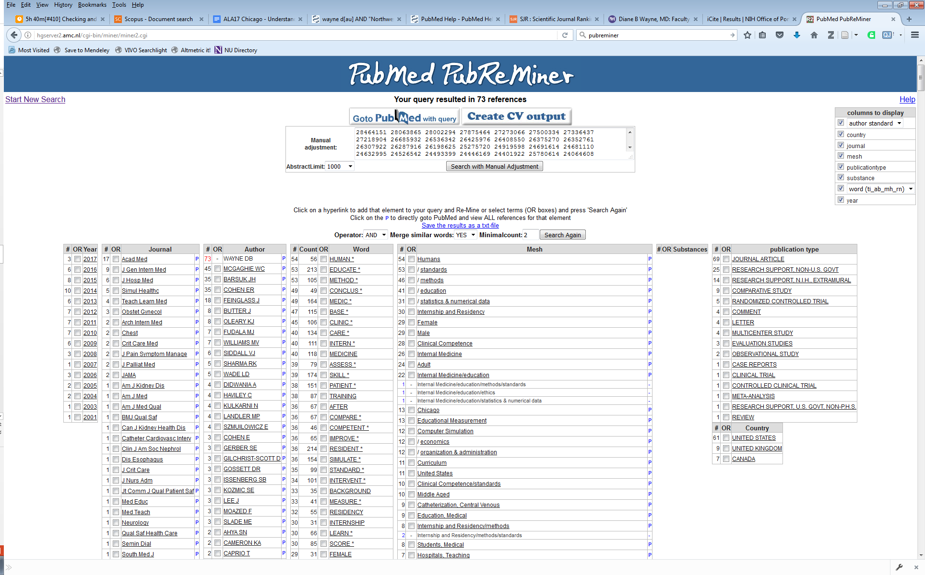
Use Case: discovering impactful research
Resource: PubReMiner
http://hgserver2.amc.nl/cgi-bin/miner/miner2.cgi
I am interviewing for medical school with several faculty.
How do I find their most important research papers?
Notes:
PubReMiner
PubReMiner is a front-end for the popular PubMed literature database at the NCBI. When you submit your query (which can be any query that can be processed by PubMed), PubReMiner will process the result of that query and display its results (in the form of selectable "keywords") in frequency tables, which can be added/excluded from the query to optimize the results.
http://hgserver2.amc.nl/cgi-bin/miner/miner2.cgi

Slide 21
Use Case: discovering impactful research
Resource: PubReMiner
http://hgserver2.amc.nl/cgi-bin/miner/miner2.cgi
I am interviewing for medical school with several faculty.
How do I find their most important research papers?
Notes:
PubReMiner
PubReMiner is a front-end for the popular PubMed literature database at the NCBI. When you submit your query (which can be any query that can be processed by PubMed), PubReMiner will process the result of that query and display its results (in the form of selectable "keywords") in frequency tables, which can be added/excluded from the query to optimize the results.
http://hgserver2.amc.nl/cgi-bin/miner/miner2.cgi

Slide 22
Use Case: discovering impactful research
Resource: PubReMiner
http://hgserver2.amc.nl/cgi-bin/miner/miner2.cgi
I am interviewing for medical school with several faculty.
How do I find their most important research papers?
Notes:
PubReMiner
PubReMiner is a front-end for the popular PubMed literature database at the NCBI. When you submit your query (which can be any query that can be processed by PubMed), PubReMiner will process the result of that query and display its results (in the form of selectable "keywords") in frequency tables, which can be added/excluded from the query to optimize the results.
http://hgserver2.amc.nl/cgi-bin/miner/miner2.cgi

Slide 23
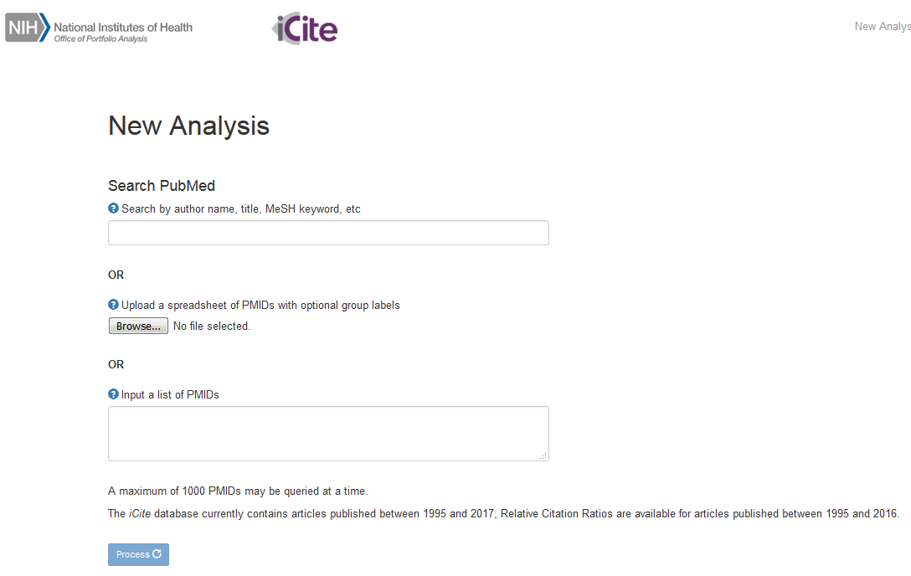
Use Case: discovering relevant information
Resource: iCite
https://icite.od.nih.gov/analysis
I am interviewing for medical school with several faculty.
How do I find their most important research papers?
Notes:
iCite is a tool to access a dashboard of bibliometrics for papers associated with a portfolio. Users type in a PubMed query or upload the PubMed IDs of articles of interest, optionally grouping IDs for comparison. iCite then displays the number of articles, articles per year, citations per year, and Relative Citation Ratio (a field-normalized metric that shows the scientific influence of one or more articles relative to the average NIH-funded paper).
https://icite.od.nih.gov/

Slide 24
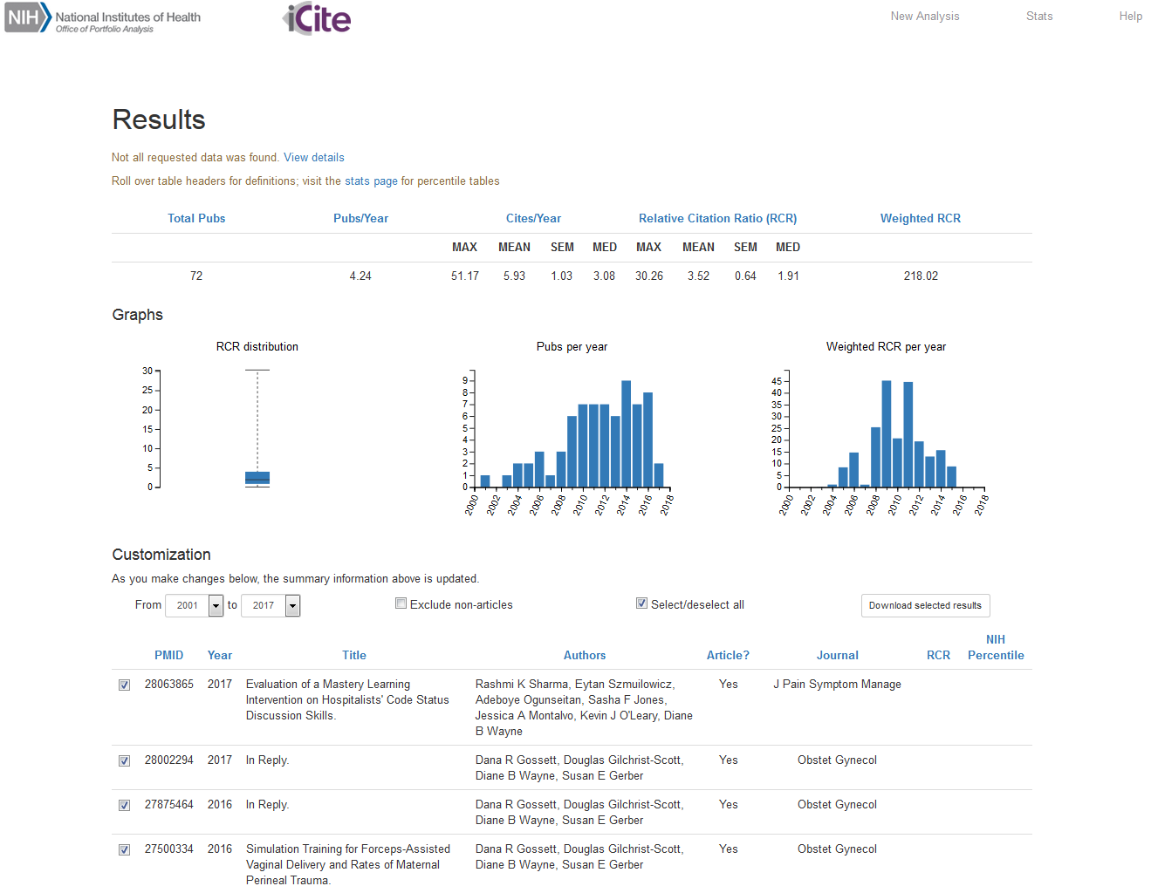
Use Case: discovering relevant information
Resource: iCite
https://icite.od.nih.gov/analysis
I am interviewing for medical school with several faculty.
How do I find their most important research papers?

Slide 25
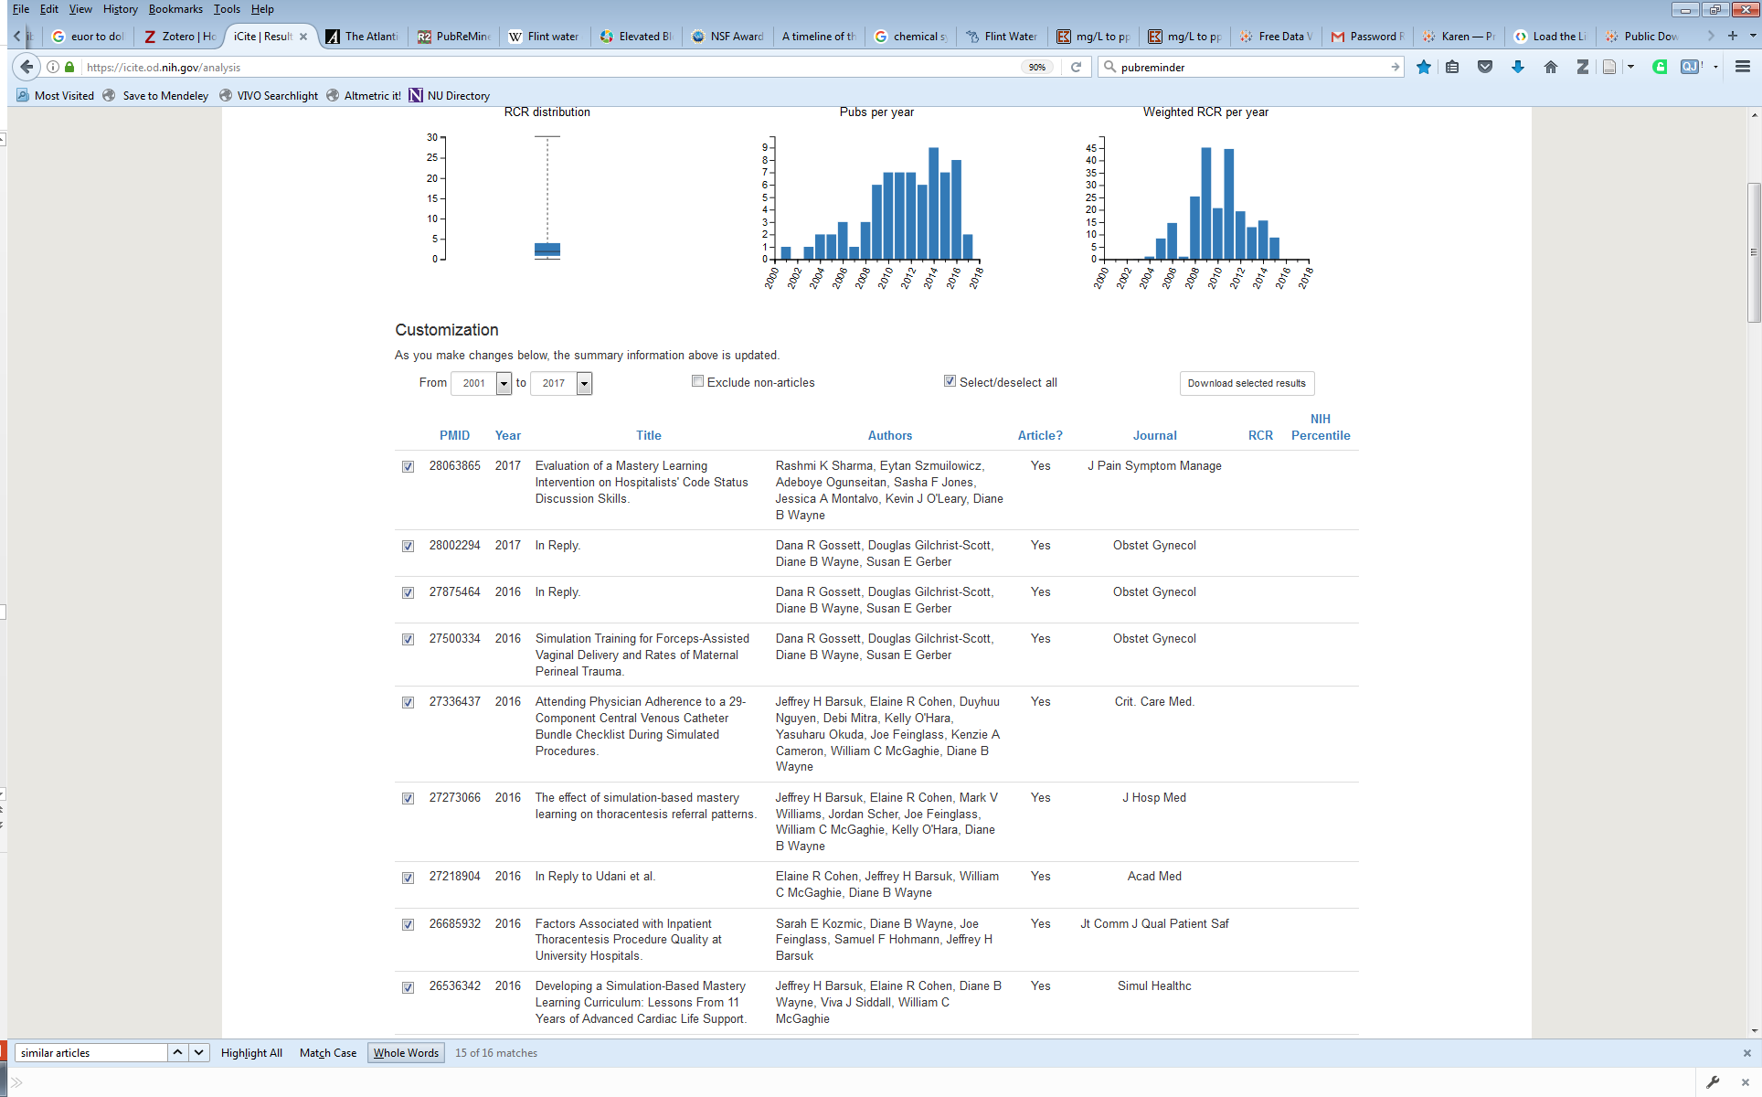
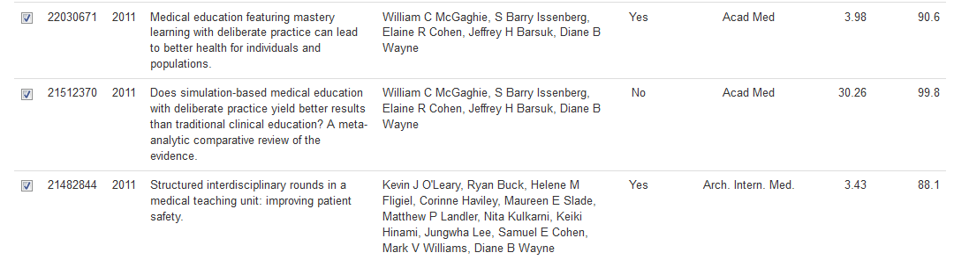
Use Case: discovering relevant information
Resource: iCite
Definition:
Relative Citation Ratio (RCR) is calculated as cites/year for each paper, and normalized to cites/year received by NIH-funded papers in the same field and year.
Example:
An RCR of 1.0 means the paper is accumulating as many citations as would be expected of an NIH-funded paper published in the same field and year.
An RCR of >1.0 means the paper is accumulating more citations than would be expected.
https://icite.od.nih.gov/analysis
I am interviewing for medical school with several faculty.
How do I find their most important research papers?
Notes:
The Relative Citation Ratio is a new metric developed within the Office of Portfolio Analysis (OPA) that represents a citation-based measure of scientific influence of one or more articles. It is calculated as the cites/year of each paper, normalized to the citations per year received by NIH-funded papers in the same field and year. This benchmarking process, performed with quantile regression, ensures that a paper with an RCR of 1.0 has received the same number of cites/year as the median NIH-funded paper in its field, while a paper with an RCR of 2.0 has received twice as many cites/year as the median NIH-funded paper in its field. The displayed values are the average and standard deviation of the papers in the group along with the median.
https://icite.od.nih.gov/help

Slide 26
Question:
I am interviewing for medical school with several faculty.
How do I find their most important research papers?
Resources:
PubMed
PubReminer
iCite

Slide 27
Scenario 3
Question:
How can I review and visualize the water-related data of the Flint, Michigan water crisis?
Resources:
Public Health Data
Open Refine
Tableau Public

Slide 28
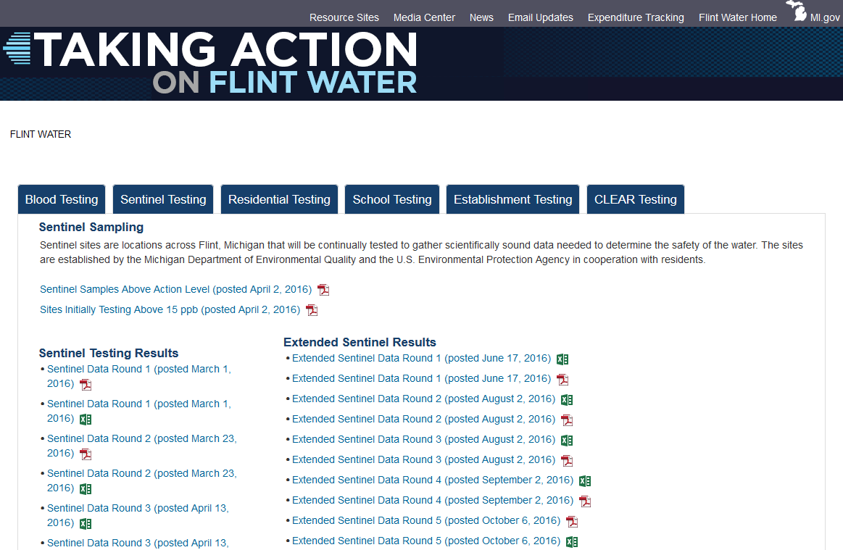
Use case: analyzing and visualizing data
Resource: public health data
http://www.michigan.gov/flintwater/0,6092,7-345-76292_76294_76297---,00.html
How can I review and visualize the water-related data of the Flint Michigan water crisis?
Notes:
Flint Water Sentinel Testing
Sentinel sites are locations across Flint, Michigan that will be continually tested to gather scientifically sound data needed to determine the safety of the water. The sites are established by the Michigan Department of Environmental Quality and the U.S. Environmental Protection Agency in cooperation with residents.
http://www.michigan.gov/flintwater/0,6092,7-345-76292_76294_76297---,00.html
Lead exposure across the U.S. has fallen dramatically since the 1980s, but no blood-lead level is considered completely safe. Children under age five, and especially infants and unborn children, bear the greatest risk of deleterious and irreversible health outcomes.^{[2]} From 2012 to 2016, the CDC set a "reference level" of 5 micrograms per deciliter (µg/dL), in order to target for case management the 2.5% of young American children with the highest blood-lead levels.
https://en.wikipedia.org/wiki/Flint_water_crisis
1 mg/dL = 1000 ppb

Slide 29
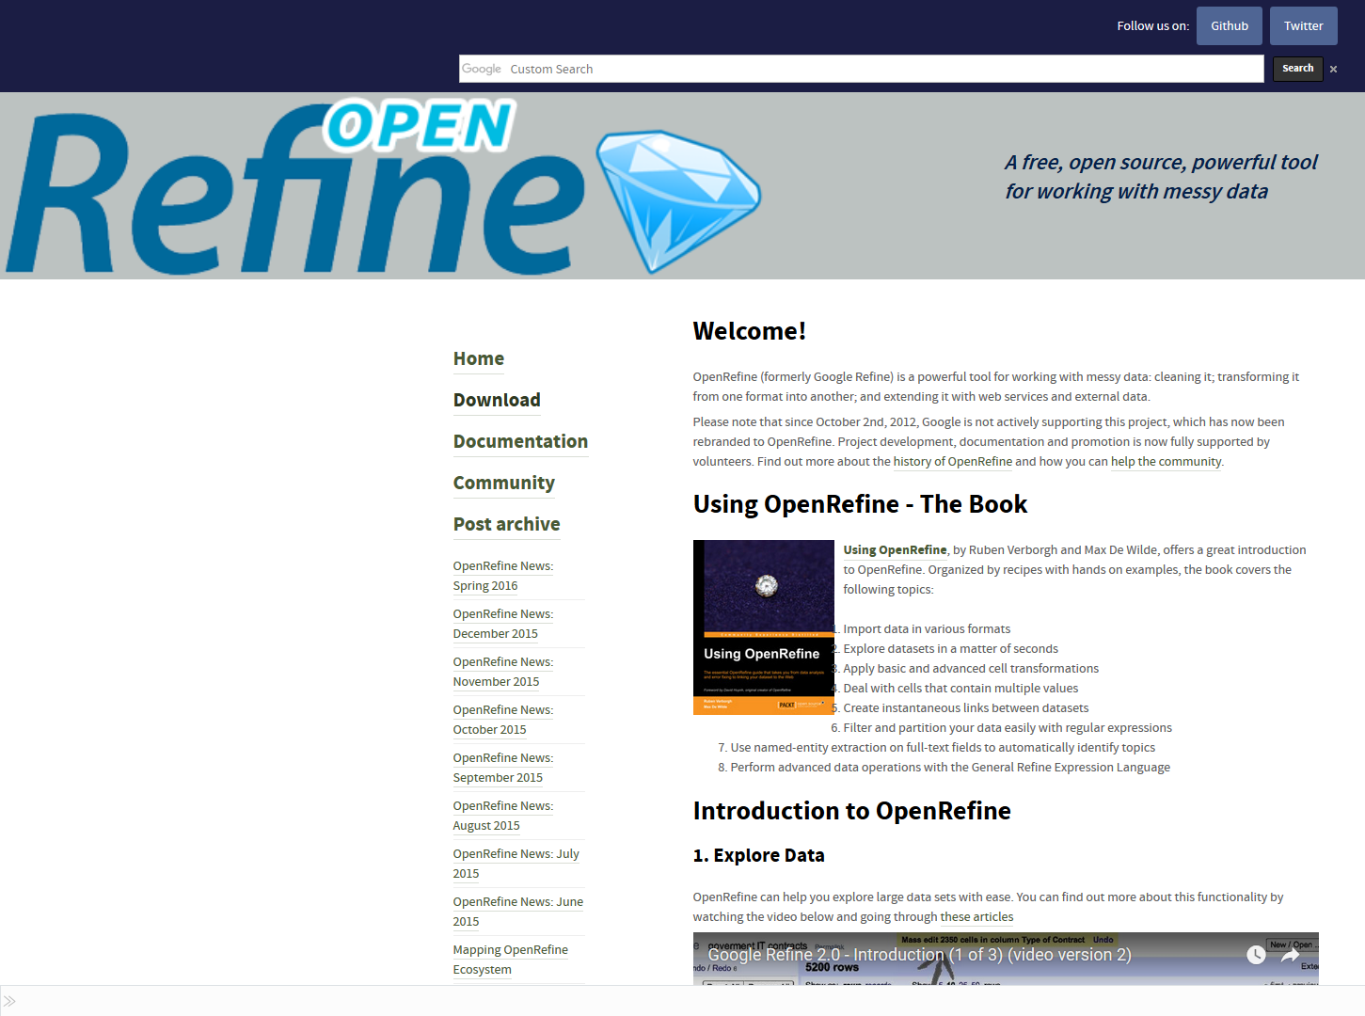
Use case: analyzing and visualizing data
Resource: OpenRefine
http://openrefine.org/
How can I review and visualize the water-related data of the Flint Michigan water crisis?
Notes:
OpenRefine (formerly Google Refine) is a powerful tool for working with messy data: cleaning it; transforming it from one format into another; and extending it with web services and external data.
Please note that since October 2nd, 2012, Google is not actively supporting this project, which has now been rebranded to OpenRefine. Project development, documentation and promotion is now fully supported by volunteers. Find out more about the history of OpenRefine and how you can help the community.
http://openrefine.org/

Slide 30
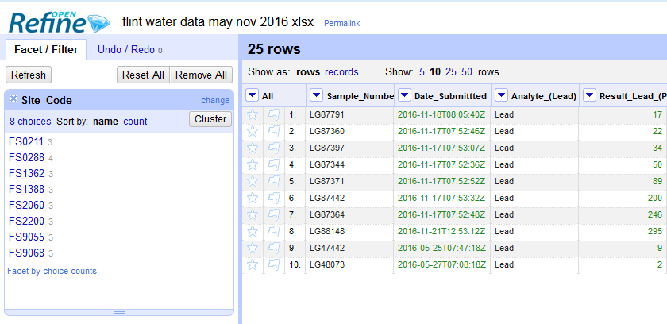
Use case: analyzing and visualizing data
Resource: OpenRefine
How can I review and visualize the water-related data of the Flint Michigan water crisis?

Slide 31
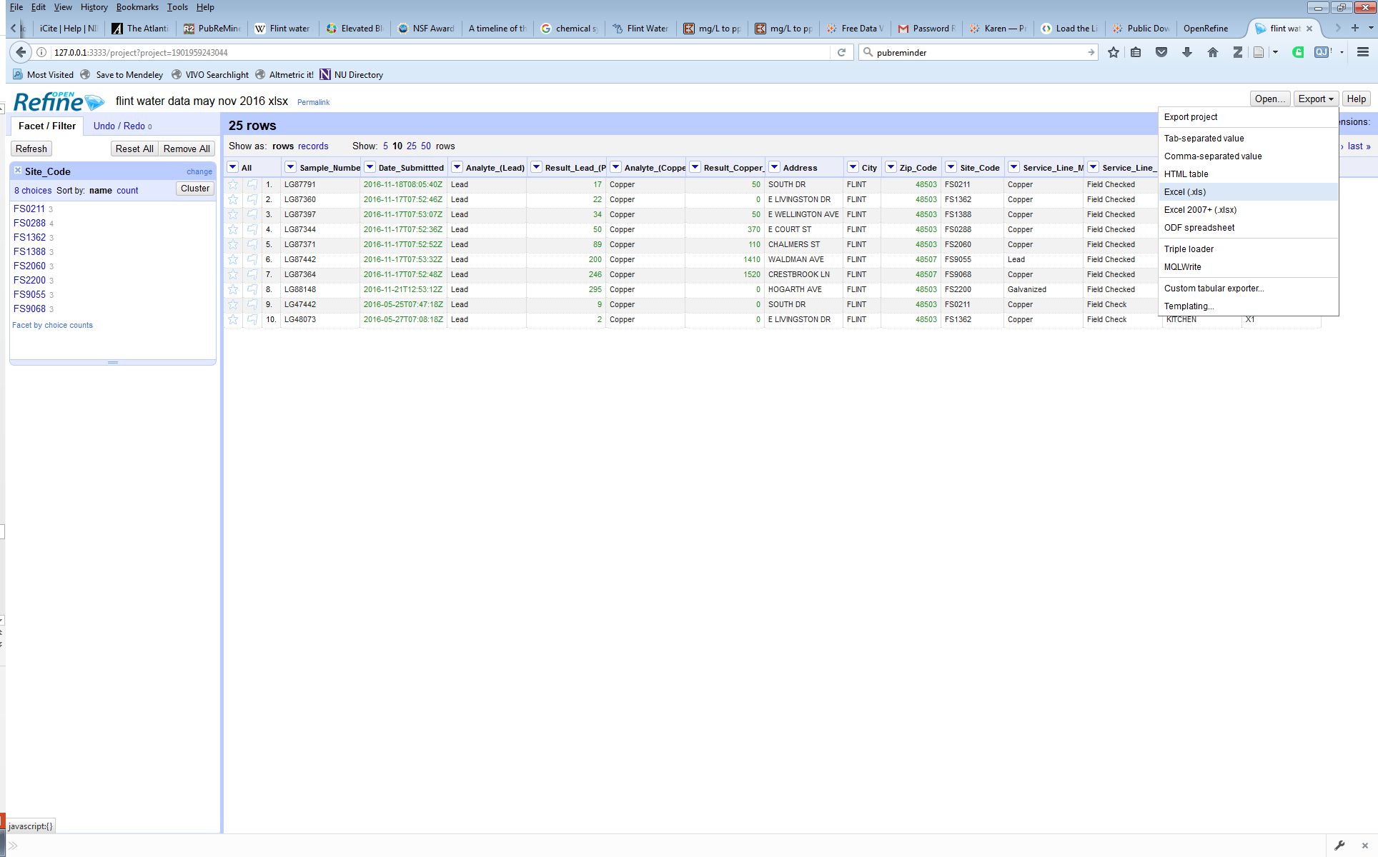
Use case: analyzing and visualizing data
Resource: OpenRefine
How can I review and visualize the water-related data of the Flint Michigan water crisis?

Slide 32
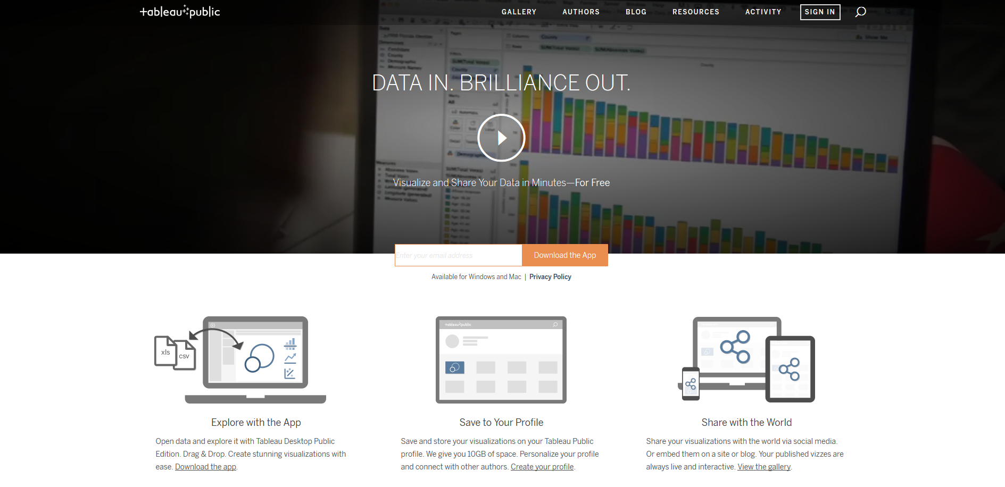
Use case: analyzing and visualizing data
Resource: Tableau Public
https://public.tableau.com/s/
How can I review and visualize the water-related data of the Flint Michigan water crisis?
Notes:
Tableau Public is free software that can allow anyone to connect to a spreadsheet or file and create interactive data visualizations for the web.
https://public.tableau.com/s/

Slide 33
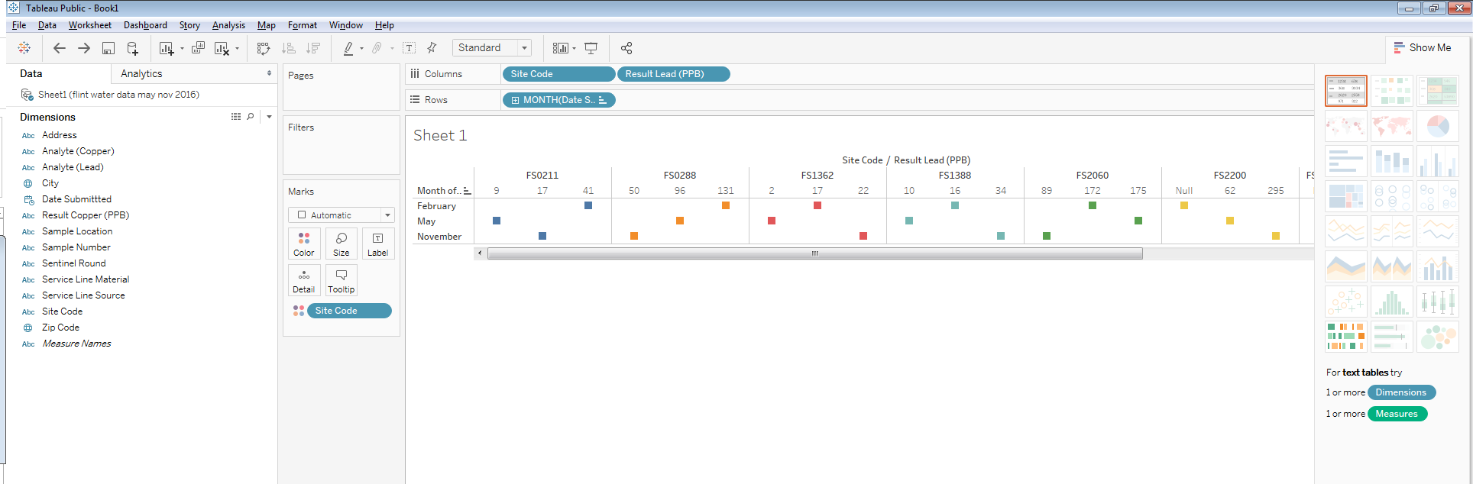
Use case: analyzing and visualizing data
Resource: Tableau Public
How can I review and visualize the water-related data of the Flint Michigan water crisis?

Slide 34
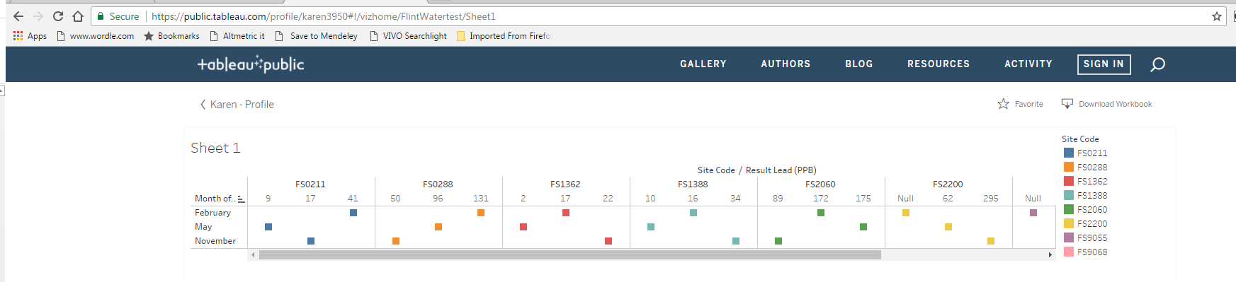
Use case: analyzing and visualizing data
Resource: Tableau Public
https://public.tableau.com/s/
How can I review and visualize the water-related data of the Flint Michigan water crisis?

Slide 35
Question:
How can I review and visualize the water-related data of the Flint, Michigan water crisis?
Resources:
Public Health Data
Open Refine
Tableau Public

Slide 36
Thank you!
Special thanks to Mary Anne Zmaczynski, Linda O’Dwyer, Patty Smith at Galter Health Sciences Library for inspiration and ideas.

