Slide 1



Digital Folder Organization: Best Practices and Strategies
Sara Gonzales, MS, MLIS
Data Librarian
Galter Health Sciences Library & Learning Center

Slide 2
What we’ll cover today
RDM Refresher
Best Practices for Naming and Organizing Folders
The Folder Structure Template: Model and Resources
  With key credit to: Demerdash, Y., Dockhorn, R., & Wilbrandt, J. (2025). Data Organization Made Easy: Comprehensive Folder Structure Template for Early Career Life/Natural Science Researchers. Data Science Journal, 24(), 35. https://doi.org/10.5334/dsj-2025-035
Questions

Slide 3
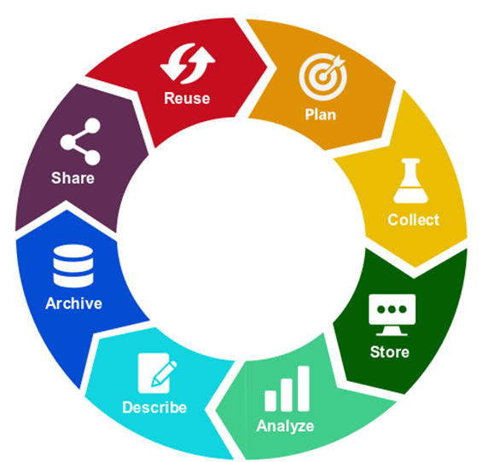
What is Research Data Management?
Research data management concerns the organization of data, from its entry to the research cycle through to the dissemination and archiving of valuable results.
  When data has been well-managed, maintained, and preserved, it will be easy to make it FAIR:
    Findable
    Accessible
    Interoperable
    Reusable
Creating, storing, and sharing FAIR data is increasingly a requirement of many federal funders* and publishers
© SZF TU Berlin, CC BY 4.0
* NIH Grants & Funding. Data Management. FAIR Principles: https://grants.nih.gov/policy-and-compliance/policy-topics/sharing-policies/dms/data-management#fair-principles

Slide 4
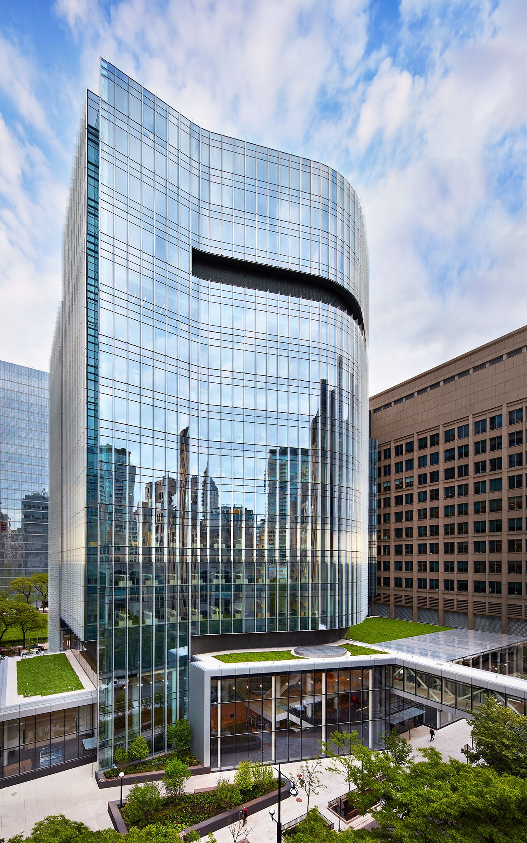
Research Data Management: Basic Tenets
  Tidy data: ensuring that data collection documents (with a focus on spreadsheet-style documents) are designed to maximize the organization and accessibility of data
    Library Carpentry - Tidy data for librarians: https://librarycarpentry.github.io/lc-spreadsheets/
  Documentation: READMEs and Standard Operating Procedures
    Cornell University Data Services – Writing READMEs for Research Data: https://data.research.cornell.edu/data-management/sharing/readme/
    Ten simple rules on how to write a standard operating procedure: https://doi.org/10.1371/journal.pcbi.1008095
    Metadata & Data Standards: DataCite, FAIRsharing.org
  File Naming:
    Galter Class – 10 Simple Rules for File Organization: https://galter.northwestern.edu/course_info/246
  Folder Naming and Organization
Notes:
File Naming Convention Worksheet, Caltech: https://doi.org/10.7907/894q-zr22

Slide 5
Digital Folder Organization

Slide 6

Best Practices for Naming Digital Folders
Aim for short names, just descriptive enough
Keep the naming convention consistent
To keep folders in chronological order, have their names begin with “YYYY-MM-DD”
If a folder order in the directory beyond alphabetical is needed, begin the names with numbers with leading zeroes. For instance:
    01-Documents
    02-Projects
Document the naming scheme in a README file, which is stored in the top-level folder
Notes:
The M_NamingSchemes.md resource from the Folder Structure GitHub project: https://github.com/RDMJeanne/FolderStructure/blob/main/PhD/M_NamingSchemes.md

Slide 7

Best Practices for Organizing Digital Folders
Keep raw data raw – always store in separate folders from processed data
Make sure your folder categories do not overlap or contain duplication
Employ a nesting structure, in which higher levels denote greater importance and/or more inclusive concepts
Consult your team members on the organizational structure to make sure it makes sense to all, and works with all applicable workflows

Slide 8
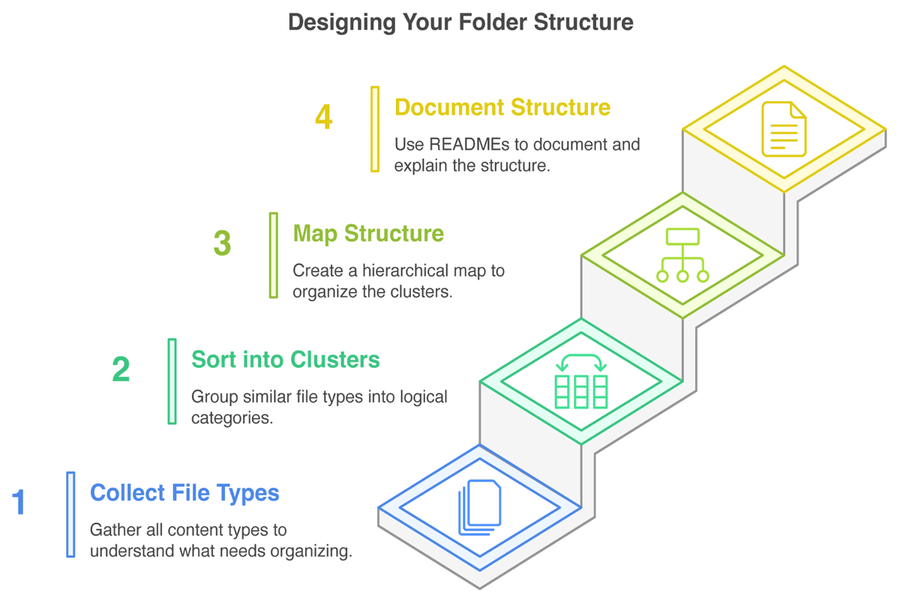
Designing a Folder Structure
Demerdash, Y., Dockhorn, R., & Wilbrandt, J. (2025). Data Organization Made Easy: Comprehensive Folder Structure Template for Early Career Life/Natural Science Researchers. Data Science Journal, 24(), 35. doi.org/10.5334/dsj-2025-035

Slide 9
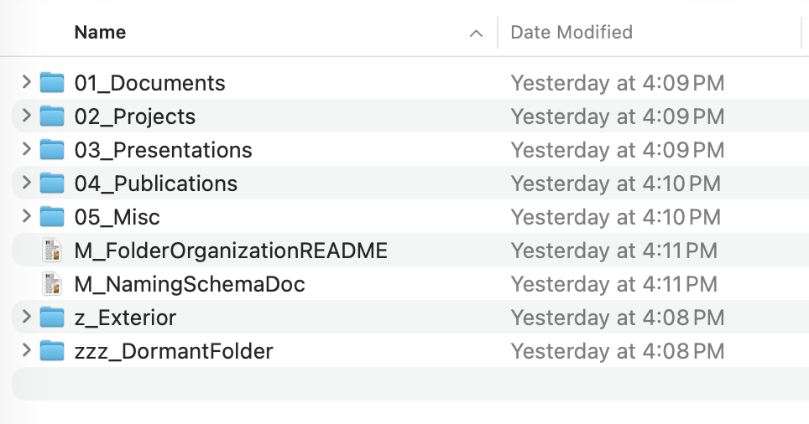
Designing a Folder Structure – Important Sub-Steps
Add a folder to store things received from outside, which may later be sorted into the regular project folders. Add a leading “z” to the folder name, and this will keep the “Exterior” folder near the bottom of the folder view
Similarly, perhaps with multiple leading “z’s” to keep it at the very bottom, create a “Dormant” folder to hold older versions of things not needed for day-to-day work, and which can likely be deleted by the end of the project
Demerdash, Y., Dockhorn, R., & Wilbrandt, J. (2025). Data Organization Made Easy: Comprehensive Folder Structure Template for Early Career Life/Natural Science Researchers. Data Science Journal, 24(), 35. doi.org/10.5334/dsj-2025-035

Slide 10

Sorting File Types into Clusters - Activity
Join the sticky-note sorting activity!
Take five minutes to drag the concept notes under one of five high-level concepts. The high-level concepts are in bold. The goal is to have five columns with smaller concepts under the high-level ones.
This exercise is based on categories introduced in the Folder Structure Template project (article linked below). Individual teams may categorize concepts differently than in this model.
The digital sticky-note or paper index card method can be used to sort any group of topics into higher and lower-level concepts, on which file folder structures can then be based.
Demerdash, Y., Dockhorn, R., & Wilbrandt, J. (2025). Data Organization Made Easy: Comprehensive Folder Structure Template for Early Career Life/Natural Science Researchers. Data Science Journal, 24(), 35. doi.org/10.5334/dsj-2025-035

Slide 11


Map the hierarchical structure, then document with a README
Sorting exercises can help group concepts into logical clusters, but a more formal mapping will depend on the team determining the most important attributes of the clusters. This allows you to determine the formal outline of folders and sub-folders. Sketch this out on paper or with an online tool before creating the folders.
Map your folder structure with your team:
README Document Resources:
Harvard University’s Longwood Research Data Management resources on README files, with template: https://datamanagement.hms.harvard.edu/collect-analyze/documentation-metadata/readme-files
University of Utah’s concise description of README documents specifically for file and folder organization: https://campusguides.lib.utah.edu/c.php?g=997634&p=7221520
Sketch with pencils
Utilize digital tools like:
  Microsoft Whiteboard
  Miro (up to 3 project boards on a free account)
  Obsidian

Slide 12
The Folder Structure Template: Model and Resources

Slide 13
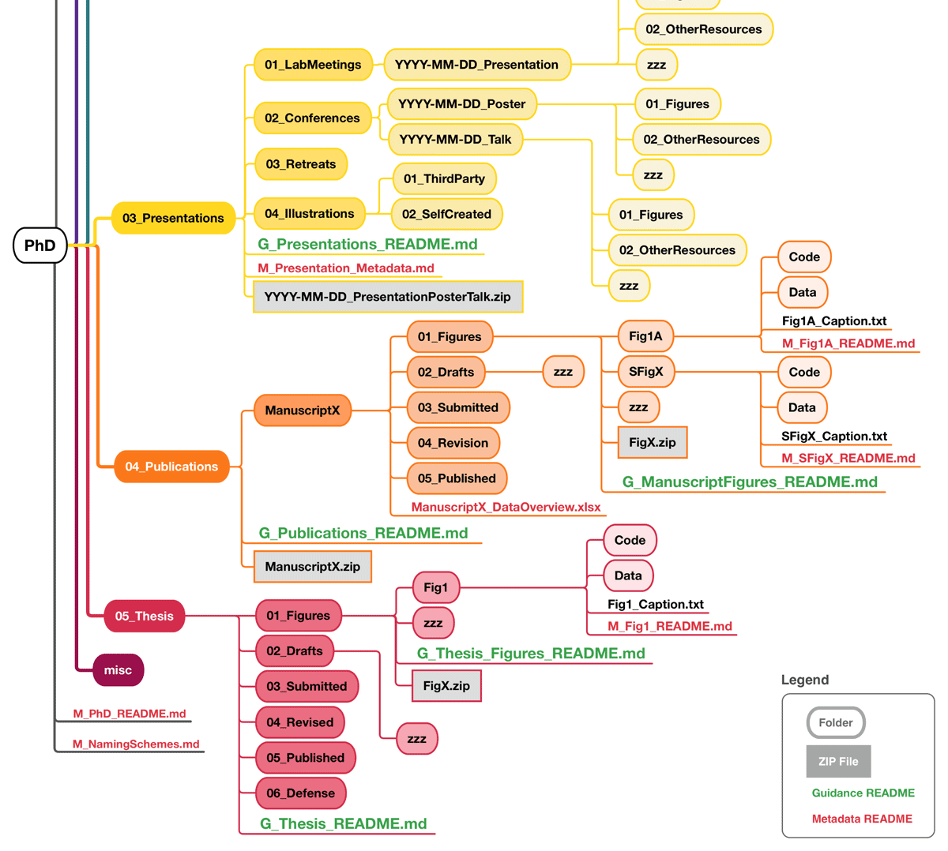
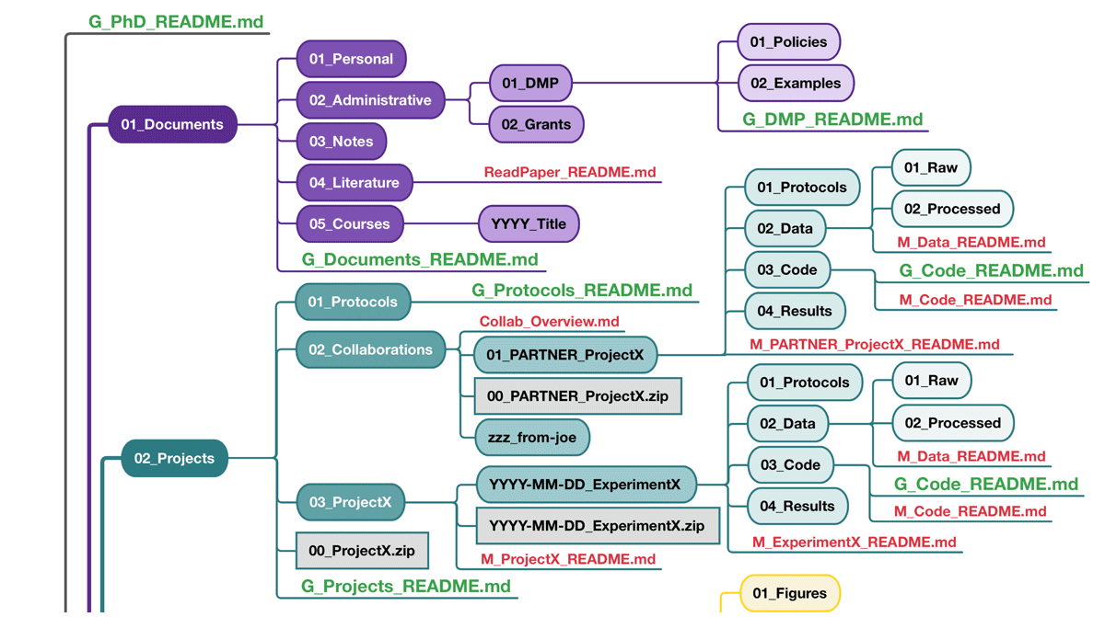
The Folder Structure Template by Demerdash, Dockhorn, and Wilbrandt
A copyright-free, publicly available resource downloadable at: https://github.com/RDMJeanne/FolderStructure
Image from: https://github.com/RDMJeanne/FolderStructure/blob/main/Illustrations/Fig2_FolderStructure.png
Notes:
Five sections for a PhD project
Folder names begin with numbers to place them in a specific order (not alphabetic)
READMEs at each folder level where they are necessary
General READMEs and Metadata READMEs

Slide 14
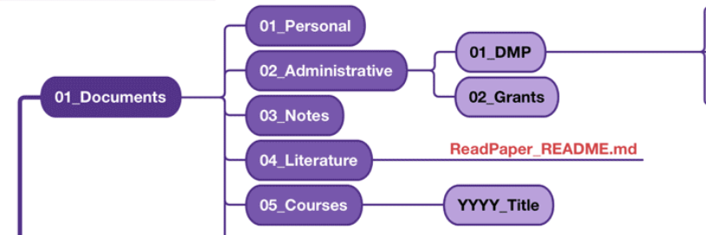
Top Level folder 01_Documents
Documents that are important to the project, but which do not include experimental results (i.e., data)
Documents Subfolders
  Note that the subfolders are numbered at the beginning of their names to make them line up in a particular order. This order is just an example; folders can be numbered in a way that makes most sense for your project.
    Personal: CVs, certificates, etc.
    Administrative: business trip forms, important administrative documents for the grant, etc.
      Note that grant information and DMPs (usually required by grants) can be stored here
    Notes
    Literature
    Courses
Notes:
The ReadPaper_README is a template which supports note-taking while reading scientific literature

Slide 15
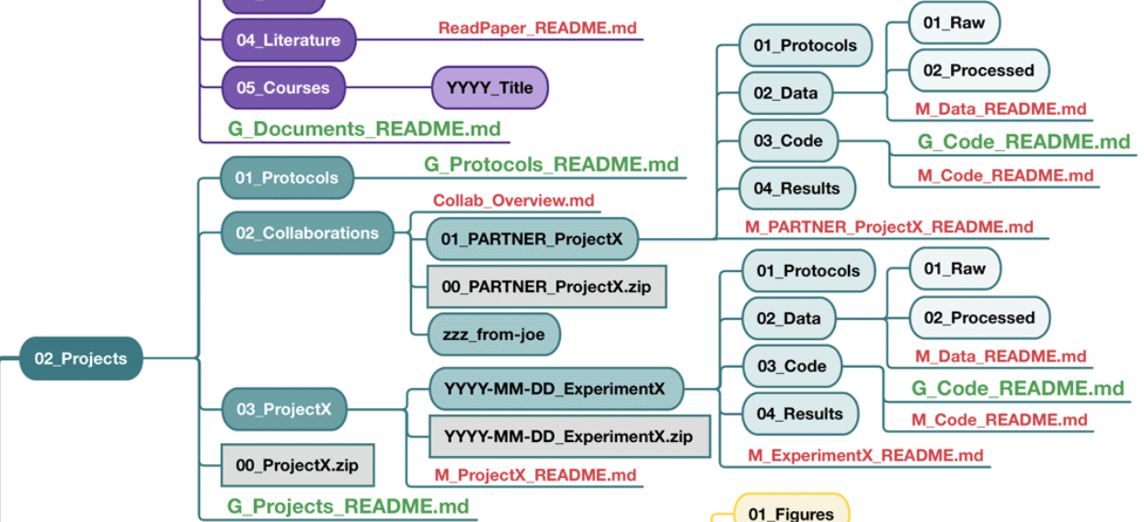
Top Level folder 02_Projects
Projects and its Subfolders
  Within Projects, the use of “ProjectX” subfolders is meant to support the “one Project, one Folder” system of organization.
    Protocols is a folder for general or frequently used protocols
    Collaborations sets up partner-driven projects in their own area. “Partner_ProjectX’s” break down from there
    Each Project (ProjectX) has its own folder, with each individual experiment with data, code, and specific protocol folders breaking down from there
Notes:
Guidance vs Metadata README differences: M_ProjectX_README.md, for example, is a metadata template designed to help the user record the metadata about the project that will be most relevant and useful to others, particularly when depositing materials related to this project into digital repositories..

Slide 16
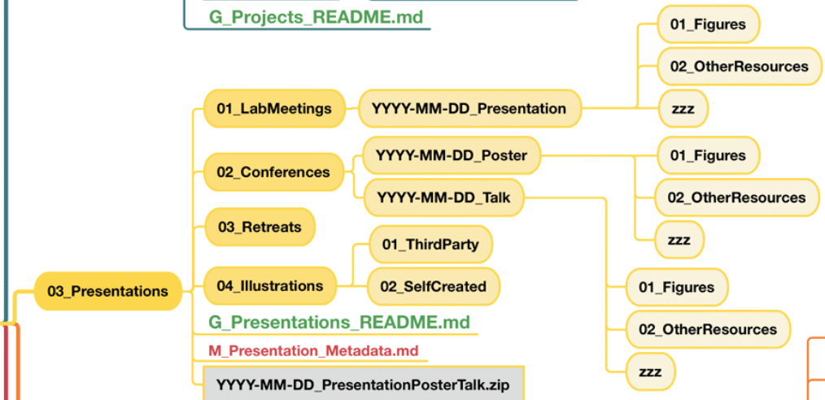
Top Level folder 03_Presentations
Presentations Subfolders
  Acknowledging the importance of presenting our work, a top-level folder is dedicated to Presentations.
    Lab Meetings
    Conferences
    Retreats
    Illustrations
    The specific folders under Presentations or its first level of subfolders may differ for your project, based on types and frequency of your presentation types. One helpful subfolder addition is the distinction between Third Party and Self Created illustrations for one’s presentations, which can help one better track rights and citation information.

Slide 17
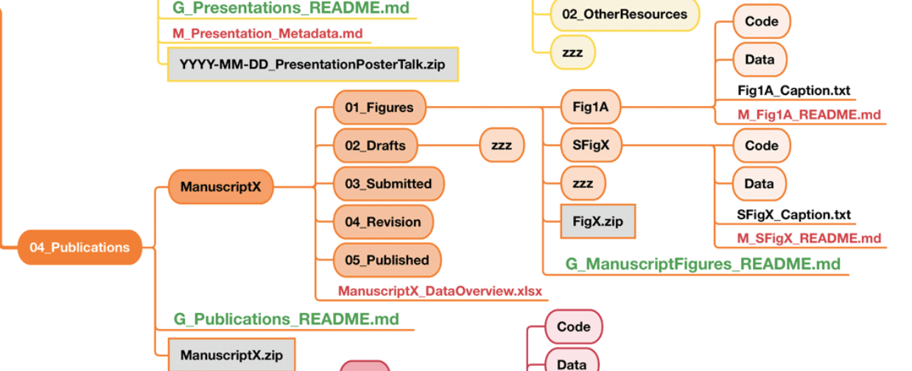
Top Level folder 04_Publications
Publications Subfolders
  Be mindful of potential overlaps between subfolder categories located here and in the Projects folder. Code and Data reproduced or copied here, for example, will likely be subsets of Code and Data from the Projects folder.
    Figures
    Draft
    Submitted
    Revision
    Published
    If there are multiple versions of the paper within the 02 – 05 subfolders, create dedicated folder or filenames for them beginning with the date in YYYYMMDD format.
Notes:
README files for the Figures can be key connectors between the Figures and the data that produced them.
We’ll not go into details about the Thesis folder here; it is a specialized type of Publication, and more information about this folder and its subfolders can be found in the source paper.

Slide 18


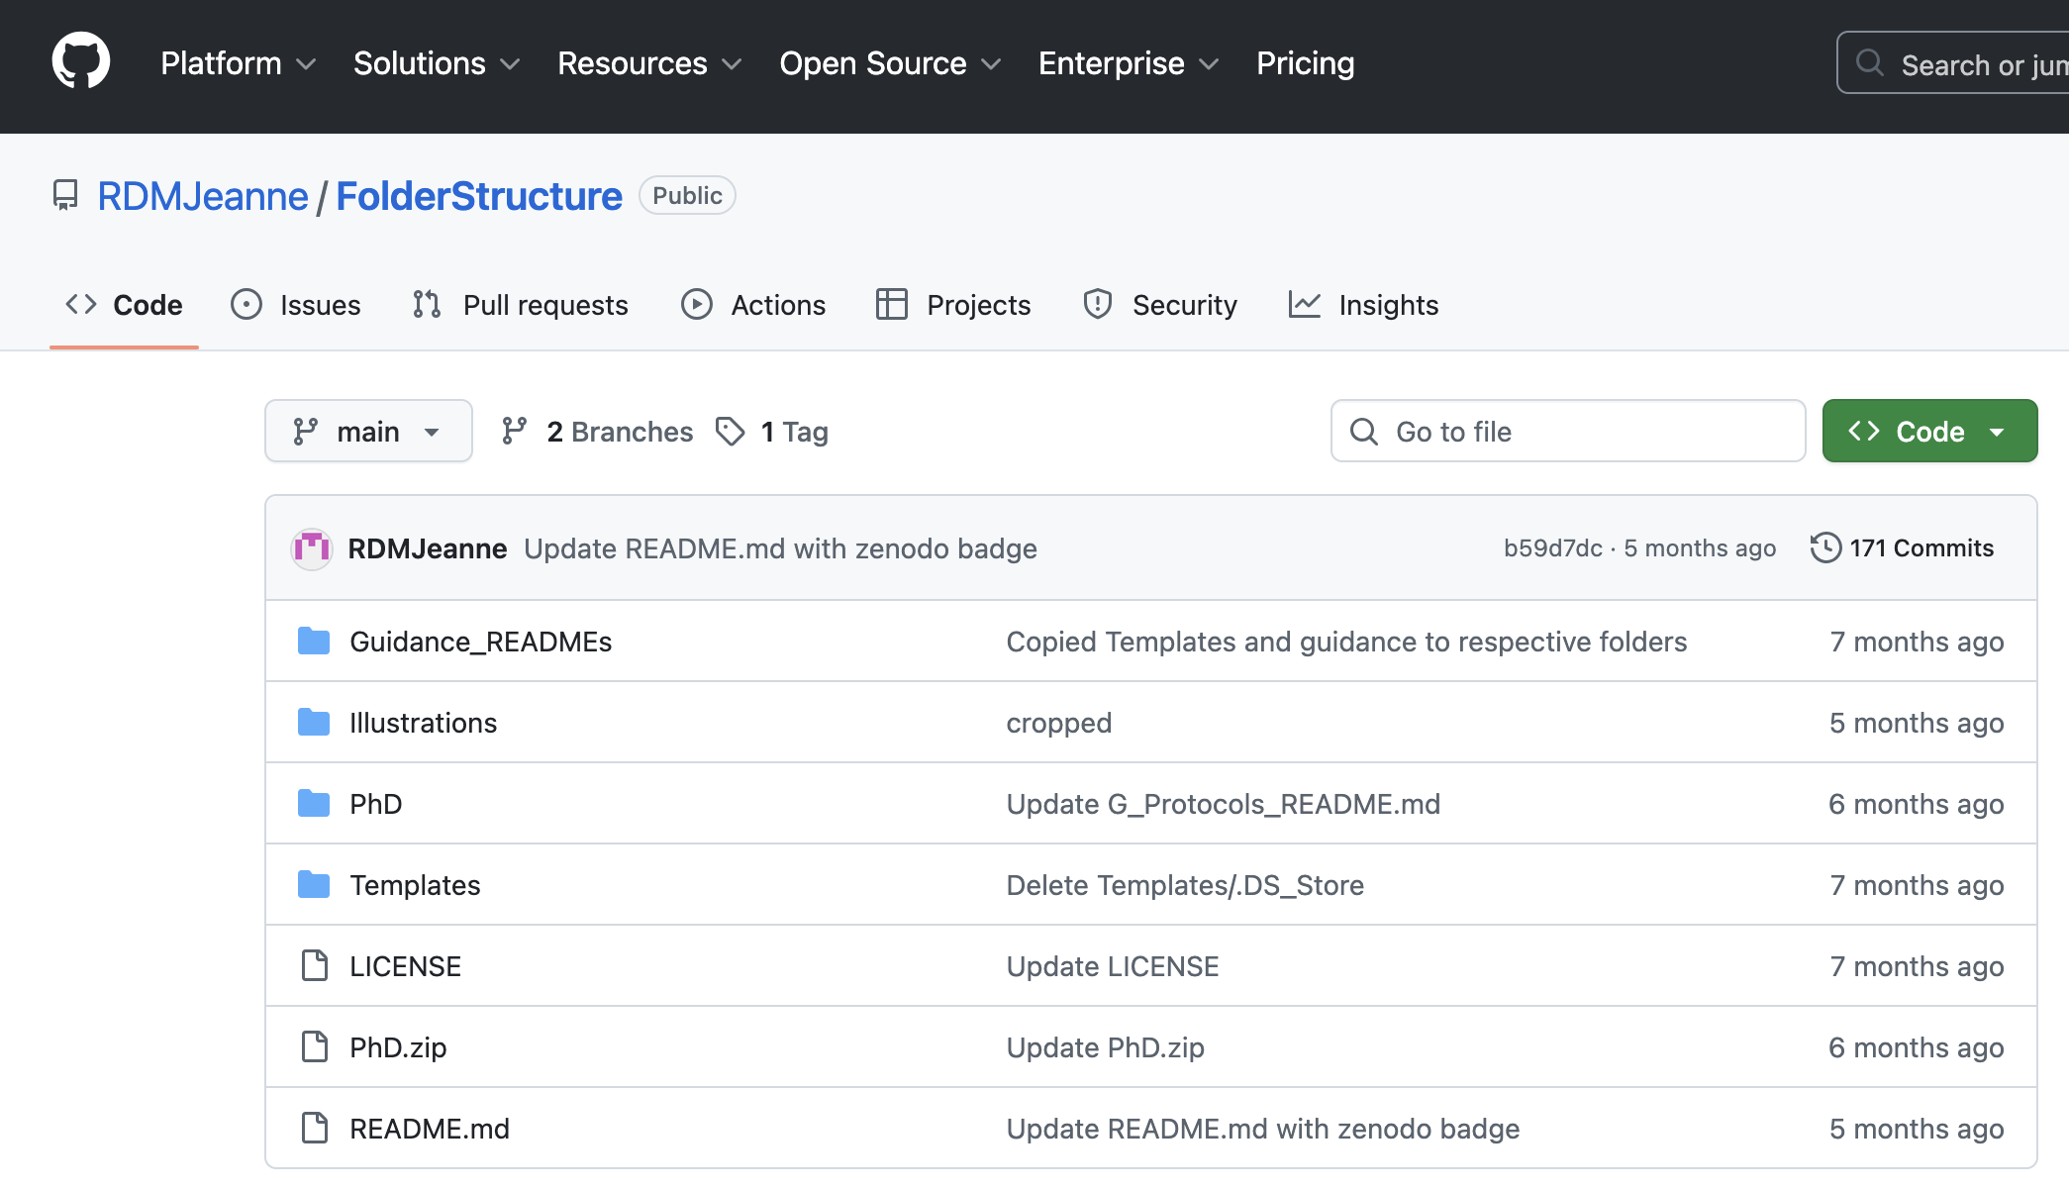


Contribute to the Folder Structure Template Project
https://github.com/RDMJeanne/FolderStructure
Naming Schemas
Download the Template, Cite, Create Issues, and More
GitHub Basics
    The entire Folder Structure Template may be downloaded from the green “Code” button at the top of the page as a Zip file
    The project is CC0, public and free
    Naming schemas: important for both file names and folder names
    Most folders in the FST: ##_<CONTENT>,
    README file schema: <TYPE>_<CONTENT>_README.md
Metadata READMEs
Guidance READMEs
    Provide an overview of their respective folder, best practices, further information, and references on the topic
Denoted with a "M_" starting the file name. They are used to provide mostly descriptive, administrative and legal information.

Slide 19
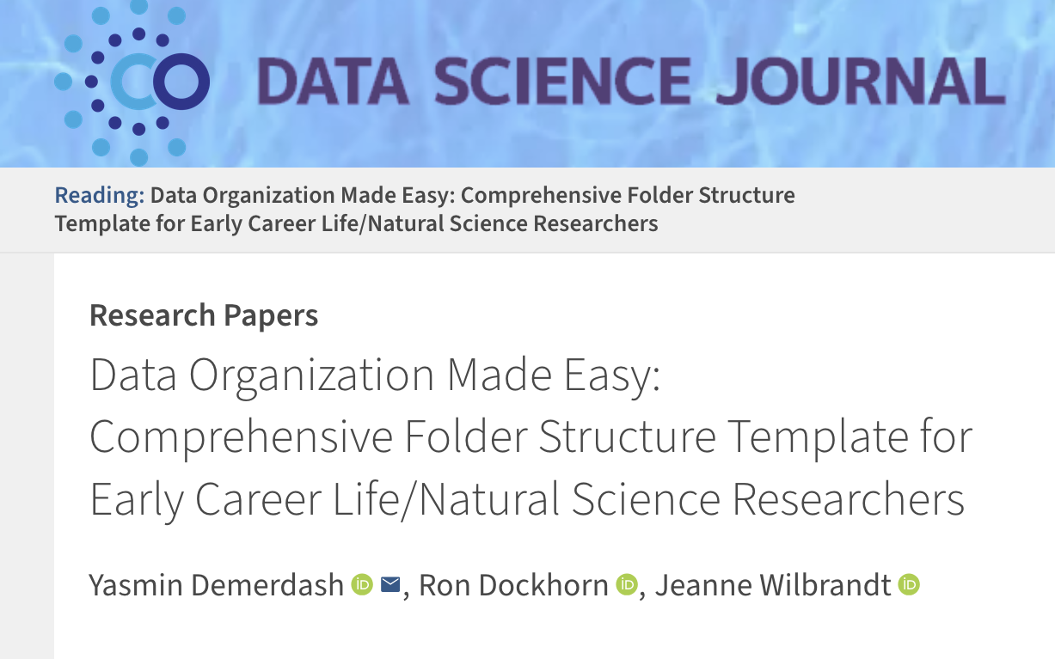
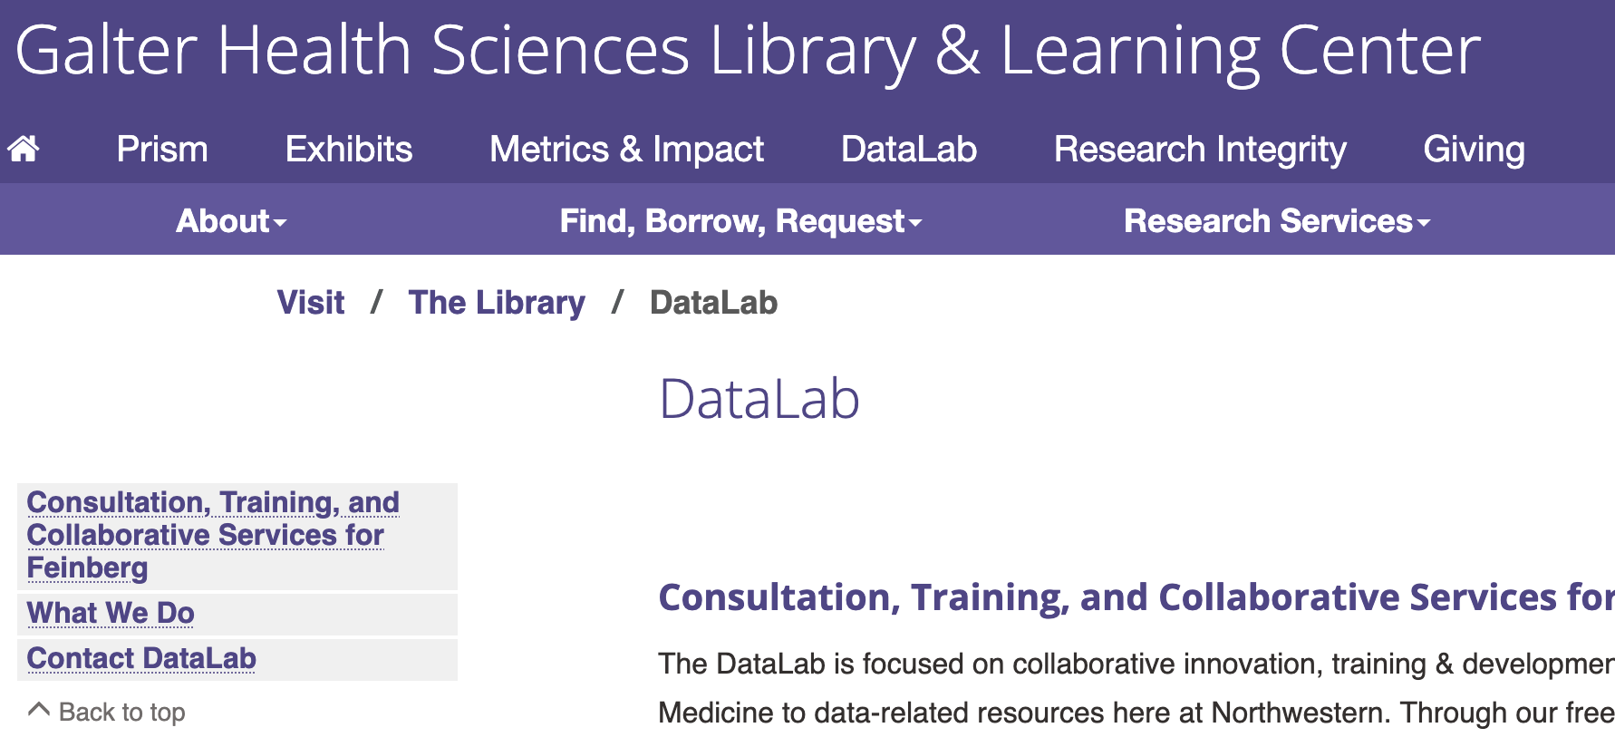
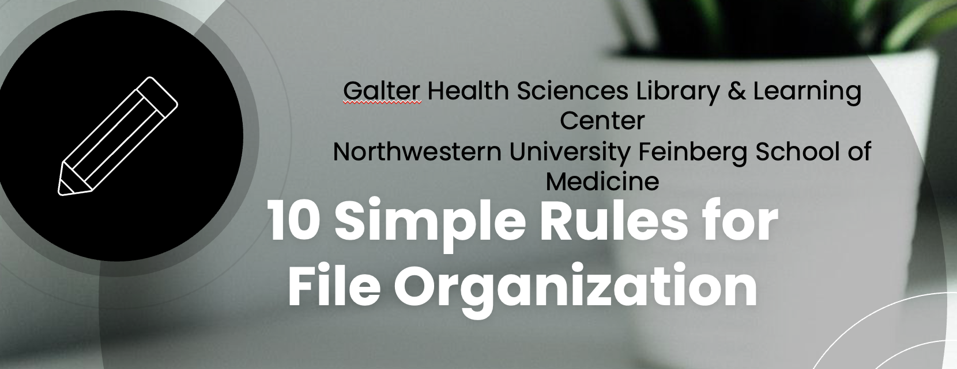
Questions?
For further information, see:
  Source Article
  Galter DataLab
  Precursor Workshop: 10 Simple Rules for File Organization
    Demerdash, Y., Dockhorn, R. and Wilbrandt, J. (2025) ‘Data Organization Made Easy: Comprehensive Folder Structure Template for Early Career Life/Natural Science Researchers’, Data Science Journal, 24(), p. 35. Available at: https://doi.org/10.5334/dsj-2025-035.
    galter.northwestern.edu/about/datalab
    Consultation, training, and support throughout all stages of the research lifecycle, including data sharing guidance
    Class page: galter.northwestern.edu/course_info/246
    Learn best practices in file naming, tips for batch re-naming, file shortcuts, and more

Slide 20
Thank you contact: sara.gonzales2@northwestern.edu

Slide 21
Credits
Cornell University Data Services – Writing READMEs for Research Data: https://data.research.cornell.edu/data-management/sharing/readme/
Demerdash, Y., Dockhorn, R., &amp; Wilbrandt, J. (2025). Data Organization Made Easy: Comprehensive Folder Structure Template for Early Career Life/Natural Science Researchers. Data Science Journal, 24(), 35. https://doi.org/10.5334/dsj-2025-035
Harvard University’s Longwood Research Data Management resources on README files, with template: https://datamanagement.hms.harvard.edu/collect-analyze/documentation-metadata/readme-files
Hollmann S, Frohme M, Endrullat C, Kremer A, D’Elia D, Regierer B, et al. (2020) Ten simple rules on how to write a standard operating procedure. PLoS Comput Biol 16(9): e1008095. https://doi.org/10.1371/journal.pcbi.1008095
Library Carpentry - Tidy data for librarians: https://librarycarpentry.github.io/lc-spreadsheets/
NIH Grants & Funding. Data Management. FAIR Principles: https://grants.nih.gov/policy-and-compliance/policy-topics/sharing-policies/dms/data-management#fair-principles
University of Utah’s concise description of README documents specifically for file and folder organization: https://campusguides.lib.utah.edu/c.php?g=997634&p=7221520
Wilbrandt, J. (2025, September 12). Love your Data! Kickstarting Data Organization with a Dedicated Folder Template. 117th Annual Meeting of the German Zoological Society (DZG 2025), Berlin. Zenodo. https://doi.org/10.5281/zenodo.17106008

