Slide 1
The Impact of Open Access on Scientific Discovery & Publishing
Publishing Issues for Researchers
Seminar Series
Pamela Shaw, MSLIS
Biosciences Librarian

Slide 2
What is Open Access?
Commonly accepted definition
Budapest Open Access Initiative led to working definition from the Bethesda Meeting on Open Access Publishing
http://www.earlham.edu/~peters/fos/bethesda.htm
The PLoS shorthand definition —"free availability and unrestricted use“
“Open Access” generally for manuscripts, but applies to data as well

Slide 3
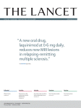
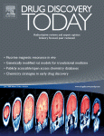
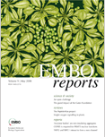





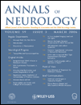
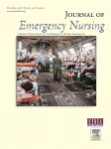
It’s an issue for…
Librarians
  ARL and SPARC
Publishers
Scientists

Slide 4
Why should we care?
Discipline | Average Price Per Title | Percent increase since 2005
Chemistry | $3,690 | 32
Physics | $3,252 | 28
Engineering | $2,047 | 34
Biology | $1,980 | 37
Technology | $1,950 | 33
Astronomy | $1,781 | 35
Geology | $1,632 | 33
Botany | $1,581 | 36
Zoology | $1,510 | 45
Math & Computer Science | $1,472 | 26
Health Sciences | $1,401 | 41
Food Science | $1,390 | 33
General Science | $1,174 | 35
Geography | $1,145 | 32
Agriculture | $1,089 | 32
Source: Periodical Price Survey 2009, Library Journal website

Slide 5
Some history of Open Access
1600s – Scientific journal created
http://www.earlham.edu/~peters/fos/timeline.htm
Or, updated:
http://oad.simmons.edu/oadwiki/Timeline
1966. MEDLINE launched by the National Library of Medicine (but not free until 1997)
August 16, 1989. The Public-Access Computer Systems Review launched by Charles W. Bailey, Jr. (An early free online journal with a peer-reviewed section starting in April 1992.)

Slide 6
Some history of Open Access
August 16, 1991. arXiv launched by Paul Ginsparg
1992. Entrez launched by the National Center for Biotechnology Information (on CDs, not free until 1993), GenBank launched by the National Center for Biotechnology Information
1994. Digital Libraries Initiative launched by the National Science Foundation and other U.S. federal agencies; the Human Genome Project launched its open-access web site.

Slide 7
Some history of Open Access
June 26, 1997. The National Center for Biotechnology Information launched PubMed. At the same time, MEDLINE content, already online, became free when incorporated into PubMed.
June 1998. Scholarly Publishing and Academic Resources Coalition (SPARC) launched by ARL
February 2000. PubMed Central (free full-text articles) launched to supplement PubMed (free citations and abstracts); July 19, 2000. BioMed Central published its first free online article

Slide 8
Some history of Open Access
October 13, 2003. The Public Library of Science launched its first open-access journal, PLoS Biology
May 15, 2002. Creative Commons launched by Lawrence Lessig; August 1, 2002. Project SHERPA (Securing a Hybrid Environment for Research Preservation and Access) launched by JISC-FAIR

Slide 9
Some history of Open Access
2003. Budapest, Bethesda and Berlin statements on Open Access created
November 18, 2004. Google announced the launch of Google Scholar
December 26, 2007. Congress passed, and the President signed, a spending bill mandating OA to research funded by the US National Institutes of Health (NIH)
September 2009. Compact for Open-Access Publishing Equity established to encourage university support for authors publishing in OA journals

Slide 10
Many models of Open Access
Author pays
  $2,900 for PLoS Medicine and $2035 for BMC Medicine
    (but BMC Medicine does offer a 15% discount to NU authors)
Sponsored articles
  Hybrid model. Author or institution pays a fee to allow immediate access to article published in a licensed journal
Delayed access
  Publishers keep literature behind the license for a period (often 12 months) then make it freely available
Archiving
  a.k.a public access. Institutional repository makes manuscript available. (e.g. PubMed Central or universities’ institutional repositories)

Slide 11
The debate (?)
“Here's the central conundrum of the open access debate: you can't find anyone who's actually opposed to it. Really.”
  Meredith Salisbury. Genome Technology, 2008

Slide 12



Advocates
Harold Varmus
PLoS
Peter Suber
SPARC
Michael Eisen
Open access: the sooner the better.
Eisen M, Salzberg S.
Science. 2009 Jul 17;
325(5938):266; author reply 266-7.
PMID: 19608896

Slide 13
Critics
McMullan E. J Neuroophthalmology. 2008. Open access mandate threatens dissemination of scientific information. Mar;28(1):72-4.
  …"open access" to copyrighted articles through a government Web site could result in a reduction of financially sustainable peer-reviewed journals and a reduction in the overall quality of articles available as publishers, societies, and authors are forced to hand over their intellectual property or restrict the peer review process because of lost sales opportunities…

Slide 14
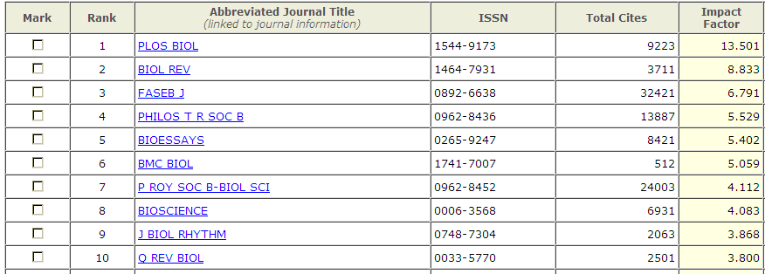
Quality
The ubiquitous Impact Factor

Slide 15
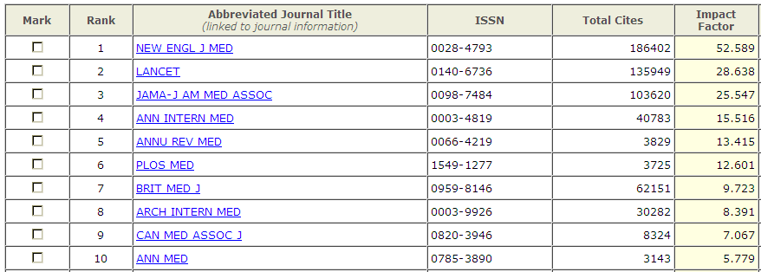
Quality

Slide 16
A big journal weighs in
ScienceBlogs
The article
PLoS stays afloat with bulk publishing
Science-publishing firm struggles to make ends meet with open-access model.
Declan Butler
  Public Library of Science (PLoS), the poster child of the open-access publishing movement, is following an haute couture model of science publishing — relying on bulk, cheap publishing of lower quality papers to subsidize its handful of high-quality flagship journals.
Nature 454, 11 (2008)

Slide 17
The future
More funding agencies requiring deposit to repositories such as PMC
Separation of publication instance from peer review
“So far, the OA movement does not pose much of a threat to the large subscription journals because both readers and authors continue to submit and subscribe to them”
  Xavier Bosch EMBO Rep. 2008

Slide 18
How to pay???
Grant funding
Collective agreements:
  http://www.oacompact.org/compact/

Slide 19


The successes: OA to data - Sequences
And more…

Slide 20




The successes: OA to data –Microarray and sequencing data

Slide 21
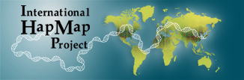

The successes: OA to data –Population and cancer project data

Slide 22
Resources
SPARC
  http://www.arl.org/sparc/index.shtml
Directory of Open Access Journals
  https://doaj.org/
Creative Commons
  http://creativecommons.org/
Science Commons
  http://sciencecommons.org/
Galter Library’s Open Access Guide
  http://www.galter.northwestern.edu/Guides-and-Tutorials/Open-Access-Resources-Guide
Northwestern University Library’s Scholarly Communications Website
  http://www.library.northwestern.edu/services/scholarly_communications/

Slide 23
Sources Cited
Association of Research Libraries. Retrieved 10/19/2009, from http://www.arl.org/.
Scholarly Publishing and Academic Resources Coalition (SPARC). Retrieved 10/15/2009, from http://www.arl.org/sparc/.
Bosch, X. (2008). "An open challenge. Open access and the challenges for scientific publishing." EMBO Rep 9(5): 404-8.
Butler, D. (2008). "PLoS stays afloat with bulk publishing." Nature 454(7200): 11.
Castillo, M. (2008). "Citations and Open Access: Questionable Benefits." AJNR Am J Neuroradiol.
McMullan, E. (2008). "Open access mandate threatens dissemination of scientific information." J Neuroophthalmol 28(1): 72-4.
Salisbury, M. (2008). "Ready or not, here comes open access." Genome Technology November(89): 40-46.
Suber, P. "Timeline of the Open Access Movement.” http://www.earlham.edu/~peters/fos/timeline.htm.
VanOrsdel, L. C. and K. Born. (Library Journal, 4/15/2009). "Reality Bites: Periodicals Price Survey 2009.” http://www.libraryjournal.com/article/CA6651248.html?q=periodical+price+survey
Wren, J. D. (2005). "Open access and openly accessible: a study of scientific publications shared via the internet." BMJ 330(7500): 1128.

