Slide 1

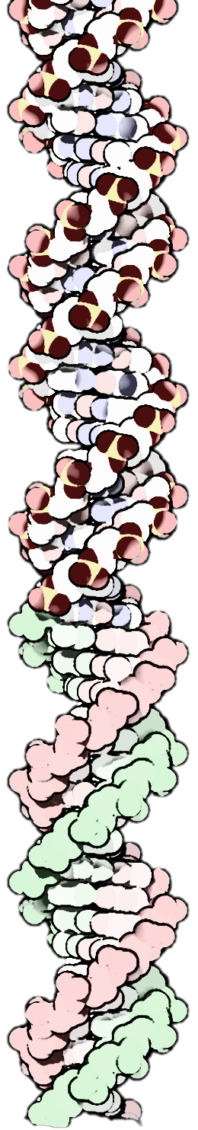
From talking dogs to personalized medicine: The weird and wonderful history of inheritance and pharmacogenomics from pups to people
Pamela L Shaw
Biosciences & Bioinformatics Librarian
Galter Health Sciences Library

Slide 2
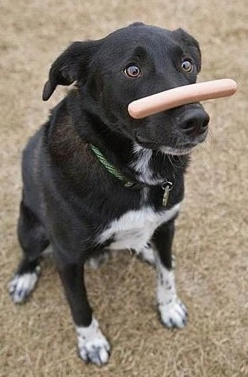
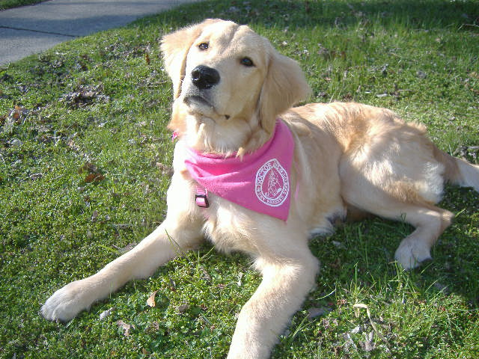
Be patient!
Genomics and evolutionary primer before therapy dog cuteness

Slide 3

Thanks to our sponsors
Consumer & Patient Health Information Section
Cosponsors
  Veterinary Medical Libraries Section, Complementary and Alternative Medicine SIG
Mary-Katherine Haver & Kelli Ham

Slide 4

Why is the dog so important?

Slide 5
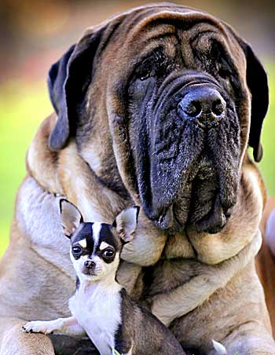
Diversity
Arguably more range and diversity in the dog than any other species
  By weight alone
    Chihuahua ≥ 2 lbs
    English Mastiff ≤ 250 lbs
  (AKC breed standards; not accounting for “world’s largest” or teacup breeds)¹⁻²

Slide 6
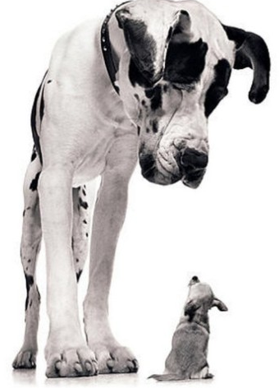
Diversity
Arguably more range and diversity in the dog than any other species
  By height alone
    Chihuahua ≥ 6 inches
    Great Dane average 40 inches
  (AKC breed standards; not accounting for “world’s largest” or teacup breeds)¹

Slide 7
A “pet” project of mine since 2008

Slide 8
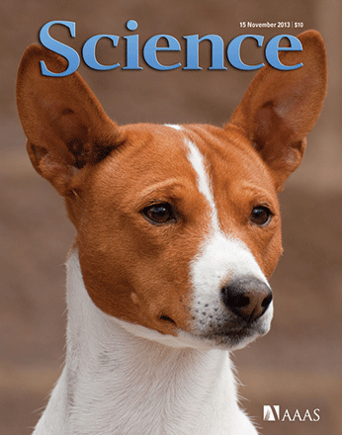
Domestication
Relationship with humans = parallel evolution
  100,000 years ago?³
  Ca. 10,000 years ago during Agricultural Revolution⁴
  Between 18,800 – 32,000 years ago during hunter-gatherer phase
    East Asia?⁵
    Europe?⁶

Slide 9
History of the genome & evolution

Slide 10


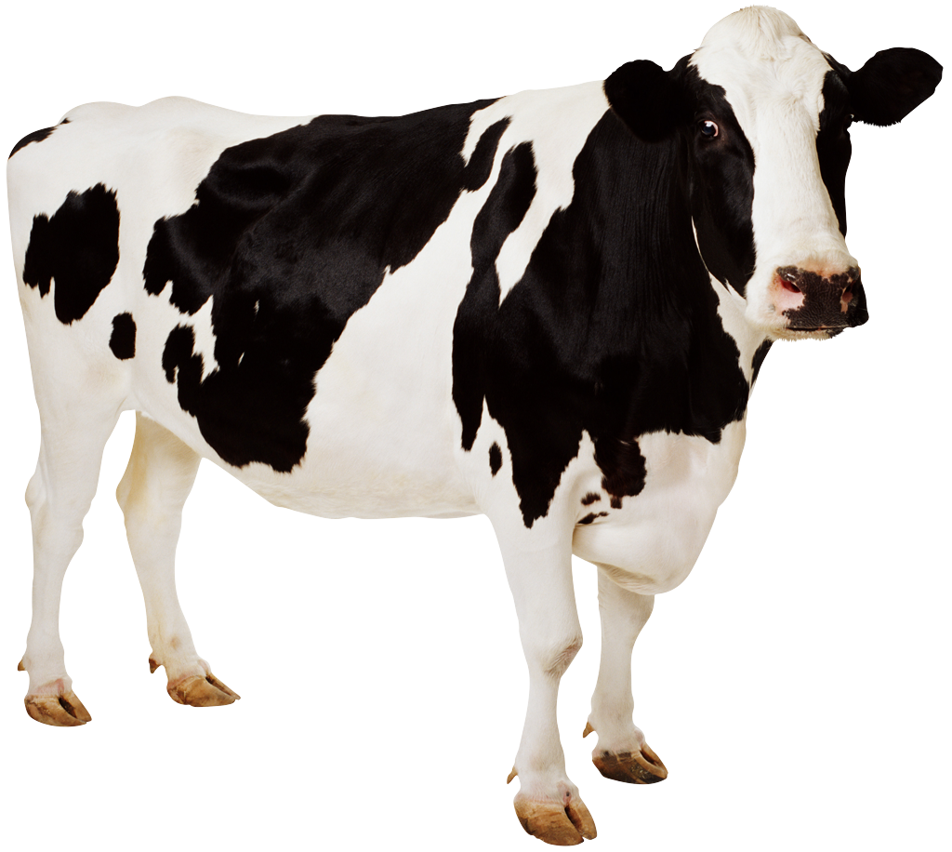
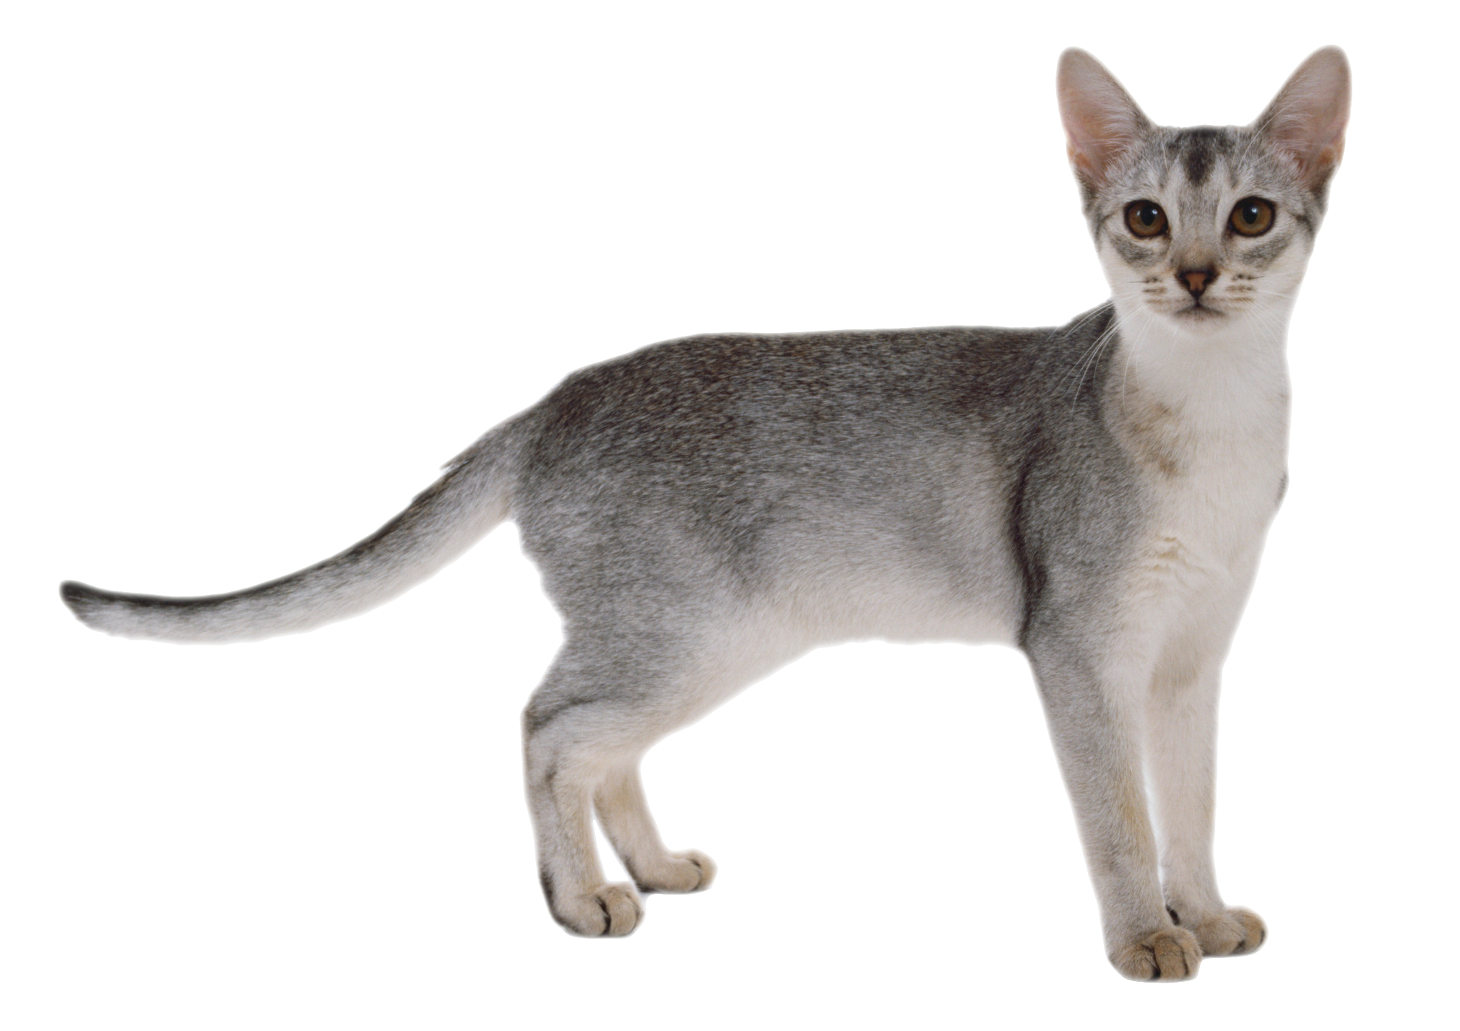
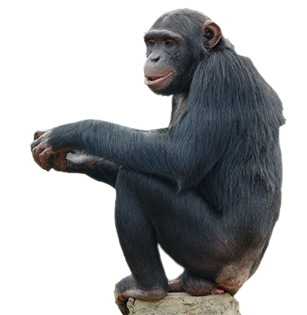
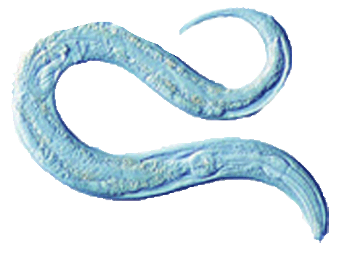
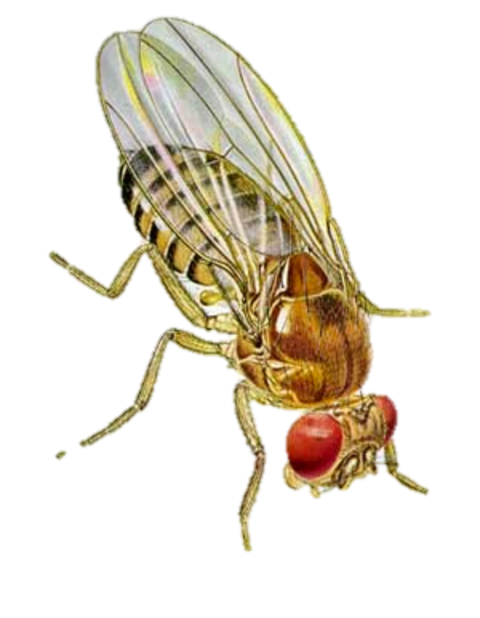
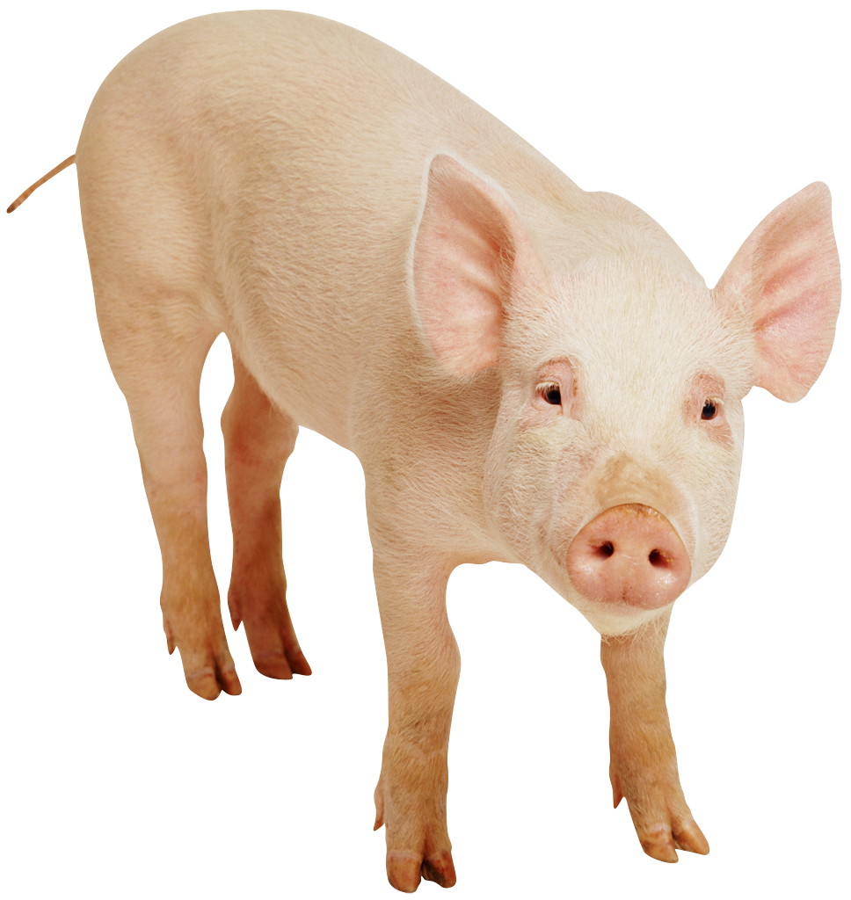

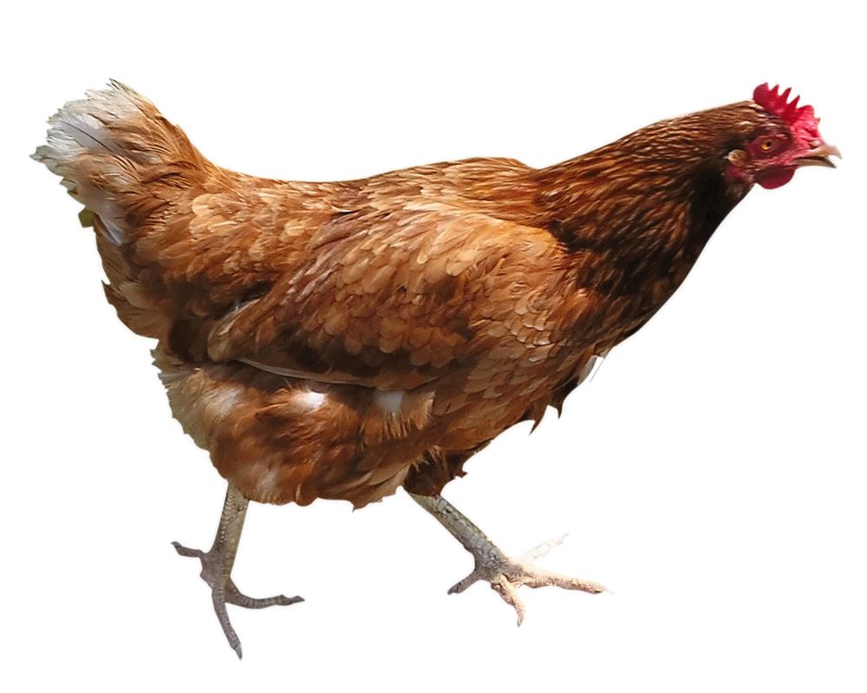
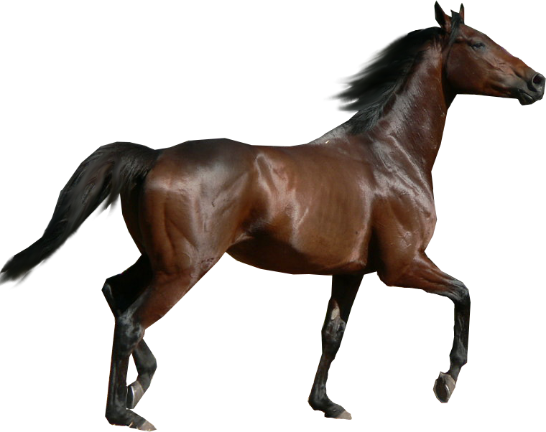
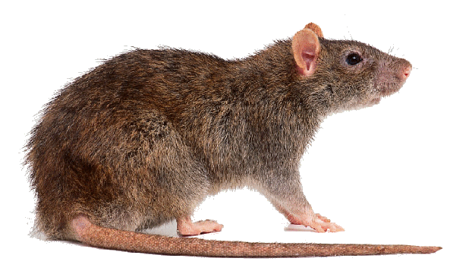
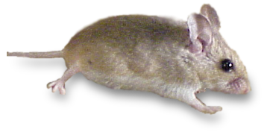
Comparative timeline with other model organisms and selected others
3/12/02
Dog
7/10/04
C. elegans
12/03/01
4/27/06
4/24/09
1999 2002 2004 2006 2009
12/6/03
2/28/04
Drosophila m.
4/30/02
Yeast
11/8/1999
7/11/08
11/27/02
9/2/04
1/24/07

Slide 11
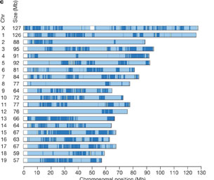
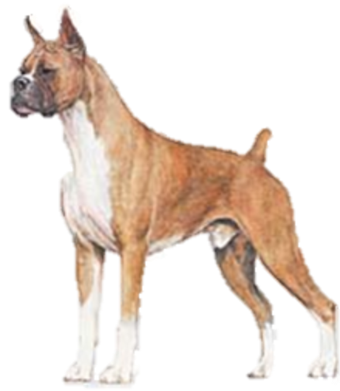
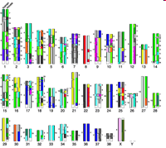
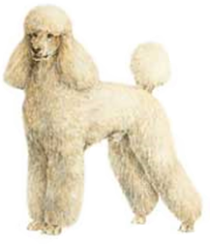


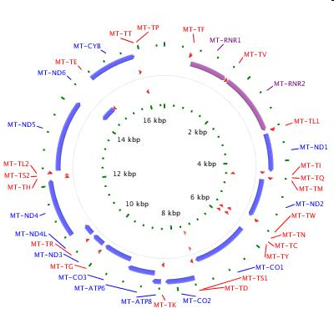
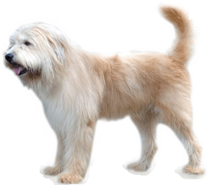
of characterizing the domestic dog genome
Steps in the history
Published sequence of Boxer
(along with comparison to 10 other breeds and other canidae)
Dec. 2005¹⁰
Survey sequencing of Standard Poole
Sept. 2003⁹
Radiation hybrid map of mongrel dog
Apr. 2003⁸
mtDNA of Sapsaree sequenced
1998⁷

Slide 12
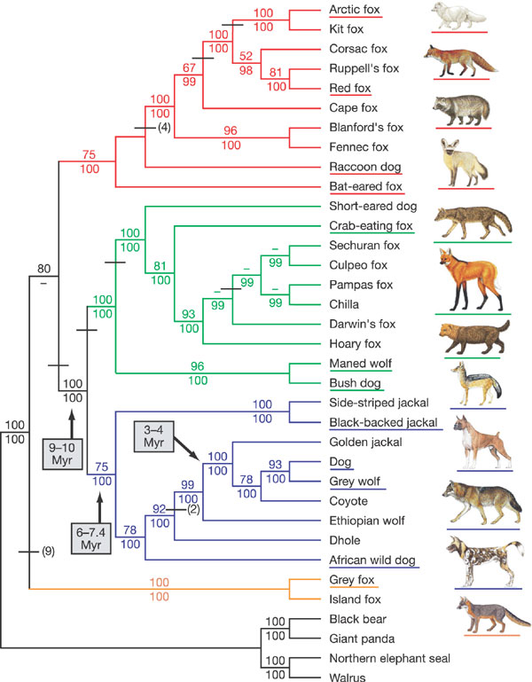
Canid species
Lindblad-Toh, et al. 2005¹⁰

Slide 13
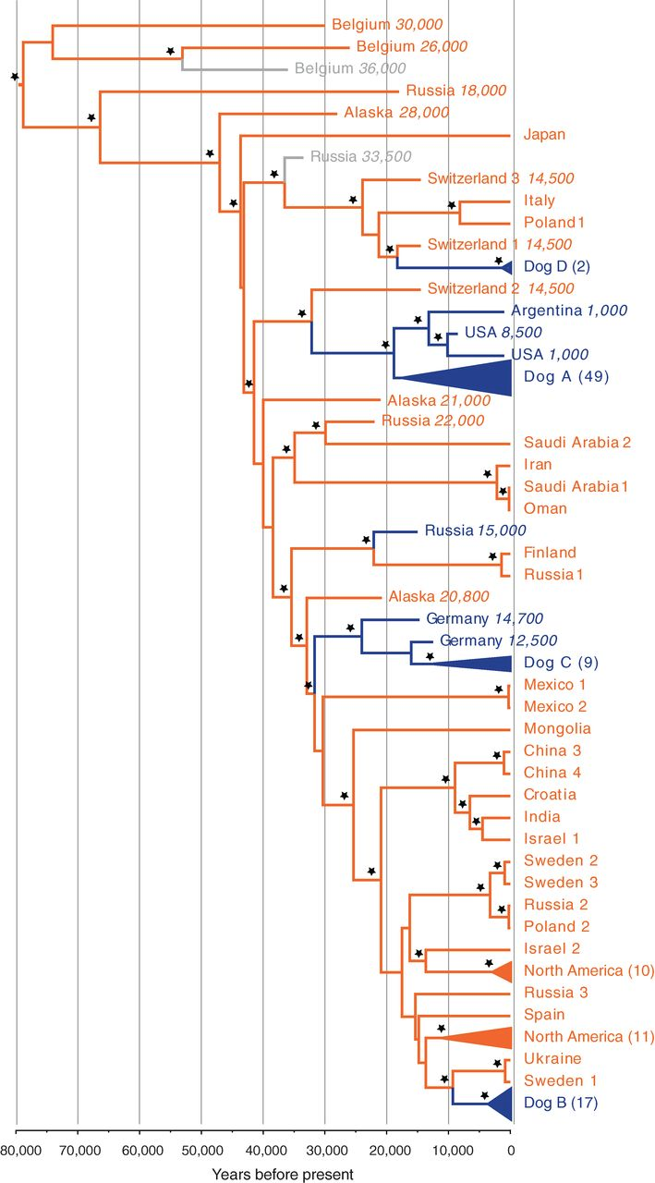
Wolf to domestic dog tree
Thalmann, et al. 2013⁶
Orange = wolves
Blue = Dogs

Slide 14
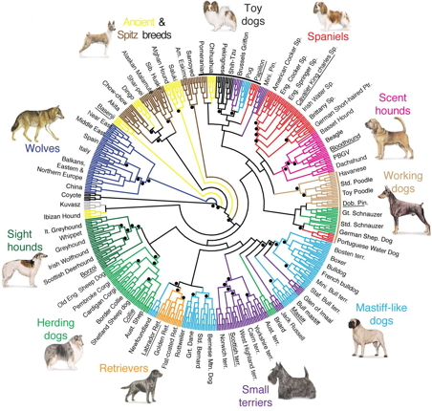
People have gone crazy with phylo trees for domestic dog breeds

Slide 15
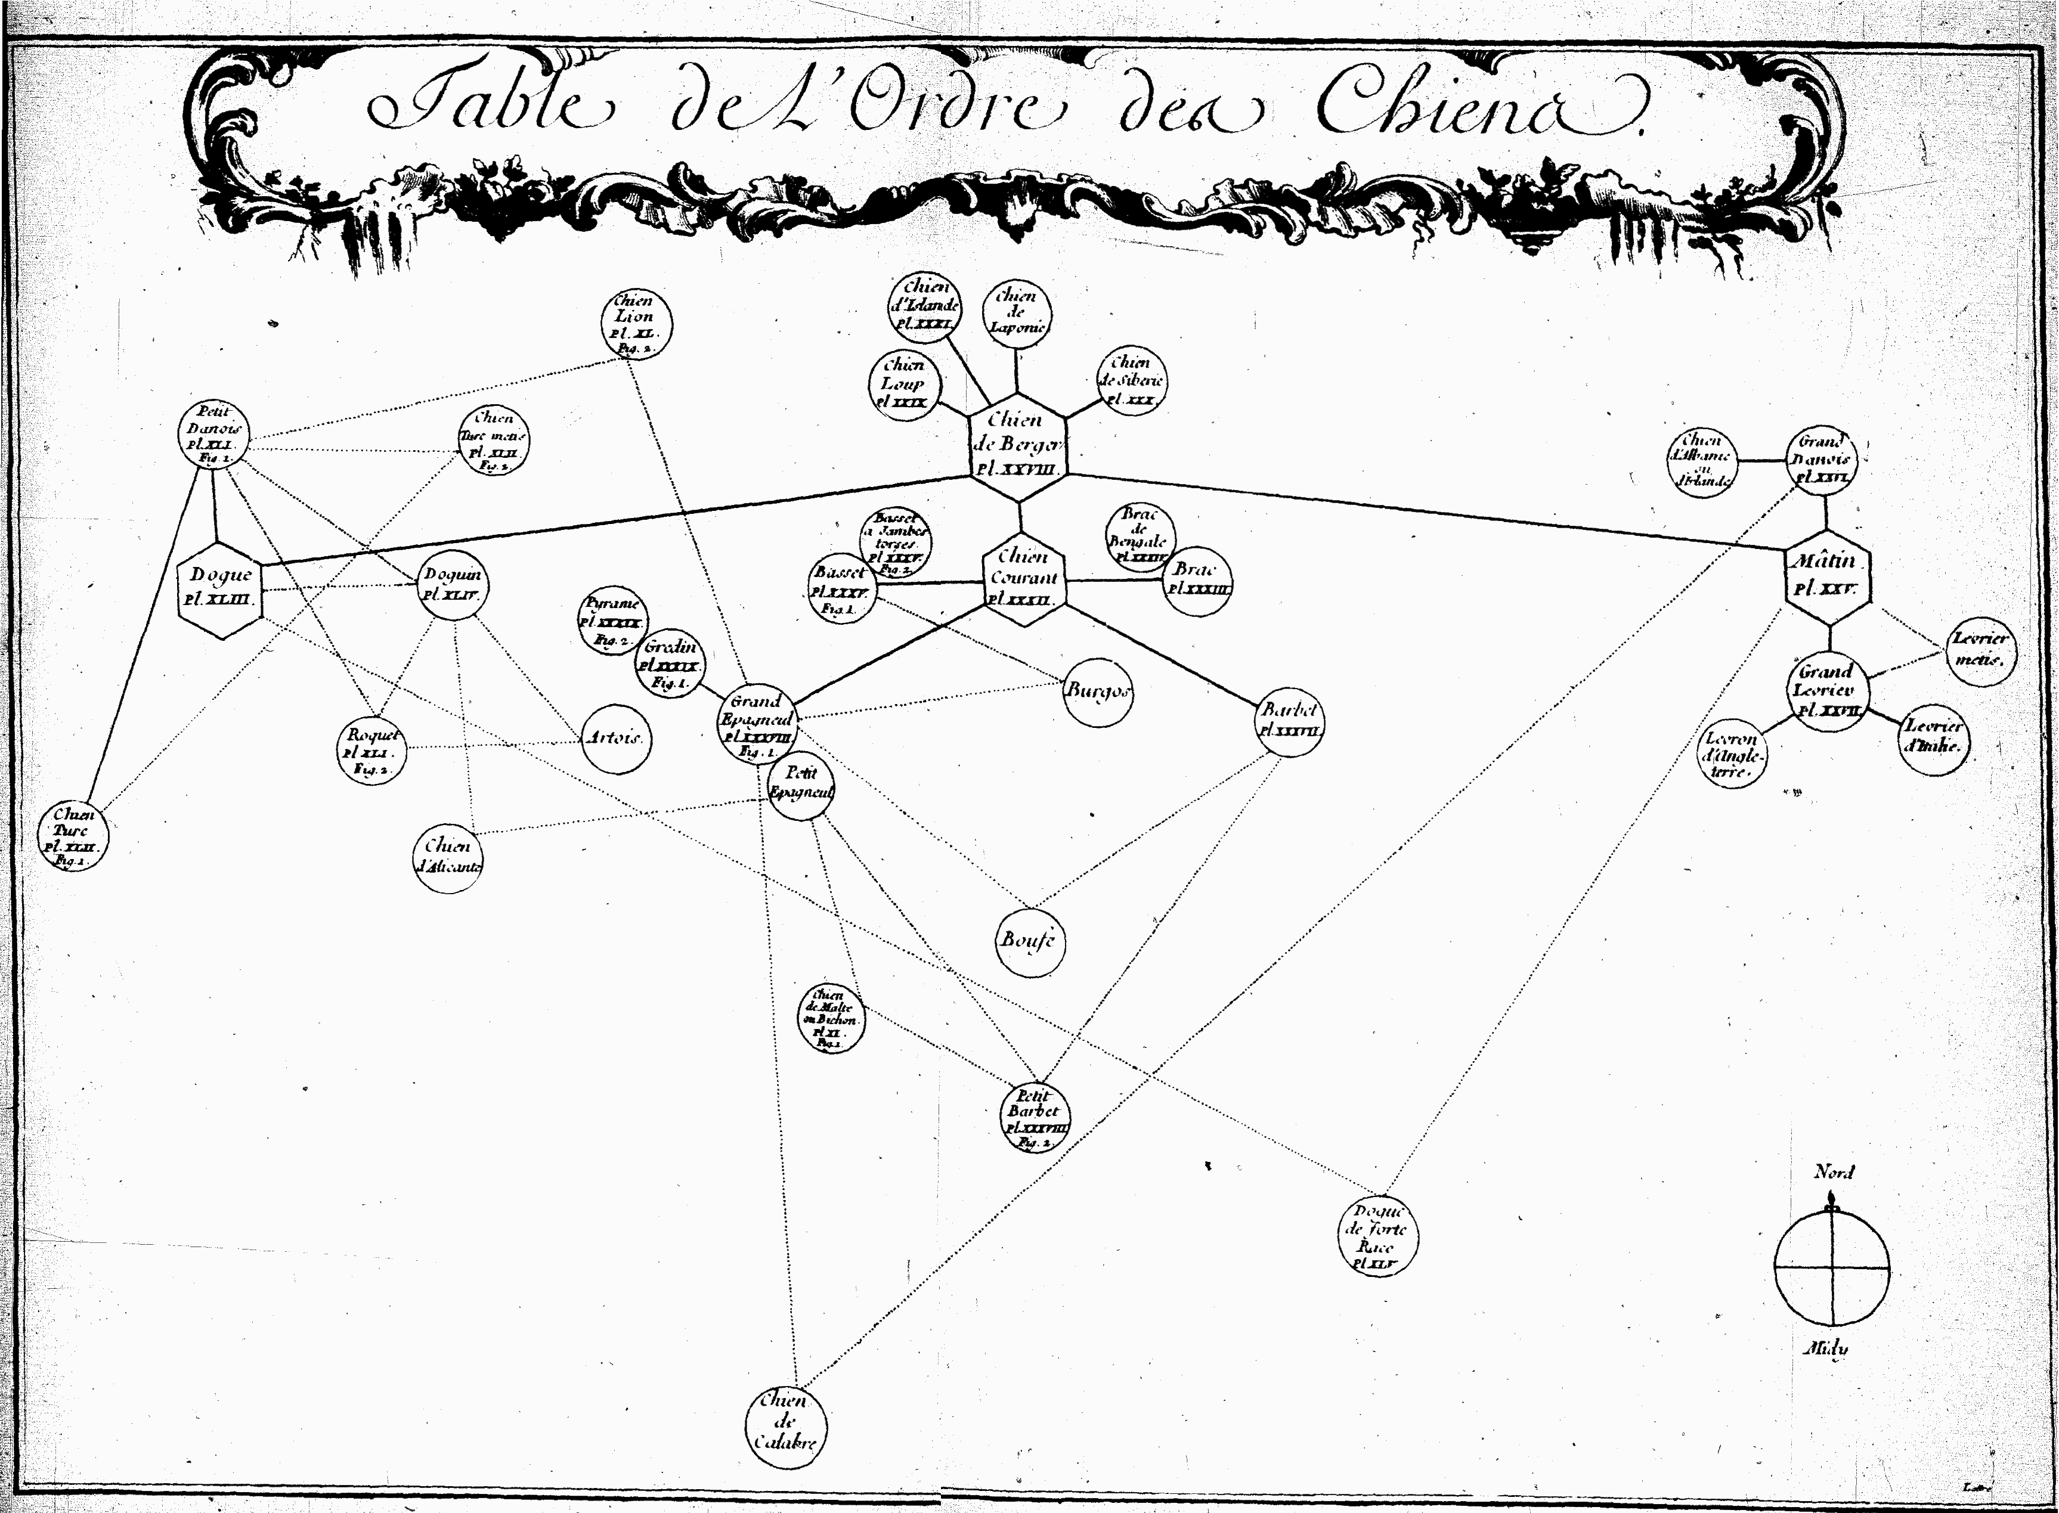
But it’s just not that simple¹¹

Slide 16
Genetics of traits and disease in the dog

Slide 17
Parallel selection in humans and dogs
  Positive natural selection for genes in humans and dogs⁵
  Metabolism & digestion
  Neurological development
  Cancer genes

Slide 18
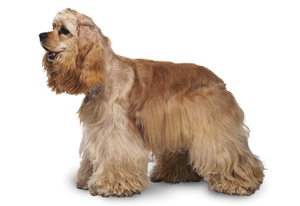
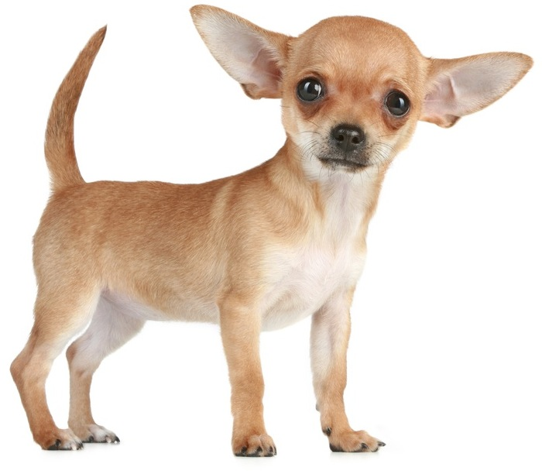
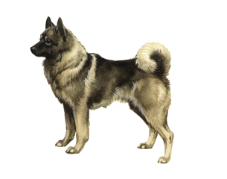
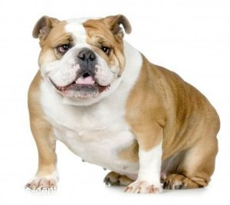
Direct human influence (breeding)

Slide 19
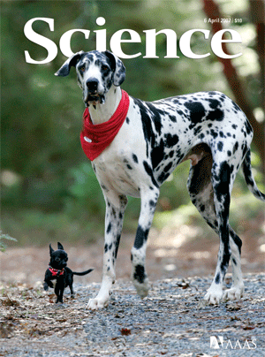
Genetics of height
  “A single IGF1 single-nucleotide polymorphism haplotype is common to all small breeds and nearly absent from giant breeds, suggesting that the same causal sequence variant is a major contributor to body size in all small dogs.”¹²

Slide 20
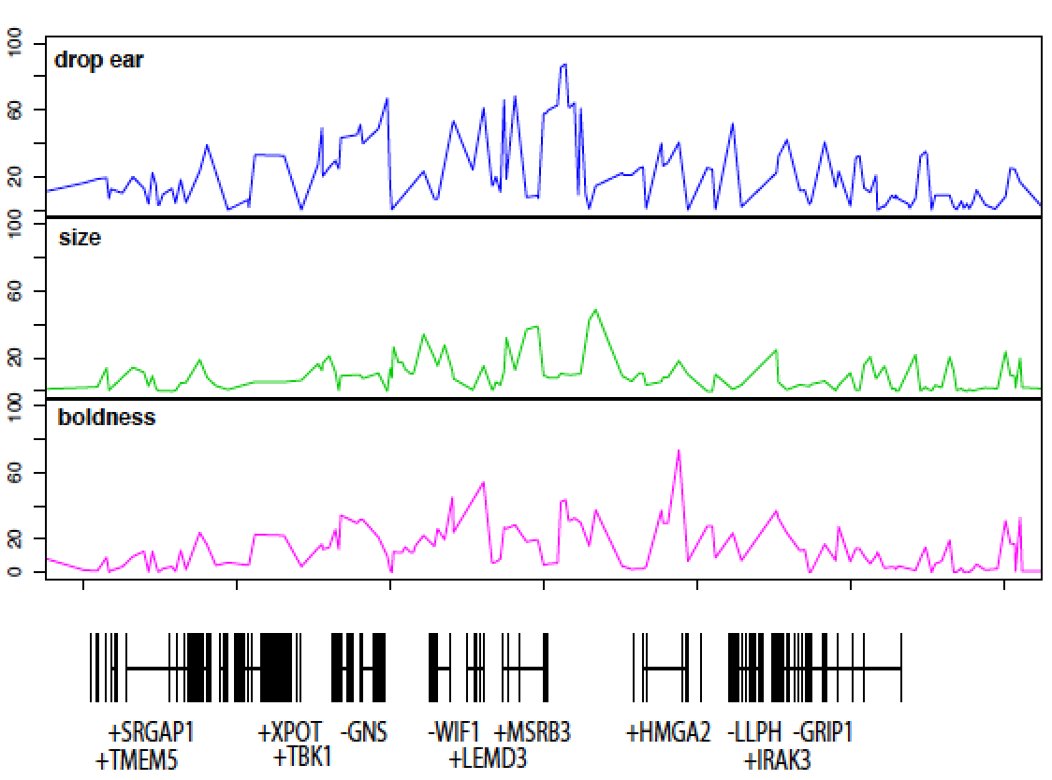
Dropped ears on Chromosome 10
…also dropped boldness?
  “All prick eared and small dogs were classified as bold in the dataset, whereas all drop eared dogs were classified as non-bold, with the exception of Bernese Mountain Dog.”¹³

Slide 21
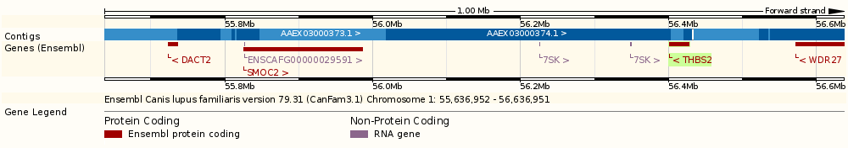
Brachycephaly
  2 regions on chromosome 1¹⁴
  THBS2
    Bone and cartilage development
  SMOC2
    Extracellular matrix interactions

Slide 22
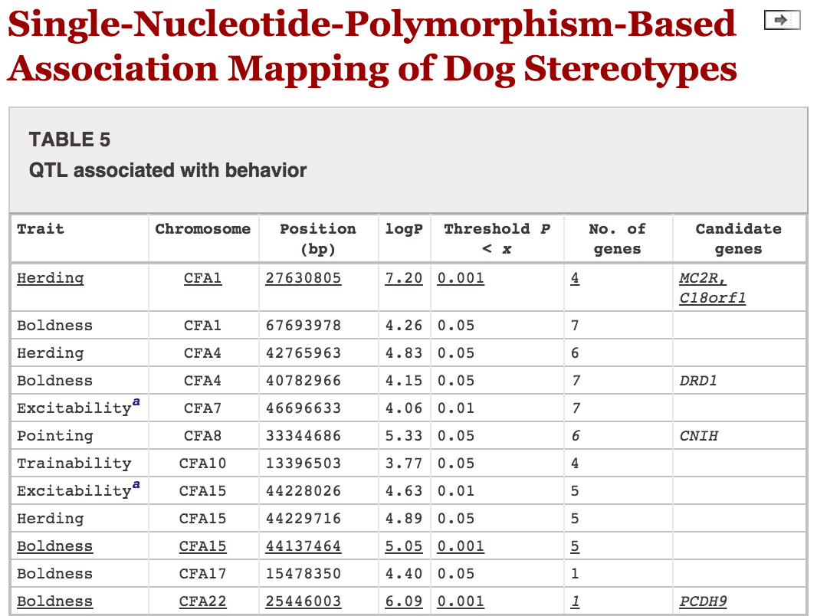
Behavior – what about those “talking dogs”?

Slide 23
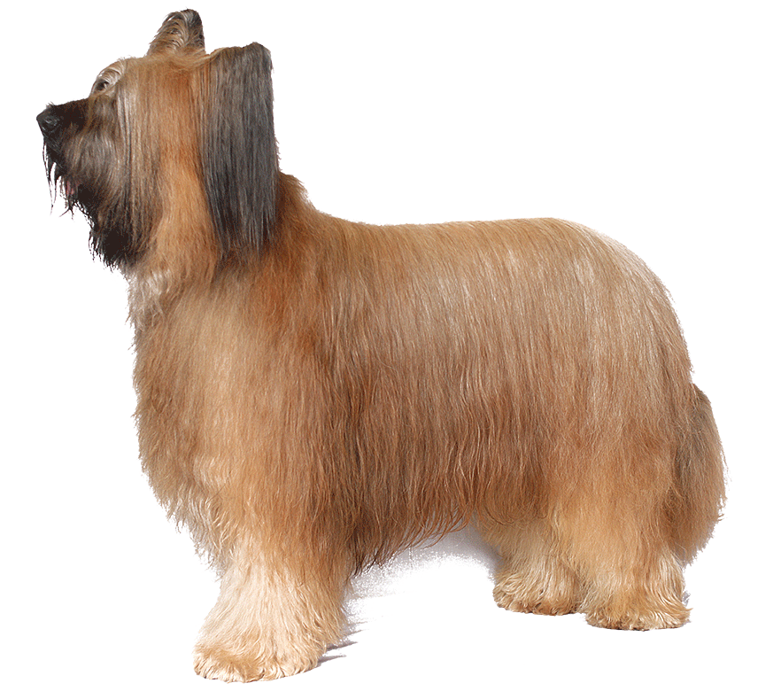
Dog as disease model - Blindness
An early-described dog model of inherited disease (1990s), congenital stationary night blindness affects Briards¹⁶
  Specific mutation: 4-nucleotide deletion in the RPE65 gene
  Same mutation is also present in retinal dystrophy in Briards. Same disorder?

Slide 24
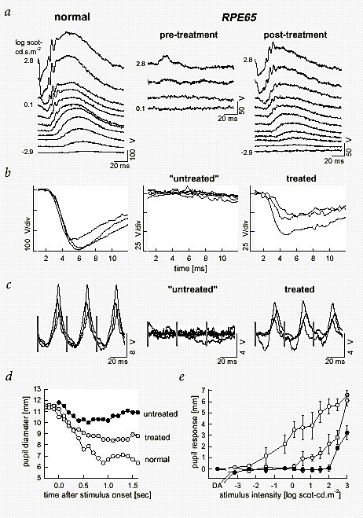
Dog as disease model - Blindness
Also an early use of gene therapy (2001)¹⁷
  Treated RPE65-/- dogs with recombinant adeno-associated virus carrying wild type RPE65 (AAV-RPE65)
  “A logical question leading from our results is whether subretinal injection of AAV-RPE65 would also correct the functional defects found in humans with [Leber congenital amaurosis] due to RPE65 mutations.”

Slide 25
It’s being done – in humans!
January 2015
  Pierce, E. A. & Bennett, J. The status of RPE65 gene therapy trials: safety and efficacy. Cold Spring Harb. Perspect. Med. (2015)¹⁸
May 4, 2015
  Wright, A. F. Long-term effects of retinal gene therapy in childhood blindness. N. Engl. J. Med. (2015)¹⁹
  Bainbridge, J. W. B. et al. Long-term effect of gene therapy on Leber’s congenital amaurosis. N. Engl. J. Med. (2015)²⁰

Slide 26
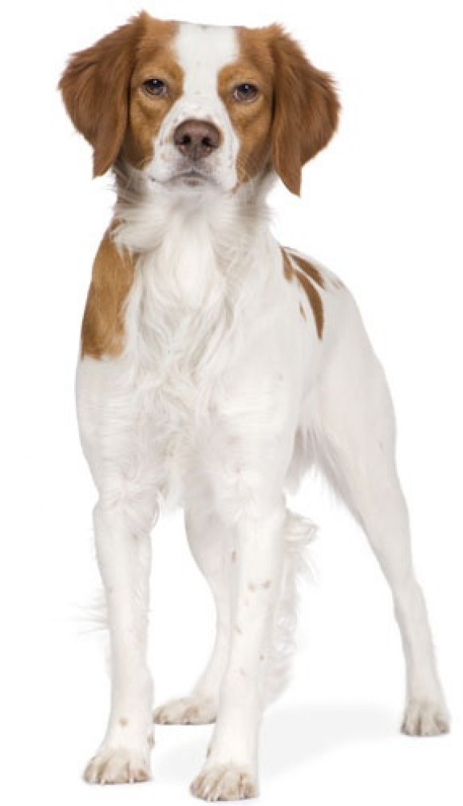
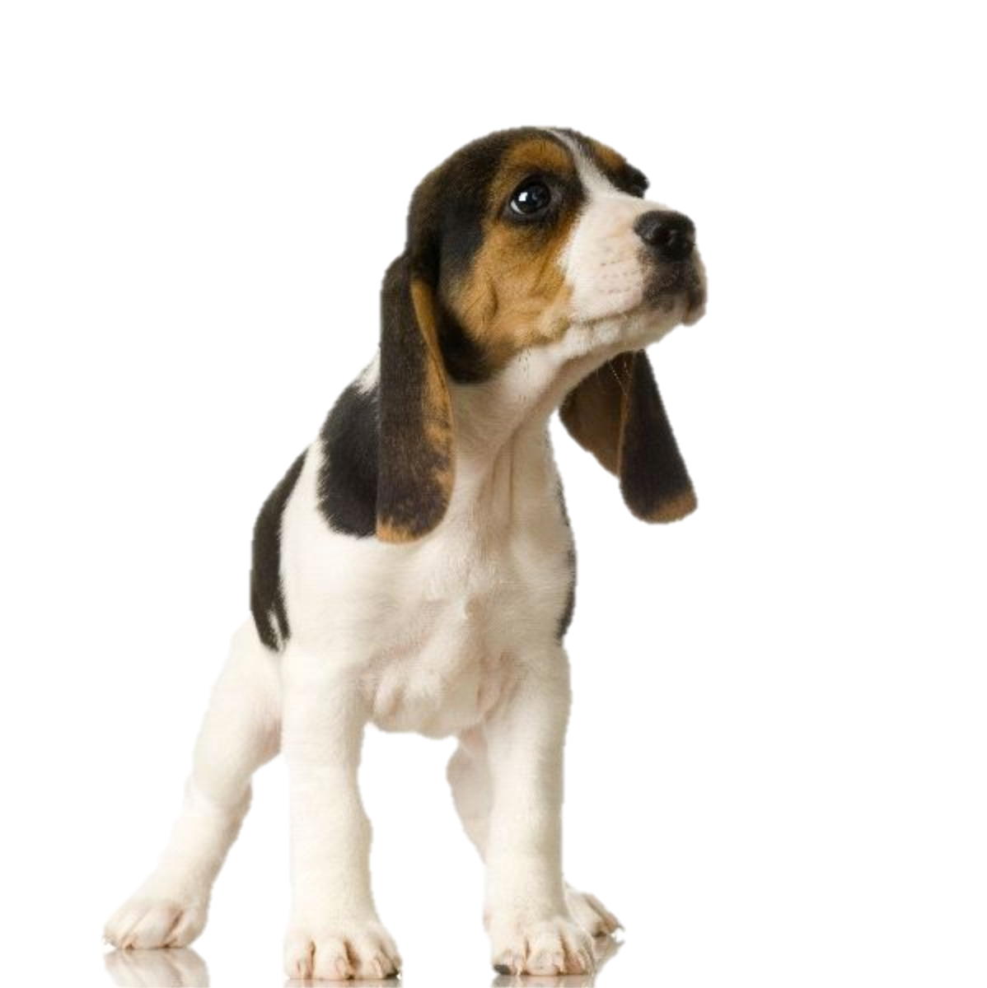
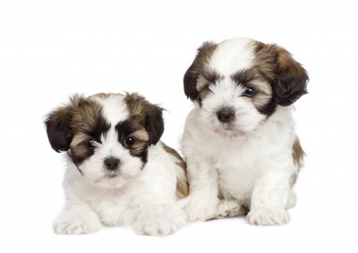
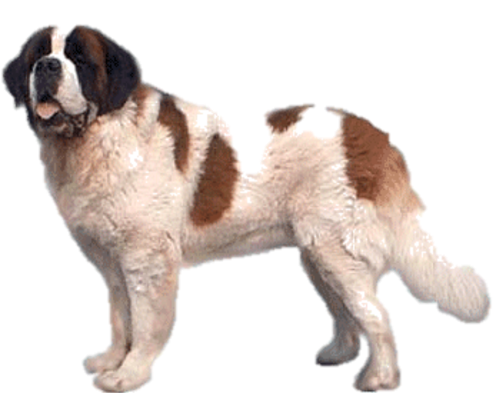
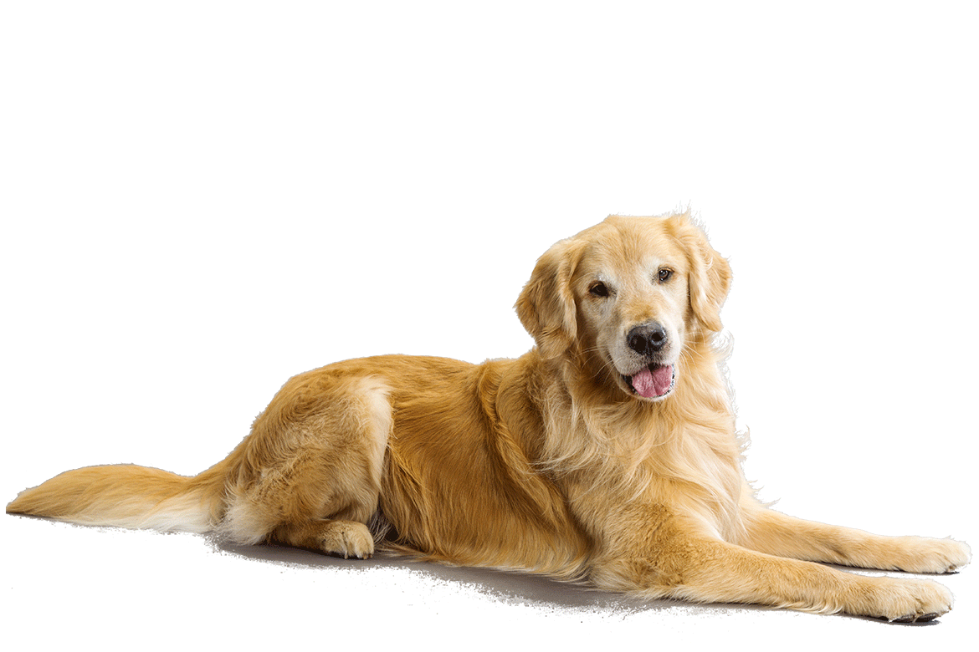
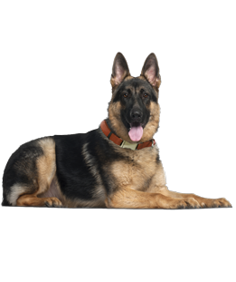
Dog as disease model – many more
Spinal muscular atrophy and motor neuron disease
Psychiatric conditions
Glycogen storage disease
Osteosarcoma
Hematological malignancies
Mammary neoplasms
(just to name a few)

Slide 27
Pharmacogenetics & Dogs
(and humans)

Slide 28
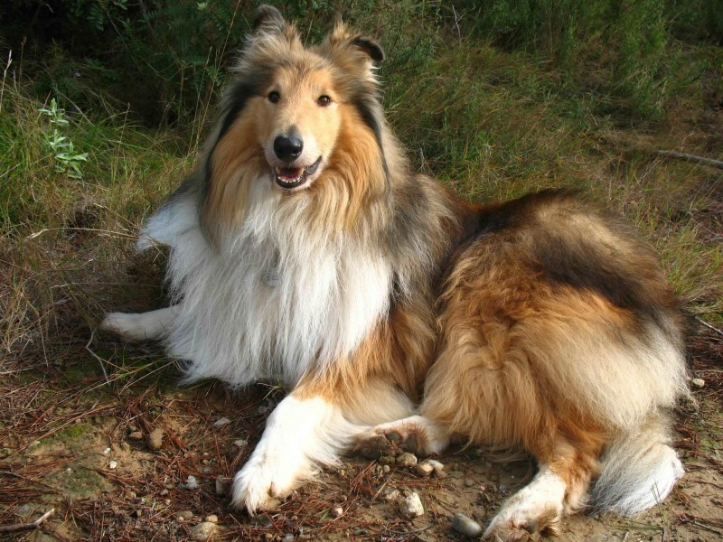
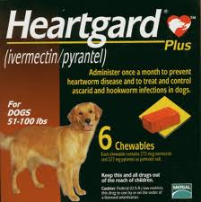
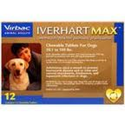

Anyone remember this?
“White feet”
“Don’t treat”
Dogs-wallpapers.com
MDR1 deletion mutation leads to malformation of p-glycoprotein transmembrane protein, avermectin/ivermectin sensitivity and neurotoxicity in some breeds²¹

Slide 29
It goes beyond ivermectin…
Fleischer, S., Sharkey, M., Mealey, K., Ostrander, E. A. & Martinez, M. Pharmacogenetic and metabolic differences between dog breeds: their impact on canine medicine and the use of the dog as a preclinical animal model. AAPS J. 10, 110–119 (2008). ²²
  Amazing paper! Cited by 22 in Scopus as of 5/11/15

Slide 30
…and parallels in humans
Just one of many examples
  Yip, V., Hawcutt, D. B. & Pirmohamed, M. Pharmacogenetic markers of drug efficacy and toxicity. Clin. Pharmacol. Ther. (2015). doi:10.1002/cpt.135²³
Clopidogrel metabolization by genotype
  “Genotype guided clopidogrel dose adjustment would be beneficial and therefore we propose mandatory genotyping before clopidogrel dosing.”²⁴

Slide 31
Are you still asking “Why is the dog so important?”

Slide 32
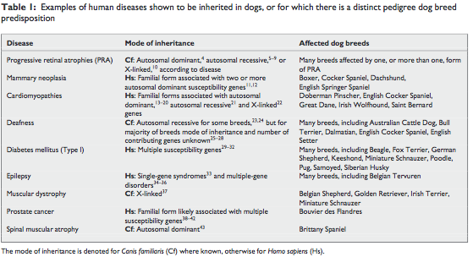
Then read this!
Starkey, M. P., Scase, T. J., Mellersh, C. S. & Murphy, S. Dogs really are man’s best friend - Canine genomics has applications in veterinary and human medicine! Briefings Funct. Genomics Proteomics 4, 112–128 (2005).²⁵
  Cited 49 times in Scopus

Slide 33
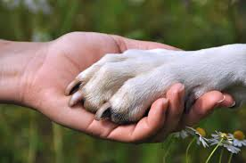
Now you know “why the dog”
“Our best friend in the animal kingdom might provide us with one of the most enchanting systems for illuminating our understandings of human evolution and disease.”
- Wang G. et al. Nature Communications, 2014⁴

Slide 34
Sources cited
http://www.akc.org
http://en.wikipedia.org/wiki/English_Mastiff
Vila, C. Multiple and ancient origins of the domestic dog. Science (80-. ). 276, 1687–1689 (1997).
Axelsson, E. et al. The genomic signature of dog domestication reveals adaptation to a starch-rich diet. Nature 495, 360–4 (2013).
Wang, G. et al. The genomics of selection in dogs and the parallel evolution between dogs and humans. Nat. Commun. 4, 1860 (2013).
Thalmann, O. et al. Complete mitochondrial genomes of ancient canids suggest a European origin of domestic dogs. Science 342, 871–4 (2013).
Kim, K. S., Lee, S. E., Jeong, H. W. & Ha, J. H. The complete nucleotide sequence of the domestic dog (Canis familiaris) mitochondrial genome. Mol. Phylogenet. Evol. 10, 210–20 (1998).
Guyon, R. et al. A 1-Mb resolution radiation hybrid map of the canine genome. Proc. Natl. Acad. Sci. 100, 5296–5301 (2003).
Kirkness, E. F. et al. The dog genome: survey sequencing and comparative analysis. Science 301, 1898–903 (2003).
Lindblad-Toh, K. et al. Genome sequence, comparative analysis and haplotype structure of the domestic dog. Nature 438, 803–819 (2005).
Morrison, D. Why do we still use trees for the dog genealogy? Geneal. World Phylogenetic Networks (2012). http://phylonetworks.blogspot.com/2012/03/why-do-we-still-use-trees-for-dog.html
Sutter, N. B. et al. A single IGF1 allele is a major determinant of small size in dogs. Science 316, 112–5 (2007).
Vaysse, A. et al. Identification of genomic regions associated with phenotypic variation between dog breeds using selection mapping. PLoS Genet. 7, e1002316 (2011).
Bannasch, D. et al. Localization of canine brachycephaly using an across breed mapping approach. PLoS One 5, e9632 (2010).
Jones, P. et al. Single-nucleotide-polymorphism-based association mapping of dog stereotypes. Genetics 179, 1033–44 (2008).
Narfström, K., Wrigstad, A. & Nilsson, S. E. The Briard dog: a new animal model of congenital stationary night blindness. Br. J. Ophthalmol. 73, 750–756 (1989).
Aguirre, G. D. et al. Congenital stationary night blindness in the dog: common mutation in the RPE65 gene indicates founder effect. Mol. Vis. 4, 23 (1998).
Pierce, E. A. & Bennett, J. The status of RPE65 gene therapy trials: safety and efficacy. Cold Spring Harb. Perspect. Med. (2015). doi:10.1101/cshperspect.a017285.
Wright, A. F. Long-term effects of retinal gene therapy in childhood blindness. N. Engl. J. Med. (2015). doi:10.1056/NEJMe1503419.
Bainbridge, J. W. B. et al. Long-term effect of gene therapy on Leber’s congenital amaurosis. N. Engl. J. Med. (2015). doi:10.1056/NEJMoa1414221.
Mealey, K. L., Bentjen, S. A., Gay, J. M. & Cantor, G. H. Ivermectin sensitivity in collies is associated with a deletion mutation of the mdr1 gene. Pharmacogenetics 11, 727–33 (2001).
Fleischer, S., Sharkey, M., Mealey, K., Ostrander, E. A. & Martinez, M. Pharmacogenetic and metabolic differences between dog breeds: their impact on canine medicine and the use of the dog as a preclinical animal model. AAPS J. 10, 110–119 (2008).
Yip, V., Hawcutt, D. B. & Pirmohamed, M. Pharmacogenetic markers of drug efficacy and toxicity. Clin. Pharmacol. Ther. (2015). doi:10.1002/cpt.135
Bin Sayeed, M. S. et al. Prevalence of CYP2C19 alleles, pharmacokinetic and pharmacodynamic variation of clopidogrel and prasugrel in Bangladeshi population. Clin. Exp. Pharmacol. Physiol. 42, 451–7 (2015).
Starkey, M. P., Scase, T. J., Mellersh, C. S. & Murphy, S. Dogs really are man’s best friend - Canine genomics has applications in veterinary and human medicine! Briefings Funct. Genomics Proteomics 4, 112–128 (2005).

Slide 35
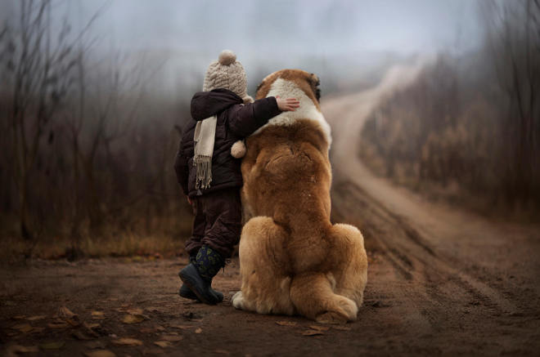
Thank you!

