Slide 1
Visualizing the impact of a new clinical informationist service
Corinne Miller, MLIS, Clinical Informationist
Jonna Peterson, MLIS, Senior Clinical Informationist
Karen Gutzman, MS, MA, Impact and Evaluation Librarian
Galter Health Sciences Library, Feinberg School of Medicine, Northwestern University
Notes:
[Corinne]

Slide 2
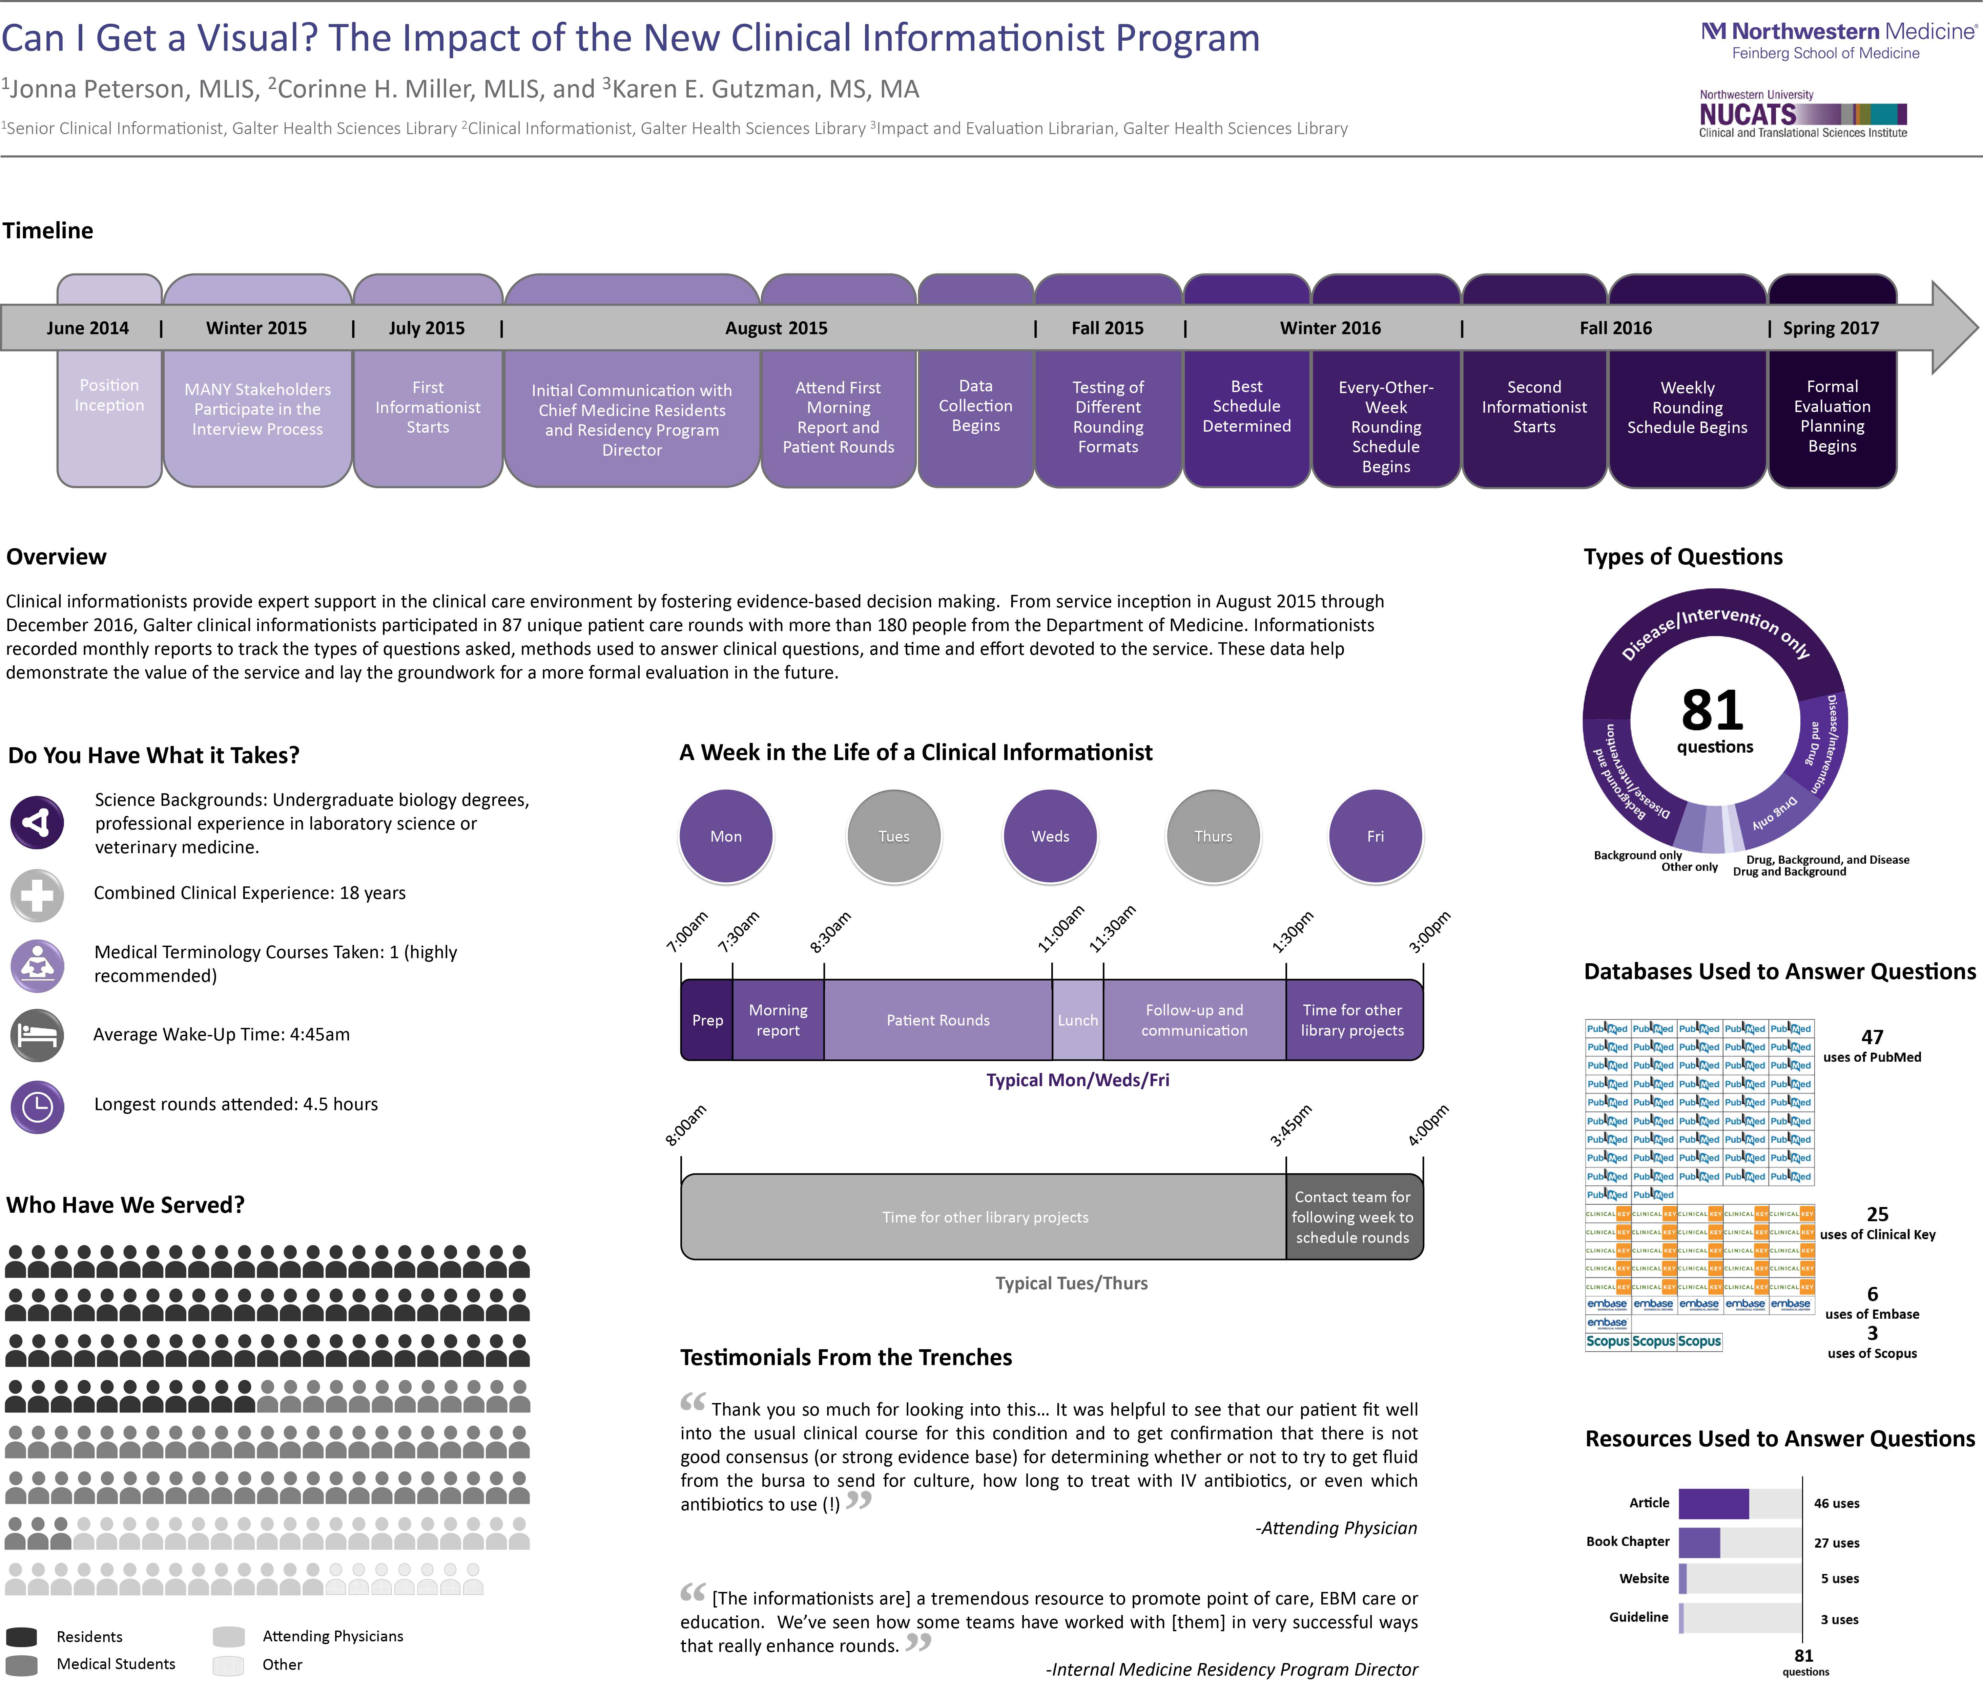
Peterson J, Miller CH, Gutzman KE. Can I get a visual? The impact of the new clinical informationist program. Poster session presented at: Medical Library Association 117th Annual Meeting and Exhibition; 2017 May 26-31; Seattle, WA.
View/download:
http://dx.doi.org/10.18131/G3P99J
Notes:
[Corinne]

Slide 3
Clinical Informationist Service Overview
Goal: To provide literature to answer clinical questions and inform patient care
Current status:
  Collaborating with Department of Medicine since July 2015
  Drafting formal evaluation plan in Fall 2017
  Taking note of opportunities to expand service
Notes:
[Corinne]

Slide 4
What We Do
Attend morning report
During rounds, listen to patient case presentations, note gaps in the knowledge or record direct questions
Identify materials/best sources to address those questions or gaps in knowledge
Share materials by email the same day with all members of the group (attending, residents, students, nurses)
Record relevant statistics
Notes:
[Corinne]
In morning report, Department of Medicine use former cases as teaching opportunities.
Explain rounds: team is made up of an attending, lead residents, interns, and medical students on their clerkships.

Slide 5
General Schedule
Notes:
[Corinne]

Slide 6
Institutional Buy-In
Medical School Dean requested position of incoming library director
Department of Medicine Residency Program Director and chief residents involved in interview process for Senior Clinical Informationist
Senior Clinical Informationist hired
Second Clinical Informationist hired after service was implemented
Notes:
[Jonna] New dean came from Vanderbilt, which has a long history of clinical informationist training programs. Dean was looking to see a similar service launch at Feinberg.
Library administration had wanted to develop a service for some time and allocated funds within the budget, but positions were never filled. Under new leadership, positions were redefined and a successful search was completed. Senior clinical informationist hired.
Involving Medicine in the hiring process helped to build relationships and establish a shared mission. Library leadership actively sought input from everyone through the process and used a lot of “We” language.
Department of Medicine was selected because of a previous relationship with the Library, and because of the Dean's suggestion.

Slide 7
Program Development
Initial contact made with “scheduling chief” and internal medicine residency program director
Attend first morning report and patient rounds
Notes:
[Jonna] In our system, there are 4 internal medicine chiefs (residents who were selected by their peers and who opted to return for an optional 4th year of residency). One is in charge of "scheduling." The scheduling chief is the person who our informationist interacted with most initially. The chief helped determine which of the six medicine teams would be best to join.

Slide 8
Bumps in the Road – The Set Up
First attempt: Round with 3 teams per day
  Plus side: reach more people
  Down sides: too chaotic, barely get to know team members
Second attempt: 3 different teams in 3 different days
  Down side: not always sufficient time to establish rapport
Third attempt: 3 days per week with same team
  Plus side: establish rapport with team and become integrated
  Down side: unable to reach more than one team per week
Notes:
[Jonna] 3 teams/ 3 days:- down side- we don’t necessarily get questions to answer every day, so we may not have a chance to truly demonstrate the value of the service in a single day. First and second scheduling models both recommended by the scheduling chief

Slide 9
Bumps in the Road – Data Collection
What data should we collect?
Early loss of data
Shared document troubles
How should we be storing this information?
Notes:
[Jonna] Not only should we be concerned about how we're storing data for security, but also how easy is it to access data about questions we've answered previously. Can we search for "NOAC" or pancreatitis in our data to find previous results we've sent on those topics? Is it easy to do?
We lost a bit of data early as we couldn't get back to some of the results that had been sent in the early months of the program due to University imposed Outlook restrictions.

Slide 10
Data Collection
No one told us what to collect
Data hoarding. It’s “a thing!”
We record:
Date Names and roles of all team members Questions asked | Time spent answering question Follow-up emails Materials sent Number of patients seen
Formal evaluation
Notes:
[Jonna] The items we record have changed over time, mostly we've added additional data. Nothing has been subtracted.
A formal evaluation plan will be drafted in Fall 2017 to determine the impact of this service.

Slide 11
Evaluation Questions To Consider
Notes:
[Karen presents all remaining slides]

Slide 12
Methods
Broad question: What methods for providing the clinical informationist service work best at Northwestern Medicine?
  Narrow question: What methods have been attempted, for how long, and what were the successes or barriers for each?
    Description of method and amount of time used
    Description of successes or barriers for each method
  Narrow question: What methods are preferred by clinicians or students?
    Aspirational: Description of method preferred by clinician or student

Slide 13
Stakeholders
Broad question: Who are the key stakeholders of the clinical informationist service?
  Narrow question: Who uses the service most often?
    Metric: Types of users
    Metric: Number of interactions user type has with service
  Narrow question: Who might the informationists reach out to for growing the service?

Slide 14
Effort, Resources, and Capacity
Broad question: What kind of effort, resources, and capacity are needed for the clinical informationist service?
  Narrow question: How much time does the informationst spend in person or via email with clinicians and students?
    Metric: Number of hours spent on rounds
    Metric: Number of hours spent responding to questions via email
  Narrow question: What library resources are needed by the informationist to adequately perform their role?
    Metric: Type of resources used by the informationist
    Metric: Number of library resources used by the informationst

Slide 15
Effort, Resources, and Capacity
Broad question: What kind of effort, resources, and capacity are needed for the clinical informationist service?
  Narrow question: In what knowledge domains are the informationists answering questions for clinicians and students?
    Metric: Classification scheme of questions
    Metric: Number of questions per classification scheme
  Narrow question: What key training or experience do the clinical informationists find most useful in their work?
    Metric: Description of key trainings or experiences informationists find most useful

Slide 16
Benefits
Broad question: What benefits does the clinical informationist service provide to the stakeholders?
  Brainstorming ways to best capture this information
    Number of questions answered
    Number of hours spent on rounds
    Number of patients seen with the teams
    Time spent answering the questions

Slide 17
Data Cleaning and Analysis

Slide 18
A Few Caveats
I am not a statistician, by any means
I use fictional data for some of the examples - just easier to explain
All examples were discussed as part of the poster project, even though not all of this made it onto the poster

Slide 19
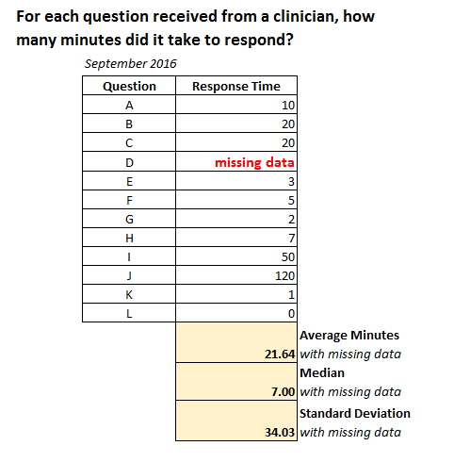
Considerations for Data Cleaning
Please note – these charts depict fictional data.
Missing Data can be handled in several ways*
Missing data: Case Deletion
      Excel handles empty cells (i.e. missing data) by effectively “deleting” those cases if a functions is used to calculate the average, median, and standard deviation.
      Instead of 12 questions, there are now only 11 questions to report on.
Missing data: Not Applicable
If the missing data is actually “not applicable” (n/a) then the data should not be included in average, median, and standard deviation.
Missing data: Visualizations
      “On average we spend 22 minutes responding to a question from a clinician.”
      (N =11, median 7.0, Std. Dev. 34.0)
Missing and non-applicable data can be portrayed in visualizations.
*Sauro, J. 7 Ways to Handle Missing Data. [blog post] June 2, 2015. Measuring U. https://measuringu.com/handle-missing-data/
Notes:
Standard deviation is a number used to tell how measurements for a group are spread out from the average (mean), or expected value. A low standard deviation means that most of the numbers are very close to the average. A high standard deviation means that the numbers are spread out.
https://simple.wikipedia.org/wiki/Standard_deviation

Slide 20
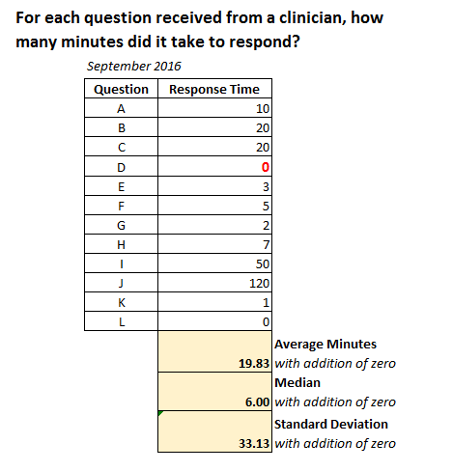
Considerations for Data Cleaning
Please note – these charts depict fictional data.
Missing Data can be handled in several ways*
Missing Data: Imputation
Imputation is similar to educated guessing or recovering the value.
Missing Data: Zero Value
If the cell was left empty to infer a zero value, then add in the zero!
Now all 12 questions can be reported on.
      “On average we spend 20 minutes responding to a question from a clinician.”
      (N =12, median 6.0, Std. Dev 33.0)
*Sauro, J. 7 Ways to Handle Missing Data. [blog post] June 2, 2015. Measuring U. https://measuringu.com/handle-missing-data/

Slide 21
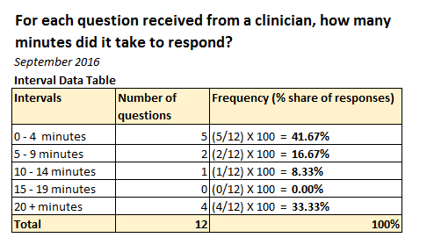
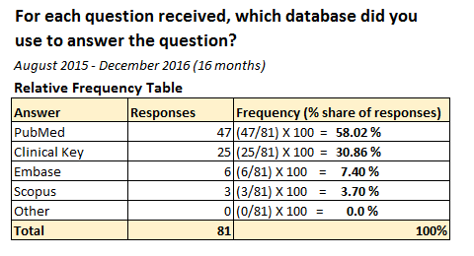
Considerations for Data Analysis
Using intervals and frequencies
“The majority of questions from clinicians take less than 10 minutes to answer.”
(58% of questions >10 minutes, N = 12)
Please note – this chart depicts fictional data.
“Based on data from the past 16 months, the majority of questions from clinicians are answered with PubMed, though ClinicalKey is a strong second.”
(58% of questions >10 minutes, N = 12)
Please note – this chart depicts actual data.

Slide 22
Considerations for Data Visualization

Slide 23
Considerations for Data Visualizations
Visualizations reveal data while using the
  greatest number of ideas
  shortest time
  least ink
  smallest space
Tufte, E. (2001). The Visual Display of Quantitative Information. 2nd Ed. Cheshire, CT. Graphics Press.

Slide 24
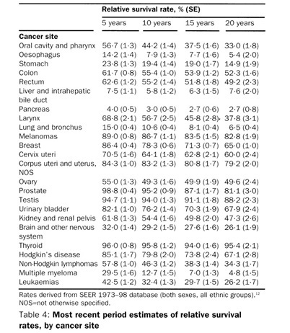
Considerations for Data Visualizations
Brenner, H. (2002). Long-term survival rates of cancer patients achieved by the end of the 20th century: a period analysis. The Lancet, 360, pp. 1131-1135

Slide 25
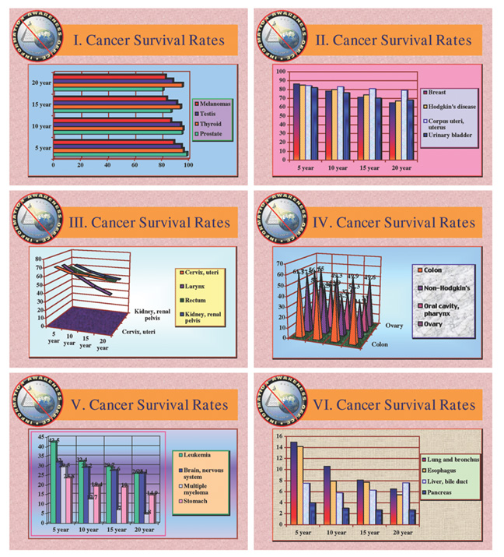
Considerations for Data Visualizations

Slide 26
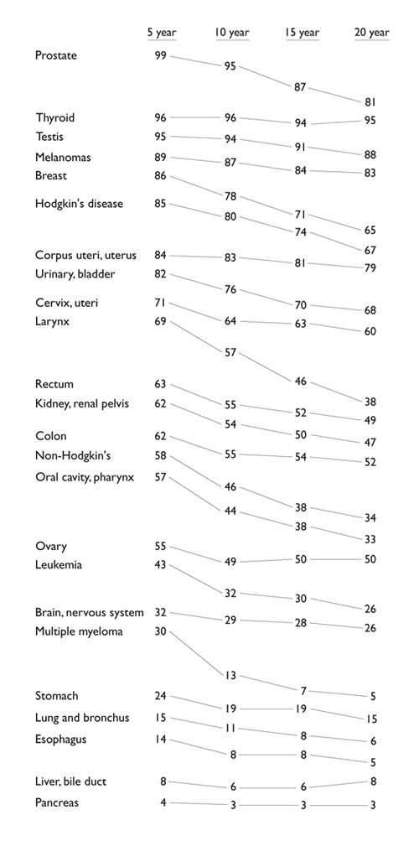
Considerations for Data Visualizations
Visualizations reveal data while using the
  greatest number of ideas
  shortest time
  least ink
  smallest space
Tufte, E. (n.d.) Cancer survival rates: tables, slopegraphs, barcharts. [online forum] Retrieved from: http://www.edwardtufte.com/bboard/q-and-a-fetch-msg?msg_id=0000Jr

Slide 27
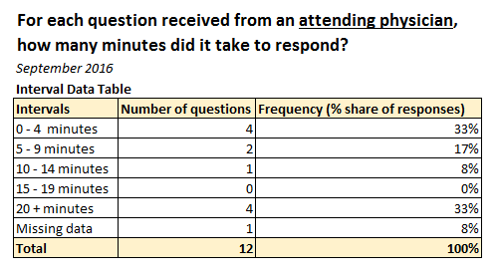
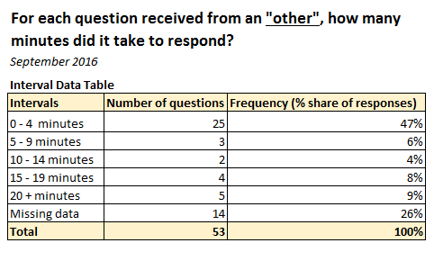
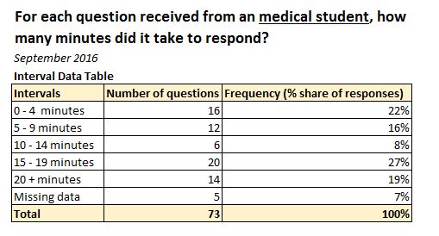
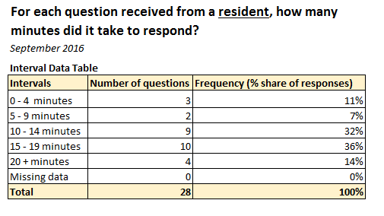
Considerations for Data Visualizations
Please note – these charts depict fictional data.

Slide 28
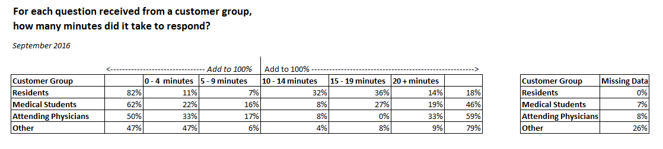
Considerations for Data Visualizations
Creating Diverging Stacked Bar Graphs in Excel
Stephanie Evergreen
http://stephanieevergreen.com/diverging-stacked-bars/
Please note – this chart depicts fictional data.

Slide 29
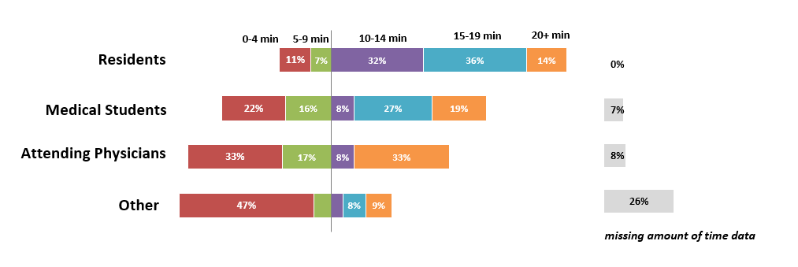
Considerations for Data Visualizations
The majority of questions from the clinical staff take longer than 10 minutes to answer.
Please note – this chart depicts fictional data.

Slide 30
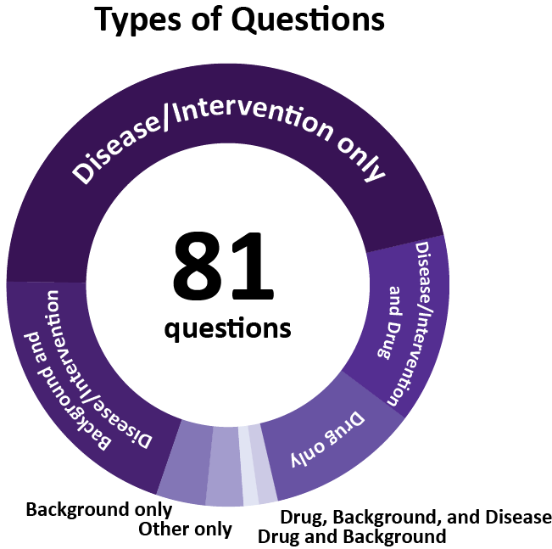
Considerations for Data Visualizations
Creating Infographics in PowerPoint
Donut hole chart (i.e. pie chart)
Please note – this chart depicts actual data.

Slide 31
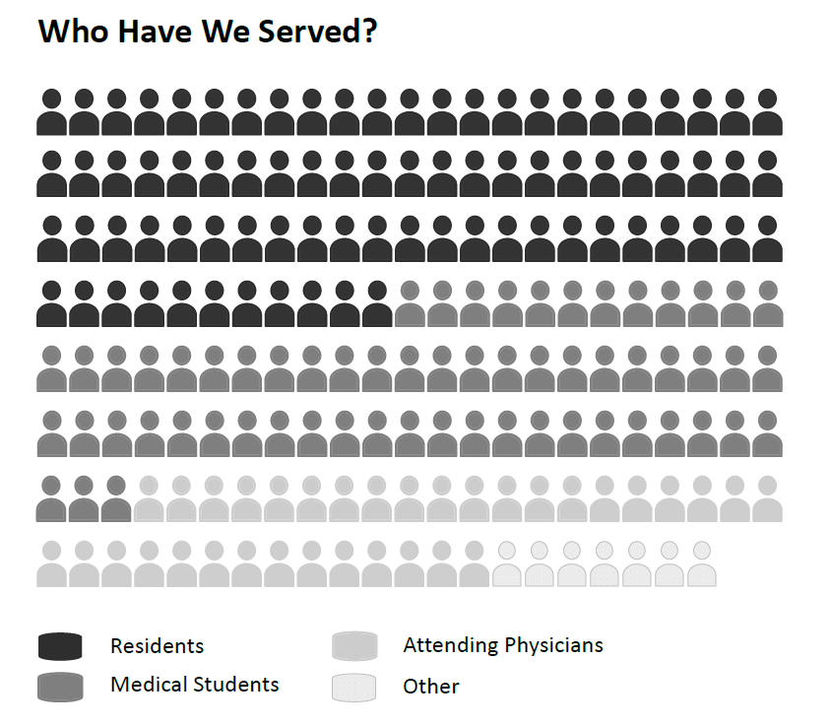
Considerations for Data Visualizations
Creating Infographics in PowerPoint
Icons available at: https://www.flaticon.com/
Please note – this chart depicts actual data.

Slide 32
Thank you!

