Slide 1
Data Sharing: Guidelines & Resources
Dissemination, Impact, and Access Workshop
July 20, 2017
Pamela Shaw, Biosciences & Bioinformatics Librarian

Slide 2
Local Data Sharing Resources
From Northwestern Libraries and the Office for Research
OSR’s Federal Policies and Guidance page
Galter Library’s Data Sharing & Data Management Plan Policies guide
NU Library’s Data Management Librarian (Cunera Buys)
Data Management Guide
(click on the “Federal Funding Agency Requirements” tab)

Slide 3
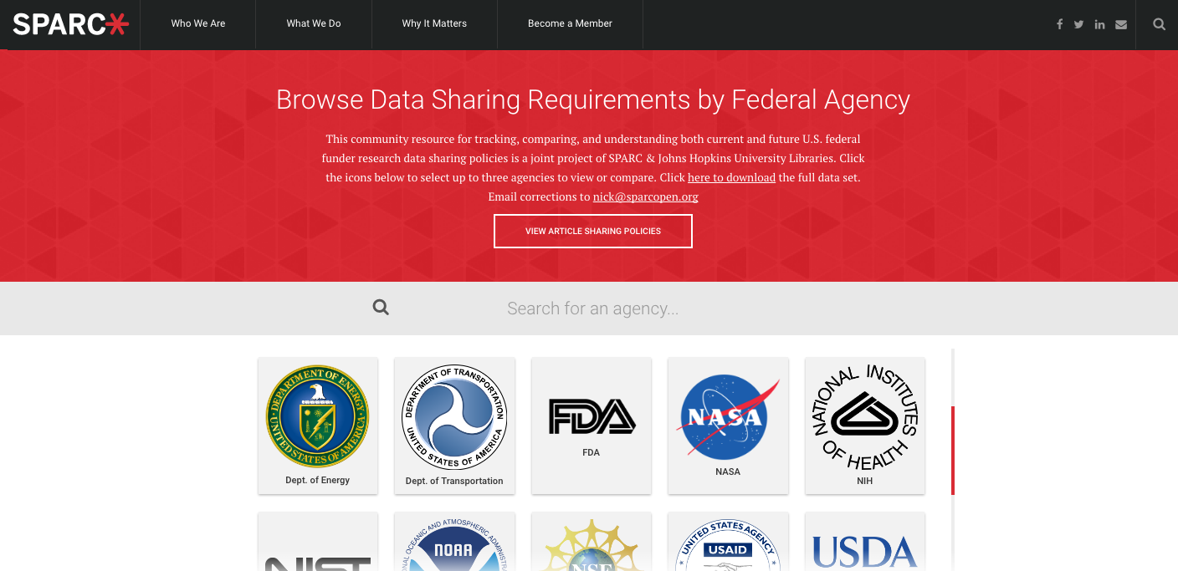
One-stop Shop for all Data Policies
SPARC web resource on data and article sharing policies
http://datasharing.sparcopen.org/

Slide 4



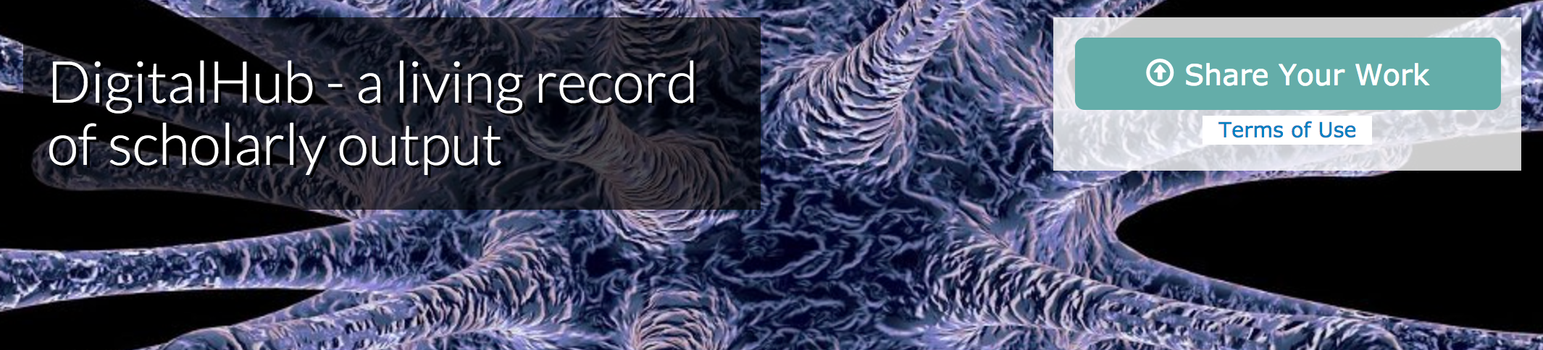
Find a data sharing repository
Many repositories for data are available to researchers. Here is a list of some links to help you find suitable repositories for data sharing.
Re3data.org: Registry of Research Data Repositories – a site with descriptions of available data sharing repositories for many disciplines
Dryad digital repository - a nonprofit repository for data underlying international scientific and medical literature. Investigators must register for a Dryad account.
figshare – figshare allows investigators to upload virtually any type of file format, from figures to spreadsheets, to slide decks. figshare supports upload of large data sets.
DigitalHub – Galter Library’s digital repository for NM researchers. Data sets can be uploaded directly up to 2 GB in size. Larger data sets can be uploaded by DigitalHub staff on behalf of investigators.

Slide 5
Thank you!
“Without data, you're just another person with an opinion.”
― W. Edwards Deming
American engineer, statistician, professor, author, lecturer, and management consultant

