Slide 1
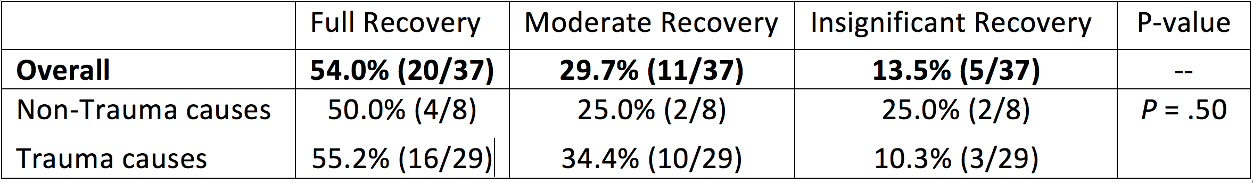
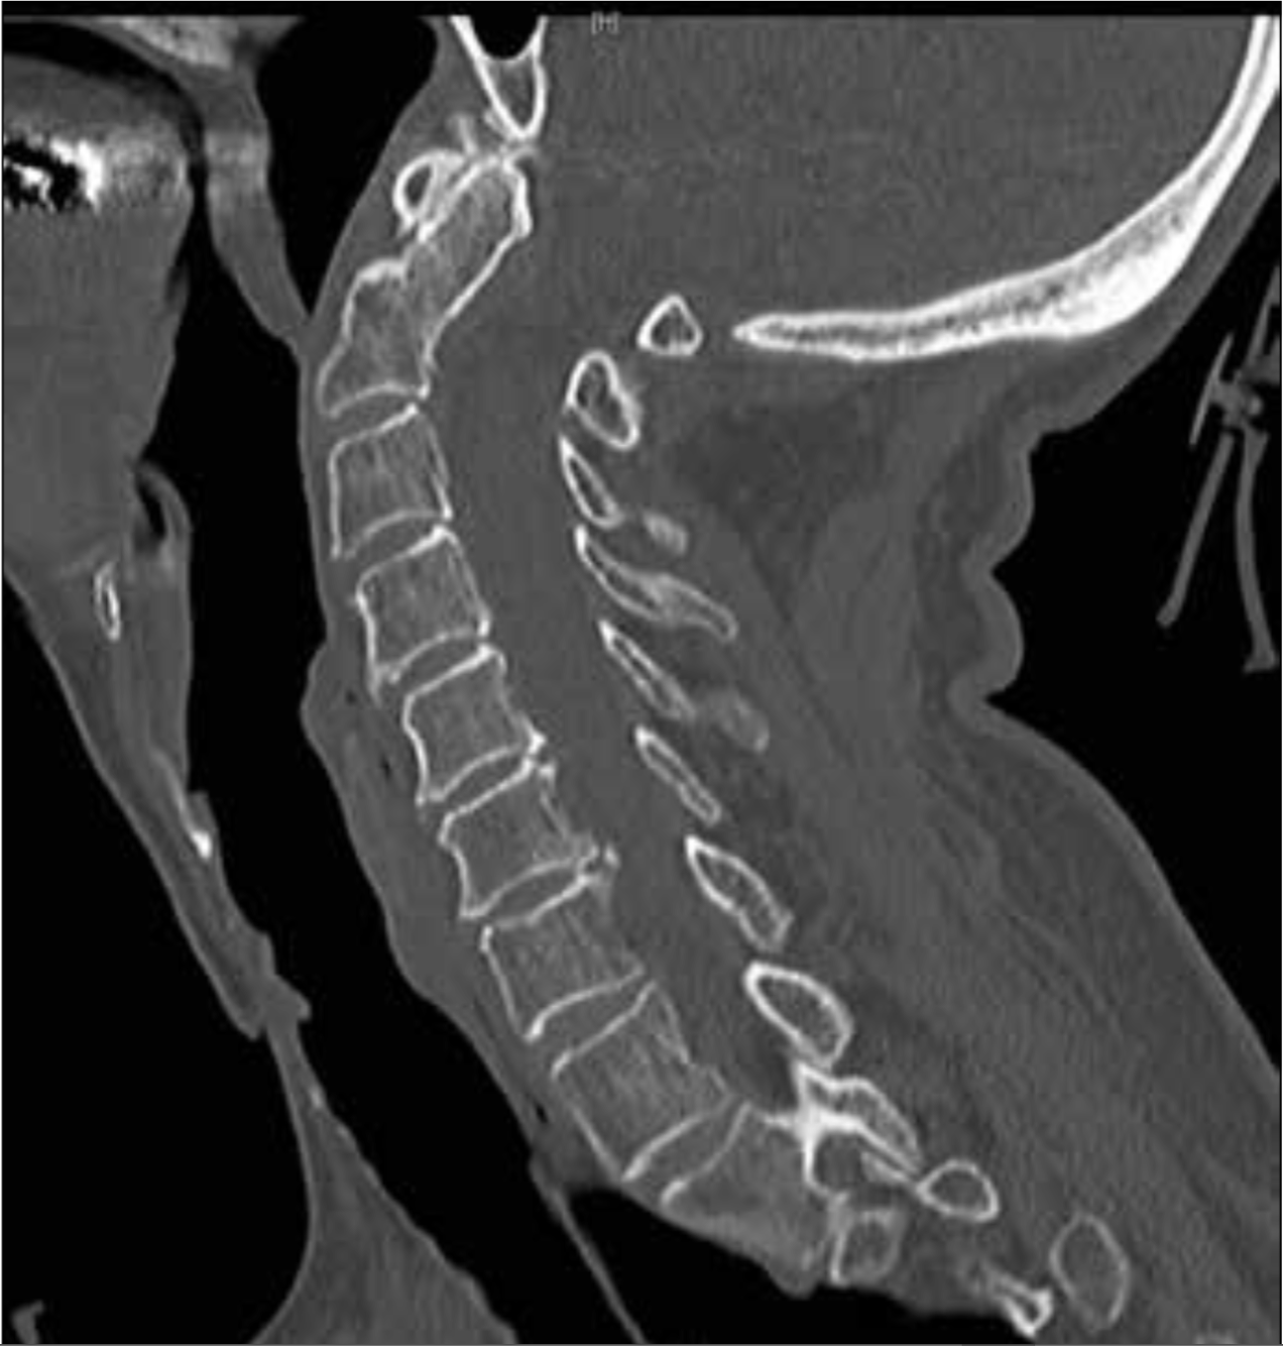
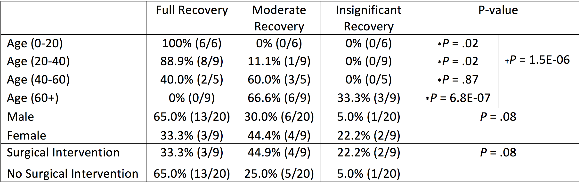
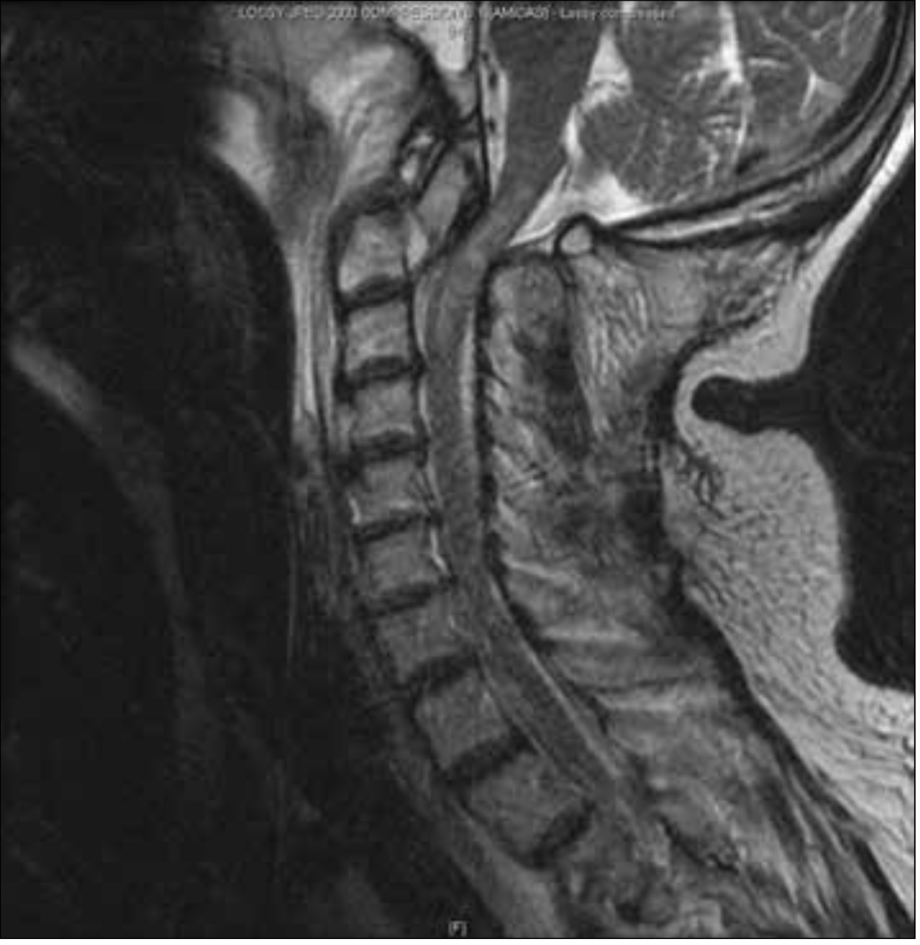
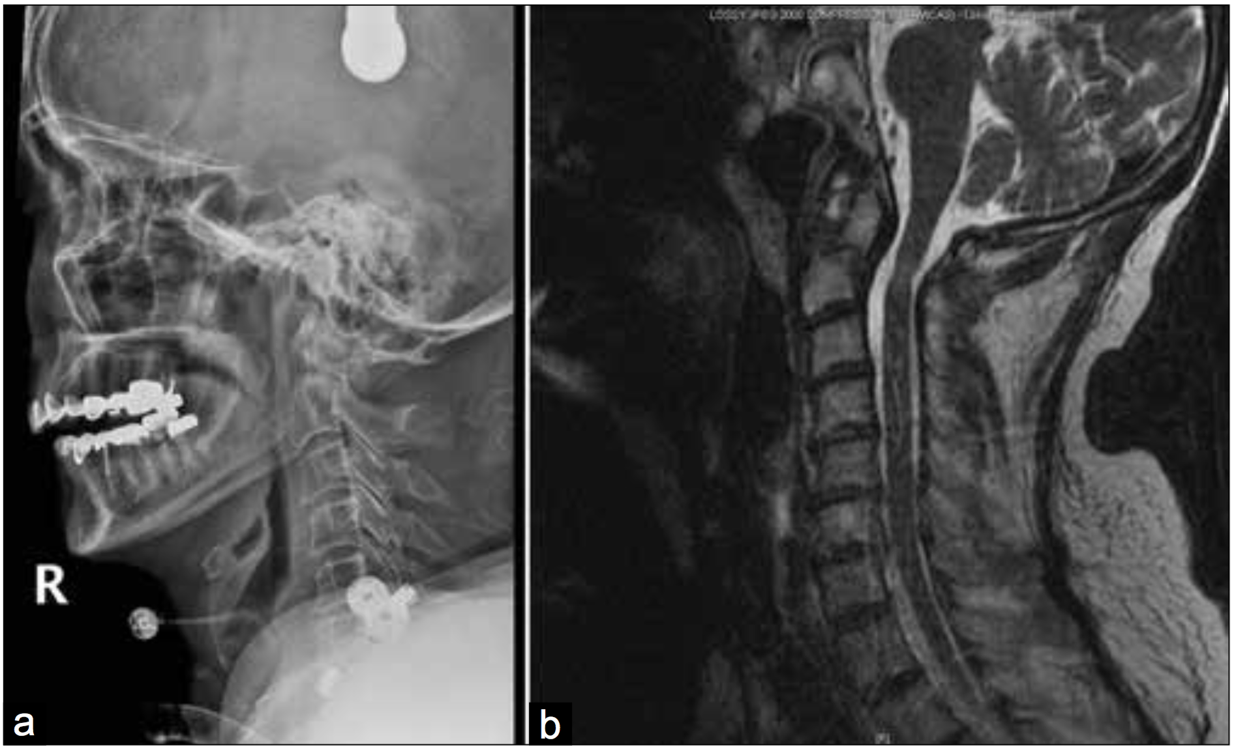
Department of Neurosurgery, Northwestern University Feinberg School of Medicine
Revisiting Cruciate Paralysis: A Case Report & Systematic Review
Benjamin Hopkins¹, Ryan Khanna², Nader S Dahdaleh³
¹Northwestern University, Feinberg School of Medicine, ²Rush Medical Center, Department of Neurosurgery, ³Northwestern Memorial Hospital, Department of Neurosurgery
Background
Table 1. Percentage of cases and extent of recovery
Figure 3.
Termed firstly by Bell in 1970, ‘Cruciate Paralysis’ is a rare neurological disease of the cervicomedullary junction. ^{[1]} Cruciate Paralysis often presents with bilateral paresis of the upper extremities while sparing the lower extremities. ^{[2]} Patients may also present with difficulty breathing, cranial nerve deficits, or a comatose state. ^{[3-5]} While trauma is the most common cause of Cruciate Paralysis, the exact mechanism for these symptoms is not entirely understood. ^{[3, 6]} The leading hypothesis involves disruption of the anatomy of the pyramidal decussation at the cervicomedullary junction. ^{[3]} Within this region, the motor tract fibers of the upper extremities cross both ventrally and superiorly to the fibers supplying the lower extremities. By crossing at a spatially different location, the independent upper extremity fibers provide a way for lesions to preferentially damage upper extremity fibers while sparing those of the lower extremities. ^{[3]}
Figure 3: The patient underwent tracheostomy and percutaneous endoscopic gastrostomy (PEG) tube placement. Her neurological examination continued to improve. Ultimately the tracheostomy and the PEG tubes were removed. She was kept in crown halo vest for 6 weeks followed by 6 weeks of rigid collar placement. During her six month follow up visit, she was ambulating with a walker. Her motor strength in her proximal upper extremities improved to +4/5. Her intrinsic hand function was 3/5 and she her speech was dysarthric. Sagittal CT of the cervical spine revealed complete healing of the fracture.
Table 2. Trauma cases and extent of recovery
Research Objectives
Results
Cruciate Paralysis is a rare, poorly understood condition of the upper craniovertebral junction that allows for selective paralysis of the upper extremities while sparing the lower extremities. Reported cases are few and best treatment practices remain up for debate. The purpose of this study was to conduct a systemic literature review in an attempt to identify prognostic predictors and outcome trends associated with cases previously reported in the literature.
In patients who carried the diagnosis of cruciate paralysis and who were not comatose, the overall reported outcome was favorable with 54 % of patients achieving full recovery and 29.7% of patients achieving moderate recovery.
The overall outcomes associated with cruciate paralysis secondary to trauma did not differ significantly from other non-traumatic causes, P = 0.5 (Table 2). Since the majority of cases of cruciate paralysis were traumatic (29 patients, 78.4%), we analyzed factors that might impact outcomes of traumatic cruciate paralysis (table 3). Patients over the age of 60 years showed significantly worse outcomes as compared to those under the age of 60, p<0.001. Similarly, patients in the both the 0-20 and the 20-40 age ranges had statistically better outcomes when compared to the rest of the cohort, p = 0.02 and p= 0.02 respectively). Male patients also seemed to have slightly better outcomes on average than female patients, p= .08. Finally, patients treated without surgical intervention had better prognoses than those treated surgically, but did not reach statistical significance, p = .08 (Table 3). We included the details of the patient with traumatic cruciate paralysis that was treated at our institution in Figures 1,2 and 3.
*Represents p-value for given age range tested against all remaining age-groups combined.
†Represents p-value for combined ANOVA test between all grouped age ranges.
Methods
Figures 1 & 2.
In this report, we conducted a systematic literature review from 1966 to the present of patients diagnosed with Cruciate Paralysis in order to identify potential prognostic predictors for outcome. Using MEDLINE and PubMed Central, a comprehensive search for all papers under MeSH and keyword term ‘Cruciate Paralysis’ was performed. A case was included if it met the following criteria: 1) The paper under review demonstrated appropriate signs and symptoms of Cruciate Paralysis as defined above; 2) a mechanism of injury was noted; 3) the type of intervention and treatment was noted; and 4) a follow-up examination was documented. Cases with patients presenting in a comatose state were excluded along with papers written in languages other than English. Our study focused on patients who were non-comatose and carried the diagnosis of cruciate paralysis. 37 of the 39 cases found met our criteria. Follow-up results were classified into 3 categories of recovery: insignificant recovery, moderate recovery, or full recovery . Each category was assigned a numerical score of 1, 2 or 3 respectively for simplicity of analysis. Each of the 36 cases were analyzed for outcome trends based on cause (trauma or non-trauma related) and an appropriate ANOVA test was run using the mean numerical scores of each category. (Table 1) The 28 cases associated with trauma were further analyzed and respective ANOVA tests were run to determine trends and associations of outcomes categorized by age, gender and type of intervention. (Table 2)
Limitations
Our study has a few limitations; the cohort size is small in size since our search focused only on papers that included cruciate paralysis as a key word and hence some papers that may have included patients with cruciate paralysis secondary to atlantooccipital dissociation and combination atlas and axis fractures were not included. Moreover, patients who were in a comatose state were excluded as well since it would be hard to ascribe coma due to an intracranial or upper cervical spine injury.
Figure 1 (Left): A 59 year old woman suffered a motor vehicle accident. She was intubated at the scene. Her neurological examination showed a motor strength of 1/5 in the upper extremities and 3/5 in the lower extremities. Sagittal T2 weighted sequence MRI of the cervical spine demonstrating a type III odontoid fracture with posterior subluxation causing compression of the cervicomedullary junction with upper cervical spine signal cord change.
Figure 2 (Right): The patient was placed in crown halo traction and her fracture fragment was reduced as demonstrated by the lateral cervical spine xray (A). The patient then was placed in crown halo vest and an MRI of the cervical spine was done revealing reduction and realignment with decompression at the cervicomedullary junction as demonstrated with a sagittal T2 weighted sequence (B)
Conclusions
While numerous cases of trauma associated Cruciate Paralysis have been reported in the literature, there remains insignificant data to make any sound conclusions concerning whether or not surgical intervention is always the best method of treatment.

