Slide 1
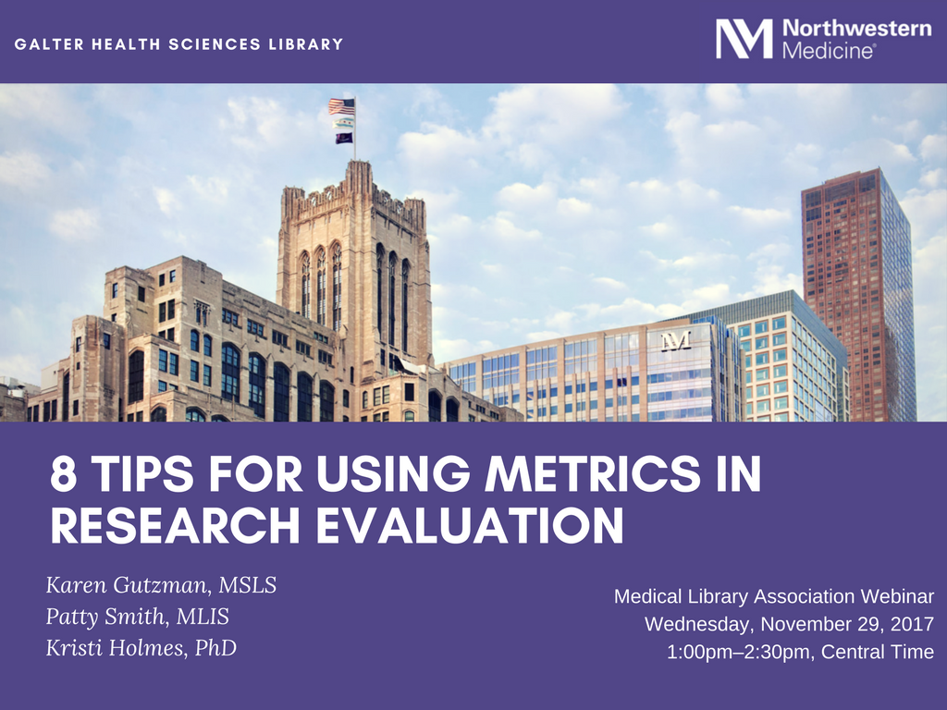

Slide 2
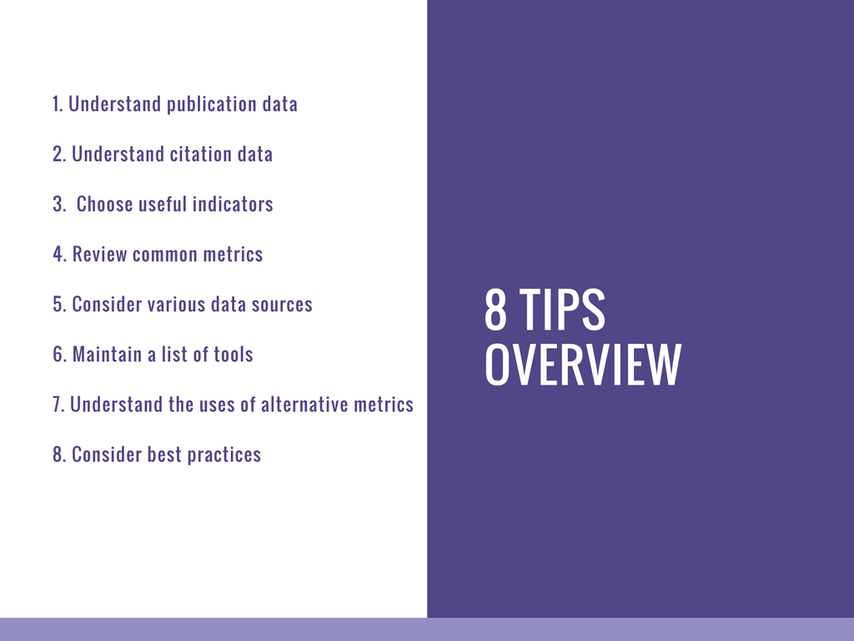
2

Slide 3
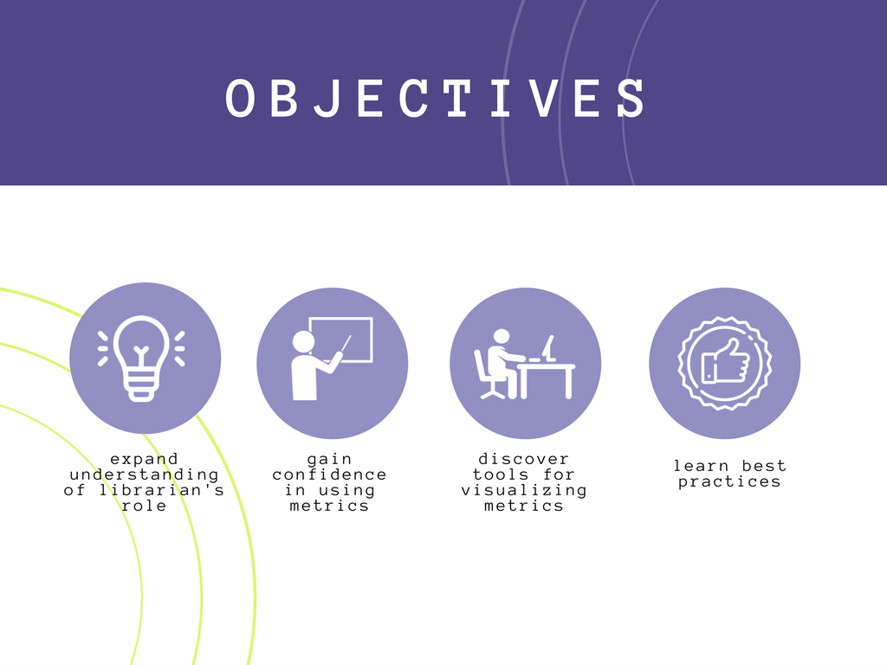
3

Slide 4
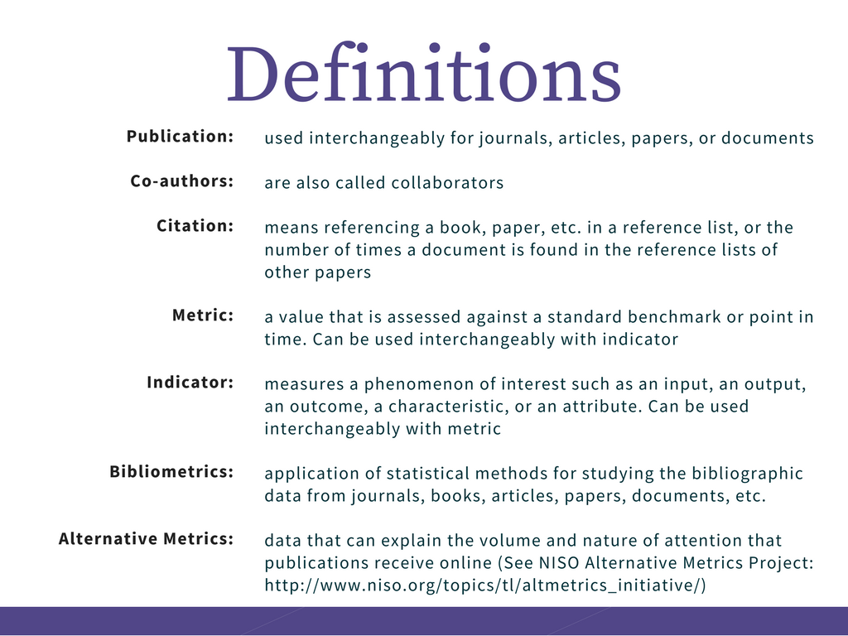
4
Notes:
Citation – “I made a citation to a paper in my reference list” or “How many citations did a paper receive.”

Slide 5
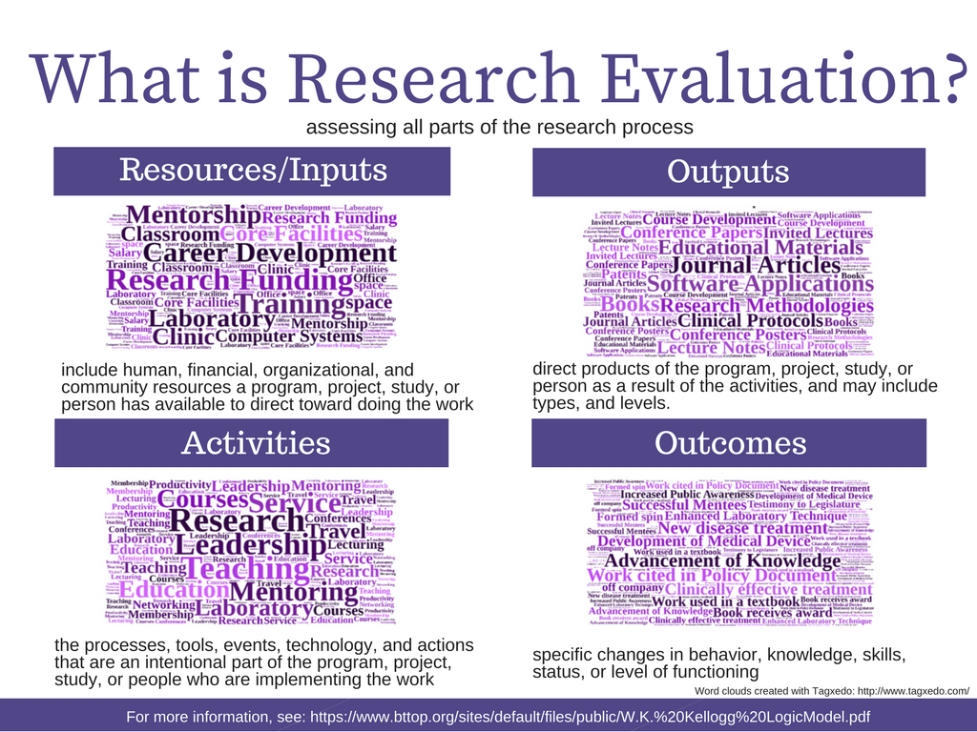
5

Slide 6
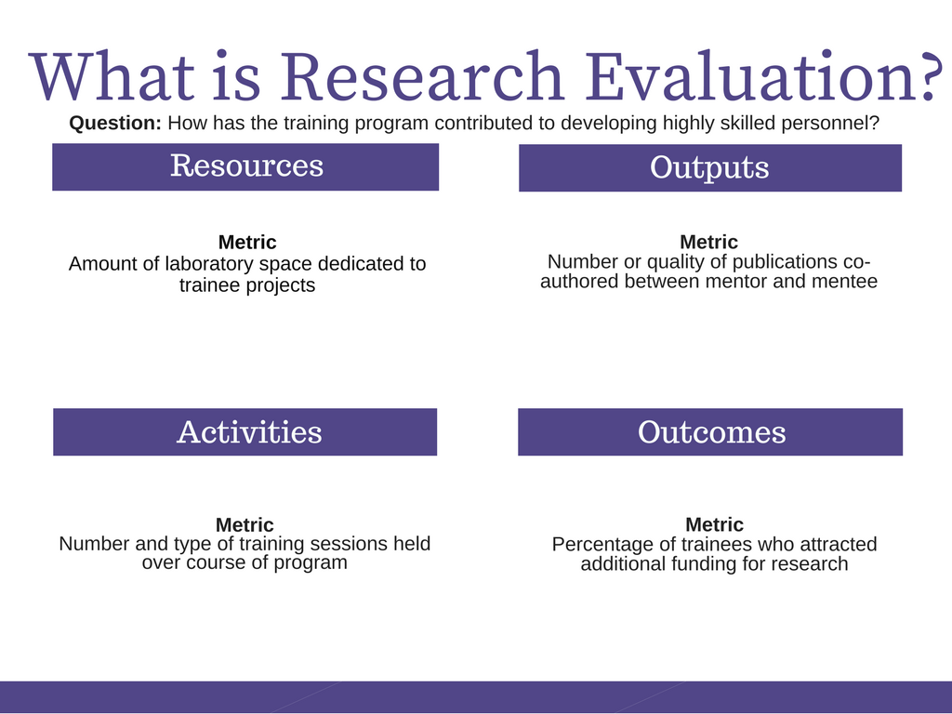
6

Slide 7
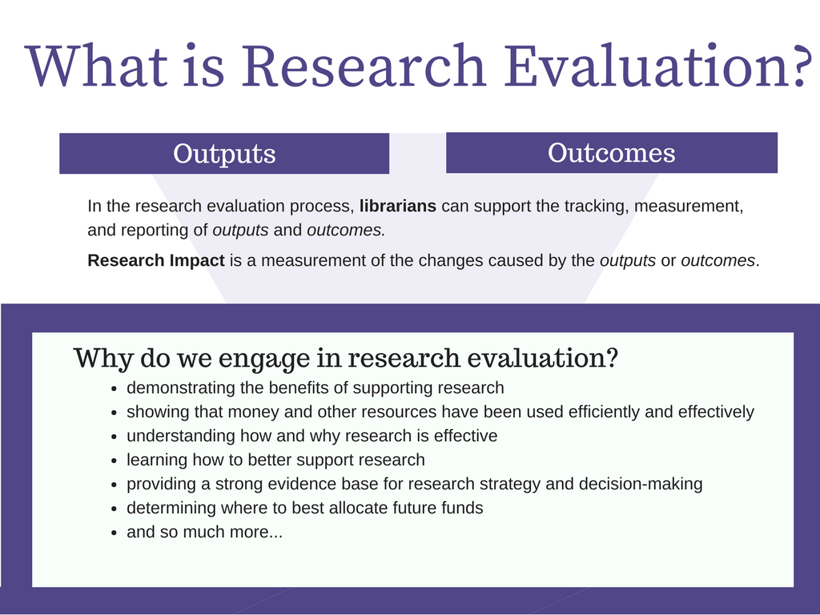
7

Slide 8
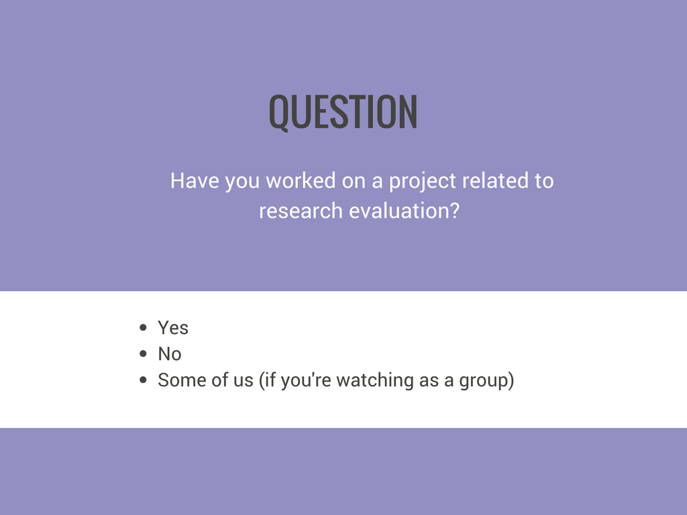
8

Slide 9
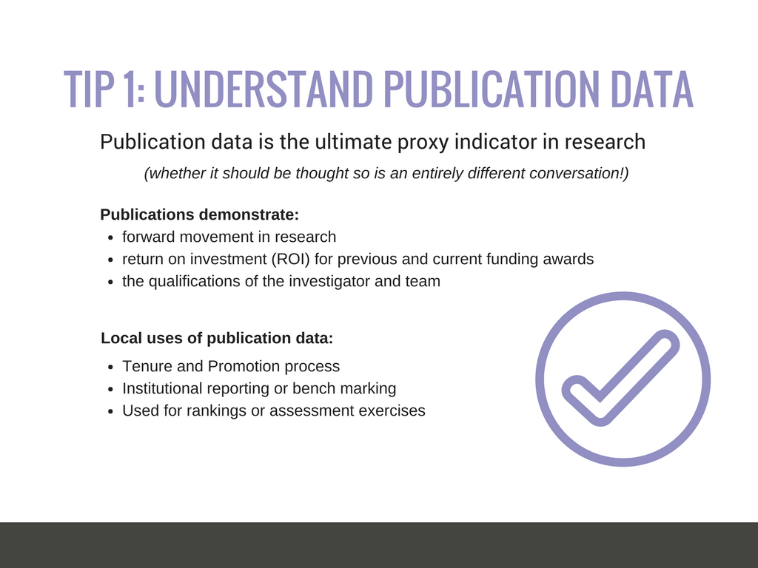
9

Slide 10
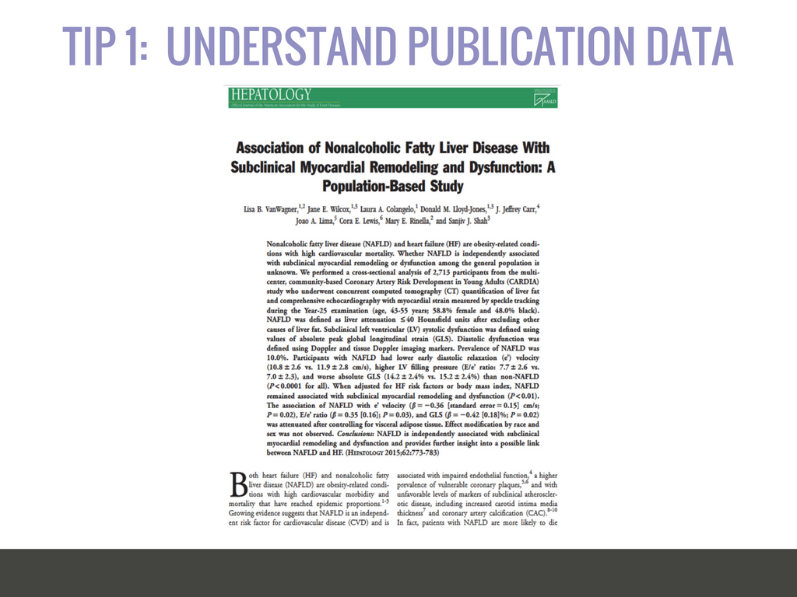
10

Slide 11
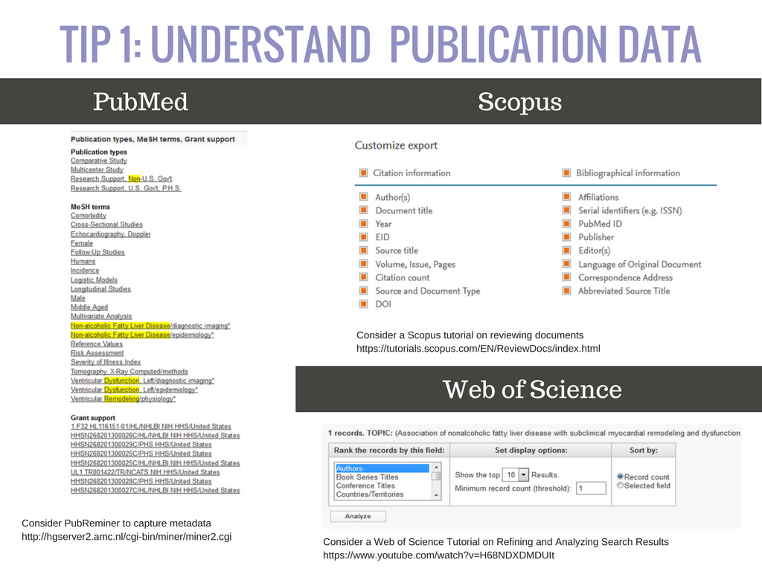
11

Slide 12
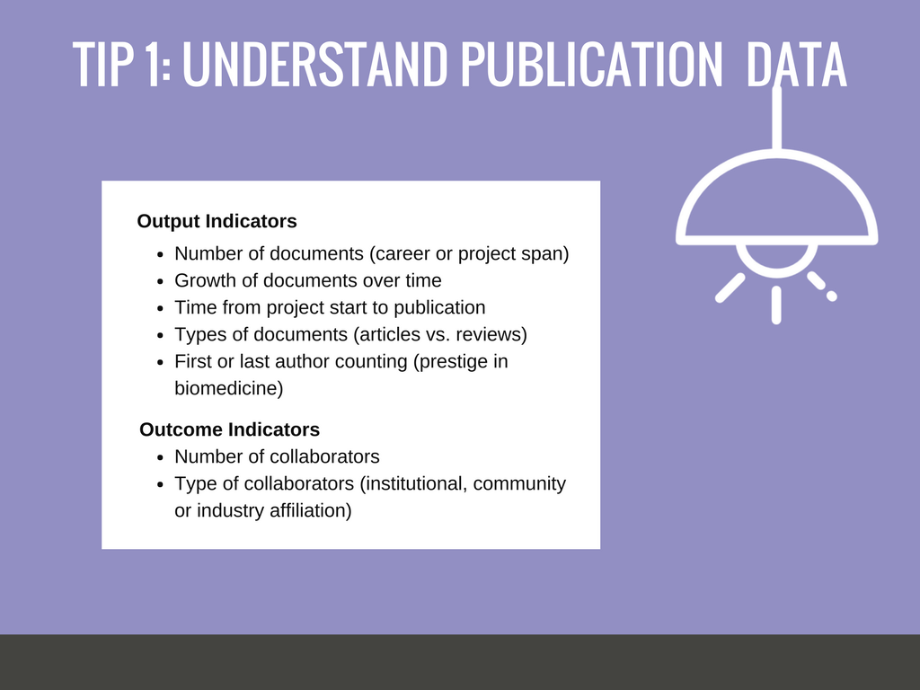
12

Slide 13
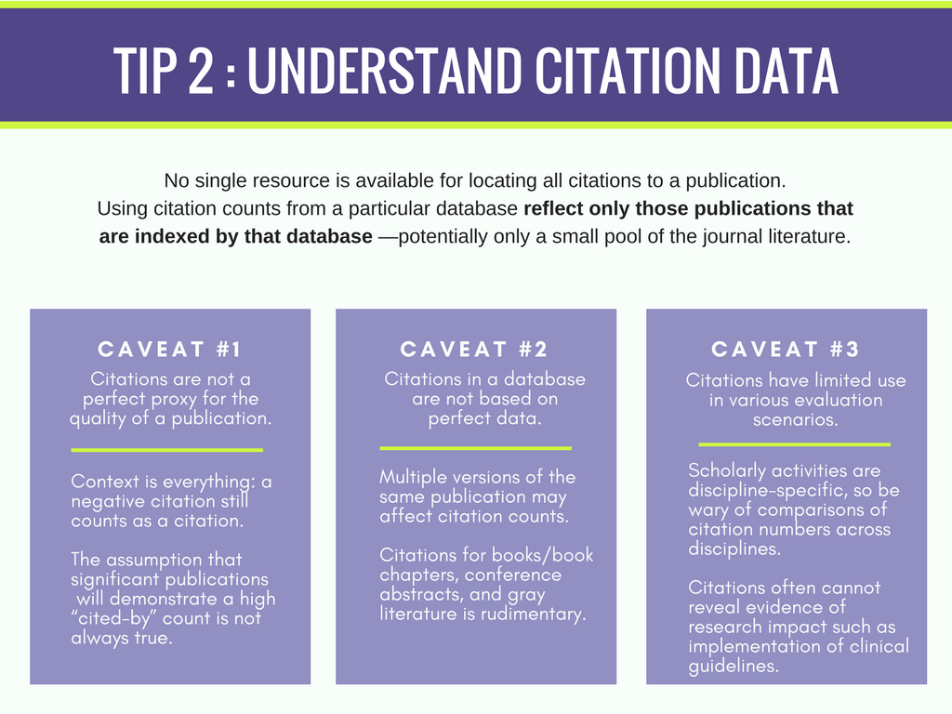
13

Slide 14
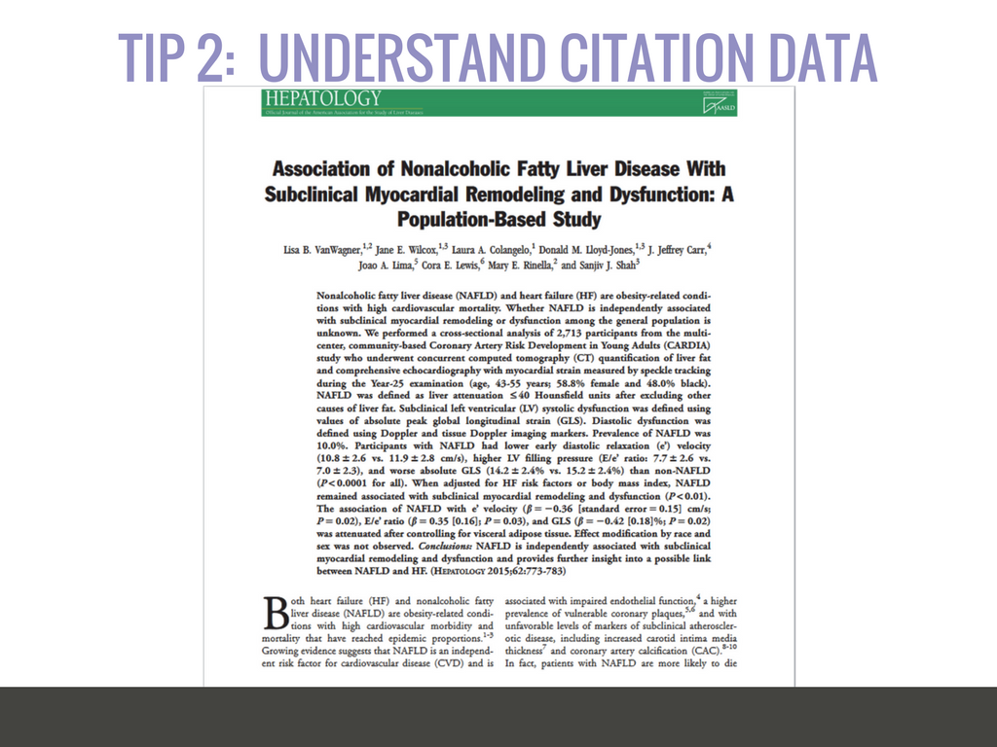
14

Slide 15
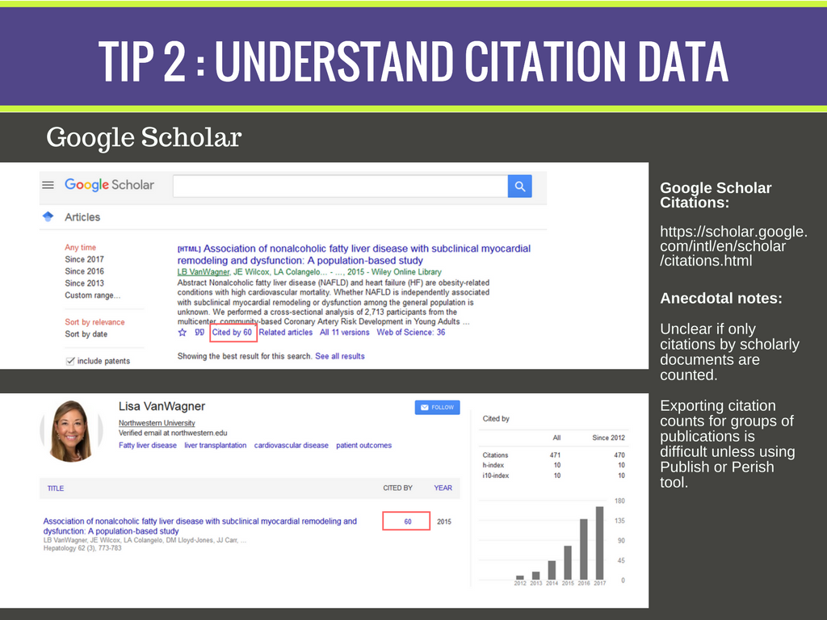
15

Slide 16
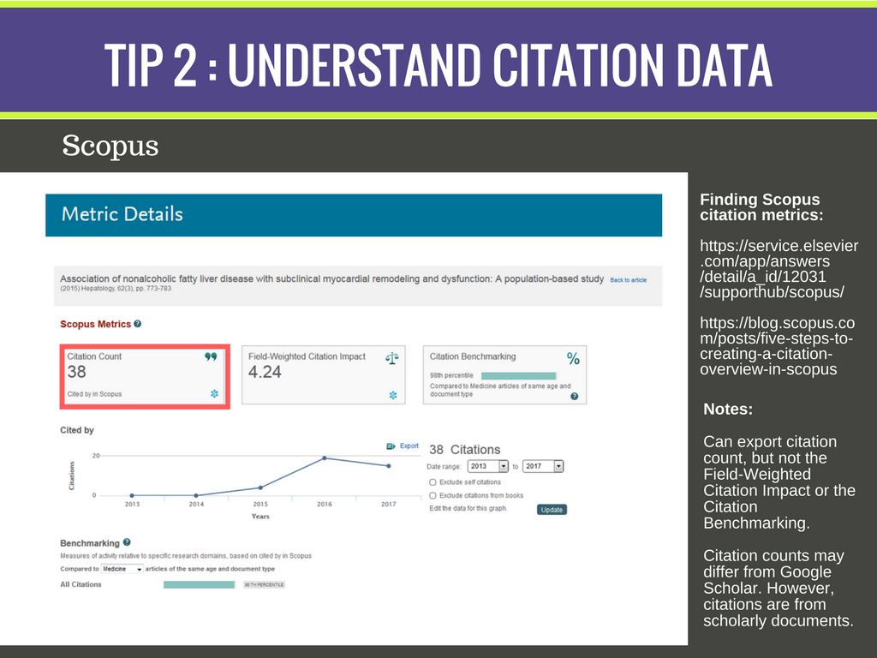
16

Slide 17
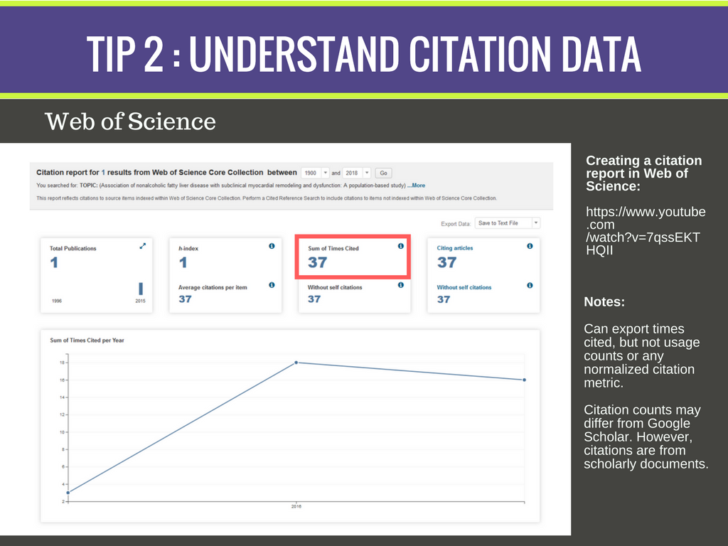
17

Slide 18
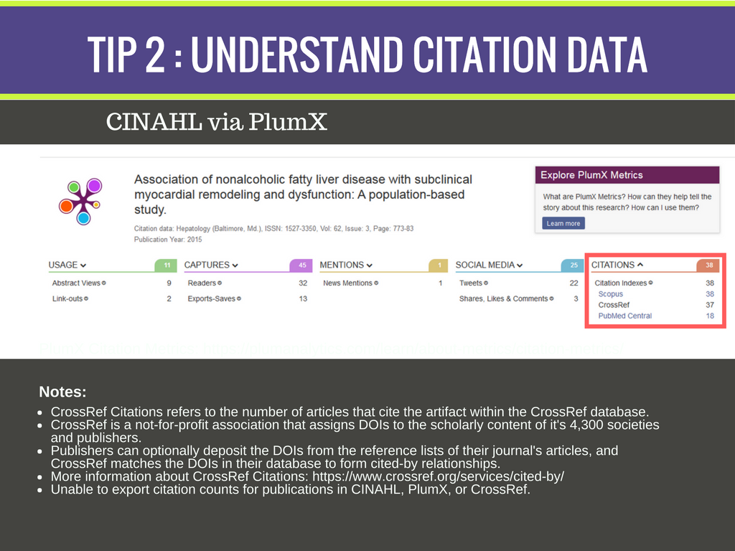
18

Slide 19
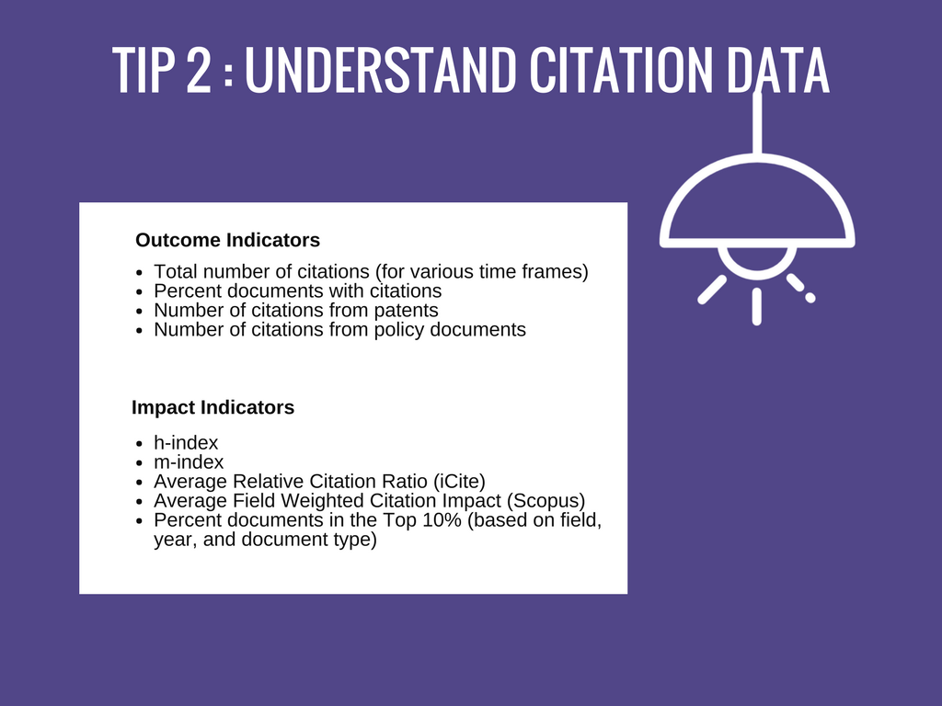
19

Slide 20
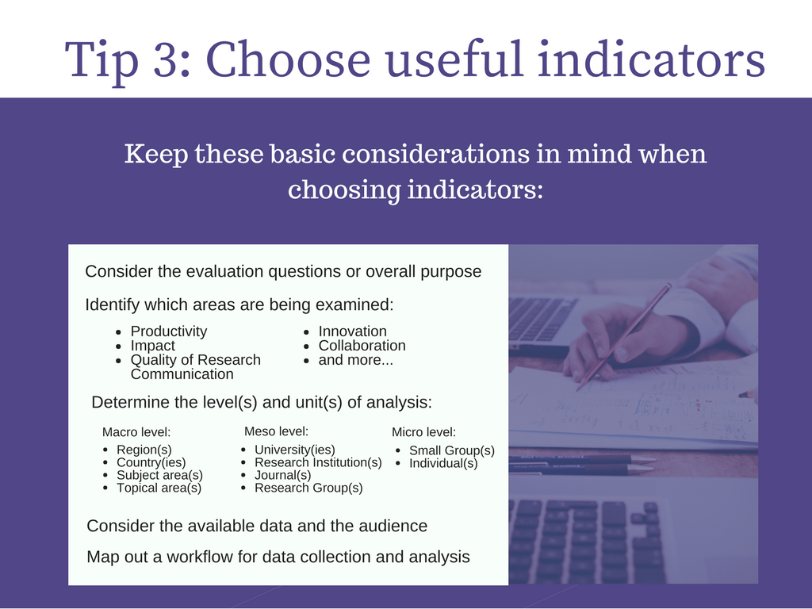
20

Slide 21
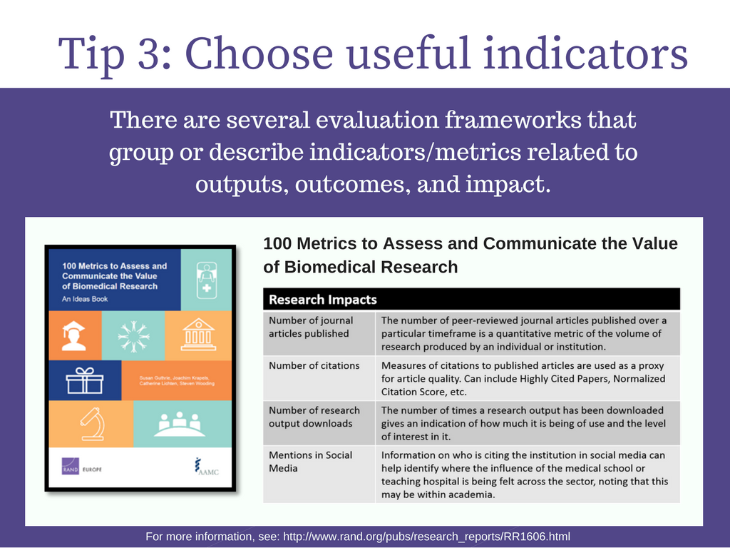
21

Slide 22
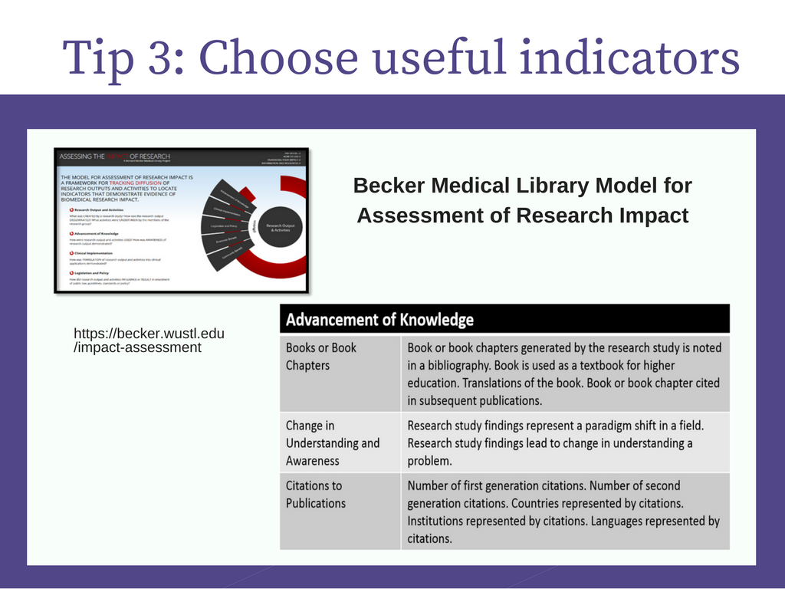
22

Slide 23
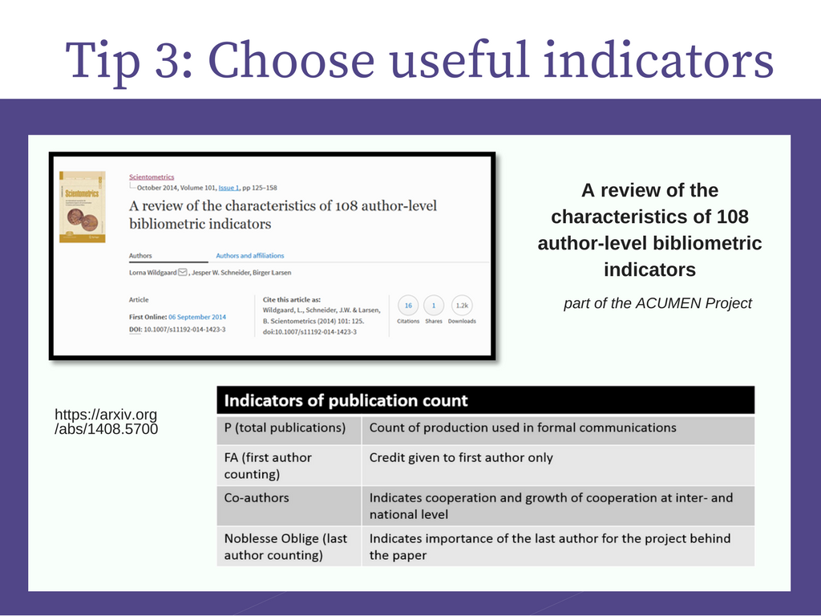
23

Slide 24
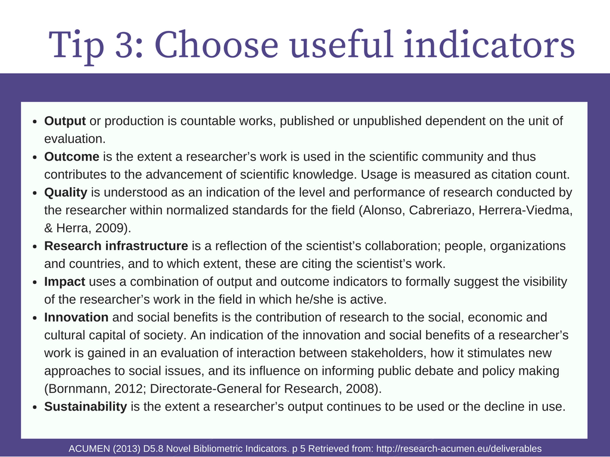
24

Slide 25
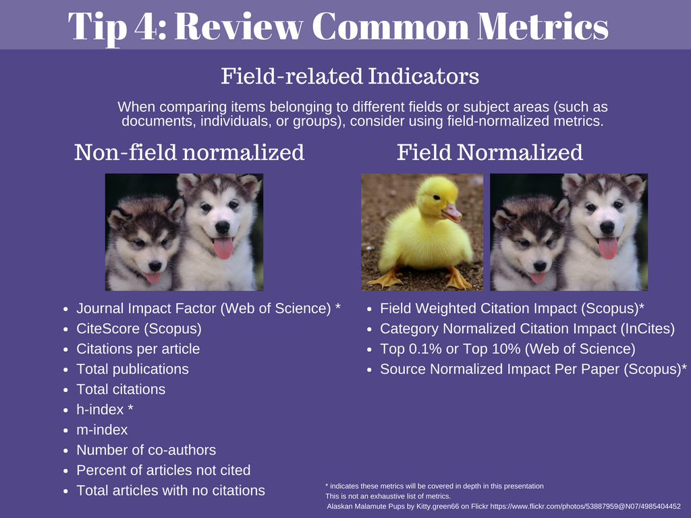
25

Slide 26
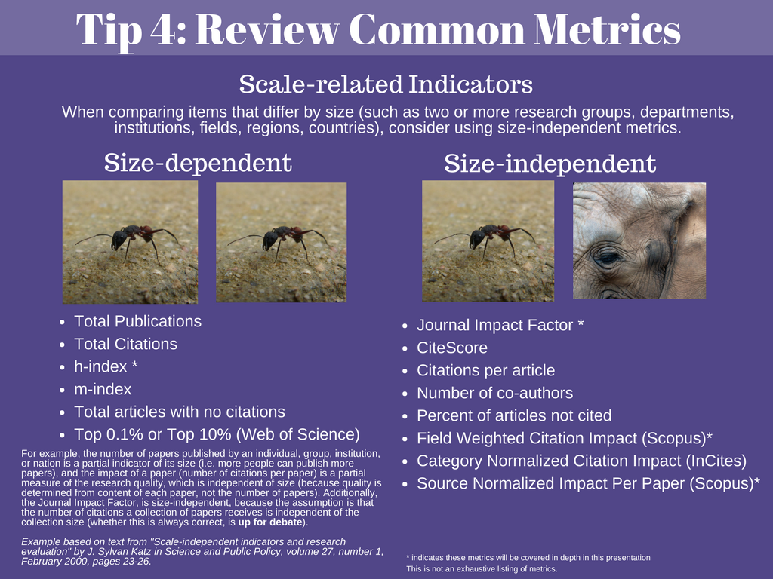
26

Slide 27
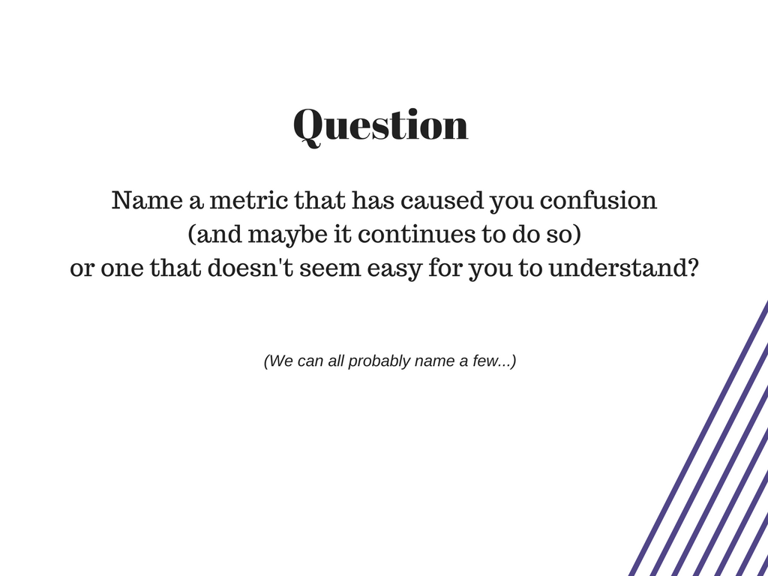
27

Slide 28
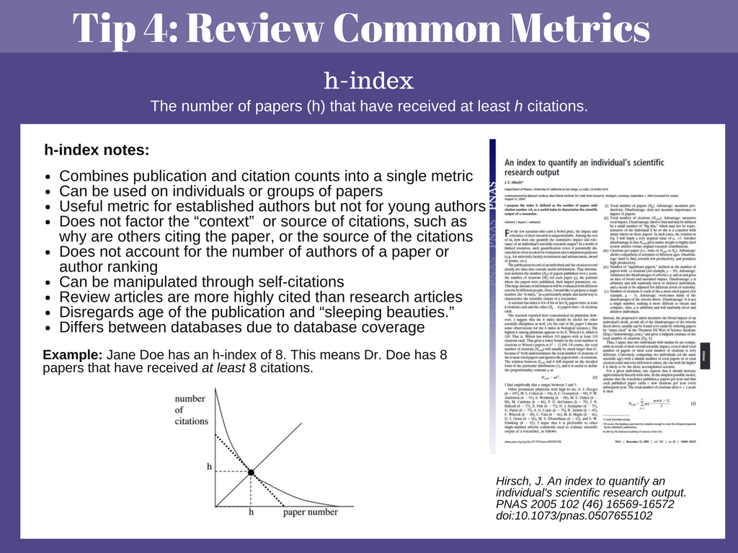
28

Slide 29
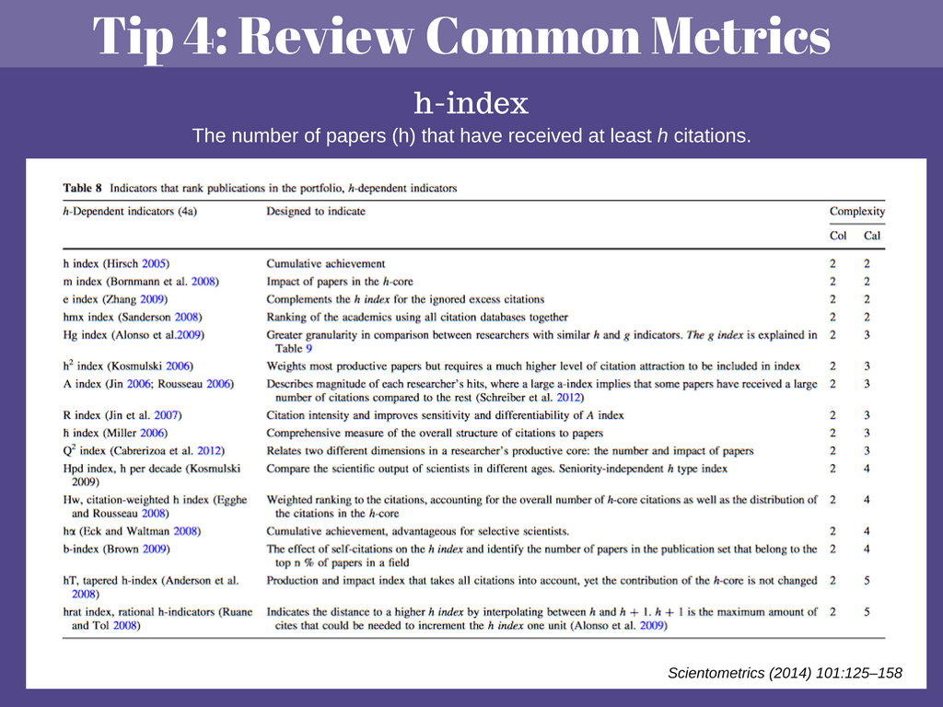
29

Slide 30
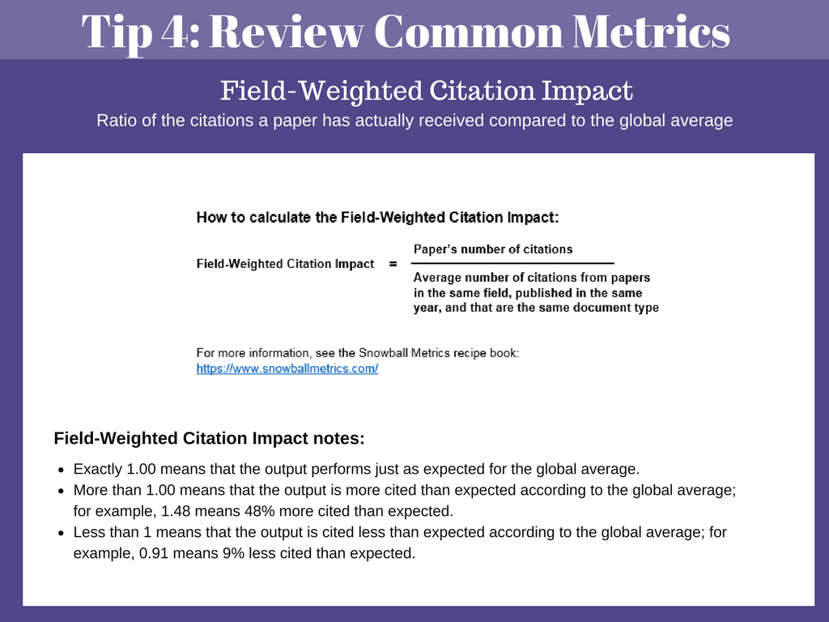
30

Slide 31
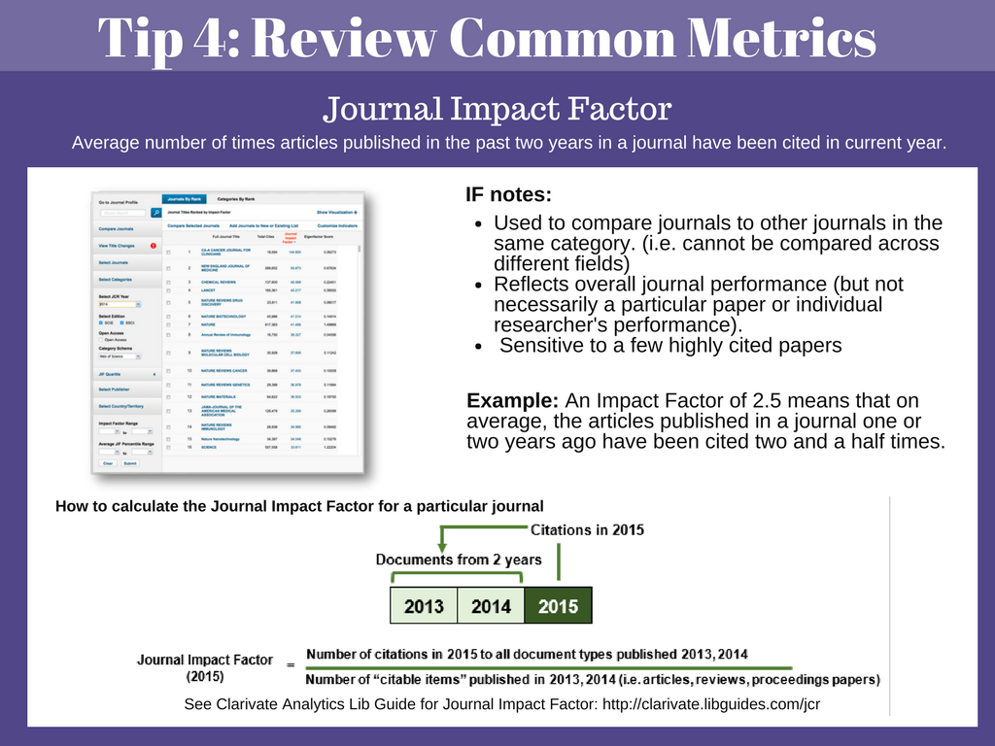
31

Slide 32
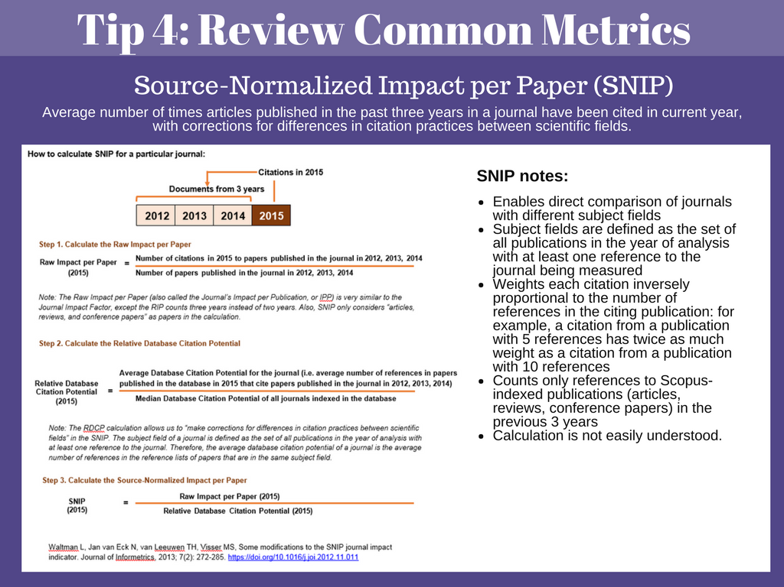
32
Notes:
Raw Impact per Paper is also called the Impact per Publication, and is similar to Journal Impact Factor, just using 3 years instead of 2 years.
Database Citation Potential is the average number of references in the reference lists of papers in the same subject field. Subject field is defined as the set of all publications in the year of analysis with at least one reference to the journal’s articles published in the previous three years.
Divided by the Median Database Citation potential of all journals indexed in the database.

Slide 33

Scope
Data Quality
Freshness of Data
Availability
Architecture
Cost
Categories from: Bioinformatics: A Practical Guide to the Analysis of Genes & Proteins, (third edition). Edited by Andreas D. Baxevanis and B.F. Francis Ouellette, New York: John Wiley & Sons; ISBN: 0471 478784
33
Notes:
Some common databases we use are Scopus, Web of Science, PubMed, NIH Reporter, and Symplectic Elements. Google Scholar is another common data source.
So how do you choose your data sources? Realistically, many people don’t have access to a plethora of databases. But whether you have access to 10 databases or 1, it is good to consider the Scope of the database, the data quality, the freshness of the data, availabiltiy/accessiblity, technical architecture, and of course, cost.
When you run your searches (for research evaluation or a systematic review, etc.), it is good to keep these points in mind or at least know where to find more information, because the architecture or data quality could inform your decision on whether or not to use (or even purchase) a particular resource.

Slide 34
Scope: What are you looking for?
Domain coverage
Citation data
Indexing of books, conference materials, etc.
Links to scope information:
Scopus
Clarivate Analytics
PubMed
https://www.elsevier.com/solutions/scopus/content
https://clarivate.libguides.com/webofscienceplatform/coverage
https://www.nlm.nih.gov/pubs/factsheets/dif_med_pub.html
34
Notes:
First on the list is Scope or the coverage of the database. You have to ask yourself the question “What am I looking for?” when you start your project.
What years does the database span?
Does the database include citation data? – if I’m working on a project where the researcher has been publishing since the 1960s, I want to make sure I’m getting the most complete picture of their research career. Maybe I want to use Web of Science for this project because they have cited references dating back to 1900, whereas Scopus goes back to ~1970.
What journals are indexed?
Does the database index other materials such as books or conference proceedings?
Nurses: Might use CINAHL.

Slide 35
Data Quality: Depends heavily on data curation, validation can be difficult.
Completeness of individual author information:
>Disambiguated author information
>Author affiliation for all authors
How clean is the data?
35
Notes:
Data quality can be difficult to assess, depends on journal info. but looking at the individual author information is often at the forefront of my mind when working on an evaluation project. Does the database list affiliations for all authors on a paper? Author name disambiguation is a huge issues – this is one thing that I think Scopus does quite well.
Also – how complete and clean data? DOI? PMIDs? E-pub ahead of print and in-press articles present a problem for many databases. Scopus doesn’t process in-press articles the same way as regular items and cited reference lists are not available and they do not contribute citations to other documents. Lag time in replacing these with the published article.
2014 – MEDLINE began allowing affiliation information for all authors.

Slide 36
Freshness of Data:
Well-maintained databases with current information can indicate a higher quality database.
Consider update frequency and the update process.
36
Notes:
In the same vein of data quality, you’ll want to consider the freshness of the data and how often the databases are updated. For example, if you’re working with a department and they give you a list of recently published articles with the PMIDs and you run that PMID search in WOS or Scopus, you won’t retrieve all of the papers you searched for. MEDLINE is searchable in WOS and Scopus, so this seems like it shouldn’t happen. Lag time.

Slide 37
Availability: Download restrictions and IP restrictions
37
Notes:
For many projects you work on, you’ll probably want to export the data to an excel spreadsheet or some other tool so you can further analyze and visualize the data. WOS standard export has a 500 record limit, whereas Scopus has an export limit of 20,000. Time!
API access.

Slide 38
Architecture: Interfaces that are easy to use. Search capabilities, i.e. Booleansearching, controlled vocabularies, etc.
38
Notes:
Is the technical architecture easy to use? Pay attention to search capabilities, boolean, controlled vocabulary, advanced searching, saving searches.

Slide 39
Cost!
39

Slide 40

What are your favorite tools for analyzing and/or visualizing data?
40

Slide 41
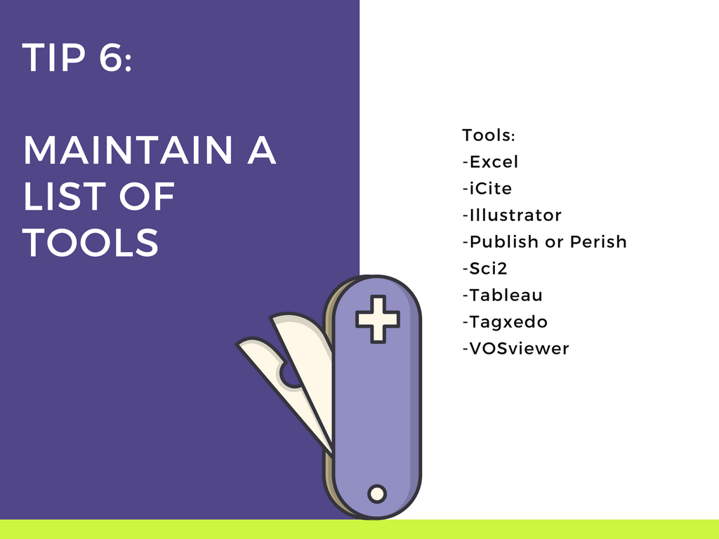
41
Notes:
It is a good idea to have a few tools in your back pocket that can help you analyze data and visualize data. I’ll go into more detail about icite, sci2, publish or perish, and vosviewer, but Tableau and Tagxedo are two additional tools that will help you visualize data. Tagxedo helps you create wordclouds
Tableau Public is free, create graphs, maps, etc.

Slide 42
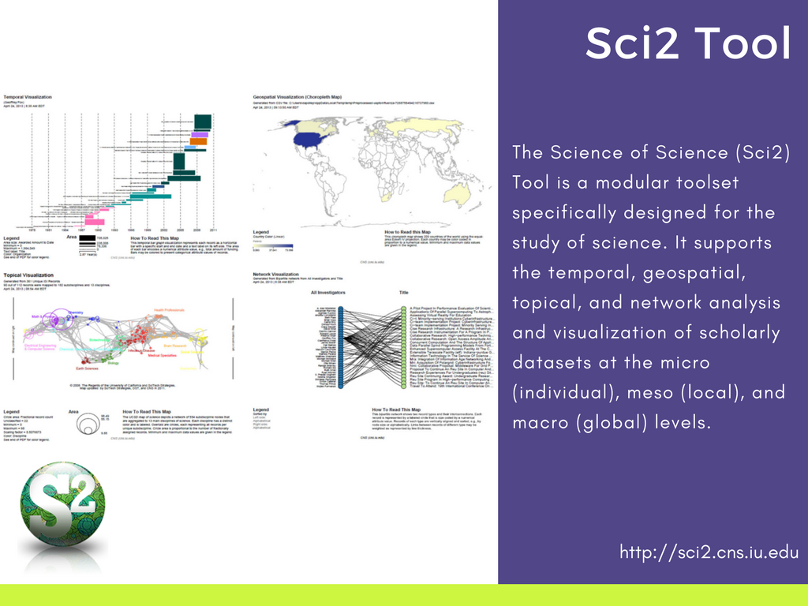
http://sci2.cns.iu.edu
42
Notes:
Developed at Indiana University, and is a “tool for the science of science” and we use it at Galter to visualize citation and publication data. Choropleth maps and co-author network maps.
You can download Sci2 for free, and they have plenty of free tutorials and the Information visualization MOOC that can help get started with using the tool.

Slide 43
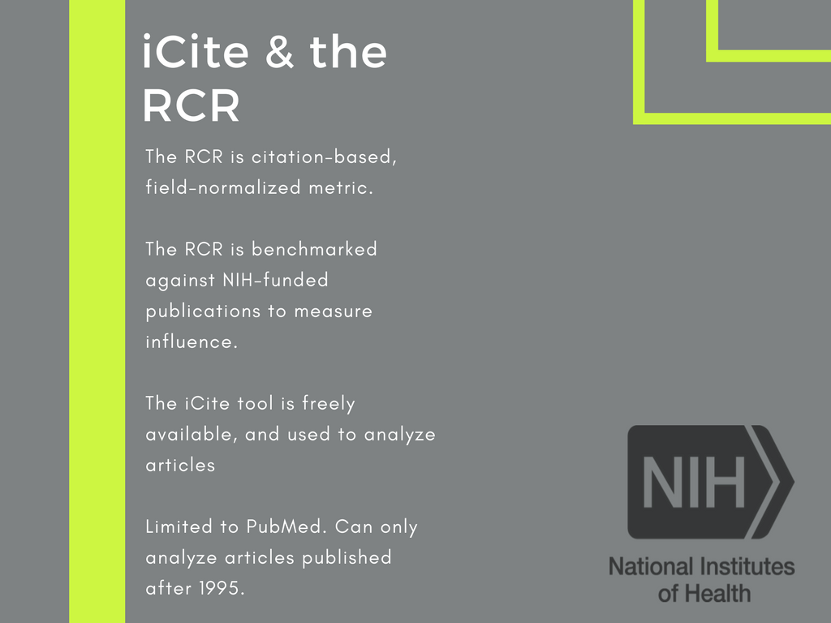
doi:10.18131/G3QM76
https://icite.od.nih.gov/
43
Notes:
The Relative Citation Ratio is a new metric developed within the Office of Portfolio Analysis (OPA) that represents a citation-based measure of scientific influence of one or more articles. Article level metric.
iCite is the tool you use to retrieve bibliographic information for an individual paper or a set of papers. Once you run your query in iCite, you’ll see the mean number of articles published per year, the number of citations per year, the Relative Citation Ratio, and the Weighted RCR. You will also see the percentile ranking for the papers.
The iCite tool is freely available, but you’re limited to searching articles that are in PubMed and you can only analyze articles back to 1995. But it is very easy to use.
When do we use it? Biosketches.

Slide 44
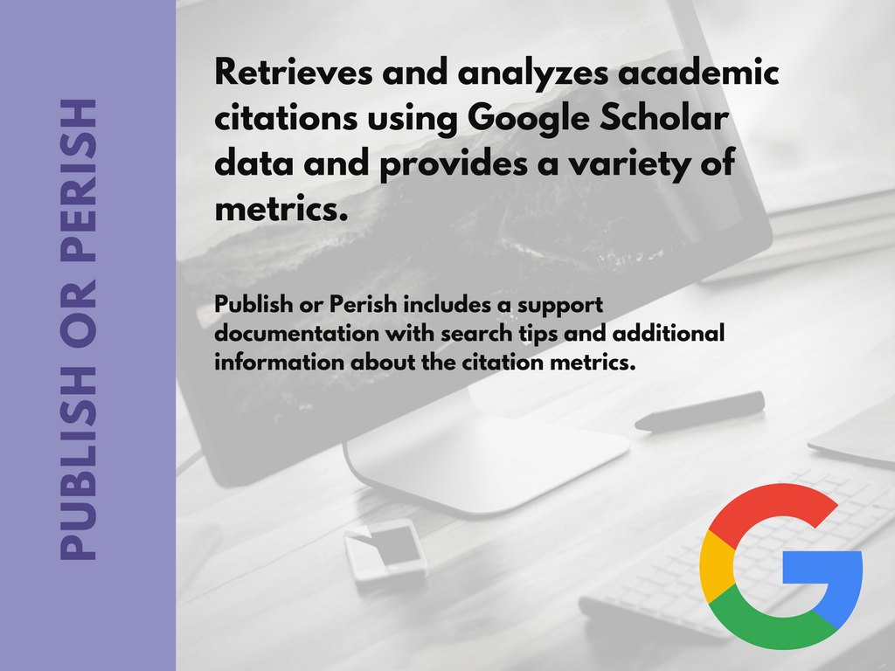
https://harzing.com/resources/publish-or-perish
44
Notes:
Created by Anne-Wil Harzing, Publish or Perish is a software program that you download to your desktop, and it retrieves and analyzes academic citations. It uses a variety of data sources (incl. Google Scholar and Microsoft Academic Search) to obtain the raw citations, then analyzes these and presents a variety of metrics.
-Total number of papers and total number of citations
-Hirsch's h-index and related parameters
-The g-index
-The average annual increase in the individual h-index
-The age-weighted citation rate
-An analysis of the number of authors per paper.
Name disambiguation problems. You can look up a Google scholar author profile, but that person has to make sure their profile is up to date. The Publish or Perish does contain a lot of information to help you use the tool, and Harzing has a book titled “The Publish or Perish Book”. She also has a nice list of definitions of different metrics.

Slide 45
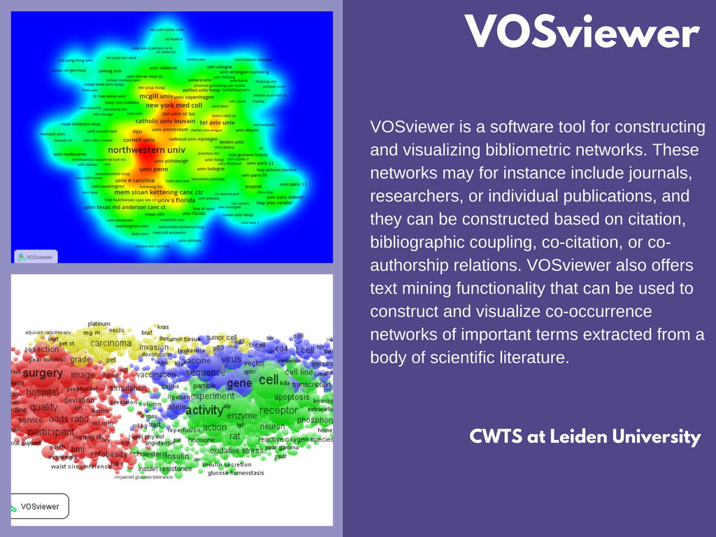
http://www.vosviewer.com/
45
Notes:
VOSviewer is a software tool for constructing and visualizing bibliometric networks. It is a free tool from the CWTS at Leiden University, and they have freely available manuals and videos to get you started. We use VOSviewer to for topical analysis and co-occurrence networks. – the bottom picture shows how to data breaks down into different clusters based on themes. And we also really like the heat maps that you can create – top picture shows that Northwestern is a hub for research on this particular topic, and we publish a lot of papers.

Slide 46
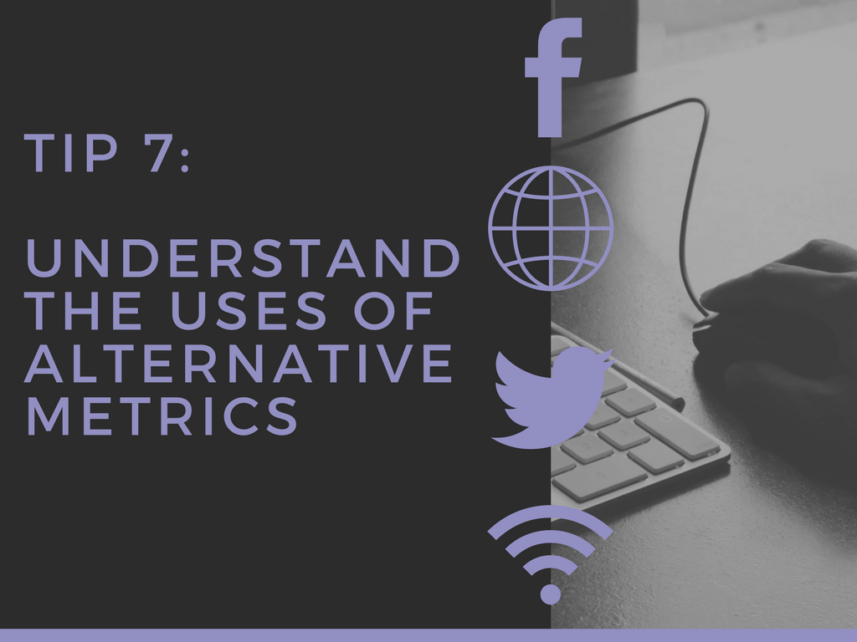
46
Notes:
Altmetrics are data that can explain both the volume and nature of attention that research receives online. Complementary to citation-based metrics or bibliometrics. Altmetrics can measure how many people have shared or engaged with a scholarly output (e.g., an article, a book, a dataset, software, videos, etc). Examples of this include mentions on Twitter or in the mainstream media; page views and downloads.

Slide 47

Have you used alternative metrics in your work?
Yes.
No, but I plan to.
No, and I don’t plan to.
Maybe. I need to learn more.
We realize that many of you are watching in groups, but please choose one answer!
47

Slide 48
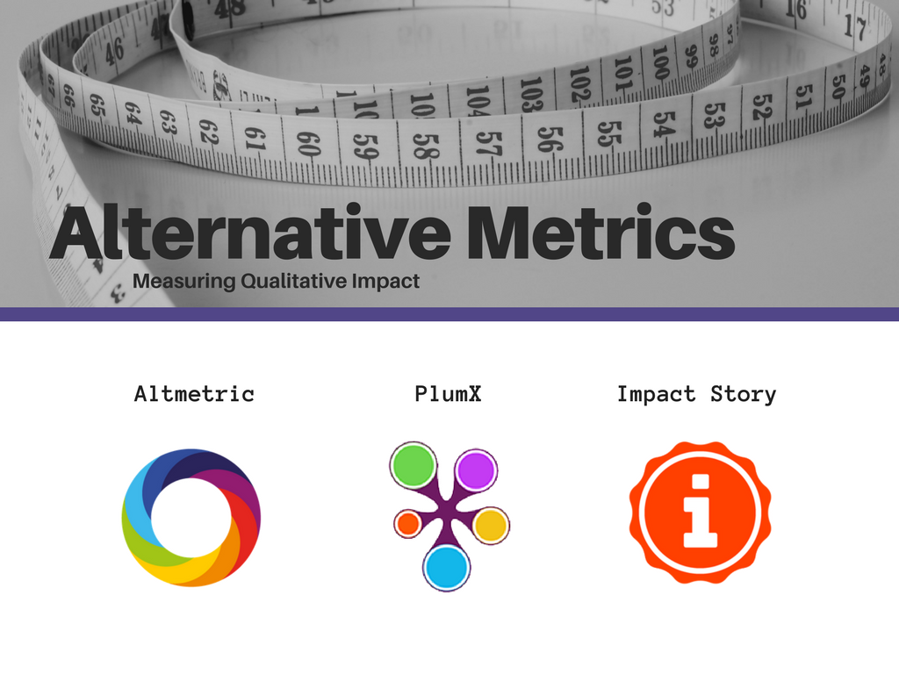
48
2
Notes:
Mention the parent companies.

Slide 49
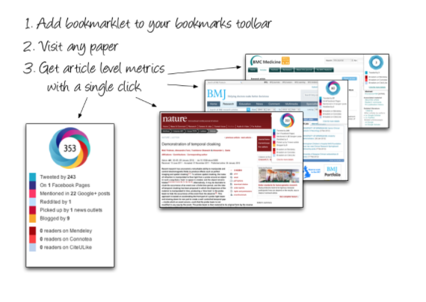
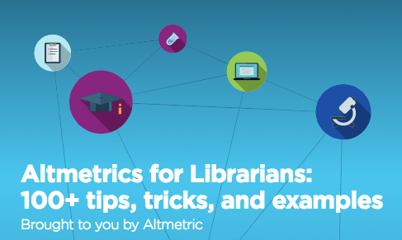

https://www.altmetric.com/products/free-tools/
https://www.altmetric.com/libraries-ebook/
49

Slide 50
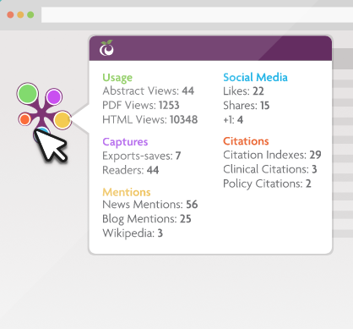

How PlumX Metrics on Scopus help tell the story of your research:
https://www.elsevier.com/solutions/scopus/support/webinars
Plum Goes Orange: Elsevier Acquires Plum Analytics
https://scholarlykitchen.sspnet.org/2017/02/02/plum-goes-orange-elsevier-acquires-plum-analytics/
Spotlight on Captures: Early indicators of citation counts:
https://plumanalytics.com/captures-early-indicators-citation-counts/
50
2

Slide 51
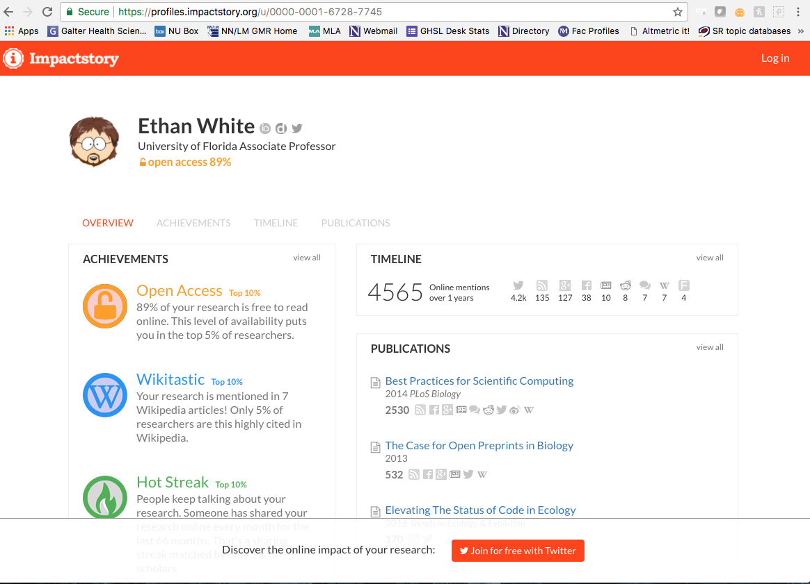
51

Slide 52
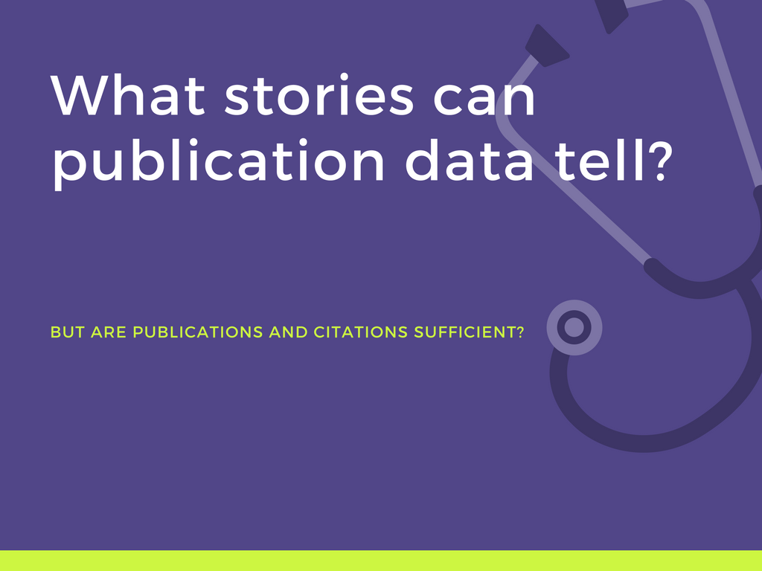
52
2

Slide 53
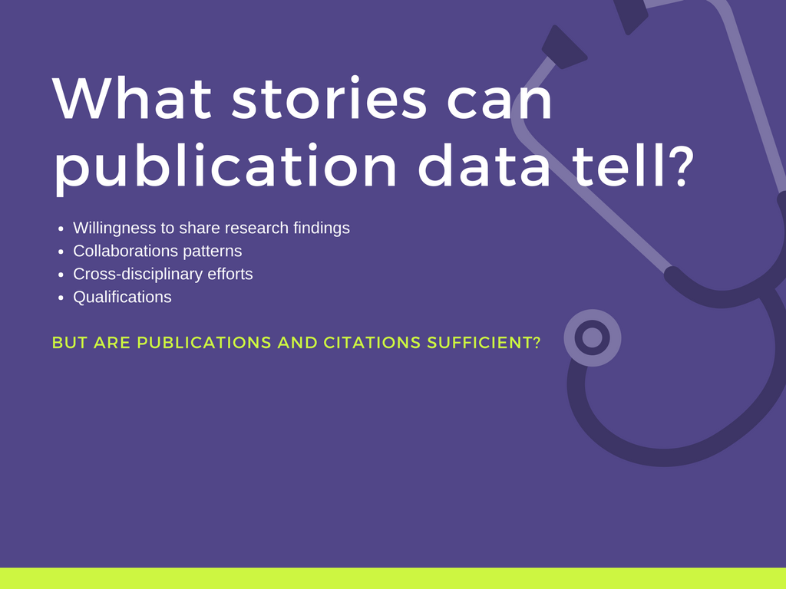
53
2
Notes:
Willingness to share research findings
Authorship/collaboration patterns show evidence of working with other authors, with various areas of research and institutional affiliations
Cross-disciplinary research efforts demonstrates sharing of expertise and efficient use of resources
Qualification to undertake research project
Justification for grant renewal
Qualification for tenure/promotion
Research foci trends illustrate changes in publication activity and evidence of interdisciplinary or transdisciplinary efforts

Slide 54
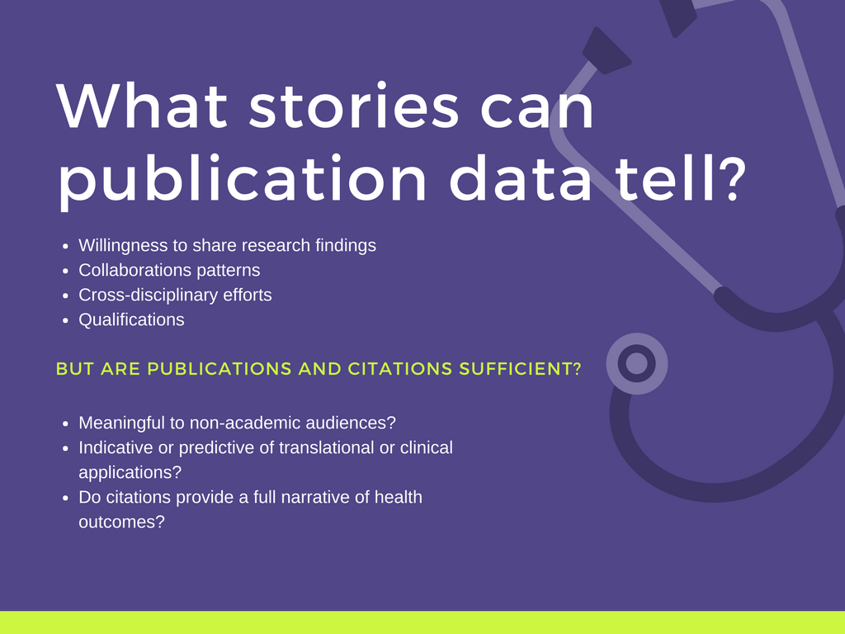
54
Notes:
Meaningful for non-academia audiences? (e.g., public, policy-makers, research participants, healthcare providers, funders, etc.)
Indicative or predictive of translational or clinical applications?
Do citations provide a full narrative of meaningful health outcomes?

Slide 55
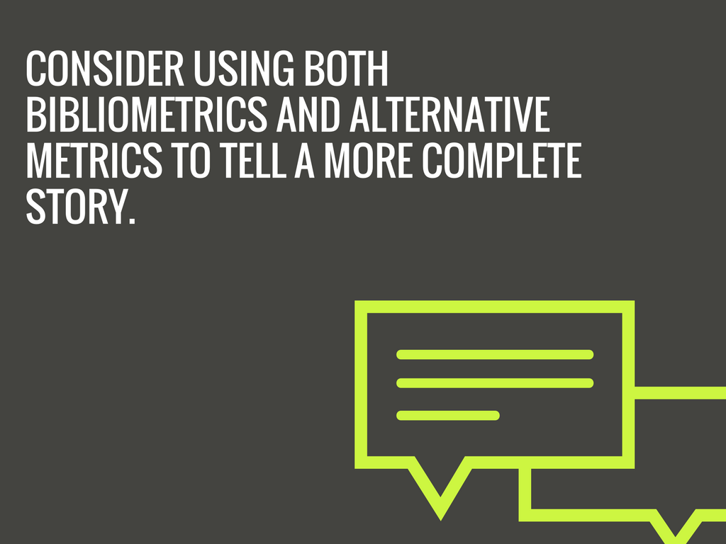
55

Slide 56
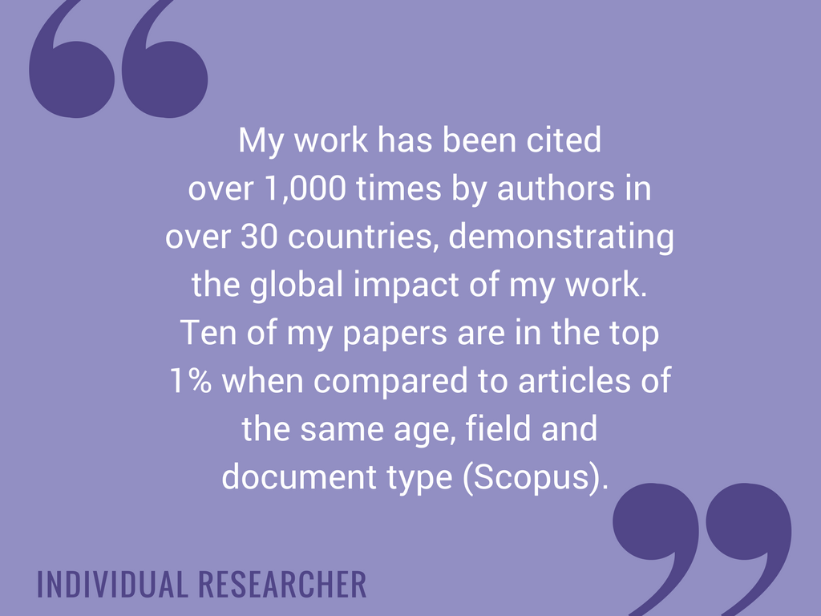
56
Notes:
Karen mentioned considering your audience. This is an example of a narrative that will resonate with funders, administrators and others in academia.

Slide 57
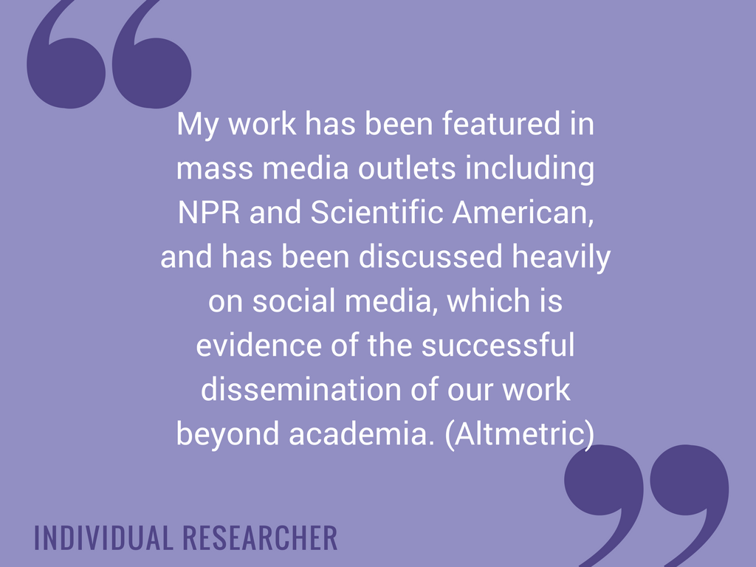
57

Slide 58
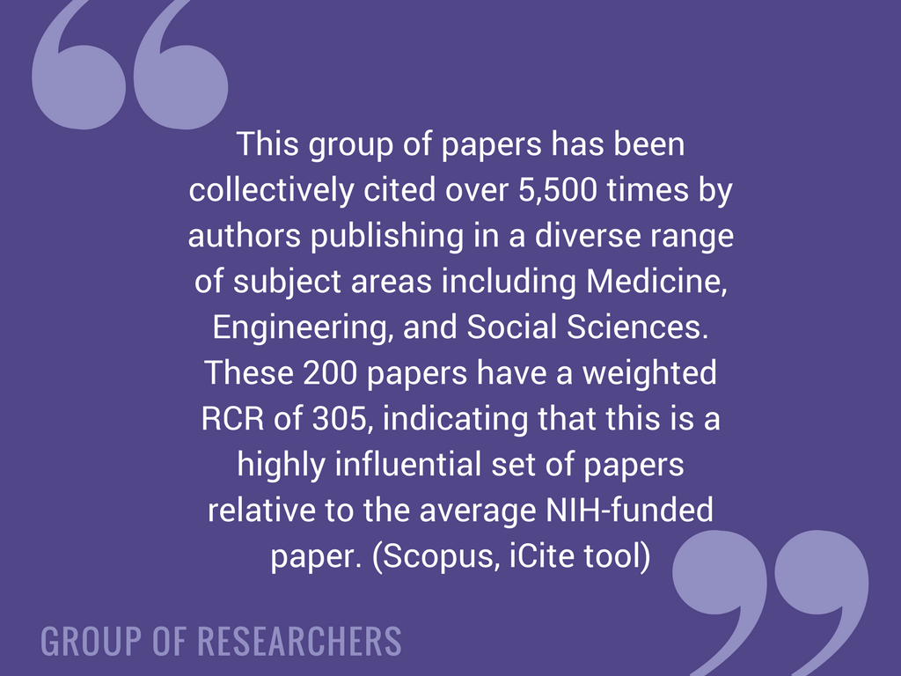
58

Slide 59

59

Slide 60

http://impact.ref.ac.uk/CaseStudies/
https://staticaltmetric.s3.amazonaws.com/uploads/2016/05/NIH-guide.pdf
https://galter.northwestern.edu/news/using-alternative-metrics-to-tell-your-science-story
60
Notes:
Fix you to your

Slide 61

Friday, May 18, 1:00pm-5:00pm
CE200 Dissemination in Action: Communicating Research in a Digital World
LEARN MORE AT MLA’18!
61
2

Slide 62

Link to video: https://vimeo.com/133683418
62
Notes:
1&7. You still need peer review. You still need to read a researcher’s portfolio in order to judge their work. You can’t rely on one number as a an indicator for all of their achievements and activities.
5. To ensure data quality, researchers should be able to check their outputs to make sure they have been correctly identified.
10.
#1, 5, 7, 10
CWTS blog,
Nature blog
Scholarly kitchen

Slide 63

Considerations for libraries and research evaluation
Preparation and Training
Time and Effort
Understanding Risks and Rewards
Possible collaborations at all levels of institution
Support from all levels of leadership
63

Slide 64
Thank you for your time and attention.
Questions?
Karen Gutzman
Karen.gutzman@northwestern.edu
Patty Smith
Patricia.smith@northwestern.edu
Kristi Holmes
Kristi.holmes@northwestern.edu
64

Slide 65
Acknowledgements
Inspiration for researcher narratives, slide deck design and content:
Cathy Sarli and Kristi Holmes, Understanding Evaluation and Research Impact. Medical Library Association Continuing Education. 2014 Medical Library Association Annual Meeting and Exhibition. http://www.cech.mlanet.org/node/846
BeckerGuides: Quantifying the Impact of My Publications: Home. http://beckerguides.wustl.edu/impactofpublications
BeckerGuides: Research Impact: Home. http://beckerguides.wustl.edu/impact
Holmes, Kristi. Using Bibliometric Data for Translational Research Evaluation (an introduction). A presentation for the American Evaluation Association, Translational Research Evaluation Topical Interest Group bi-monthly webinar. August 17, 2016.
65

