Slide 1
Evaluating Research Impact:
Tools, resources, and ideas for getting involved
Karen E Gutzman
Galter Health Sciences Library & Learning Center
Northwestern University Feinberg School of Medicine
Library Connect Webinar Series
Thursday, July 12, 2018

Slide 2
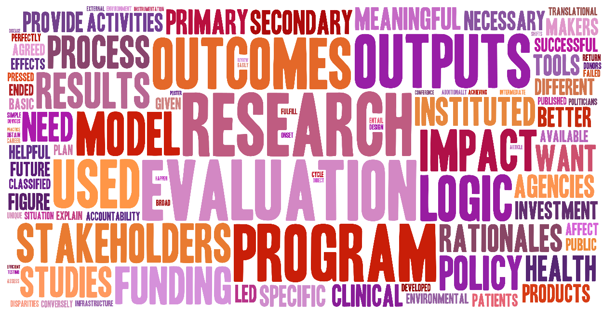
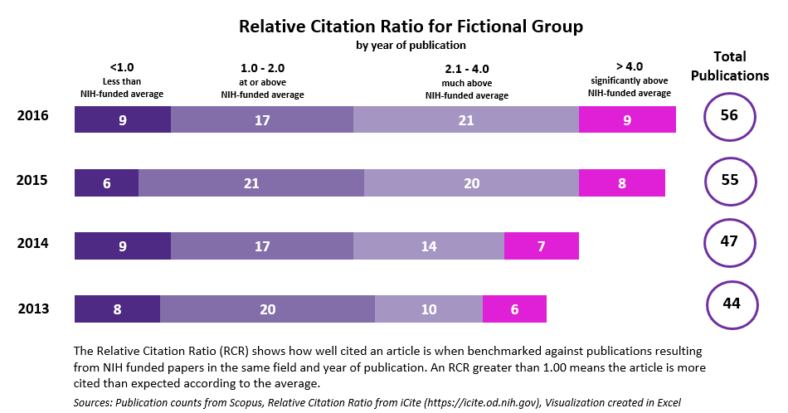
Overview
Part 1.
What is research evaluation?
Part 2.
Tools and resources for evaluation
Part 3.
Options for library involvement

Slide 3




Why do we evaluate research?
Advocacy
Analysis
Accountability
Allocation
Guthrie S, Wamae W, Diepeveen S, Wooding S, Grant J. Measuring research. 2013. http://www.rand.org/pubs/monographs/MG1217.html.
Notes:
Advocacy: to demonstrate the benefits of supporting research, enhance understanding of research and its processes among policymakers and the public; to make the case for policy and practice change.
Accountability: to show that money has been used efficiently and effectively, and hold researchers to account.
Analysis: to understand how and why research is effective and how it can be better supported, feeding into research strategy and decision-making by providing a stronger evidence base.
Allocation: to determine where best to allocate funds in the future, making the best use possible of a limited funding pot.
“Interest in and demand for the evaluation of research is increasing internationally. This is linked to a growing accountability agenda, driven by the demand for good governance and management growing in profile on national and international stages and fiscal austerity in a number of countries. There is a need to show that policymaking is evidence based and, particularly in the current economic climate, to demonstrate accountability for the investment of public funds in research…Given this growing need for effective and appropriate evaluation of research, it is increasingly important to understand how research can and should be evaluated in different contexts and to meet different needs.”
http://www.rand.org/pubs/monographs/MG1217.html

Slide 4
Why do we evaluate research?
Advocacy
Analysis
Making the case for research
Accountability
Allocation
Guthrie S, Wamae W, Diepeveen S, Wooding S, Grant J. Measuring research. 2013. http://www.rand.org/pubs/monographs/MG1217.html.
Notes:
Advocacy: to demonstrate the benefits of supporting research, enhance understanding of research and its processes among policymakers and the public; to make the case for policy and practice change.
Accountability: to show that money has been used efficiently and effectively, and hold researchers to account.
Analysis: to understand how and why research is effective and how it can be better supported, feeding into research strategy and decision-making by providing a stronger evidence base.
Allocation: to determine where best to allocate funds in the future, making the best use possible of a limited funding pot.

Slide 5
Why do we evaluate research?
Advocacy
Analysis
Making the case for research
Accountability
Allocation
…to taxpayers and donors
Guthrie S, Wamae W, Diepeveen S, Wooding S, Grant J. Measuring research. 2013. http://www.rand.org/pubs/monographs/MG1217.html.
Notes:
Advocacy: to demonstrate the benefits of supporting research, enhance understanding of research and its processes among policymakers and the public; to make the case for policy and practice change.
Accountability: to show that money has been used efficiently and effectively, and hold researchers to account.
Analysis: to understand how and why research is effective and how it can be better supported, feeding into research strategy and decision-making by providing a stronger evidence base.
Allocation: to determine where best to allocate funds in the future, making the best use possible of a limited funding pot.

Slide 6
Why do we evaluate research?
Advocacy
Analysis
Making the case for research
Understanding what works
Accountability
Allocation
…to taxpayers and donors
Guthrie S, Wamae W, Diepeveen S, Wooding S, Grant J. Measuring research. 2013. http://www.rand.org/pubs/monographs/MG1217.html.
Notes:
Advocacy: to demonstrate the benefits of supporting research, enhance understanding of research and its processes among policymakers and the public; to make the case for policy and practice change.
Accountability: to show that money has been used efficiently and effectively, and hold researchers to account.
Analysis: to understand how and why research is effective and how it can be better supported, feeding into research strategy and decision-making by providing a stronger evidence base.
Allocation: to determine where best to allocate funds in the future, making the best use possible of a limited funding pot.

Slide 7
Why do we evaluate research?
Why do we evaluate research?
Advocacy
Analysis
Making the case for research
Understanding what works
Accountability
Allocation
…to taxpayers and donors
Rewarding impact
Guthrie S, Wamae W, Diepeveen S, Wooding S, Grant J. Measuring research. 2013. http://www.rand.org/pubs/monographs/MG1217.html.
Notes:
Advocacy: to demonstrate the benefits of supporting research, enhance understanding of research and its processes among policymakers and the public; to make the case for policy and practice change.
Accountability: to show that money has been used efficiently and effectively, and hold researchers to account.
Analysis: to understand how and why research is effective and how it can be better supported, feeding into research strategy and decision-making by providing a stronger evidence base.
Allocation: to determine where best to allocate funds in the future, making the best use possible of a limited funding pot.

Slide 8
Why do we evaluate research?
Advocacy
Analysis
Making the case for research
Understanding what works
Understand the objective of the research evaluation
Accountability
Allocation
…to taxpayers and donors
Rewarding impact
Guthrie S, Wamae W, Diepeveen S, Wooding S, Grant J. Measuring research. 2013. http://www.rand.org/pubs/monographs/MG1217.html.
Notes:
Advocacy: to demonstrate the benefits of supporting research, enhance understanding of research and its processes among policymakers and the public; to make the case for policy and practice change.
Accountability: to show that money has been used efficiently and effectively, and hold researchers to account.
Analysis: to understand how and why research is effective and how it can be better supported, feeding into research strategy and decision-making by providing a stronger evidence base.
Allocation: to determine where best to allocate funds in the future, making the best use possible of a limited funding pot.

Slide 9
How do we evaluate research?
Basic tool of an evaluation: the Logic Model
Basic organizational diagram of a program.
What RESOURCES
are used?
What ACTIVITIES do we do with those resources?
What OUTPUTS
are produced?
What OUTCOMES do they create?
PROGRAM
Environmental factors: external influences on the process or program
Notes:
Shows an example of a traditional “cause and effect” logic model which describes how the available resources (also known as inputs) and program activities will lead to desired outputs and outcomes (both of which can be measured in the short , intermediate, or long term), given a specific environmental context.

Slide 10
Evaluating a Pre-doctoral Training Program
Environmental factors: external influences on the process or program
What RESOURCES
are used?
What ACTIVITIES do we do with those resources?
What OUTPUTS
are produced?
What OUTCOMES do they create?
Program Manager
Researchers
Conference Room
Funding
Mentorship sessions
Training sessions
Certificate of completion
Joint publications between mentees and mentors
Increased career prospects of mentees
Pre-doctoral Training Program
Notes:
Shows an example of a traditional “cause and effect” logic model which describes how the available resources (also known as inputs) and program activities will lead to desired outputs and outcomes (both of which can be measured in the short , intermediate, or long term), given a specific environmental context.

Slide 11
Evaluating a Pre-doctoral Training Program
What RESOURCES
are used?
What ACTIVITIES do we do with those resources?
What OUTPUTS
are produced?
What OUTCOMES do they create?
What amount of time and money was used?
How many mentorship sessions?
How many attended or did not attend?
How many trainees completed the program?
How many documents were published in scholarly literature?
Did mentees have improved career prospects?
To what extent has the program developed the careers of mentees?
Evaluation Questions
Notes:
Shows an example of a traditional “cause and effect” logic model which describes how the available resources (also known as inputs) and program activities will lead to desired outputs and outcomes (both of which can be measured in the short , intermediate, or long term), given a specific environmental context.

Slide 12
Evaluating a Pre-doctoral Training Program
What RESOURCES
are used?
What ACTIVITIES do we do with those resources?
What OUTPUTS
are produced?
What OUTCOMES do they create?
Indicators
# of Staff
Costs
# of sessions held
Quality criteria of sessions
# of mentees
# and types of mentees reached
# of publications
% employed
% remain in research over time
Notes:
Shows an example of a traditional “cause and effect” logic model which describes how the available resources (also known as inputs) and program activities will lead to desired outputs and outcomes (both of which can be measured in the short , intermediate, or long term), given a specific environmental context.

Slide 13
Evaluating a Pre-doctoral Training Program
What RESOURCES
are used?
What ACTIVITIES do we do with those resources?
What OUTPUTS
are produced?
What OUTCOMES do they create?
Indicators
# of Staff
Costs
# of sessions held
Quality criteria of sessions
# and types of mentees reached
% employed
% remain in research over time
Process Indicators
Impact Indicators
Notes:
Shows an example of a traditional “cause and effect” logic model which describes how the available resources (also known as inputs) and program activities will lead to desired outputs and outcomes (both of which can be measured in the short , intermediate, or long term), given a specific environmental context.
Outcomes and Impacts are downstream measures of performance.

Slide 14
Evaluating a Pre-doctoral Training Program
What RESOURCES
are used?
What ACTIVITIES do we do with those resources?
What OUTPUTS
are produced?
What OUTCOMES do they create?
Indicators
# of Staff
Costs
# of sessions held
Quality criteria of sessions
# and types of mentees reached
% employed
% remain in research over time
Process Indicators
Impact Indicators
Notes:
Shows an example of a traditional “cause and effect” logic model which describes how the available resources (also known as inputs) and program activities will lead to desired outputs and outcomes (both of which can be measured in the short , intermediate, or long term), given a specific environmental context.

Slide 15
Overview
Part 1.
What is research evaluation?
Part 2.
Tools and resources for evaluation
Part 3.
Options for library involvement

Slide 16
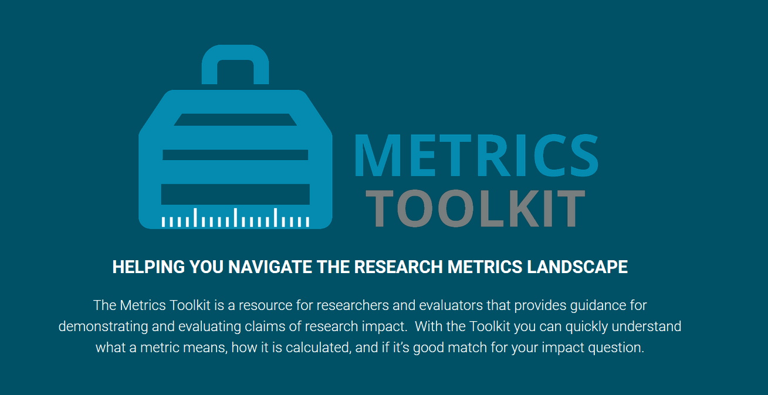
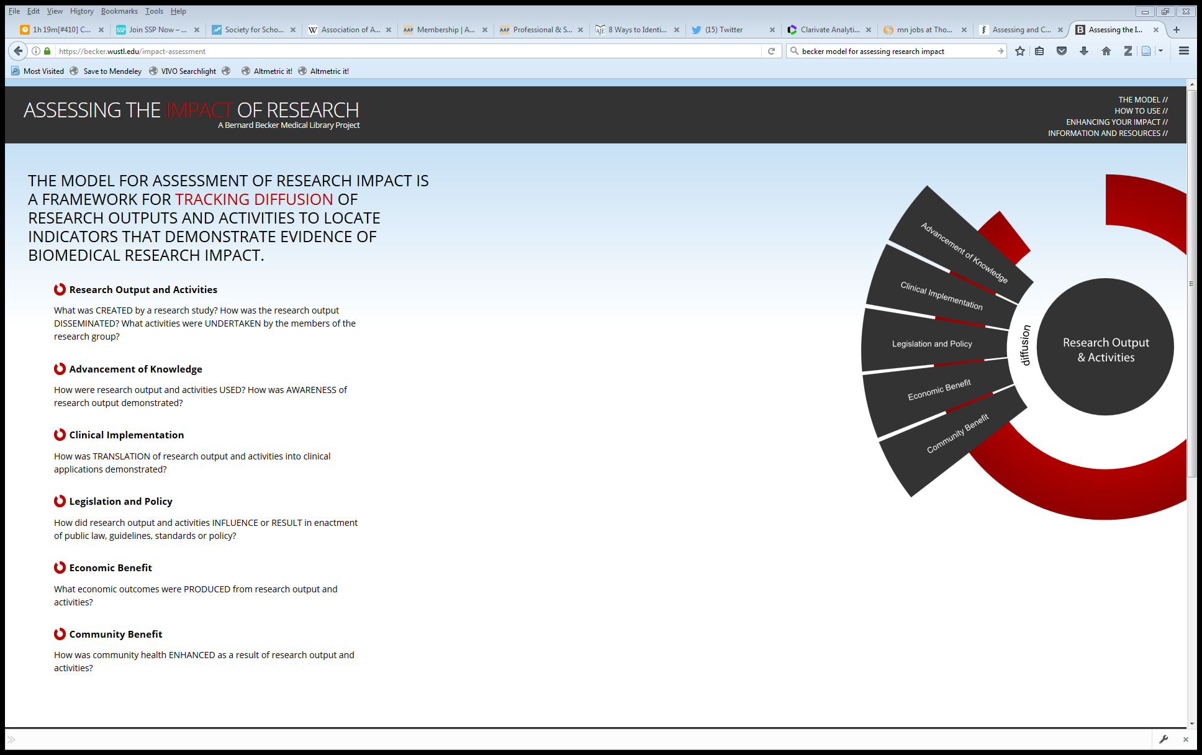
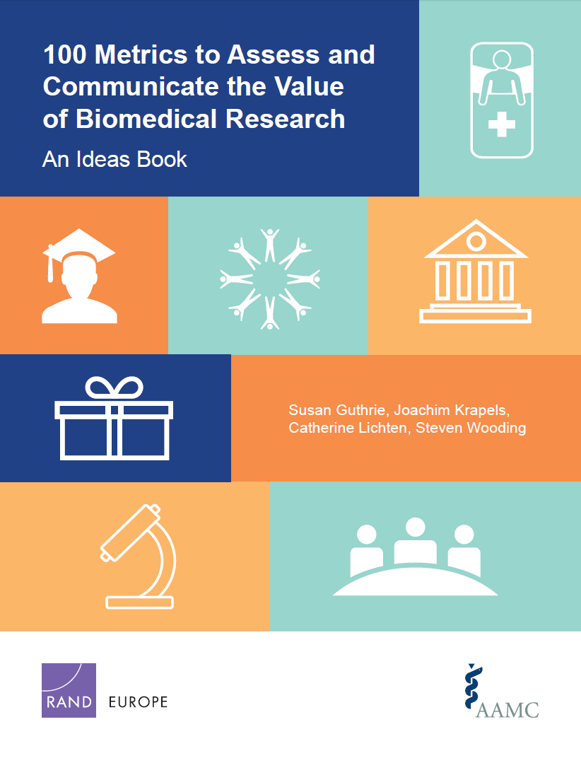
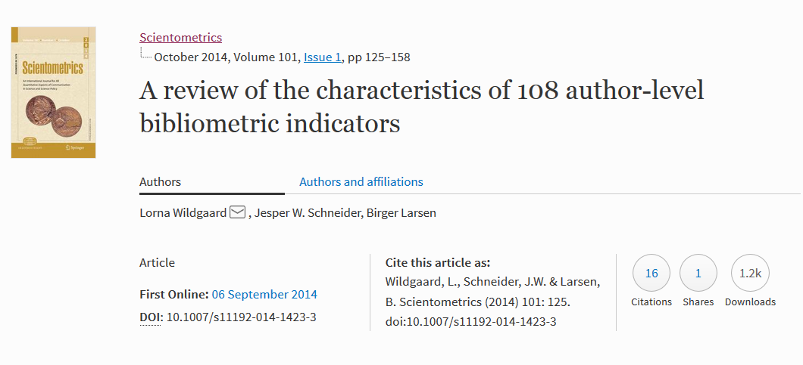
Building a library of indicators
above: http://www.metrics-toolkit.org/
above: https://becker.wustl.edu/impact-assessment
above: https://arxiv.org/abs/1408.5700
above: http://www.rand.org/pubs/research_reports/RR1606.html

Slide 17

Building a library of indicators
100 Metrics to Assess and Communicate the Value of Biomedical Research
Research Impacts
Number of journal articles published | The number of peer-reviewed journal articles published over a particular timeframe is a quantitative metric of the volume of research produced by an individual or institution.
Number of citations | Measures of citations to published articles are used as a proxy for article quality. Can include Highly Cited Papers, Normalized Citation Score, etc.
Number of research output downloads | The number of times a research output has been downloaded gives an indication of how much it is being of use and the level of interest in it.
Mentions in Social Media | Information on who is citing the institution in social media can help identify where the influence of the medical school or teaching hospital is being felt across the sector, noting that this may be within academia.
http://www.rand.org/pubs/research_reports/RR1606.html

Slide 18


Building a library of indicators
Becker Medical Library Model for Assessment of Research Impact
Advancement of Knowledge
Books or Book Chapters | Book or book chapters generated by the research study is noted in a bibliography. Book is used as a textbook for higher education. Translations of the book. Book or book chapter cited in subsequent publications.
Change in Understanding and Awareness | Research study findings represent a paradigm shift in a field. Research study findings lead to change in understanding a problem.
Citations to Publications | Number of first generation citations. Number of second generation citations. Countries represented by citations. Institutions represented by citations. Languages represented by citations.
https://becker.wustl.edu/impact-assessment

Slide 19
Building a library of indicators
A review of the characteristics of 108 author-level bibliometric indicators
Indicators of publication count
P (total publications) | Count of production used in formal communications
FA (first author counting) | Credit given to first author only
Co-authors | Indicates cooperation and growth of cooperation at inter- and national level
Noblesse Oblige (last author counting) | Indicates importance of the last author for the project behind the paper
https://arxiv.org/abs/1408.5700

Slide 20
Building a library of indicators
Metrics Toolkit
Indicators of Attention, Research, or Diffusion
Blog Mentions | The number of times a scholarly output has been linked to from a blog.
Software Citations | The number of times a piece of software or code (or a paper that describes software or code) has been cited as a resource in a journal article or book.
Software Downloads | File downloads over a period of time.
Github: Forks, Collaborators, Watchers | Github “Forks” are created when a user makes a copy of a repository (i.e., a group of files). A “collaborator” is another Github user who is able to perform many actions on the files within the repository, including edits. “Watchers” are Github users who have asked to be notified of activity in a repository, but have not become collaborators. Watching a repository is similar to following an RSS feed to see changes.
http://www.metrics-toolkit.org/
Notes:
The Metrics Toolkit is a resource for researchers and evaluators that provides guidance for demonstrating and evaluating claims of research impact. With the Toolkit you can quickly understand what a metric means, how it is calculated, and if it’s good match for your impact question.

Slide 21
Overview
Part 1.
What is research evaluation?
Part 2.
Tools and resources for evaluation
Part 3.
Options for library involvement

Slide 22

Host a class at your library
Enhancing the Impact of Your Research
  Want to make your research more discoverable? Wonder how to discuss your research impact? Join us for this practical class in learning how to enhance your research impact. The class briefly covers the concept of research impact, including definitions and a discussion on why thinking about research impact is important, and is offered to faculty, students or staff.
  Participants will learn practical strategies on:
    establishing an online presence
    enhancing the discovery of scholarly outputs
    increasing the dissemination of scholarly outputs
    communicating the impact of your research
above: screenshot of Enhancing the Impact of Your Research opening slide
Notes:
developing successful publishing strategies
managing or tracking publications
maintaining an impactful online identity
measuring or assessing research impact by discipline
communicating research impact to audiences
Karen Gutzman is our Impact and Evaluation Librarian. You can contact her directly or through your liaison librarian.

Slide 23
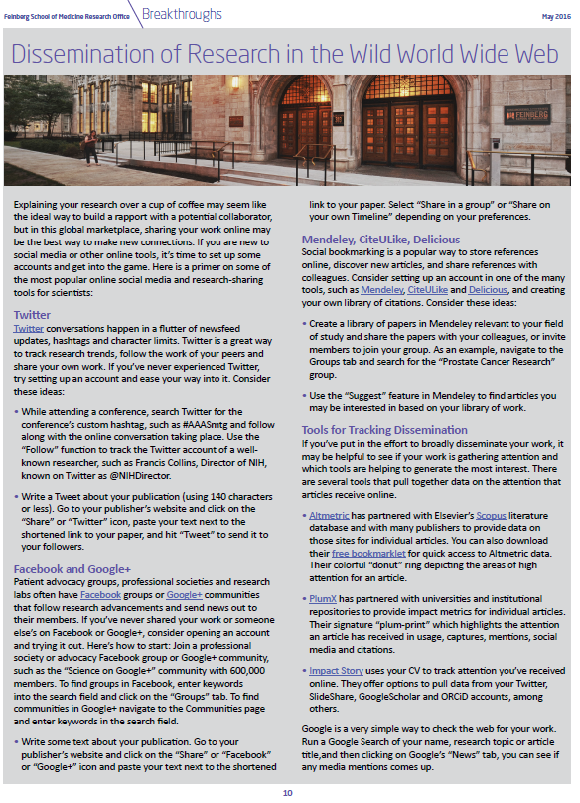
Disseminate information about metrics and indicators
We write content for Breakthroughs
(FSM Office of Research monthly newsletter) and Galter News
  Recent news items include:
    Writing About Your Impact on the New NIH Biosketch
    Sharing, Publishing, and Archiving Your Work
    Visualizing Science at Feinberg School of Medicine
    Matchmaker, Make Me a Match: Choosing a Journal
above: screenshot of Breakthroughs article : Dissemination of Research in the Wild World Wide Web
Optimizing Your Article for Discovery
https://galter.northwestern.edu/news/optimizing-your-article-for-discovery
Notes:
developing successful publishing strategies
managing or tracking publications
maintaining an impactful online identity
measuring or assessing research impact by discipline
communicating research impact to audiences
Karen Gutzman is our Impact and Evaluation Librarian. You can contact her directly or through your liaison librarian.

Slide 24
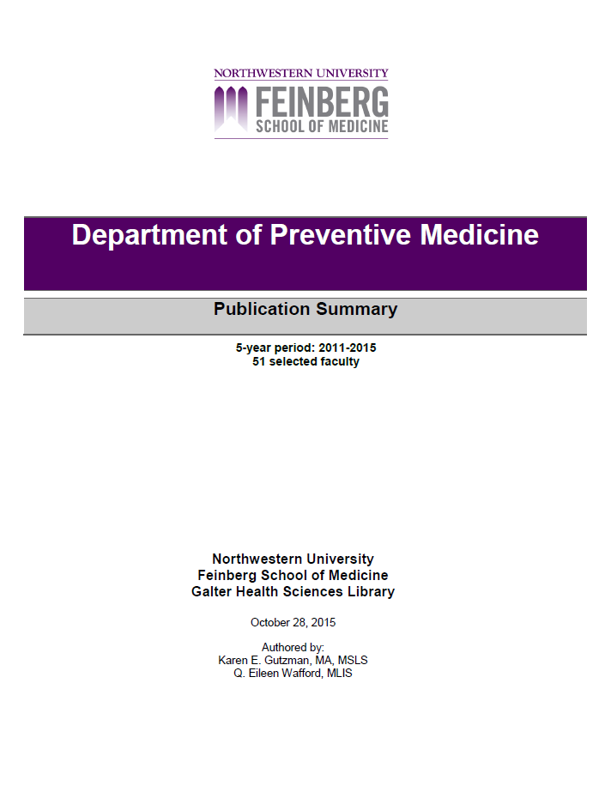
Create an impact report template for groups
Productivity: how much research was produced and who produced it
  # of researchers in department
  # of articles published by faculty
  Average articles per year
  # of unique source (journal) titles
Collaboration: who worked together to make the research happen
  # of country affiliations of co-authors
  # of top institutional affiliations of co-authors
  Listing of funding organizations from 2014 to present
Research Topics: what the research was about
  Document types for published articles
  Top key words used in articles
  Top subject areas of source (journal) titles
above: screenshot of title page of group publication summary
Requestor: Office of Finance and Administration or departmental administrators, NU FSM
Please note: this is not an exhaustive list of indicators. Indicator categories by Chris Belter, NIH Library

Slide 25
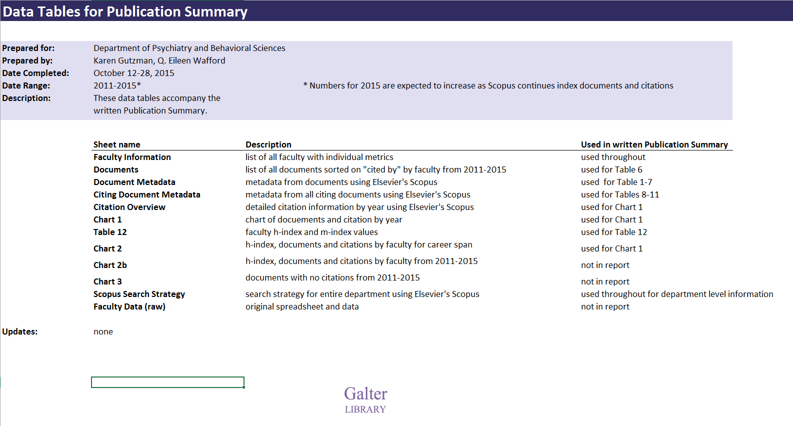
Group Publication Summaries continued…
Create an impact report template for groups
Citation Impact for Department: the impact it had on subsequent scientific research
  Total citations
  Average citations per year
  Average citations per publication
  Citations by year of publication
  Citations cumulative
  Citations by year of publication per publication
  Most highly cited publication
  # of country affiliations of citing authors
  # of languages of citing articles
  # of unique source (journal titles) from citing articles
  # of unique country affiliations of citing authors
  # of unique institutional affiliations of citing authors
  h- index of departmental documents
  # of documents with no citations
  Hot or Highly Cited publications
    Citation Impact for Individuals: the impact he/she had on subsequent scientific research
  Total published articles (career span and report timespan)
  Total citations (career span and report timespan)
  h-index
  m-index
  # of co-authors
Please note: this is not an exhaustive list of indicators. Indicator categories by Chris Belter, NIH Library
above: screenshot of excel data tables file for group publication summary

Slide 26
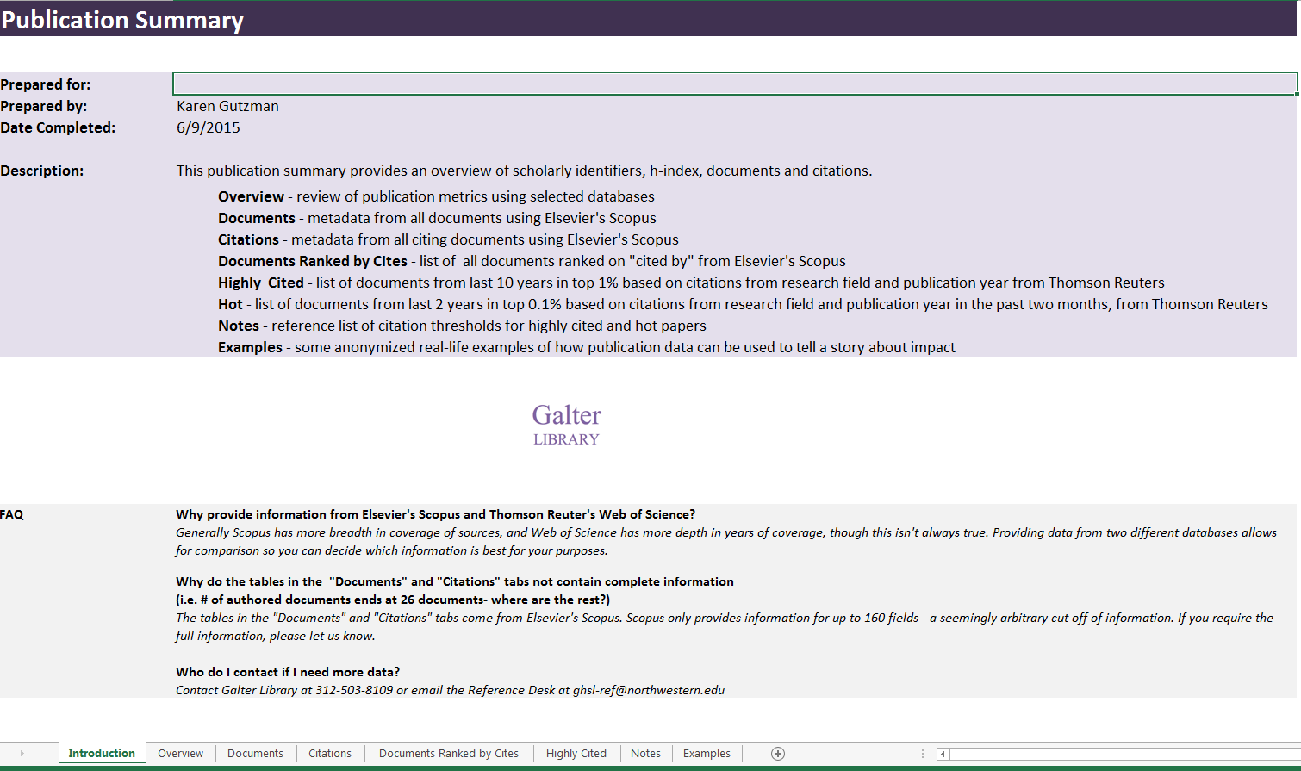
Individual Publication Summary
Create an impact report template for individuals
Productivity: how much research was produced and who produced it
  # of articles published by faculty
  Average articles per year
  # of unique source (journal) titles
Collaboration: who worked together to make the research happen
  # of country affiliations of co-authors
  # of top institutional affiliations of co-authors
  Listing of funding organizations from 2014 to present
Research Topics: what the research was about
  Document types for published articles
  Top key words used in articles
  Top subject areas of source (journal) titles
Citation Impact: the impact it had on subsequent scientific research
  Total citations
  Average citations per year
  Most highly cited publication
  # of country affiliations of citing authors
  # of languages of citing articles
  # of unique institutional affiliations of citing authors
  Hot or Highly Cited publications
  h-index
  m-index
above: screenshot of excel data tables file for individual publication summary
Please note: this is not an exhaustive list of indicators. Indicator categories by Chris Belter, NIH Library
Requestor: Researchers, NU FSM

Slide 27
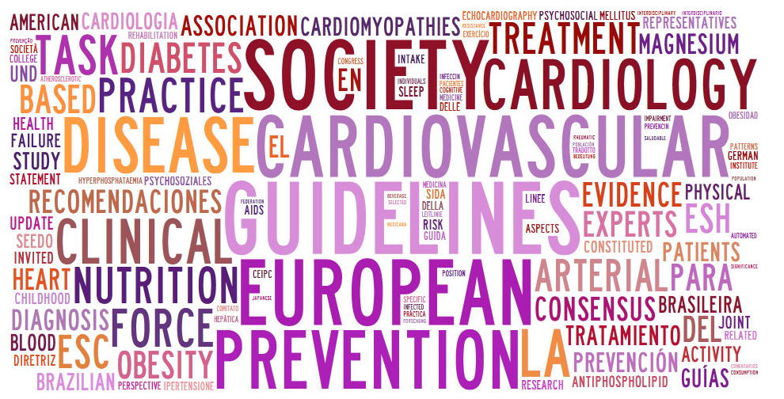
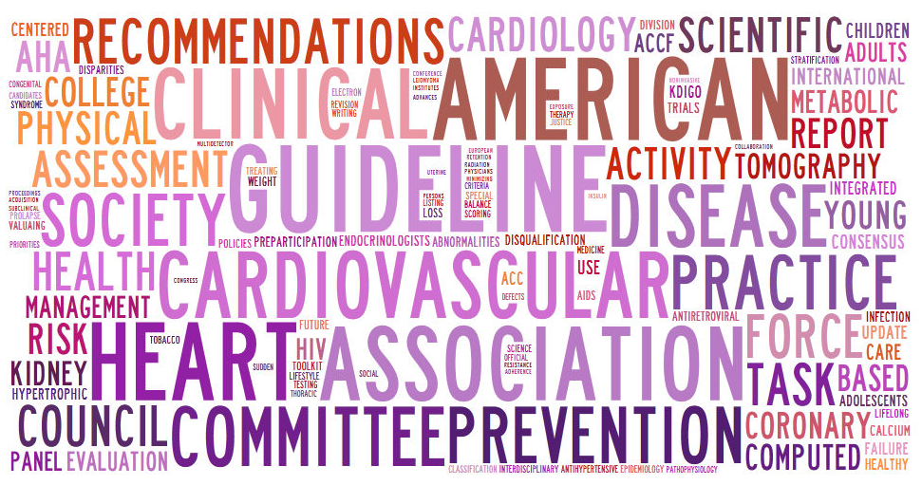
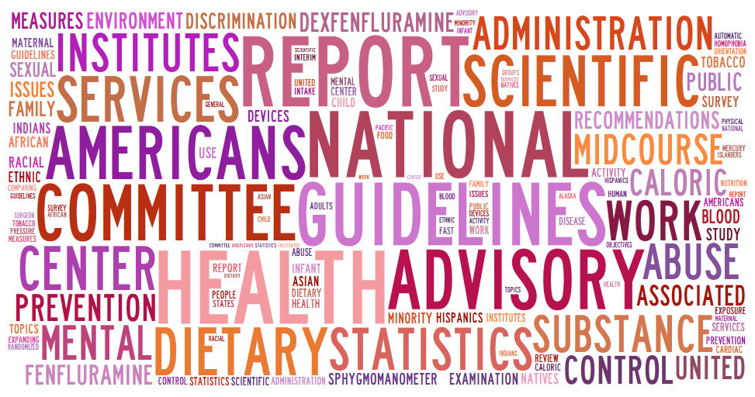
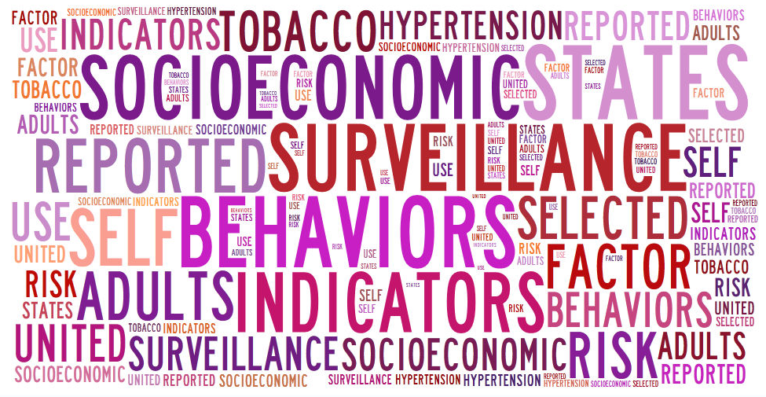
Assist with finding citations in policy documents
International Policies and Guidelines
US Clinical Guidelines/Scientific Statements
41
59
16
2
US Governmental Policies and Guidelines
US State Policies and Guidelines
Numbers reflect citations in documents. Word clouds of document titles by tagxedo.com

Slide 28
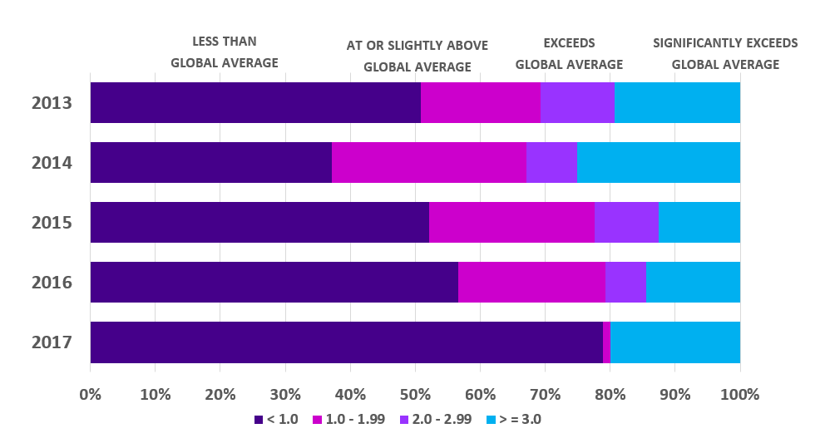
Write simple statements of impact
Text for a group of researchers’ publications
Chart for a group of researchers’ publications
Field Weighted Citation Impact by Year
Group: Department of Name Here
Timespan: 2013 - 2017
Source: Scopus
55% of the group’s documents have a citation impact at or above global average
(391 of 710 articles, reviews, conference proceedings indexed in Scopus from 1987 - 2017 have a Field Weighted Citation Impact of >= 1.0)
15% of the group‘s documents have a citation impact significantly exceeding the global average
(136 of 710 articles, reviews, conference proceedings indexed in Scopus from 1987 - 2017 have a Field Weighted Citation Impact of >= 3.0)

Slide 29

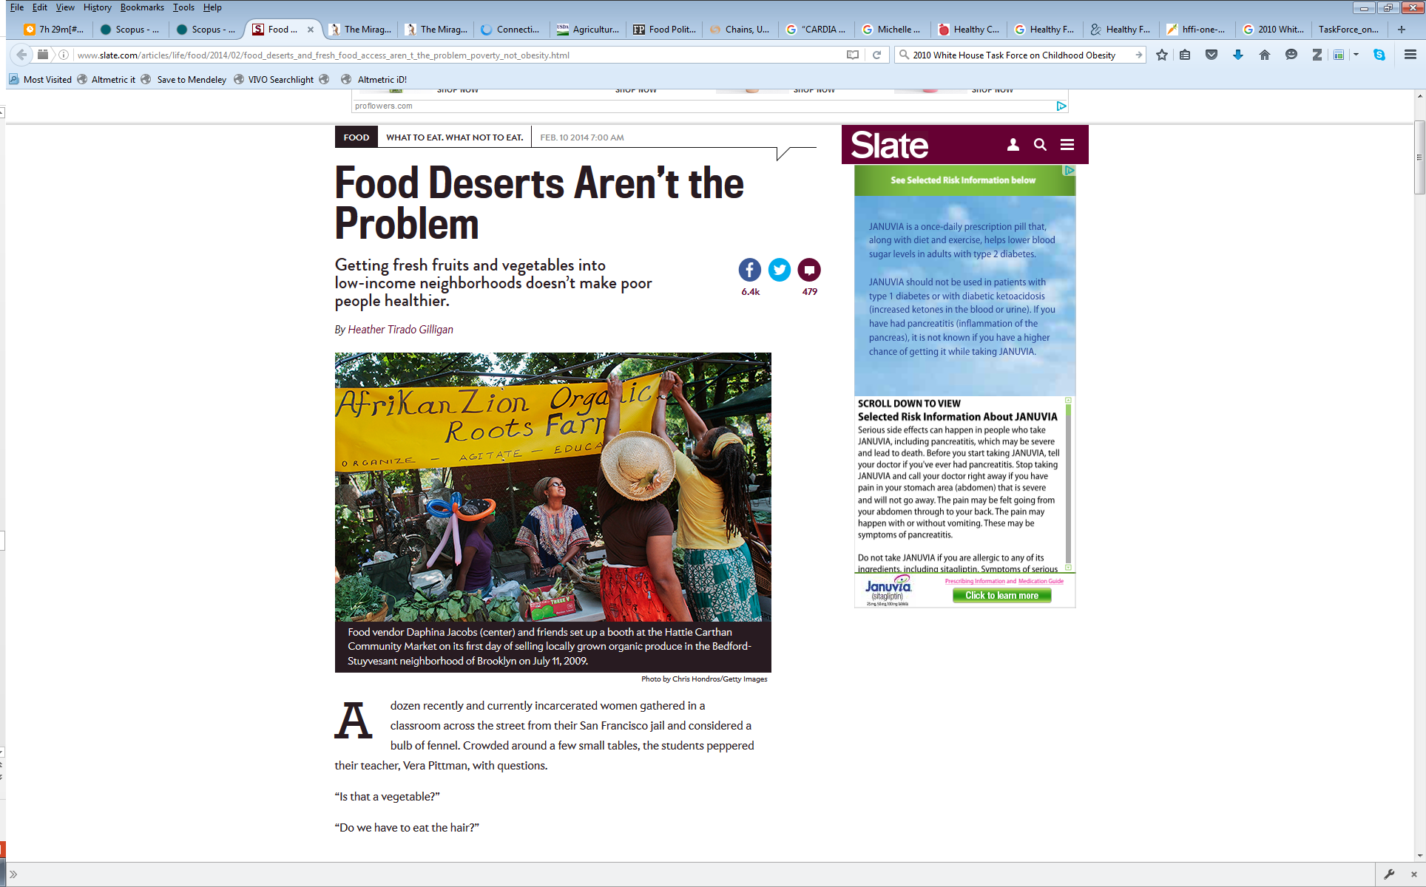
Create a visual timeline of impact
2011
Boone-Heinonen J, Gordon-Larsen P, Kiefe CI, Shikany JM, Lewis CE, Popkin BM. Fast food restaurants and food stores: Longitudinal associations with diet in young to middle-aged adults: The CARDIA study. Arch Intern Med 171(13):1162–70. 2011.
2014
cited in Andrew Sullivan’s “The Dish” article on The Mirage of Food Deserts
http://dish.andrewsullivan.com/2014/02/11/the-importance-of-food-deserts-is-a-mirage/?utm_source=feedburner&utm_medium=feed&utm_campaign=Feed%3A+andrewsullivan%2FrApM+%28The+Dish%29
cited in Slate.com article Food Deserts Aren’t the Problem
http://www.slate.com/articles/life/food/2014/02/food_deserts_and_fresh_food_access_aren_t_the_problem_poverty_not_obesity.html
2015
cited in report on 2015 Dietary Guidelines
U.S. Department of Health and Human Services and U.S. Department of Agriculture. Scientific Report of the 2015 Dietary Guidelines Advisory Committee. December 2015. Available at http://health.gov/dietaryguidelines/2015-scientific-report/
Notes:
The study found:
Fast food consumption was related to fast food availability among low-income respondents, particularly within 1.00 to 2.99 km of home among men (coefficient, 0.34; 95% confidence interval, 0.16-0.51). Greater supermarket availability was generally unrelated to diet quality and fruit and vegetable intake, and relationships between grocery store availability and diet outcomes were mixed.
Also relevant:
2013 cited by National Center for Health Statistics Data Brief
Fryar, Cheryl, Bethene Ervin, R. Center for Disease Control and Prevention/ National Center for Health Statistics. Caloric Intake From Fast Food Among Adults: United States, 2007-2010. NCHS Data Brief No. 114, Feb. 2013. Available at: http://www.cdc.gov/nchs/data/databriefs/db114.htm

Slide 30
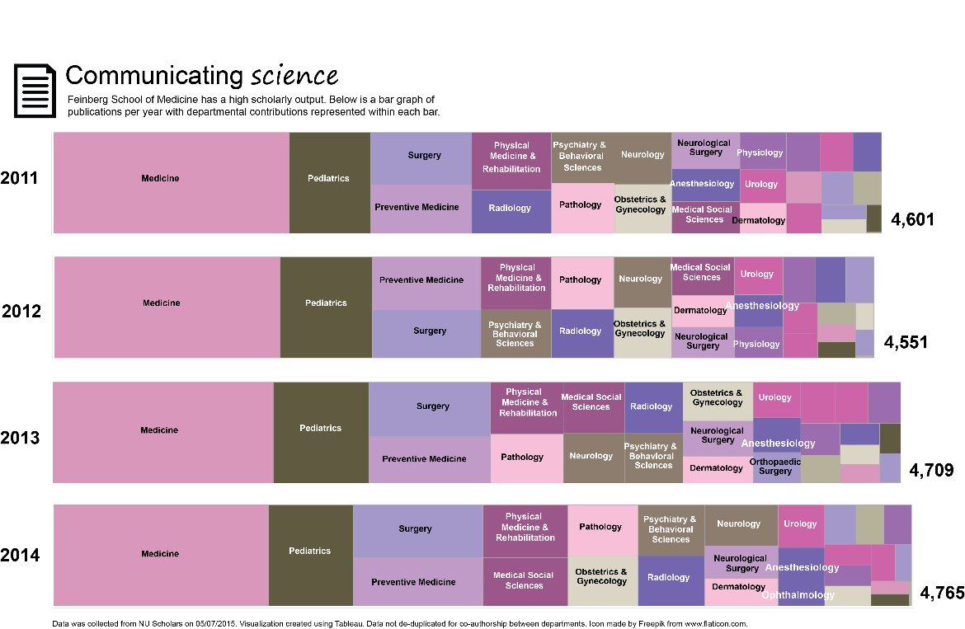
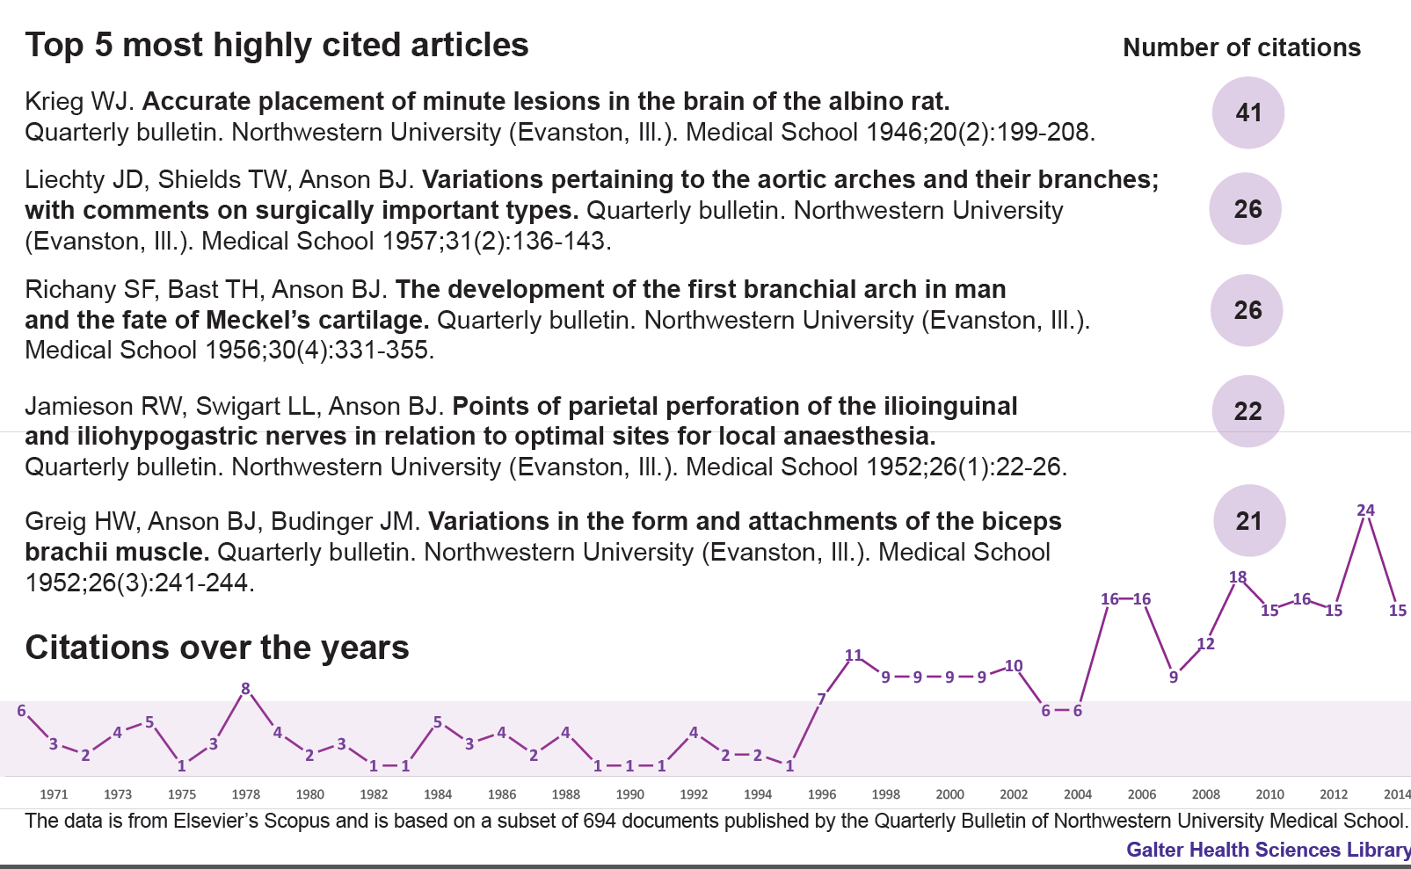
Create visualizations for exhibits or other reports
above: screenshot of visualization for library exhibit on the Places and Spaces of science at NU Feinberg School of Medicine
above: screenshot of visualization for library exhibit celebrating the digitization of the NU Quarterly Bulletin in PubMed Central

Slide 31
Overview
Part 1.
What is research evaluation?
Part 2.
Tools and resources for evaluation
Part 3.
Options for library involvement

Slide 32
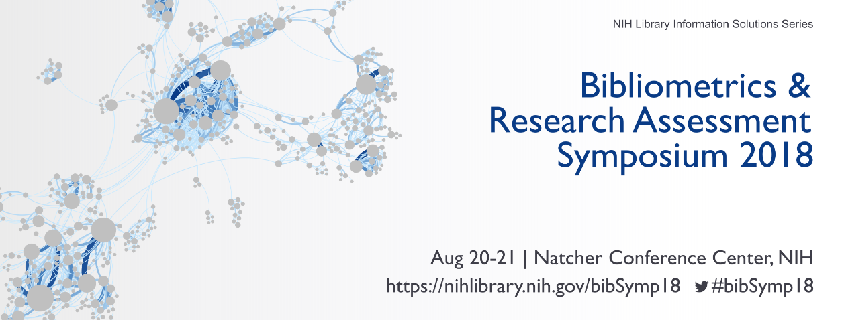
Acknowledgements
The following people are instrumental in developing research impact and dissemination materials and training, and from whose guidance I have greatly benefited.
Cathy Sarli
Becker Medical Library, Washington University in St. Louis
Amy Suiter
Becker Medical Library, Washington University in St. Louis
Kristi Holmes
Galter Health Sciences Library & Learning Center, Northwestern University
Chris Belter
NIH Library, US National Institutes of Health
Ya-Ling Lu
NIH Library, US National Institutes of Health
If you’re interested in bibliometrics, I highly recommend attending the upcoming (free!!) Bibliometrics & Research Assessment Symposium (see details below)

Slide 33
Thank You
image: Northwestern University stained glass window

