Slide 1
New metrics for research evaluation in the age of social media
Kristi L. Holmes, PhD*
Ehsan Mohammadi**
*Director, Galter Health Sciences Library
Associate Professor, Preventative Medicine-Health and Biomedical Informatics
Northwestern University, Feinberg School of Medicine
**Post-doc Fellow, Preventative Medicine-Health and Biomedical Informatics
Northwestern University, Feinberg School of Medicine

Slide 2
Overview
Traditional metrics and their limitations
Why new metrics are needed?
Suggestions
Conclusions

Slide 3


Use of metrics in evaluation
The San Francisco Declaration on Research Assessment
Signed by:
12,697 individual signatures
622 scientific organizations
Journal Impact Factor

Slide 4
Citation counts give incomplete impact evidence
Citations:
  are limited to authors’ perspectives
  need 3-5 years to accumulate
  more appropriate for theoretical publications

Slide 5



Looking for new metrics
Considers the non-conventional products of research along side publications.
In new biosketch format supports diverse research impact.
Considers all types of research impact outside academia in the Research Excellent Framework (REF).

Slide 6

Scholarly communication is changing

Slide 7
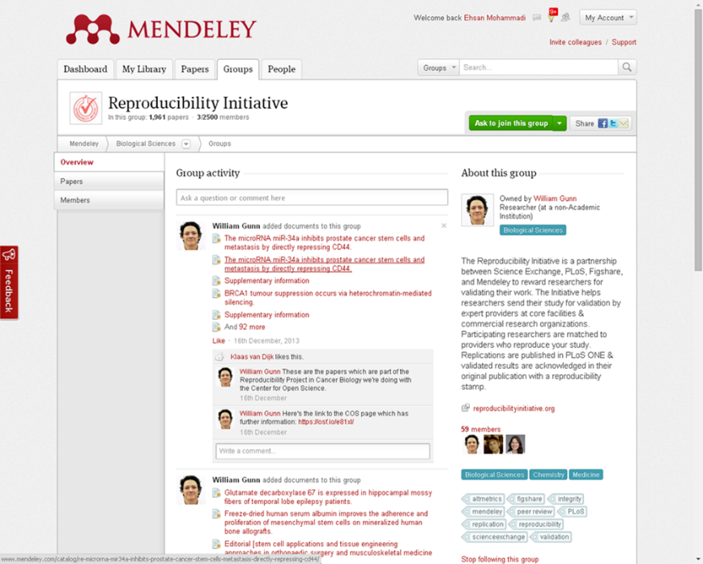
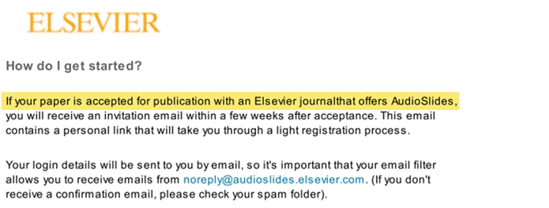

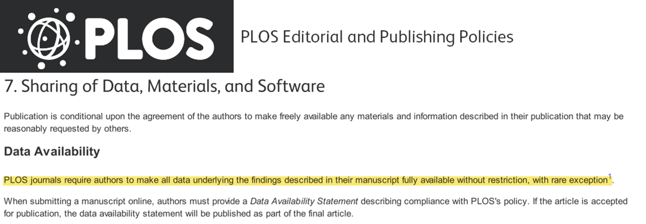
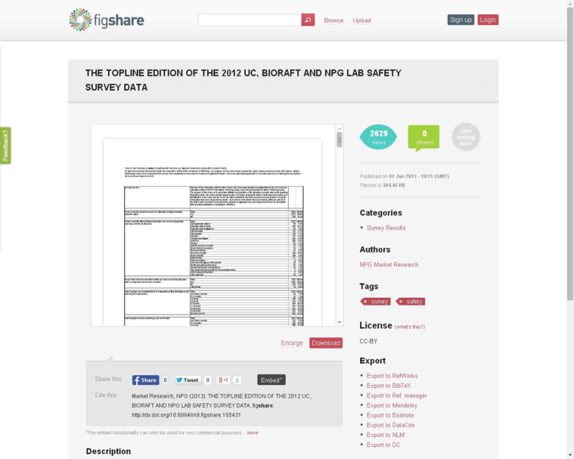

The changing scholarly communication cycle
  Translation and engagement
Lectures
Presentations
  Conceptualisation
Literature reviews
Bibliographies
Sharing Culture
Openness and diversity
The “enhanced publication”
Data linked, and shareable
  Findings
Books
Journal articles
  Data collection
Datasets
Recorded interviews

Slide 8

New metrics are coming into vogue
Altmetrics aims to find complementary measures for traditional metrics based on scholars’ activities in social web platforms
Complementary
metrics
Social media
metrics
Influmetrics
Notes:
“Metrics à la mode" as solutions?

Slide 9
Some frameworks as solutions
Becker Model for Assessing Research Impact
  https://becker.wustl.edu/impact-assessment/how-to-use
Academic Careers Understood through Measurement and Norms (ACUMEN)
  http://research-acumen.eu/portfolio
Research Excellence Framework (REF) Impact Case Studies
  http://impact.ref.ac.uk/CaseStudies/
Canadian Academy of Health Sciences (CAHS) Framework
  http://www.cahs-acss.ca/wp-content/uploads/2011/09/ROI_FullReport.pdf

Slide 10
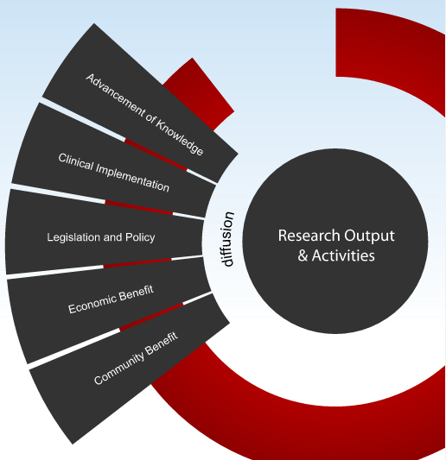
The Becker Model as a comprehensive example

Slide 11
The Becker Model
Provides a supplement to publication analysis to provide a more robust and comprehensive perspective of biomedical research impact.
  reporting templates, glossary of resources and terms, examples of relevant indicators of impact across the research process, and readings
Straightforward framework for tracking diffusion of research outputs and activities to locate indicators that demonstrate evidence of biomedical research impact
  individual, core, and institutional-level; modify for different disciplines
Guidance for quantifying and documenting research impact as well as resources for locating evidence of impact.
Strategies for enhancing the impact of research

Slide 12
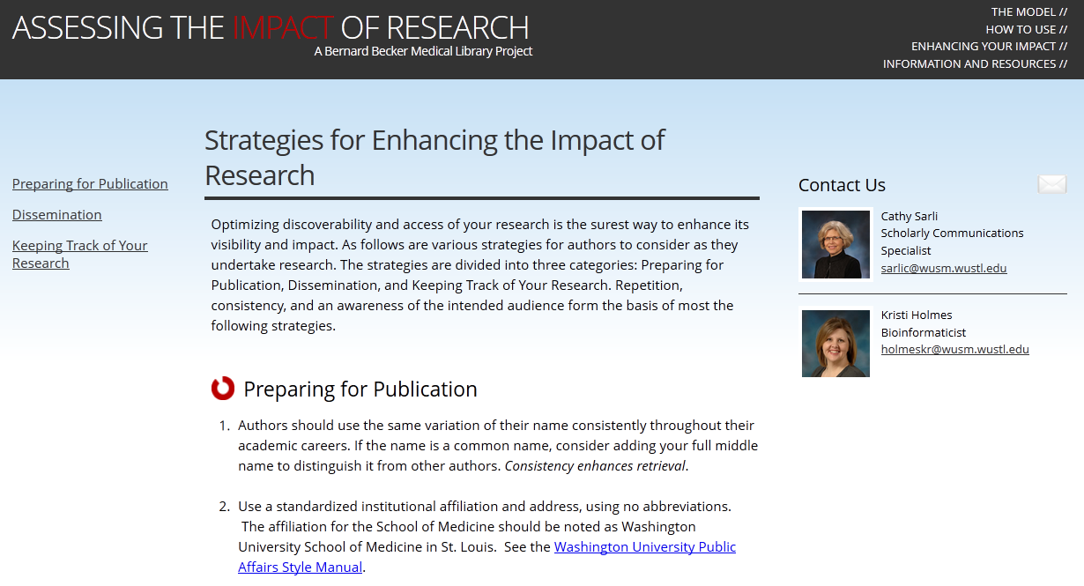
Strategies for enhancing the impact of research
Optimizing discoverability and access of your research is the surest way to enhance its visibility and impact.
The strategies focus upon Preparing for Publication, Dissemination, and Keeping Track of Your Research.
Repetition, consistency, and an awareness of the intended audience form the basis of most the strategies.
Suggestions for researchers and recommendations to reach out to their library for assistance.
https://becker.wustl.edu/impact-assessment/strategies
Notes:
Consistency enhances retrieval.
A lot of the suggestions lie directly in our wheelhouse – makes this a great opportunity for the library

Slide 13
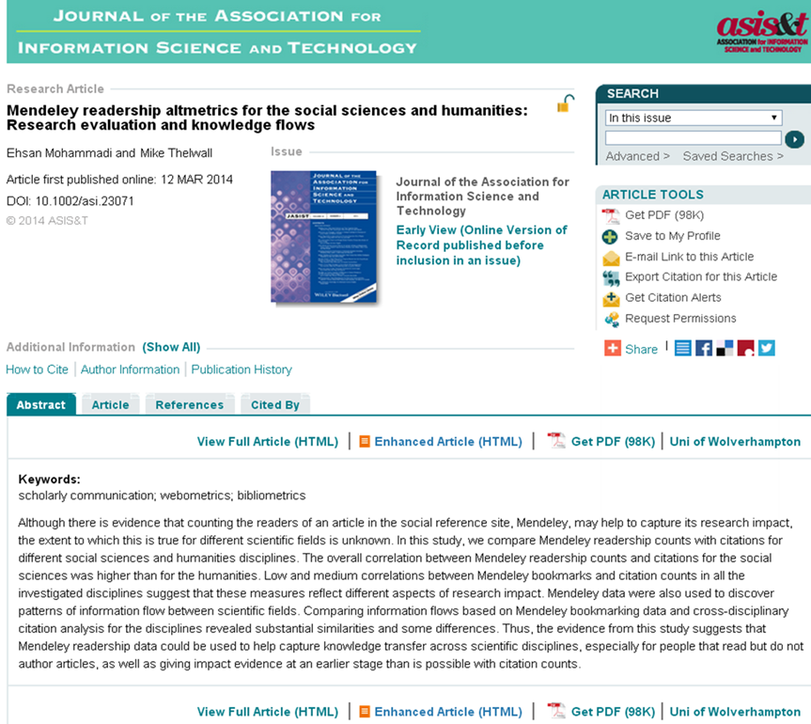
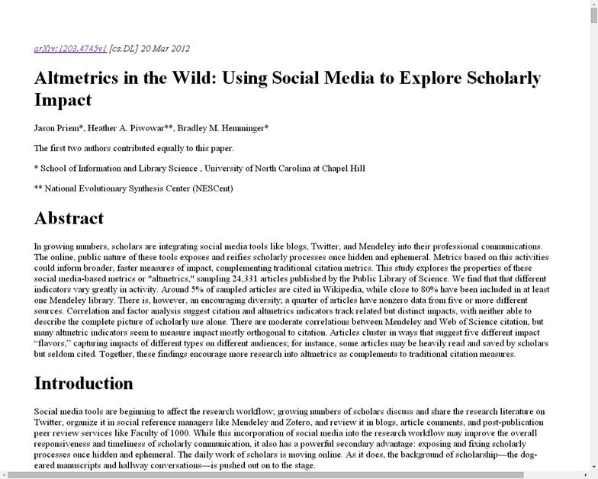
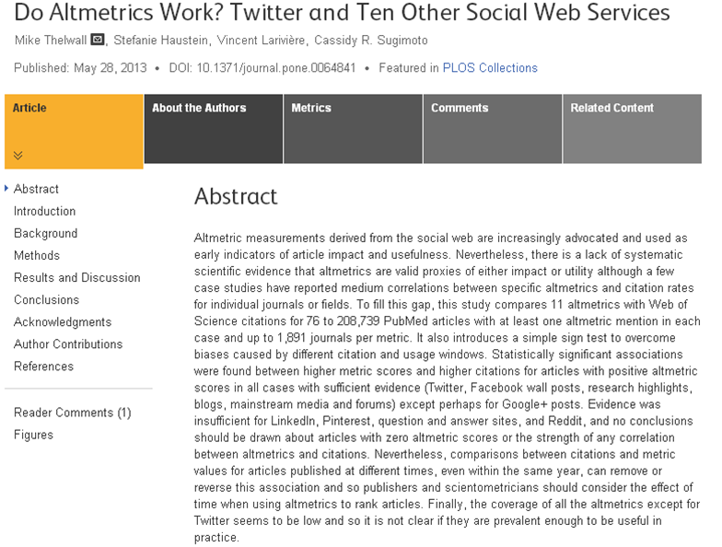
Empirical altmetrics studies so far
Significant but medium correlations have been found between altmetrics and citations.
Among altmetrics, Mendeley readership counts had the highest correlations with citations.

Slide 14
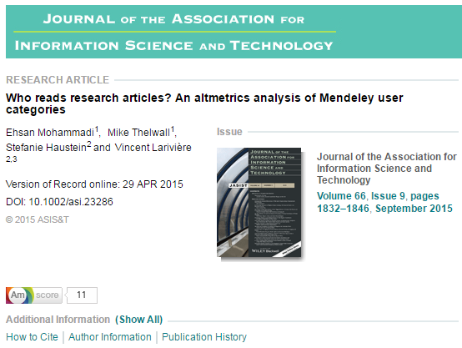
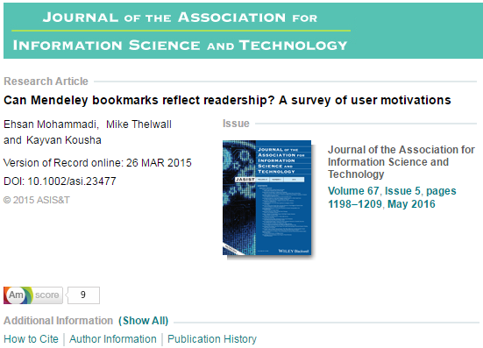
Empirical altmetrics studies so far
Using both quantitative and qualitative methods, we found Mendeley readership can reveal some invisible research impacts such educational and practical impacts.

Slide 15
Conclusions
Publishers, funders and researchers engaged in the new metrics.
Defining standards in altmetrics is in progress by NISO.
Altmetrics have pros and cons.
More studies are needed.

Slide 16
References
Cronin, B. (2013). Metrics à la mode. Journal of the American Society for Information Science and Technology, 64(6), 1091–1091.
Czerniewicz, L., Kell, C., Willmers, M., & King, T. (2014). Changing Research Communication Practices and Open Scholarship: A Framework for Analysis.
Priem, J., Taraborelli, D., Groth, P., & Neylon, C. (2010). Altmetrics: A manifesto.
Rousseau, R., & Ye, F. (2013). A multi-metric approach for research evaluations. Chinese Science Bulletin, 1–7.

Slide 17
Thank you

Slide 18
Thank you

